Slide 1
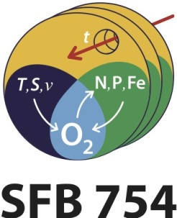
Ventilation of the Equatorial Atlantic
P. Brandt R. J. Greatbatch, M. Claus, S.-H. Didwischus, J. Hahn GEOMAR Helmholtz Centre for Ocean Research Kiel

Slide 2
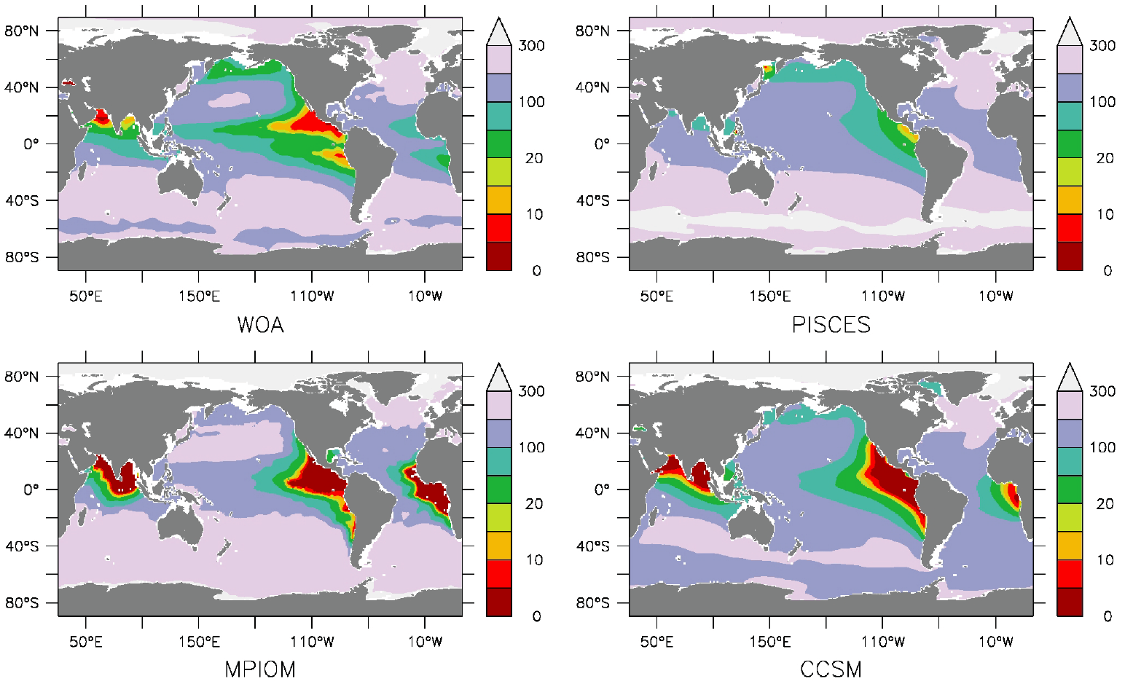
Global Model Simulations
Annual mean oxygen [μmol/kg] at 300m in observations (WOA) and different state-of-the-art global models
Oschlies, pers. comm. 2013

Slide 3
Atlantic Oxygen Distribution
Oxygen distribution at 600m depth as measured during the German Atlantic Meteor expedition 1925-27
Oxygen Minimum Zones (OMZ) in both hemispheres separated by an equatorial oxygen maximum
Wyrtki (1962) concluded that the position and distribution of the oxygen minimum layer are determined by circulation
Wattenberg 1939

Slide 4
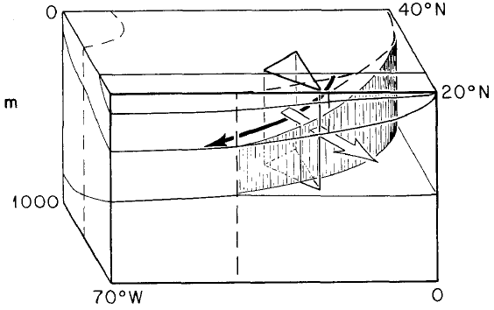
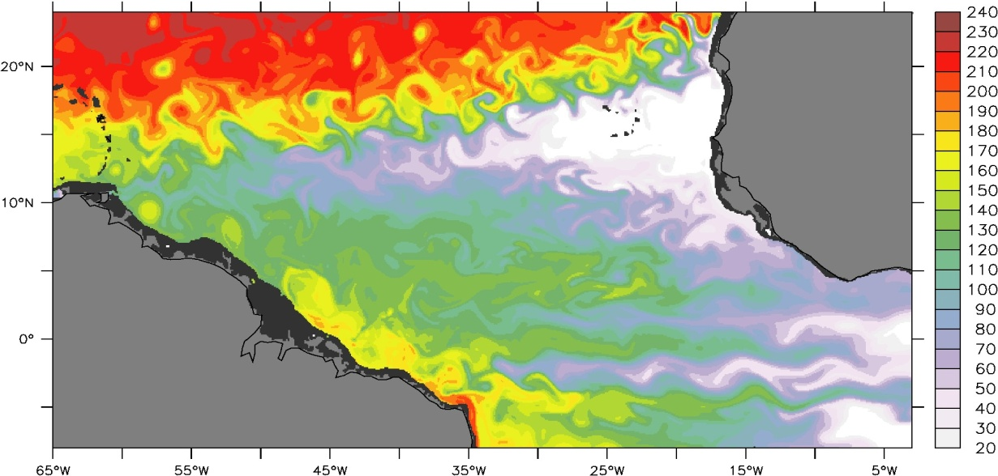
Oxygen Minimum Zones
Ventilated thermocline: oxygen supply along isopycnal surfaces from the outcrop regions in the subtropics toward the equator and the western boundary (solid arrow).
Luyten et al. 1983
Mesoscale eddy field plays a dominant role in the ventilation of the OMZ (open arrow).
μmol/kg
FLAME simulation, C. Eden

Slide 5
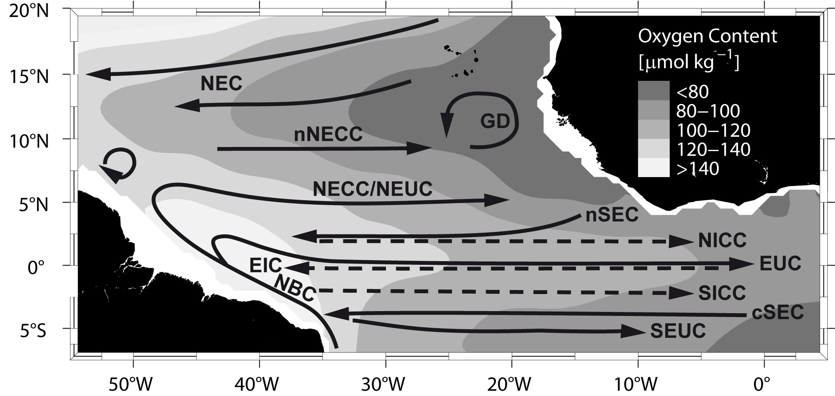
Mean Circulation and Oxygen Distribution
Complex zonal current system connects high-O₂ western boundary regime with sluggish flow in the eastern basin.
Brandt et al. 2008, 2010
Notes:
Schematic diagram of the shallow subtropical and tropical Atlantic circulation superimposed on the WGHC distribution of oxygen concentration (µmol/kg) at 300–500-m depth. Our repeat ship section cuts through the complex zonal current system.

Slide 6
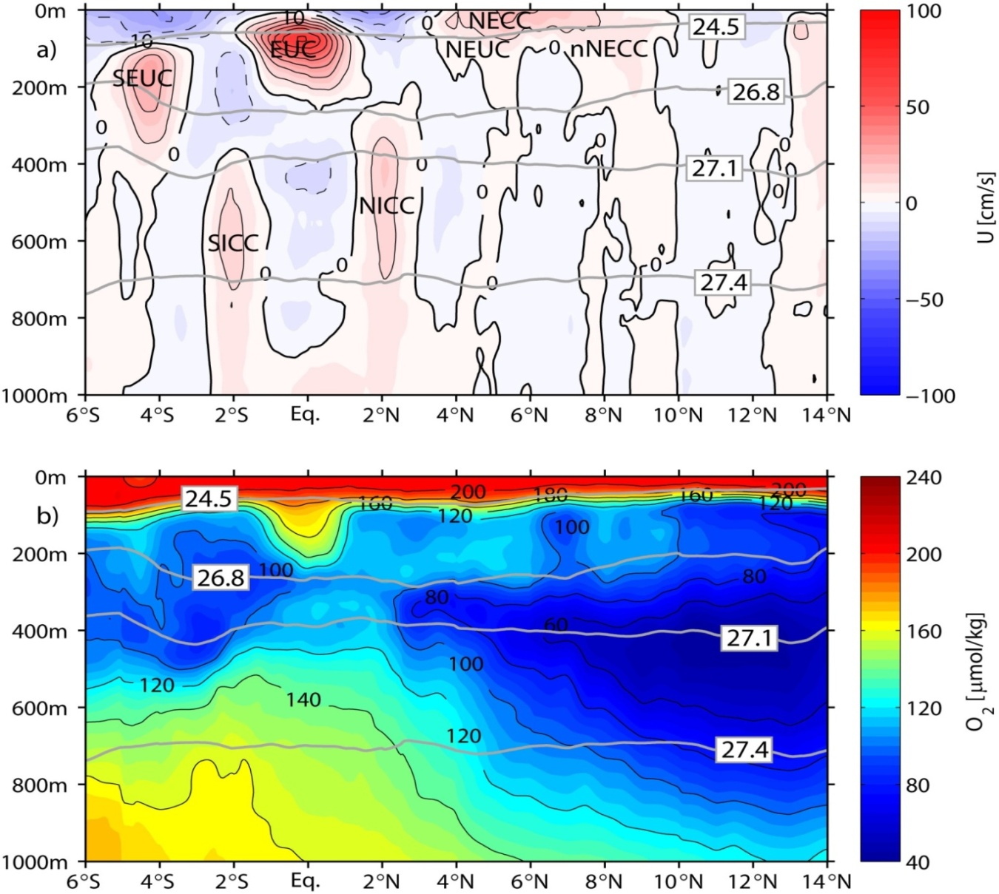
Latitudinally Alternating Zonal Jets in the OMZ
Narrow alternating zonal currents in the depth range of the OMZ
Strongest currents near the equator: SICC, EIC, NICC
Broad oxygen maximum at the equator
1999-2008
Brandt et al. 2010
Notes:
Mean zonal velocity, and oxygen content as obtained from 18 meridional ship sections taken between 28.5° and 23°W during 1999–2008. Eastward current bands, marked by reddish colors, are generally associated with elevated oxygen content. Gray lines mark neutral density, γ_{n}. At γ_{n}=27.1, which corresponds to the core of the OMZ, highest oxygen content is found in the equatorial region.

Slide 7
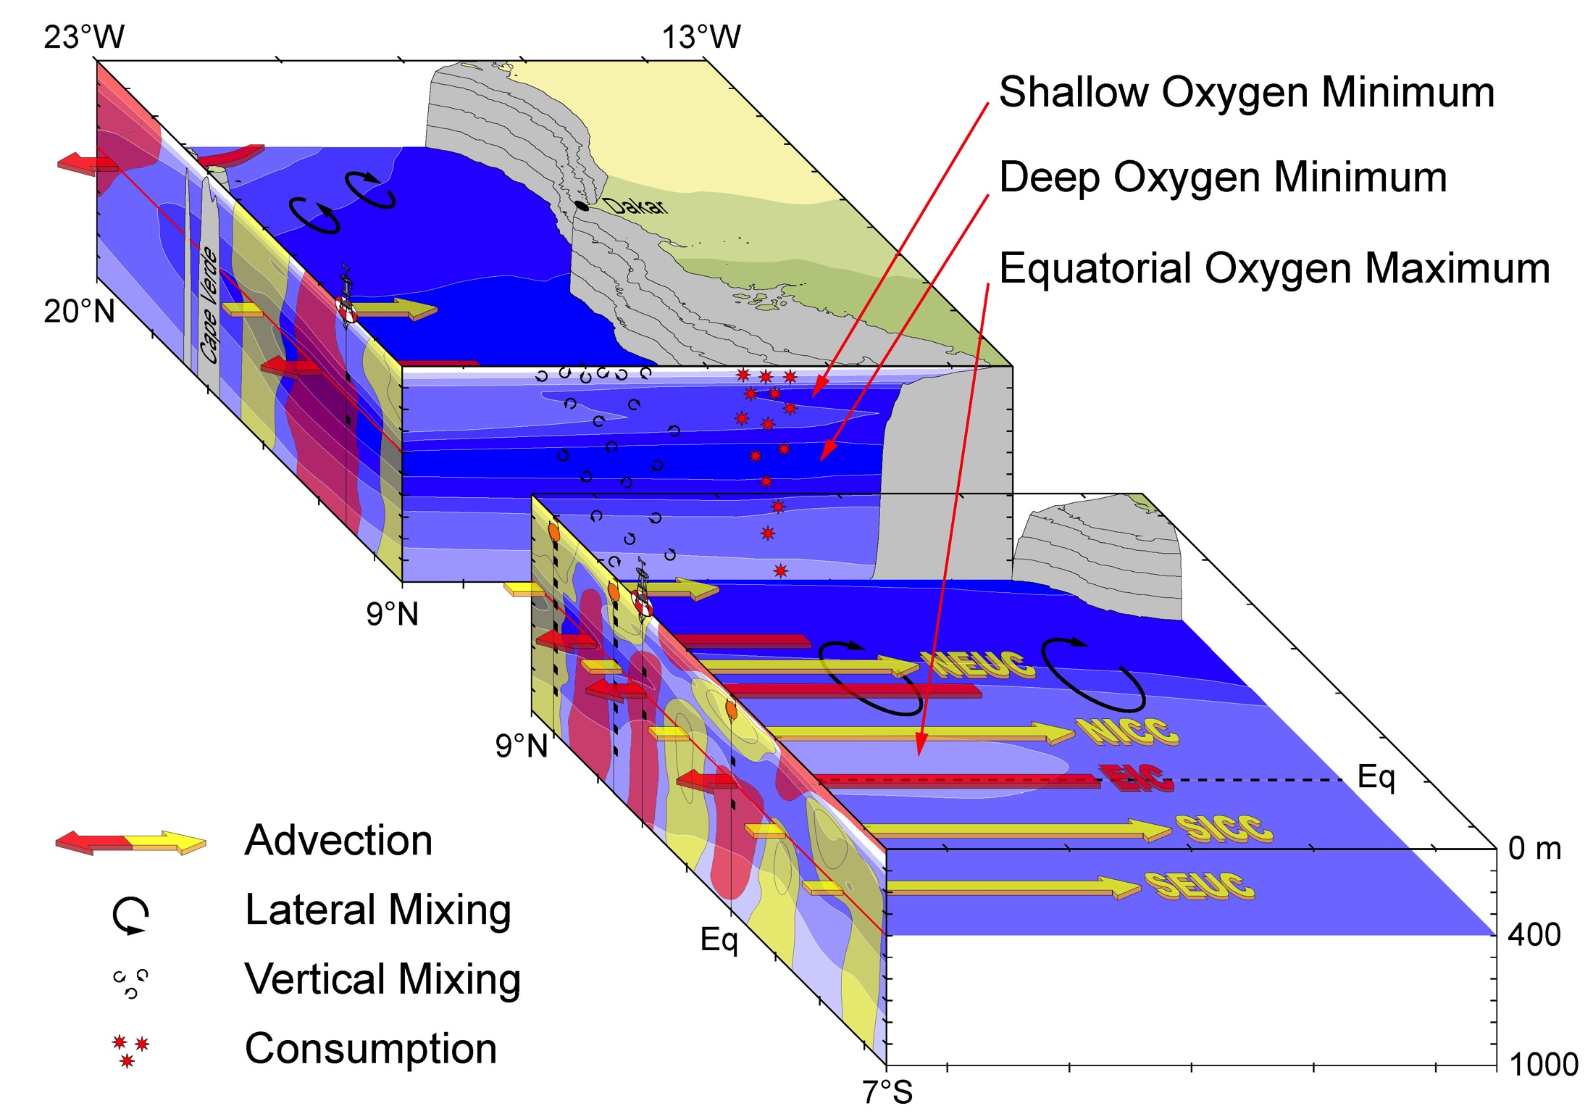
Why there is an oxygen maximum at the equator?

Slide 8
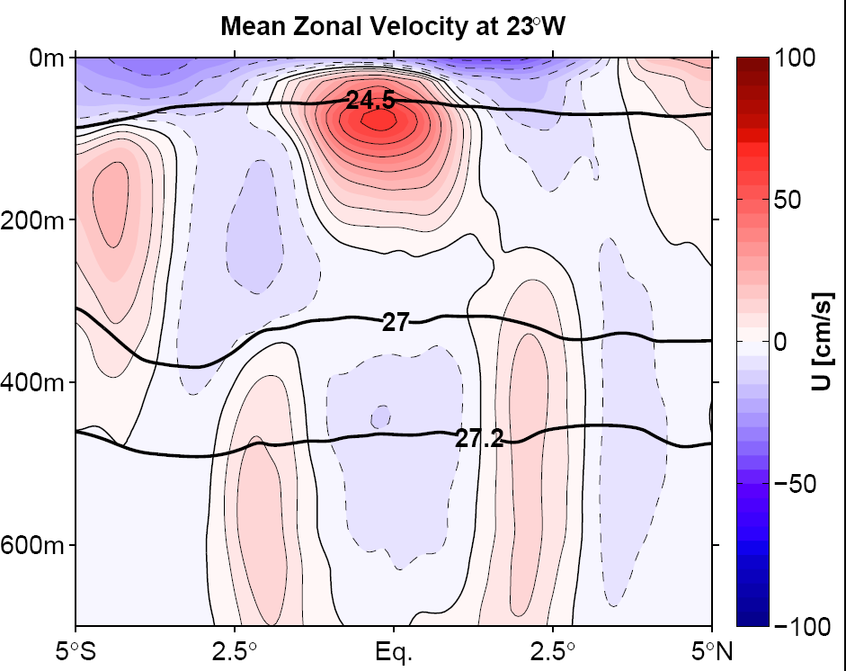
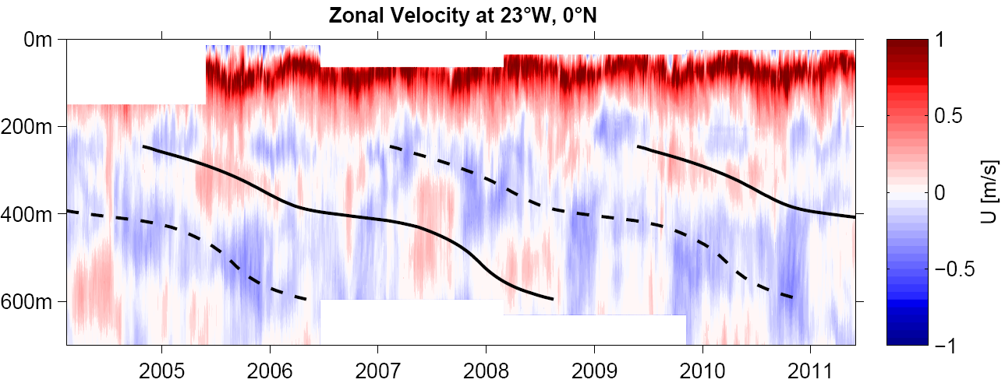
Mean Zonal Velocity along 23°W and Equatorial Time Series
NICC/SICC at 2°N/S supplies oxygen to the eastern Atlantic
Strong mean westward flow at the equator below 380 m
Equatorial Deep Jets with downward phase propagation
SEUC
NICC
SICC
Brandt et al. 2012
300m
500m
Notes:
Moored data represents an update of the data published in Brandt et al. (2011) covering now a period of about 7 years.

Slide 9
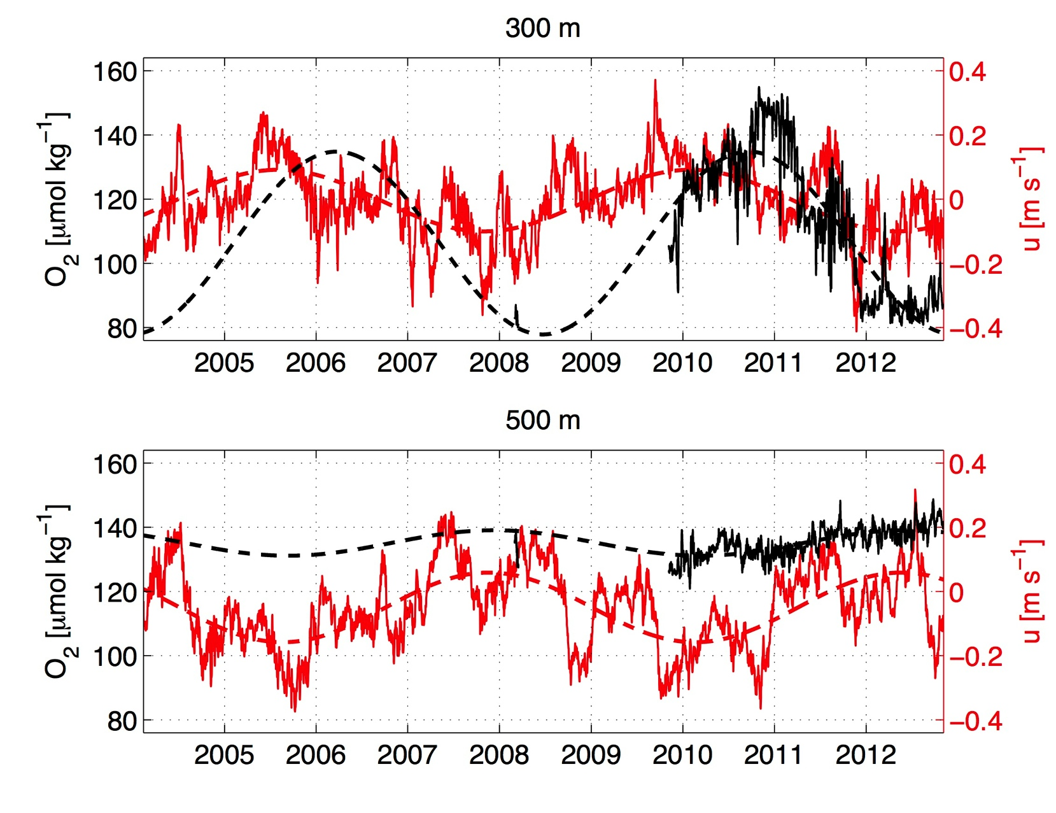
4.5-yr Deep Jet Cycle in Moored Observations at Equator, 23°W
Max O₂ slightly after max zonal velocity
Larger O₂ amplitude at 300 m than at 500 m
Ventilation of equatorial Atlantic by Deep Jets
Update of Brandt et al. 2012
Notes:
Oxygen time series are from March 1st to March 16th, 2008 and from November, 2009 to October, 2012.

Slide 10
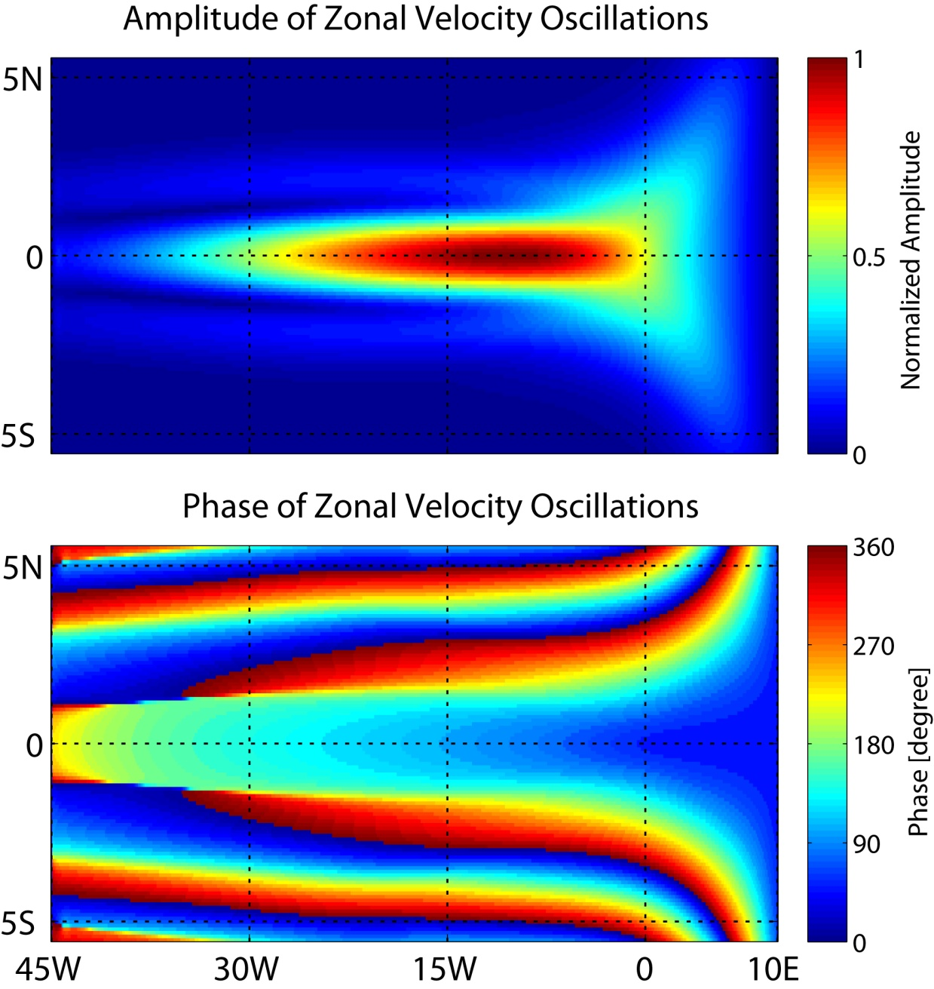
EDJ-like Equatorial Basin Mode
Zonal velocity of a basin mode solution from a single mode model
Strong east- and westward velocity along the equator represents exchange between well-ventilated western boundary and interior
Greatbatch et al. 2012
Notes:
The similarity between the EDJ and the gravest equatorial basin mode (Cane and Moore, 1981) for a high order baroclinic vertical normal mode has been noted by many authors, e.g. Johnson and Zhang (2003), d’Orgeville et al. (2007) and Brandt et al. (2011), although since the EDJ propagate vertically they cannot correspond exactly to such a mode (in reality there is forcing and dissipation as well as the influence of variable bottom topography and non-linearity to break an exact correspondence to a basin mode).

Slide 11
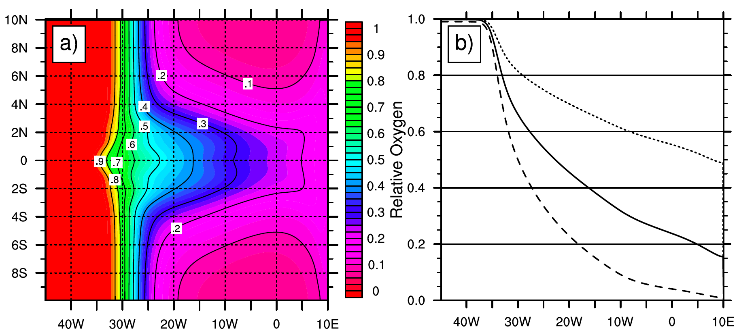
Advection-Diffusion Model
Model forced by velocity field of equatorial basin mode, O₂ source at the western boundary layer; O₂ consumption
Consumption × 0.2
Consumption × 5
Mean relative oxygen concentration shows ventilation of the
equatorial band due to basin mode oscillations

Slide 12
Observed Mean Zonal Velocity and Oxygen along 23°W
Mean eastward currents are partly supplied out of the well-ventilated western boundary current
At 300 m depth: South Equatorial Undercurrent (SEUC) at 4°S and Northern Intermediate Countercurrent (NICC) at 2°N
At 500 m depth: Southern Intermediate Countercurrent (SICC) at 2°S and NICC
SEUC
NICC
SICC

Slide 13
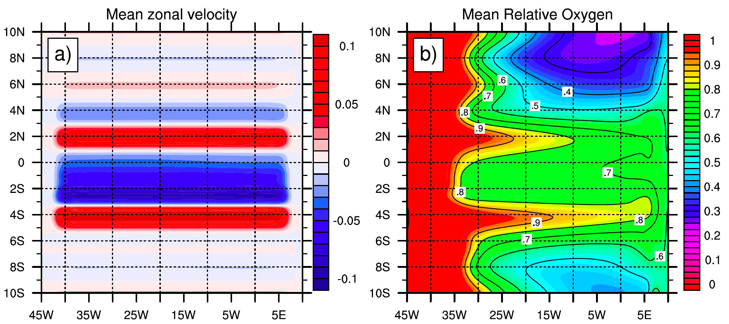
Advection-Diffusion Model
Model forced by velocity field of equatorial basin mode and mean flow observed at 300 m depth
Mean O₂ tongues associated with NICC and SEUC
NICC
SEUC

Slide 14
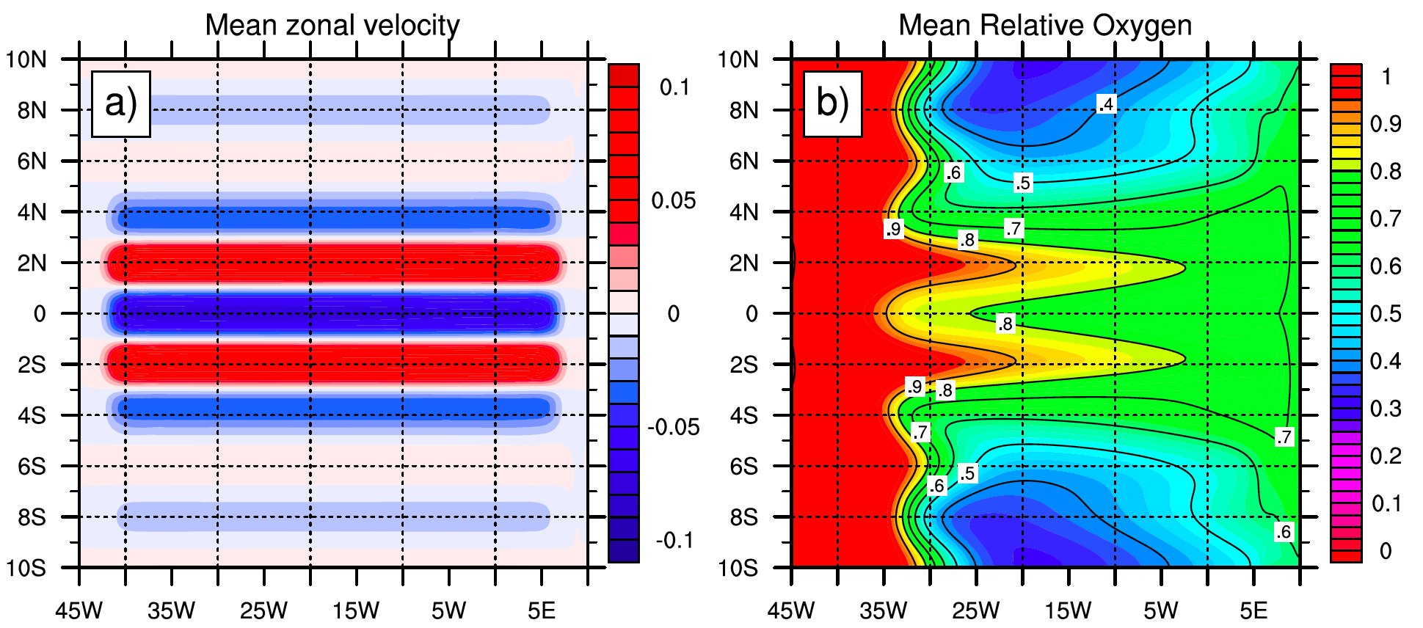
Advection-Diffusion Model
Model forced by velocity field of equatorial basin mode and mean flow observed at 500 m depth
Mean O₂ tongues associated with NICC and SICC
NICC
SICC

Slide 15
Summary
Global models do not correctly capture location and distribution of low-oxygen layer in the tropics
One obvious reason is the too weak mean and variable intermediate circulation in these simulations
Observations show equatorial oxygen maximum and strong poleward oxygen fluxes toward the OMZs that can be reproduced by idealized simulations with an advection-diffusion model
Simple parameterizations like e.g. extremely increased zonal diffusivities near the equator might help to improve tropical oxygen distribution in global simulations

Slide 16
Acknowledgements
This study was supported by the German Science Foundation (DFG) as part of the Sonderforschungsbereich 754 “Climate-Biogeochemistry Interactions in the Tropical Ocean” and by the German Federal Ministry of Education and Research as part of the co-operative projects “NORDATLANTIK” and “RACE”.
Moored velocity observations were acquired in cooperation with the PIRATA project.

