Slide 1
Equatorial Circulation and Tropical Atlantic Variability during the Tropical Atlantic Climate Experiment
Peter Brandt¹, Andreas Funk², Alexis Tantet¹,
Bill Johns³, Jürgen Fischer¹
¹GEOMAR, Kiel, GER; ²FWG, Kiel, GER; ³RSMAS, Miami, USA

Slide 2
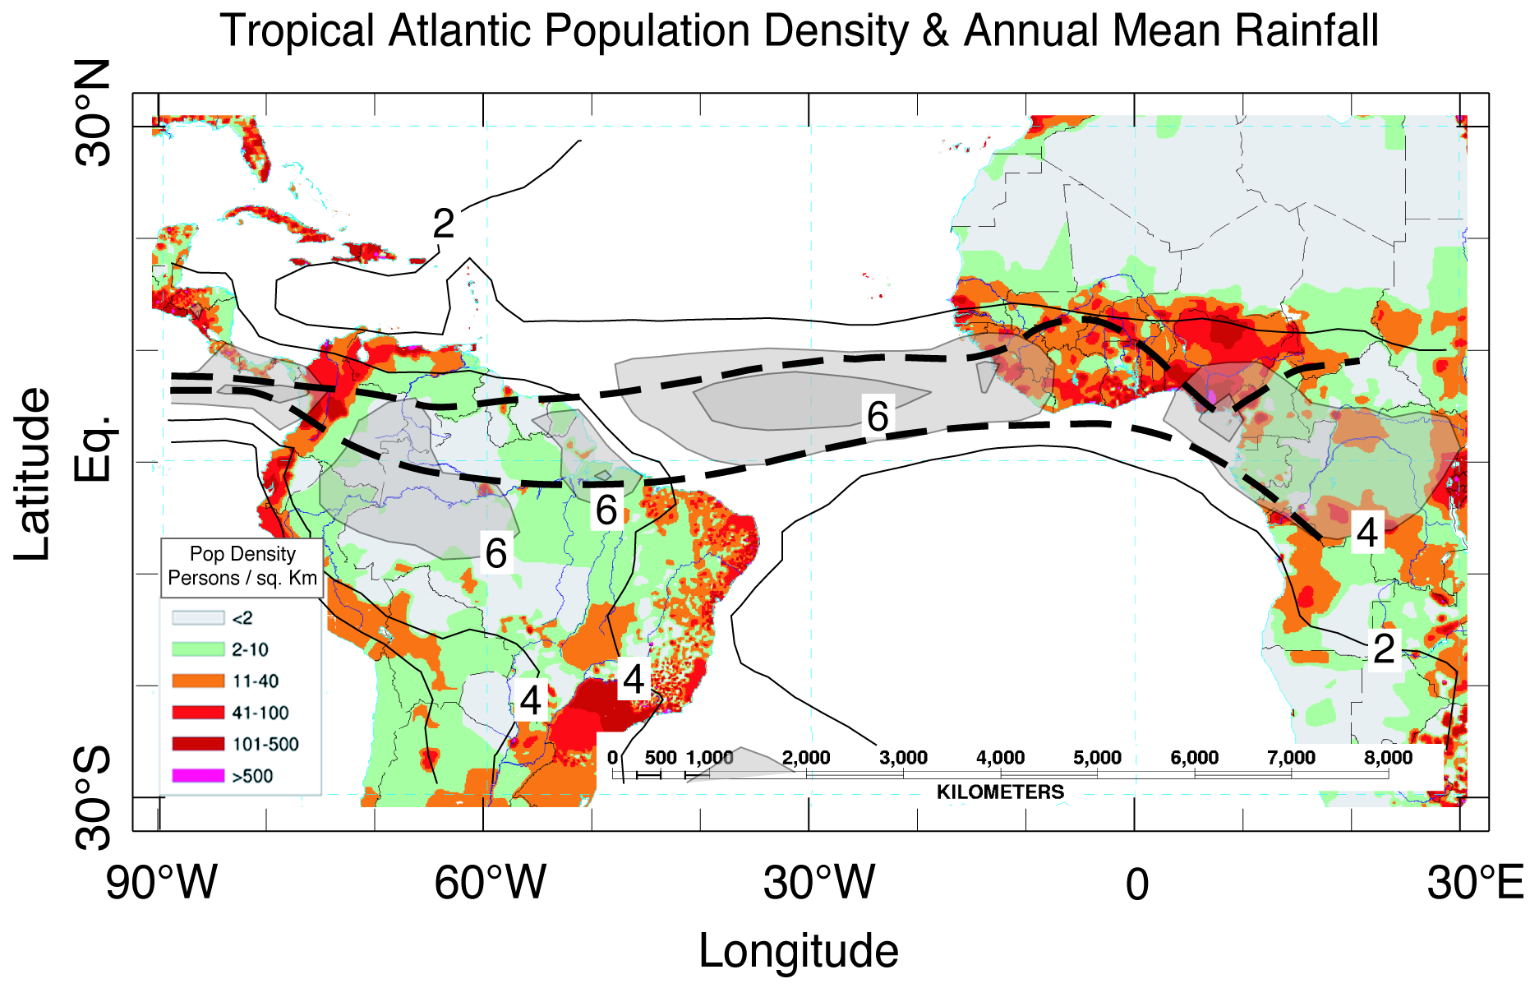
Atlantic Marine ITCZ Complex
Introduction Data & Methods EUC Transport EUC-TAV Relation Equatorial Deep Jets Summary Outlook
ITCZ position and rainfall intensity affect densely populated regions in West Africa
JJA-Position
MA-Position
Kushnir et al., 2003
Tropical Atlantic Variability (TAV) influenced by ENSO / NAO
Internal variability: Meridional and Zonal Modes
Notes:
2
A map of population density in persons/km² (colors, see inserted legend), overlaid by contours of annual mean rainfall (in mm/day) with values > 4 mm/day (~150 cm/yr) shaded in transparent gray to indicate the mean position of the ITCZ. The north (July-August) and south (March-April) limits of the ITCZ climatological annual migration are indicated by thick dashed lines.

Slide 3
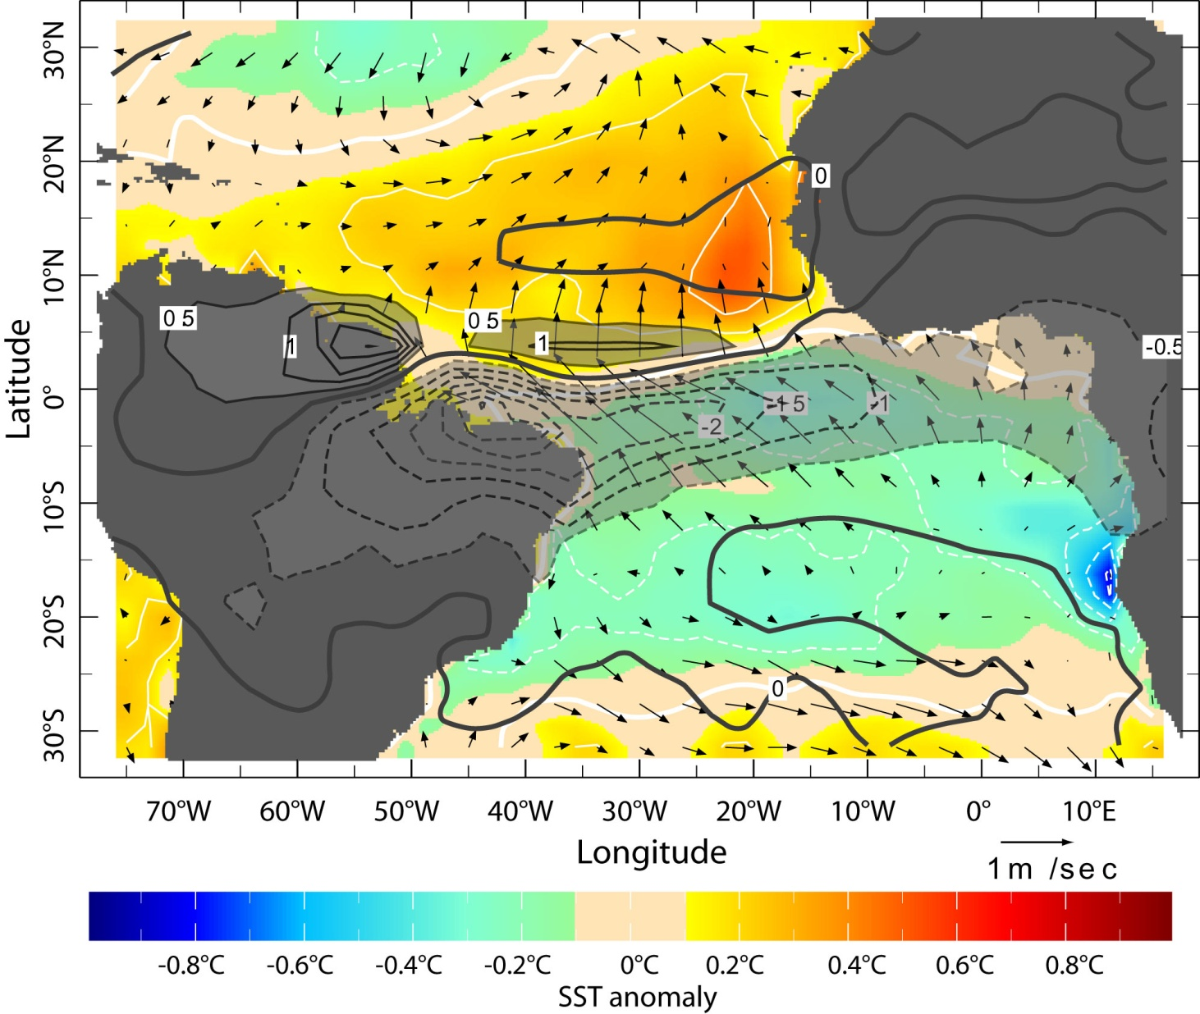
Meridional Mode (March-April)
During spring the meridional SST gradient dominates TAV
Underlying mechanism is the Wind-Evaporation-SST (WES) Feedback Mechanism (Saravanan and Chang, 2004)
Kushnir et al. 2006
Notes:
3
First EOF (33%) of the March-April rainfall from GPCP 1979-2001 (contours in mm/day). March-April SST anomaly (colors, in °C & white contours, every 0.2°) and surface wind anomaly (vector, in m/sec) are determined by regression on the time series of the rainfall EOF.

Slide 4
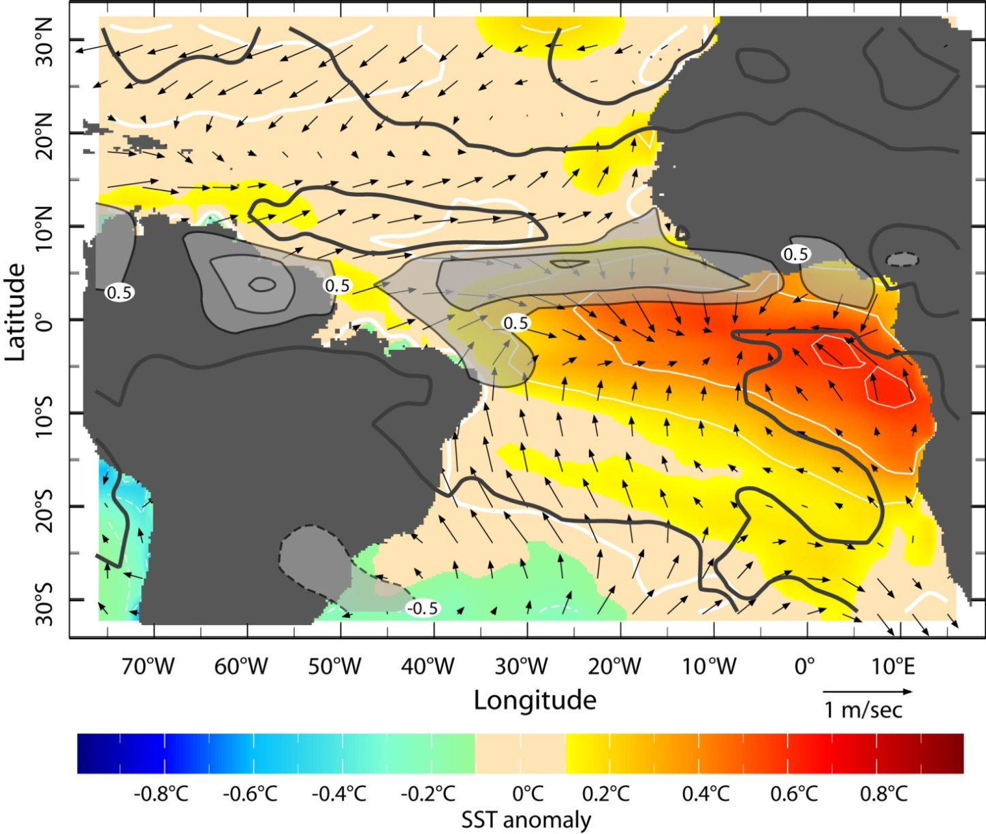
Zonal Mode (June-August)
Zonal Mode is associated with rainfall variability, onset and strength of African Monsoon (Caniaux et al. 2011, Brandt et al. 2011)
Underlying mechanism is the Bjerknes feedback that is strong during boreal spring/summer (Keenlyside and Latif 2007)
Kushnir et al. 2006
Notes:
4
First EOF (23%) of the June-August rainfall from GPCP 1979-2001 (contours in mm/day). June-August SST anomaly (colors, in °C & white contours, every 0.2°) and surface wind anomaly (vector, in m/sec) are determined by regression on the time series of the rainfall EOF.

Slide 5
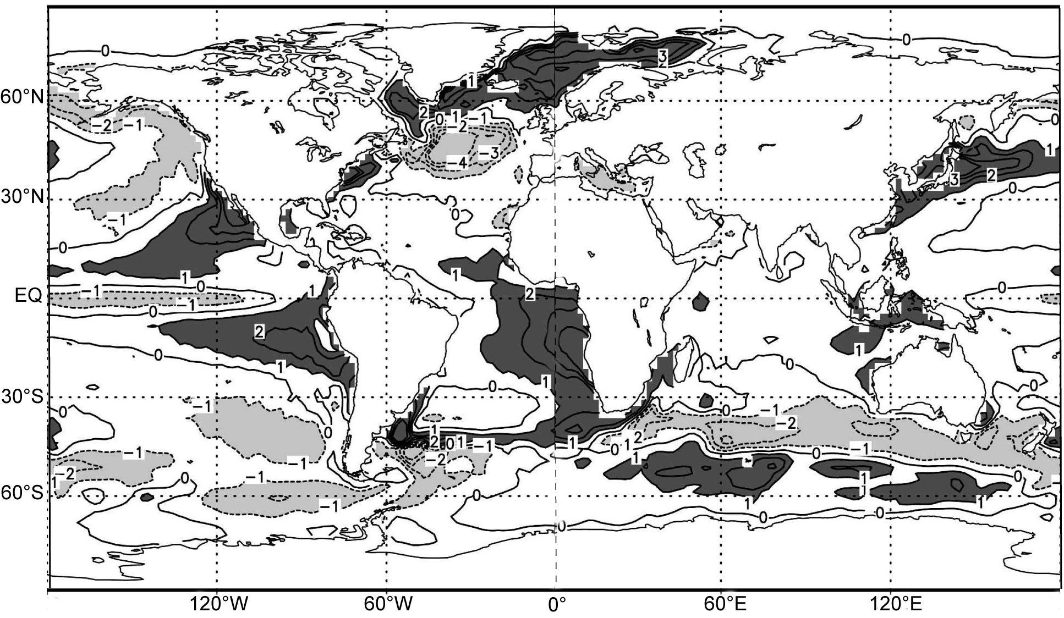
SST Errors in Coupled Climate Models
Dark gray
⇒ model too warm
Large errors in the eastern tropical Atlantic
From Jungclaus et al. 2006

Slide 6
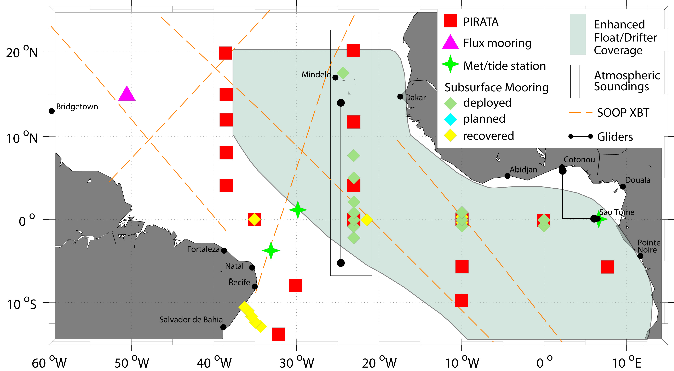
2006-2011 CLIVAR Tropical Atlantic Climate Experiment
Advance the predictability of climate variability by enhanced observations and modeling studies
Focus on the eastern equatorial Atlantic
TACE observational network

Slide 7
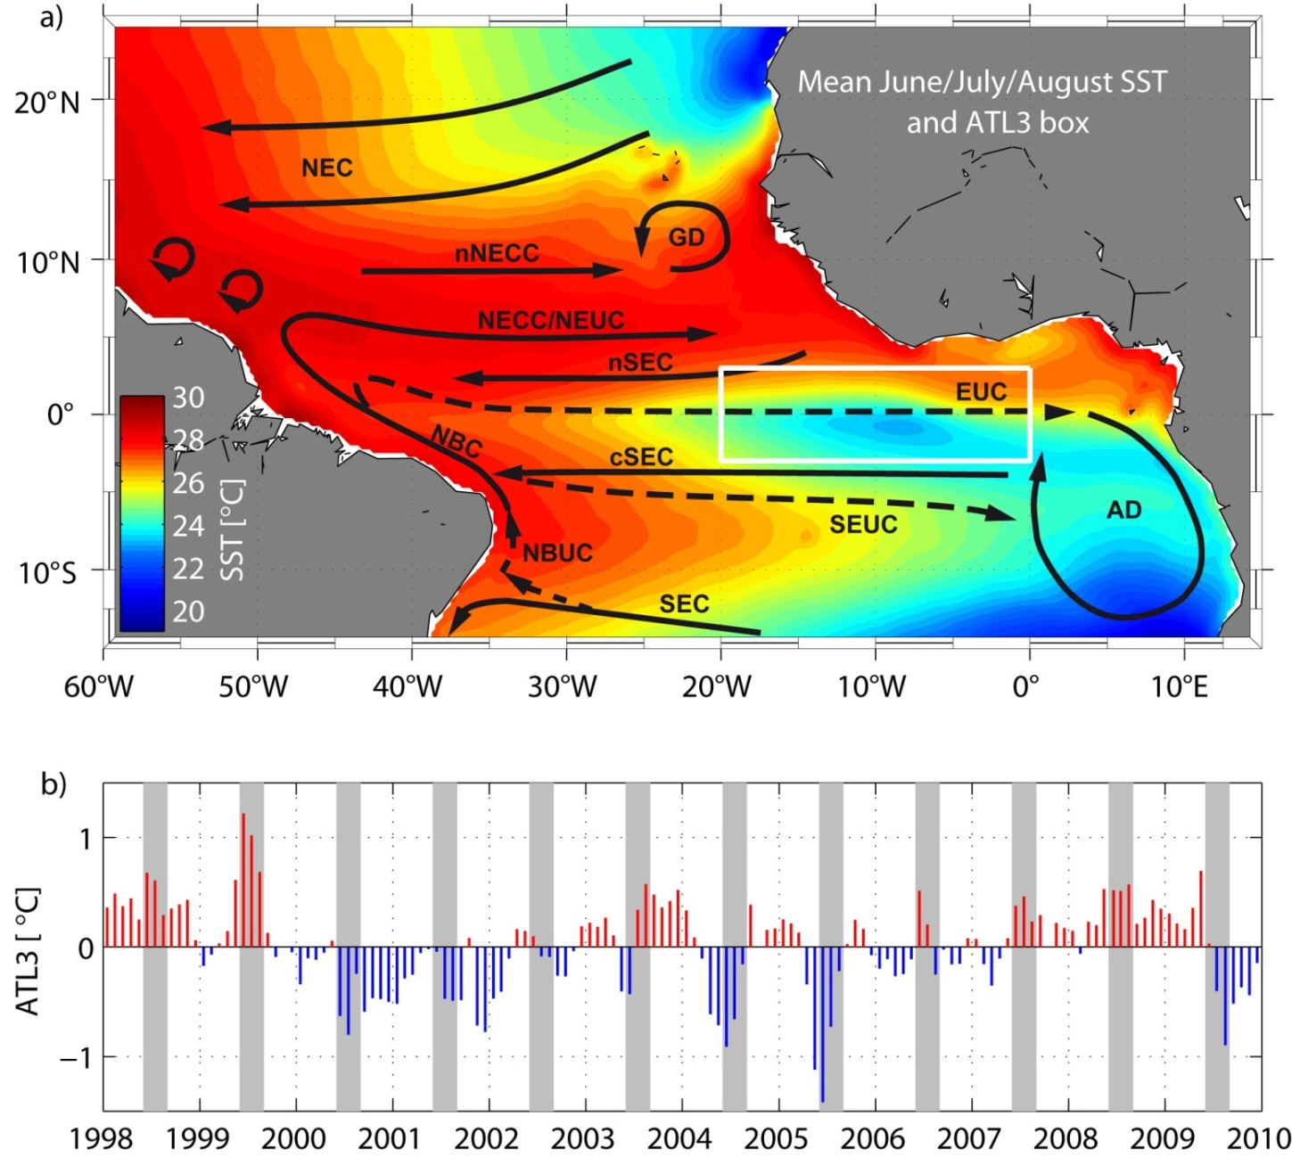
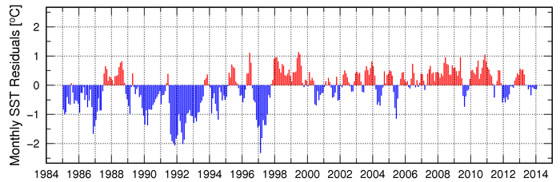
Equatorial Atlantic Cold Tongue
Cold tongue develops during boreal summer
Interannual variability of
ATL3 SST index (3°S–3°N,
20°W–0°)
Brandt et al. 2011
http://www.aoml.noaa.gov

Slide 8
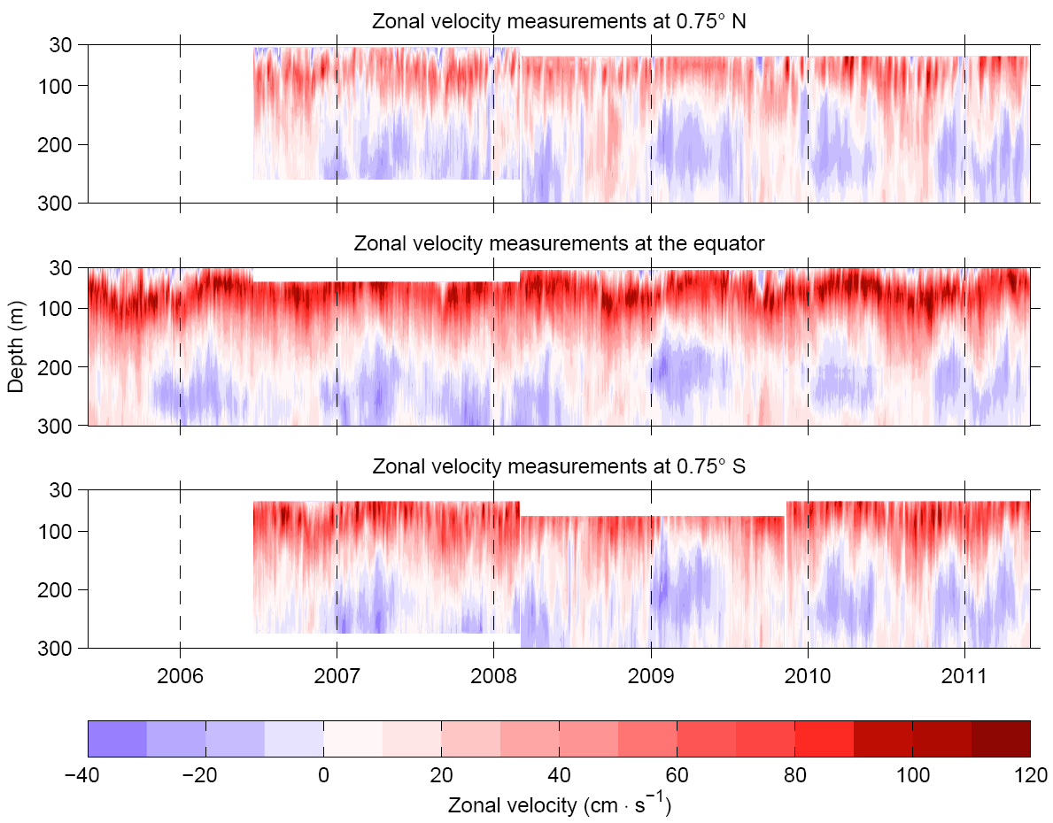
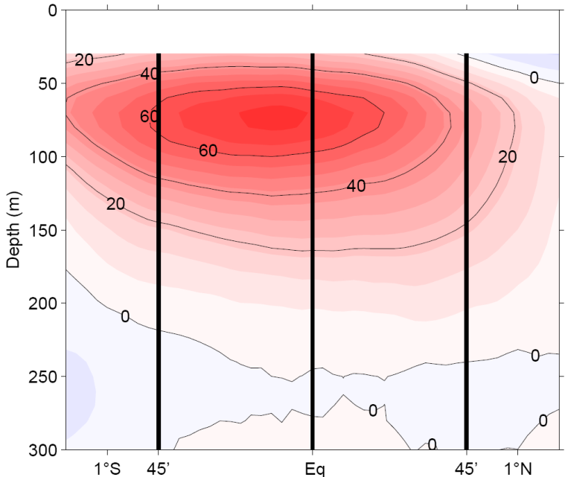
Equatorial Mooring Array at 23°W
single mooring from June 2005
3 moorings
from June 2006 to May 2011
Ship Section Mean
Brandt, et al. 2014

Slide 9
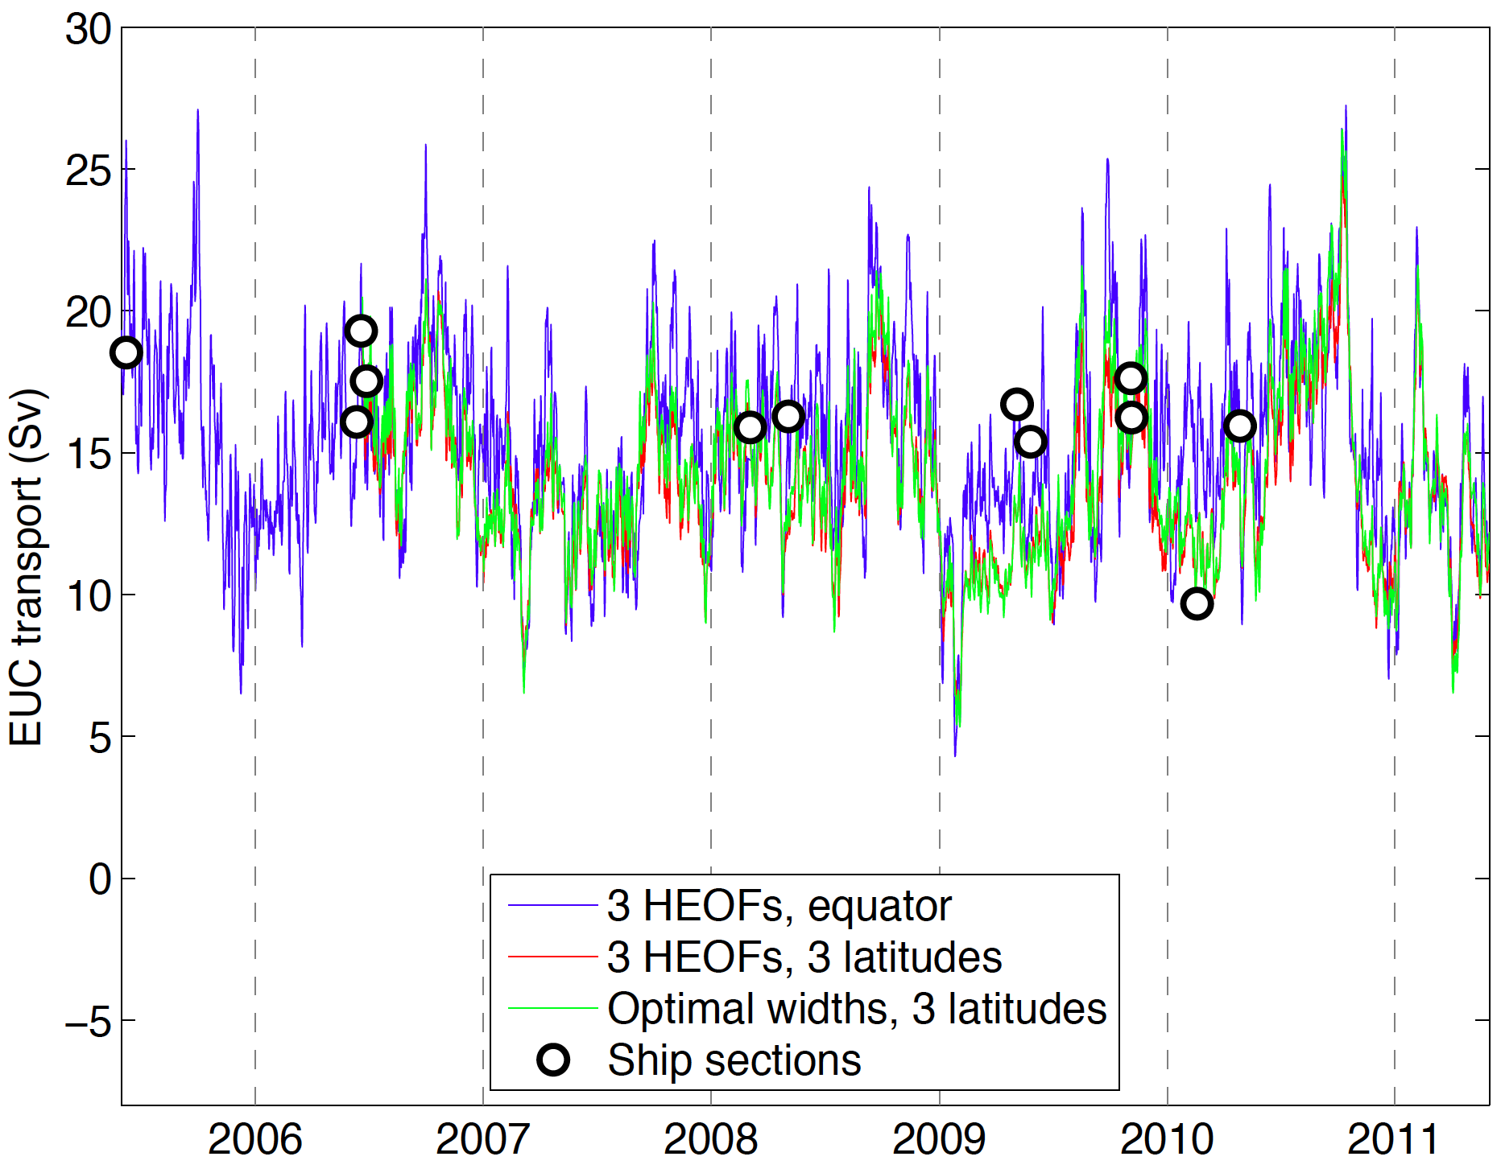
First EUC Transport Time Series
Different inter-/extra-polation schemes applied
General agreement between different methods: uncertainty of ~1 Sv

Slide 10
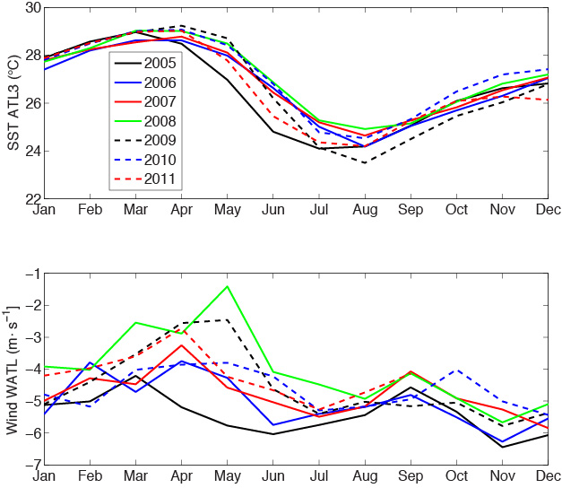
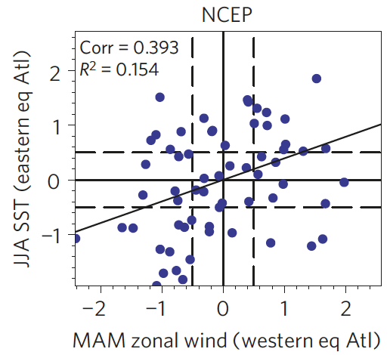
Interannual Variability: SST ATL3 and Wind Western Atlantic
Richter et al. (2013): canonical events have strong/weak winds prior to
cold/warm events
2008
2005

Slide 11
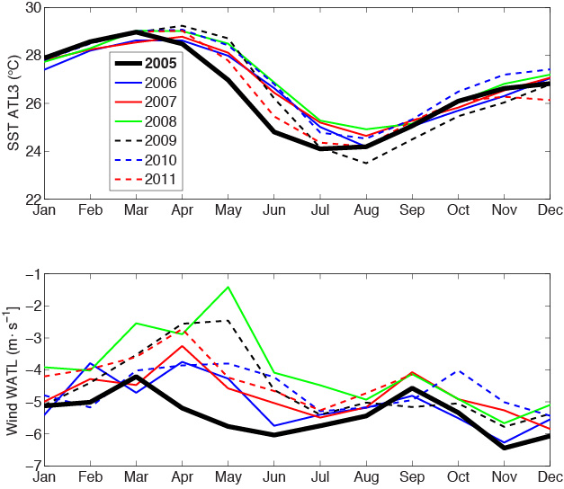
Interannual Variability: SST ATL3 and Wind Western Atlantic
Richter et al. (2013): canonical events have strong/weak winds prior to
cold/warm events
Canonical cold event: 2005

Slide 12
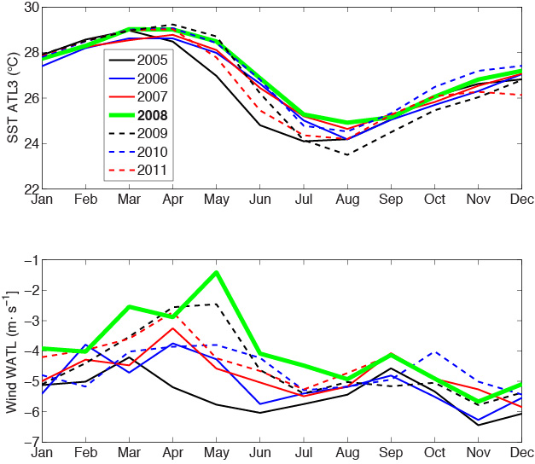
Interannual Variability: SST ATL3 and Wind Western Atlantic
Richter et al. (2013): canonical events have strong/weak winds prior to
cold/warm events
Canonical cold event: 2005
Canonical warm event: 2008

Slide 13
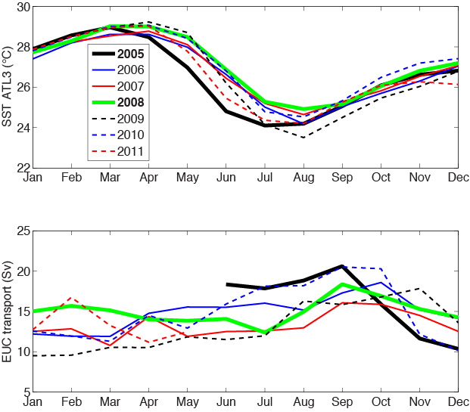
Interannual Variability: SST ATL3 and EUC Transport
Canonical cold/warm events are associated with strong/weak EUC

Slide 14
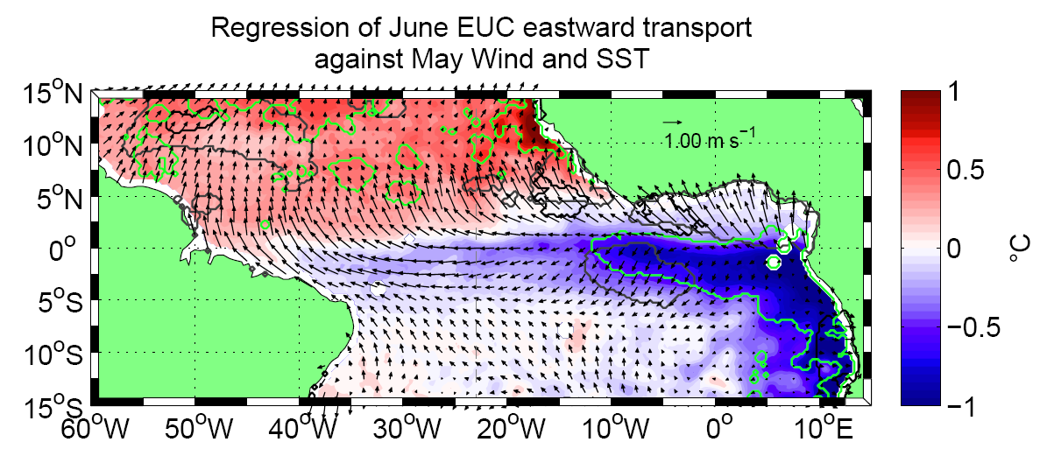
Regression onto June EUC Transport
Strong June EUC associated with anomalous cold Cold Tongue and southerly wind anomalies in the northern hemisphere ⇒ early onset of the West African Monsoon
Notes:
Transport anomalies from 2005/06 to 2011/05 have been used, thus 5 to 6 years are used depending on the months;
Wind : NOAA-NCDC blended sea winds (scatterometer + microwave), 0.25°, 6 hourly (only the averaged daily and monthly data have been used);
SST: TMI SST (microwave), 0.25°, daily (monthly averages also used)

Slide 15
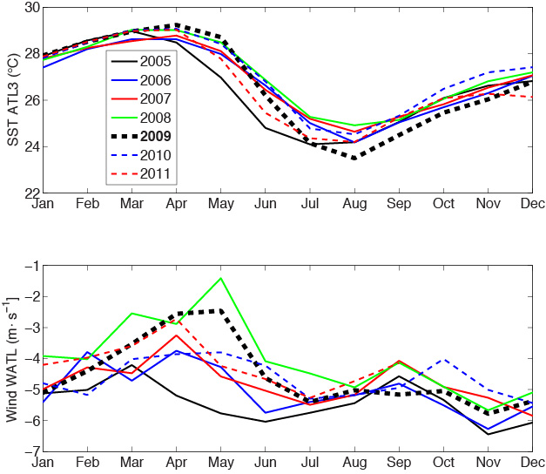
Interannual Variability: SST ATL3 and Wind Western Atlantic
Noncanonical cold event: 2009 (warmest spring with weak winds, but coldest SST in August)
2009

Slide 16
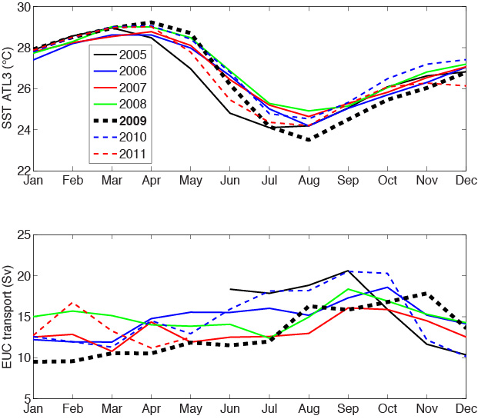
Interannual Variability: SST ATL3 and EUC Transport
Noncanonical cold event: 2009 (warmest spring with weak winds, but coldest SST in August)
EUC during 2009 was weak and shows no variation during the strong cooling from May to July

Slide 17
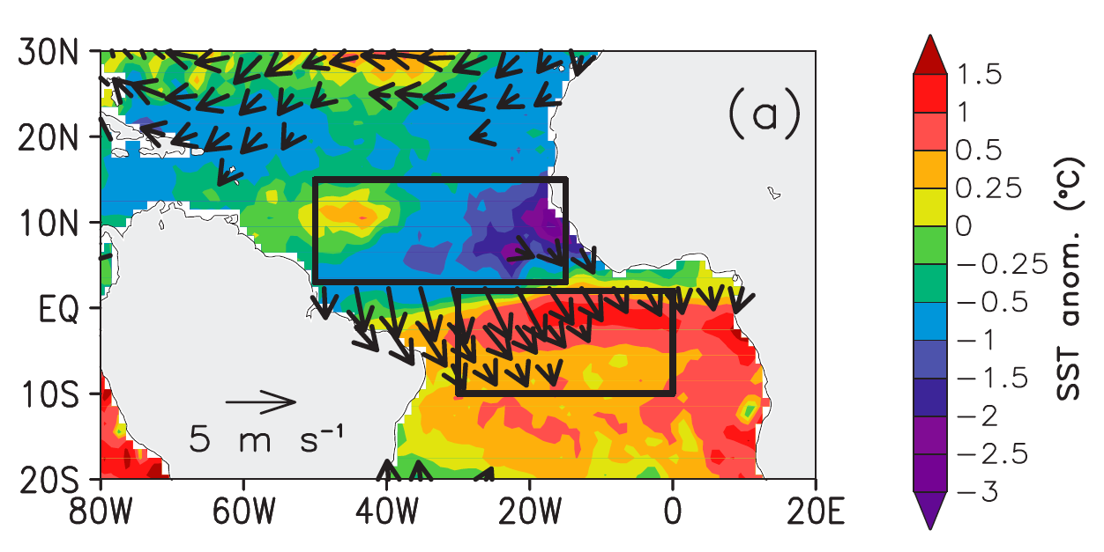
Interannual Variability: SST ATL3 and April/May 2009 Anomalies
According to Richter et al.(2013) noncanonical events are driven by advection from northern hemisphere during strong meridional mode events
SST and wind anomalies during April/May 2009 (Foltz et al. 2012)

Slide 18
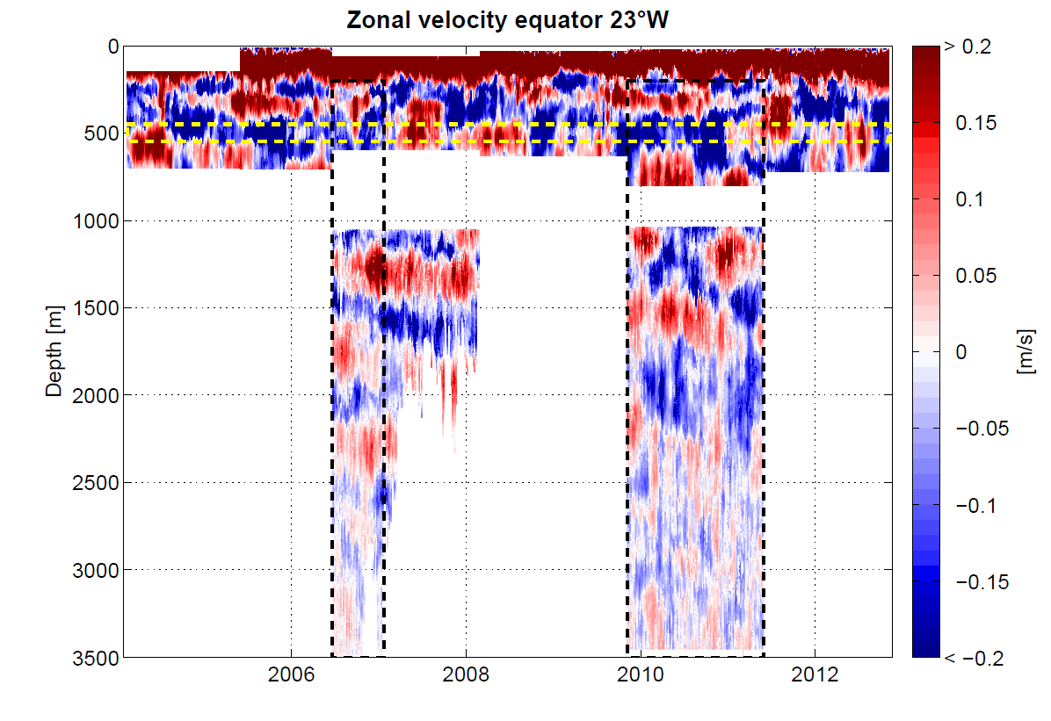
Equatorial Deep Jets
Deep ocean dominated by regular interannual EDJ oscillations
Downward phase and upward energy propagation
update from Brandt et al. 2011
Regular basin mode oscillations with possible impact
on surface velocity, SST, and TAV

Slide 19
Summary
Interannual EUC transport variability largely in agreement with zonal mode variability
2009 noncanonical cold event associated weak EUC and no transport change during cooling phase: likely associated with meridional mode event during boreal spring and meridional advection (Richter et al. 2013)
4.5-yr EDJ oscillations dominate depth range below the EUC: high-baroclinic, equatorial basin modes

Slide 20
Persistent errors in climate models with little sign of reduction
Summer (JJA) Sea Surface temperature bias pattern for CMIP5
White stipples indicate where models are consistently wrong
Toniazzo and Woolnough, 2013
Despite improved process understanding, model errors
remained large resulting in poor TA climate prediction.

Slide 21
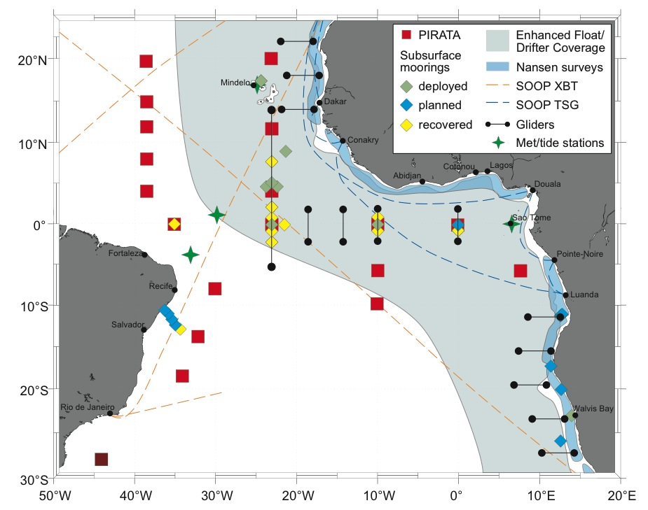
New Focus: Coastal Upwelling
New programs including EU PREFACE and others:
Shipboard and glider observations in coastal upwelling region
Moored observations along the eastern boundary:
11°S, 18°S, 20°S, 23°S
8°E, 6°S PIRATA mooring
New observations are aimed to close our knowledge
gaps in the eastern boundary upwelling regions

