Slide 1
The Equatorial Undercurrent in the central Atlantic and its relation to tropical Atlantic variability
Peter Brandt¹, Andreas Funk², Alexis Tantet¹,
Bill Johns³, Jürgen Fischer¹
¹GEOMAR, Kiel, GER; ²FWG, Kiel, GER; ³RSMAS, Miami, USA

Slide 2
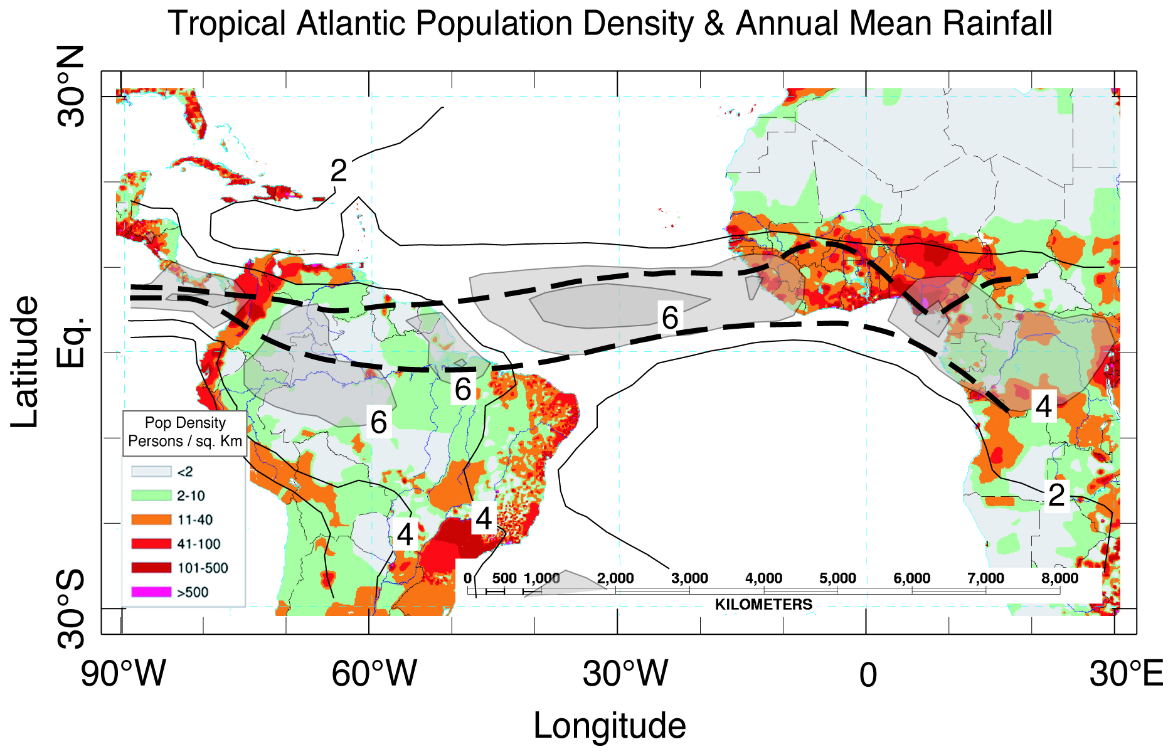
Atlantic Marine ITCZ Complex
ITCZ position and rainfall intensity affect densely populated regions in West Africa
JJA-Position
MA-Position
Tropical Atlantic Variability (TAV) influenced by ENSO / NAO
Internal variability: Meridional and Zonal Modes
Notes:
2
A map of population density in persons/km² (colors, see inserted legend), overlaid by contours of annual mean rainfall (in mm/day) with values > 4 mm/day (~150 cm/yr) shaded in transparent gray to indicate the mean position of the ITCZ. The north (July-August) and south (March-April) limits of the ITCZ climatological annual migration are indicated by thick dashed lines (from Kushnir et al. 2003, presentation).

Slide 3
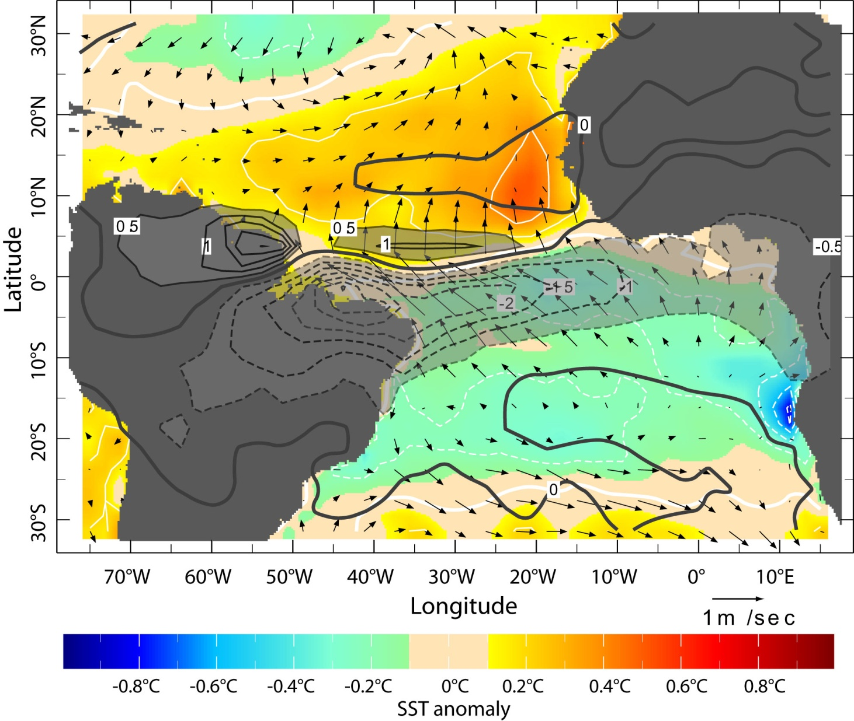
Meridional Mode (March-April)
During spring the meridional SST gradient dominates TAV
Underlying mechanism is the Wind-Evaporation-SST (WES) Feedback Mechanism (Saravanan and Chang, 2004)
Kushnir et al. 2006
Notes:
3
First EOF (33%) of the March-April rainfall from GPCP 1979-2001 (contours in mm/day). March-April SST anomaly (colors, in °C & white contours, every 0.2°) and surface wind anomaly (vector, in m/sec) are determined by regression on the time series of the rainfall EOF.

Slide 4
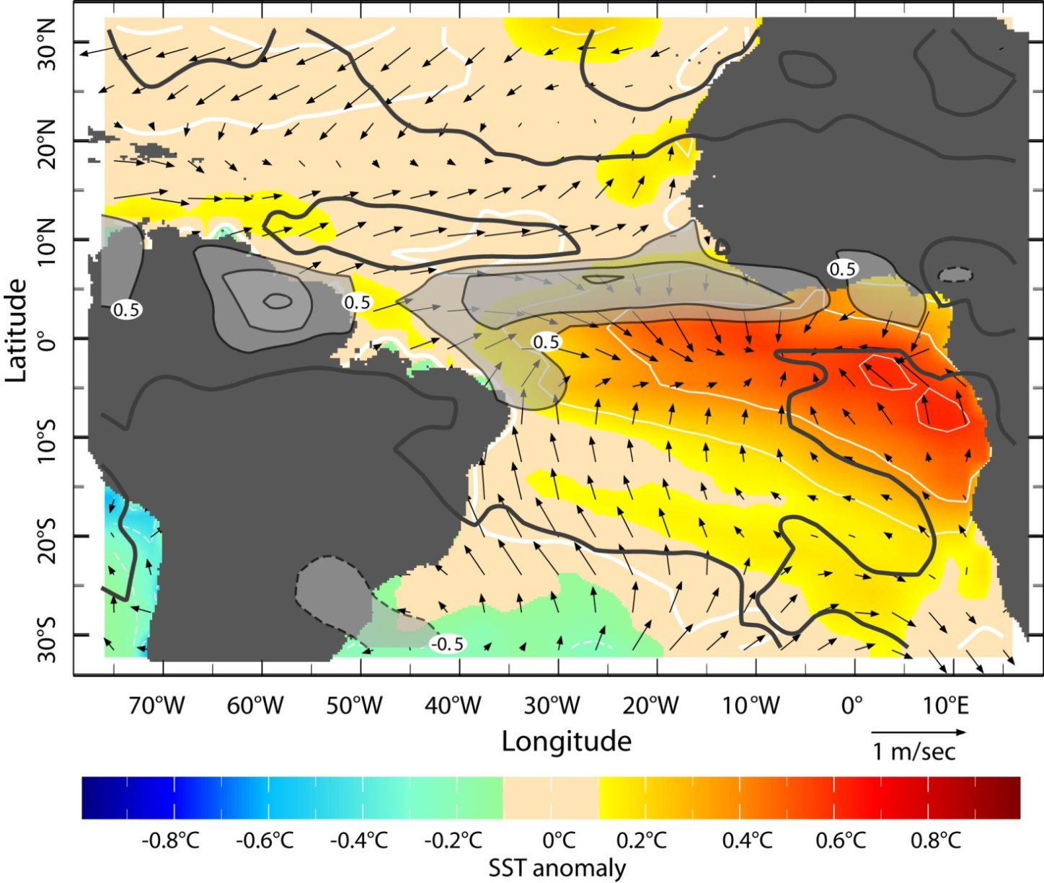
Zonal Mode (June-August)
Zonal Mode is associated with rainfall variability, onset and strength of African Monsoon (Caniaux et al. 2011, Brandt et al. 2011)
Underlying mechanism is the Bjerknes feedback that is strong during boreal spring/summer (Keenlyside and Latif 2007)
Kushnir et al. 2006
Notes:
4
First EOF (23%) of the June-August rainfall from GPCP 1979-2001 (contours in mm/day). June-August SST anomaly (colors, in °C & white contours, every 0.2°) and surface wind anomaly (vector, in m/sec) are determined by regression on the time series of the rainfall EOF.

Slide 5
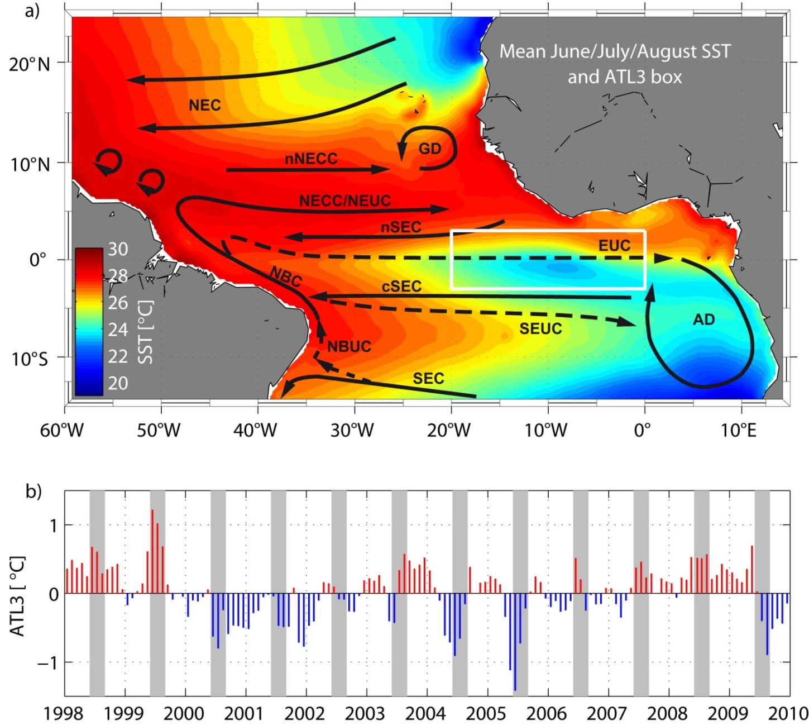
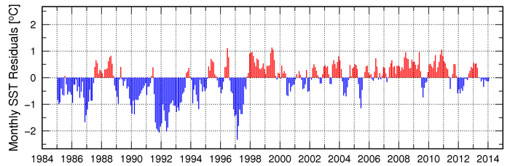
Equatorial Atlantic Cold Tongue
Cold tongue develops during boreal summer
Interannual variability of
ATL3 SST index (3°S–3°N,
20°W–0°)
Moored observations as part of the CLIVAR Tropical Atlantic Climate Experiment
*
*
*
Brandt et al. 2011
http://www.aoml.noaa.gov

Slide 6
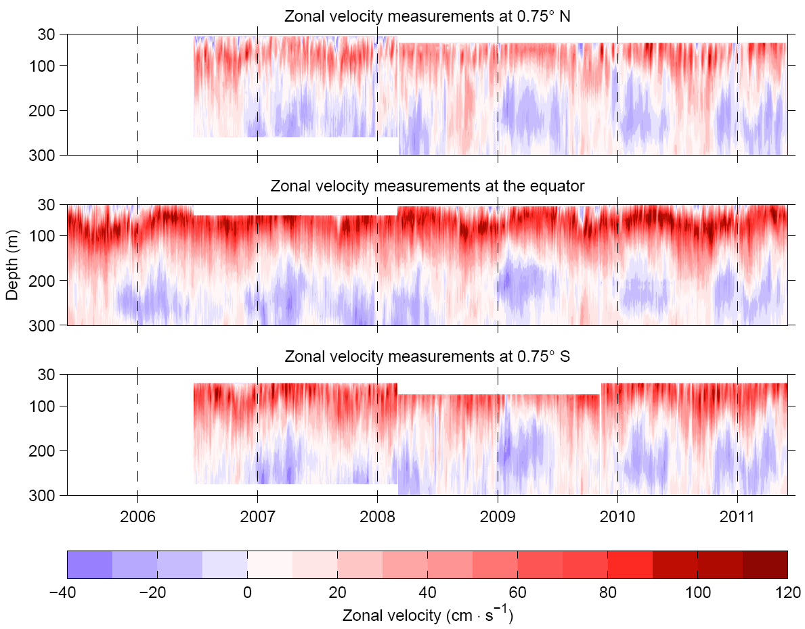
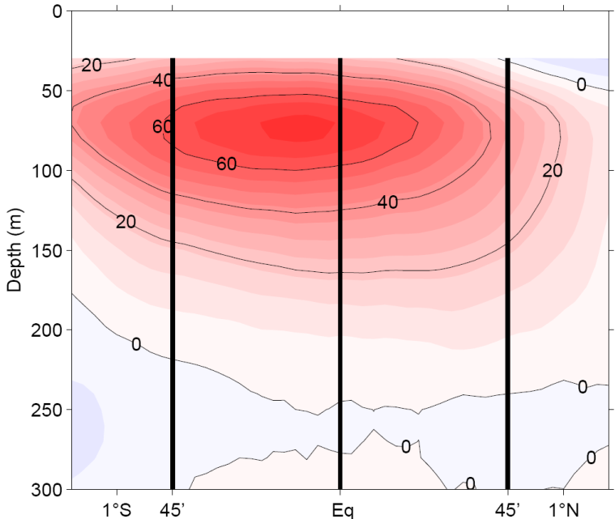
Equatorial Mooring Array at 23°W
single mooring from June 2005
3 moorings
from June 2006 to May 2011
Ship Section Mean
Brandt, et al. 2014

Slide 7
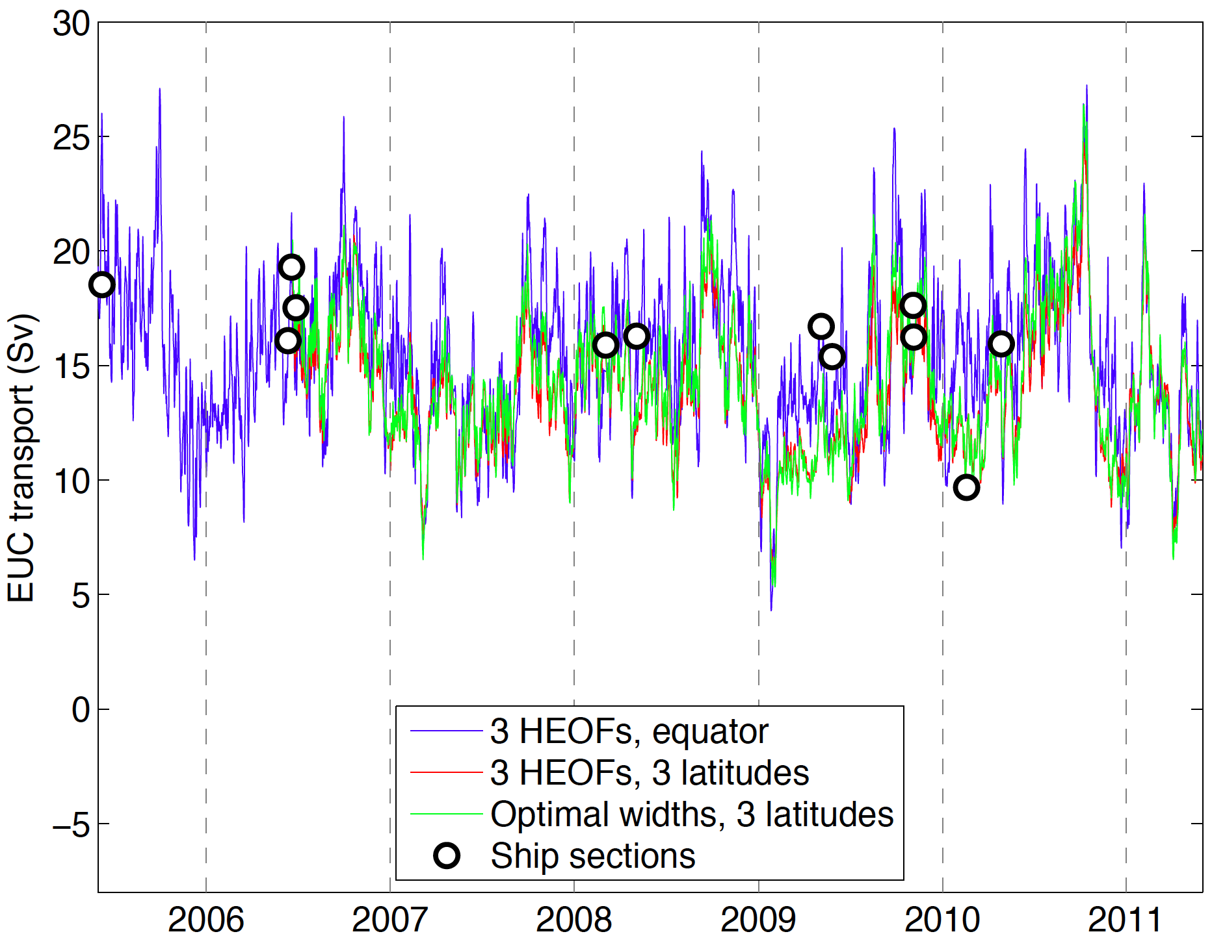
First EUC Transport Time Series
Different inter-/extra-polation schemes applied
General agreement between different methods: uncertainty of ~1 Sv

Slide 8
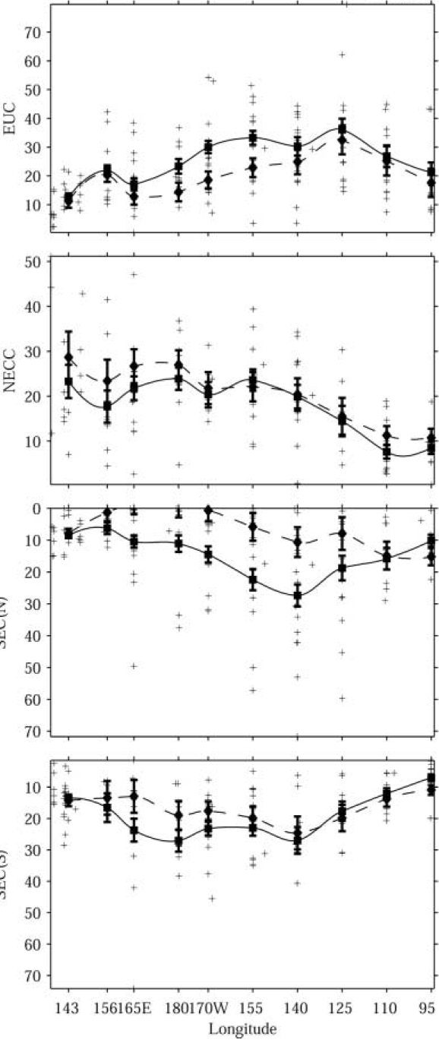
Pacific EUC Transport
Mean EUC Transport (solid) and EUC transport for strong El Niños (dashed)
Strongly reduced EUC transport during El Niños
EUC disappeared during 1982/83
El Niño (Firing et al. 1983)
Johnson et al. 2002
What is the relation between Atlantic EUC transport
and tropical Atlantic variability?

Slide 9
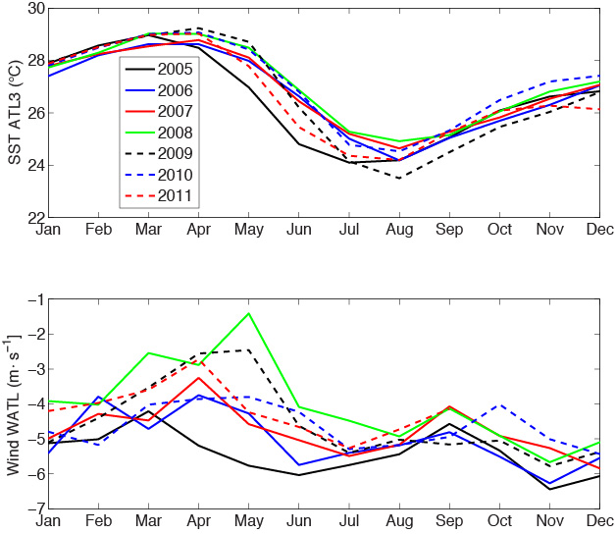
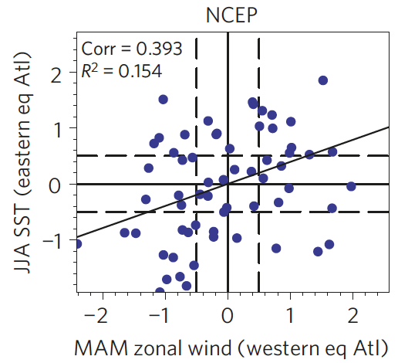
Interannual Variability: SST ATL3 and Wind Western Atlantic
Richter et al. (2013): canonical events have strong/weak winds prior to
cold/warm events
2008
2005
Notes:
ATL3 SST index (20°W–0°, 3°S–3°N)
westernAtlantic (WATL) wind index (40°W–20°W, 3°S–3°N)

Slide 10
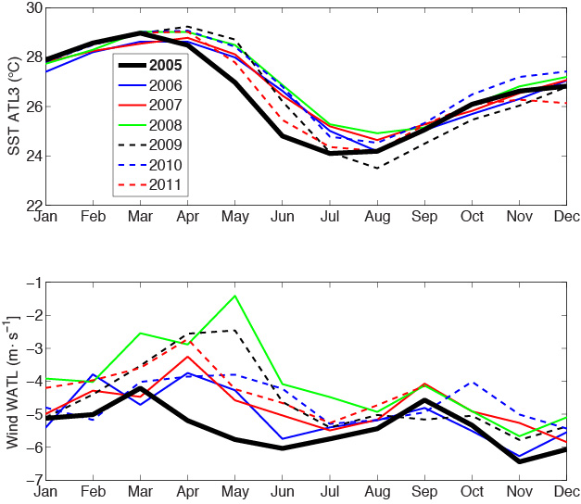
Interannual Variability: SST ATL3 and Wind Western Atlantic
Richter et al. (2013): canonical events have strong/weak winds prior to
cold/warm events
Canonical cold event: 2005

Slide 11
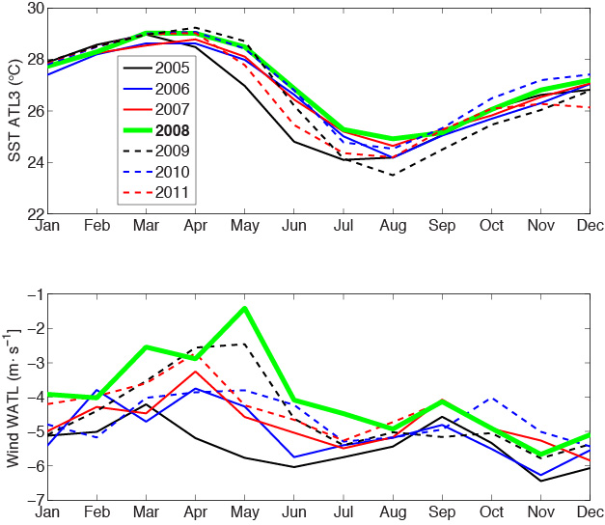
Interannual Variability: SST ATL3 and Wind Western Atlantic
Richter et al. (2013): canonical events have strong/weak winds prior to
cold/warm events
Canonical cold event: 2005
Canonical warm event: 2008

Slide 12
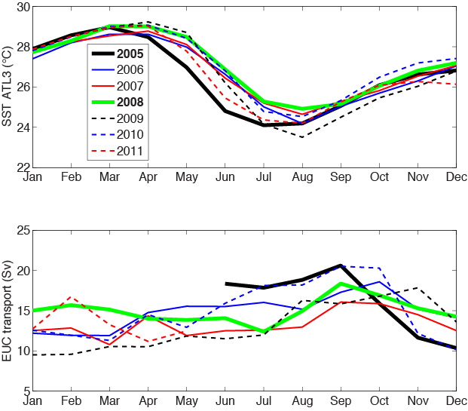
Interannual Variability: SST ATL3 and EUC Transport
Canonical cold/warm events are associated with strong/weak EUC

Slide 13
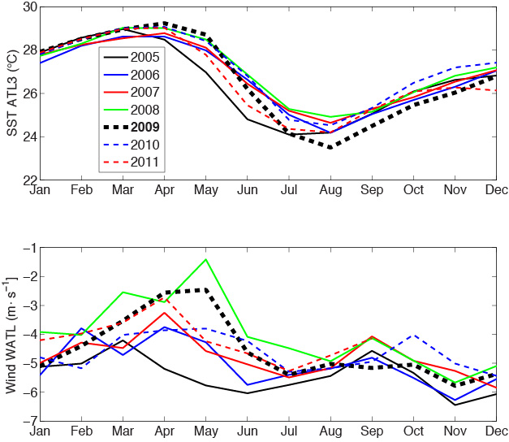
Interannual Variability: SST ATL3 and Wind Western Atlantic
Noncanonical cold event: 2009 (warmest spring with weak winds, but coldest SST in August)
2009

Slide 14
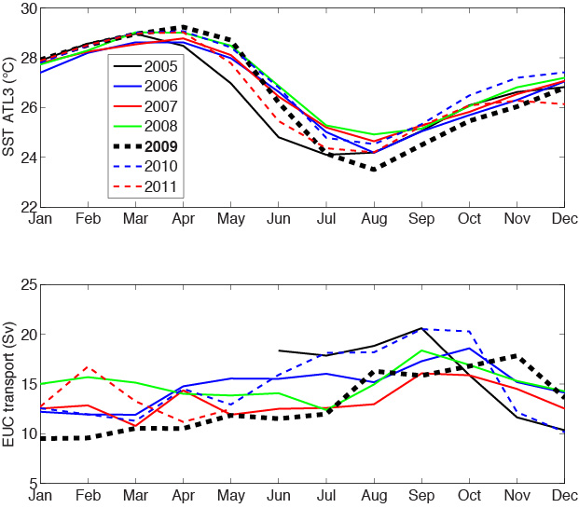
Interannual Variability: SST ATL3 and EUC Transport
Noncanonical cold event: 2009 (warmest spring with weak winds, but coldest SST in August)
EUC during 2009 was weak and shows no variation during the strong cooling from May to July

Slide 15
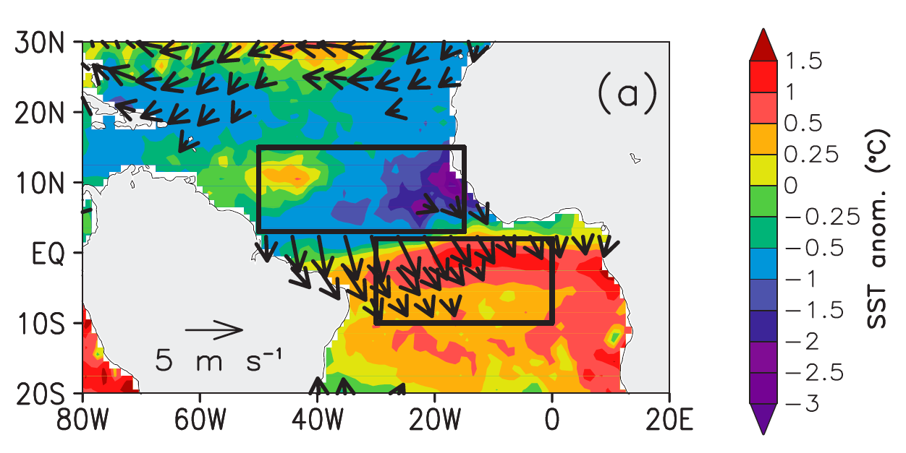
Interannual Variability: SST ATL3 and April/May 2009 Anomalies
According to Richter et al.(2013) noncanonical events are driven by advection from northern hemisphere during strong meridional mode events
SST and wind anomalies during April/May 2009 (Foltz et al. 2012)

Slide 16
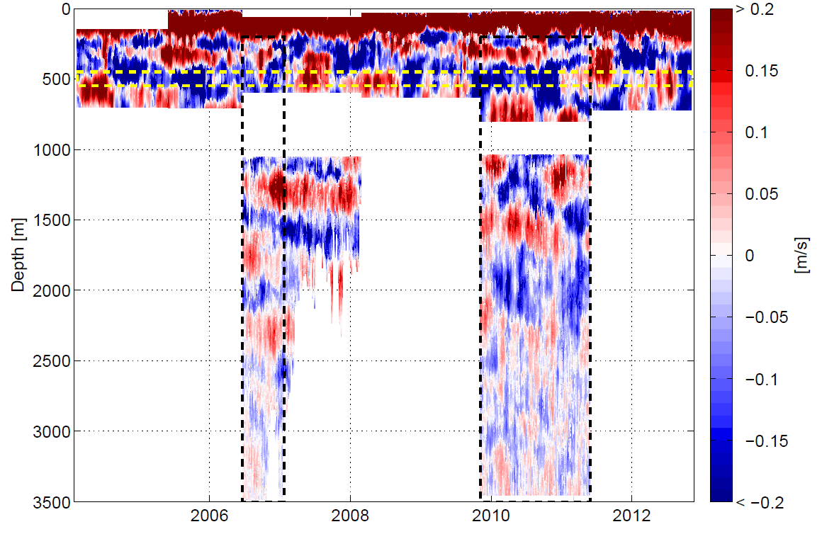
Zonal Velocity Measurements at the Equator, 23°W
Deep ocean is dominated by Equatorial Deep Jets
Downward phase and upward energy propagation
update from Brandt, Funk, Hormann, Dengler, Greatbatch, Toole 2011
At a given depth, EDJ oscillate with a period of about
4.5 yrs (Johnson and Zhang 2003; Brandt et al., 2011)

Slide 17
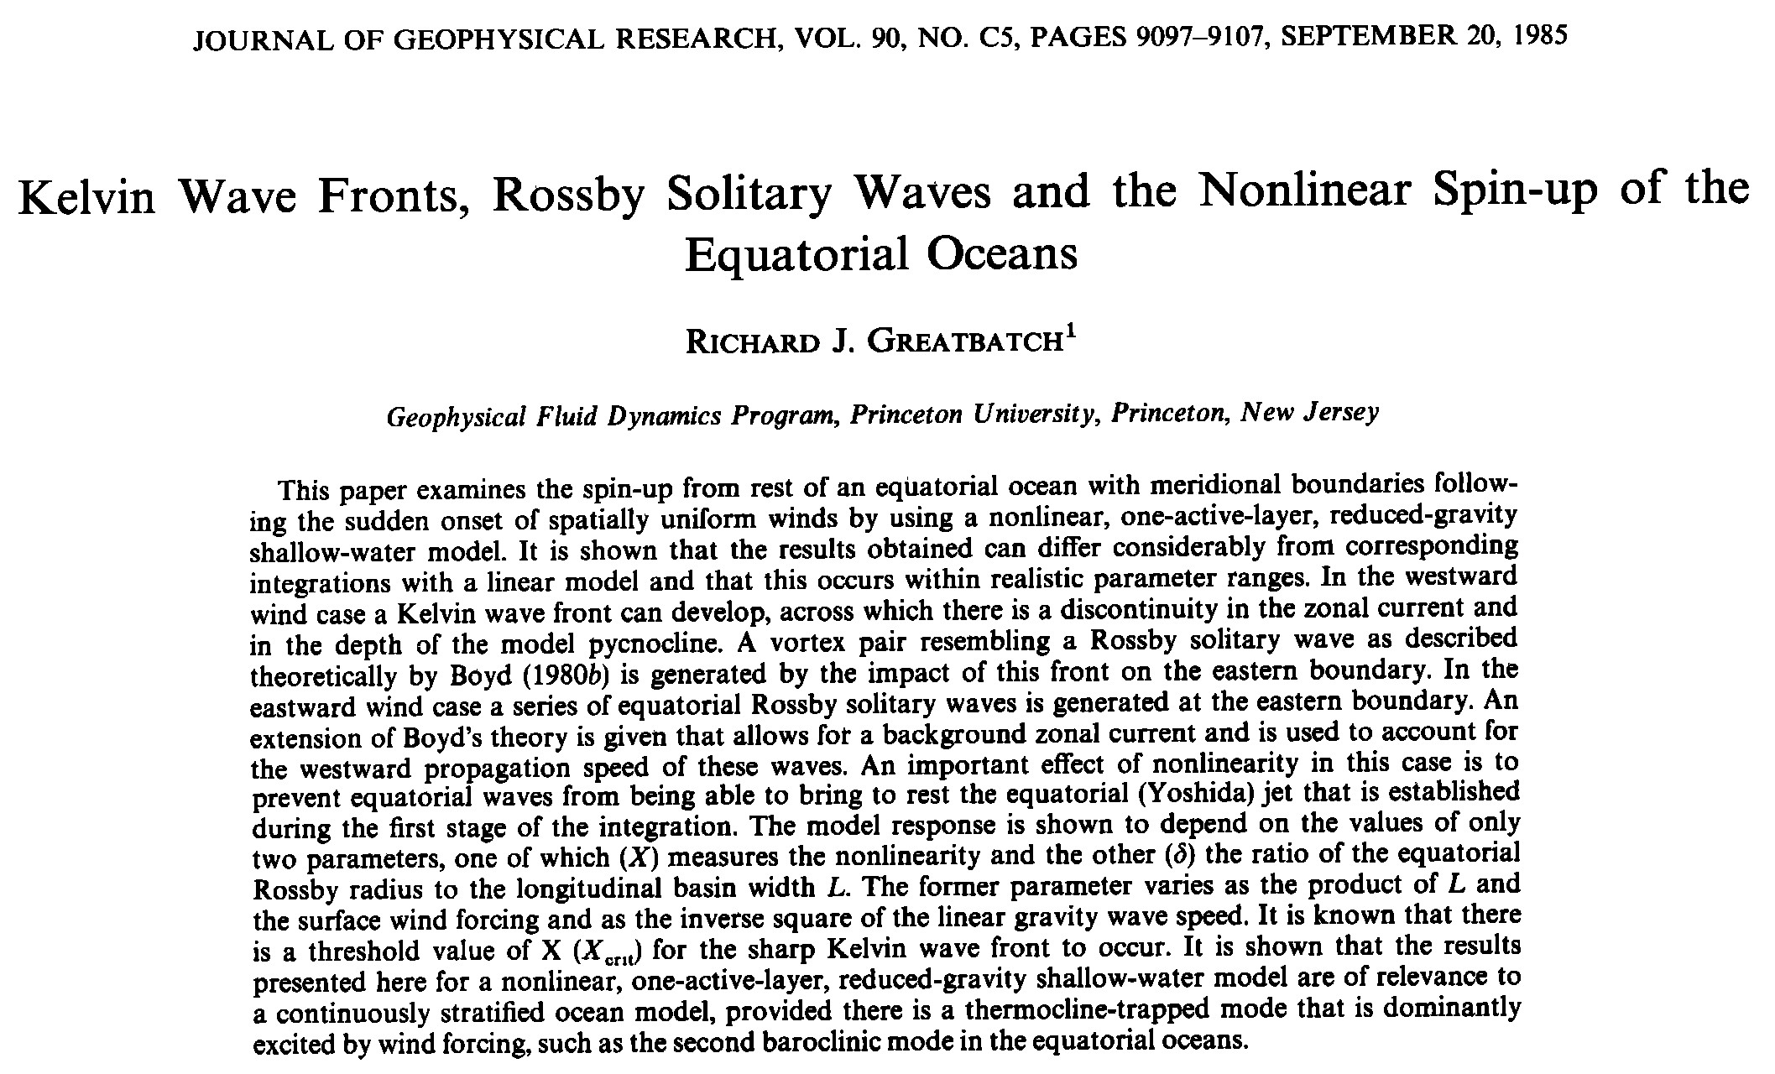

Slide 18

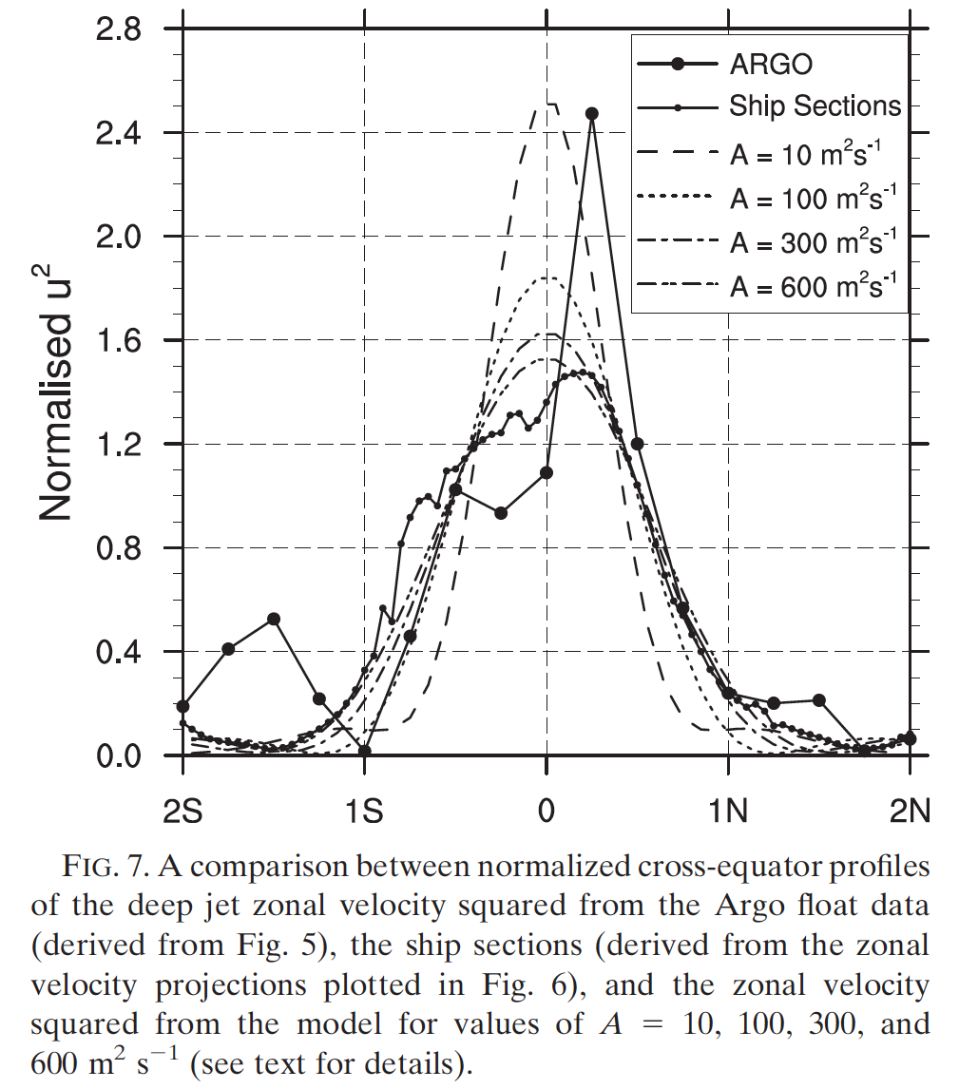
Excitation of equatorial basin modes (Cane and Moore, 1981)
Greatbatch et al. 2012

Slide 19
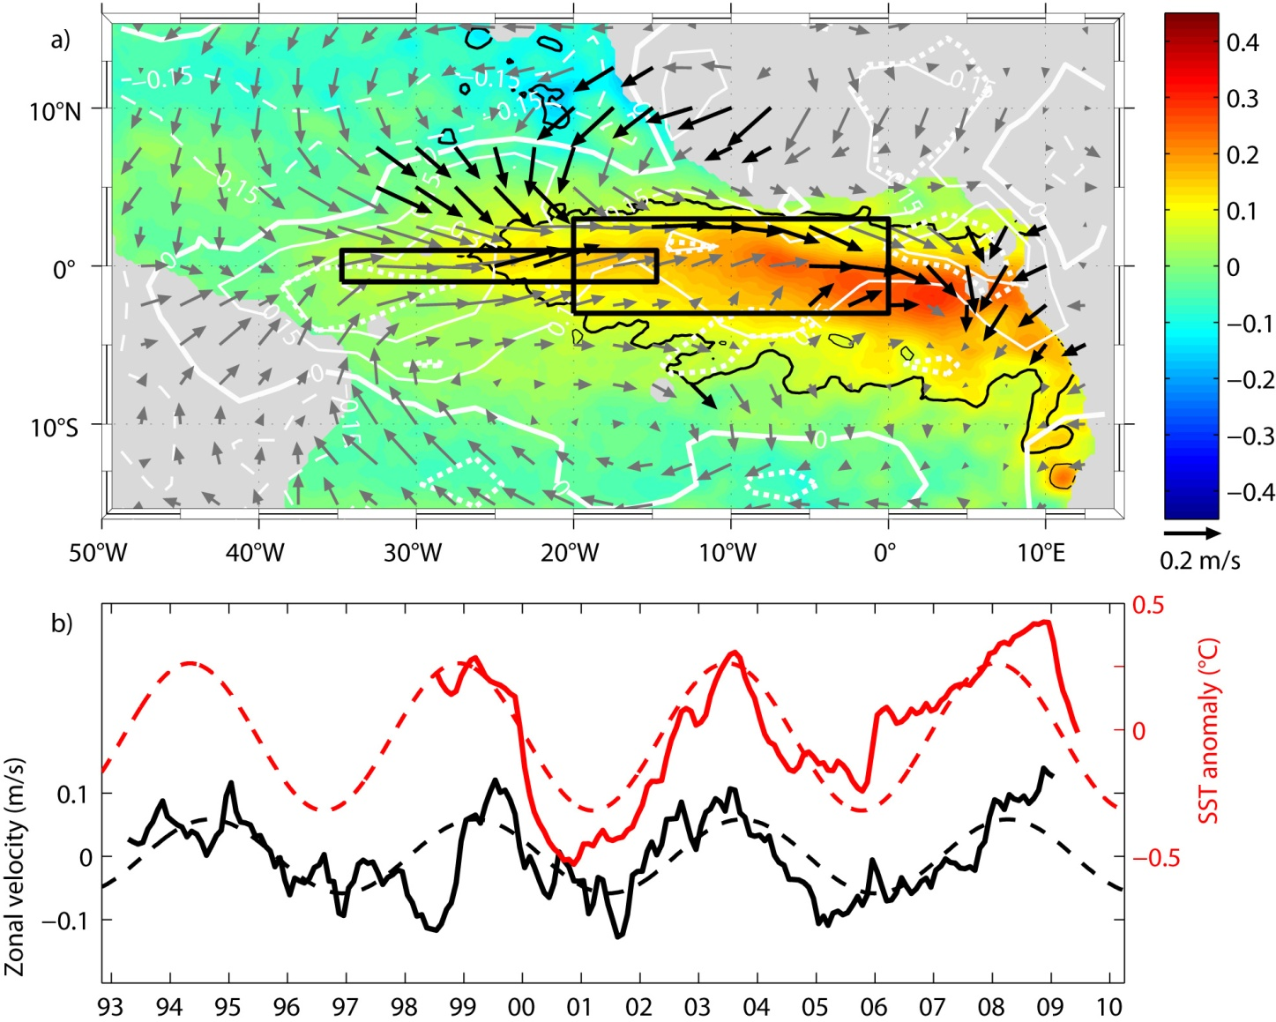
4.5-year Climate Cycle
Geostrophic equatorial zonal surface velocity, SST, and wind with 4.5-year variability
However, many open questions regarding EDJ oscillations …
Brandt, Funk, Hormann, Dengler, Greatbatch, Toole 2011

Slide 20
Summary
Interannual EUC transport variability largely in agreement with zonal mode variability
2009 noncanonical cold event associated weak EUC and no transport change during cooling phase: likely associated with meridional mode event during boreal spring and meridional advection (Richter et al. 2013)
4.5-yr EDJ oscillations dominate depth range below the EUC: high-baroclinic, equatorial basin modes with possible impact on surface velocity, SST and climate

