Slide 1



Mixed layer heat and freshwater budgets:
Improvements during TACE
Rebecca Hummels¹, Marcus Dengler¹, Peter Brandt¹, Michael Schlundt¹
¹GEOMAR Helmholtz Zentrum für Ozeanforschung, Kiel, Germany
Ocean Sciences Meeting 2014, Honolulu, Hawaii USA, 26.02.2014

Slide 2
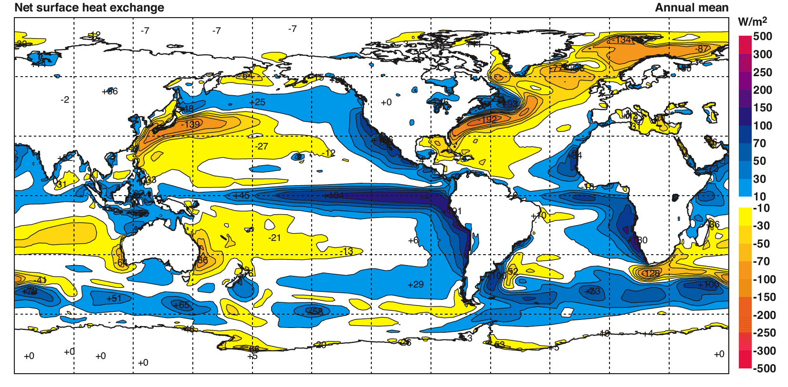
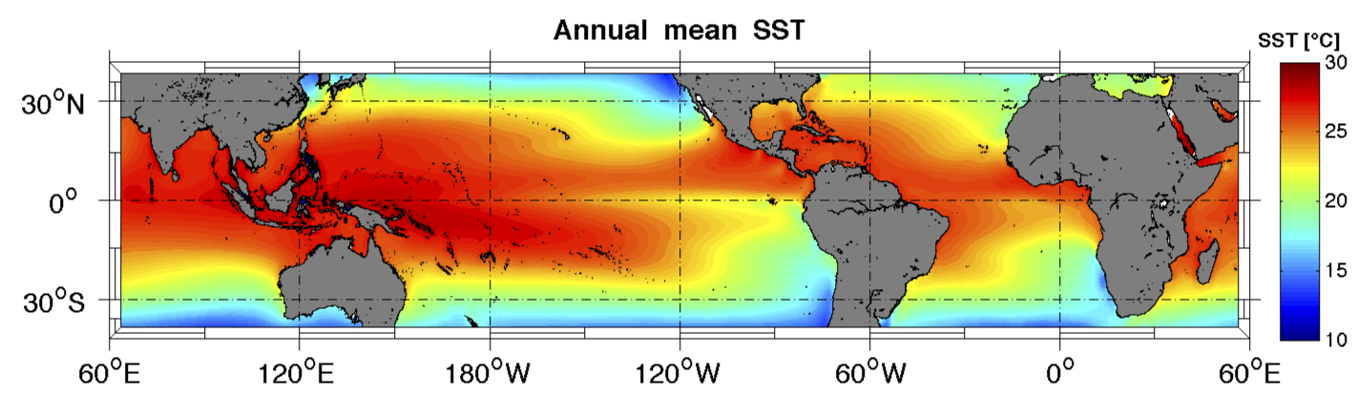
Motivation: Why look at Mixed Layer (ML) heat budgets in Tropics?
￼
￼
￼
Annual-mean heat flux through sea surface calculated from the ECMWF 40-year reanalysis
(Kallberg et al., 2005)
Annual-mean Sea Surface Temperature (SST) from TMI satellite observations
Notes:
Why should we look at the ML heat budgets in the tropical regions. If we look at this picture of the annual mean net surface heat fluxes, we see that highest annual net surface heat fluxes are found in the tropical regions of the Pacific and Atlantic. If we compare this with the mean annual SST, we see that these regions do not coincide with highest SSTs. This already tells us that oceanic processes within the ML have to redistribute large amounts of heat, which is brought into the ocean at the surface. The lower annual SSTs surrounding the equator are the imprint of the so called Cold Tongues in the Pacific and the Atlantic. In the following we will conentrate on the Atlantic ocean:

Slide 3
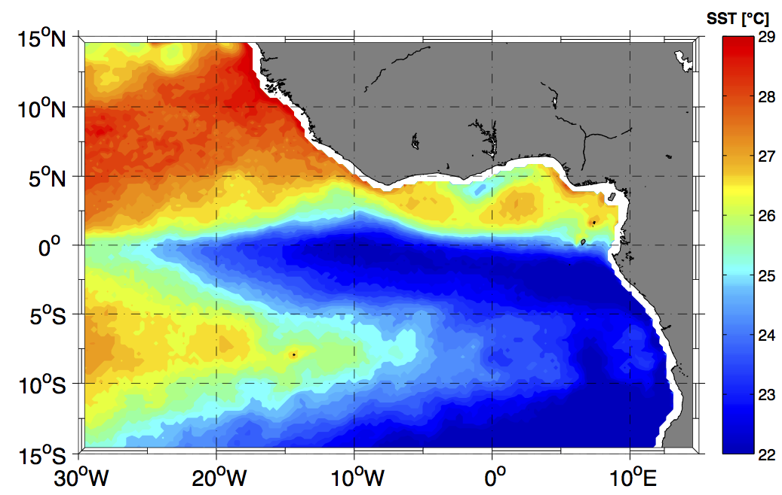
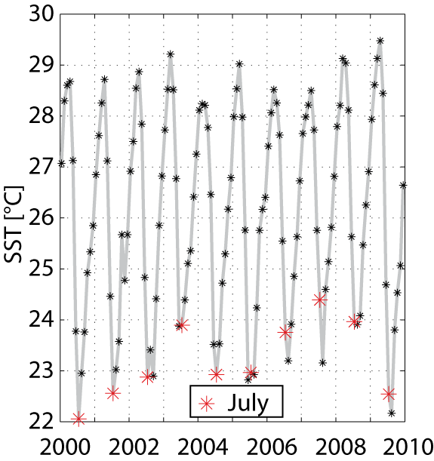
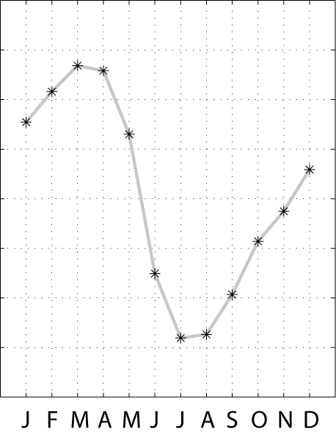
Motivation: SST variability in the Atlantic Cold Tongue (ACT)
Which processes drive seasonal SST variability ?
Interannual variability of ACT SSTs is tied to interannual variations in rainfall over the adjacent continents
Notes:
The Atlantic Cold Tongue shortly named ACT is shown here at its maximum extent reached around July extending from the west African coast to about 25°W. If we focus on 10°W on the equator, which is often considered the center of the ACT and look at a 10 years timeseries of monthly SSTs we see the regular annual cooling. There is some inter-annual variability in strength and onset time of the cooling, which has been linked to rainfall anomalies over the adjacent continents,however the dominating signal in this timeseries is the seasonal cycle, which is shown on average in this plot. SSTs drop about 6°C from about April to July every year. The question is which processes are responsible for this cooling ?. A common approach to tackle this question is to investigate the individual contributions to the mixed layer heat budget.

Slide 4
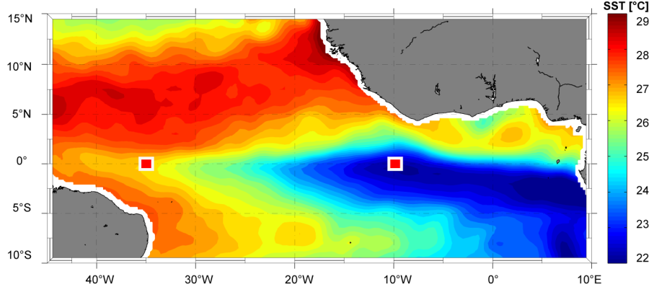
Motivation: Mixed layer heat budget
individual contributions
to heat balance
Sum and local
storage
Contributions to residual:
coarse resolution of surface velocity climatology
bad data coverage for relative humidity
neglection of diapycnal heat flux out of the ML
Foltz et. al 2003
Notes:
10 years ago, Foltz and collegues have evaluated the individual contributions to the seasonal ML heat budget at several locations in the tropical Atlantic. At 35°W on the equator outside of the ACT region the sum of their contributing terms (shown as dotted line her) closely follows the observed local storage. But at 10°W on the equator in the center of the they had a large residual between their sum of terms and the local storage. Besides of some maybe insufficiently resolved data sets, the main point is that they neglected the diapycnal heat flux due to turbulence because they did not have any observations to estimate ist magnitude. Concerning this point we now have

Slide 5
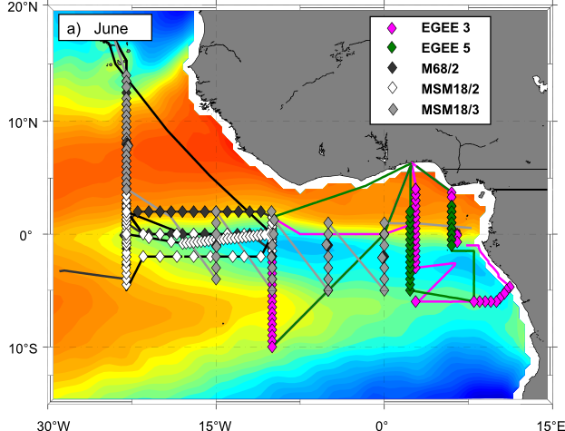
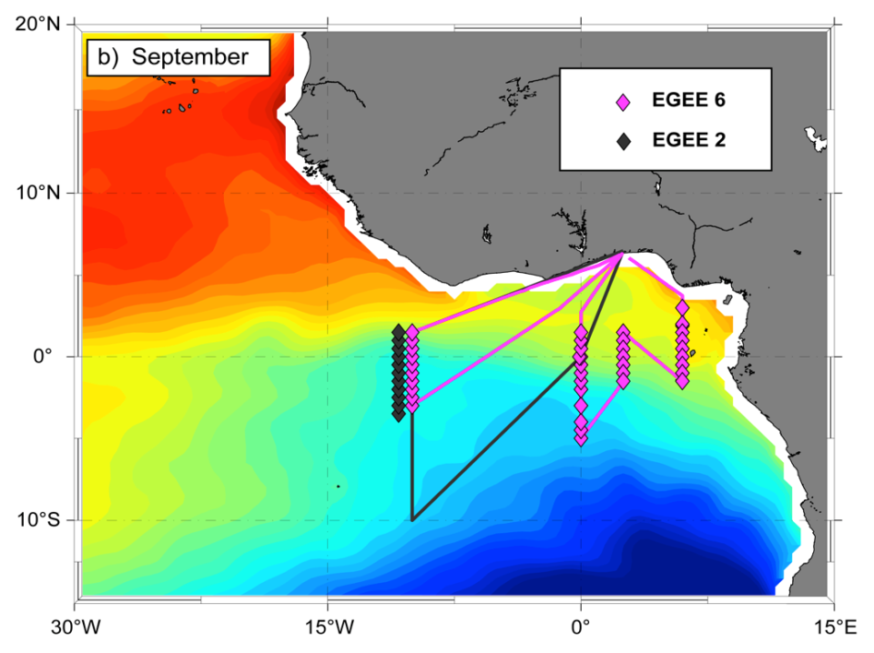
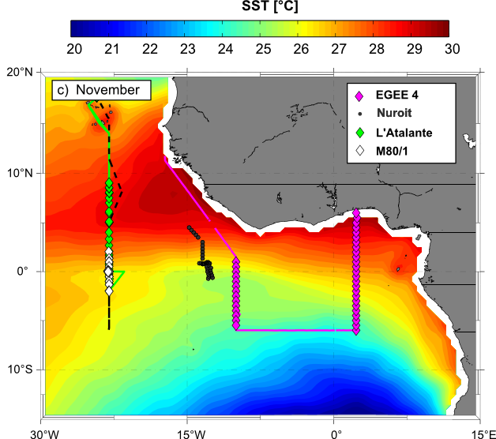
Observational program
repetitive microstructure sections within the cold tongue region: 11 cruises during different seasons
individual stations with at least 3 profiles (>2000 profiles)
shipboard ADCP measurements
Notes:
An extensive set of microstructure observations at hand, which was collected on 11 cruises to the ACT region during different seasons. Several sections were repeated to highlight some regional and seasonal variability in turbulent mixing intensity on over 2000 Microstructure stations. Additionally the horizontal flow field was monitored with ship board ADCPs. Microstructure observations were performed using a

Slide 6
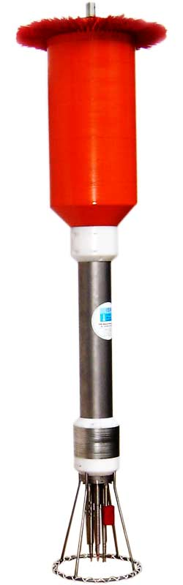
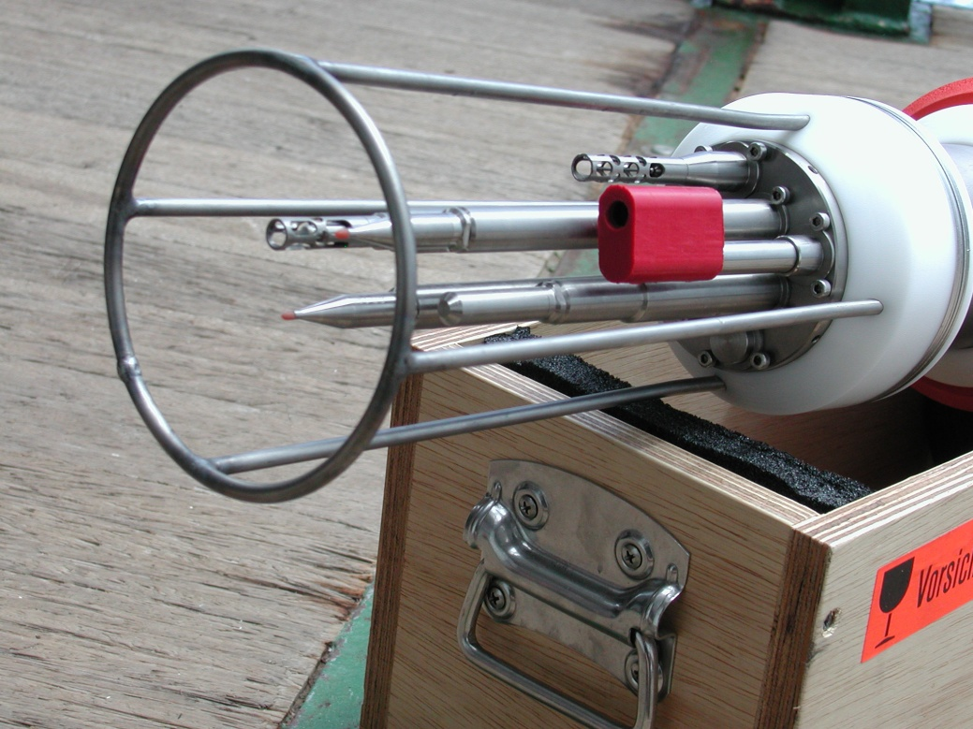
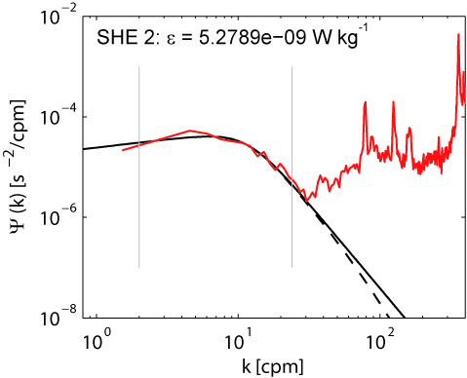
Data Treatment
From MSS measurements to diapycnal heat fluxes
CTD sensors → T, C, p →
Shear sensors →
Dissipation rate of turbulent kinetic energy for isotropic turbulence is given by:
Eddy diffusivities for mass can be estimated as:
(Osborn, 1980)
(Osborn and Cox, 1972)
Notes:
So called microstructure profiler, which is shown here. It is equipped with standard CTD sensors as well as sensors measuring the small scale velocity shear. This small scale velocity shear can then be used to estimate dissipation rates of turbulent kinetic energy, by integrating shear spectra and in further steps is used to calculate eddy diffusivities and diapycnal heat fluxes.

Slide 7
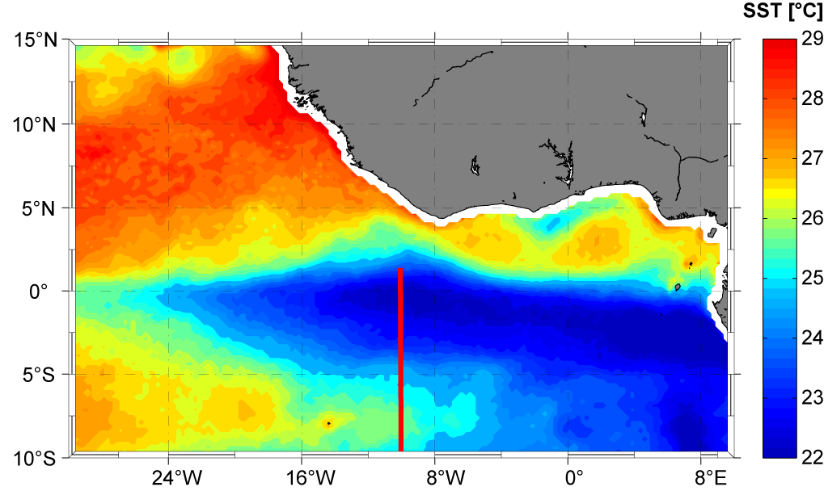
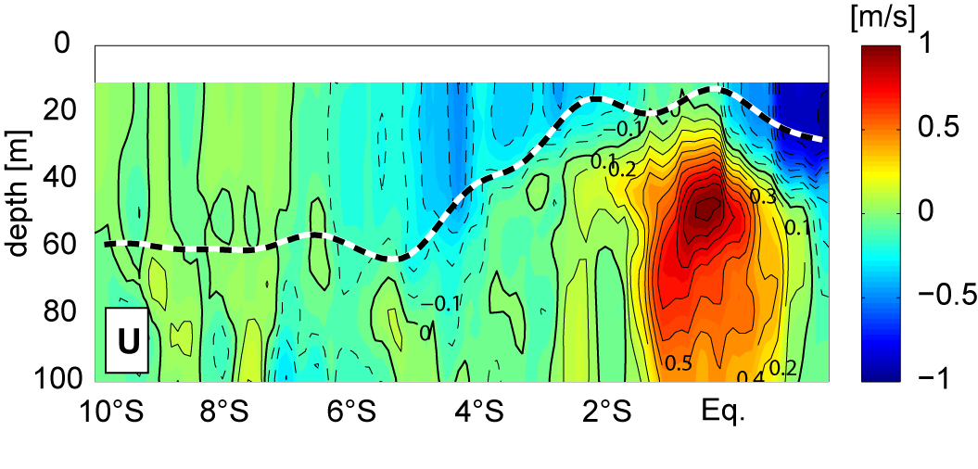
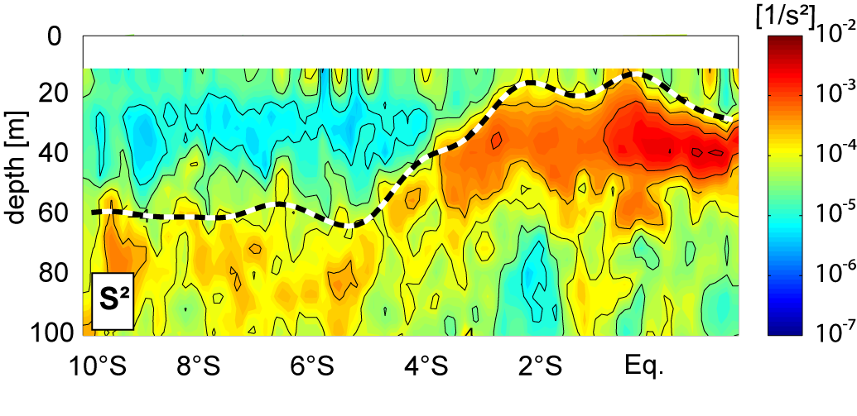
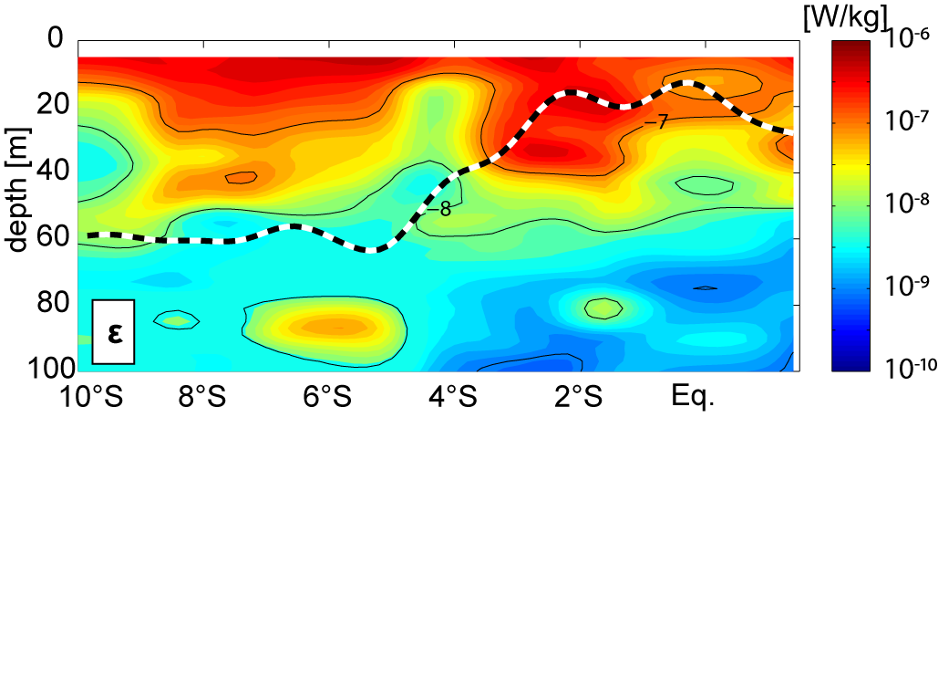
Background settings within the ACT
cSEC
nSEC
EUC
3°S-1.5°N (equatorial ACT):
elevated shear levels (due to strong currents (EUC,cSEC,nSEC)
enhanced dissipation rates below MLD
10°S-4°S (southern ACT):
moderate shear levels due to the lack of strong currents
background dissipation rates below MLD
Notes:
Just a short illustration to understand the variability of mixing intenstify can be obtained by looking at an exemplary section across the ACT along 10°W.
The regional and seasonal variability of these background conditions in terms of shear and stratification leads to a corresponding variability pattern for diapycnal ML heat losses:

Slide 8
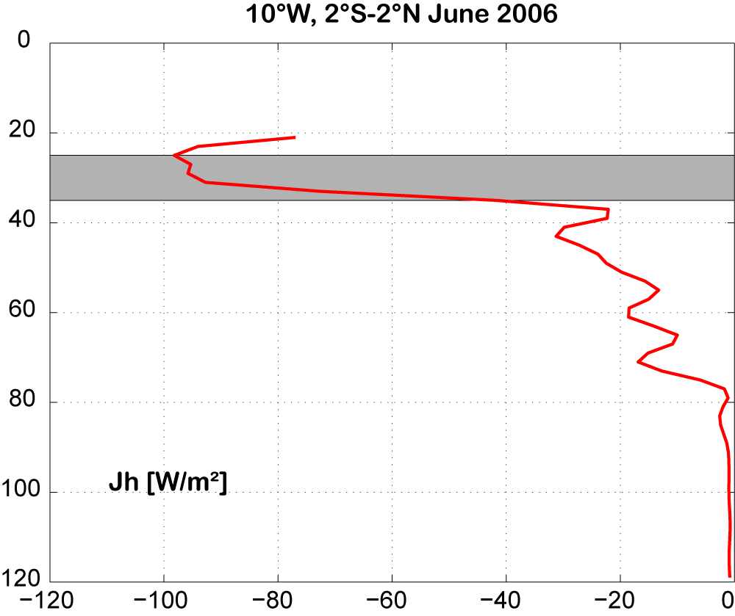
Diapycnal heat flux: Layer of interest
MLD
Divergent profile of diapycnal heat flux
heat loss due to diapycnal mixing is characterized by diapycnal heat flux in thin layer below the ML
this value is included in the ML heat budget
Notes:
A typical profile of the diapycnal heat flux for the tropical Atlantic is shown here. As you can see the profile is highly divergent in the vertical increasing in absolute magnitude towards the ML base and hence cooling the overlying layer and decreasing below distributing the heat to the lower layers. Hence the heat loss of the ML due to diapycnal mixing is characterized by the diapycnal heat flux averaged over this this narrow layer. These average values for the different regions and seasons will be included in the refined ML heat budgets.

Slide 9
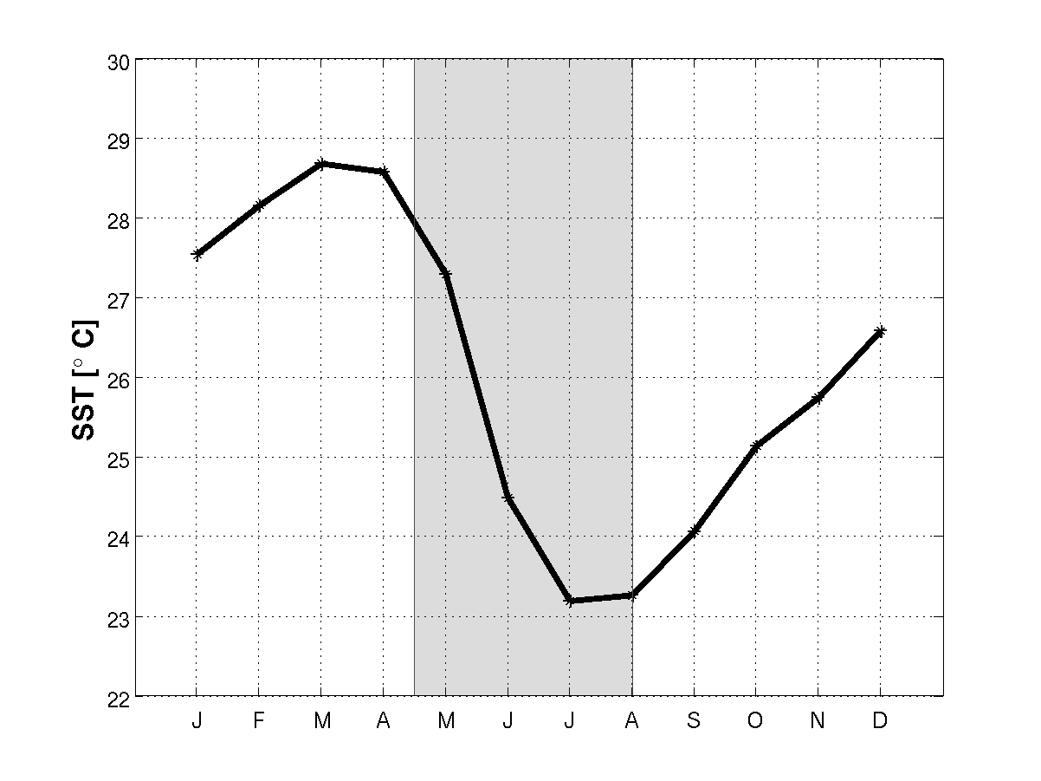
Mixed layer heat budget
Evaluation at the 4 PIRATA buoy locations within the ACT
0°N, 10°W
3 phases of ACT development:
Absence (January-April)
Development (May-August)
Mature phase (September- December)
Notes:
The budgets are evaluated at the 4 PIRATA buoy locations within the ACT region, where several atmospheric and oceaniv parameters are monitored at high reolstuion since more than 10 years and we will concentrate on the development phase of the ACT when SSTs strongly drop.

Slide 10
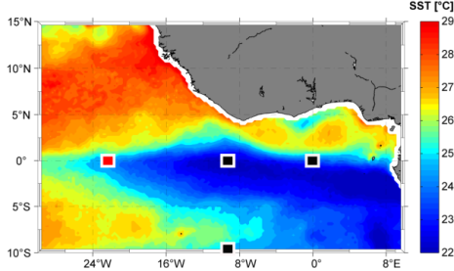
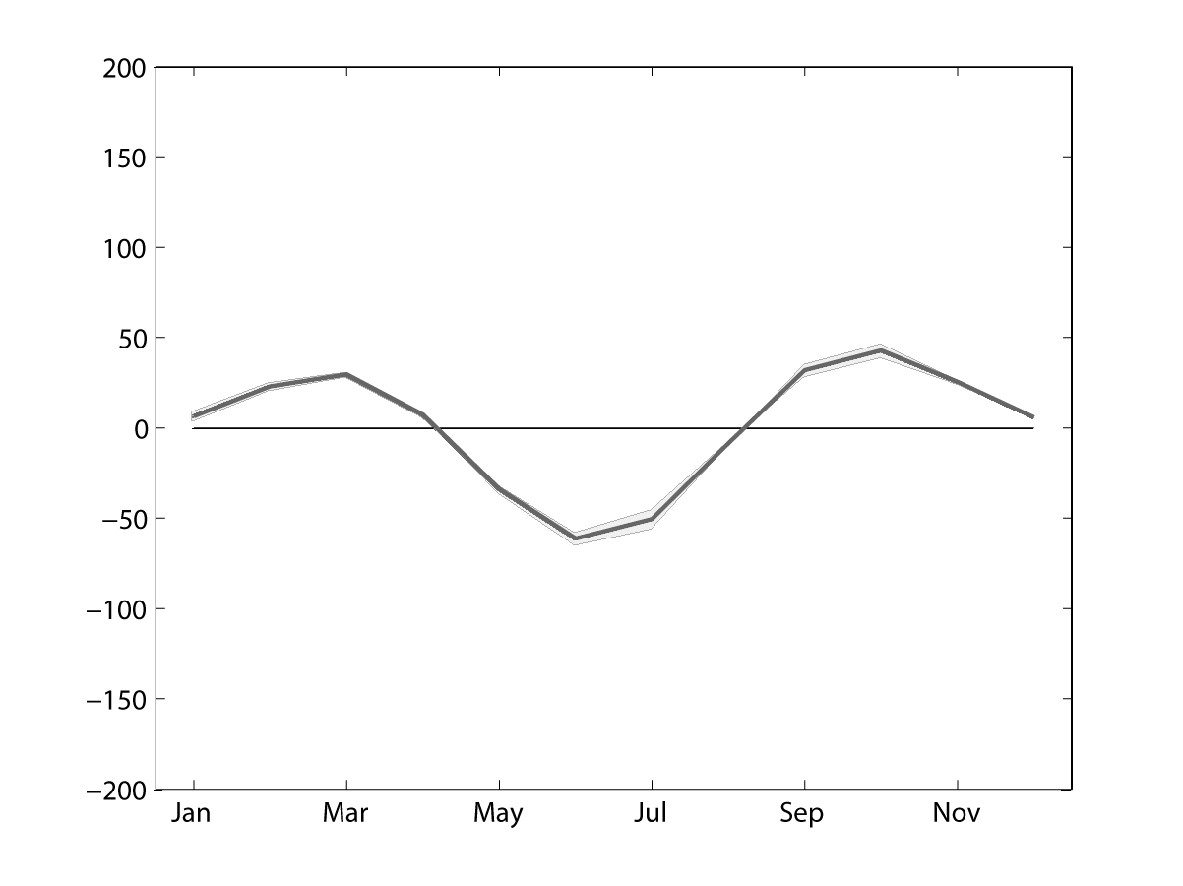
Mixed layer heat budget
0°N, 23°W
local storage = net surface - advection – eddy advection - entrainment – diapycnal ML heat loss
Notes:
We start at 23°W on the equator. Here you see the mixed layer heat budget in equations and we will go through the different terms now at this location investigating their contribution to the budget during ACT development. We start with the left hand side, the local heat storage, which is negative during ACT development describing the cooling of the ML.This we want to explain by summing up the right hand side.

Slide 11
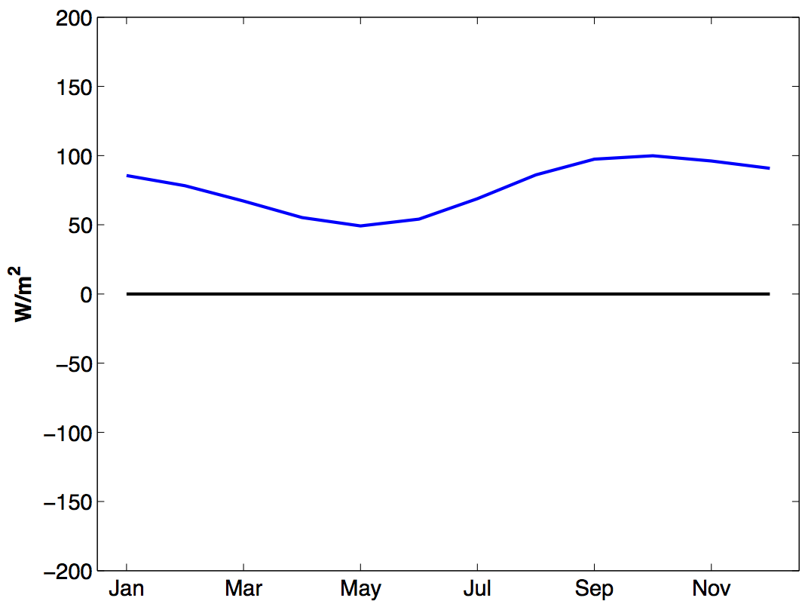
Mixed layer heat budget
0°N, 23°W
local storage = net surface - advection – eddy advection - entrainment – diapycnal ML heat loss
net surface heat flux
Warming:
Cooling:
Notes:
So starting with the net surface heat fluxes, which contribute to warm the ML during ACT development.

Slide 12
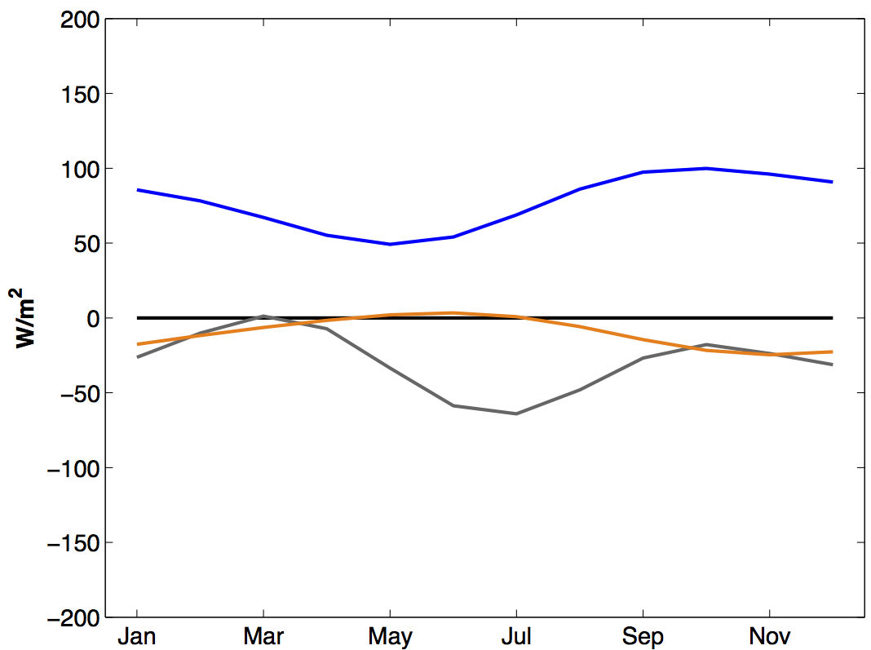
Mixed layer heat budget
0°N, 23°W
local storage = net surface - advection – eddy advection - entrainment – diapycnal ML heat loss
net surface heat flux
Warming:
Cooling:
zonal and meridional heat advection
Notes:
The advection terms, which can be divided into their zonal component in grey and their meridional component in orange cool the ML.

Slide 13
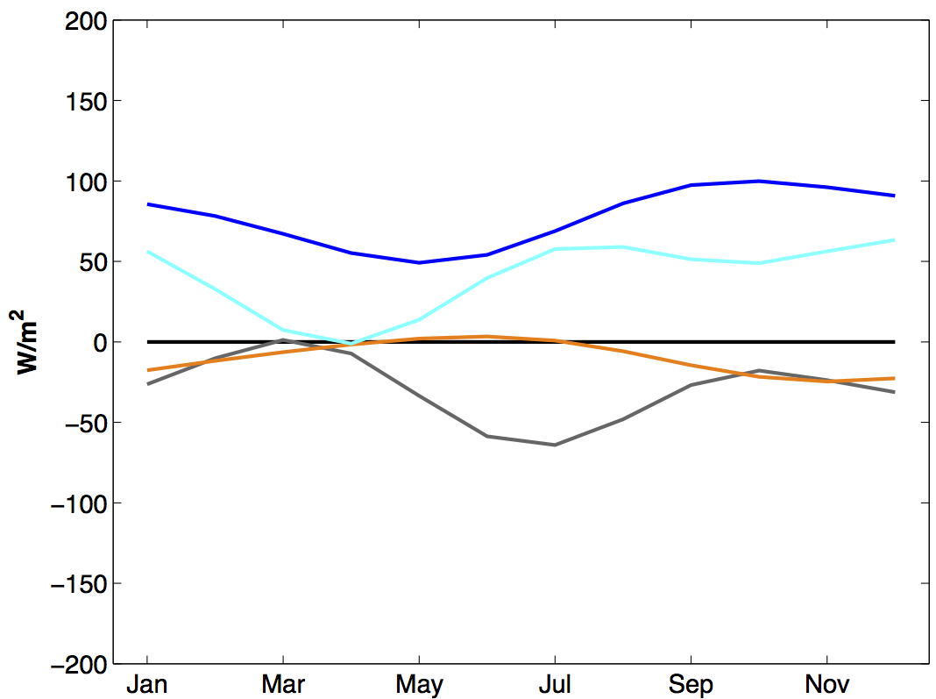
Mixed layer heat budget
0°N, 23°W
local storage = net surface - advection – eddy advection - entrainment – diapycnal ML heat loss
net surface heat flux
, eddy advection
Warming:
Cooling:
zonal and meridional heat advection
Notes:
Eddy advection warms the ML.

Slide 14
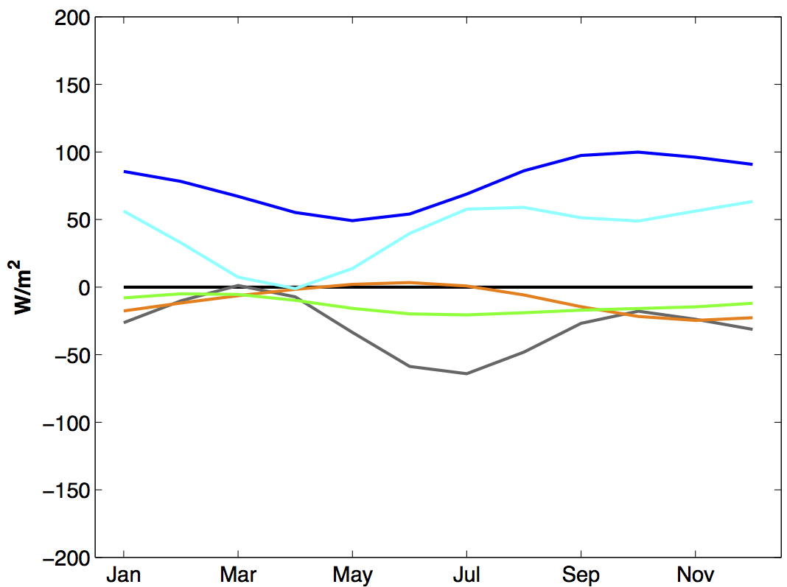
Mixed layer heat budget
0°N, 23°W
local storage = net surface - advection – eddy advection - entrainment – diapycnal ML heat loss
net surface heat flux
, eddy advection
Warming:
Cooling:
zonal and meridional heat advection
, entrainment
Notes:
Whereas entrainment contributes to the cooling.

Slide 15
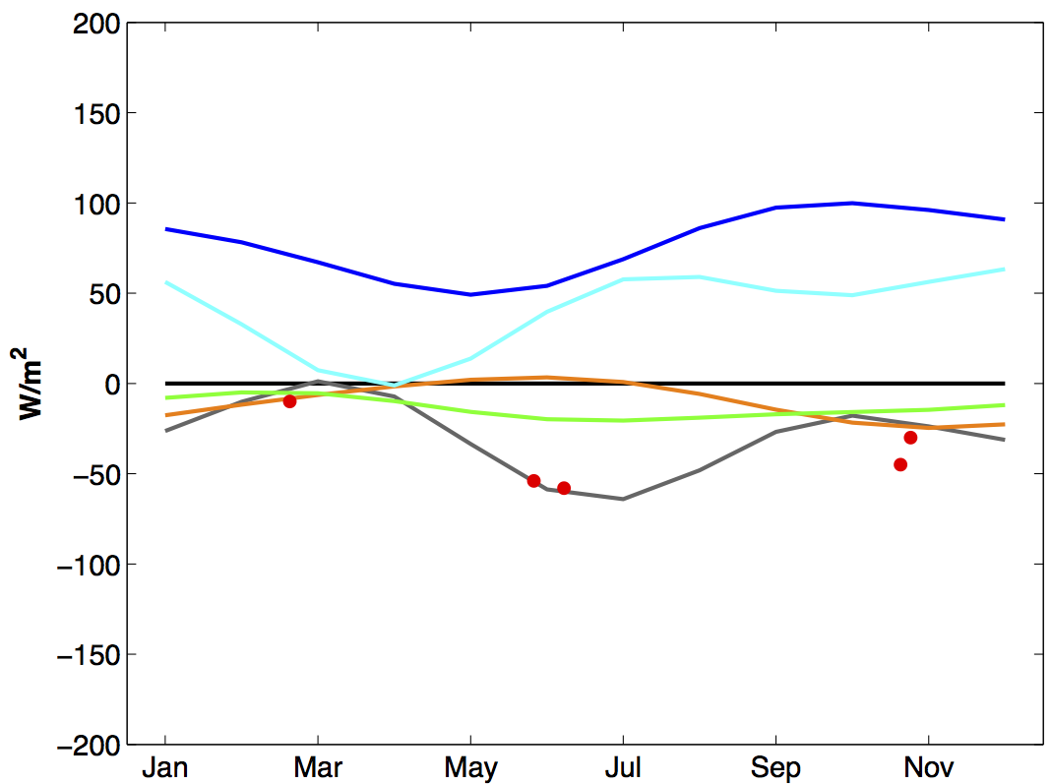
Mixed layer heat budget
0°N, 23°W
local storage = net surface - advection – eddy advection - entrainment – diapycnal ML heat loss
net surface heat flux
Warming:
Cooling:
zonal and meridional heat advection
, entrainment
, diapycnal
Notes:
Now we can add the diapycnal ML heat loss during the seasons where it was sampled and see that it acts to strongly cool the ML.

Slide 16
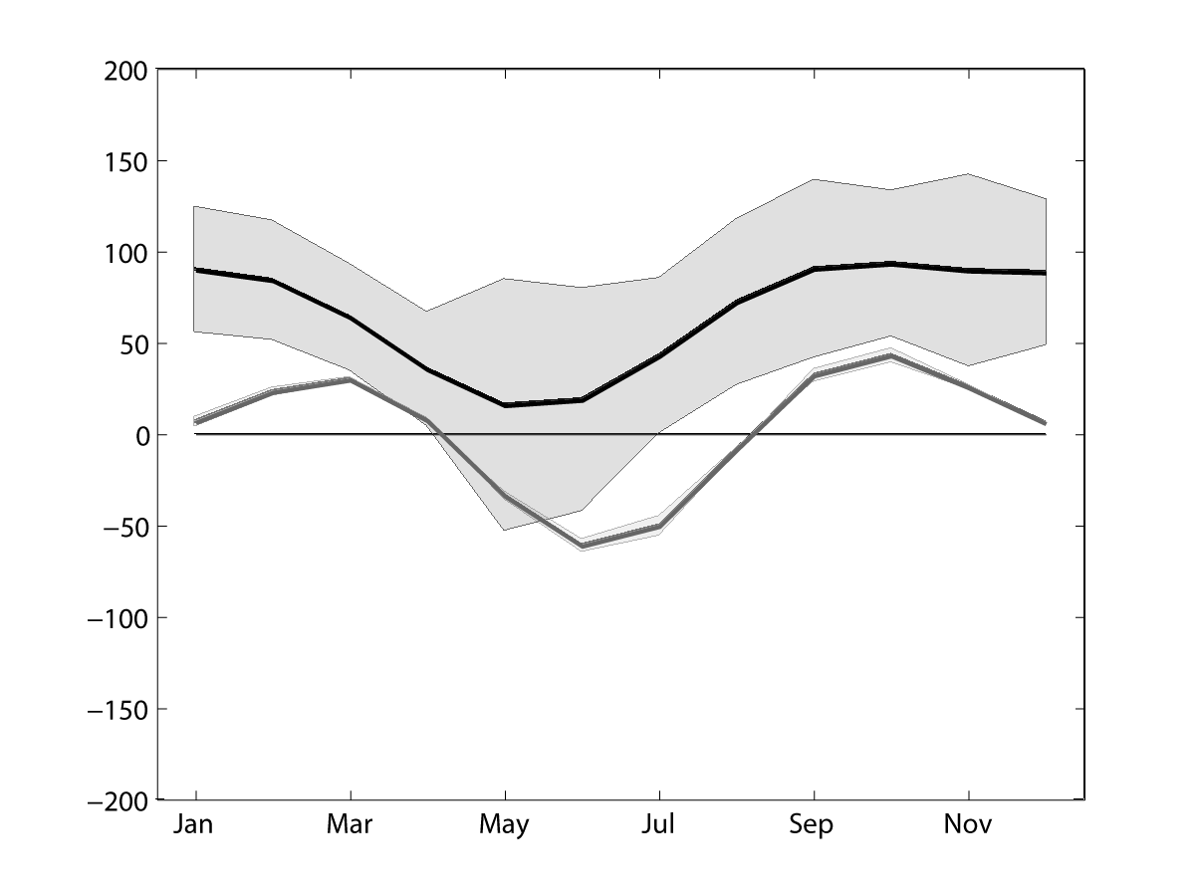
Mixed layer heat budget
0°N, 23°W
local storage = net surface - advection – eddy advection - entrainment – diapycnal ML heat loss
net surface heat flux
, eddy advection
Warming:
Cooling:
zonal and meridional heat advection
, entrainment
, diapycnal
Notes:
If we now sum up the terms as in the study of Foltz without the diapycnal component, we end up with a residual during ACT development, but if we included this term

Slide 17
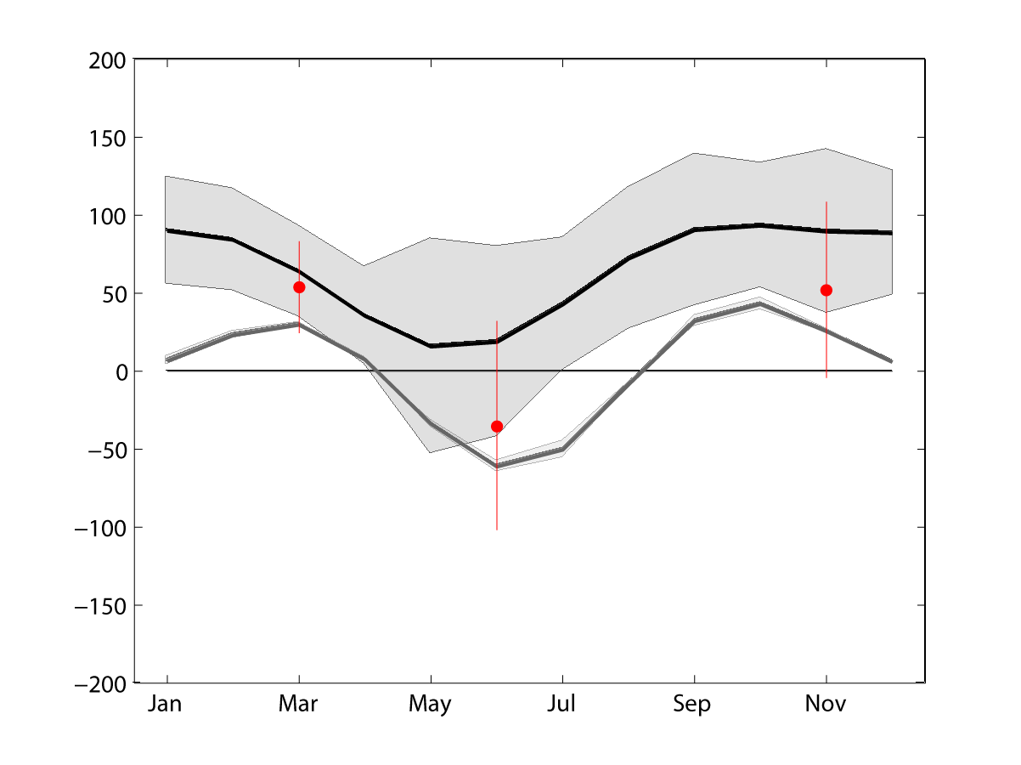
Mixed layer heat budget
0°N, 23°W
local storage = net surface - advection – eddy advection - entrainment – diapycnal ML heat loss
net surface heat flux
, eddy advection
Warming:
Cooling:
zonal and meridional heat advection
, entrainment
, diapycnal
Notes:
We can explain the observed heat storage at least within the uncertainties and we have identified the main cooling contributos as the zonal heat advection and diapycnal mixing.

Slide 18

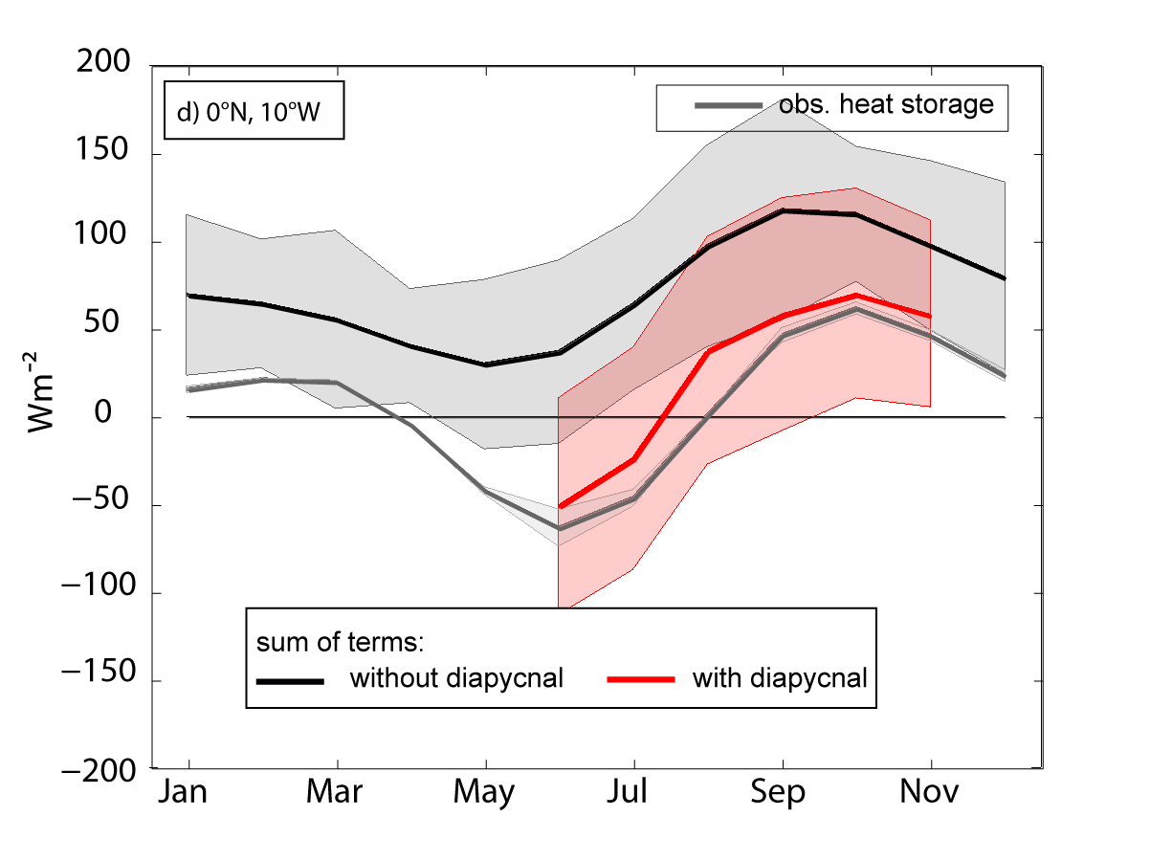
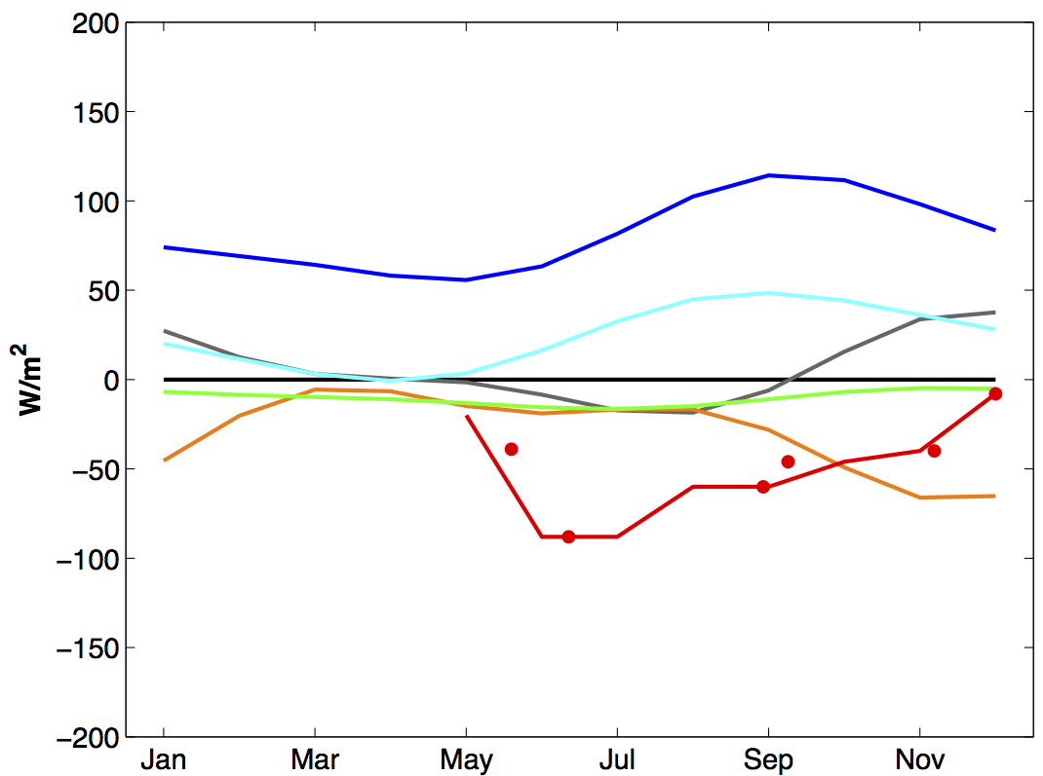
Mixed layer heat budget
0°N, 10°W
local storage = net surface - advection – eddy advection - entrainment – diapycnal ML heat loss
Warming: net surface heat flux, eddy advection
Cooling: zonal and meridional heat advection, entrainment, diapycnal
Notes:
Similar contributions are found at 10°W, although here diapycnal mixing is the dominant cooling as zonal heat advection is strongly reduced. Again summing up including the diapycnal component closes the budget.

Slide 19
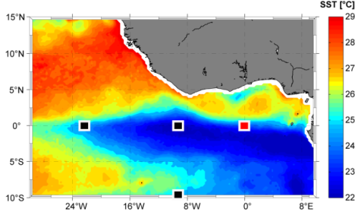
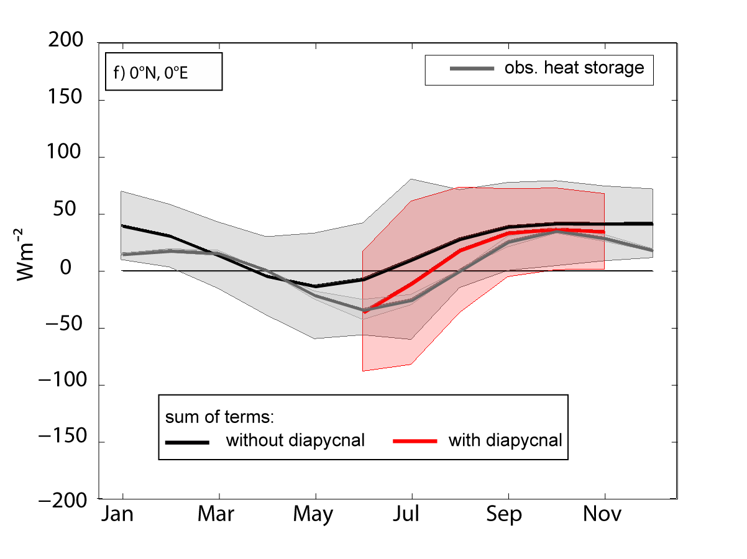
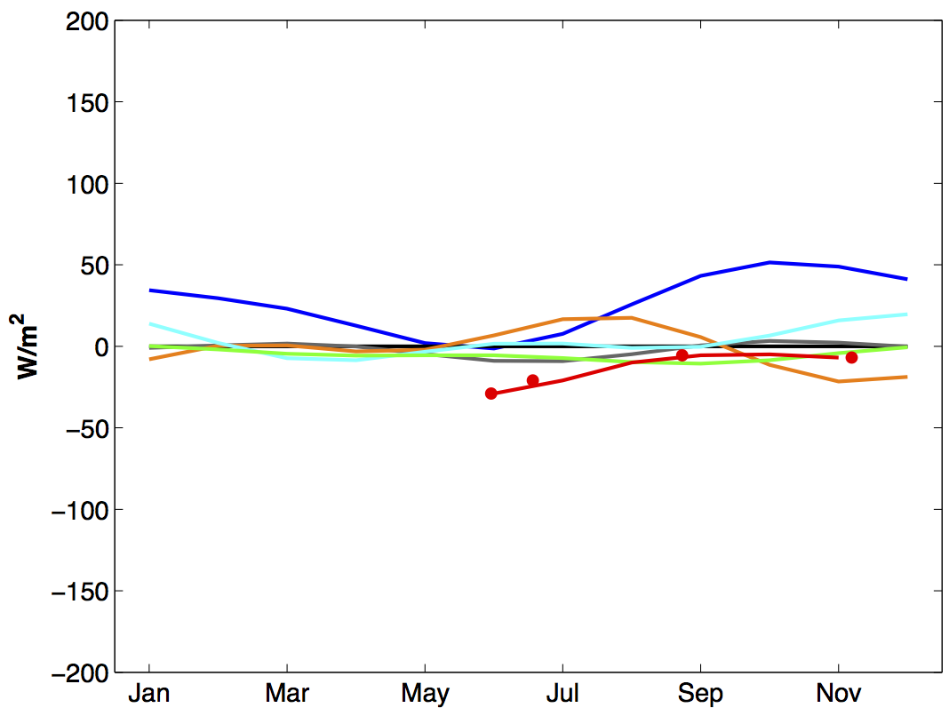
Mixed layer heat budget
0°N, 0°E
local storage = net surface - advection – eddy advection - entrainment – diapycnal ML heat loss
Warming: net surface heat flux (strongly reduced), eddy advection, meridional
Cooling: zonal heat advection, entrainment, diapycnal
Notes:
At 0°E the net surface heat flux is strongly reduced compared to the western ACT. Neverthelessthe diapycnal component is again the strongest cooling term closing the budget.

Slide 20

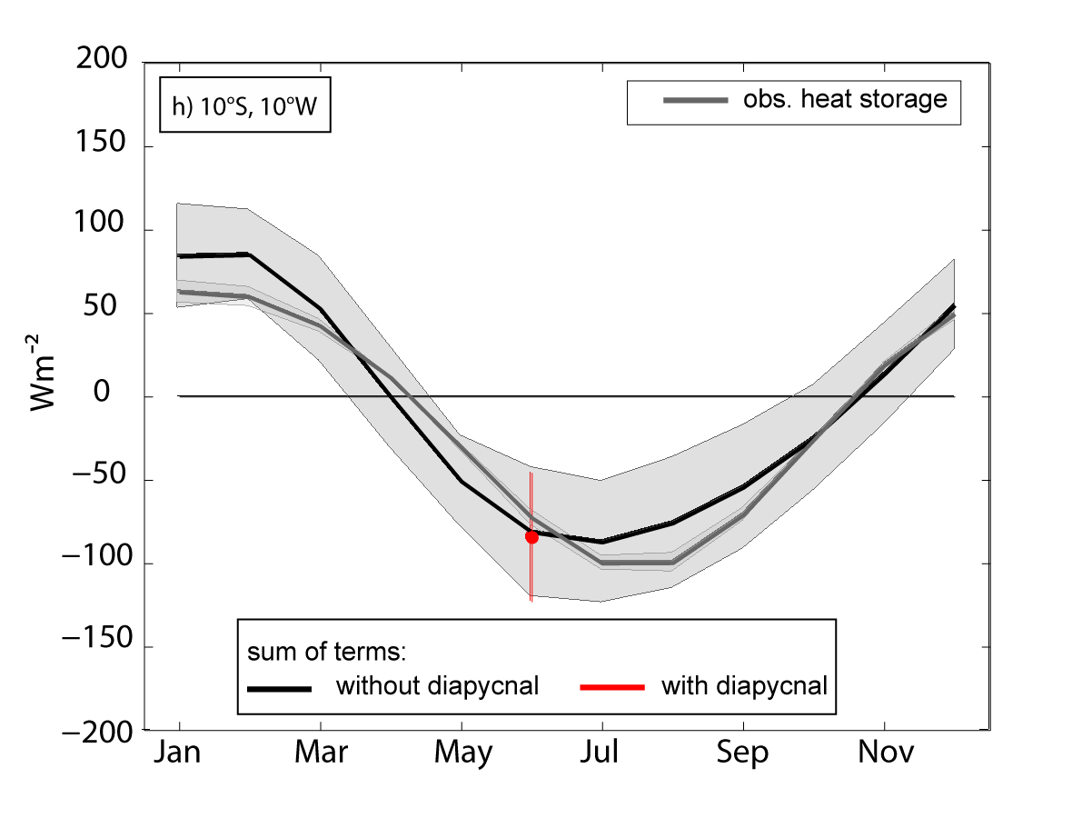
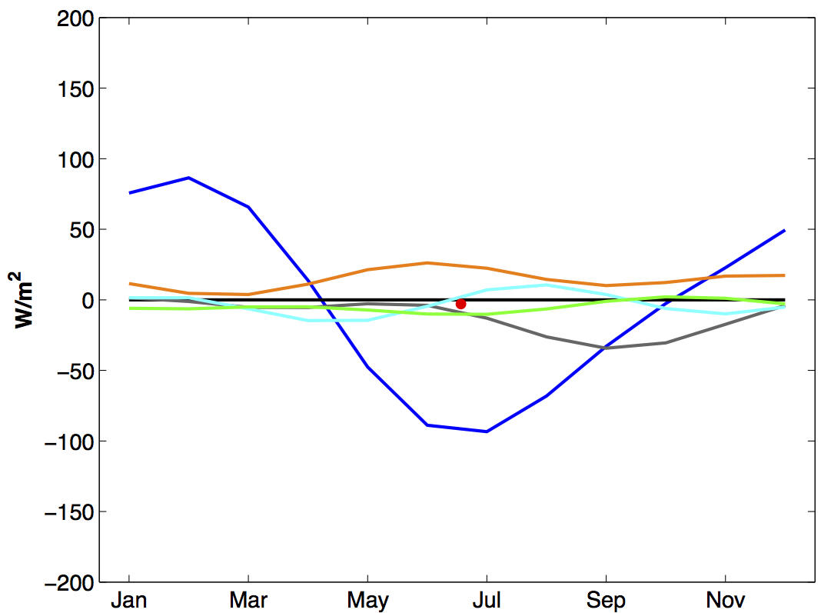
Mixed layer heat budget
10°S, 10°W
local storage = net surface - advection – eddy advection - entrainment – diapycnal ML heat loss
Warming: eddy advection and meridional heat advection
Cooling: net surface heat flux, zonal heat advection, entrainment, diapycnal
Notes:
A totally different picture is obtained in the southern ACT region where largest cooling is provided by the net surface heat flux and diapycnal heat fluxes are neglegible.

Slide 21
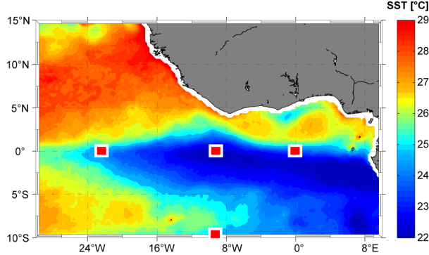
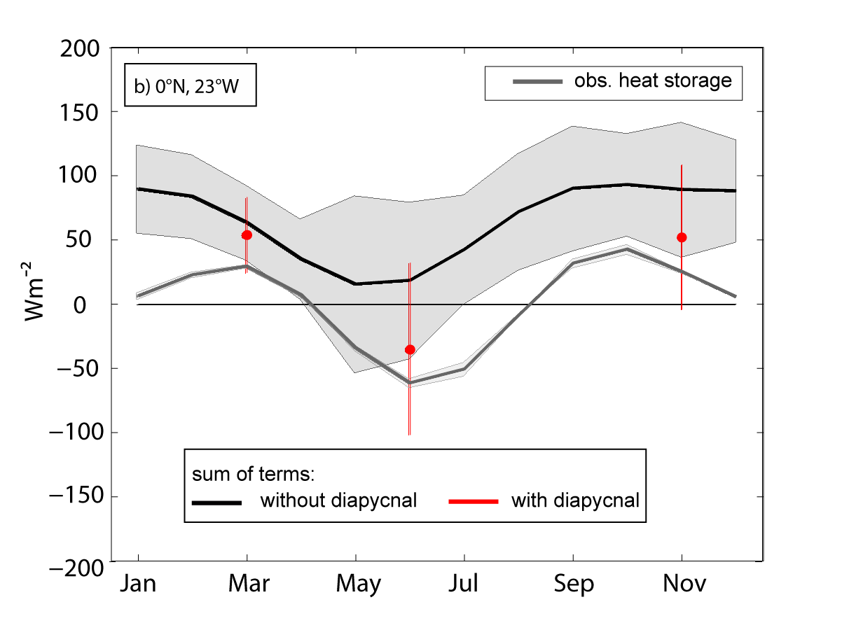
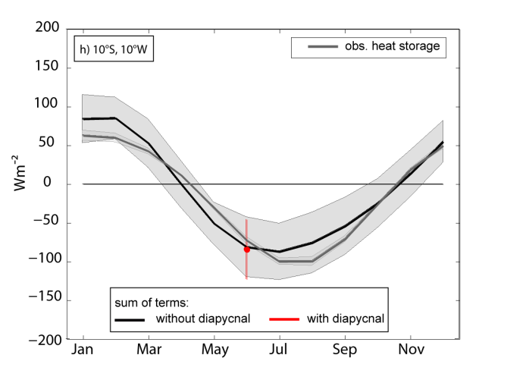
Mixed layer heat budget
0°N, 23°W
0°N, 10°W
0°N, 0°E
10°S, 10°W
closed ML heat budget within uncertainties during sampled periods
diapycnal heat flux and zonal advection are the terms dominating the cooling within the equatorial ACT
Notes:
In summary we can close budgets within the ACT and identify the diapycnal ML heat loss as the dominant cooling term within the equatorial ACT

Slide 22
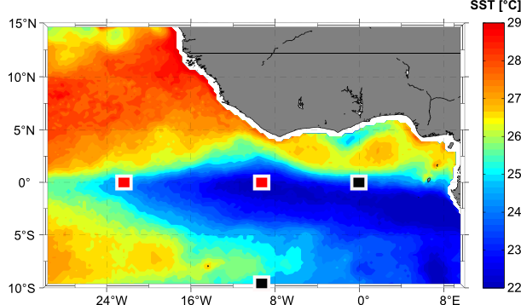
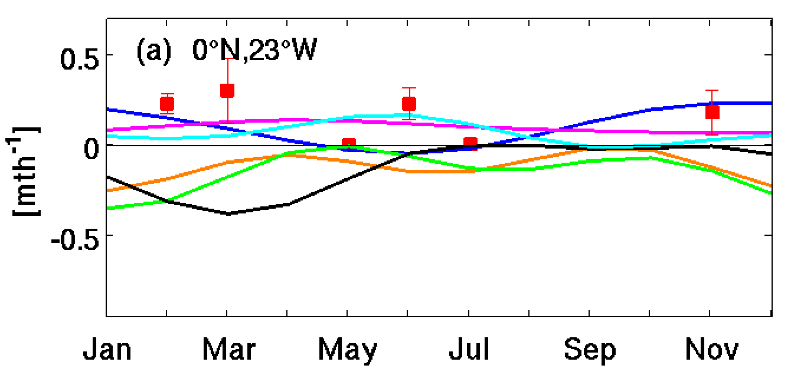
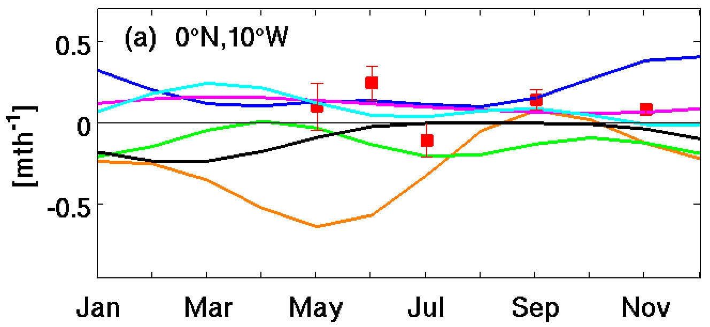
Freshwater budget
0°N, 23°W
0°N, 10°W
Salinification: E-P>0, entrainment, meridional heat advection and diapycnal salt flux
Freshening: eddy advection and zonal heat advection
Notes:
Another question is, can we explain the salinity tendency at these locations and does the diapycnal component also strikes out as such a dominating contributiont. Recently, my collegue Michael Schlundt estimated the individual contributions to the freshwater budget at 2 of the PIRATA buoy locations within the ACT with a similar approach. For the freshwater budget the net surface heat fluxes has to be replaced with the difference between evaporation and precipitation, the other terms can be calculated in a rather similar way. His results show that the ML gets more saline due to excessive evaporation, entrainment, meridional heat advection and the diapycnal salt flux.
Freshening of the ML is achieved via eddy advection and zonal heat advection, the latter appears extremely high at 10°W. This is due to very large zonal salinity gradients, which might be the result of still insufficient data coverage.

Slide 23
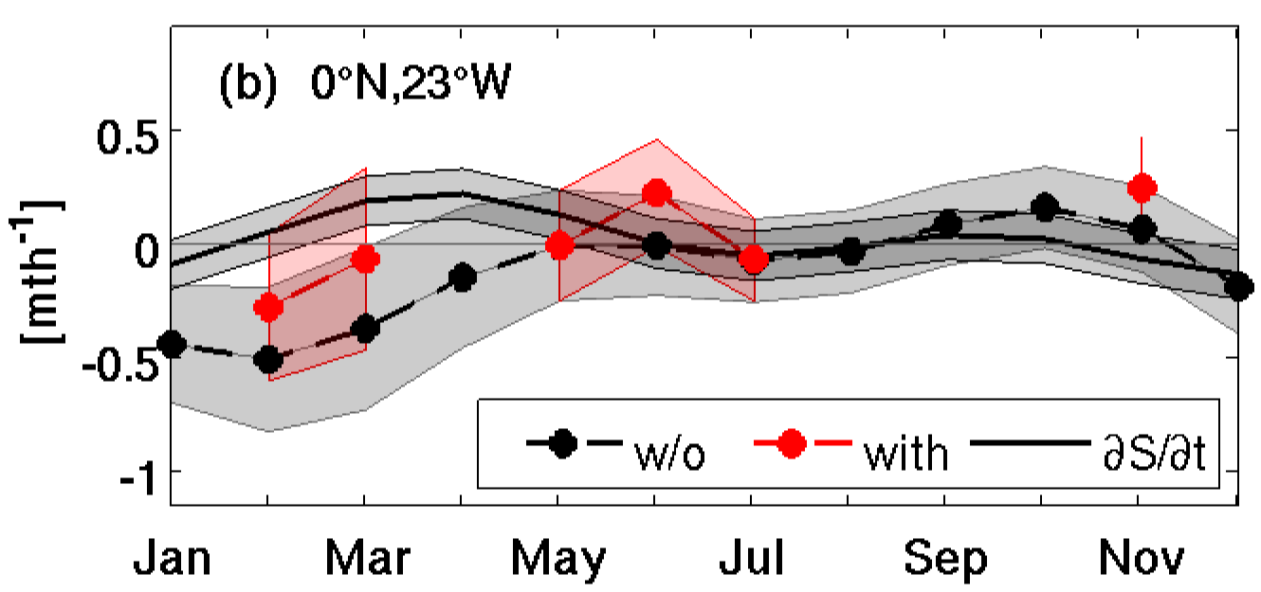
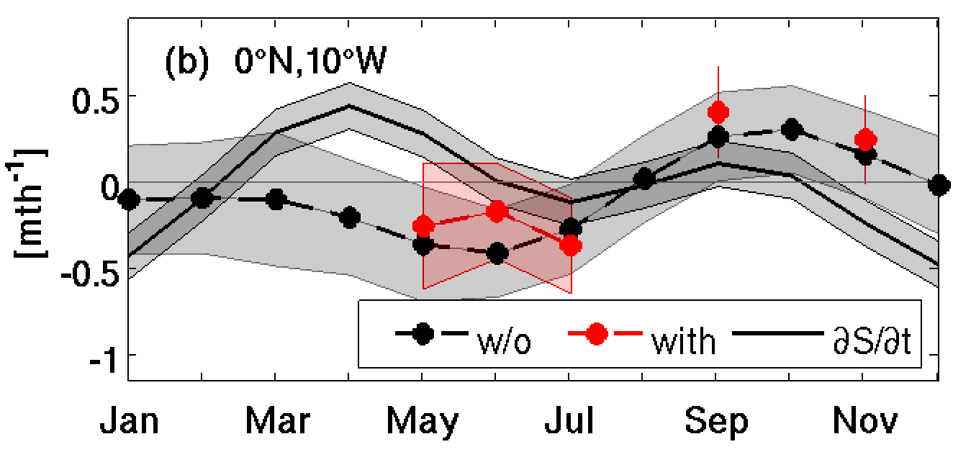
Freshwater budget
0°N, 23°W
0°N, 10°W
Salinification: evaporation, entrainment, meridional heat advection and diapycnal salt flux
Freshening: precipitation, eddy advection and zonal heat advection
during ACT development mixed layer salinity increases
largest terms: entrainment and diapycnal salt flux
Notes:
We can compare the sum of terms again to the observed salinity tendency, which predicts a slight salinification during ACT development. At 23°W the sum of contributing terms seems to explain the local storage, but at 10°W we end up with a residual. This is obviously caused by the strong zonal freshwater advection, which is due to very large salinity gradients, which might be caused by insuffient MLS data. For the salinification the diapycnal salt flux and diapycnal salt flux seem to be dominating. So also for salinity the diapycnal component seems to be cruical.

Slide 24
Summary and Outlook
P
improvement of the ML heat budget
a higher resolved surface velocity climatology
improved net surface heat fluxes (TropFlux)
estimates of the diapycnal ML heat loss
closure of the budgets within the incertainties within the ACT
identification of main cooling terms during ACT development:
diapycnal heat flux (partly zonal advection) in the entire equatorial ACT region
further required improvements (specially for investigations of inter annual variability of ML budget contributions):
surface velocities
resolution of diapycnal ML heat loss
Notes:
.... For the diapycnal ML heat loss this could possibly be accomplished by moored instruments or gliders collecting much more data or via parametrization schemes for this quantity

Slide 26
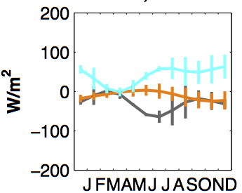
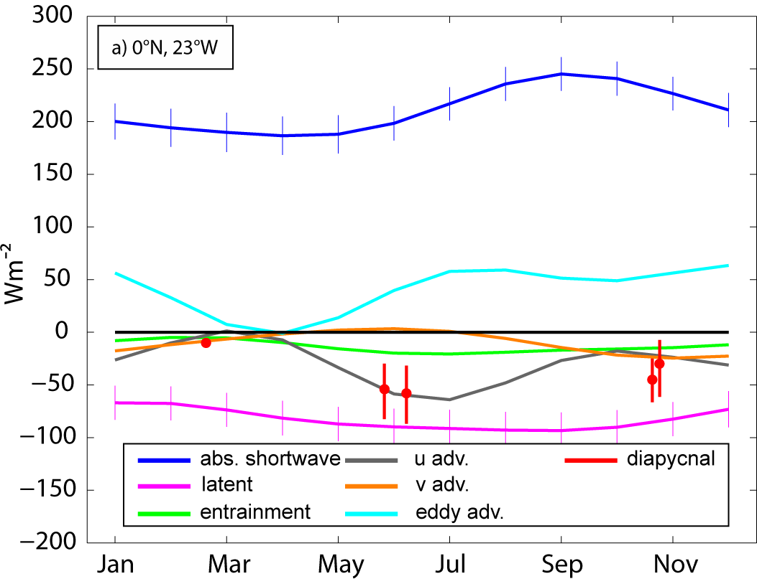
Uncertainties
0°N, 23°W
Drifter and ARGO (used here)
OSCAR
Lumpkin et al., 2005
choice of surface velocity product
seasonal variability of diapycnal ML heat loss not sufficiently resolved
Notes:
Another uncertainty in this approach is the choice of the product of seasonal monthly surface velocities.
As a reminder here are the individual contributions to the ML heat budget for 23°W, where the advection terms are calculated with a surface velocity climatlogy, in which all available drifter and ARGO estimates are included. The advection terms could also be calculated with monthly surface velocities from the OSCAR product, which is derived from observations of sea level, wind stress and SST data...or from the drifter climatology published by Lumpkin. If we calculate the advection terms separately for these different products and then take the the standard deviation of these 3 different approach as some measure of uncertainty, we end up with this. At times the products do not even agree on the sign of the velocities forcing the advection terms to change sign depending on which product is used and another point is clearly that the diapycnal ML heat loss is not sufficiently resolved.

Slide 27
Mixed layer heat budget
0°N, 23°W
0°N, 10°W
0°N, 0°E
10°W, 10°S
Improvements
P
closed ML heat budget within uncertainties during sampled periods
diapycnal heat flux and zonal advection are the terms dominating the cooling within the equatorial ACT
Notes:
So we could really improve the

Slide 28
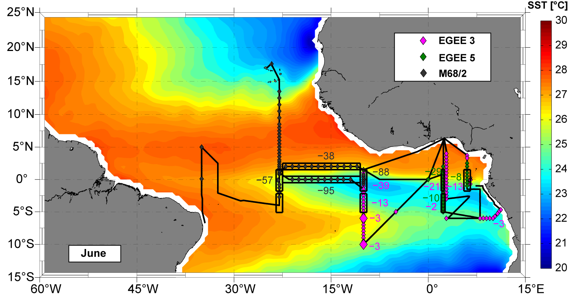
Diapycnal ML heat loss: Seasonal and regional variability
MLD
Heat loss of the MLD due to turbulent mixing is elevated :
within the equatorial region
in the western equatorial ACT compared to the east
in early summer compared to September and November
Notes:
Here, diapycnal ML heat loss in June is summarized. We find that it is elevated in the equatorial region, where we find up to 95 Wm^2 compared to the off equatorial regions, where shear levels are found much lower as pointed out before. and higher in the western equatorial ACT compared to the east, where it reaches a maximum of about 25 Wm^2

Slide 29
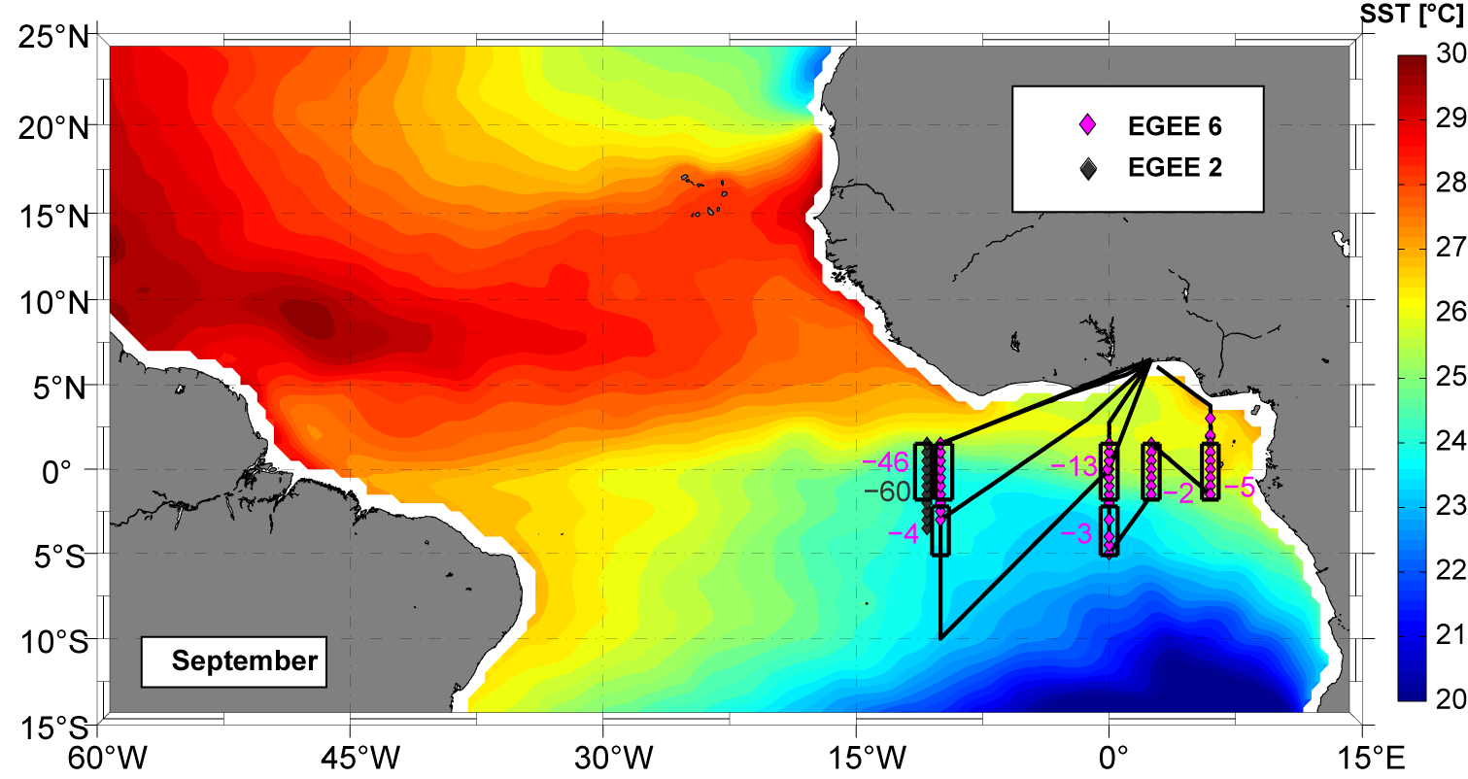
Diapycnal ML heat loss: Seasonal and regional variability
MLD
Heat loss of the MLD due to turbulent mixing is elevated :
within the equatorial region
in the western equatorial ACT compared to the east
Notes:
In September maximum 60 are found in the western equatorial ACT again reducing to the south and east.

Slide 30
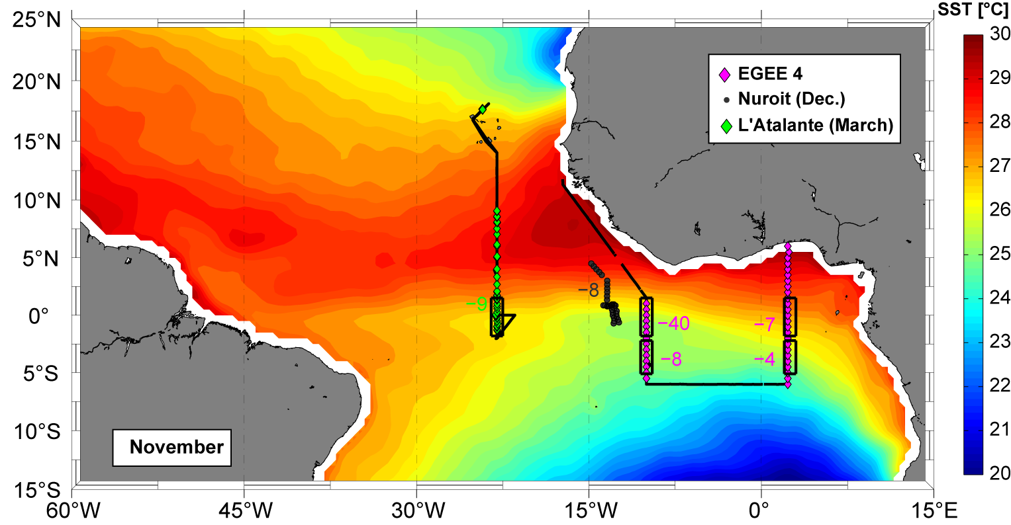
Diapycnal ML heat loss: Seasonal and regional variability
MLD
Heat loss of the MLD due to turbulent mixing is elevated :
within the equatorial region
in the western equatorial ACT compared to the east
in early summer compared to September and November
Notes:
We will now take these inferred diapycnal ML heat losses and insert them into the refined ML heat budget

Slide 31
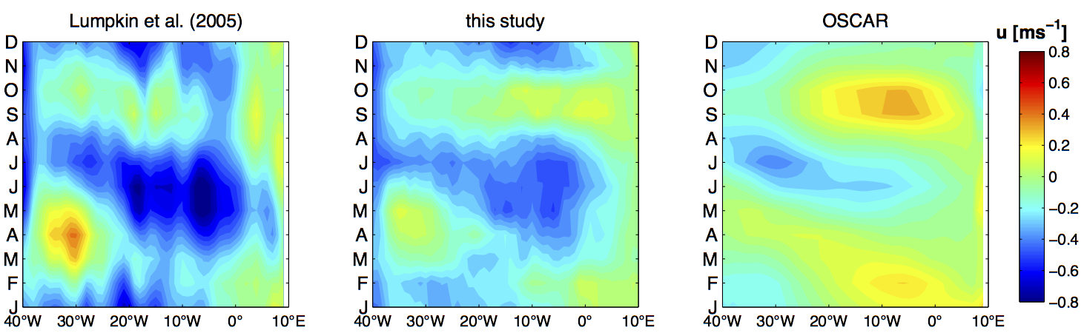
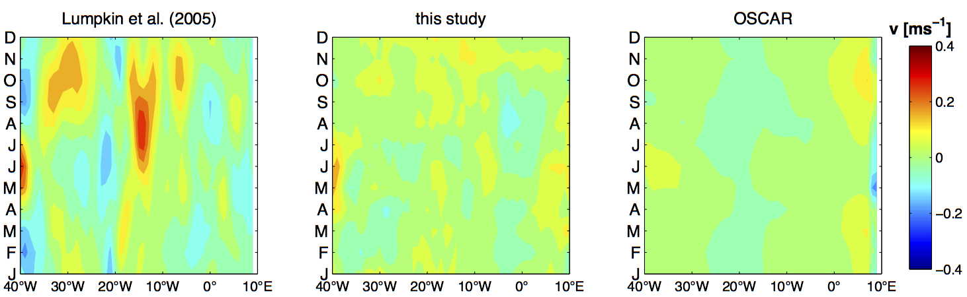
Uncertainties
Comparison of zonal and meridional velocity of different surface velocity products

Slide 32
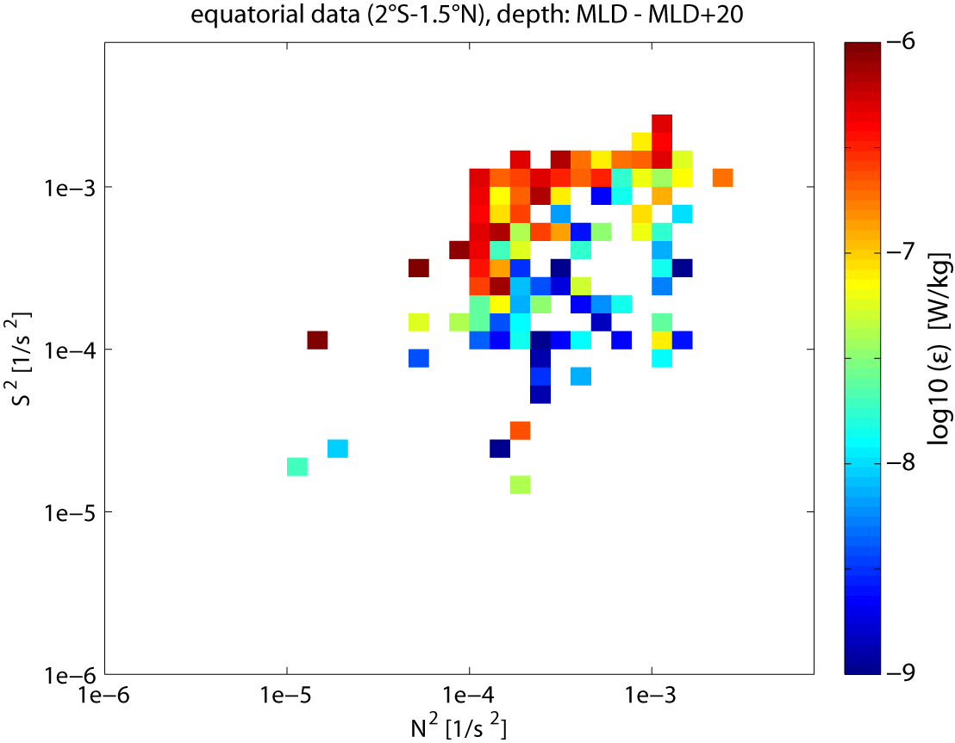
Parametrization

Slide 33

Parametrization
Existing parametrization schemes for the equatorial region are based on a simple Ri (N²/S²) dependence:
Pacanowski and Philander 1981
Peters 1988 (2 different formulations)
KPP (Large et al 1994)
Zaron and Moum 2009 (2 different
formulations)
Propose a simple dependence fitted to the observational data of this study

Slide 34


Parametrization
10°W, 0°N
Parametrizations
N²,S² → Ri → K → $J_{h}$

Slide 35


Parametrization
MLD
→ Most existing parametrization schemes cleary overestimate the heat loss of the mixed layer due to diapycnal mixing
→ Seasonal parametrized heat loss based on independent data set with new fit is closest to observations

Slide 36


Parametrization
10°W, 0°N
All individual terms of the mixed layer heat budget at 10°W on the equator are estimated from observations of the PIRATA buoy and climatological products

