Slide 1
About the contribution of the diapycnal heat flux to the heat budget of the mixed layer
Rebecca Hummels¹, Marcus Dengler¹, Bernard Bourles²
¹GEOMAR Helmholtz Zentrum für Ozeanforschung, Kiel, Germany
²LEGOS, IRD, CRHOB, Cotonou, Benin
TAV Meeting 2012, Kiel, Germany, 11.09.2012
Notes:
Finde ich noch meine Notizen was ich eigentlich bei meinem Diss Vortrag gesagt habe??

Slide 2
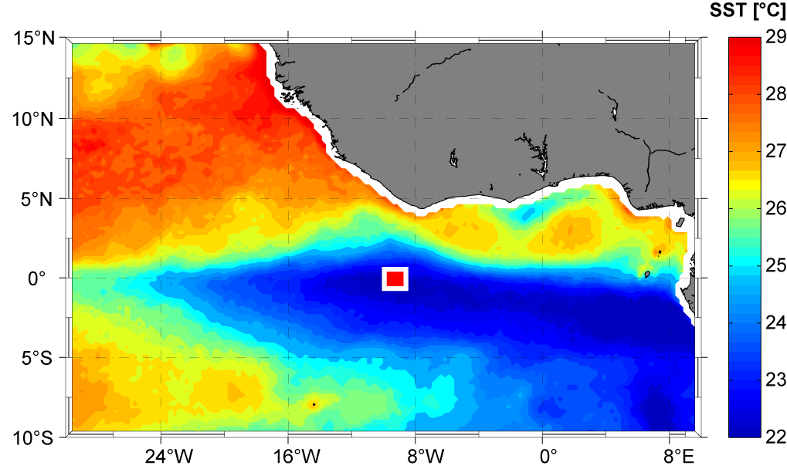
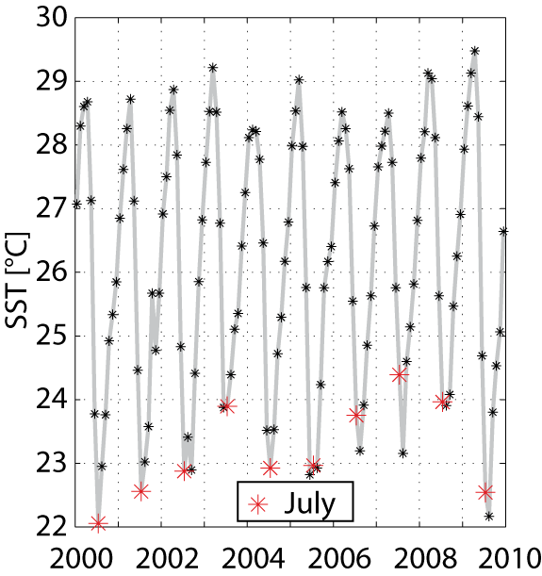
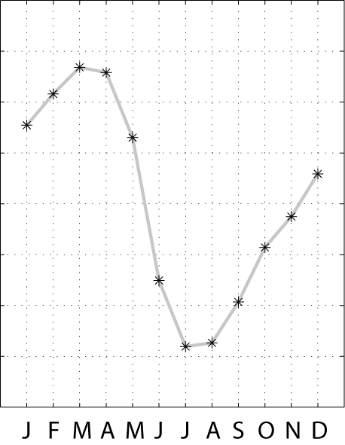
Motivation: SST variability in the Atlantic Cold Tongue (ACT) region
understanding of all contributing processes shaping seasonal cycle of SST is necessary
interannual variability of cold tongue SSTs is tied to interannual variations in rainfall over the adjacent continents
Notes:
Vorher sagen: SST variability in the tropical Atlantic is an important factor for climate variability especially for the surrounding continents. An important feature of SST variability within this region is the Atlantic Cold tongue shown in ist full extent in this figure. The interannual …. However, the dominating signal of this timeseries of SST variability is the seasonal cycle. To understand this all …. Several former studies have adressed this task by investigating the individual contributions to the mixed layer heat budget.

Slide 3
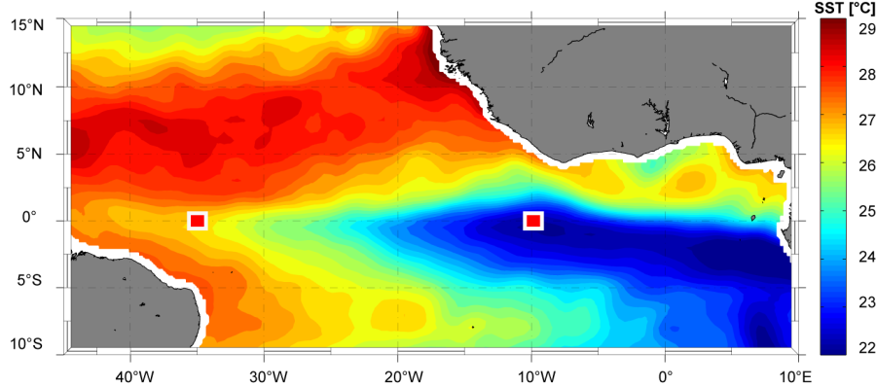
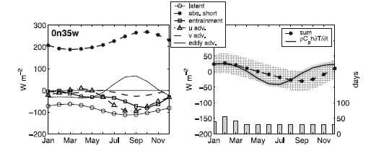
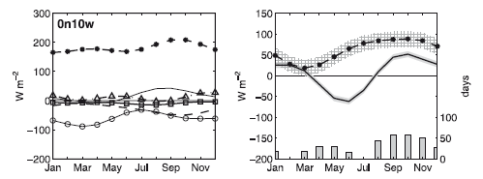
Motivation: mixed layer heat balance
Contributions to residual:
under-estimation of entrainment due to coarse drifter climatology
under-estimation of latent heat flux due to bad data coverage for relative humidity
Neglection of diapycnal heat flux out of the ML
Foltz et. al 2003
Notes:
Hier also sagen die ersten beiden Punkte brauchen nicht viel erläuterung, der letzte ein wenig mehr, wie wir dies gemessen haben

Slide 4
Motivation: mixed layer heat balance
Contributions to residual:
under-estimation of entrainment due to coarse drifter climatology
under-estimation of latent heat flux due to bad data coverage for relative humidity
Neglection of diapycnal heat flux out of the ML
use a higher resolved,
more recent drifter climatology
Foltz et. al 2003
Notes:
Hier also sagen die ersten beiden Punkte brauchen nicht viel erläuterung, der letzte ein wenig mehr, wie wir dies gemessen haben

Slide 5
Motivation: mixed layer heat balance
Contributions to residual:
under-estimation of entrainment due to coarse drifter climatology
under-estimation of latent heat flux due to bad data coverage for relative humidity
Neglection of diapycnal heat flux out of the ML
use a higher resolved,
more recent drifter climatology
use a longer timeseries
of measurements
Foltz et. al 2003
Notes:
Hier also sagen die ersten beiden Punkte brauchen nicht viel erläuterung, der letzte ein wenig mehr, wie wir dies gemessen haben

Slide 6
Motivation: mixed layer heat balance
Contributions to residual:
under-estimation of entrainment due to coarse drifter climatology
under-estimation of latent heat flux due to bad data coverage for relative humidity
Neglection of diapycnal heat flux out of the ML due to turbulence
use a higher resolved,
more recent drifter climatology
use a longer timeseries
of measurements
Foltz et. al 2003
use an extensive
observational program to estimate this term
Notes:
Hier also sagen die ersten beiden Punkte brauchen nicht viel erläuterung, der letzte ein wenig mehr, wie wir dies gemessen haben

Slide 7
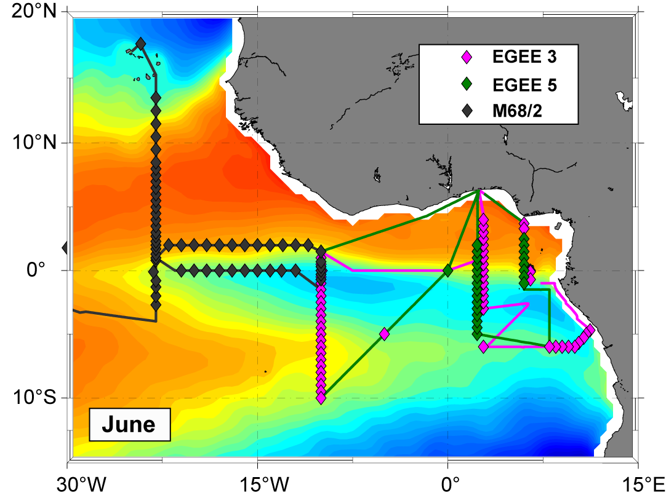
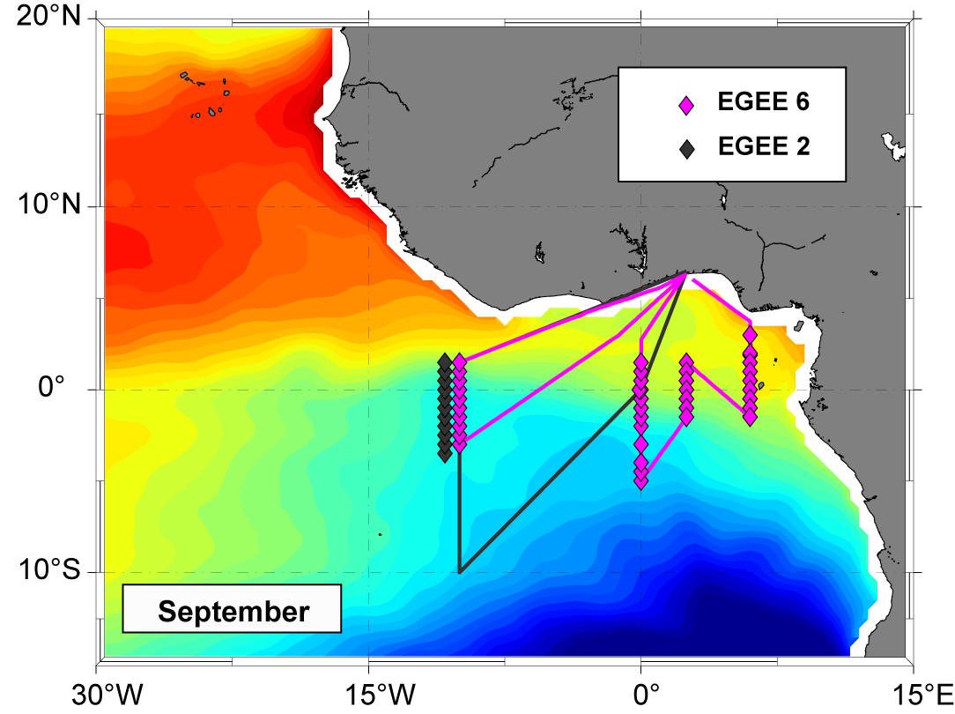
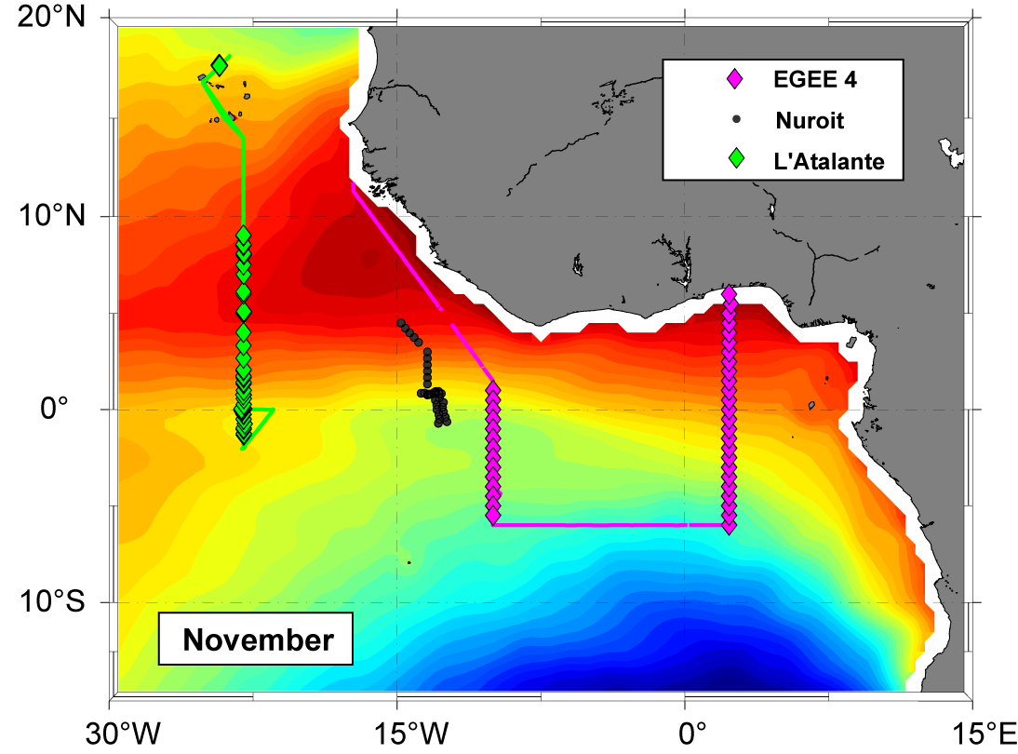
Data: Observational program
Repetitive microstructure sections within the cold tongue region formed by individual stations with at least 3 profiles/station (8 cruises resulted in > 1000 profiles)
Additional CTD stations
Shipboard ADCP measurements

Slide 8
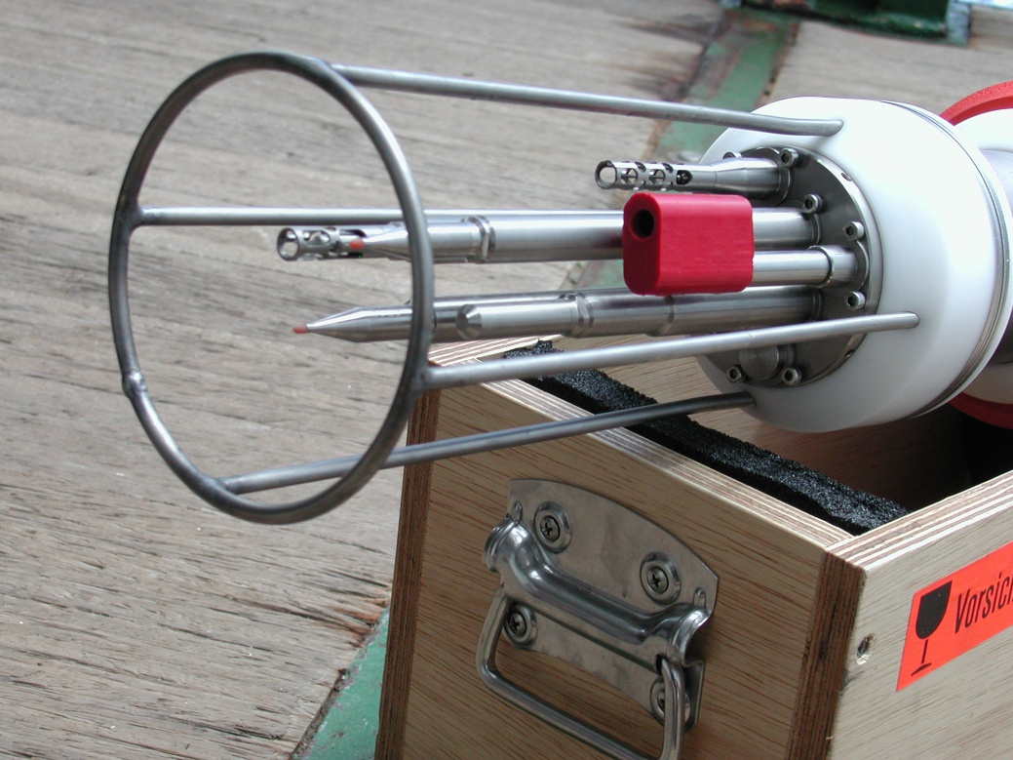
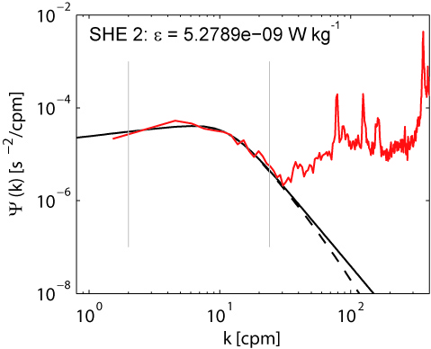
Data Treatment
From MSS measurements to diapycnal heat fluxes
CTD sensors → T, C, p →
Shear sensors → → ?
Dissipation rate of turbulent kinetic energy for isotropic turbulence is given by:
Eddy diffusivities for mass can be estimated as:
(Osborn, 1980)
(Osborn and Cox, 1972)

Slide 9
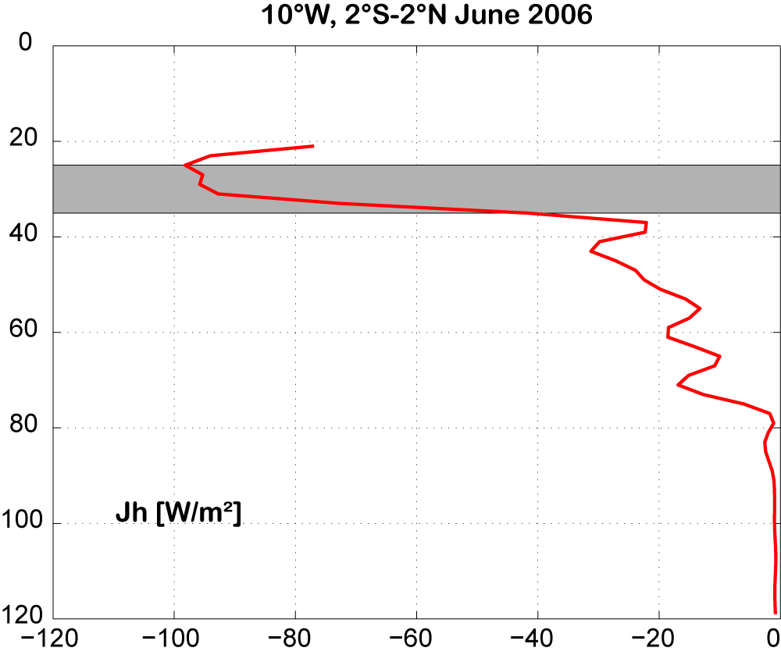
Diapycnal heat flux: Layer of interest
MLD
Divergent profile of diapycnal heat flux
heat loss due to diapycnal mixing is characterized by diapycnal heat flux in thin layer below the ML
→ this measure is included in the ML heat budget

Slide 10
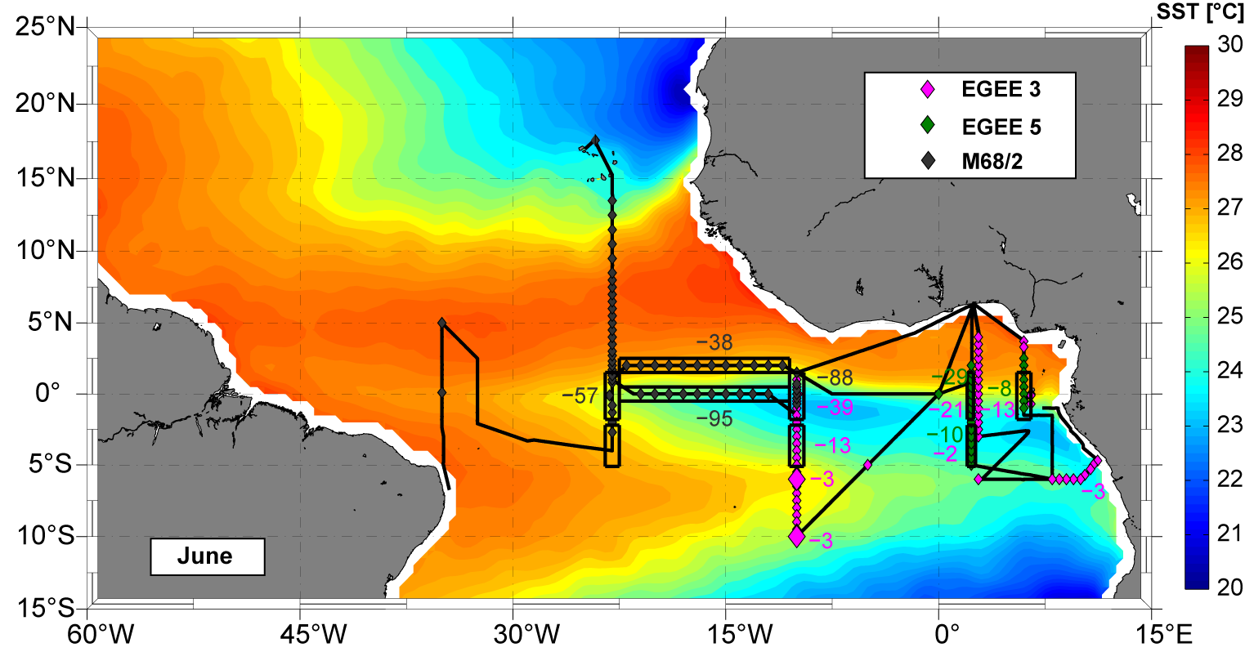
Diapycnal heat flux out of ML: Seasonal and regional variability
MLD
Heat loss of the MLD due to turbulent mixing is elevated :
within the equatorial region
in the western equatorial ACT compared to the east

Slide 11
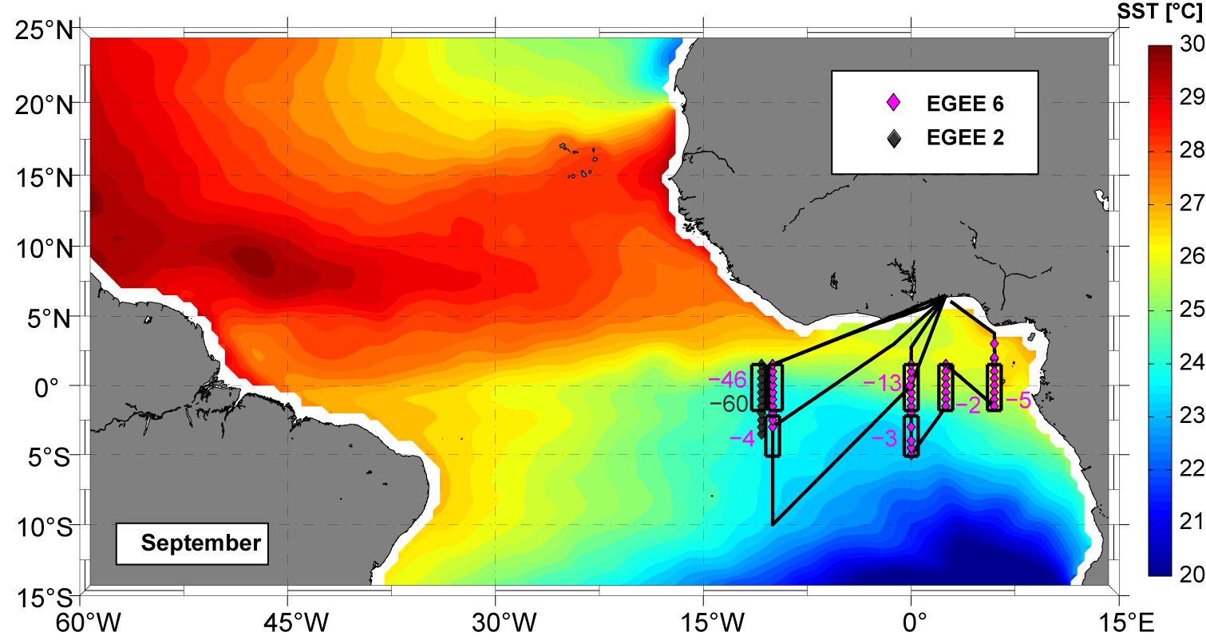
Diapycnal heat flux out of ML: Seasonal and regional variability
MLD
Heat loss of the MLD due to turbulent mixing is elevated :
within the equatorial region
in the western equatorial ACT compared to the east

Slide 12
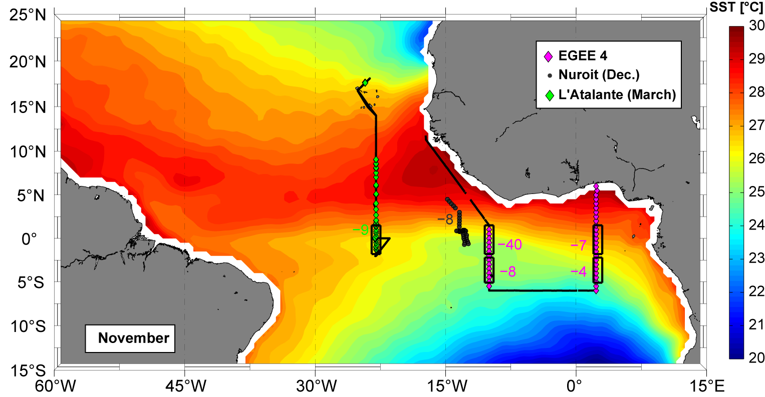
Diapycnal heat flux out of ML: Seasonal and regional variability
MLD
Heat loss of the MLD due to turbulent mixing is elevated :
within the equatorial region
in the western equatorial ACT compared to the east
in early summer compared to September and November

Slide 13
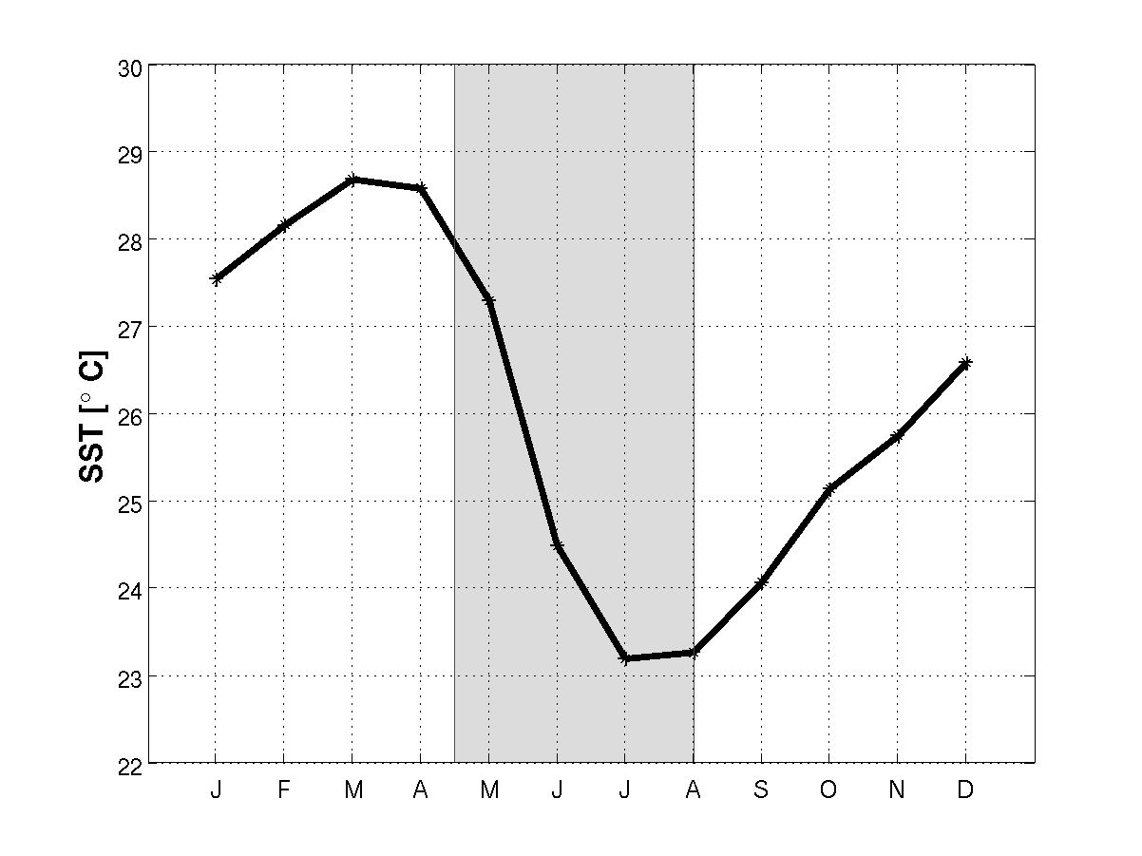
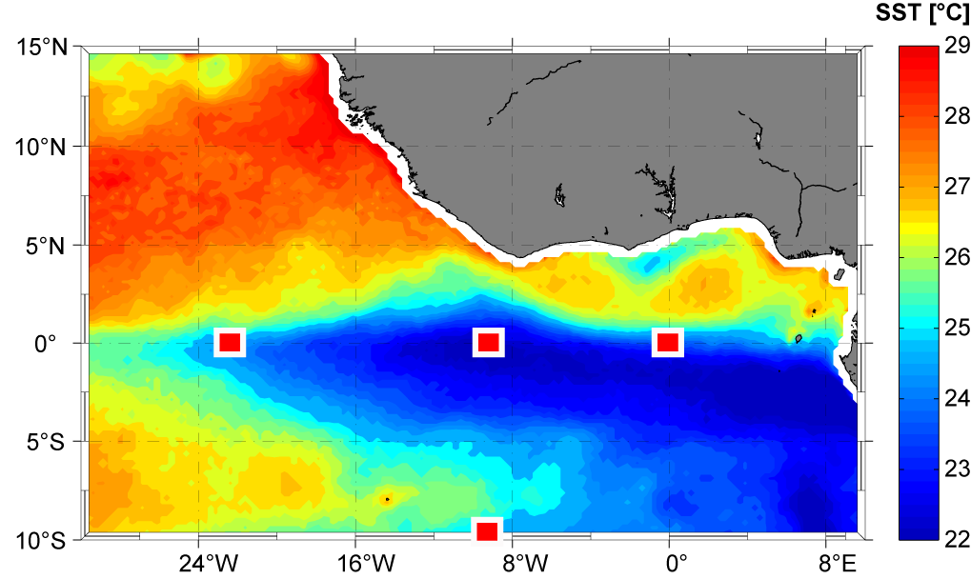
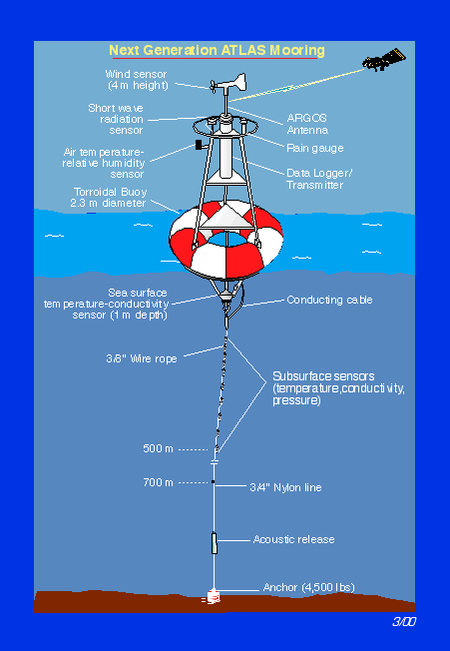
Mixed layer heat budget
3 phases of ACT development:
Absence (January-April)
Development (May-August)
Mature phase (September- December)
10°W, 0°N
Notes:
Now we want to investigate the individual contributions to the ML heat budget at four characteristic locations within the ACT region, where atmospheric and oceanic parameters are monitored with the Pirata buoys

Slide 14
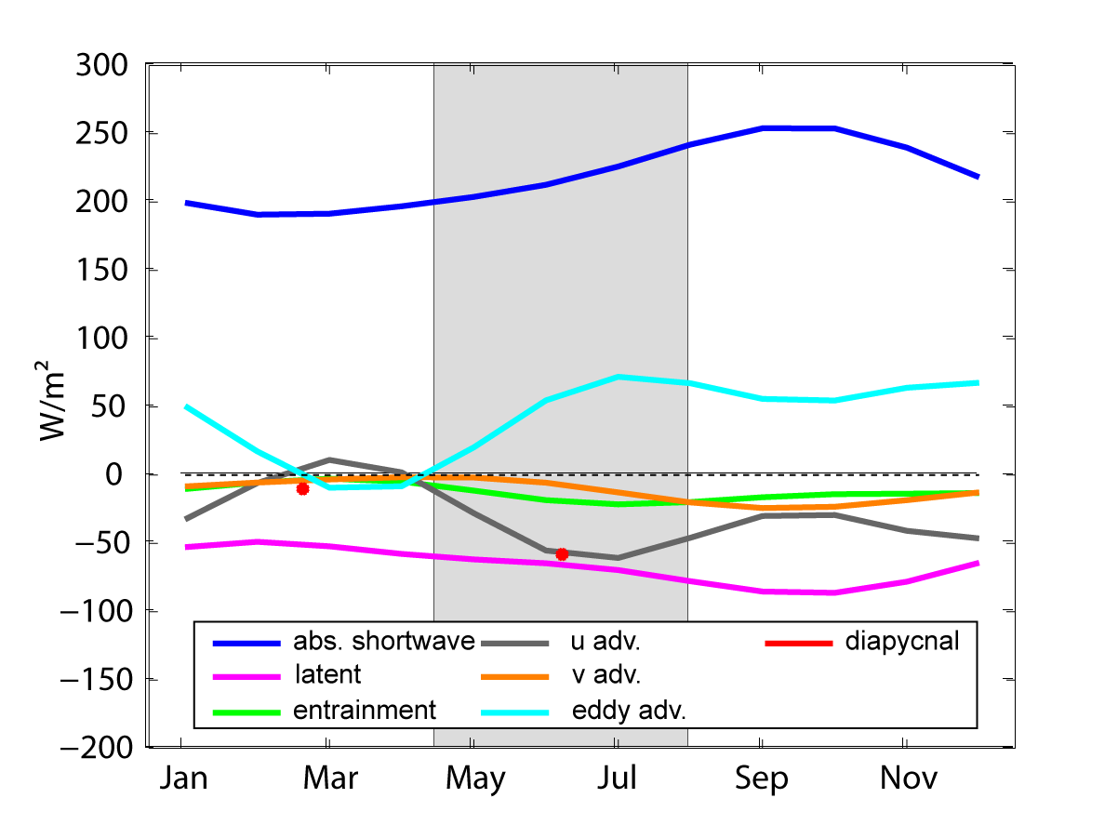
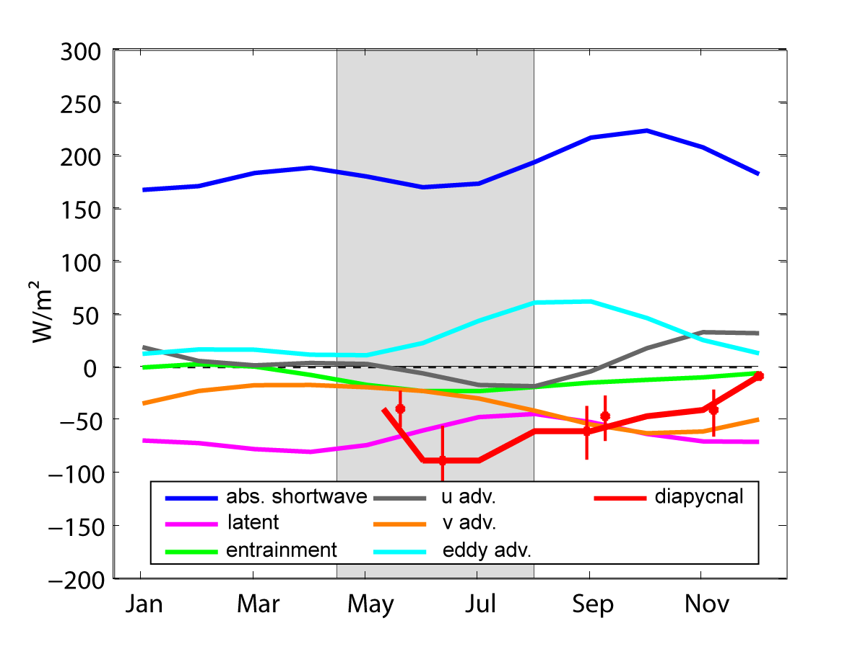
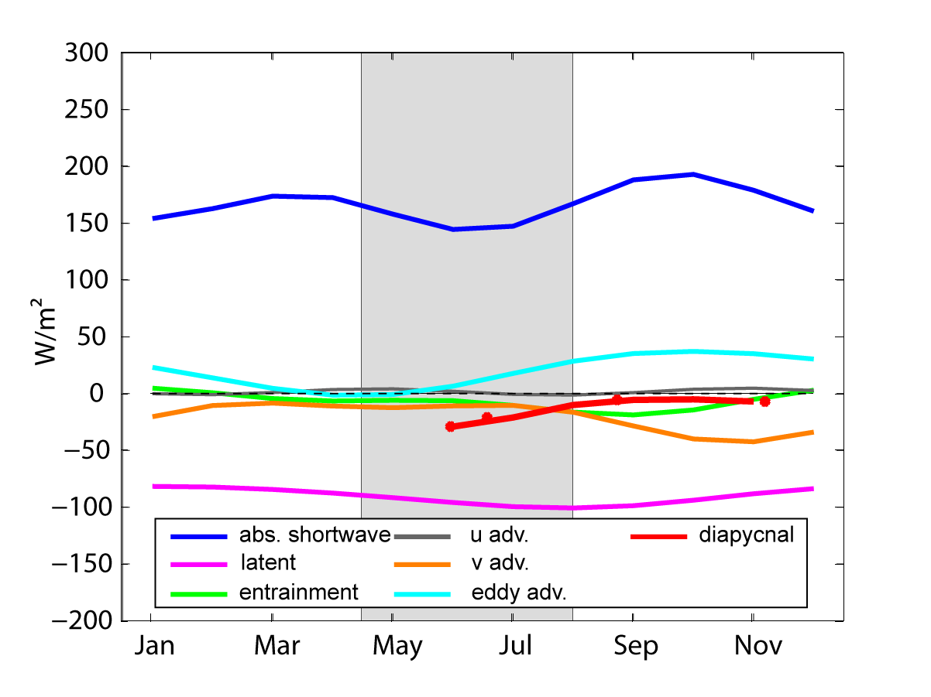
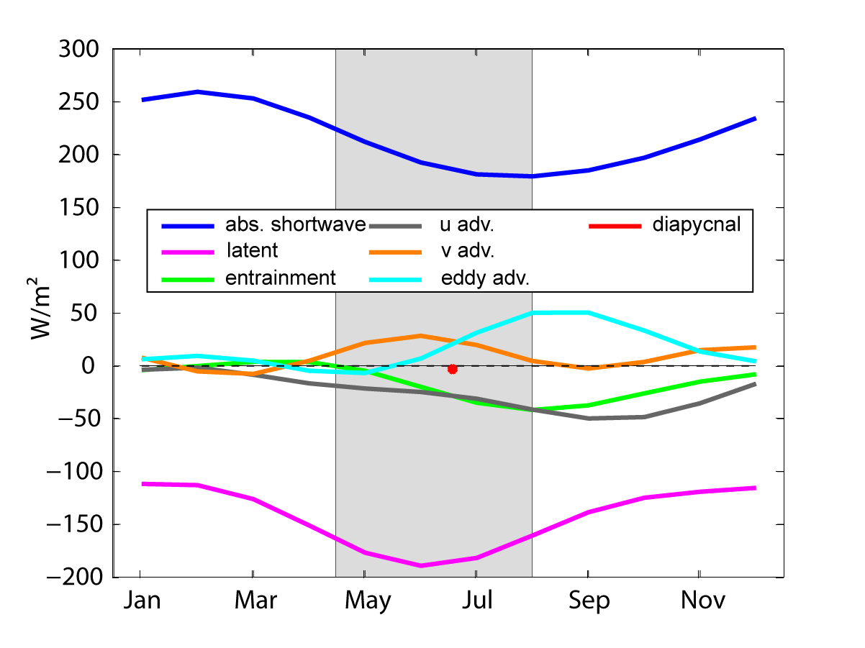
Mixed layer heat budget
23°W, 0°N
10°W, 0°N
0°E, 0°N
10°W, 10°S
Notes:
blabla

Slide 15
Mixed layer heat budget
23°W, 0°N
Warming: atmospheric forcing, eddy advection
Cooling: subsurface processes (entrainment, diapycnal), zonal and meridional heat advection
Notes:
Was sehen wir alles? Dieses Bild wird genau erläutert die anderen dann schneller
Atmospheric forcing terms are shown as absorved shortwave and latent heat flux, sensible and outgoing longwave rather constant throughout the year. Oceanic terms: entrainment in green, the advection terms devided into zonal (grey) and meridional (orange) as well as eddy (cyan) advection and the diaypcnal contribution estimated as described previously in red;
At this location warming of the ML within the development phase of the ACT is achiedved by…

Slide 16
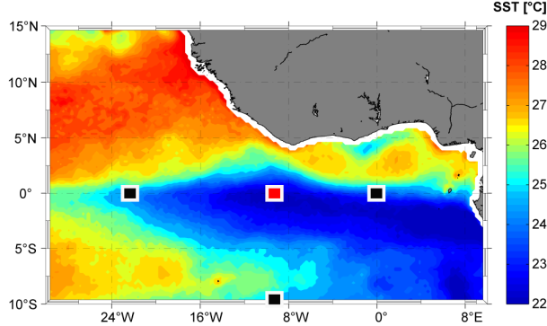
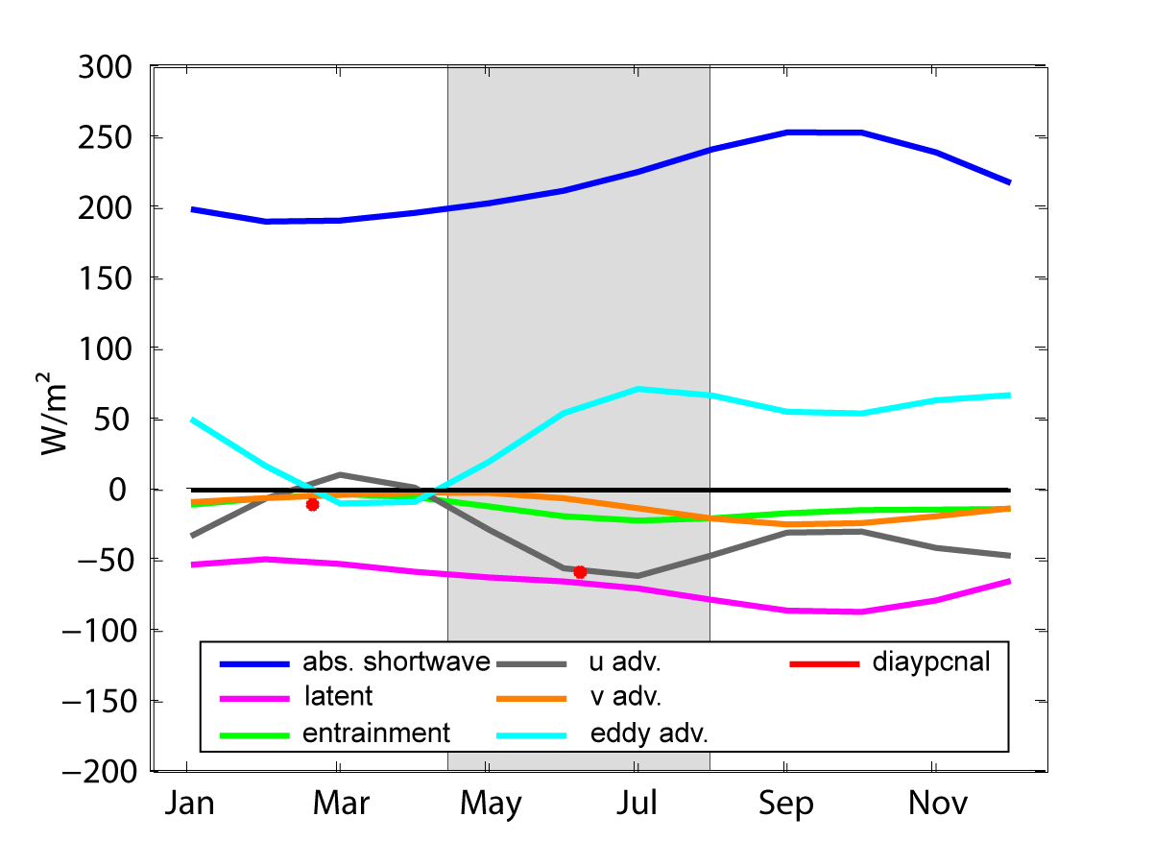
Mixed layer heat budget
10°W, 0°N
Warming: atmospheric forcing, eddy advection
Cooling: subsurface processes (entrainment, diapycnal), zonal and meridional heat advection

Slide 17
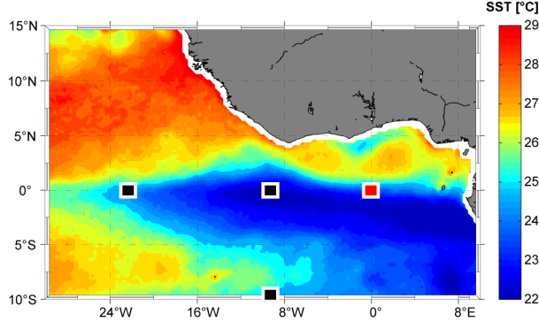
Mixed layer heat budget
0°E, 0°N
Warming: atmospheric forcing (strongly reduced), eddy advection
Cooling: subsurface processes (entrainment, diapycnal) and meridional heat advection

Slide 18
Mixed layer heat budget
10°W, 10°S
Warming: eddy advection, meridional heat advection
Cooling: atmospheric forcing, subsurface processes (entrainment, diapycnal) and zonal heat advection

Slide 19
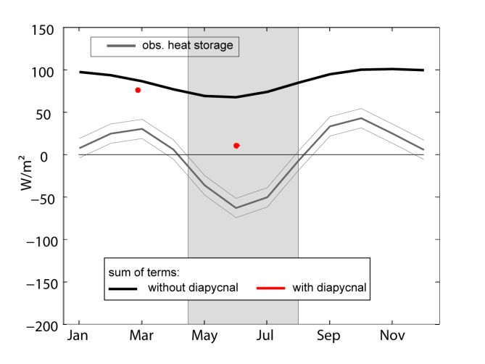
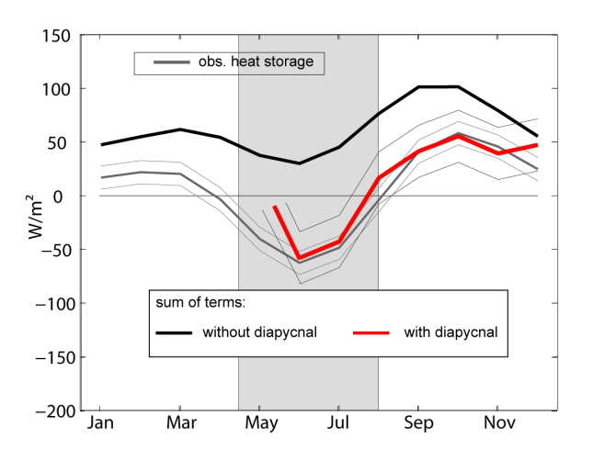
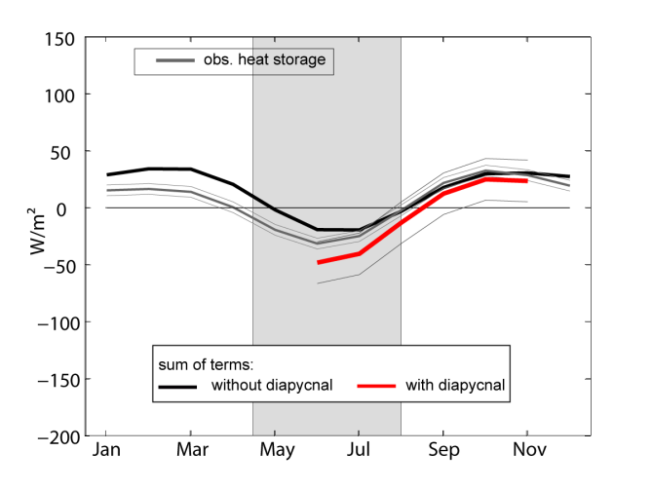
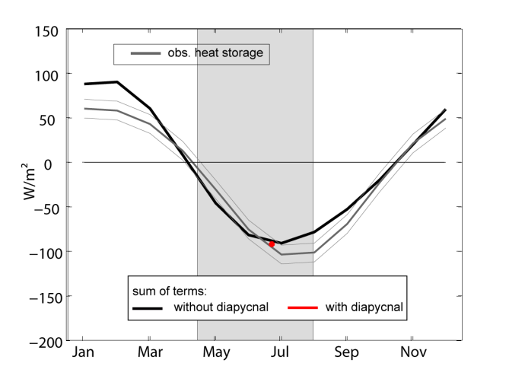
Mixed layer heat budget
23°W, 0°N
10°W, 0°N
0°E, 0°N
10°W, 10°S
Besides at 23°W,0°N closed ML heat budget within uncertainties during sampled periods
Diapycnal heat flux is an important cooling term within the entire equatorial ACT region within the development phase of the ACT
Notes:
If we compare the sum of individual contributing terms as explained before to the observed heat storage at the different locations, we find that ….
Unfortunately the estimates of the turbulent term are only sparse despite this extensive observational program. Hence the question arises about the quality of parametrization schemes estimating this quantity via the observation of other parameters.
Within the equatorial region turbulent mixing intensity is associated with shear instabilities caused by the large scale current system. Can turbulent mixing intensity be estimated via the variability of shear and stratification within this region?
motivation dass dies klappen könnte ist folgendes zumindest also unter der Ml

Slide 20
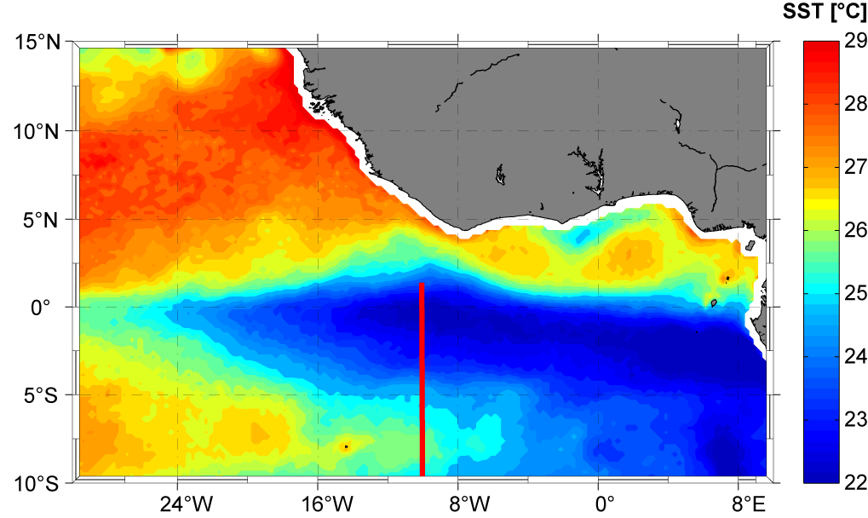
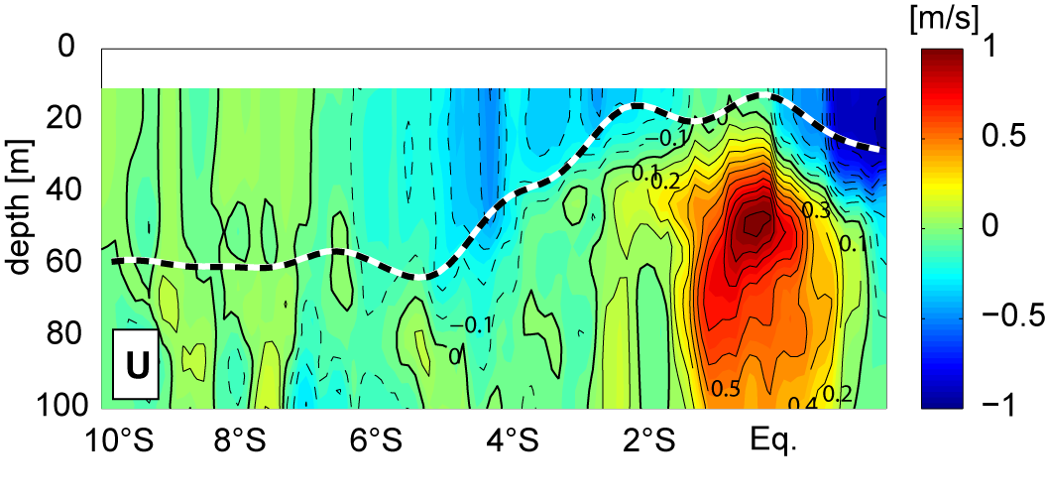
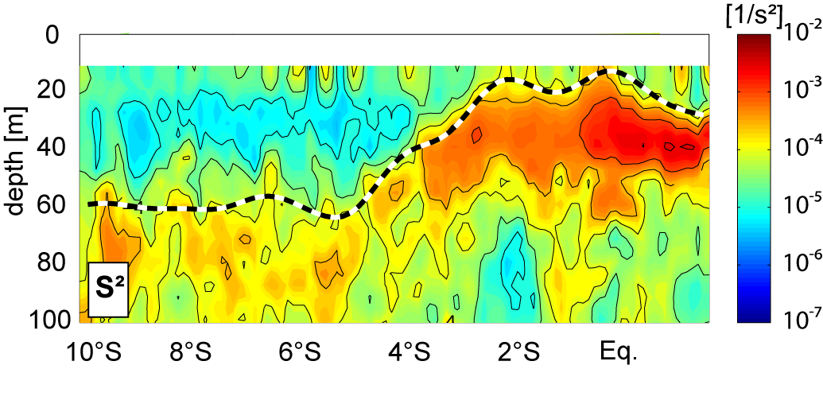
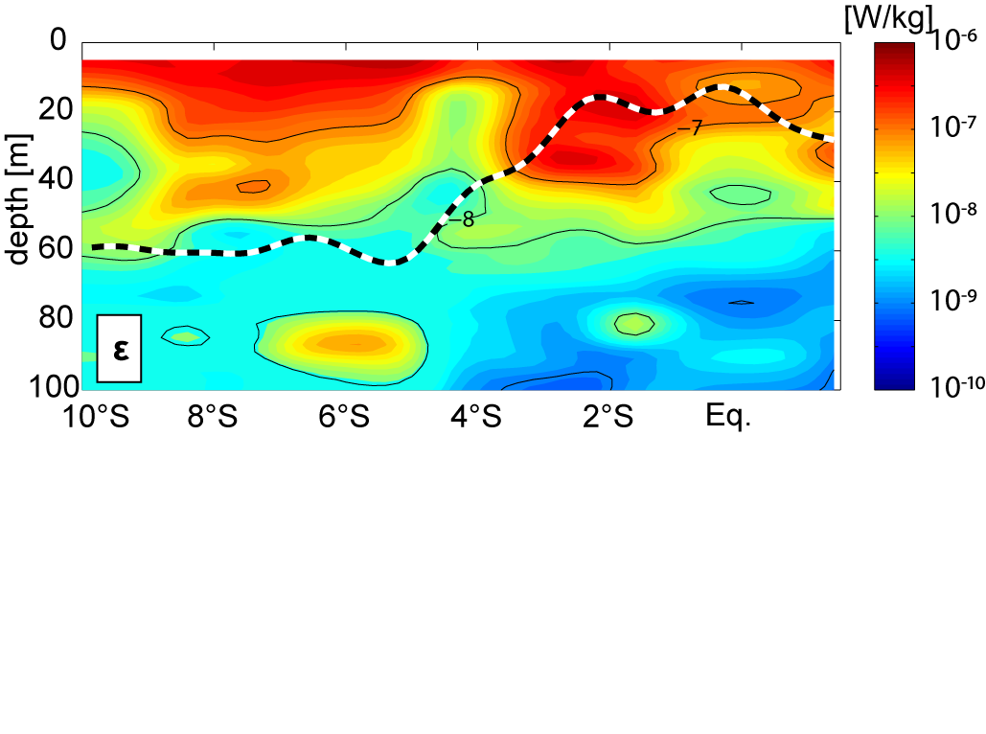
Background settings within the ACT
cSEC
nSEC
EUC
4°S-2°N (equatorial ACT):
Flat MLDs
strong currents (EUC,cSEC,nSEC)
10°S-4°S (southern ACT):
Deep MLDs
No strong current bands
Elevated shear levels ($S^{2}={\left({du}/{dz}\right)}^{2}+{\left({dv}/{dz}\right)}^{2}$
Moderate shear levels
Enhanced dissipation rates below MLD
Background dissipation rates below MLD
Notes:
If we look at an exemplary section across the ACT along 10°W we find…
So lets try it…

Slide 21
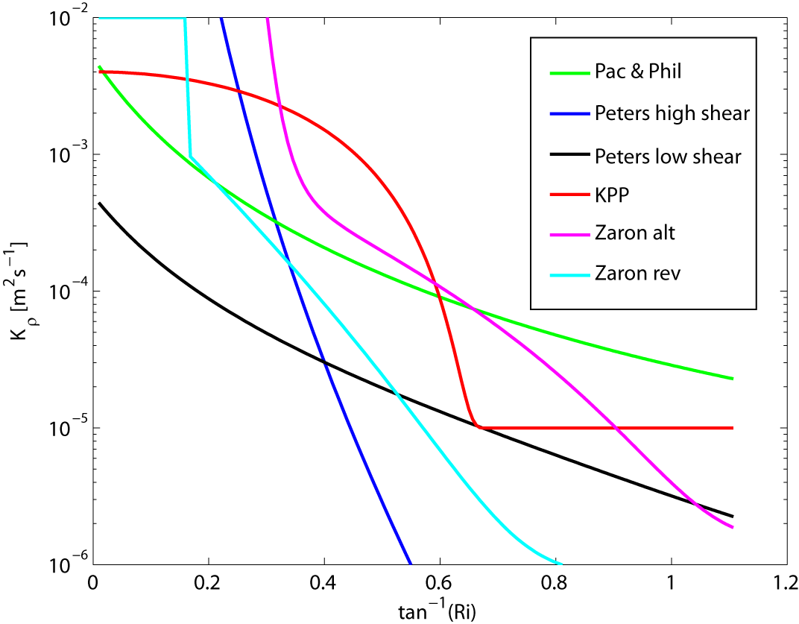
Parametrization
Existing parametrization schemes for the equatorial region are based on a simple Ri (N²/S²) dependence:
Pacanowski and Philander 1981
Peters 1988 (2 different formulations)
KPP (Large et al 1994)
Zaron and Moum 2009 (2 different
formulations)
Propose a simple dependence fitted to the observational data of this study

Slide 22
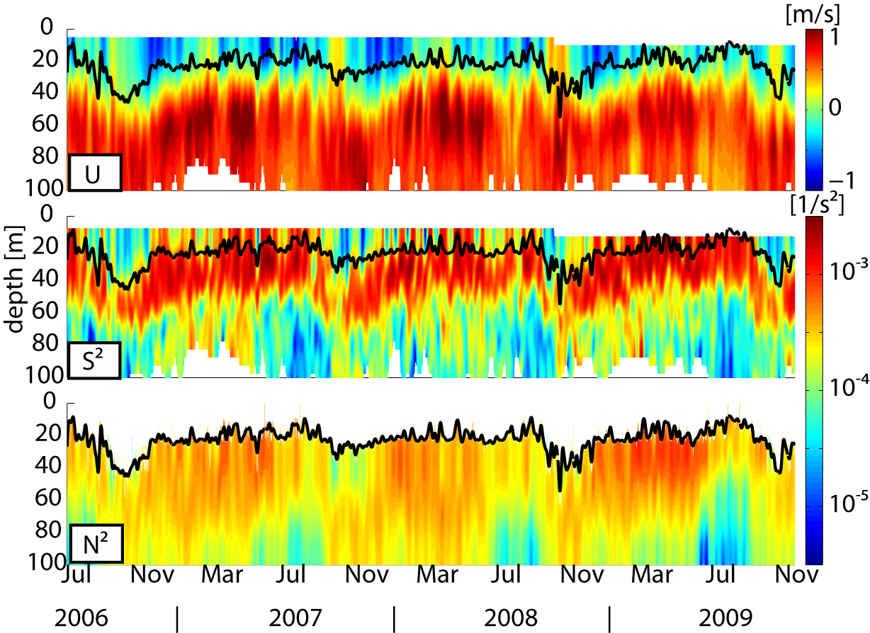
Parametrization
10°W, 0°N
Parametrizations
N²,S² → Ri → K → $J_{h}$

Slide 23
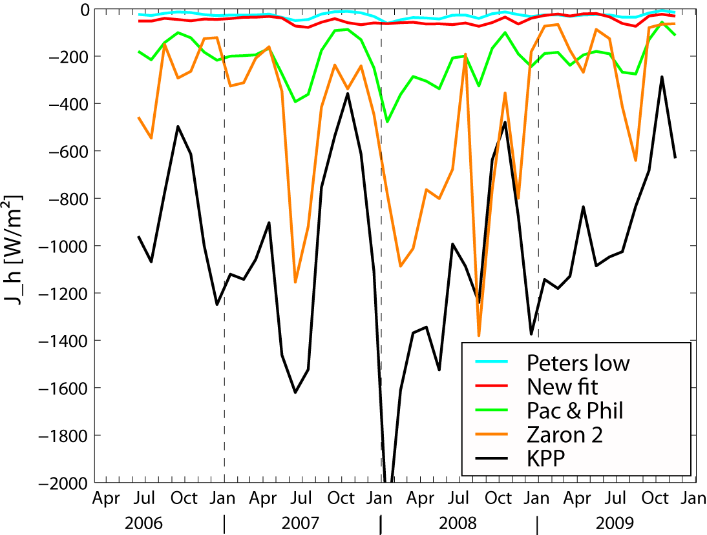
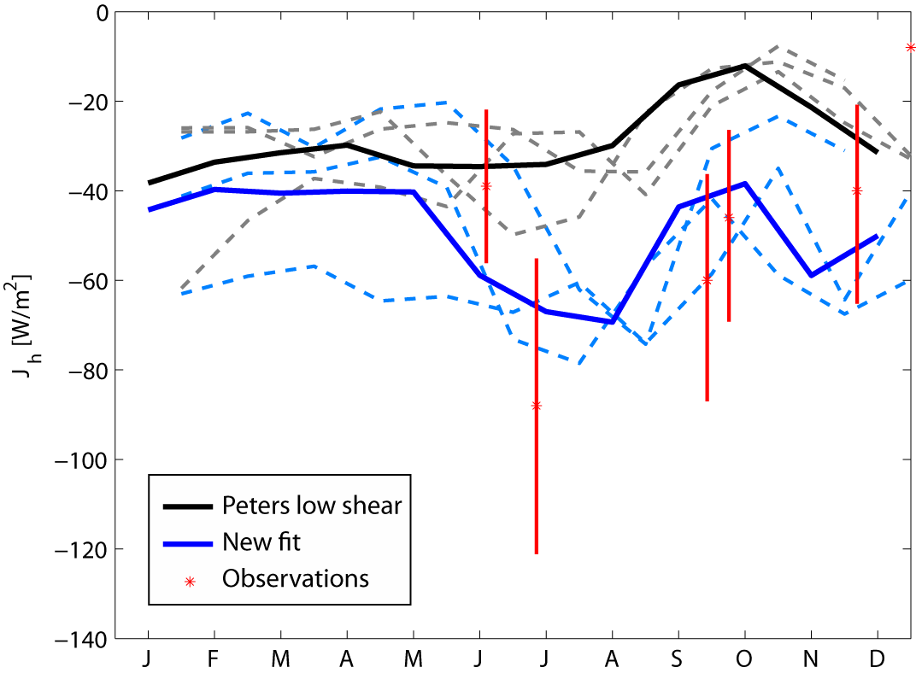
Parametrization
MLD
→ Most existing parametrization schemes cleary overestimate the heat loss of the mixed layer due to diapycnal mixing
→ Seasonal parametrized heat loss based on independent data set with new fit is closest to observations

Slide 24
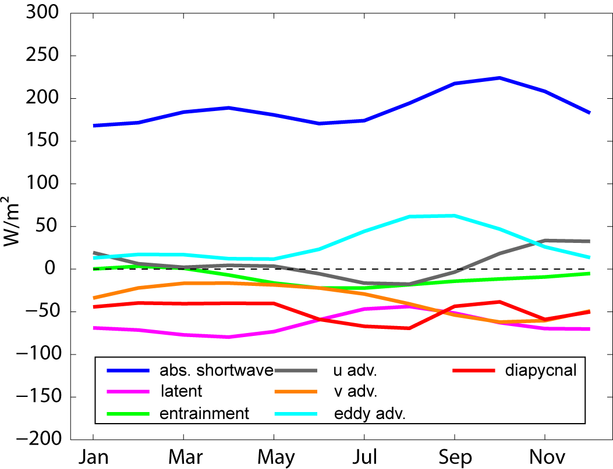
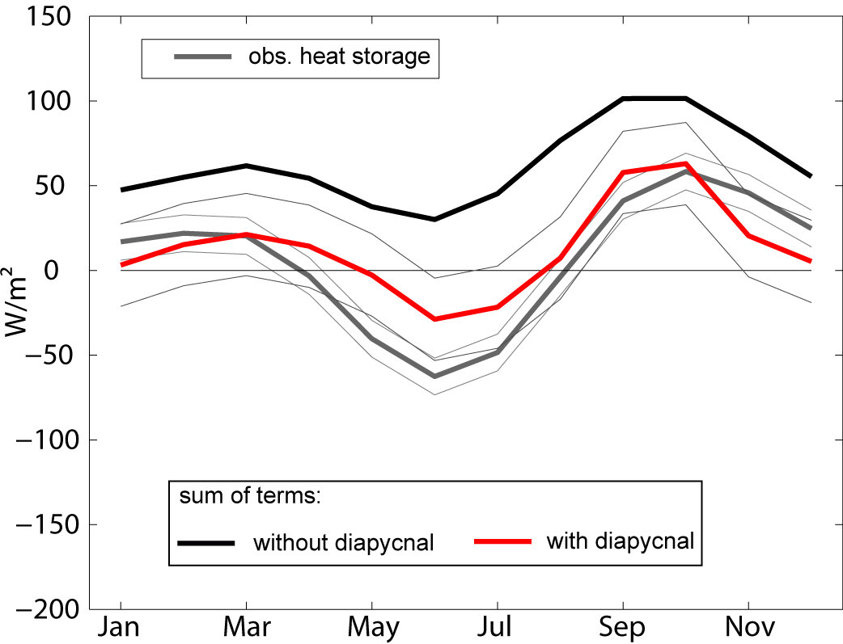
Parametrization
10°W, 0°N
All individual terms of the mixed layer heat budget at 10°W on the equator are estimated from observations of the PIRATA buoy and climatological products
Notes:
Remember now that there was still a large residual at 23°W , where the diapycnal heat flux was estimated only twice from observations

Slide 25
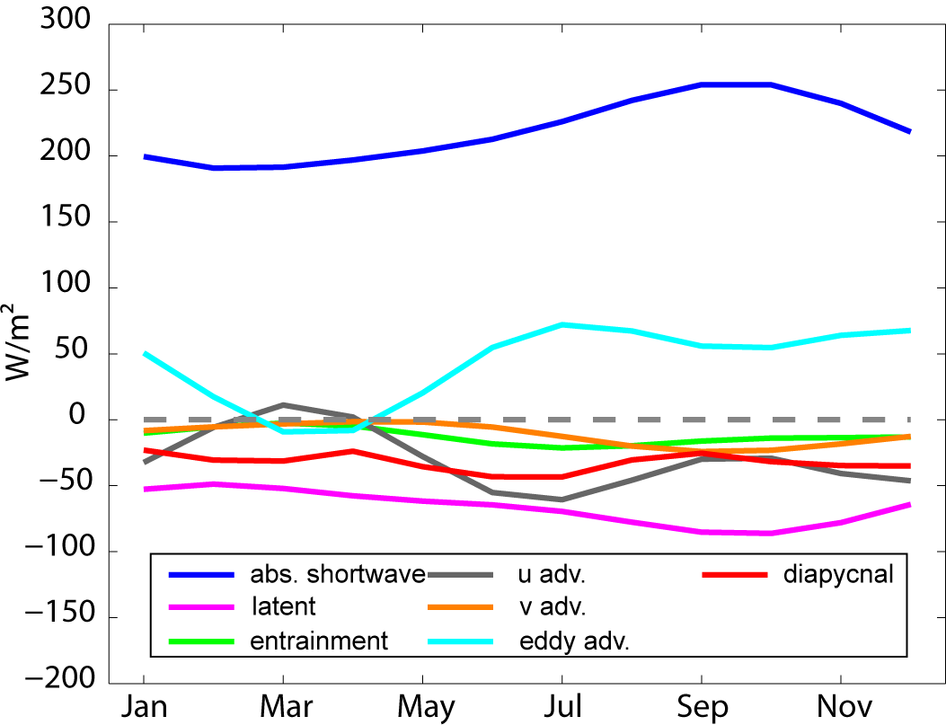
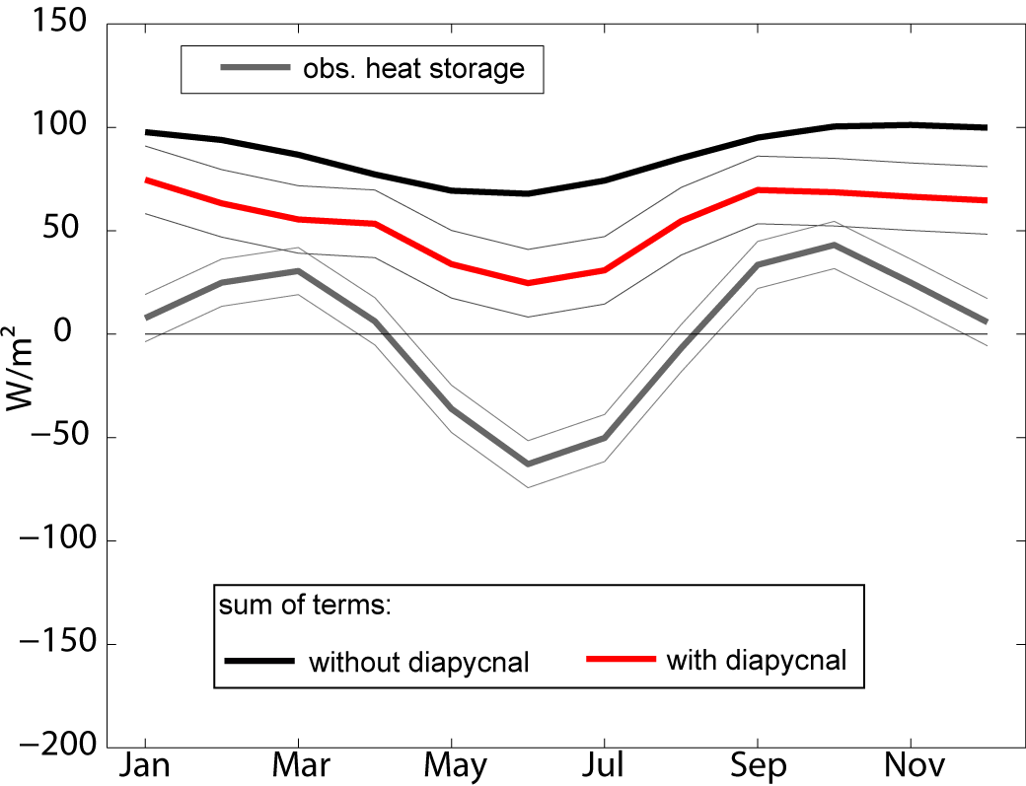
Parametrization
23°W, 0°N
Large residual at this location remains
Largest differences to Foltz et. al, 2003 are zonal advection and eddy advection

Slide 26
Summary
New, extensive set of MSS observations used to infer magnitude of diapycnal heat losses of the ML in the ACT region; some regional and seasonal variability resolved
The assessed variability of this term was included into the ML heat budget at 4 characteristic locations within the ACT. The results claim the diapycnal heat flux the dominant contribution for the cooling in the entire equatorial ACT region and a negegible contribution to the cooling in the southern ACT
A new parametrization is proposed, which seems to provide plausible estimates of the diapycnal heat loss of the ML using only observations of the Pirata buoy
The new parametrization has to be further tested
Individual contributions to the ML heat budget at 23°W need clarification

Slide 28
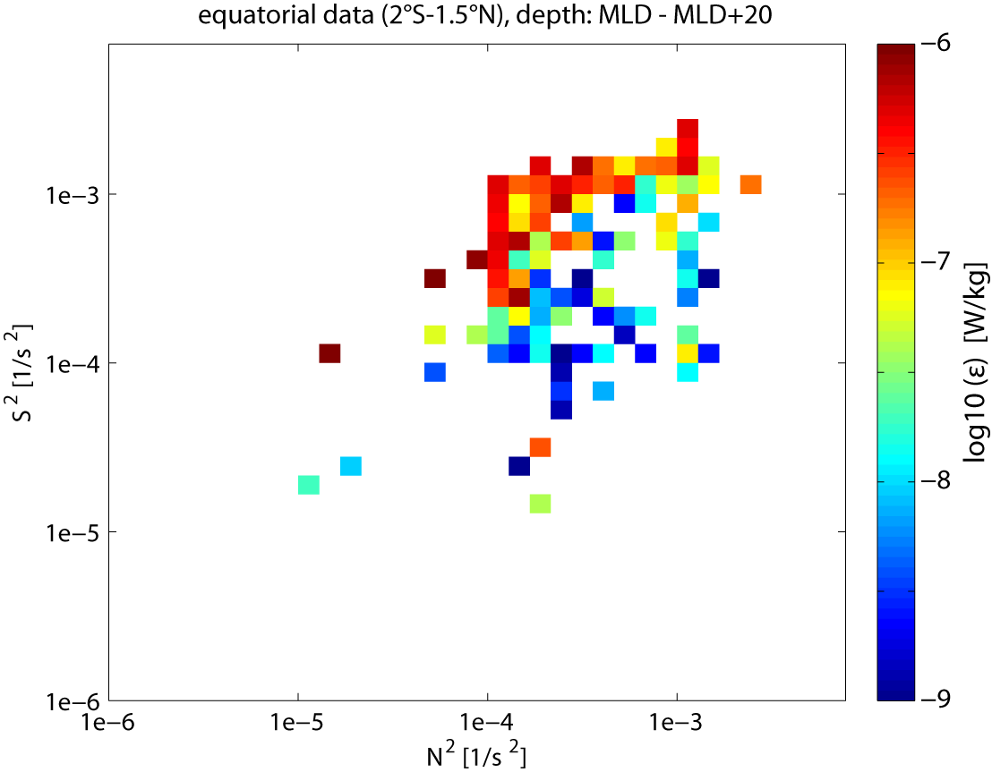
Parametrization
Notes:
Axchtung Erwähnen Focus on below the ML

Slide 29
Parametrization
Existing parametrization schemes for the equatorial region are based on a simple Ri (N²/S²) dependence:
Pacanowski and Philander 1981 $K= \frac{υ}{{(1+αRi)}^{n}}+ K_{b}$
Peters 1988 (2 different formulations) $K=a{Ri}^{b}, K=\frac{υ}{{(1+αRi)}^{n}}+ K_{b}$
KPP (Large et al 1994) $K= K_{0} {({1−({Ri/Ri}_{0})}^{2})}^{3}$
Zaron and Moum 2009 (2 different formulations) $K=\frac{{\left|\vec{U}\right|}^{2}}{S}φ (Ri)$
$$φ_{1}=a {(\frac{{Ri}_{1}}{Ri−{Ri}_{1}})}^{α}+be^{−βRi}+c$$
$$φ_{2}= \left\{\begin{aligned}{φ_{θ}}_{}^{max} Ri≤{Ri}_{2} \\ Δφ_{θ}e^{−γ(Ri−{Ri}_{2})}+ {φ_{}^{w}}_{θ} otherwise\end{aligned}\right.$$
Propose a simple dependence fitted to the observational data of this study $K=a{Ri}^{b}$

