Slide 1
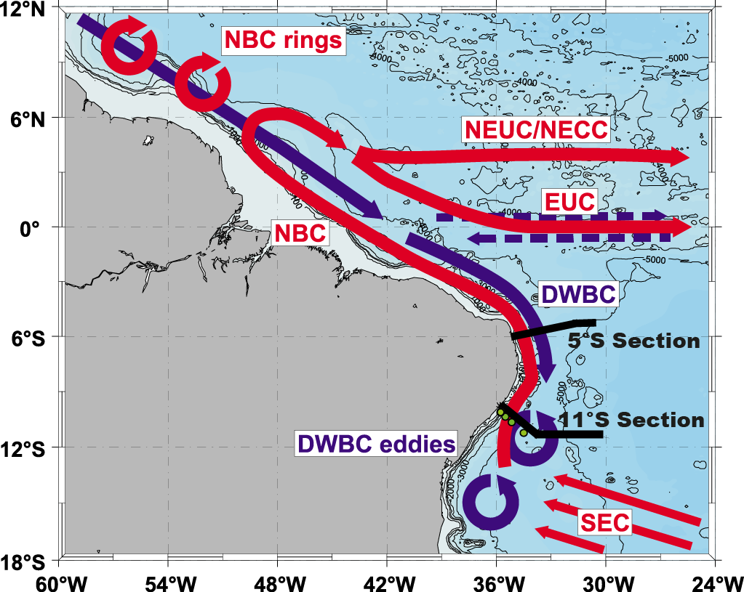
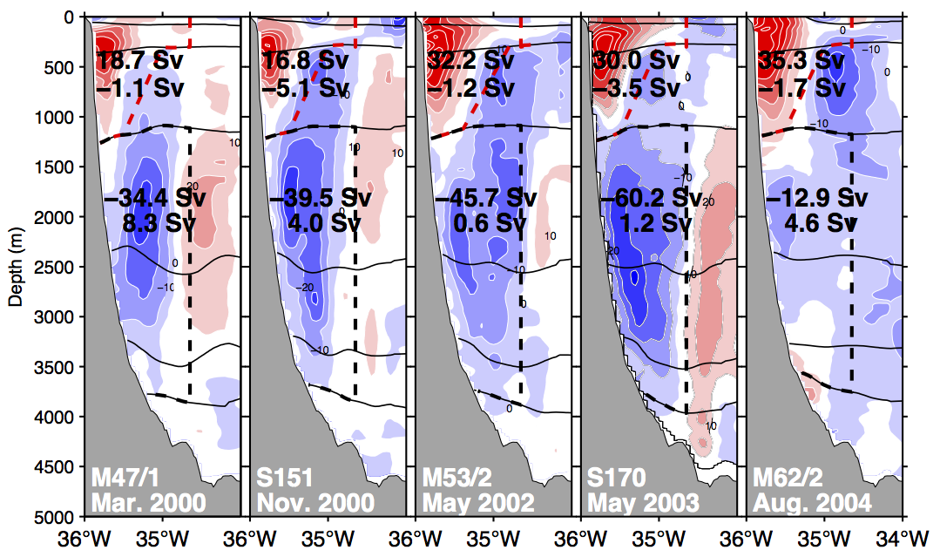
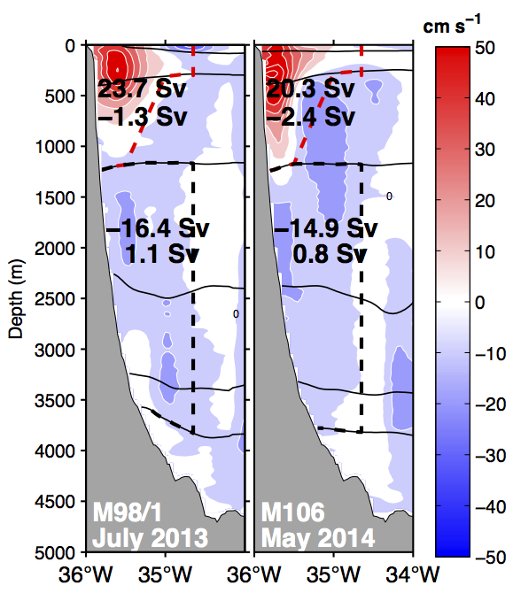
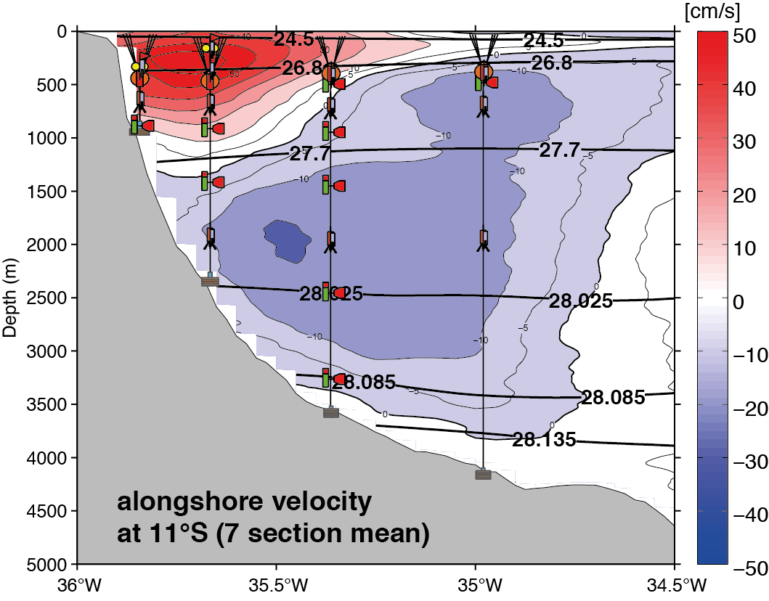
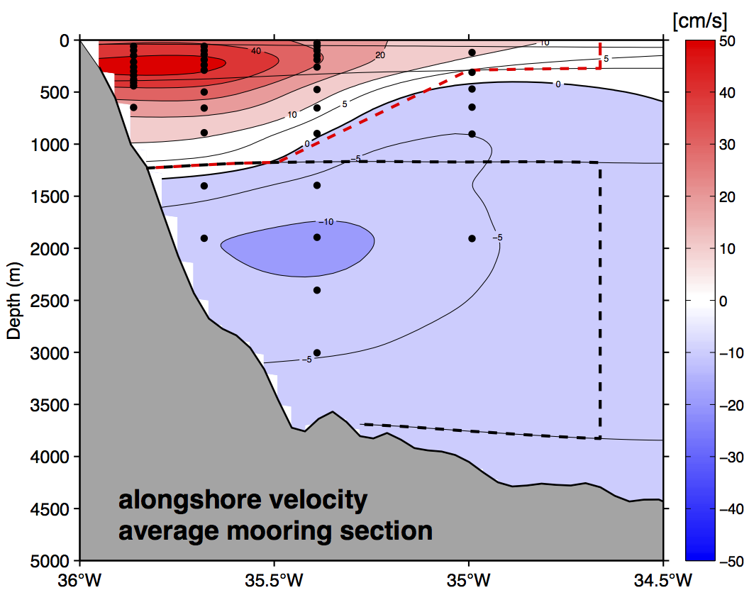
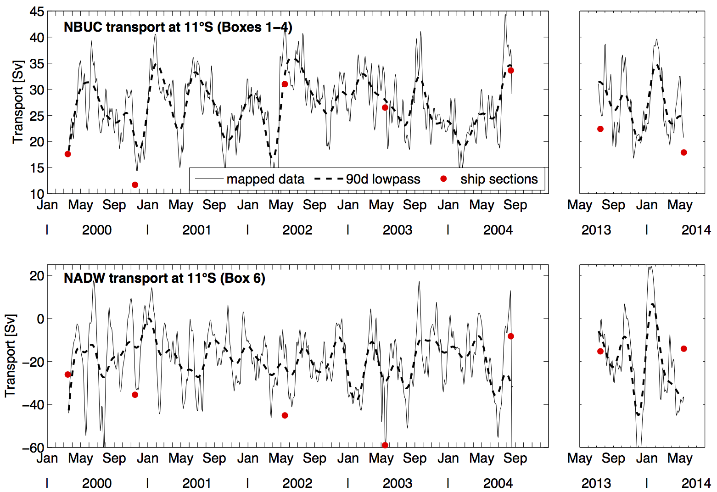
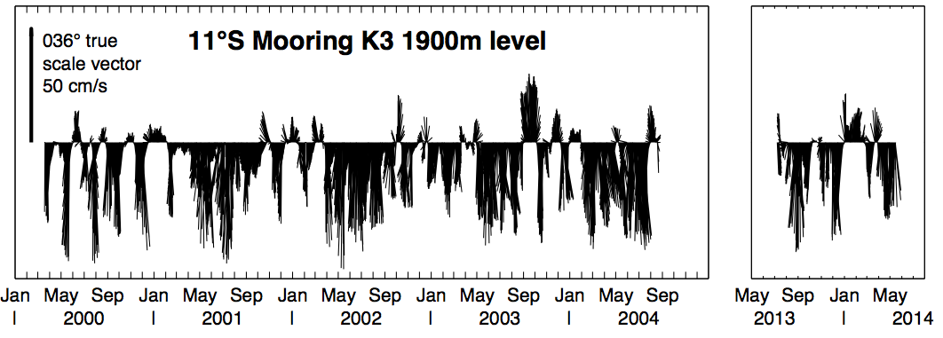
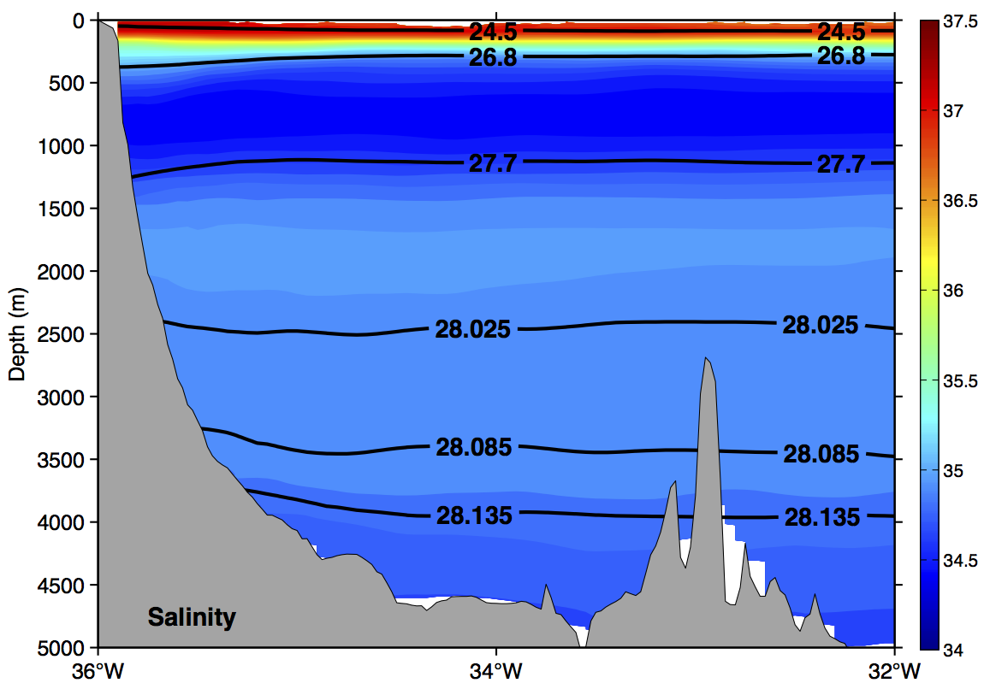
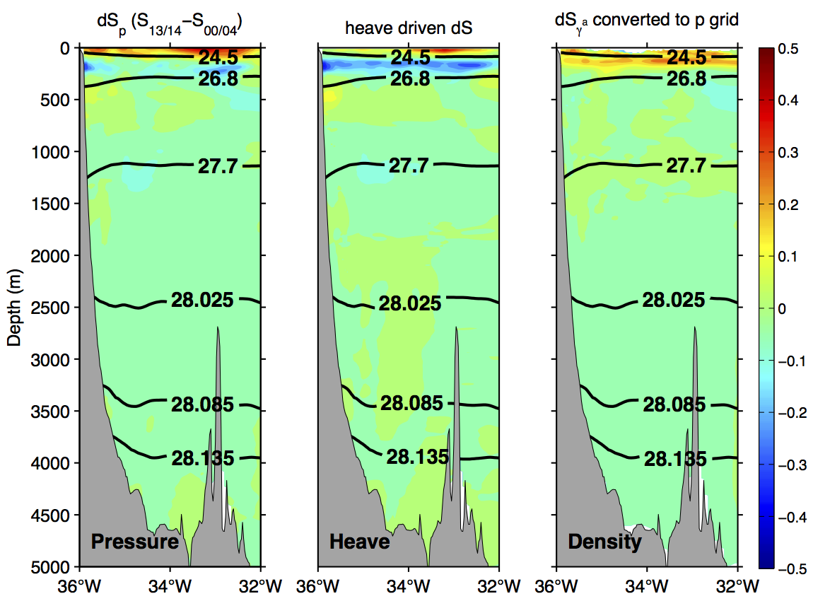
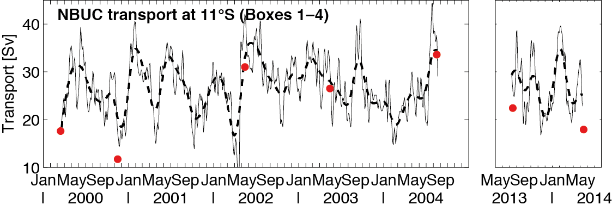
Variability of the Western Boundary Current
at 11°S off Brazil
First results from new observations
R. Hummels, P. Brandt, M. Dengler and J. Fischer, AP 1.1: Rolle des tropischen Atlantiks für Klimaschwankungen im atlantischen Raum
Fig.1: Sketch of the warm (red) and cold water (blue) routes of the AMOC (from Kuhlbroedt et al. 2007).
The tropical Atlantic Ocean plays an important role for climate variability in the Atlantic region. A key region within the tropical Atlantic is the western boundary current, where the variability of the North Brazil Undercurrent (NBUC) and the Deep Western Boundary Current (DWBC) exhibit variations of the meridional overturning circulation (AMOC, Fig. 1) and the subtropical cells (STCs). Currently, the western boundary current off the coast of Brazil at 11° S (see Fig.2) is investigated with a mooring array and ship based observations including direct current as well as hydrographic measurements. Two research cruises in 2013 and 2014 delivered first insights into changes in the currents and water mass properties nowadays compared to similar observations taken during the period of 2000-2004. In addition, the data of the first mooring period was successfully retrieved in May 2014 with an instrument performance of over 90%.
Fig.2: Circulation sketch of the western tropical Atlantic (from Dengler et al., 2004). Warm and cold water routes of the AMOC are indicated in red and blue. The sections at 5°S and 11°S are marked in black and the mooring array is indicated with green circles.
Observed current and transport variability at 11°S
Shipboard observations
Moored observations
2000-2004
2013-2014
a)
K1
K2
K3
K4
b)
Fig. 3 Shipboard sections of along-shore velocity (slanted toward 36°T) along 11°S. Red and black dotted lines mark the boxes used for transport calculations. The black contours mark lines of constant neutral density as in Fig. 4. (Note that the five sections from 2000-2004 are a remake of the sections presented in Schott et al., 2005).
Fig. 4 Average shipboard velocity section at 11°S (averaged over 7 sections from Fig.3) overlain with the mooring array design. Black contours mark lines of constant neutral density.
Fig. 5a) Average mooring section at 11°S averaged over the periods 2000-2004 and 2013-2014; b) transport time series of the NBUC (top) and DWBC layer (bottom) obtained from moored observations calculated in corresponding boxes; red dots are transports inferred from the ship sections.
In the shipboard velocity sections along 11°S the northward flowing NBUC, representing the upper limb return flow of the AMOC and STCs, is clearly visible within the upper 1000m close to the shelf. Below, the flow that is dominantly to the south is associated with the DWBC. These snapshots show the high variability of the velocity field especially at depths below 1000m. In these layers the transport was associated with deep eddies rather than a laminar flow (Dengler et al. 2004, Fig.2). Calculated transports of the NBUC range between 16 and 36 Sv to the north. In the DWBC layer they reach from 13 to 60 Sv to the south. On average the shipboard observations lead to transport estimates of 23 Sv for the NBUC and 29 Sv for the DWBC (Tab. 1). These snapshots would suggest that the transport in the DWBC layer is lower in the new observational period (2013-2014) compared to 10 years ago (2000-2004). Whether this is due to the absence of deep eddies can only be answered using moored observations.
In order to investigate the variability of the current system in more detail the mooring array at 11°S has been (re-)installed (Fig.4). The average velocity section inferred from the mooring observations (Fig. 5a) fits rather well to the average ship section (Fig. 4). However, the transport time series (Fig. 5b) show large variability inherent to the western boundary current system, especially in the DWBC layers due to the presence or absence of deep eddies. Dengler et al. 2004 suggested that in case of a decrease of the DWBC north of 11°S, the transport should be accomplished by a laminar flow instead of deep eddies. However, the transport time series (Fig. 5b) as well as the velocity time series at 1900m depth (Fig.6) show that the deep eddies are still present.
Average transport estimates [Sv]
 | Total Average | 2000-2004 | 2013-2014
NBUC Ship | 23±3 | 24±4.1 | 20.2±2.3
NBUC Mooring | 27±1.1 | 26.9±1 | 27±1.2
DWBC Ship | -29±7 | -34.8 ±8.6 | -14.7±0.6
DWBC Mooring | -18.9±3.4 | -18.6±3.3 | -20.4±4.3
Tab. 1 Comparison of box averaged moored and ship based transport estimates and their error estimates. Error estimates are given as standard errors.
Fig. 6 Time series of alongshore velocity from K3 (Fig.4) at 1900m depth.
Changes in water mass properties
Summary and Outlook
a)
SACW
b)
Fig. 7a) salinity averaged on density surfaces for the 7 sections
b) salinity differences analyzed on pressure surfaces, due to isopycnal heave and on density surfaces
Two research cruises were successfully conducted in 2013 and 2014. Shipboard and moored observations show that:
at first glance no significant decadal changes in transport estimates are apparent (neither NBUC nor DWBC layer)
the transport within the DWBC layer is still accomplished by deep eddies
salinity has increased in the upper layers (SACW and AAIW) and decreased in NADW layers, if differences on density surfaces are considered
For the future two additional cruises are planned in 2015 and 2017 to maintain the mooring array and get additional shipboard observations. The increased data set will be used to:
investigate interannual and decadal transport variability ( )
calibrate geostrophic transport calculations in order
to possibly fill the gap in the transport time series by
using historical CTD and ARGO data ( )
analyze water mass variability in more detail
investigate the meridional coherence of AMOC signals in the Atlantic in comparison to results from the basin wide AMOC observing system
AAIW
uNADW
mNADW
lNADW
AABW
?
Comparison of water mass properties at 11°S for the two observational periods (2000-2004 and 2013-2014) exposes decadal changes in salinity. Differences in salinity are analyzed on pressure surfaces, due to the heave of isopycnals and on density surfaces (according to Durack and Wijffels, 2010, Fig. 7b). Averaged over the entire section and between 100-600m depth, which can be associated with the depth range of the NBUC, differences on density surfaces show an increase in salinity of 0.024. Averaging the differences on density surfaces between 1500-4000m shows a freshening of 0.007.
?
?
?
References: Dengler M, Schott FA, Eden C, Brandt P, Fischer J and RJ Zantopp (2004) Break-up of the Atlantic deep western boundary current into eddies at 8 S, Nature 432:1018-1020 doi:10.1038/nature03134
Schott FA, Dengler M, Zantopp R, Stramma L, Fischer J, Brandt P (2005) The shallow and deep western boundary circulation of the South Atlantic at 5°-11°S, Journal of Physical Oceanography 35:2031-2053 doi:10.1175/jpo2813.1
Durack PJ, Wijffels SE (2010) Fifty-Year Trends in Global Ocean Salinities and Their Relationship to Broad-Scale Warming Journal of Climate 23:4342-4362 doi:10.1175/2010jcli3377.1

