Slide 1
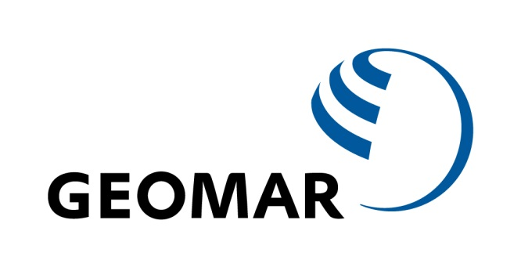

Western boundary circulation in the tropical South Atlantic and its relation to Tropical Atlantic Variability
Rebecca Hummels¹, Peter Brandt¹, Marcus Dengler¹, Jürgen Fischer¹
¹GEOMAR Helmholtz Zentrum für Ozeanforschung, Kiel, Germany
SAMOC V Workshop, Buenos Aires, Argentina, 03.12.2014

Slide 2
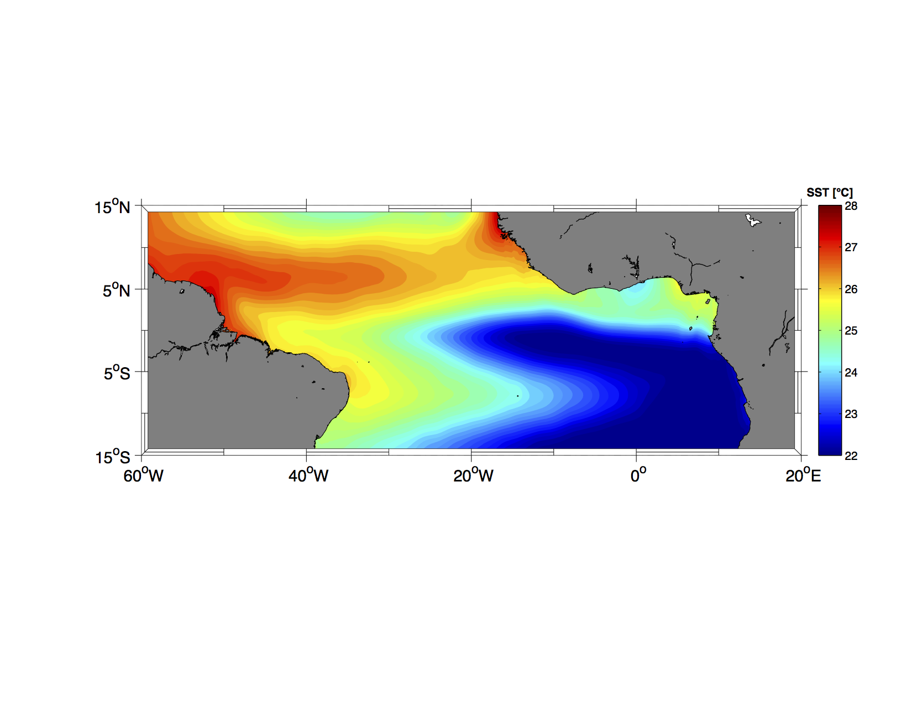
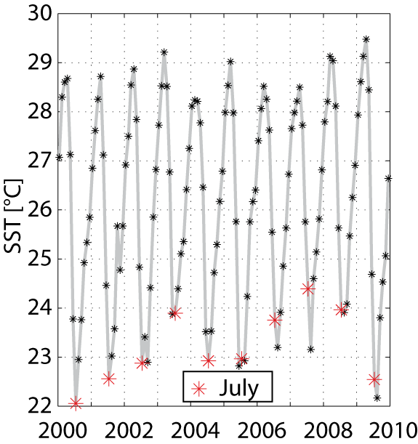
Tropical Atlantic Variability (TAV)
TAV comprised of 2 dominant climate phenomena:
- Merdional mode (across equatorial SST anomaly pattern)
- Zonal mode (along equatorial SST anomaly pattern)
SST anomaly patterns related to rainfall anomalies over adjacent continents on inter-annual time scales
Notes:
Tav is comprised of two dominant climate phenomen, which are called the meriodioanl and the zonal mode, where across and along equatorial SST anomaly patterns are related to rainfall anomalies over the adjacent continents. As an illustration I am showing you the typcial SST pattern of the Atlantic cold tongue, which appears annualy in summer. SSTs decrease by about 6°C between May and August. Looking at the inter-annual variability of SST at 10°W, shows inter-annual variability in onset and strength of this phenmenem, which is described in the so called zonal mode and was e..g. related to the onset of the WAM. The idea is that improved forecast skill for SSTs on these time-scales should improve the forecast skill of rainfall anomalies. There is some evidence that inter-annual SST anomalies are related to ocean dynamics, which would give hope that forecasting of SSTs might be possible.

Slide 3
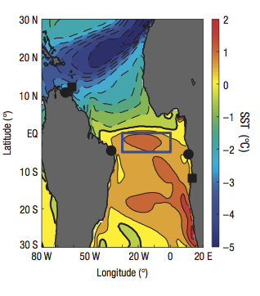
AMOC and TAV
Chang et al. 2008
On decadal timescales changes in the AMOC at high latitudes lead via interaction with the Subtropical Cells (STCs) to a transition between monsoon states
Currently it is still unclear how changes in the MOC affect the pathways of the STCs and how these changes in the STCs affect the SSTs
Notes:
So what does the AMOC have to do with TAV. At least on decadal timescales Chang et al. found In a model study that changes in the MOC at high latitudes such as slow down of the ATH , which they mimicked with water housing experiments, has a strong impact on SSTs within the tropical Atlantic and that this crucially impacts the state of the monsoon switching from a generally more wet to more dry state on top of the inter-annual variability. At least for this transition between the more wet or more dry states they find that ocean dynamics in particular the interaction of the changes in the AMOC with the subtropical Cells responsible. Currently, ...but it seems a good idea to monitor the variability of both the ATHC and the STCs within the tropics.

Slide 4
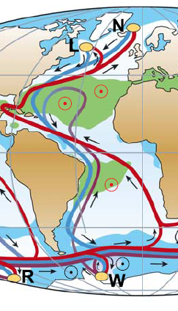
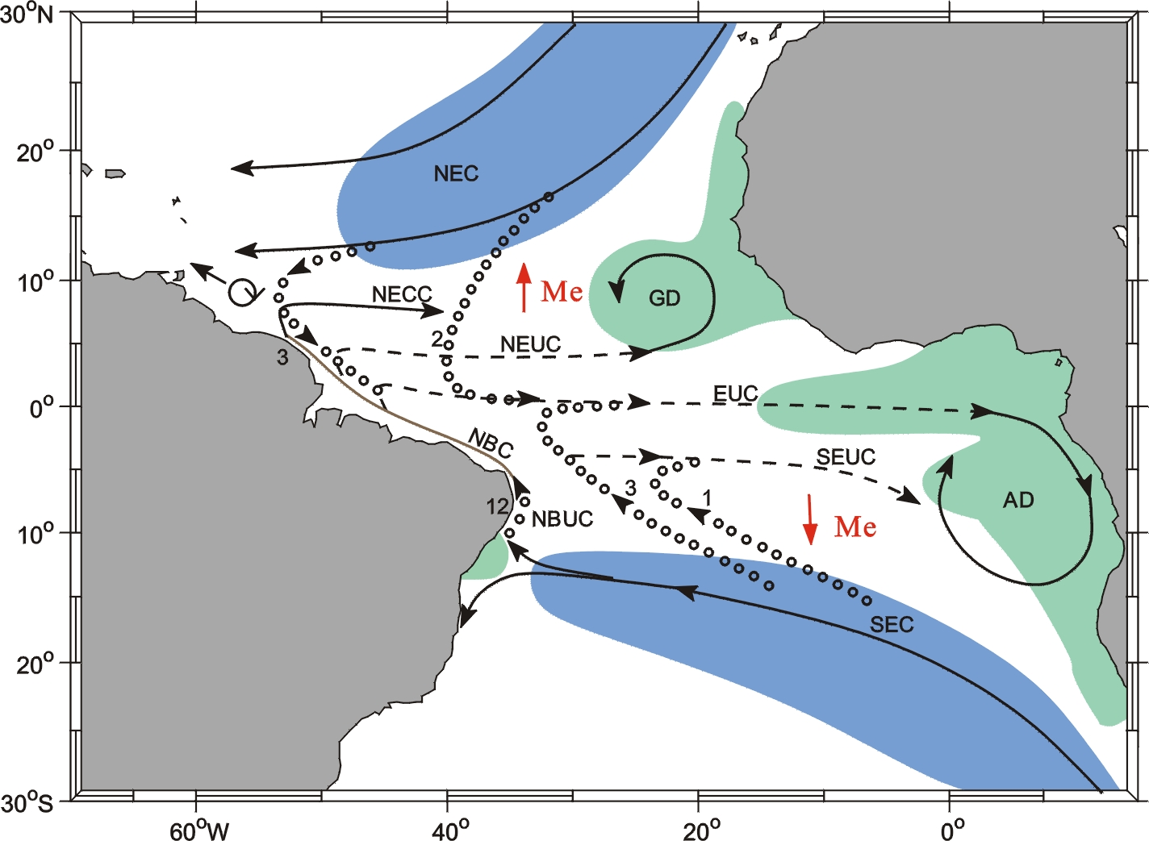
Circulation within the tropical Atlantic
Atlantic thermohaline circulation (ATHC)
Shallow Subtropical-tropical Cells (STC)
→ Interaction between the hemispheres is focused on the western boundary
Notes:
That both routes: the lower limb bringing cold, deep waters to the south in the warm water sphere we have the return flow to the north are focused on the western boundary. The subtropical cells of both hemispheres connect subduction areas in the subtropics shaded here in blue with upwelling areas in the eastern equatorial region shaded in green. These cells are wind driven by the poleward Ekman transports draining water out of the equatorial region and forcing a compensating return flow. This compensation occurs mainly over the western boundary
If we consider both components it gets obvious that the interaction between the hemispheres for both of these circulation features is at the western boundary, which appears as a chokepoint. So It seems sensible to monitor the variability of the circulation system of the tropical Atlantic as part of the MOC and STCs is here, where everything seems to converge. Note that also Chang claimed that the NBC at the western boundary holds the key for the interaction between ATHC and STC. In fact this region already has attracted observational interest

Slide 5
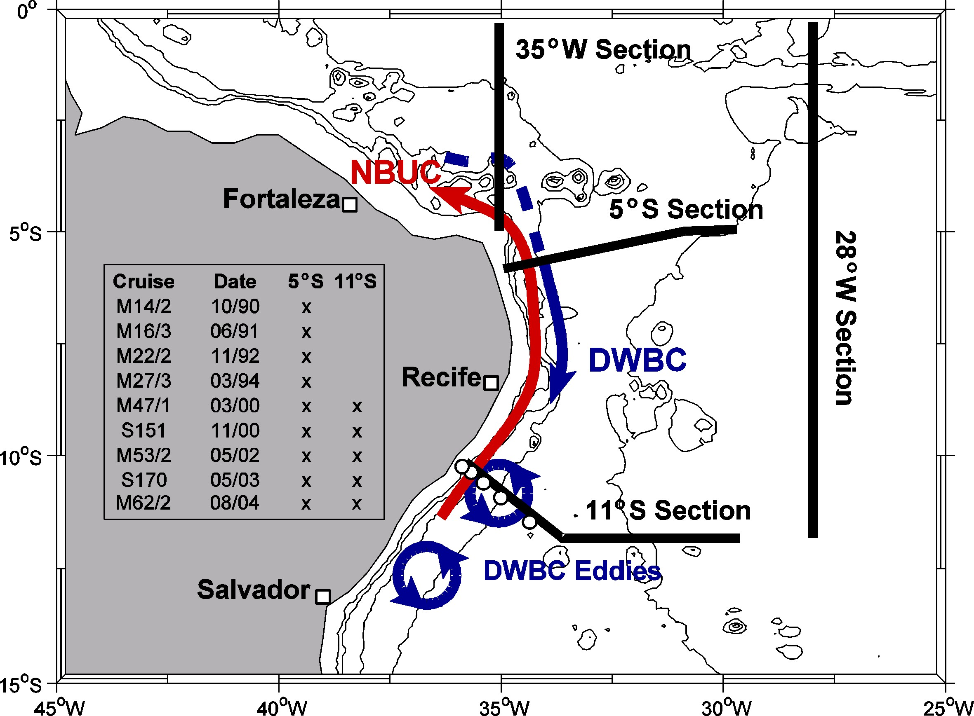
Observations at 5°S and 11°S between 1990-2004:
Observations:
9 research cruises: repeatedly occupied the 5°S and 11°S section
Mooring array at 11°S
2000-2004
Schott et al. 2005
Notes:
Between 1990 and 2004 9 research cruises to this area have been undertaken to investigate the mean transports of the warm and cold water route as well as their variability. During this field campaign the focus in terms of variability was on the seasonal and shorter term variability, however I want to point towards the main results here. To better resolve the variability of the warm and cold water route additionally a mooring array was deployed at 11°S. In the following I will concentrate on observations and results at 11°S.

Slide 6
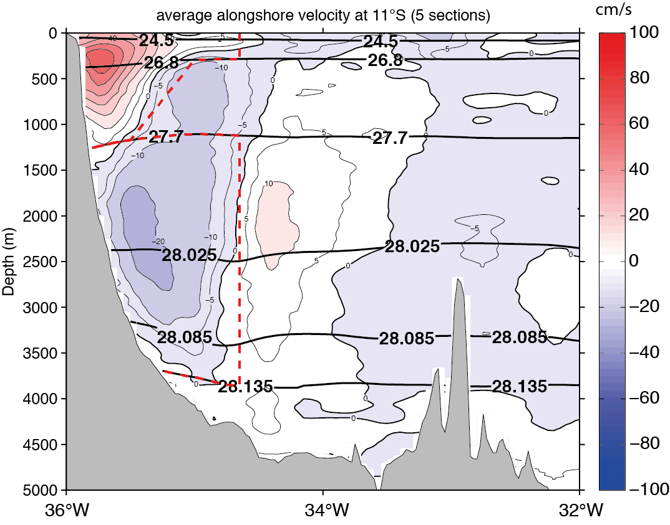
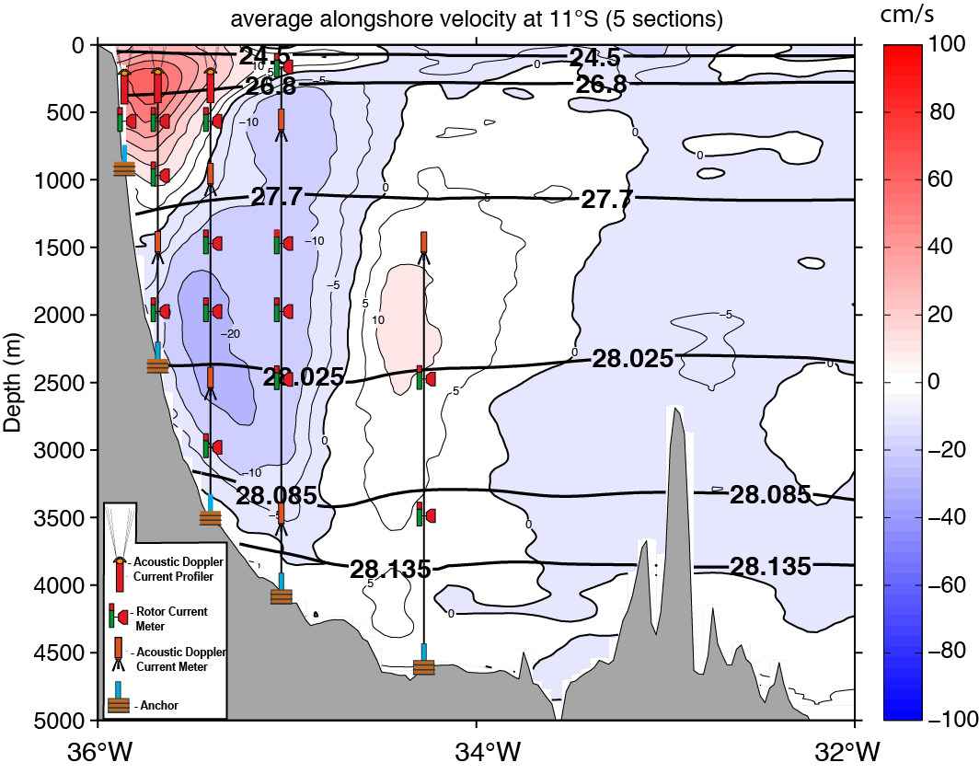
Observations at 11°S between 2000-2004: Mean state
cm/s
remake of Schott et al. 2005
Average transports at 11°S (ship):
NBUC 24 +/- 4 Sv [=1 x10⁶ m³s⁻¹]
DWBC -34.8 +/- 8.6 Sv
Average transports at 11°S (mooring):
NBUC 27.1 +/- 1.1 Sv
DWBC -18.6 +/- 1.7 Sv
Notes:
The mean longitude depth section at 11°S from the 5 cruises occupying this section during this time is shown here. In the upper about 1000m we see the NBUC flowing „northward“ in the central and intermediate water range and the DWBC flowing southward within the layers of the North Atlantic deep water. The average transports estimated in the two boxes shown with the dashed red lines and which are associated with the NBUC and DWBC transports respectively can be estimated as .....
As I mentioned before a mooring array was additionally installed along the 11°S section. The observations of this array can be used to conctruct velocittz sections and also used for transport estimates. The results for the average transport between 2000 and 2004 were ...., which fits to the shipboard estimate for the NBUC, but is significantly lower on average for the DWBC. In order to investigate this descrepancy in more detail, you can analyze the transport timeseries in more detail:

Slide 7
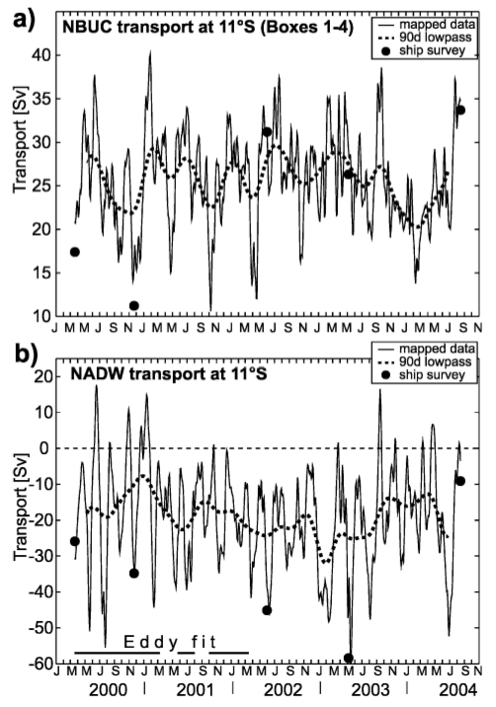
Observations at 11°S between 2000-2004: Variability
NBUC:
Average transport is similar
to ship sections
Seasonal variability :
amplitude of annual and
semi-annual harmonics < 2 Sv
Interannual variability: for the 4 years is estimated to +/- 1.2 Sv
NADW:
Average transport is lower than from ship sections
Extremely large variability
Spectral peak at 60-70 days period associated with deep eddies
Schott et al. 2005
Notes:
Looking at the transport time series for the warm and cold water route shows strong variability in both layers. The NBUC transport ranges between 10 and 40 Sv. However, the average transport is similar to the one estimated from the ship sections, seasonal variations were estimated small as well as the, inter annual variations. However, inter annual variations could only be assessed for this rather short time series of 4 years.
In the deeper layer, the transport variability is even larger ranging from 60 southward to 20 northward. Further analysis of velocity and transport timeseries within the NADW layer revealed a spectral peak at 60-70 days, which could be associated with deep eddies. In fact the structure of these deep eddies is also mirrowed in the average section. This lead to the discovery that the DWBC ...

Slide 8
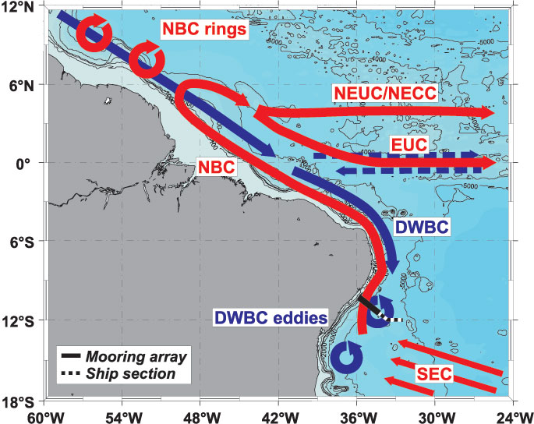
Observations at 11°S between 2000-2004:
Break up of DWBC in to deep eddies at around 8°S
Dengler et al. 2004
Notes:
Deep eddies. In the model additionally analysed in Dengler et al. 2004 the laminar flow of the DWBC breaks up into these deep eddies at around 8°S and from then on eddies accomplish the transport. This explains the extremely large transport variability depending on the actual eddy state and explains that the ship average is is probably biased due to the actual passing of eddies when the section was occupied.
After this intense observational period, which focused on time scales from intra-seasonal to seasonal scale other studies have further invesigated the variability of different properties within this region with the focus mainly on longer time scales and how this variability is possibly linked to large scale circulation features such as the MOC:

Slide 9
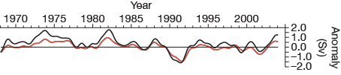
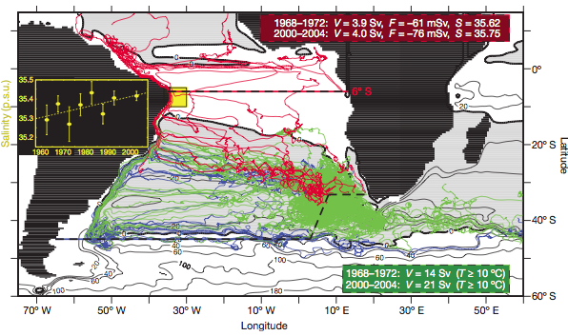
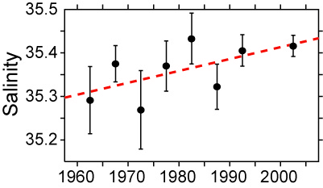
Other studies after observational period:
Biastoch et al. 2008:
close correspondence between AMOC strength and NBUC transport on inter-annual time scales
AMOC strength at 6°S
NBUC transport
Biastoch et al. 2009:
Salinity anomalies within the NBUC are related to the variability of the Agulhas leakage and might have implications for further evolution of MOC
Notes:
For instance, Biastoch found in their model study an extremely good correspondence of the inter-annual variability in AMOC strength at 6°S and the NBUC transport variability over decades
In another model study Biastoch find that the Agulhas leakage has increased within the past decades, bringing more saline and warmer waters into the South Atlantic. They find that these salinity anomalies can be traced in the thermocline waters within the NBUC region in observations. Furthermore they point out that these waters have already begun to invade the North Atlantic an have potentially an implication for the future evolution of the MOC.

Slide 10
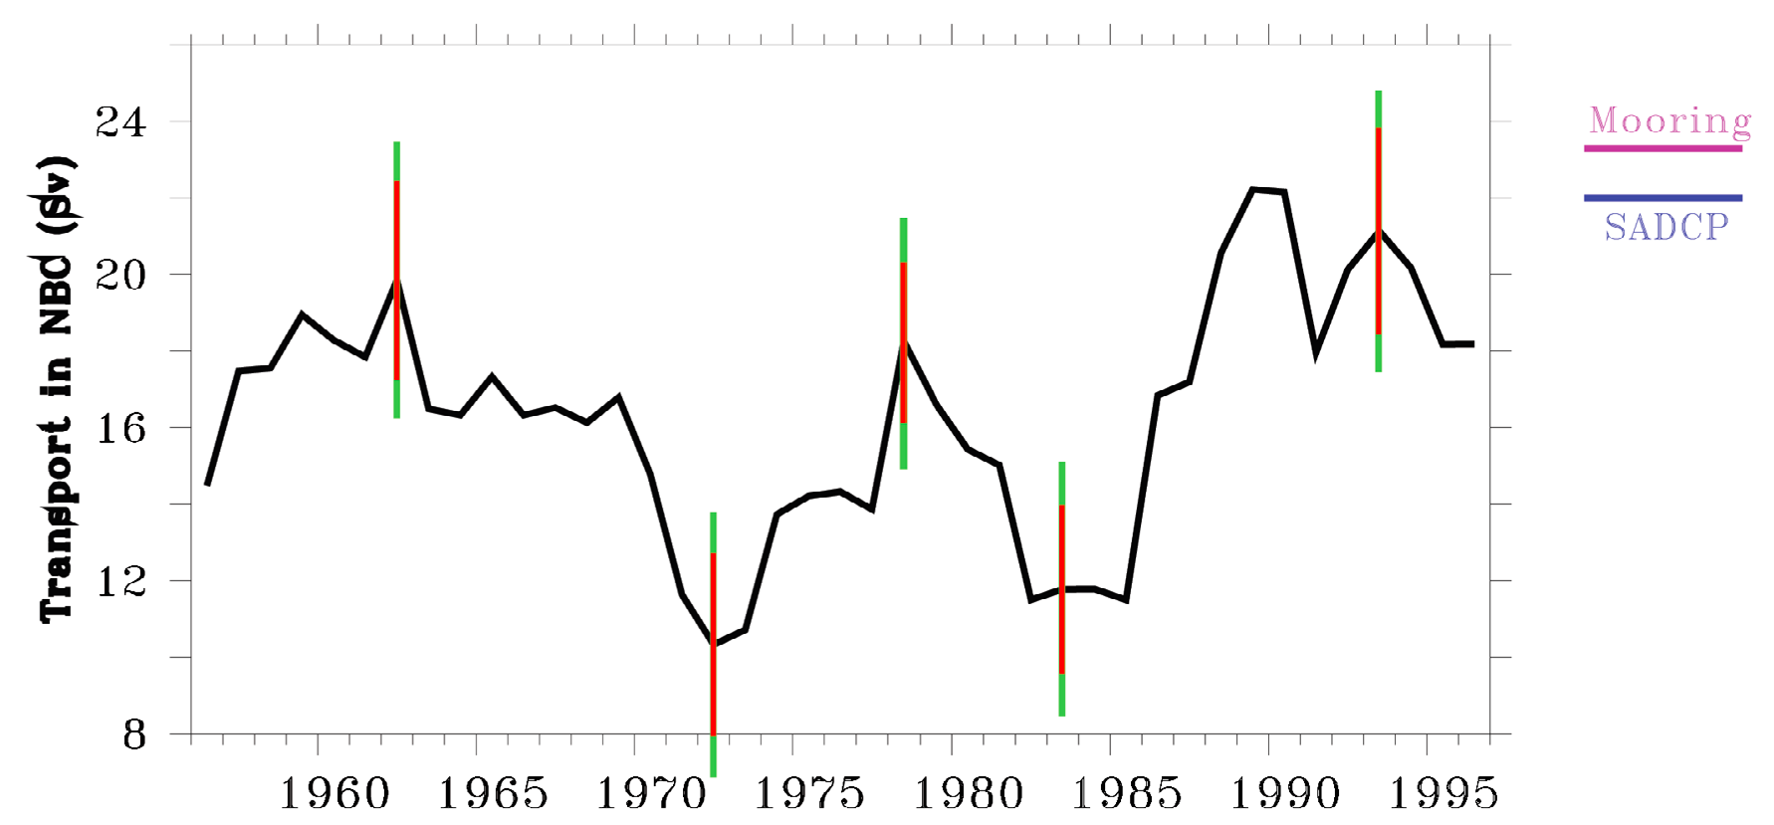
Other studies after observational period:
Transport in NBC (Sv)
Zhang et al. 2011:
Strong interannual NBUC transport variability in geostrophic transport timeseries based on historical hydrographic observations
Notes:
In another study the inter-annual variability of the NBUC was investigated by contructing a yearly geostrophic transport timeseries of the NBUC from available historial hydrographic observations within the NBUC region. Zhang et al. Find in their study that there is quite a strong interannual transport variability with transport variations up to a factor of 2 contradicting the findings of Schott. However the transport timeseries of Schott et al. Onlz covered 4 subsequent years.

Slide 11
Other studies after observational period:
Biastoch et al. 2008
Biastoch et al. 2009
?
Transport in NBC (Sv)
Zhang et al. 2011
2000
2005
2010
2015
Notes:
However, all these results motivated us at GEOMAR to initiate another observational period at 11°S which is embedded in the framework of the RACE-project:
We found that it would be of great interest to have a pro-longed timeseries of the NBUC and DWBC transports and further data on hydrographic properties in order to investigate the inter-annual to decadal variability of velocity and hydrography within this region in more detail

Slide 12
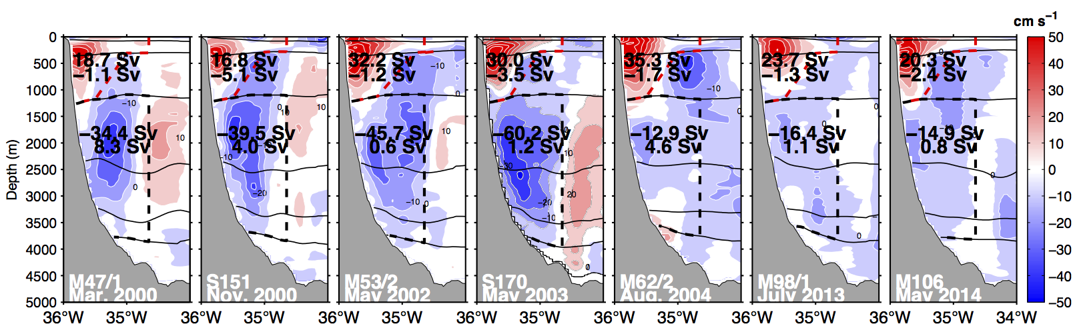
New observations at 11°S: velocities
2 research cruises:
M98 (July 2013)
M106 (May 2014)
redeployment of mooring array in 2013
Notes:
2 research cruises have been undertaken in 2013 and 2014 and the mooring array at 11°S has been redeployed. Some first results: Comparing the individual snapshots of the velocity field from all available ship sections again shows the high variability of the WBC system at 11°S, which is caused by the passgae of the deep eddies I mentioned above. Comparison of the new snapshots shows that the NBUC seems rather similiar in extent and strength, whereas in the layer of the DWBC the estimated transports are clearly at the lower end. Whether the transport in this layer is in general reduced nowadays has to be further investigated with the moored observations: As we recovered the first 10.5 months of the moored record in May 2014, a first glimpse at the transport variability from the new observational period is possible:

Slide 13
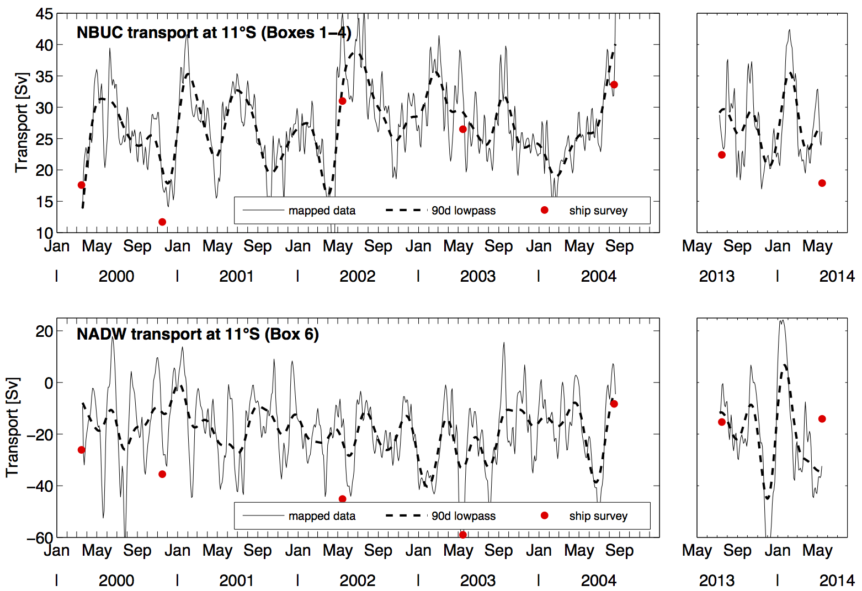
New observations at 11°S: velocities
2 research cruises:
M98 (July 2013)
M106 (May 2014)
redeployment of mooring array in 2013
Notes:
On the left hand side you see the transport time series I showed before, which were presented in Schott et al. 2005. The new 10.5 months are highlighted here on the left hand side. You see that the range and variability seems rather similar and the average values also did not change significantly neither in the NBUC nor in the DWBC layer. So in terms of average transports it seems that within both layers the system is rather stable and at least from this declared really short timeseries we can for now not conform the large variability of NBUC transport reported in Zhang et al. 2011. To further clarify, why the ship sections give the impression of reduced transport we looked at the velocity time series at NADW depth:

Slide 14
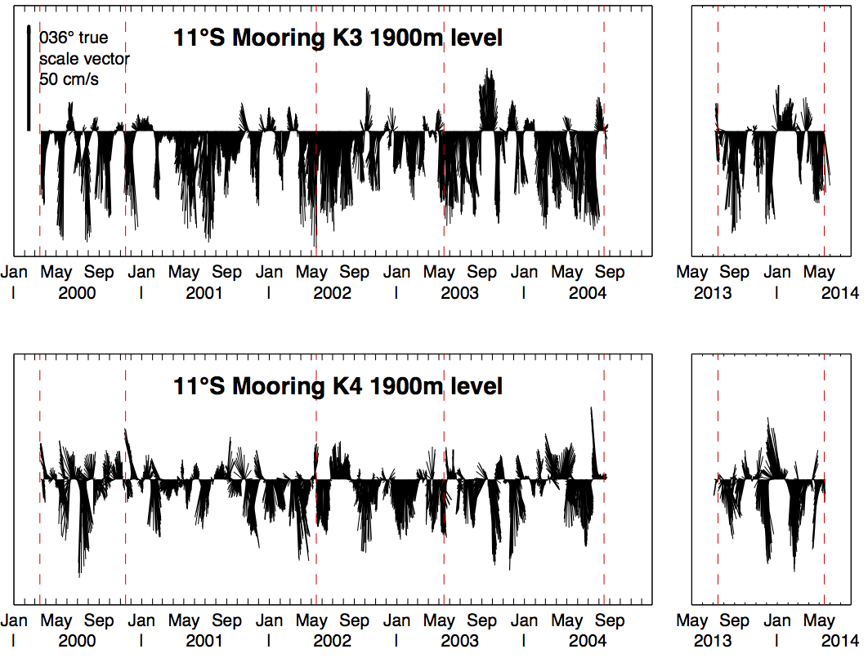
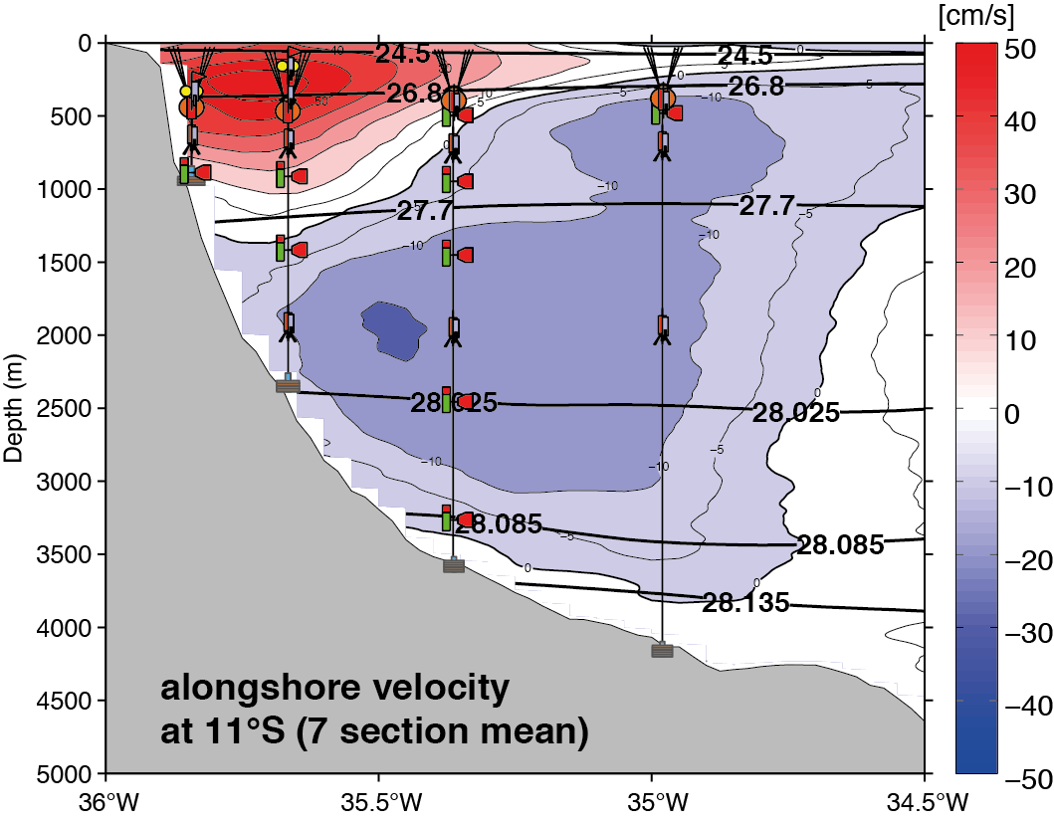
New observations at 11°S: velocities
2 research cruises:
M98 (July 2013)
M106 (May 2014)
redeployment of mooring array in 2013
K1
K2
K3
K4
Notes:
At the moorings K3 and K4, which are our offshore moorings. You can nicely see the passage of the deep eddies in this time series in the old as well as in the new observational period. You can also see that the ship sections were occupied during times with extremely low velocity values within this layer. However, the strength and frequency of these deep eddies still seem rather similar in both observational periods. Dengler et al. Speculated that if the DWBC north of 8°S should decrease e.g, due to a slow down of the AMOC, then the transport within the DWBC layer at 11°S should be accomplished by a laminar flow instead of by eddies. This has clearly not happened so far.

Slide 15
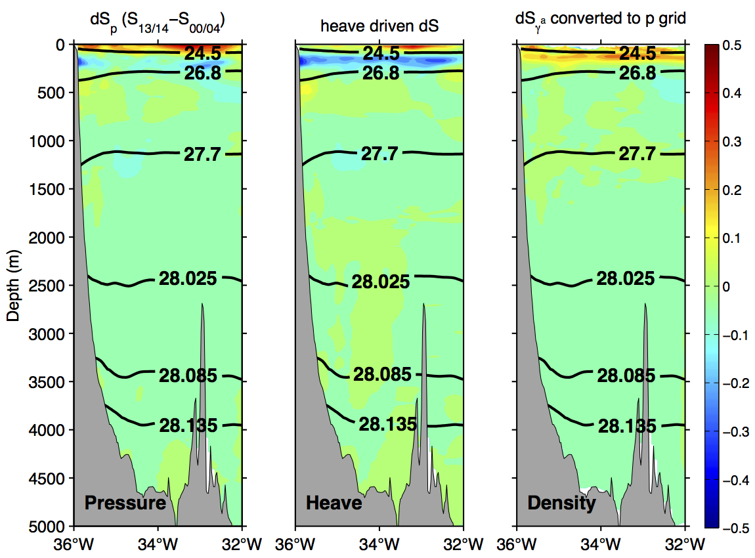
New observations at 11°S: hydrography
2 research cruises:
M98 (July 2013)
M106 (May 2014)
redeployment of mooring array in 2013
Biastoch et al., 2009:
trend: +0.028 psu / decade
(100-600m NBUC region)
Average salinity differences across section:
dS_{γ} (100-600m) = 0.024 / decade
dS_{γ} (1500-4000m) = -0.007 / decade
Notes:
In addition to this highly variable velocity field, we can also look at changes in hydrographic properties. We contrast the salinity field observed about a decade ago to the new observation. As salinity changes can have different sources such as changes in air-sea interactions in the formation region of water masses, global warming or changes in the circulation ? Kann man das so sagen? Differences in salinity between the two observationsl periods are displayed here in different ways trying to entangle some of the causes for these changes. On the left hand side we see the differences in salinity on pressure surfaces. This tells us that within the core NBUC region (100-600m) a freshening has occurred. This freshening on pressure surfaces is due to the combined effect of the heave of isopycnals, which is shown here in the middle panel and displays even stronger freshening than is observed in pressure surfaces, This is partly compensated by the salinity changes density surfaces, which are shown on the right, which refects actual changes in water mass properties. The freshening due to the heave of isopynal is masked by an increase of salinty on density surfaces. If we calculate the average salinity increase over the NBUC core depth over the entire section , we get a salinity increase of 0.024 psu / decade. Recalling the study of Biastoch, where they claim that the Agulhas leakage has increased and that this is mirrowed in the salinity trend over the last few decades, this estimates seems to be in the same range although they are estimated from different data sources. In the layers associated with the NADW between 1500-4000m a freshening is observed, which is nearly entirely due to changes on denity surfaces We will investigate these changes in hydrographic properties in more detail also using addtional data sources and then try to relate the changes to changes in the North Atlantic or the Agulhas region concerning signal propagation within the AMOC.

Slide 16
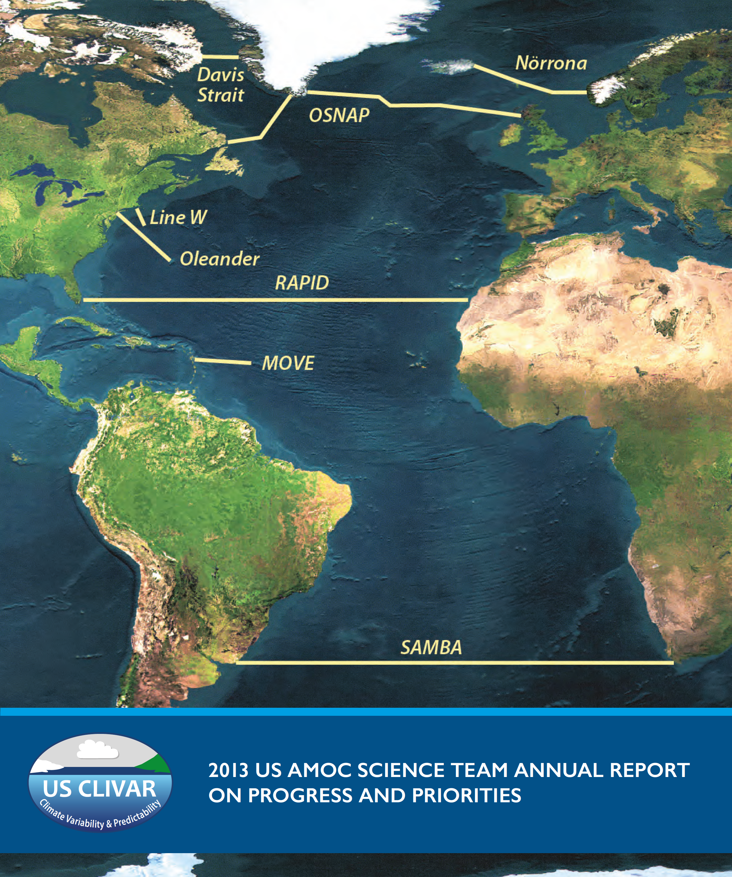
AMOC observations in the North Atlantic particularly including BMBF RACE measurements are well established.
The tropical array measurements will significantly contribute to the understanding of AMOC coherence and propagation of signals of northern and southern hemisphere origin.
Notes:
So far you have seen that the focus of the observational program within the next phase of BMBF RACE will be on the variability of the circulation system at the western boundary. But we will also try to contribute an estimate for the basin-wide SAMOC at 11°S by estimating the variability of the basin wide SAMOC from bottom pressure sensors, which were additionally deployed at the eastern and western continental slopes at that latitude at 300 and 500m depths. These Bottom pressure measurements also started in July 2013 and we will retrieve the first data set on the cruise in September 2015.

Slide 17
Further plans and aims
  2 research cruises: September 2015, March 2017
  mooring array at least until 2017
Notes:
In terms of real at sea actions, we are planning two .... and we will maintain the mooring array definately until 2017. The plan up to now is that we then probably hand over the maintenance of the array to the Brazilians and for this reason two brazilian technians will accompany the cruise in September 2015 for training purposes.
The aims with the extended data set in the framework of the project RACE is to ... 1), then we want to 2) this will be achieved by collaborating with other subprojects in RACE, which focus on the subpolar North Atlantic, then we want to analyze 3) as the EUC variability at 23°W is monitored since a long time at GEOMAR as well. Further we want to analyze 4) with the use of all available hydrographic data within this region including WODB, ARGO etc. and finally as our contribution to SAMOC we will investigate 5).

Slide 18
Further plans and aims
  2 research cruises: September 2015, March 2017
  mooring array at least until 2017
  estimate the northward transport of central and intermediate water within the NBUC as part of the AMOC and STC on inter-annual to decadal time scales
Notes:
As soon as we have more data available from our moored array, we will 1), then we want to 2) this will be achieved by collaborating with other subprojects in RACE, which focus on the subpolar North Atlantic, then weIn terms of real at sea actions, we are planning two .... and we will maintain? the mooring array definately until 2017. The plan up to now is that we then probably hand over the maintenance of the array to the Brazilians and two brazilian technians will be onboard in September 2015 for training purposes.
The aims with the extended data set in the framework of the project RACE is to ... 1), then we want to 2) this will be achieved by collaborating with other subprojects in RACE, which focus on the subpolar North Atlantic, then we want to analyze 3) as the EUC variability at 23°W is monitored since a long time at GEOMAR as well. Further we want to analyze 4) with the use of all available hydrographic data within this region including WODB, ARGO etc. and finally as our contribution to SAMOC we will investigate 5).

Slide 19
Further plans and aims
  2 research cruises: September 2015, March 2017
  mooring array at least until 2017
  estimate the northward transport of central and intermediate water within the NBUC as part of the AMOC and STC on inter-annual to decadal time scales
  analyze the connection between transport variations in the western boundary current system of the tropical South Atlantic (warm and cold water route) and the variability of the subpolar North Atlantic with respect to the signal propagation within the AMOC
Notes:
In terms of real at sea actions, we are planning two .... and we will maintain? the mooring array definately until 2017. The plan up to now is that we then probably hand over the maintenance of the array to the Brazilians and two brazilian technians will be onboard in September 2015 for training purposes.
The aims with the extended data set in the framework of the project RACE is to ... 1), then we want to 2) this will be achieved by collaborating with other subprojects in RACE, which focus on the subpolar North Atlantic, then we want to analyze 3) as the EUC variability at 23°W is monitored since a long time at GEOMAR as well. Further we want to analyze 4) with the use of all available hydrographic data within this region including WODB, ARGO etc. and finally as our contribution to SAMOC we will investigate 5).

Slide 20
Further plans and aims
  2 research cruises: September 2015, March 2017
  mooring array at least until 2017
  estimate the northward transport of central and intermediate water within the NBUC as part of the AMOC and STC on inter-annual to decadal time scales
  analyze the connection between transport variations in the western boundary current system of the tropical South Atlantic (warm and cold water route) and the variability of the subpolar North Atlantic with respect to the signal propagation within the AMOC
  analyze the connection between assessed NBUC variability at 11° S and EUC variability at 23°W on the equator and its relevance for climate variability
Notes:
In terms of real at sea actions, we are planning two .... and we will maintain? the mooring array definately until 2017. The plan up to now is that we then probably hand over the maintenance of the array to the Brazilians and two brazilian technians will be onboard in September 2015 for training purposes.
The aims with the extended data set in the framework of the project RACE is to ... 1), then we want to 2) this will be achieved by collaborating with other subprojects in RACE, which focus on the subpolar North Atlantic, then we want to analyze 3) as the EUC variability at 23°W is monitored since a long time at GEOMAR as well. Further we want to analyze 4) with the use of all available hydrographic data within this region including WODB, ARGO etc. and finally as our contribution to SAMOC we will investigate 5).

Slide 21
Further plans and aims
  2 research cruises: September 2015, March 2017
  mooring array at least until 2017
  estimate the northward transport of central and intermediate water within the NBUC as part of the AMOC and STC on inter-annual to decadal time scales
  analyze the connection between transport variations in the western boundary current system of the tropical South Atlantic (warm and cold water route) and the variability of the subpolar North Atlantic with respect to the signal propagation within the AMOC
  analyze the connection between assessed NBUC variability at 11° S and EUC variability at 23°W on the equator and its relevance for climate variability
  analyze the propagation of water mass anomalies in the AMOC, which can e.g. be caused by the variability in the Agulhas leakage
Notes:
In terms of real at sea actions, we are planning two .... and we will maintain? the mooring array definately until 2017. The plan up to now is that we then probably hand over the maintenance of the array to the Brazilians and two brazilian technians will be onboard in September 2015 for training purposes.
The aims with the extended data set in the framework of the project RACE is to ... 1), then we want to 2) this will be achieved by collaborating with other subprojects in RACE, which focus on the subpolar North Atlantic, then we want to analyze 3) as the EUC variability at 23°W is monitored since a long time at GEOMAR as well. Further we want to analyze 4) with the use of all available hydrographic data within this region including WODB, ARGO etc. and finally as our contribution to SAMOC we will investigate 5).

Slide 22
Further plans and aims
  2 research cruises: September 2015, March 2017
  mooring array at least until 2017
  estimate the northward transport of central and intermediate water within the NBUC as part of the AMOC and STC on inter-annual to decadal time scales
  analyze the connection between transport variations in the western boundary current system of the tropical South Atlantic (warm and cold water route) and the variability of the subpolar North Atlantic with respect to the signal propagation within the AMOC
  analyze the connection between assessed NBUC variability at 11° S and EUC variability at 23°W on the equator and its relevance for climate variability
  analyze the propagation of water mass anomalies in the AMOC, which can e.g. be caused by the variability in the Agulhas leakage
  investigate the variability of the basin-wide AMOC at 11°S
Notes:
In terms of real at sea actions, we are planning two .... and we will maintain? the mooring array definately until 2017. The plan up to now is that we then probably hand over the maintenance of the array to the Brazilians and two brazilian technians will be onboard in September 2015 for training purposes.
The aims with the extended data set in the framework of the project RACE is to ... 1), then we want to 2) this will be achieved by collaborating with other subprojects in RACE, which focus on the subpolar North Atlantic, then we want to analyze 3) as the EUC variability at 23°W is monitored since a long time at GEOMAR as well. Further we want to analyze 4) with the use of all available hydrographic data within this region including WODB, ARGO etc. and finally as our contribution to SAMOC we will investigate 5).

