Slide 1

Equatorial Kelvin waves and related oceanic variability in the Atlantic
Robert Kopte, Peter Brandt, Marcus Dengler
PREFACE General Assembly
Casablanca, Morocco
October 30, 2014

Slide 2

Equatorial and coastal upwelling regions
Atlantic Niño
Atlantic Niña
Lübbecke et al. 2010
Hormann & Brandt 2009
Richter et al. 2013
ATL3
Benguela Niño
ABA
Benguela Niña
Florenchie et al. 2004
Rouault et al. 2007
Interannual variability within the upwelling regions with impact on continental rainfall rates, local fisheries etc.
Remote vs. local forcing, i.e. wind stress variations in the western tropical Atlantic vs. local variations
  If remotely forced, are extreme events predictable?

Slide 3
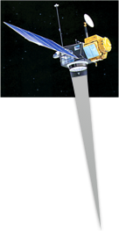
Equatorial Kelvin waves
e.g. Polo et al. 2008:
Analysis of AVISO SLA along equator and African coast
Continuous and recurrent eastward/poleward propagations detectable as far as 10-15°latitude
Satellite altimetry
Wind stress change
Wind stress
0
SLA
Thermocline
Depth
Equatorial mooring array
Thermocline slope anomaly
Is there related oceanic variability detectable in the mooring data?
Moorings
West
East

Slide 4
Moorings along equatorial wave track
Moored velocity observations
PIRATA temperature
Zonal + meridional velocity
EUC transport estimates (Brandt et al. 2014, Johns et al. 2014)
T(z), S(z)
Thermocline depth proxy (depth of 20°C-isotherm)
[°C]

Slide 5
Moorings along coastal wave track
During M98
(July 2013)
11°S
Mooring array
2 ADCP bottom shields, 1 ADCP mooring, 1 mooring equipped with T/S/O₂ sensors
Deployed during M98 (July 2013), scheduled for recovery and redeployment during PS88b (next month), but cancelled on short notice
Next chance for recovery during Meteor cruise in November 2015

Slide 6
Propagations as seen by AVISO
AVISO SLA [cm] – 25-90-day bandpassed – 1993-2013
AVISO SLA [cm] – 25-90-day bandpassed – Climatology
Continuous and recurrent eastward propagations, especially during autumn/winter season
Amplitude of intraseasonal climatology represents about 20% of seasonal cycle amplitude

Slide 7
Phase speed estimates…
…from band-passed SLA:
…from band-passed thermocline depth:
Correlation
From SLA: Phase speeds of 2.1-2.2 m/s → near 1st baroclinic KW mode
From thermocline depth/zonal velocity: Smaller phase speeds (1.2-1.8 m/s) → Influence of higher baroclinic modes?!

Slide 8
Wave activity November-March
SLA climatology [cm]
+
-

Slide 9
2005/06: Upper ocean variability
23°W
10°W
0°E
23°W
Coherent variability in the band-passed time series of SLA, SST, z20, and EUC transport
Strongest temperature variability in the thermocline depth range
Corresponding fluctuations of SST and subsurface temperature
10°W
Good agreement between SLA, SST, and z20, although SST appears to be slightly leading
0°E
No clear relation between SST and SLA/z20 → other processes dominant?!
Still reasonable agreement between SLA and z20

Slide 10
Summary
Analysis of eastward wave propagations along the equator is underway, using satellite SLA and mooring data (velocity, transport, thermocline depth, temperature)
  Reveals continuous and recurrent eastward propagations particularly during boreal autumn/winter, but also interannual variability
  For 2005/06 upper ocean variability shows high coherency with SLA at 23°W, decreasing coherency to the east where different/more processes might be of importance
Next steps
Find a more objective way to classify “strong”/”weak” years of wave activity (e.g. by complex EOF analysis)
Extend analysis of upper-ocean variability, study variability of the lower baroclinic modes using zonal velocity at 23°W
Investigate possible forcing mechanisms, e.g. wind forcing in the western tropical Atlantic vs. Rossby waves radiating from the barotropically unstable NECC
Compare observational results with model data: INALT01 (global 0.5° model with regional 0.1° nest [south Atlantic, western Indian Ocean], with CORE v2b forcing)

Slide 11
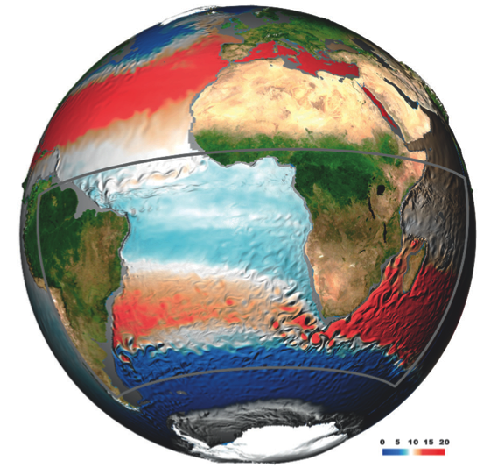
Some details on INALT01
Consists of base global model identical to ORCA05 (0.5° horizontal resolution) and regional nest (0.1° horizontal resolution), embedded within between 50°S-8°N, 70°W-70°E
ORCA setup
  Tripolar grid
  Arakawa-C arrangement
  z-coordinates (46 levels)
Atmospheric forcing: Prescribed using interannually varying CORE fields (version 2b, CORE v2b, Large and Yeager 2009)
Fig.: INALT01 configuration, tenth-degree nest is illustrated by gray box, (Colors: 5-day snapshot centered on 17. Jun 2006 of mid-depth (250-400m) temperature.)
Durgadoo et al. 2013

