Slide 1
From Data to Best Available Knowledge New Developments in FishBase
Rainer Froese, GEOMAR, rfroese@geomar.de
12th FishBase Symposium
Big Old Data and Shiny New Insights: Using FishBase for Research
Beaty Museum of Biodiversity, UBC, Vancouver, 09.09.2014

Slide 2
Overview
Data in FishBase as of August 2014
From Data to Insights
Example of Qualifying, Summarizing and Spreading Existing Knowledge
The Most Important Number
Ongoing Research Towards that Number
Discussion

Slide 3
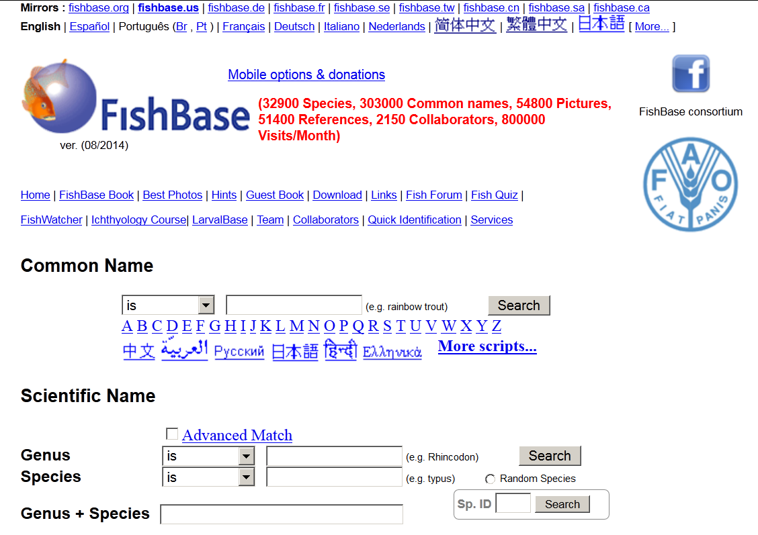

Slide 4
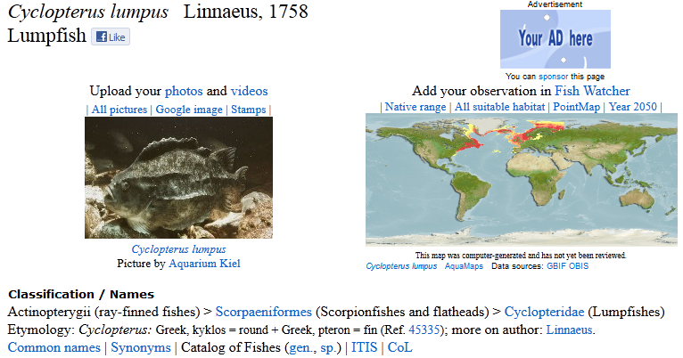
Data in FishBase

Slide 5
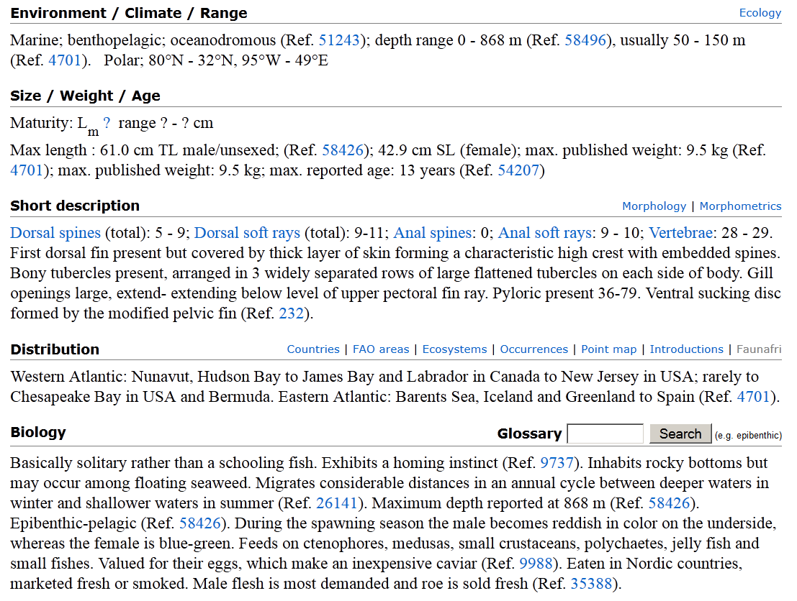

Slide 6
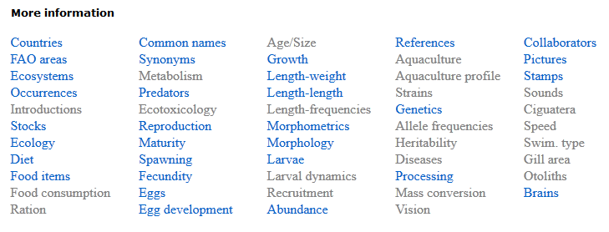
Available Data

Slide 7
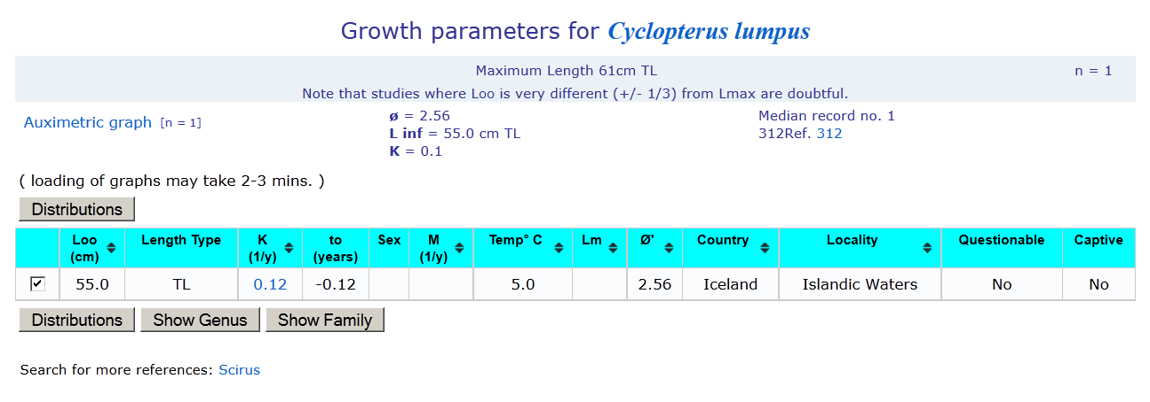
Available Data for Growth

Slide 8
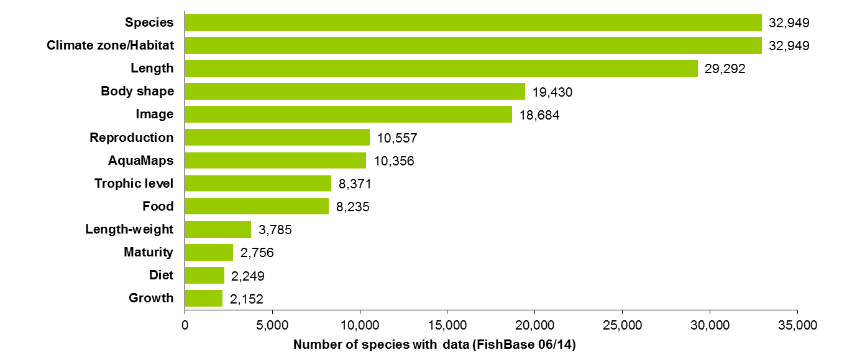
Data in FishBase

Slide 9
From Data to Insights
FishBase has compiled thousands of studies on growth, maturity, reproduction, diet, etc
How can the information be summarized?
How good is a single study?
How can new studies be informed?
How can best estimates for species without studies be derived?

Slide 10
From Data to Insights
Assemble all relevant facts, with probability distributions
Establish their correlations, with probability distributions
Select suitable models to explain data and predict key parameters
Let the computer test all possible combinations and select those with highest overall probability

Slide 11
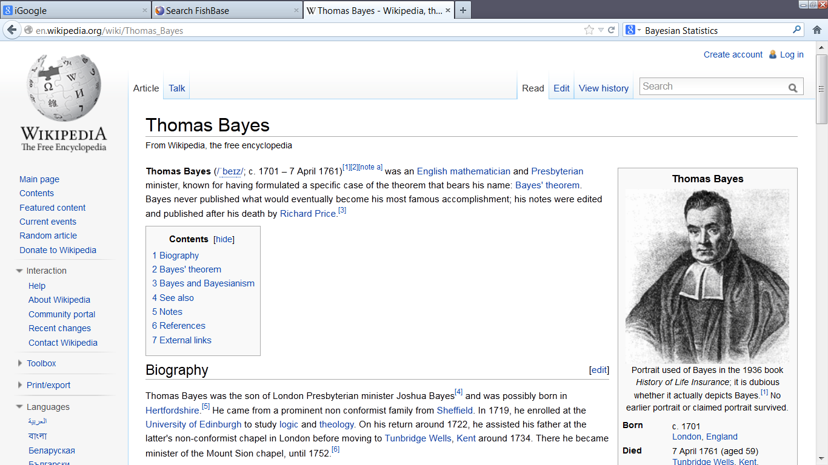

Slide 12
Bayesian Inference in a Nutshell
Prior: express existing knowledge (textbook, common sense, logic, best guess, previous studies) with a central value (such as a mean) and a distribution around it (such as a normal distribution and a standard deviation).
Likelihood function: analyze new data, get the mean and distribution
Posterior: Combine prior and likelihood into a new, intermediate mean and distribution

Slide 13
Accumulation of LWR and species with LWR
3,600 species have LWR; 28,400 do not
284 families do not have a single LWR
Search for refs showed this as a knowledge gap

Slide 14
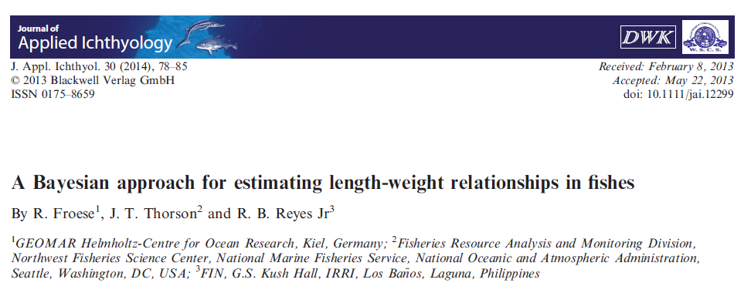
Length Weight Relationships

Slide 15
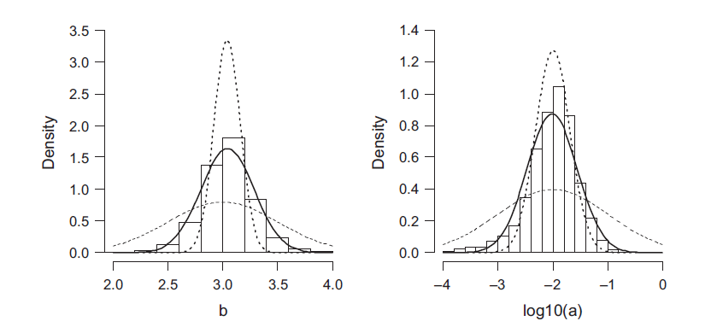
LWR Across All Studies
Weighted distribution of parameters b and log10(a) in 5150 studies for 1821 species.
___ from mean and standard deviation of the data
___ from overall priors derived from the literature
___ predictive posterior distribution

Slide 16
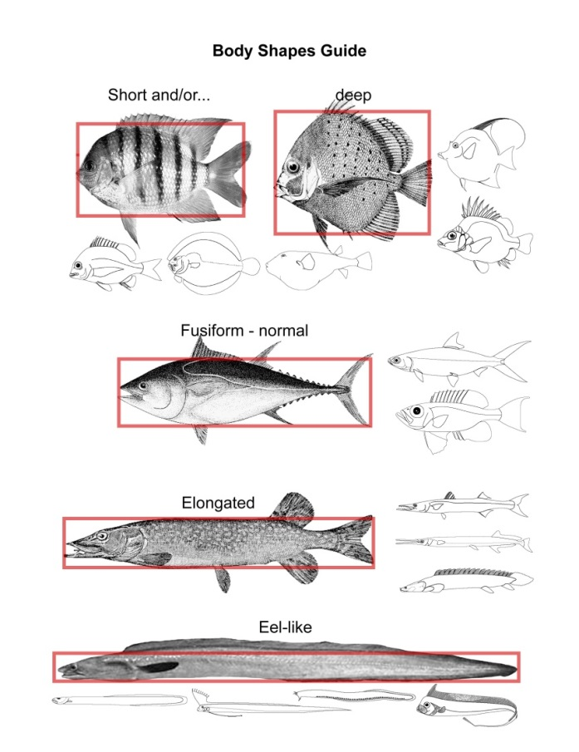
Body shape priors
- Eel-like (1,700 species)
- Elongated (7,300 species)
- Fusiform (7,100 species)
- Short and /or deep (2,600 species)
- Other (700 species; e.g., seahorses)

Slide 17
LWR Priors
Weighted means and standard deviations of parameters a and b from 5150 studies for 1821 species of fishes, by body shape. Geom. mean = geometric mean and 95% range includes about 95% of observations.

Slide 18
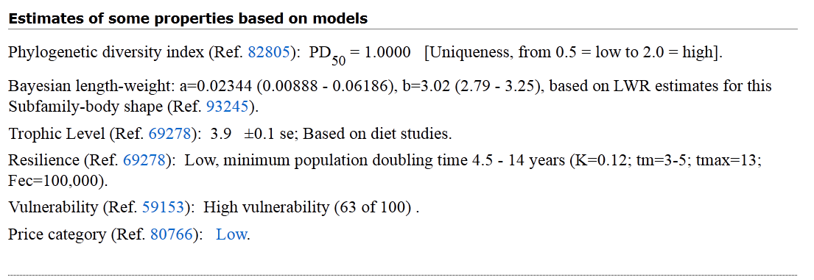
LWR for all species Example: Cyclopterus lumpus

Slide 19
Self-Learning Database
When Daniel and Rainer first discussed about FishBase, they envisioned an artificial intelligence system
Some years (decades) later, we are getting there:
the addition of LWRs for 16 species improved LWR quality for over 400 species

Slide 20
The Most Important Number
r_{max}
maximum intrinsic rate of population increase
Determines:
- productivity (F_{msy})
- population recovery time
- resilience
- vulnerability

Slide 21
The Most Important Number
Estimating viable r-k pairs
from catch and resilience

Slide 22
The Most Important Number
r_{max}
is highly correlated with
age at maturity / generation time
body size
natural mortality
somatic growth rate
metabolism/temperature
life style / activity

Slide 23
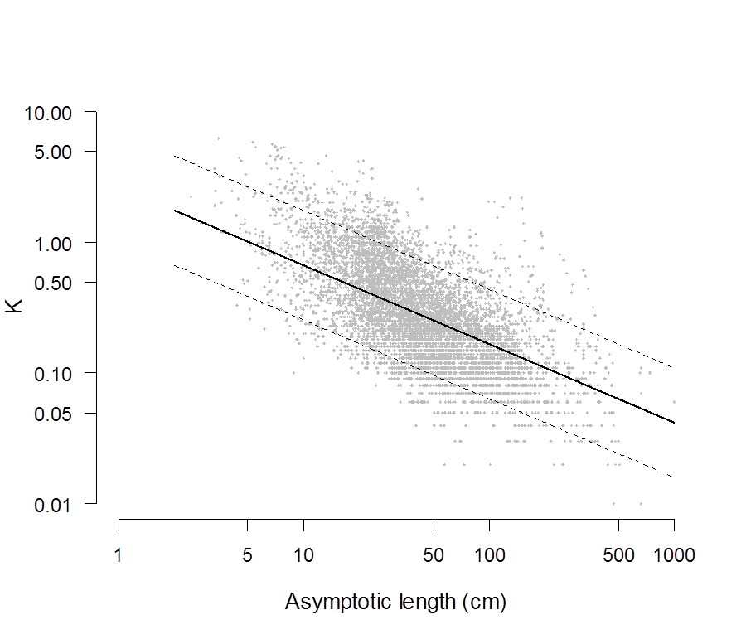
Ongoing Research
Growth parameter K plotted over asymptotic length, based on 7,275 growth studies for
1,863 species, with the bold line representing the mean for demersal subtropical species
and with dashed lines indicating the 95% high density interval. Note that these lines would shift
upward for tropical species and downward for temperate and cold species, with the same slope.

Slide 24
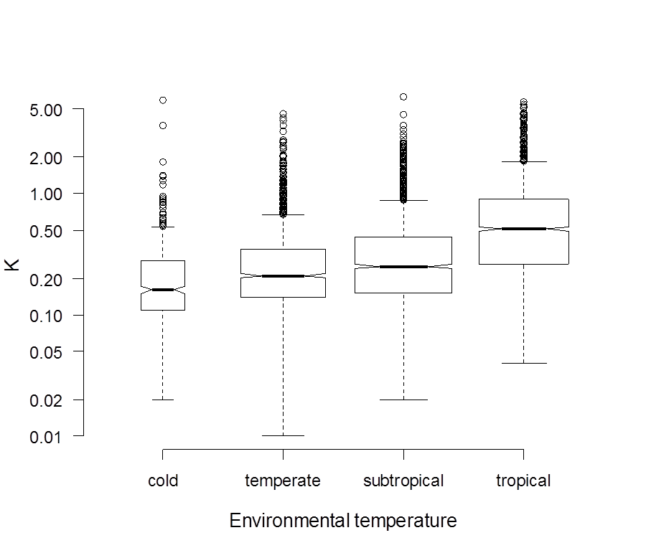
Ongoing Research
Box plots of growth parameter K for different environmental temperatures, based on
7,275 growth studies for 1,863 species. The width of the boxes is proportional to the square
root of the number of observations.

Slide 25
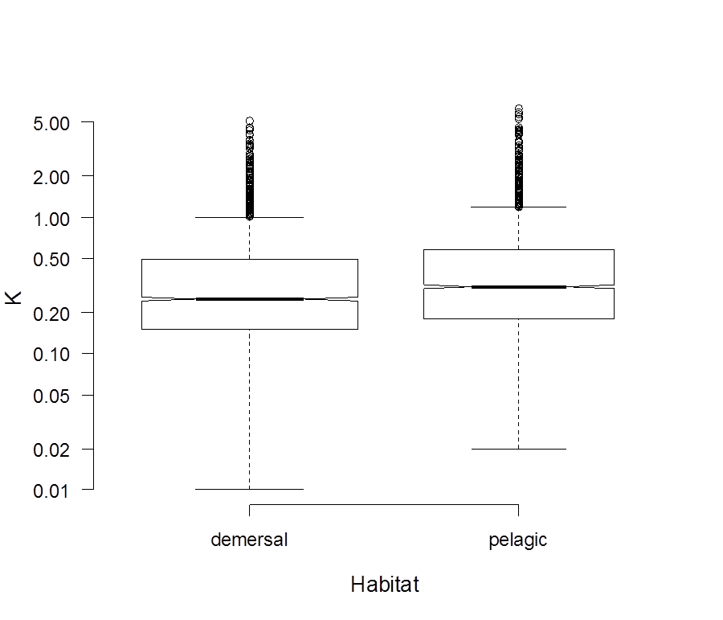
Ongoing Research
Box plots of growth parameter K for different habitat uses, based on 7,275 growth
studies for 1,863 species. The width of the boxes is proportional to the square root of
the number of observations.

Slide 26
Ongoing Research for all Species
Phylogeny: Genus, Subfamily, Family √
Length-Weight: a, b √
Climate / Habitat: √
Growth: K, Linf, Winf
Longevity: t_{max}
Natural mortality: M
Maturity: Lm, tm
Production: r, k
Resilience / Productivity: r_{max}

Slide 27
Resilience for all species, to be replaced by rmax with confidence limits

Slide 28
Thank You Questions?

