Slide 1
International Summer School in Parallel Patterns 2014
Christian Wulf – 11.06.2014
Software Engineering Group
by Prof. Dr. Wilhelm Hasselbring
Kiel University, Germany

Slide 2
Current Research Activities
Pattern-Based Detection and Utilization of Potential Parallelism in Software Systems
TeeTime: A generic, concurrency-aware Pipes & Filters framework for Java

Slide 3
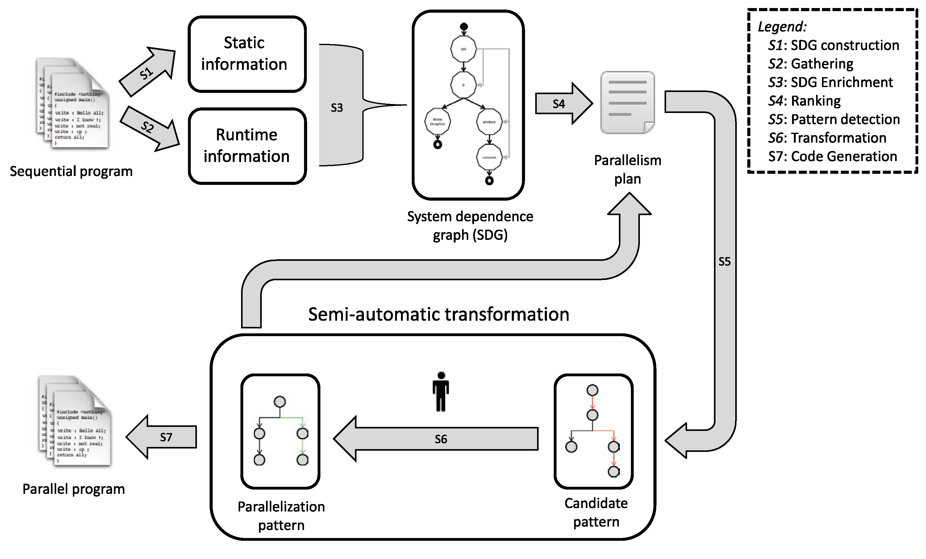
Overview of our Approach
Notes:
roughly:
information collection
data structure construction
detection and transformation

Slide 4
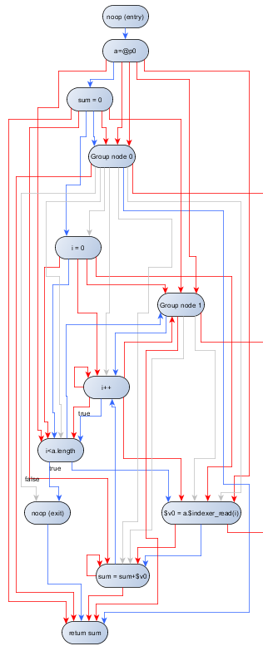
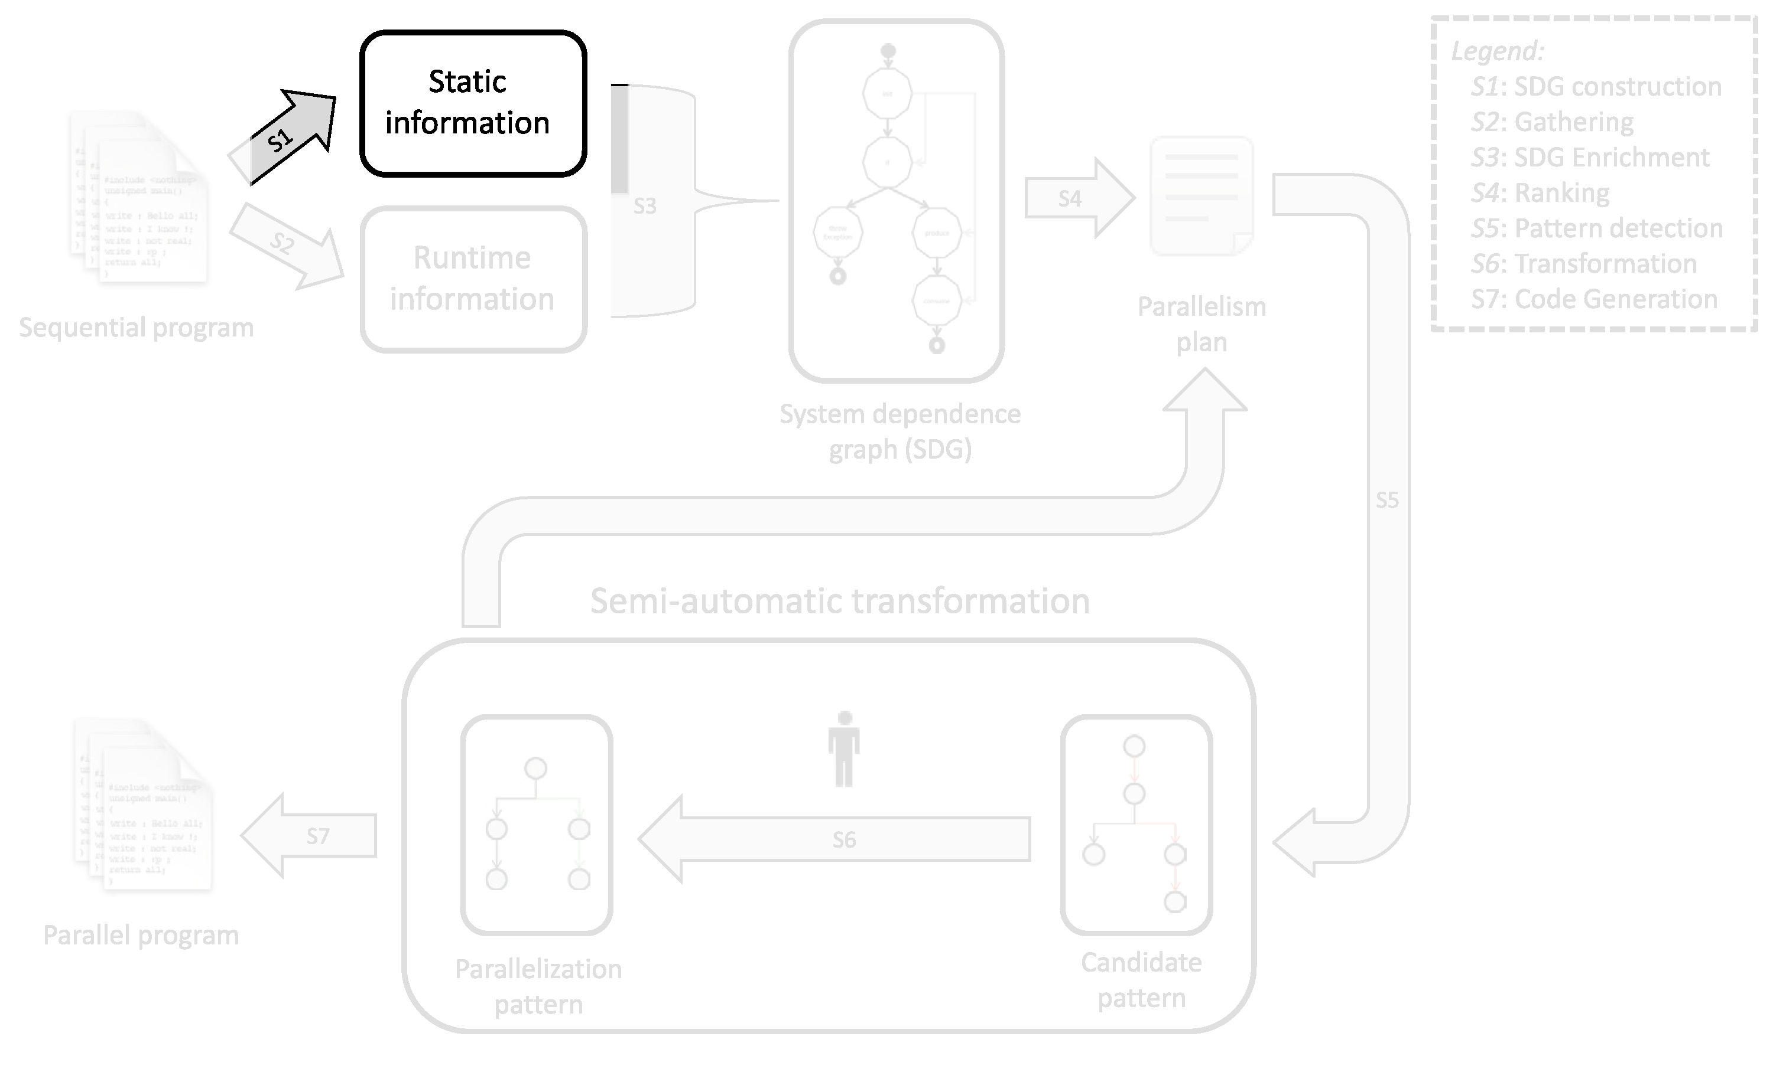
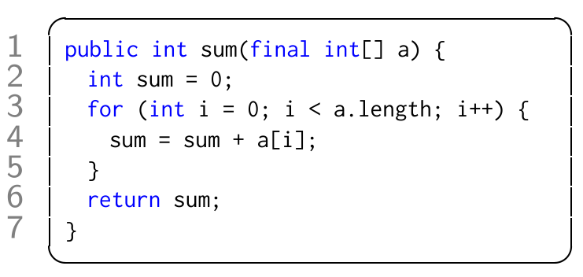
S1: SDG Construction
e.g., with Soot or Wala
control flow
dependencies
data flow
hierarchy

Slide 5
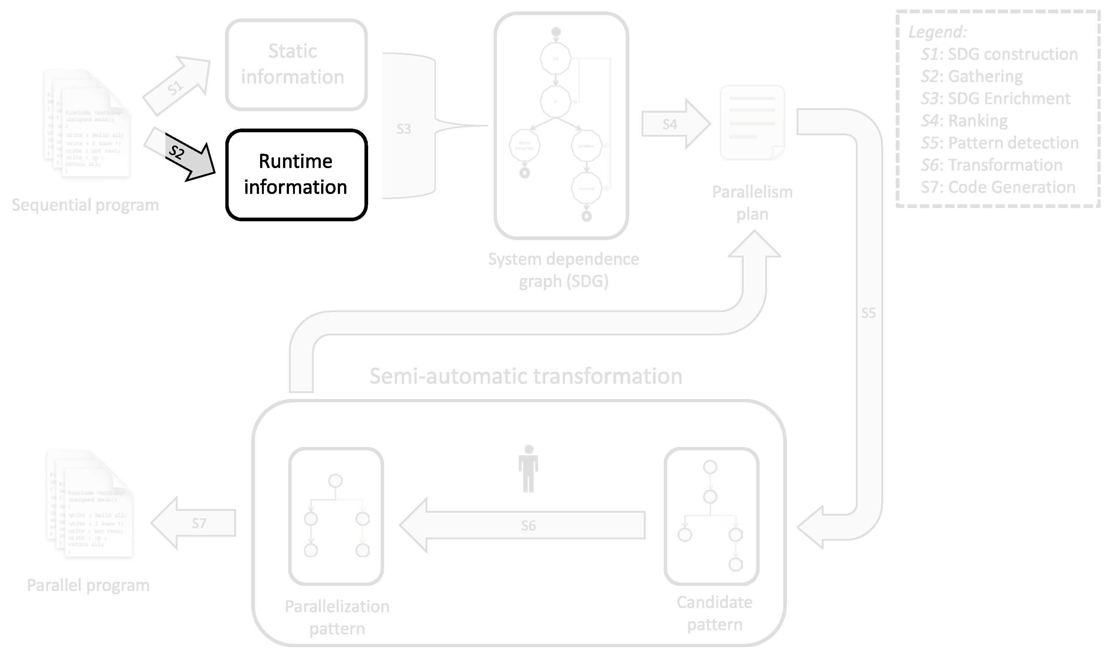
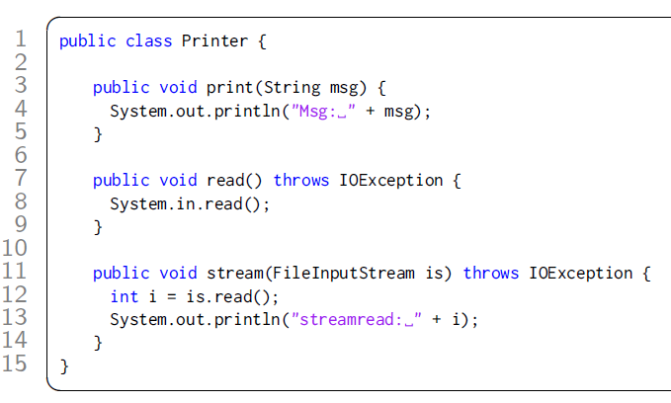
S2: Runtime Information Gathering
e.g., with
Instrumentation
Profiling/Monitoring
number of method invocations
method execution time
number of loop iterations
I/O accesses
accessed array positions

Slide 6
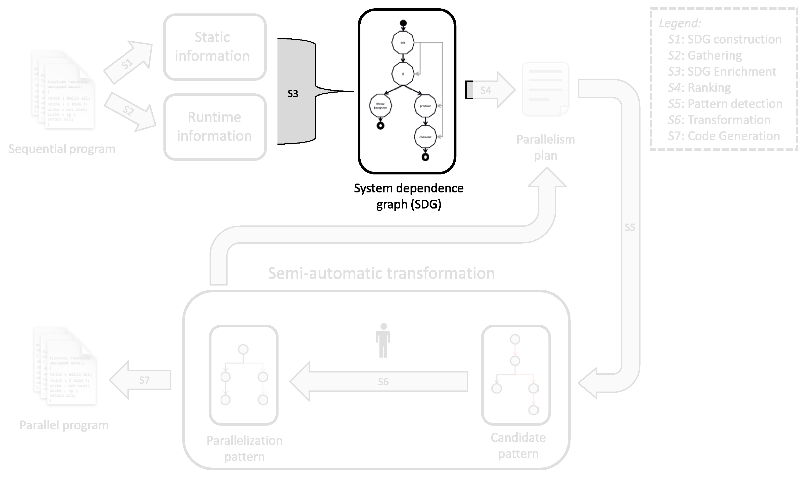
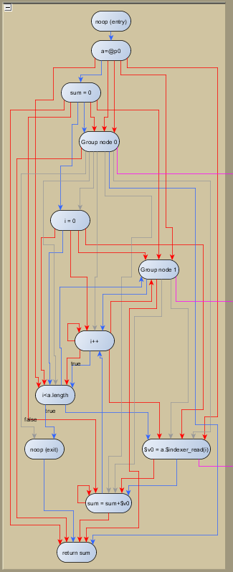
S3: SDG Enrichment
type: method invocation
name: file.updateContents(text)
variable: writtenBytes
type: method invocation
name: file.updateContents(text)
variable: writtenBytes
invocations: 10
exec. time: avg: 300ms, mean: 290ms,
min: 250ms, max: 600ms
filenames: (“C:/../Person.java”,
“C:/../Address.java”,
“C:/../Cridentials.java”, …)
Graph transformation
Notes:
highlight parallelization potential in I/O accesses
mention time threshold for loop

Slide 7
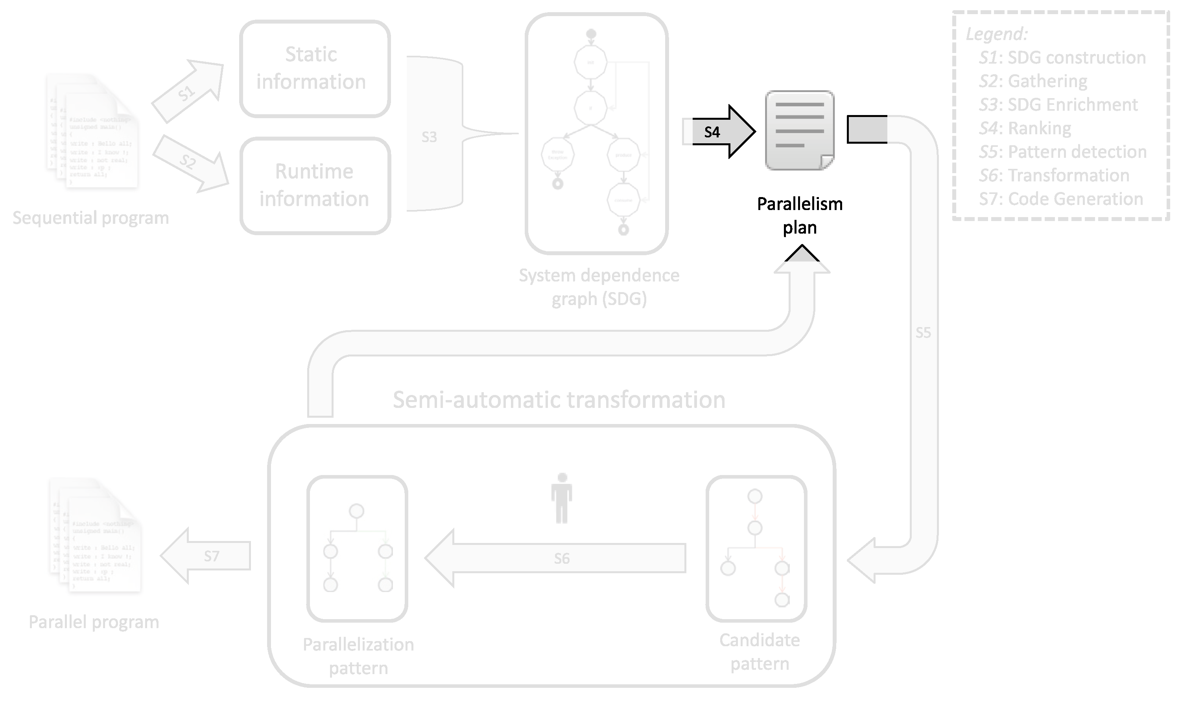
S4: Ranking

Slide 8
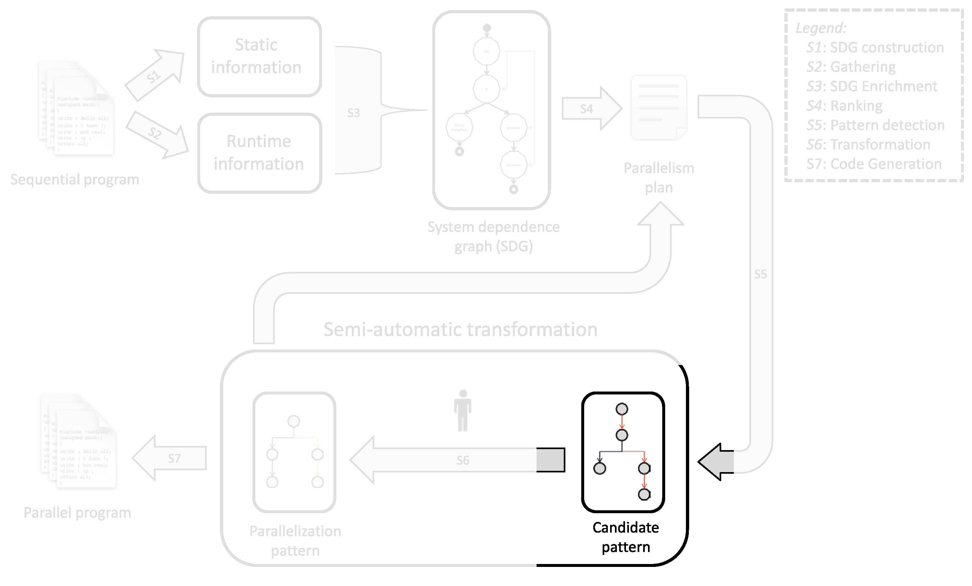
S5: Pattern Detection

Slide 9
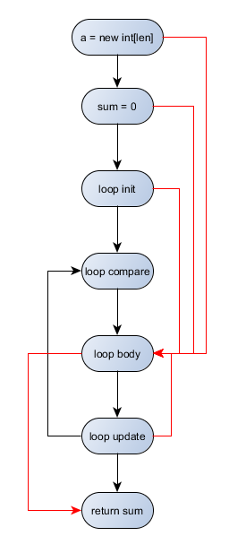
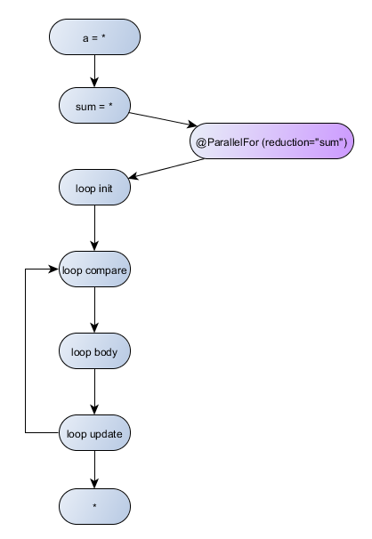
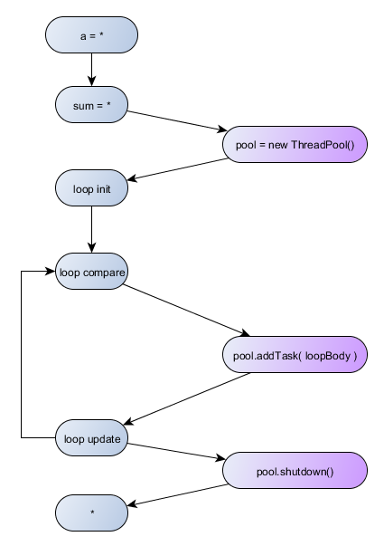
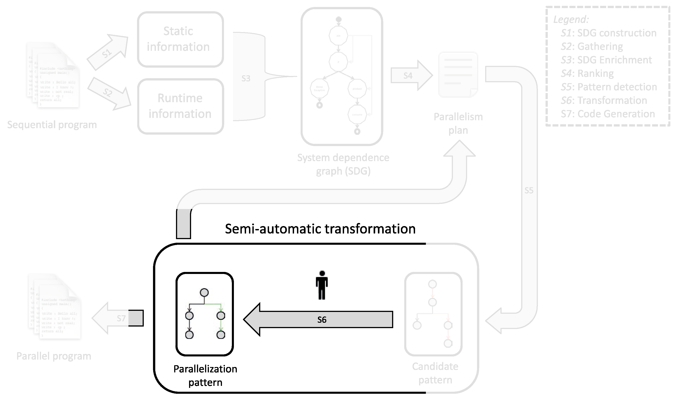
S6: Transformation
graph refactoring
introduction of concurrency
introduction of synchronization
final approval by the user
graph transformation
matched instance of a
candidate pattern
corresponding instance of a
parallelization pattern
Notes:
S7: Code Generation or next item from the parallelization plan

Slide 10
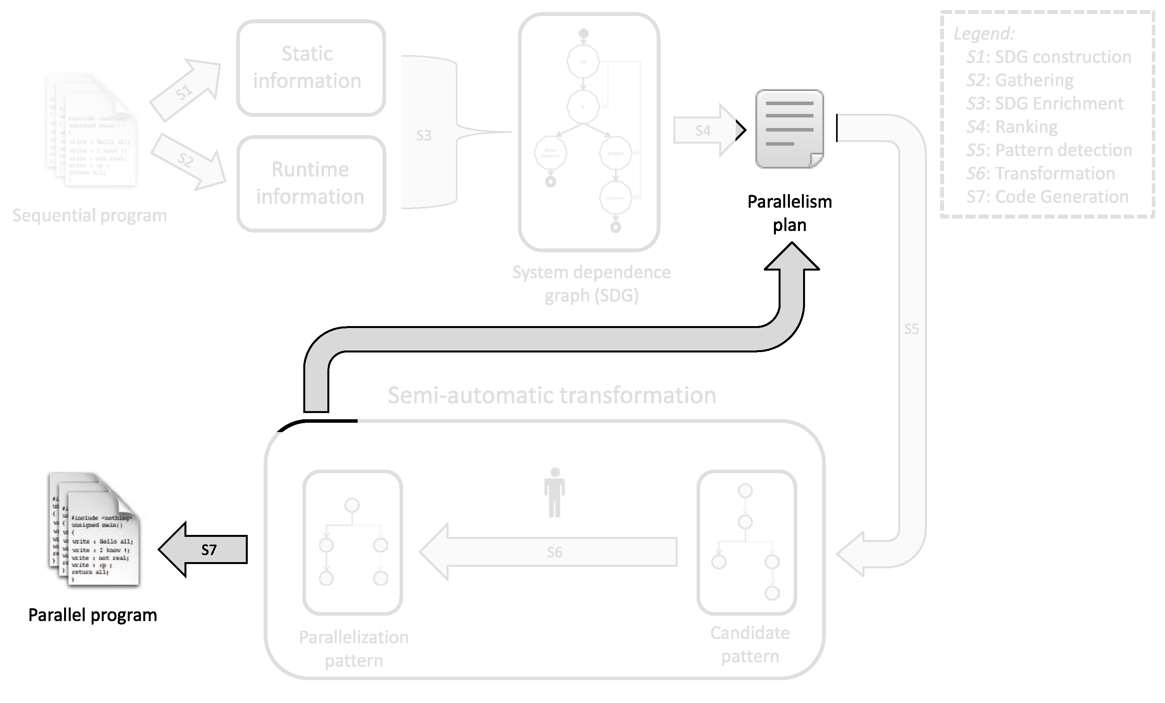
S7 or S4

Slide 11
TeeTime
An example Pipes-and-Filters pipeline
Read
Process
Write
filter or stage
pipe

Slide 12
TeeTime
An example Tee-and-Join pipeline
port
Read
Process
Process
Write
Write
Process
loop

Slide 13
TeeTime
SPSC pipe
between different threads
Lock-free work stealing pipe
within same thread
Read
Process
Process
Write
High abstraction of concurrency
High efficiency
Transparent thread creation and management
Type-safe connection of ports
Development in beta phase
Write
Process
Thread boundary
Notes:
What about pipelines without if-stages?

Slide 14
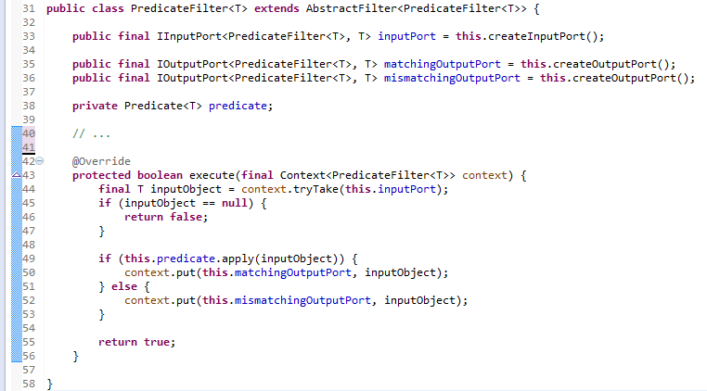
Example Filter in TeeTime

