Slide 1
Physical and biogeochemical observations during recent cruises in the tropical Atlantic
Peter Brandt

Slide 2
Physical and Biogeochemical Observations in the Tropical Atlantic
With contributions from:
Johannes Hahn¹, Tim Fischer¹, Marcus Dengler¹, Gerd Krahmann¹, Sunke Schmidtko¹, Robert Kopte¹, Florian Schütte¹, Rainer Kiko¹, Helena Hauss¹
¹GEOMAR Helmholtz-Zentrum für Ozeanforschung Kiel, Germany

Slide 3
Projects, Questions, Topics
Kiel Collaborative Research Centre SFB 754
  Mean and long-term variability of oxygen distribution and circulation
  Spatial and temporal variability of oxygen variance and eddy mixing
  Ventilation of equatorial oxygen maximum
  Zooplankton, particle fluxes and role in oxygen consumption
  Distribution of nitrogen fixation by trichodesmium
BMBF joint project NORDATLANTIK/RACE
  Equatorial circulation and role in Tropical Atlantic Variability
BMBF joint project SOPRAN
  Multidisciplinary CVOO mooring near Cape Verde (north of Sao Vicente) since 2006
German/French/West African project AWA
  Multidisciplinary study of mesoscale eddies and their role in the lateral exchange in the coastal upwelling region of NW Africa
Notes:
AWA: Ecosystem Approach to the management of fisheries and the marine environment in West African waters

Slide 4
Work Program
4 mooring recoveries, 6 deployments
115 CTD stations with water bottle sampling for O₂, nutrients, chlorophyll, salinity, POC/PON/POP, LADCP, UVP, TAPS
Zooplankton net (19 daytime and 20 night-time stations)
111 microstructure profiles
Deployments and recoveries of 3 gliders (1 glider with microstructure
probe)
Underway measurements of currents 75kHz/38kHz ADCPs, S,T, pCO₂, O₂, total gas pressure

Slide 5
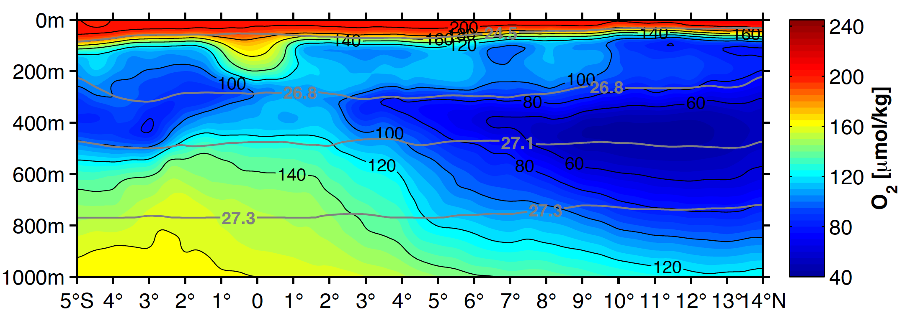
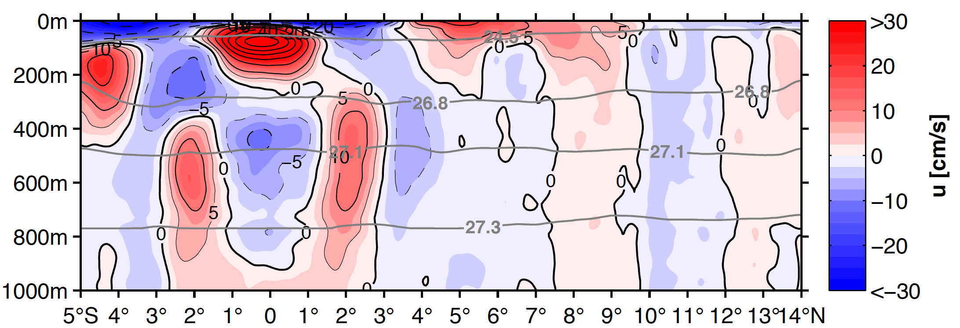
Mean 23°W Section
Equatorial oxygen maximum
Deep oxycline at about 300m or σ_{θ}=26.8 kg/m³
OMZ is ventilated from the west by zonal currents

Slide 6
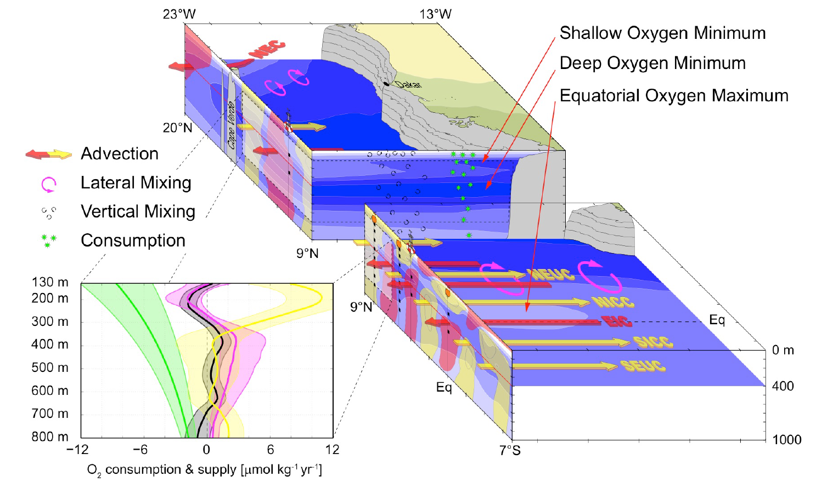
Schematic of
Oxygen Minimum Zone

Slide 7
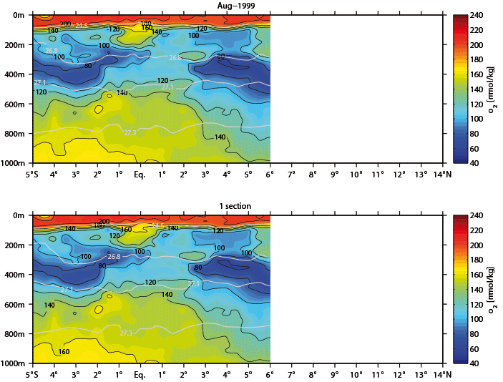
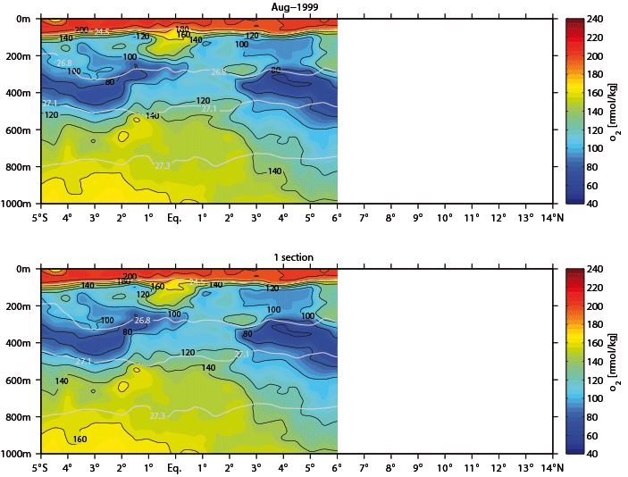

Slide 8
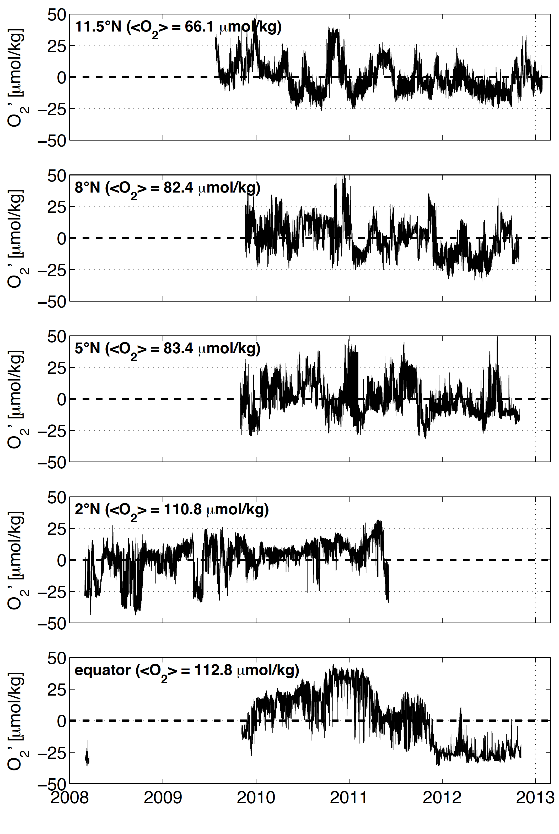
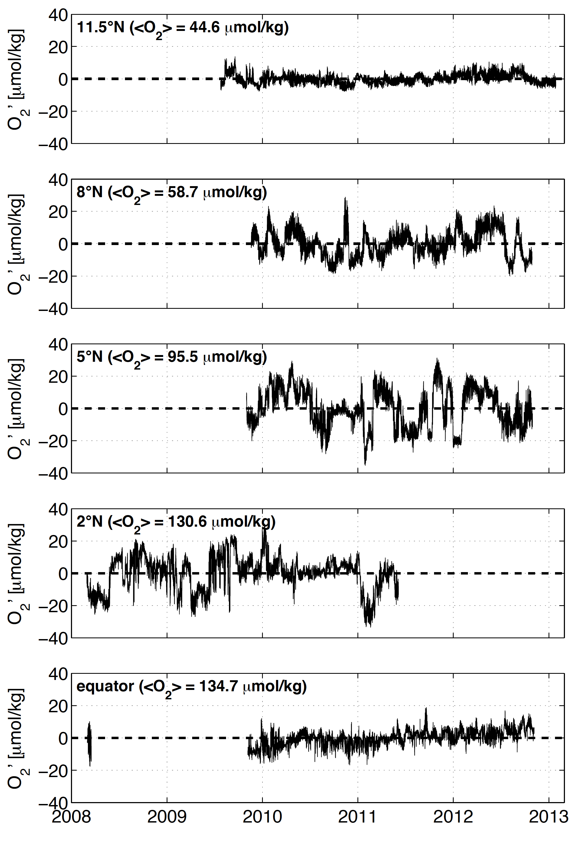
Multi-Year O₂ Time Series along 23°W
300 m
500 m
Brandt et al.,
BGS, 2015

Slide 9
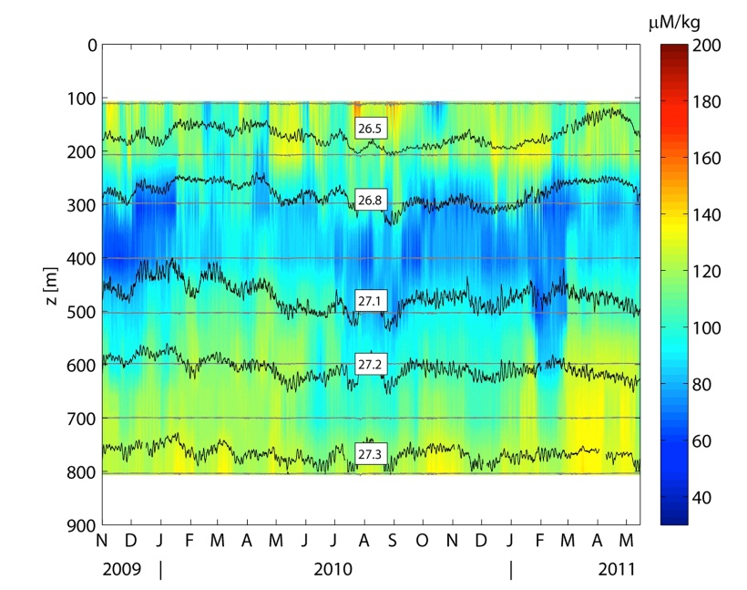
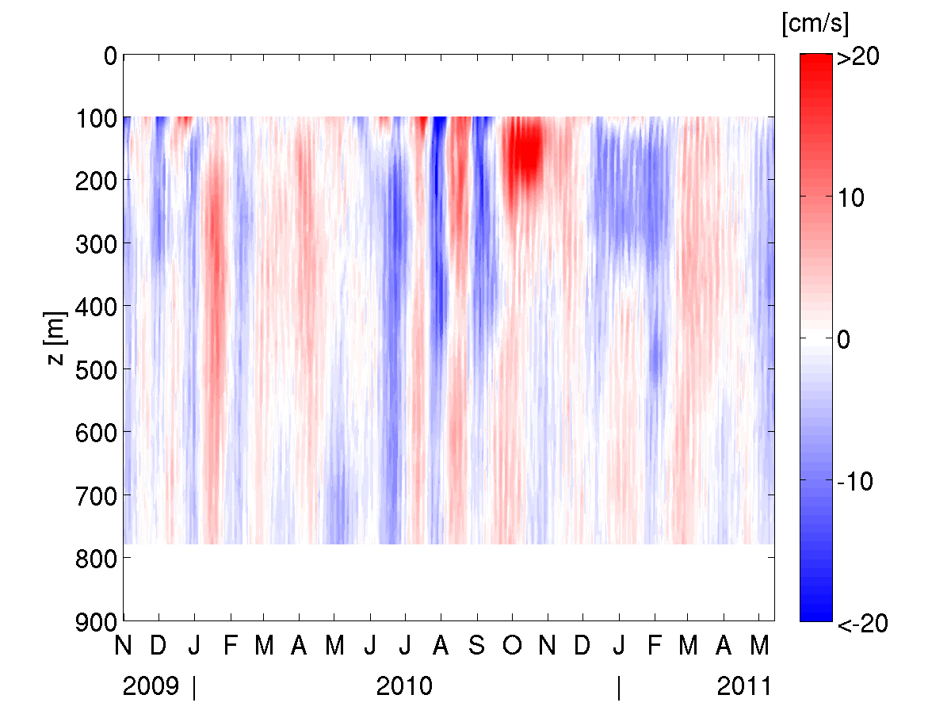
Meridional Eddy Fluxes
Ventilation Processes
Two Methods
Eddy correlation method applied to moored observations of oxygen and meridional velocity (here at 5°N, 23°W)
Flux gradient parameterization based on repeat ship sections
Hahn et al. 2014

Slide 10
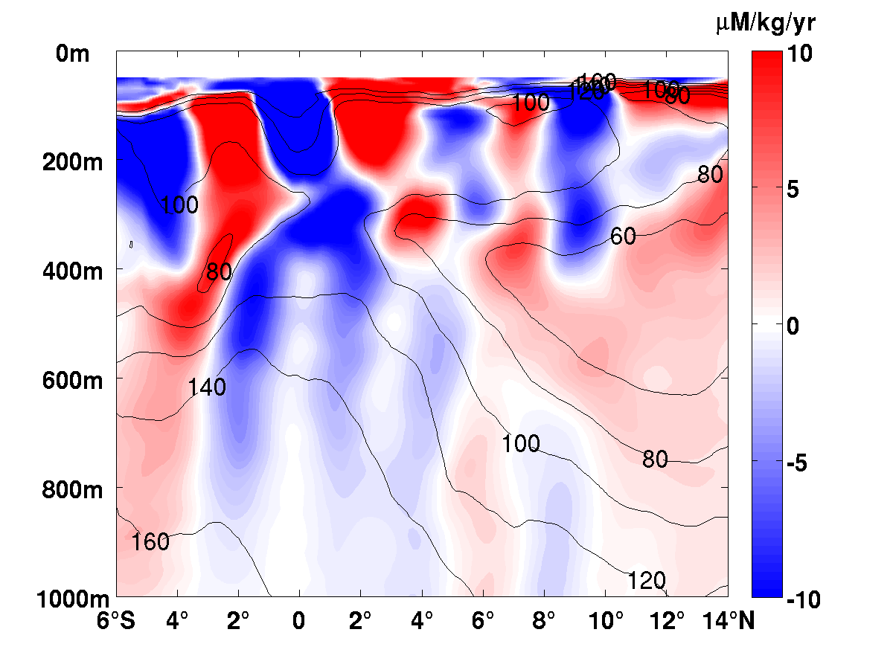
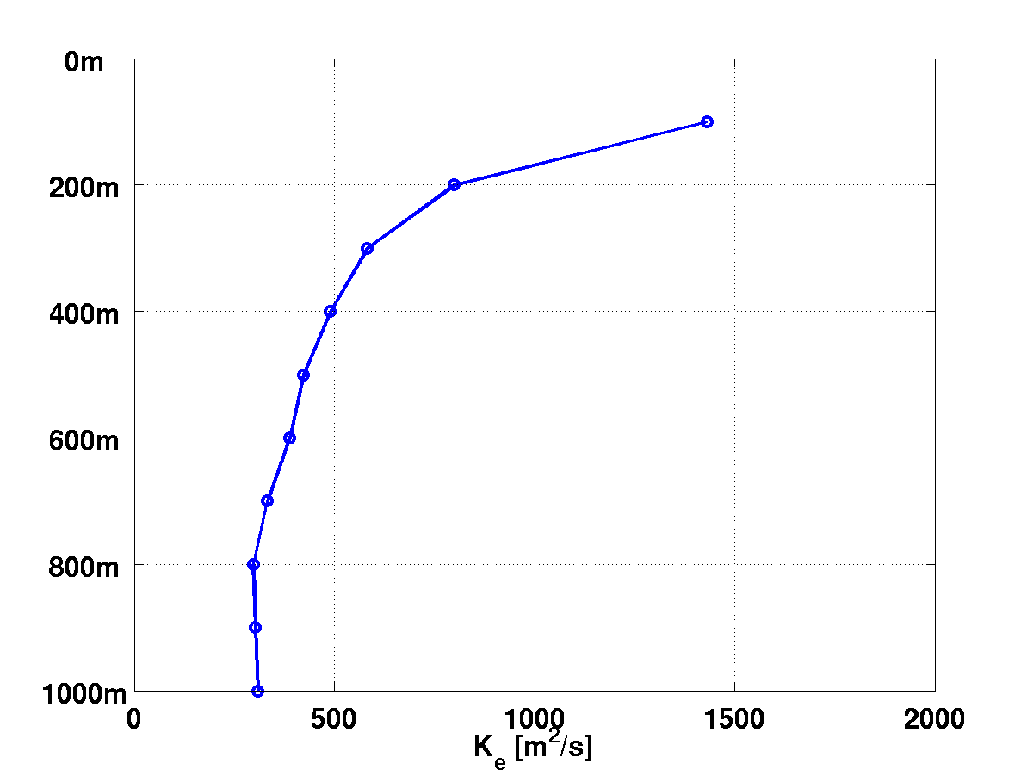
Eddy Flux Divergence
Ventilation Processes
Oxygen supply due to meridional eddy flux
Upper 300-400m dominated by zonal jets
Meridional eddy diffusivity
Hahn et al. 2014
Notes:
In the jet like structures of the upper ocean, eddy diffusivity distributes oxygen: high-oxygen cores of eastward currents looses oxygen, while low-oxygen cores of westward currents gains oxygen.

Slide 11
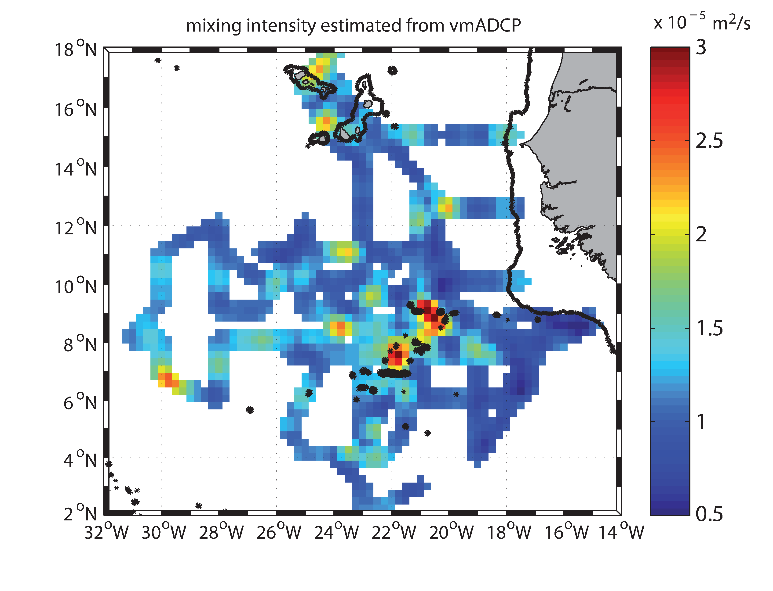
Enhanced mixing in the vicinity of Sierra Leone Rise
Diapycnal diffusivity derived from ADCP estimated shear levels.
Diffusivity K estimated from vmADCP
Tim Fischer,
PhD thesis
Glider track 2014
2000 m contour

Slide 12
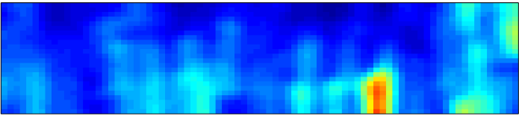
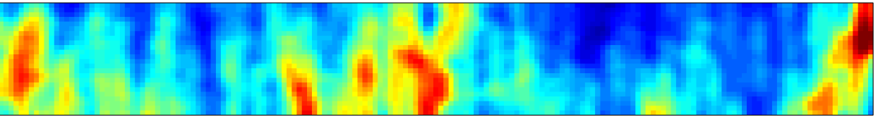

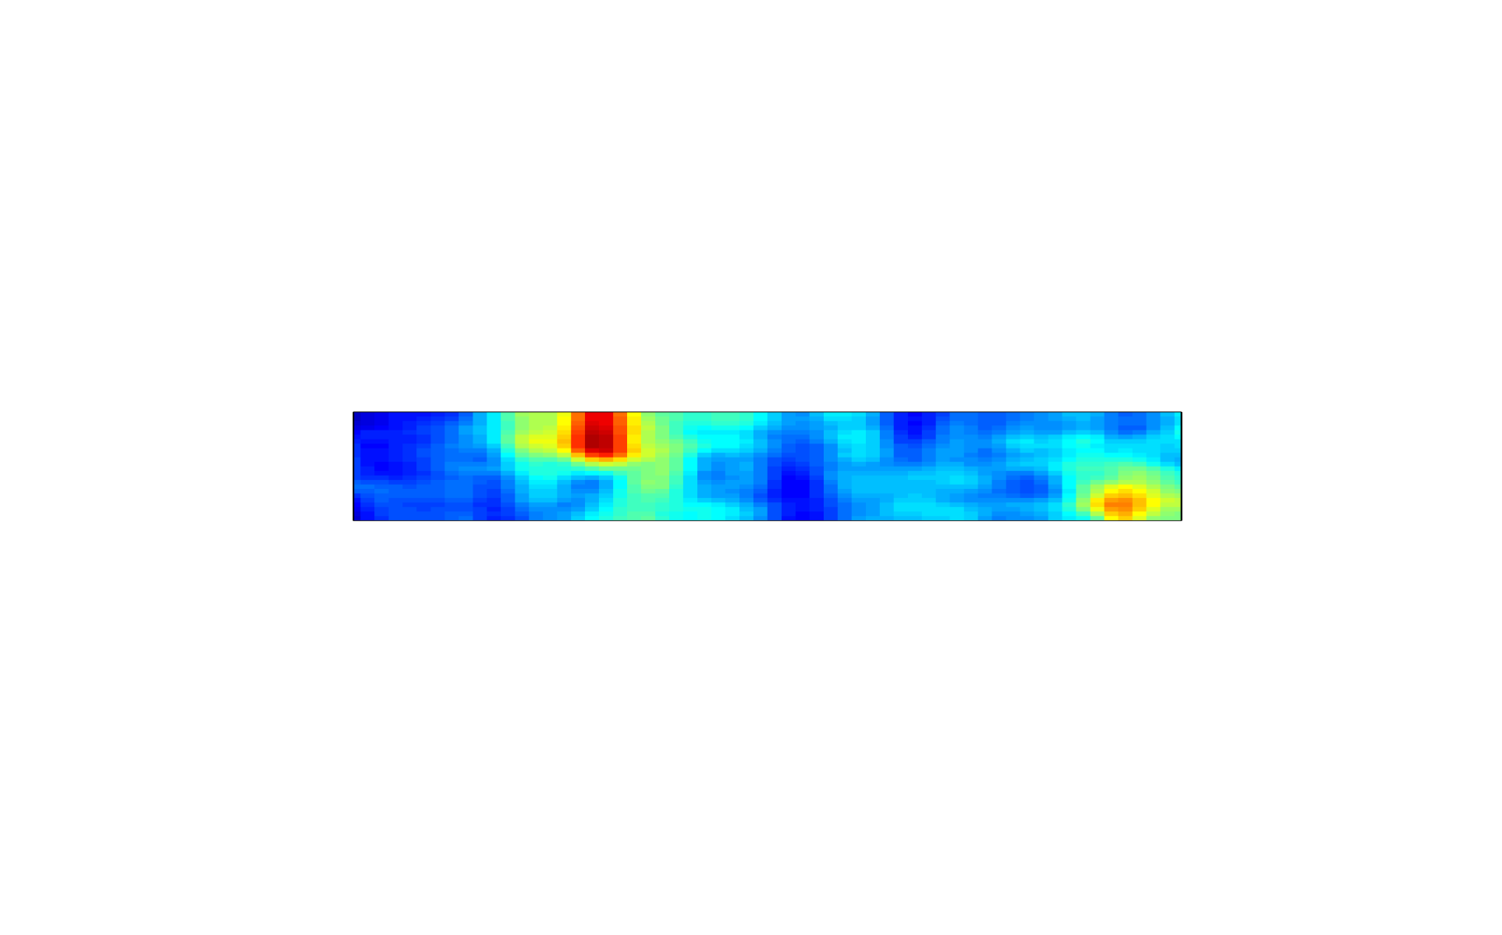
Internal Wave Intensity at Sierra Leone Rise
300 m
10.5°N 21.5°W
500 m
700 m
Strain rate spectral
level from Glider
density field
9.2°N 21.3°W
7°N 23°W
Strain rate power spectral density
in cpm⁻¹
6°N 23°W
Tim Fischer

Slide 13
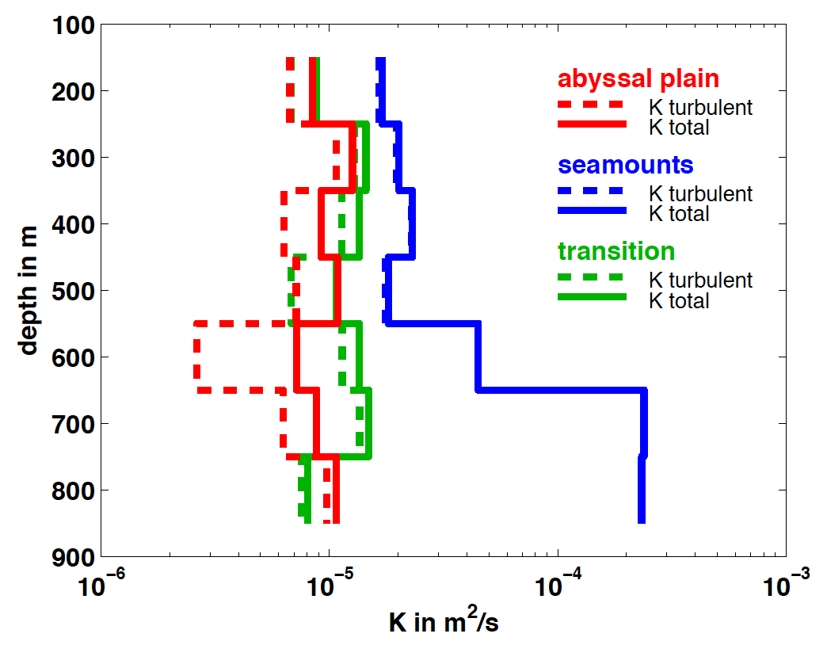
Shipboard Microstructure Measurements
Diapycnal eddy diffusivity from MSS (dashed lines) and by accounting for the effect of double diffusion (solid lines)

Slide 14
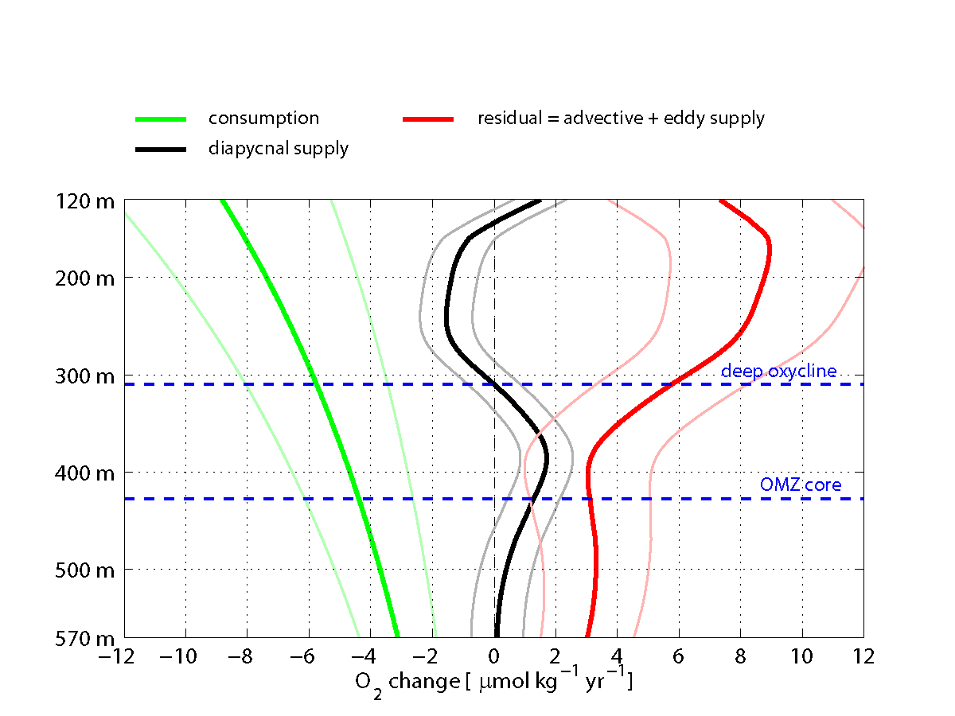
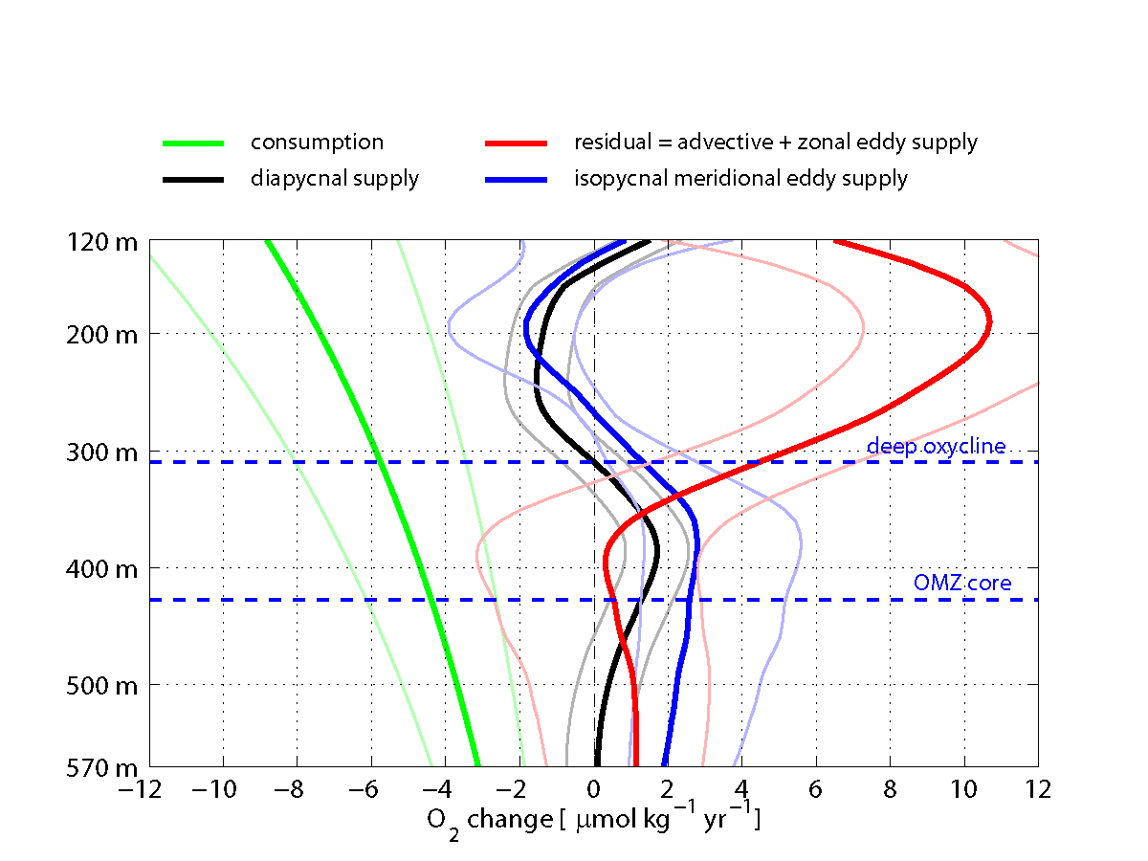
Meridional Eddy Supply
Ventilation Processes
Hahn et al. 2014
Notes:
Terms of the oxygen budget (diapycnal supply + isopycnal supply + consumption rate = 0) as a function of density. Diapycnal supply = negative diapycnal flux divergence (black) was determined in this study. Oxygen consumption (green) was estimated according to Karstensen et al. (2008); the exponential decrease in depth coordinates turns out to be hardly discernible from linear when transformed to isopycnal coordinates in the depth interval 150 to 500 m. The residual that closes the budget must account for isopycnal supply (red). Uncertainties are 95% confidence limits.

Slide 15
Ocean Deoxygenation
Long-term Oxygen Changes
Increased stratification and a corresponding reduction of ventilation, or solubility changes associated with a warming of subducted water masses (Bopp et al. 2002; Matear and Hirst 2003)
Increase in heterotrophic respiration along the pathways of ventilating water masses due to excess organic carbon formed at higher CO₂ levels (Oschlies et al. 2008)
Simulated global O₂ changes in response to external forcing (90% confidence), but Atlantic O₂ changes undistinguishable from internal variability (Andrews et al. 2013)
Observations indicate circulation changes:
e.g. weakening of zonal jets (Brandt et al. 2010)

Slide 16
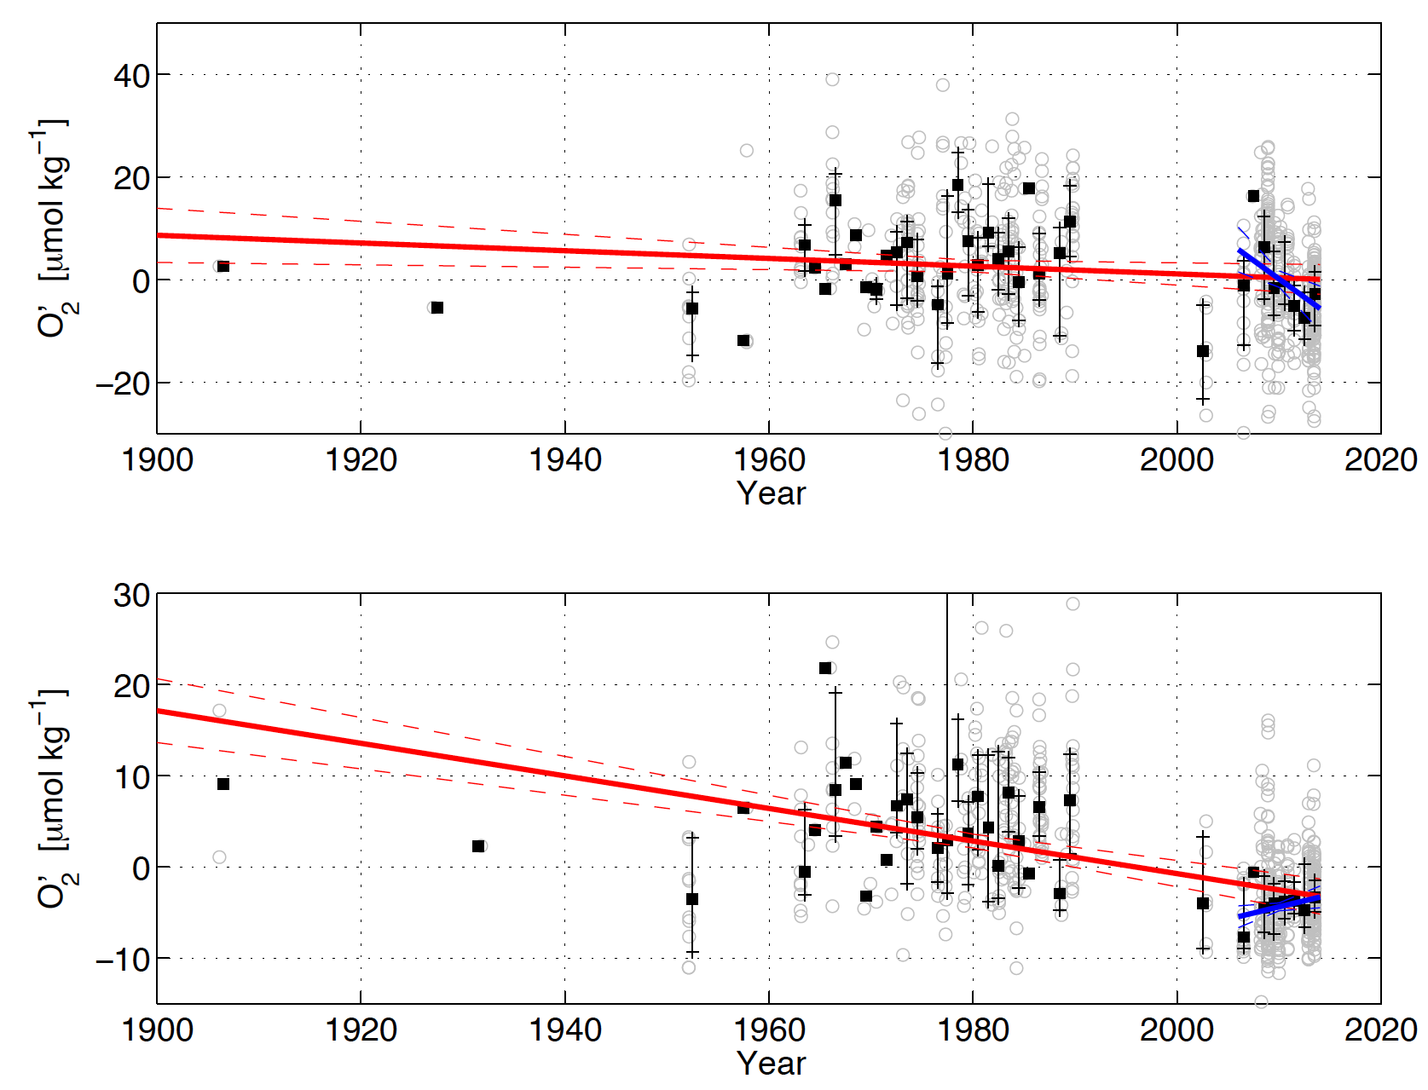
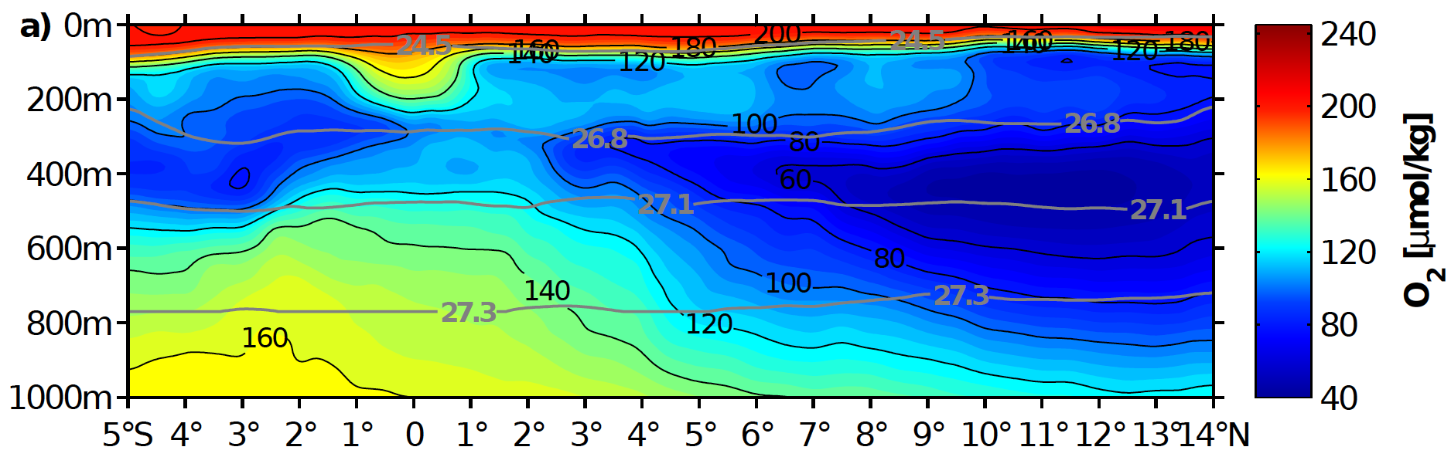
150-300m, 9-15°N, 20-26°W
350-700m, 9-15°N, 20-26°W

Slide 17
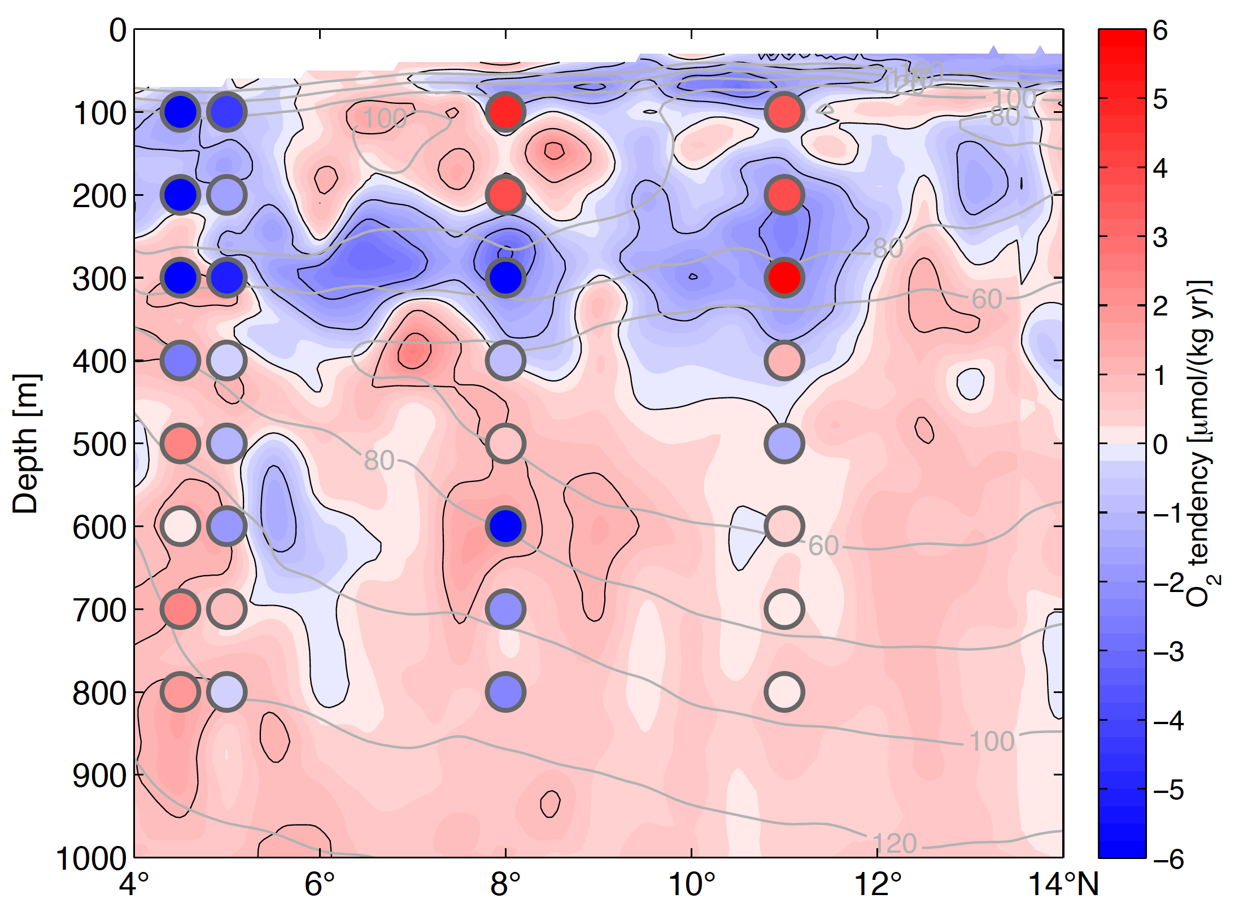
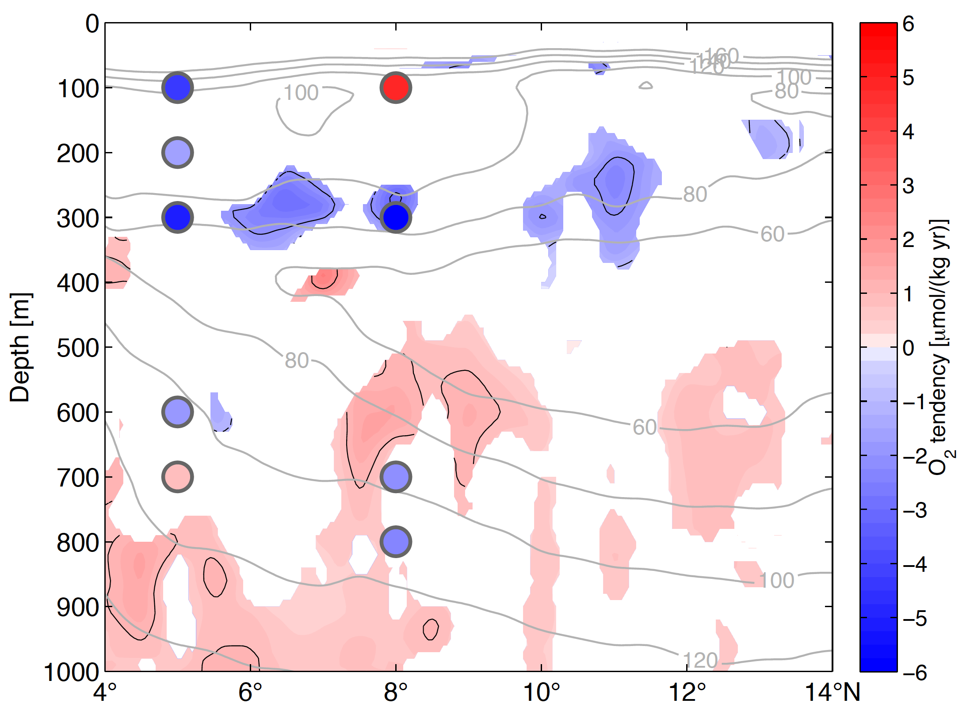
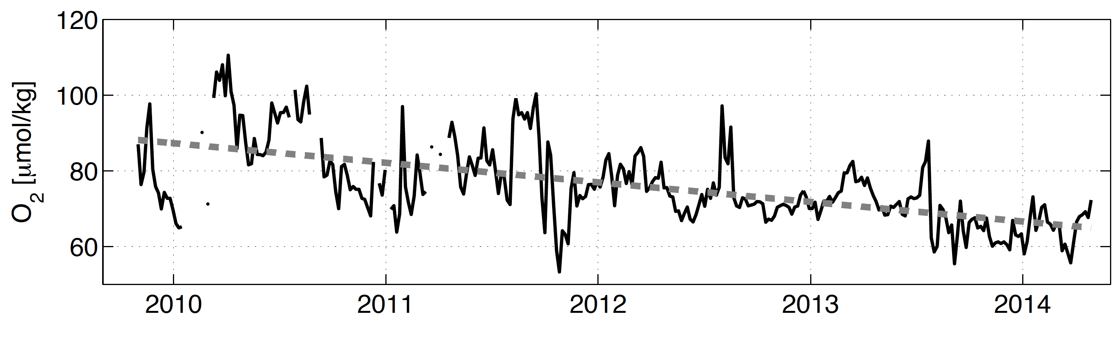
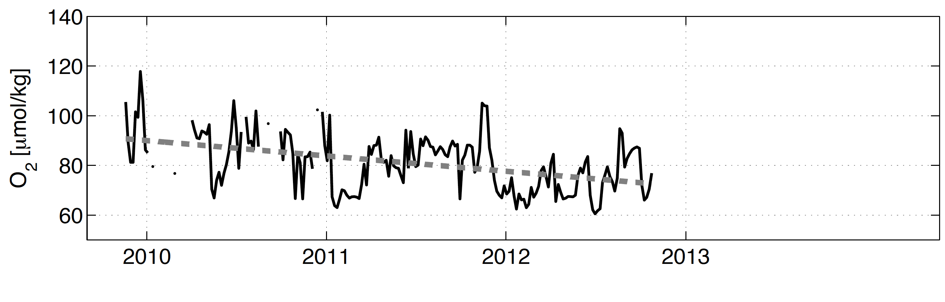
Trends from Moored and Shipboard Observations
Long-term Oxygen Changes
New sections in 2015, 2017 and 2018 and moored observations will help to improve the pattern of ongoing oxygen changes
5°N, 23°W, 300m
Trend 2006-2014
Extrem O₂ decline (on isopycnal surfaces) at the deep oxycline
8°N, 23°W, 300m
Which processes lead to the
upward expansion of the OMZ?

Slide 18
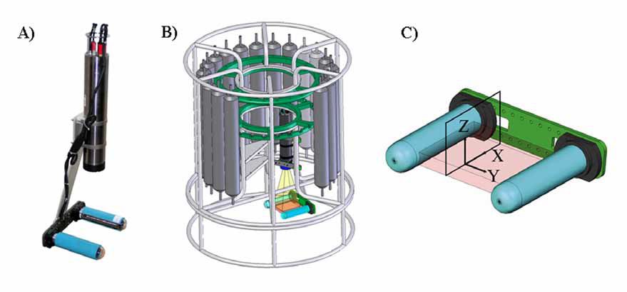
Underwater Vision Profiler
kindly provided by Lars Stemmann (LOV) for MSM22
Notes:
Camera that takes about 11 pictures per minute and counts all particles in the illuminated field. Pressure safe down to 6000 m depth and integrated into the ctd.

Slide 19
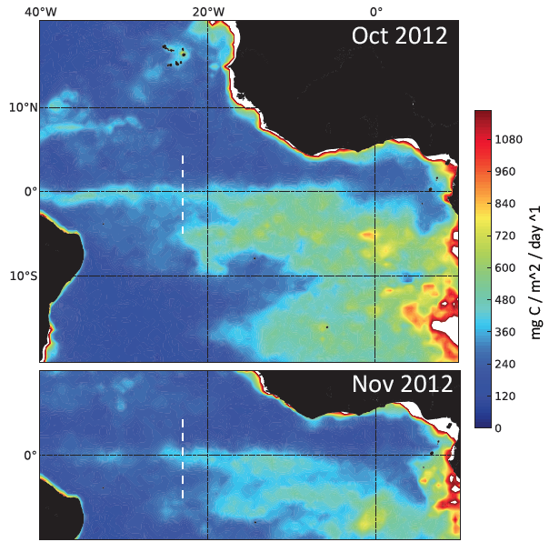
Primary productivity
NPP estimates from http://www.science.oregonstate.edu/ocean.productivity/
Notes:
Transect in white that will be shown on next slide, high primary productivity observed in a band along the equator.

Slide 20
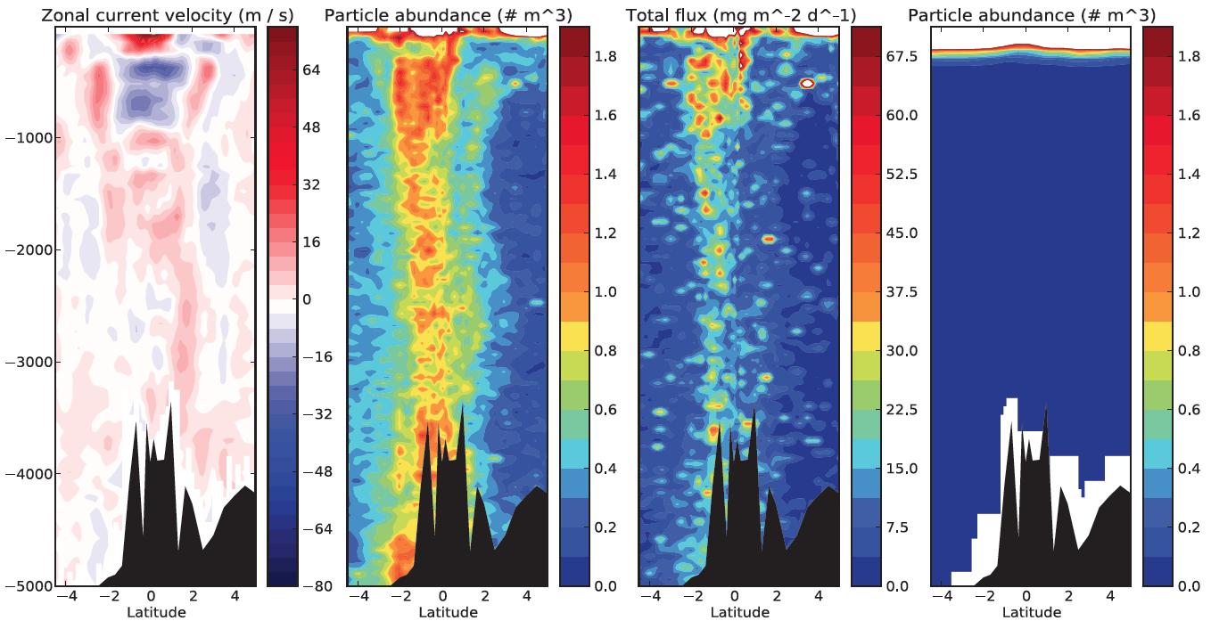
Equatorial marine snowfall
EUC
EIC
eastward
westward
Kiko et al., in prep.
Notes:
Enhanced surface productivity at the equator, but also a particle maximum in the EIC. This is probably derived from enhanced productivity further east, but also due to enhanced aggregation of particles at current speeds of 0.3 to 0.5 m/s. Both factors lead to a marine snowfall that extends to the deep sea. This snowfall is not represented in a model that explicitly describes particle aggregation, likely due to a coarse resolution of the equtorial current system.

Slide 21
Mesoscale eddies in the coastal upwelling region off NW Africa
Data basis:
CTD profiles of 15 research cruises
CVFZ
CVOO
ARGO floats
CVOO mooring
Main eddy formation regions near headlands of the coast
Polarity dependent westward
propagation of eddies from the
coast into the open ocean
Goal: Estimates of volume anomaly flux, heat and salt transport due to the combination of the vertical profiles and eddies identified via satellite data
Florian Schütte, PhD thesis
in progress

Slide 22
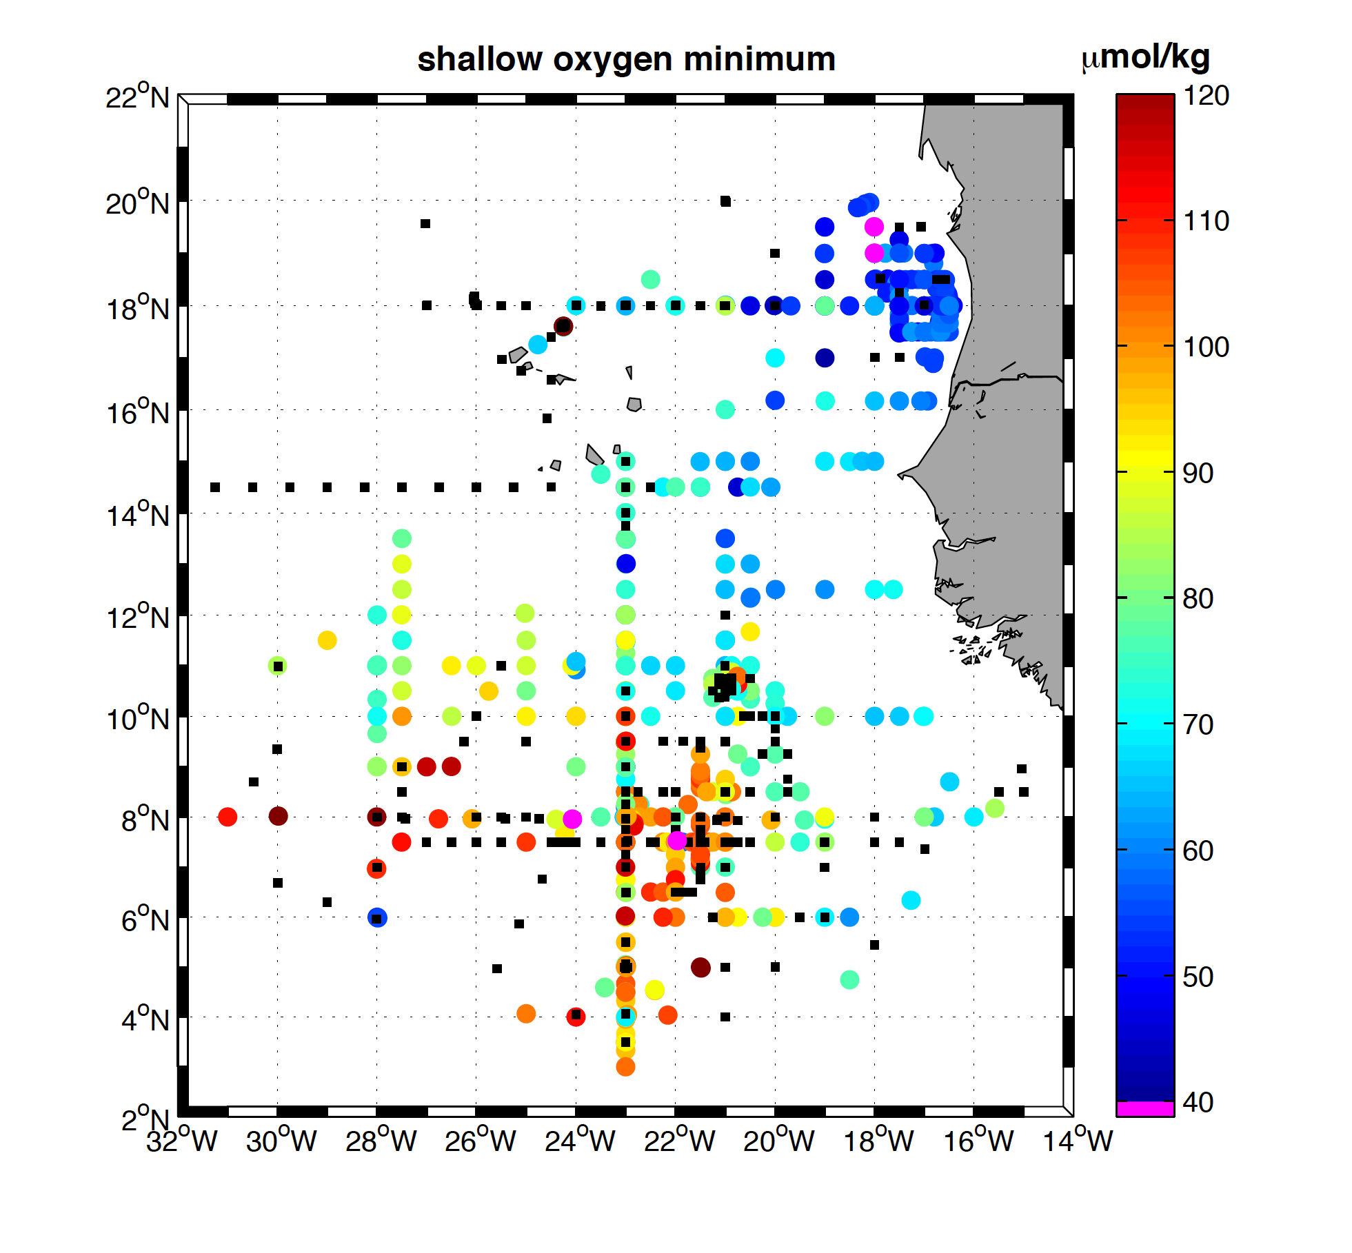
Oxygen at Shallow Oxygen Minimum
Shallow OMZ close to the eastern boundary upwelling region
Single low oxygen events typically associated with cyclonic or anticyclonic modewater eddies also in the region of the deep OMZ

Slide 23
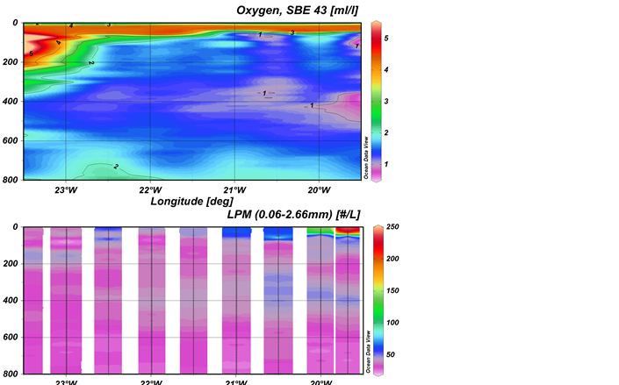
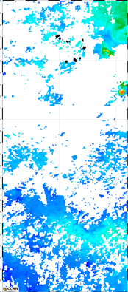
Eddy Hunt during MSM22
Chlorophyll

Slide 24
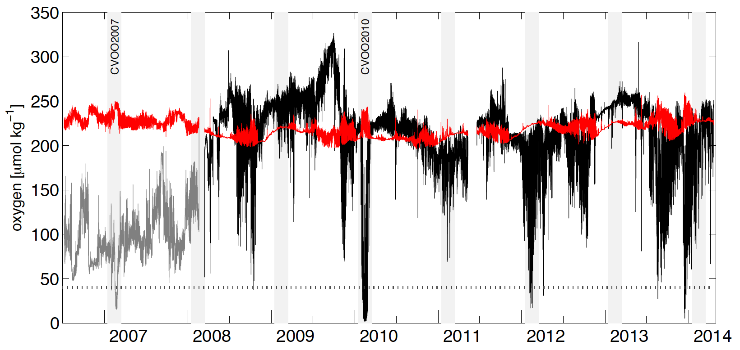
Oxygen at CVOO Mooring
Oxygen at 40-60m (black),
140m (grey) and
oxygen saturation (red)
Karstensen et al., 2015

Slide 25
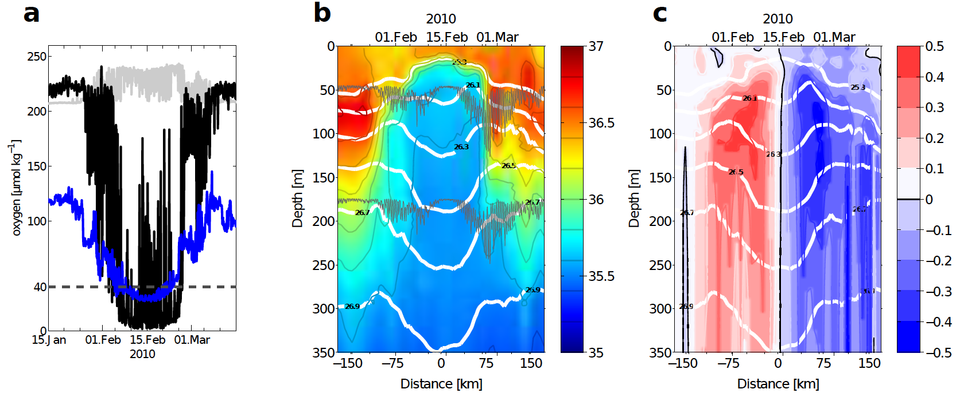
Passage of a Mode-Water Eddy at the CVOO Mooring
Low oxygen zones are created just below the mixed-layer, in the euphotic zone of high productive anticyclonic modewater eddies (oxygen at 42 and 170m, salinity, meridional velocity [m/s])
Karstensen et al., 2015

Slide 26
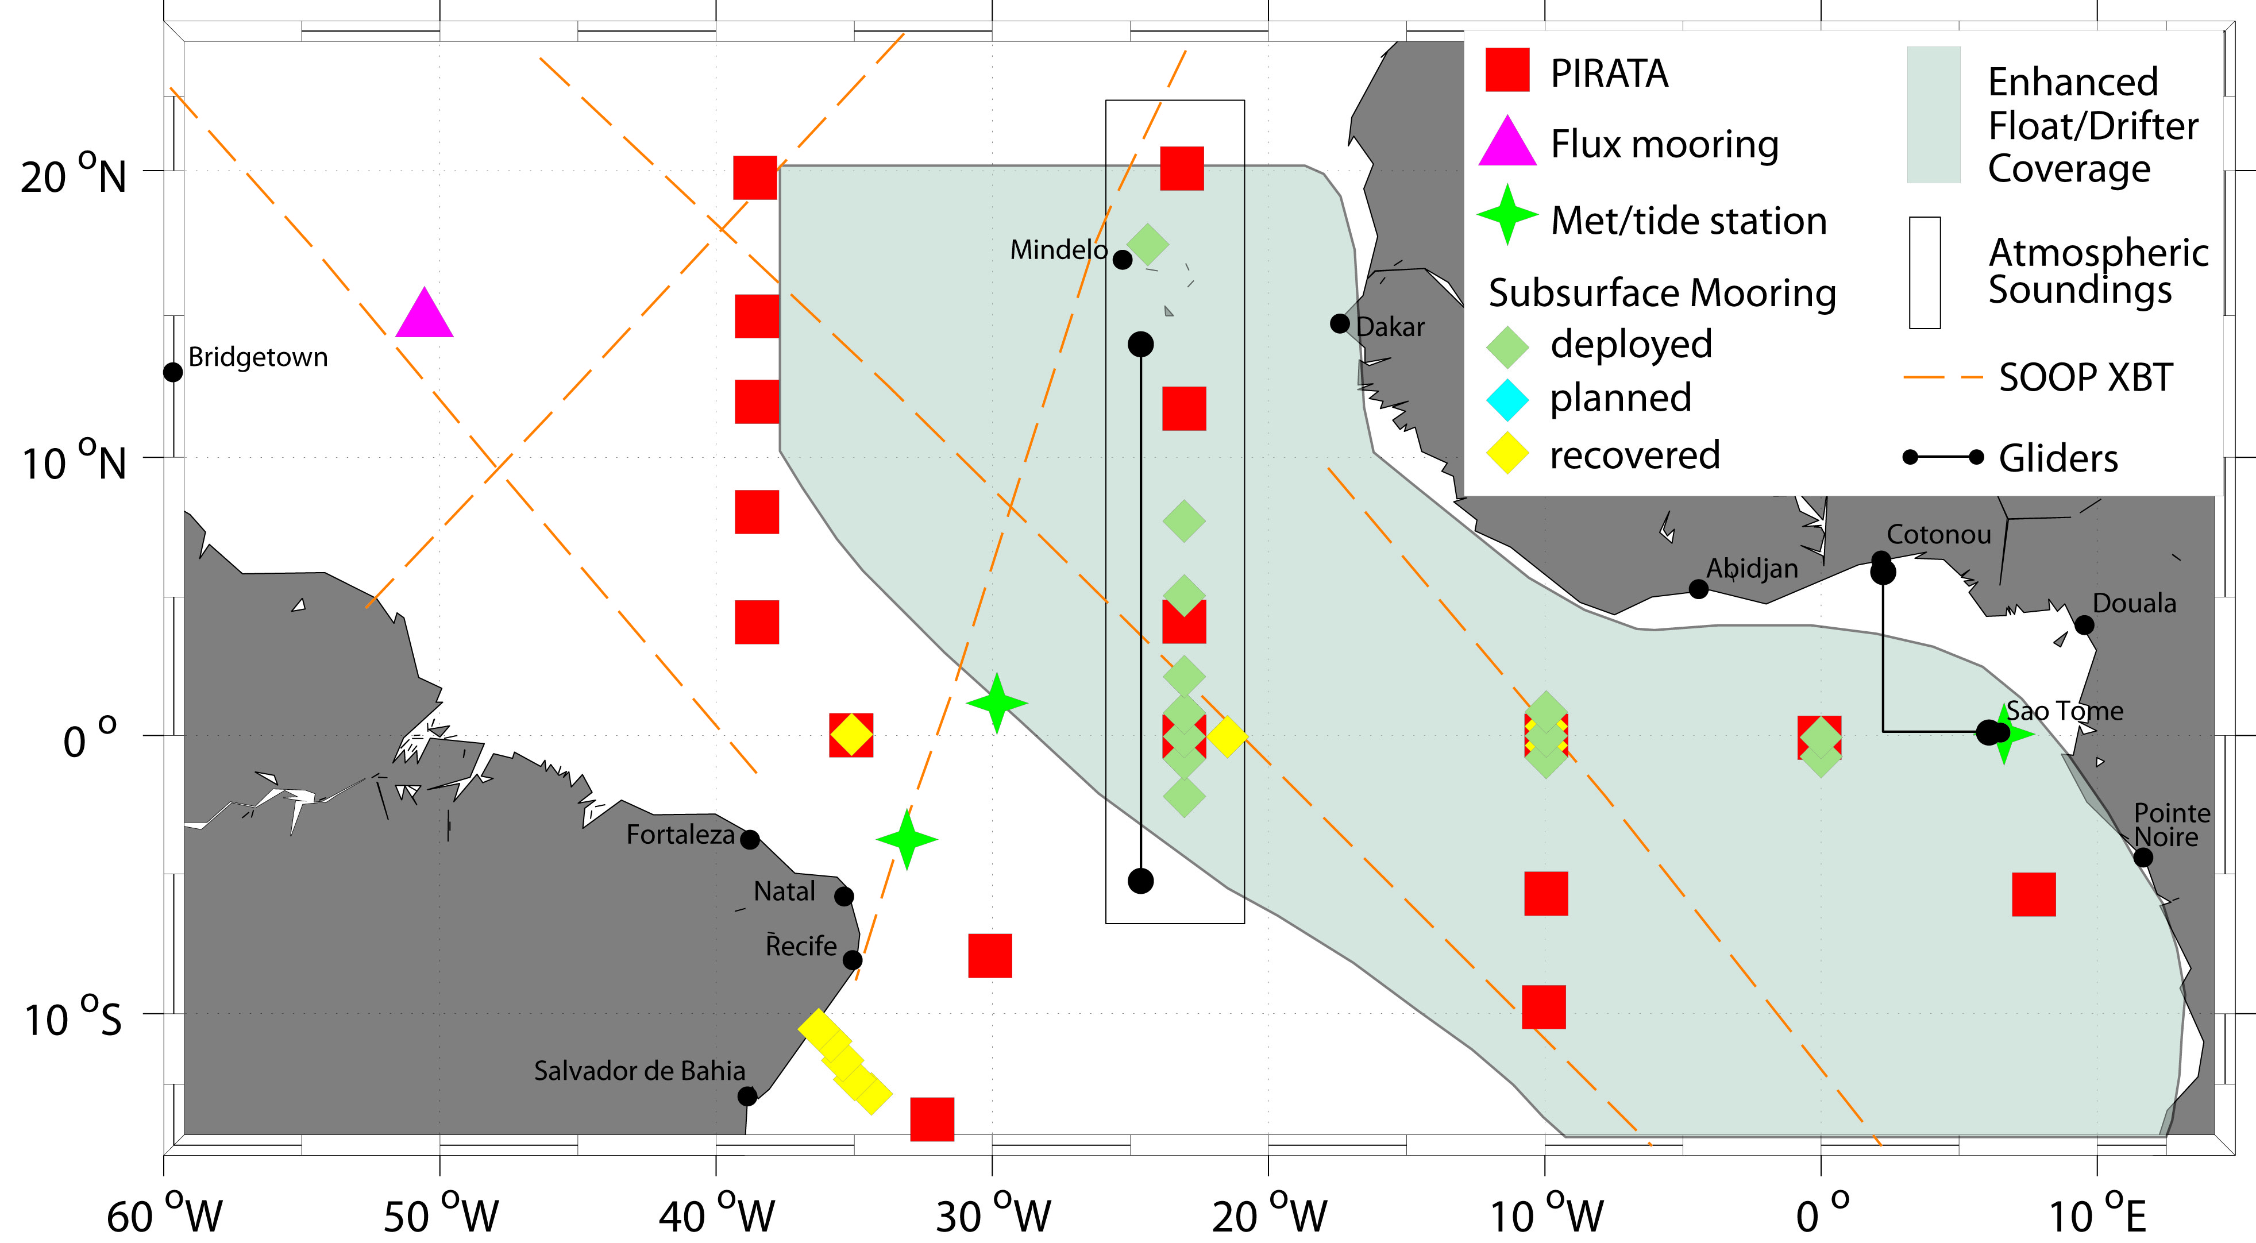
TACE Observational Network
Observing system during TACE (2006-2011) included different
process studies, like e.g. the 23°W equatorial moorings

Slide 27
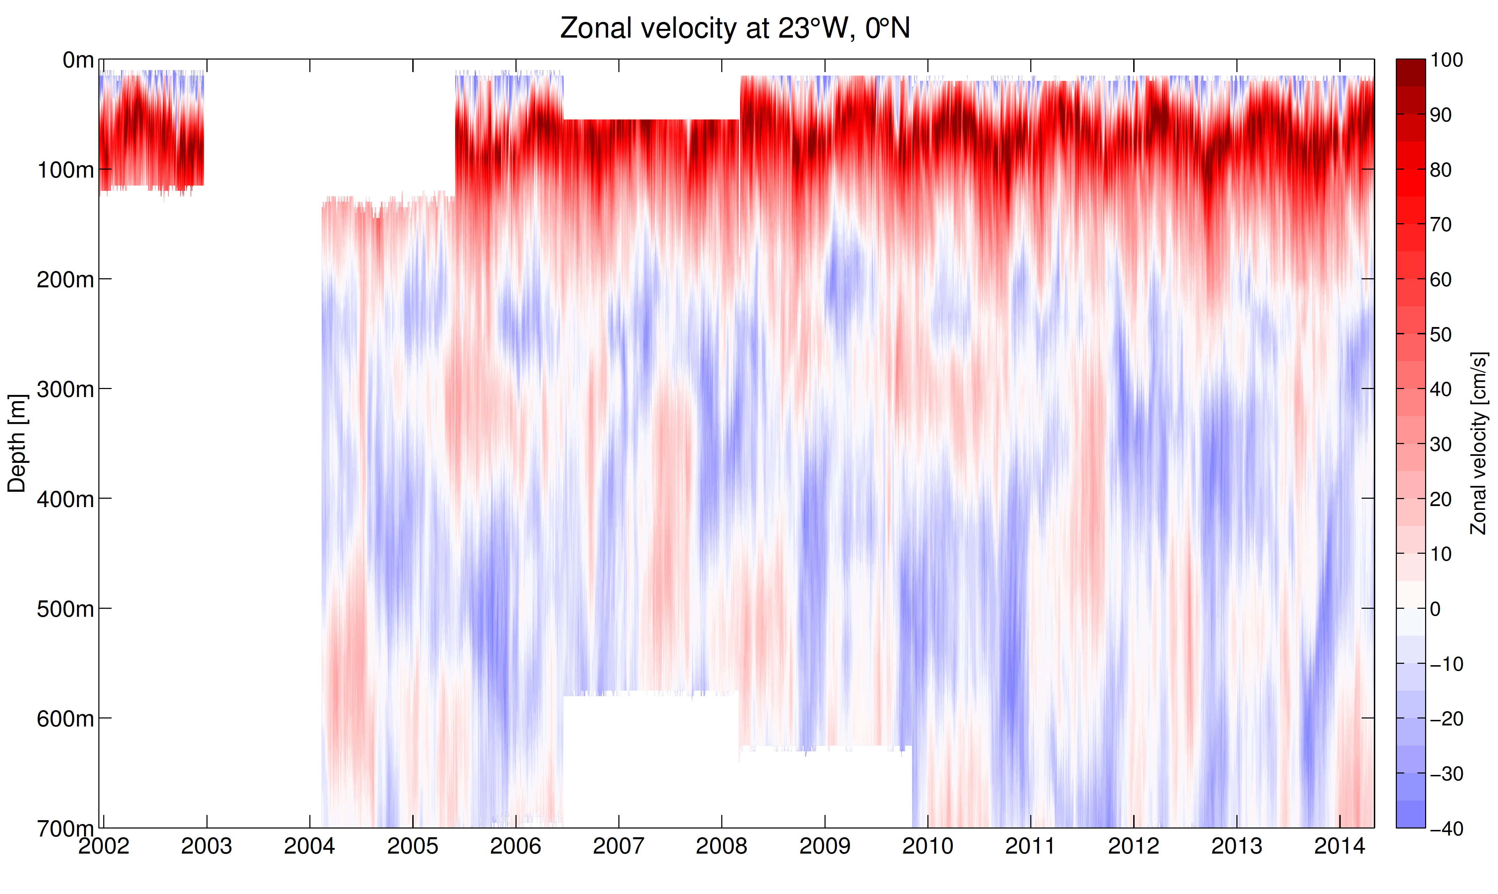
Equatorial Circulation Variability at 23°W

Slide 28
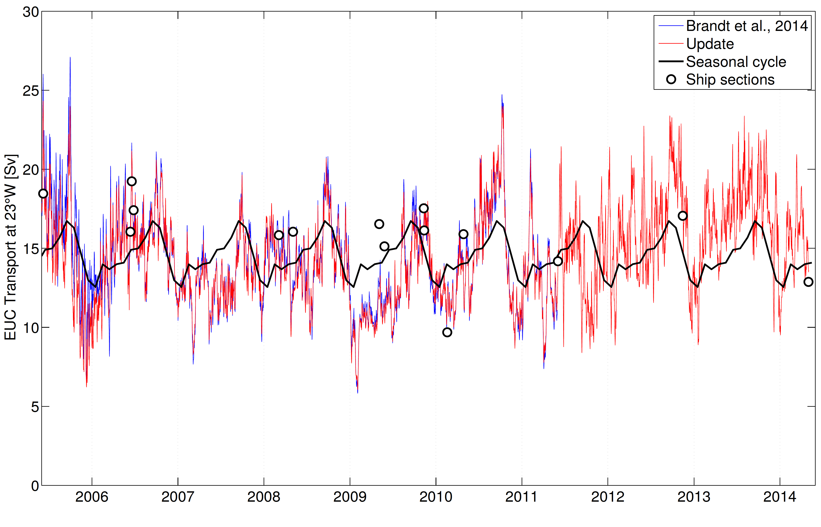
Equatorial Undercurrent Transport at 23°W
Robert Kopte, PhD thesis in progress

Slide 29
Summary
Kiel Collaborative Research Centre SFB 754: first two phases from 2008-2011 and 2012-2015, third and last phase is in the stage of proposal submission
Multi-year program to study ocean processes as well as long-term changes
Strong cooperation between physical and biogeochemical working groups

