Slide 1
Tropical Atlantic Circulation and Variability: Equatorial Dynamics and Ventilation Physics
Peter Brandt
GEOMAR, Kiel, Germany

Slide 2
Tropical Atlantic Circulation and Variability
With contributions from:
Richard J. Greatbatch¹, Alexis Tantet^{1,2}, Johannes Hahn¹, Sven-Helge Didwischus¹, William E. Johns³, John M. Toole⁴, Francois Ascani⁵, Martin Claus¹, Jan-Dirk Matthießen¹, Sunke Schmidtko¹, Marcus Dengler¹
¹GEOMAR Helmholtz-Zentrum für Ozeanforschung Kiel, Germany
²now at Institute for Marine and Atmospheric Research, Utrecht University, The Netherlands
³RSMAS/MPO, University of Miami, USA
⁴Woods Hole Oceanographic Institution, Woods Hole, USA
⁵Marine Science Department, University of Hawaii, USA

Slide 3
Outline
Introduction
ITCZ and tropical Atlantic variability (TAV)
TACE observing system and ongoing activities
EUC-TAV Relation
EUC Transport
EUC during warm/cold events
Deep Equatorial Circulation
Equatorial basin modes
Equatorial deep jets
Ventilation of the tropical North Atlantic
Equatorial oxygen maximum
Latitudinally stacked zonal jets

Slide 4
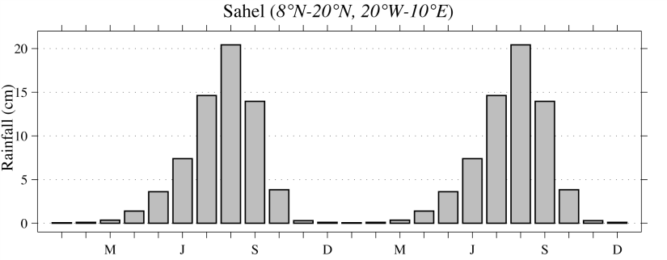
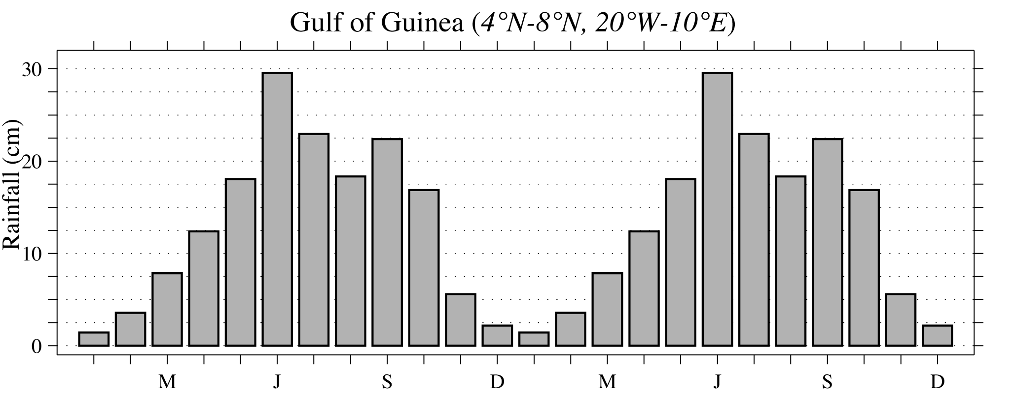
Atlantic Marine ITCZ Complex
ITCZ position and rainfall intensity affect densely populated regions in West Africa
Sahel
JJA-Position
Guinea
MA-Position
Kushnir et al., 2003
Sahel rainfall climatology
Guinea rainfall climatology
Notes:
4
A map of population density in persons/km² (colors, see inserted legend), overlaid by contours of annual mean rainfall (in mm/day) with values > 4 mm/day (~150 cm/yr) shaded in transparent gray to indicate the mean position of the ITCZ. The north (July-August) and south (March-April) limits of the ITCZ climatological annual migration are indicated by thick dashed lines.

Slide 5
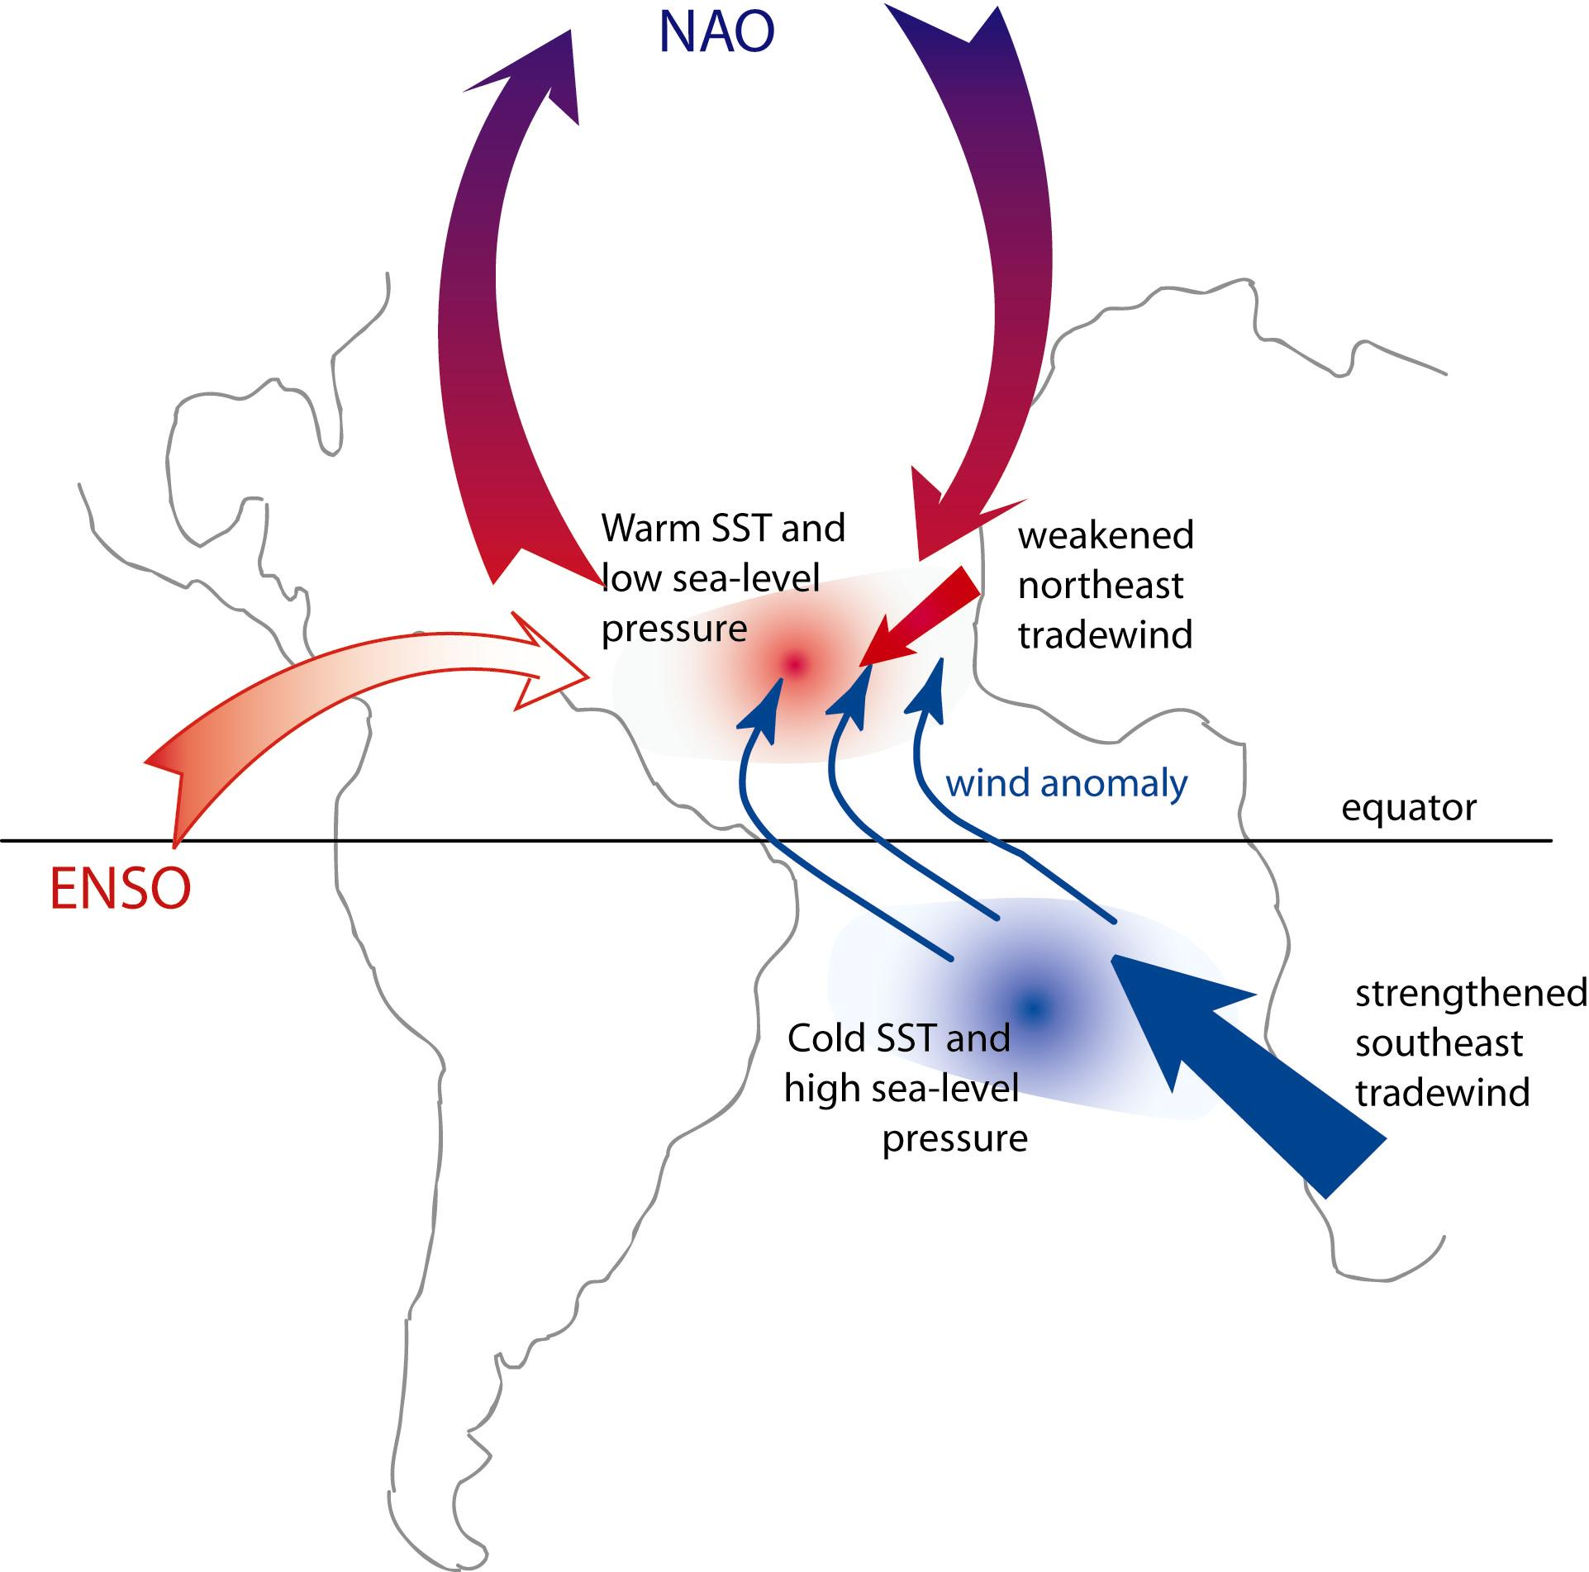
Mechanisms of Tropical Atlantic Variability
Mechanisms influencing Variability of Tropical Atlantic SST
Chang et al., 2006
Notes:
5

Slide 6
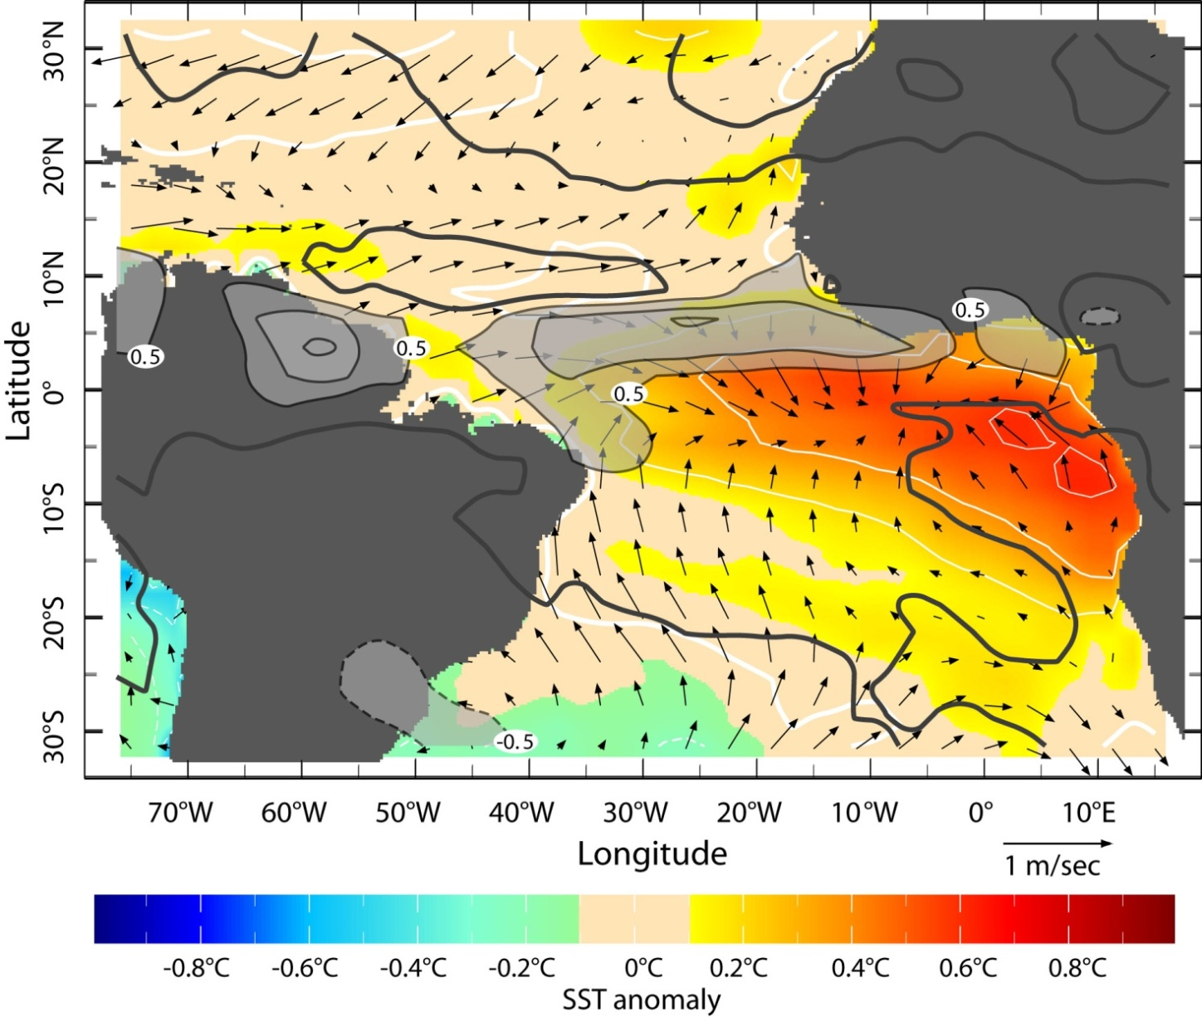
Zonal Mode (June-August)
Zonal Mode is associated with rainfall variability, onset and strength of African Monsoon (Caniaux et al. 2011, Brandt et al. 2011)
Underlying mechanism is the Bjerknes feedback that is strong during boreal spring/summer (Keenlyside and Latif 2007)
Kushnir et al. 2006
Notes:
6
First EOF (23%) of the June-August rainfall from GPCP 1979-2001 (contours in mm/day). June-August SST anomaly (colors, in °C & white contours, every 0.2°) and surface wind anomaly (vector, in m/sec) are determined by regression on the time series of the rainfall EOF.

Slide 7
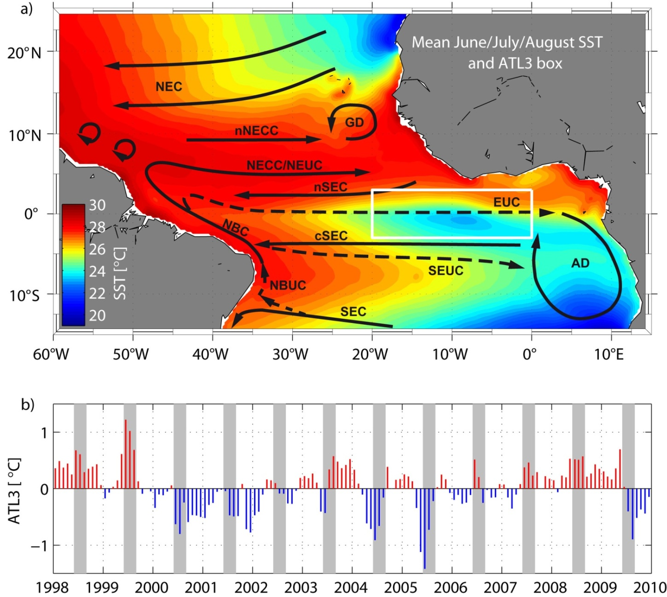
Equatorial Atlantic Cold Tongue
Cold tongue develops during boreal summer
Interannual variability of ATL3 SST index (3°S–3°N, 20°W–0°) much smaller than seasonal cycle
Brandt et al. 2011

Slide 8
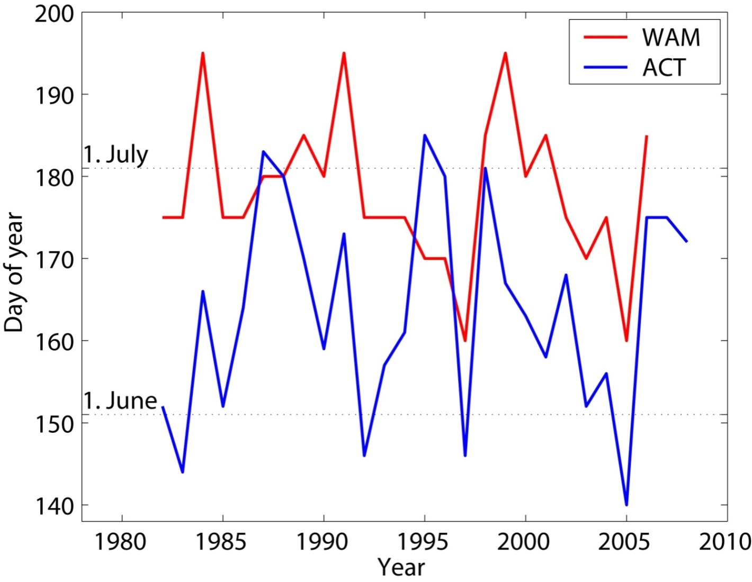
Onset of Atlantic Cold Tongue and West African Monsoon
WAM onset follows the ACT onset by some weeks.
Significant correlation of ACT and WAM onsets
WAM onset – northward migration of rainfall (10°W-10°E) (Fontaine and Louvet, 2006)
ACT onset – surface area (with T<25°C) threshold
Caniaux et al. 2011, Brandt et al. 2011
Notes:
Correlation: 0.45, significant at the 97% confidence level

Slide 9
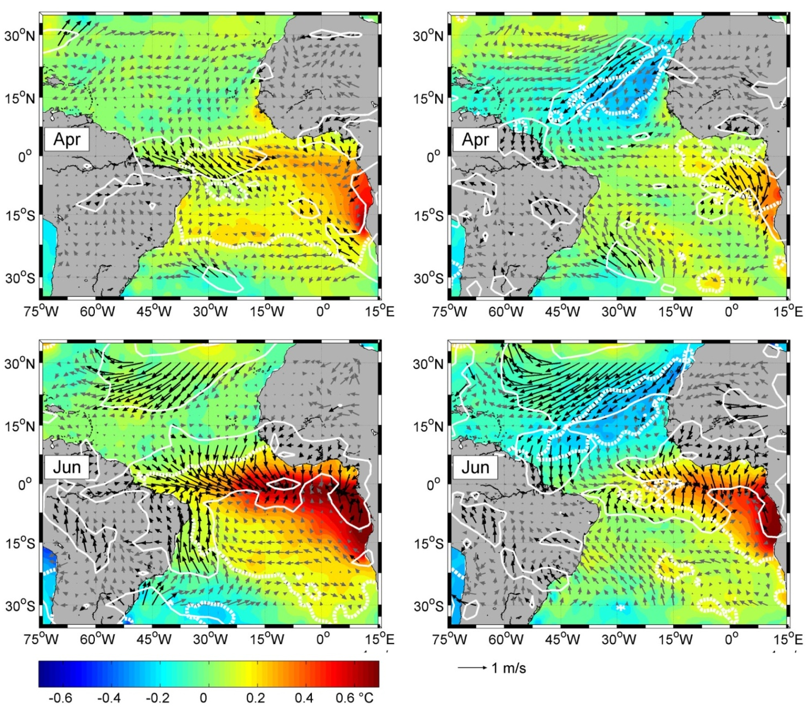
Regression of SST and Wind onto
ACT
Onset
Cold tongue SST;
Wind forcing in the western equatorial Atlantic
(zonal mode)
WAM
Onset
Significantcorrelation with cold tongue SST (zonal mode) and
SST in the tropical NE Atlantic
(meridional mode)
Brandt et al. 2011

Slide 10
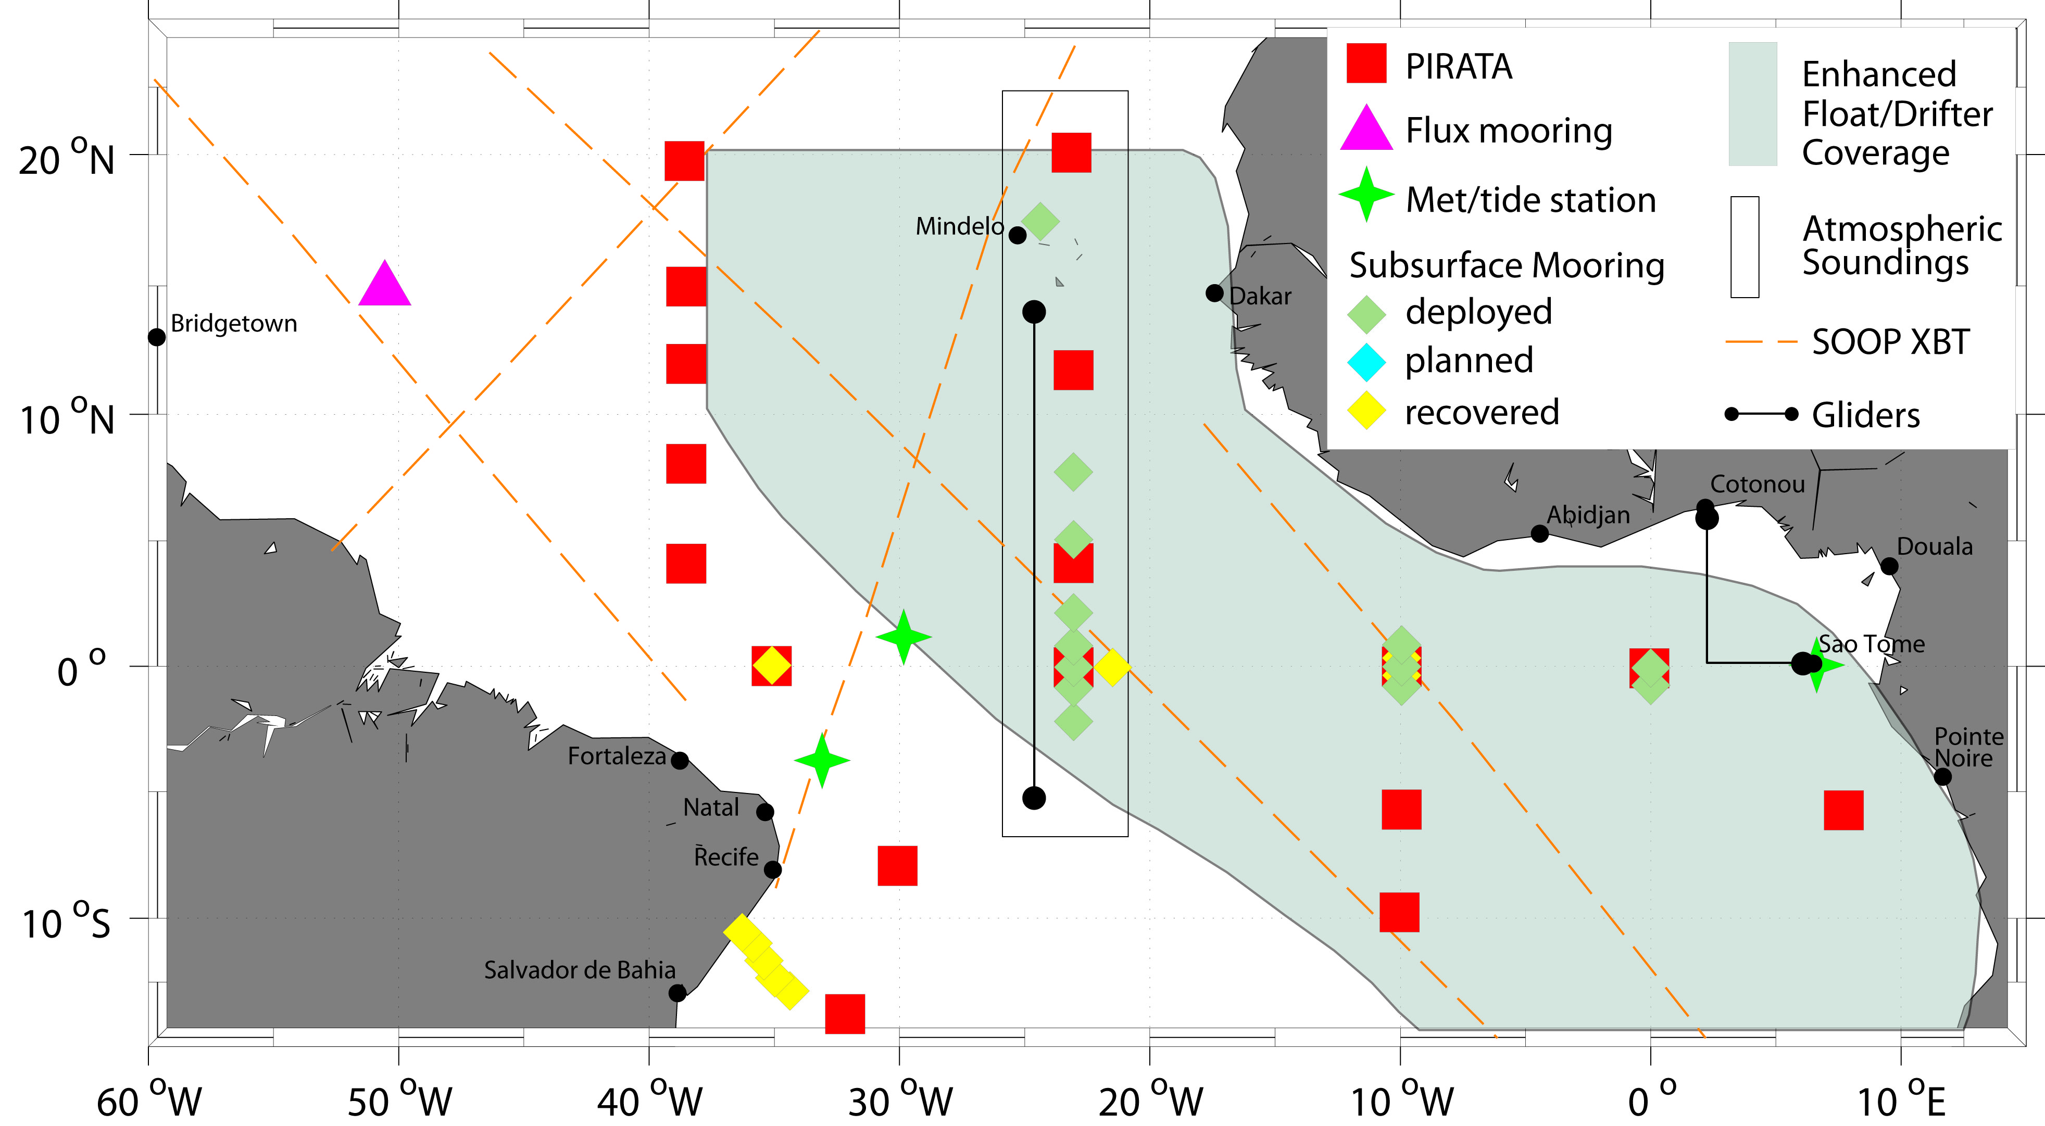
TACE Observational Network
Observing system during TACE (2006-2011) included different process studies, like e.g. the 23°W equatorial moorings

Slide 11
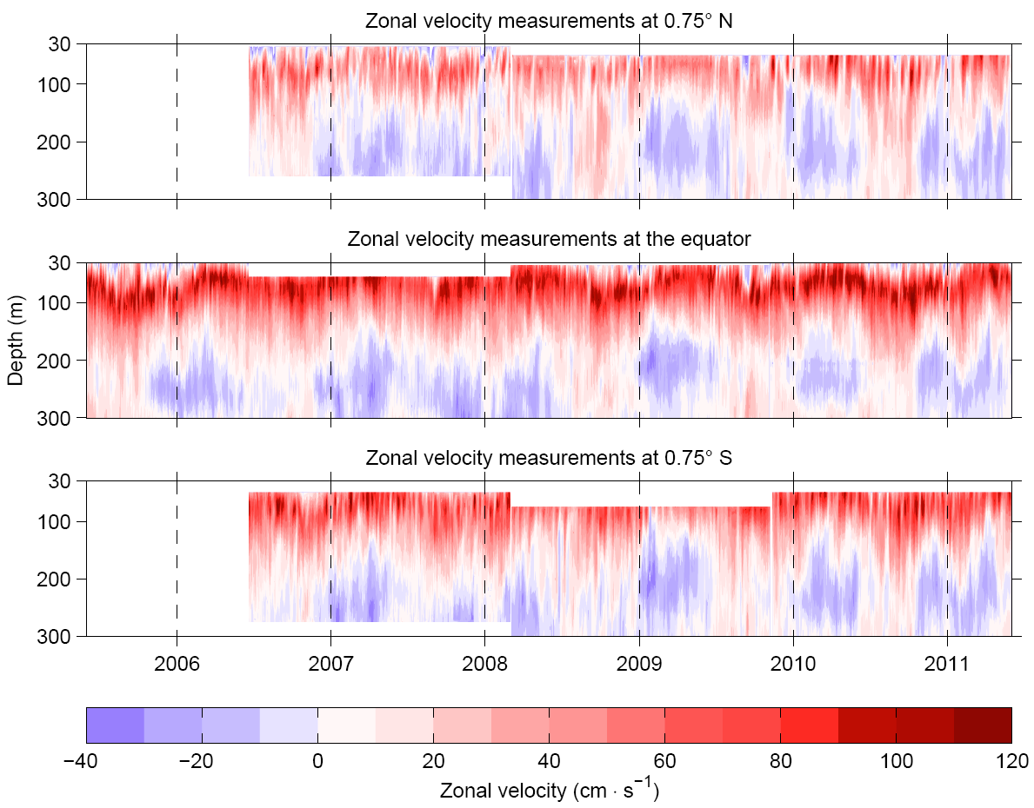
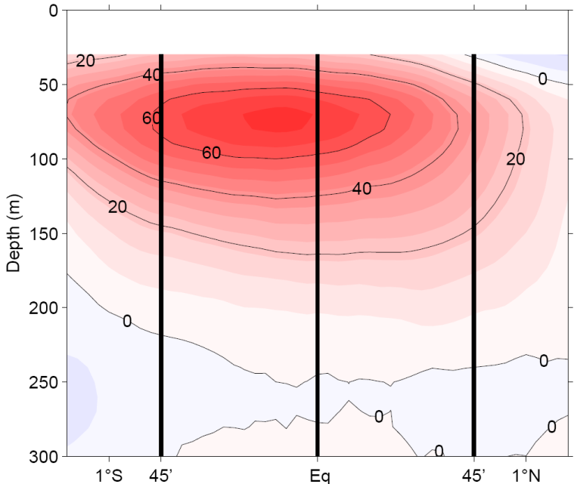
Observing the Equatorial Undercurrent at 23°W
Single mooring from June 2005
3 moorings from June 2006 to May 2011
Ship Section Mean
Brandt, et al. 2014

Slide 12
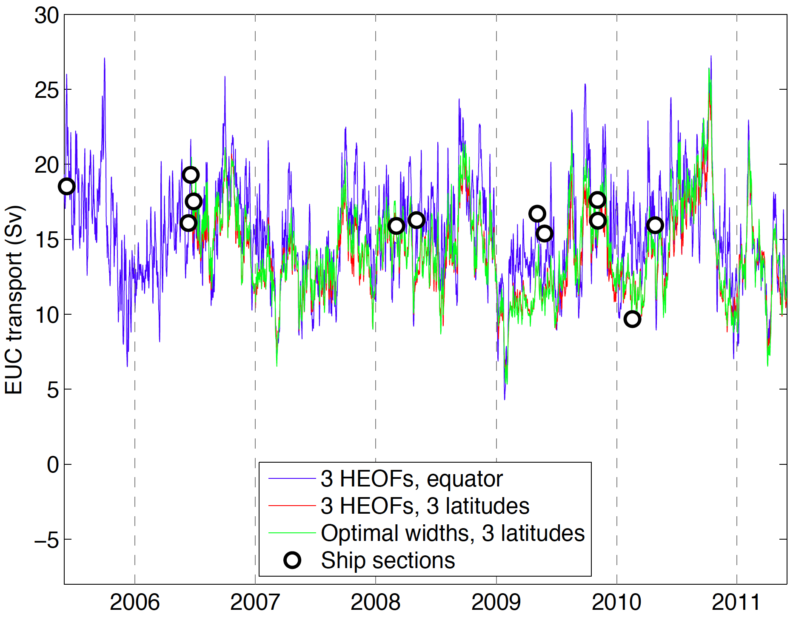
Eastward EUC Transport
Different methods to obtain transport time series
General agreement between different methods
Substantial interannual variability

Slide 13
Pacific EUC Transport
Mean EUC Transport (solid) and EUC transport for strong El Niños (dashed)
Strongly reduced EUC transport during El Niños. EUC disappeared during 1982/83 El Niño (Firing et al. 1983)
Johnson et al. 2002
What is the relation between Atlantic EUC transport and Atlantic zonal mode variability?

Slide 14
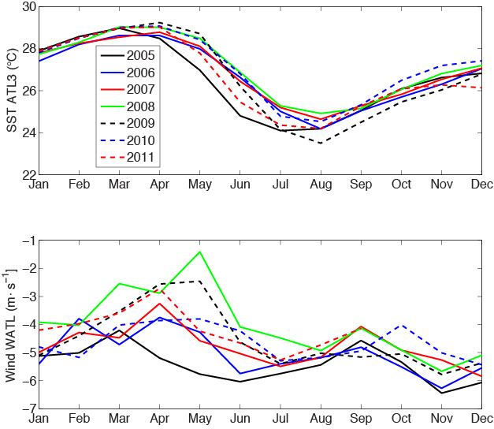
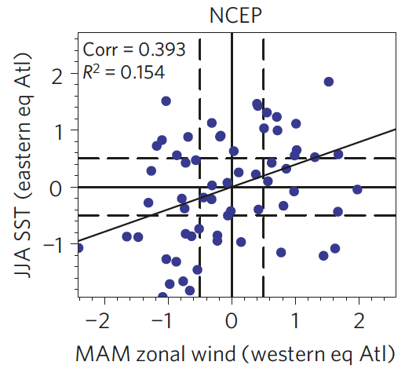
Interannual Variability: SST ATL3 and Wind Western Atlantic
Richter et al. (2013): canonical events have strong/weak winds prior to cold/warm events
2008
2005
Notes:
ATL3 SST index (20°W–0°, 3°S–3°N)
westernAtlantic (WATL) wind index (40°W–20°W, 3°S–3°N)

Slide 15
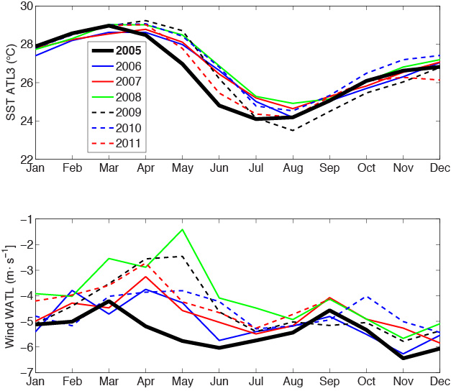
Interannual Variability: SST ATL3 and Wind Western Atlantic
Richter et al. (2013): canonical events have strong/weak winds prior to cold/warm events
Canonical cold event: 2005

Slide 16
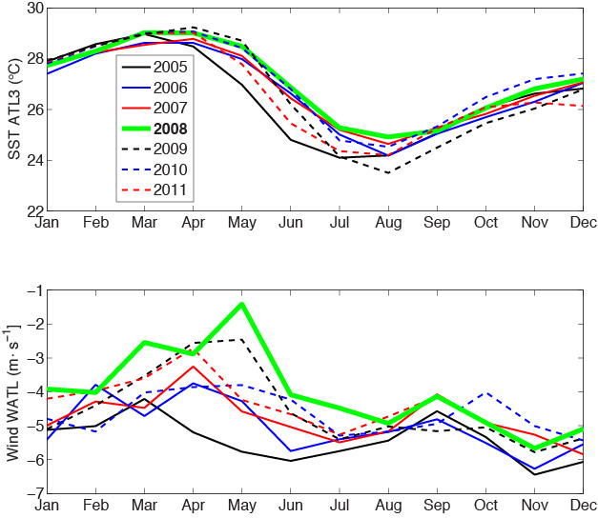
Interannual Variability: SST ATL3 and Wind Western Atlantic
Richter et al. (2013): canonical events have strong/weak winds prior to cold/warm events
Canonical cold event: 2005
Canonical warm event: 2008

Slide 17
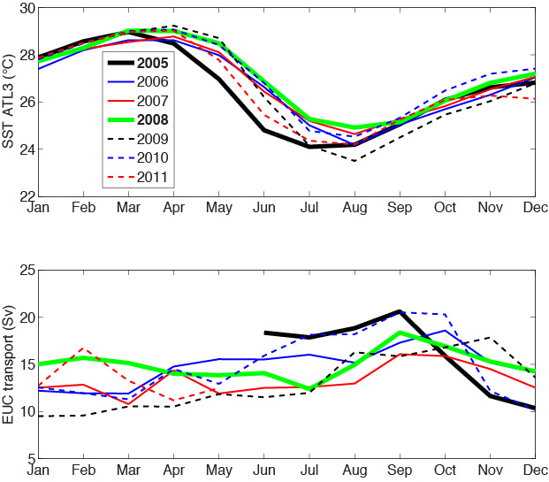
Interannual Variability: SST ATL3 and EUC Transport
Canonical cold/warm events are associated with strong/weak EUC

Slide 18
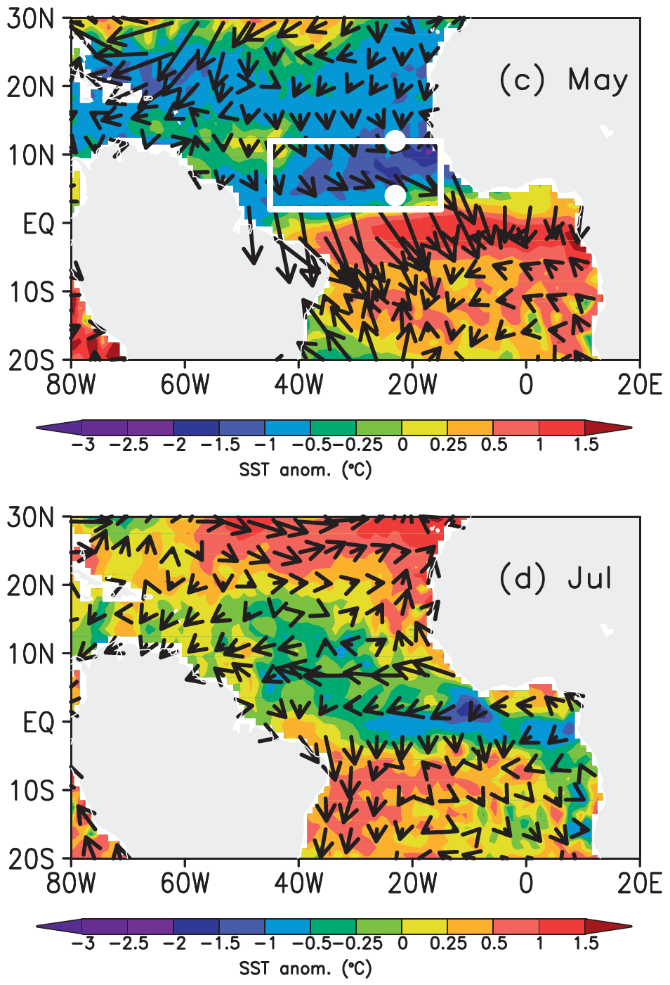
Anomalous Year 2009
Strong meridional mode event during boreal spring that developed into an equatorial cold event during summer
Foltz and McPhaden (2010): weak winds during spring associated with eq. Rossby wave generation, boundary reflection and delayed cold event
Richter et al. (2013): noncanonical events associated with meridional advection within tropical cells (e.g. Perez et al. 2014)
Foltz et al. 2012

Slide 19
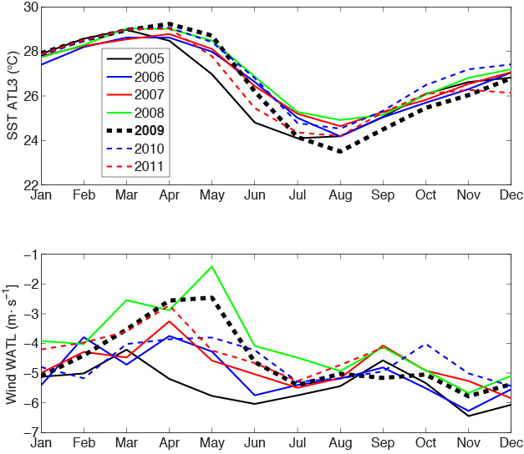
Anomalous Year 2009
Noncanonical cold event: 2009 (warmest spring with weak winds, but coldest SST in August)
2009

Slide 20
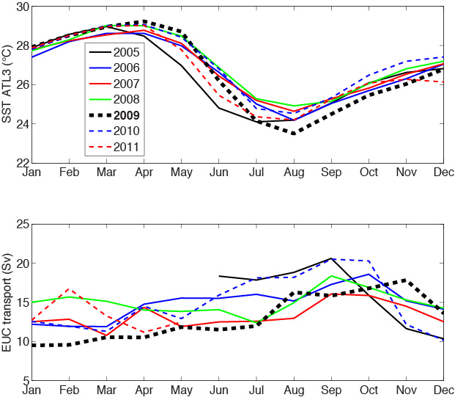
Anomalous Year 2009
Noncanonical cold event: 2009 (warmest spring with weak winds, but coldest SST in August)
EUC during 2009 was weak and shows no variation during the strong cooling from May to July
Untypical EUC
behavior during development of
2009 cold event

Slide 21
Summary (1)
Interannual EUC transport variability largely in agreement with boreal summer zonal mode variability:
strong easterlies in the western tropical Atlantic during spring are associated with strong EUC and cold event
There are noncanonical events likely associated with meridional mode events during boreal spring
2009 extremely anomalous, weak winds, no change in EUC transport, but late and extreme cooling with coolest SST in August
mechanism for this behavior is still under debate

Slide 22
Deep Equatorial Circulation
Zonal velocity from shipboard ADCP and lowered ADCP
High baroclinic mode variability: Equatorial deep jets
Low baroclinic mode variability: Seasonal cycle

Slide 23
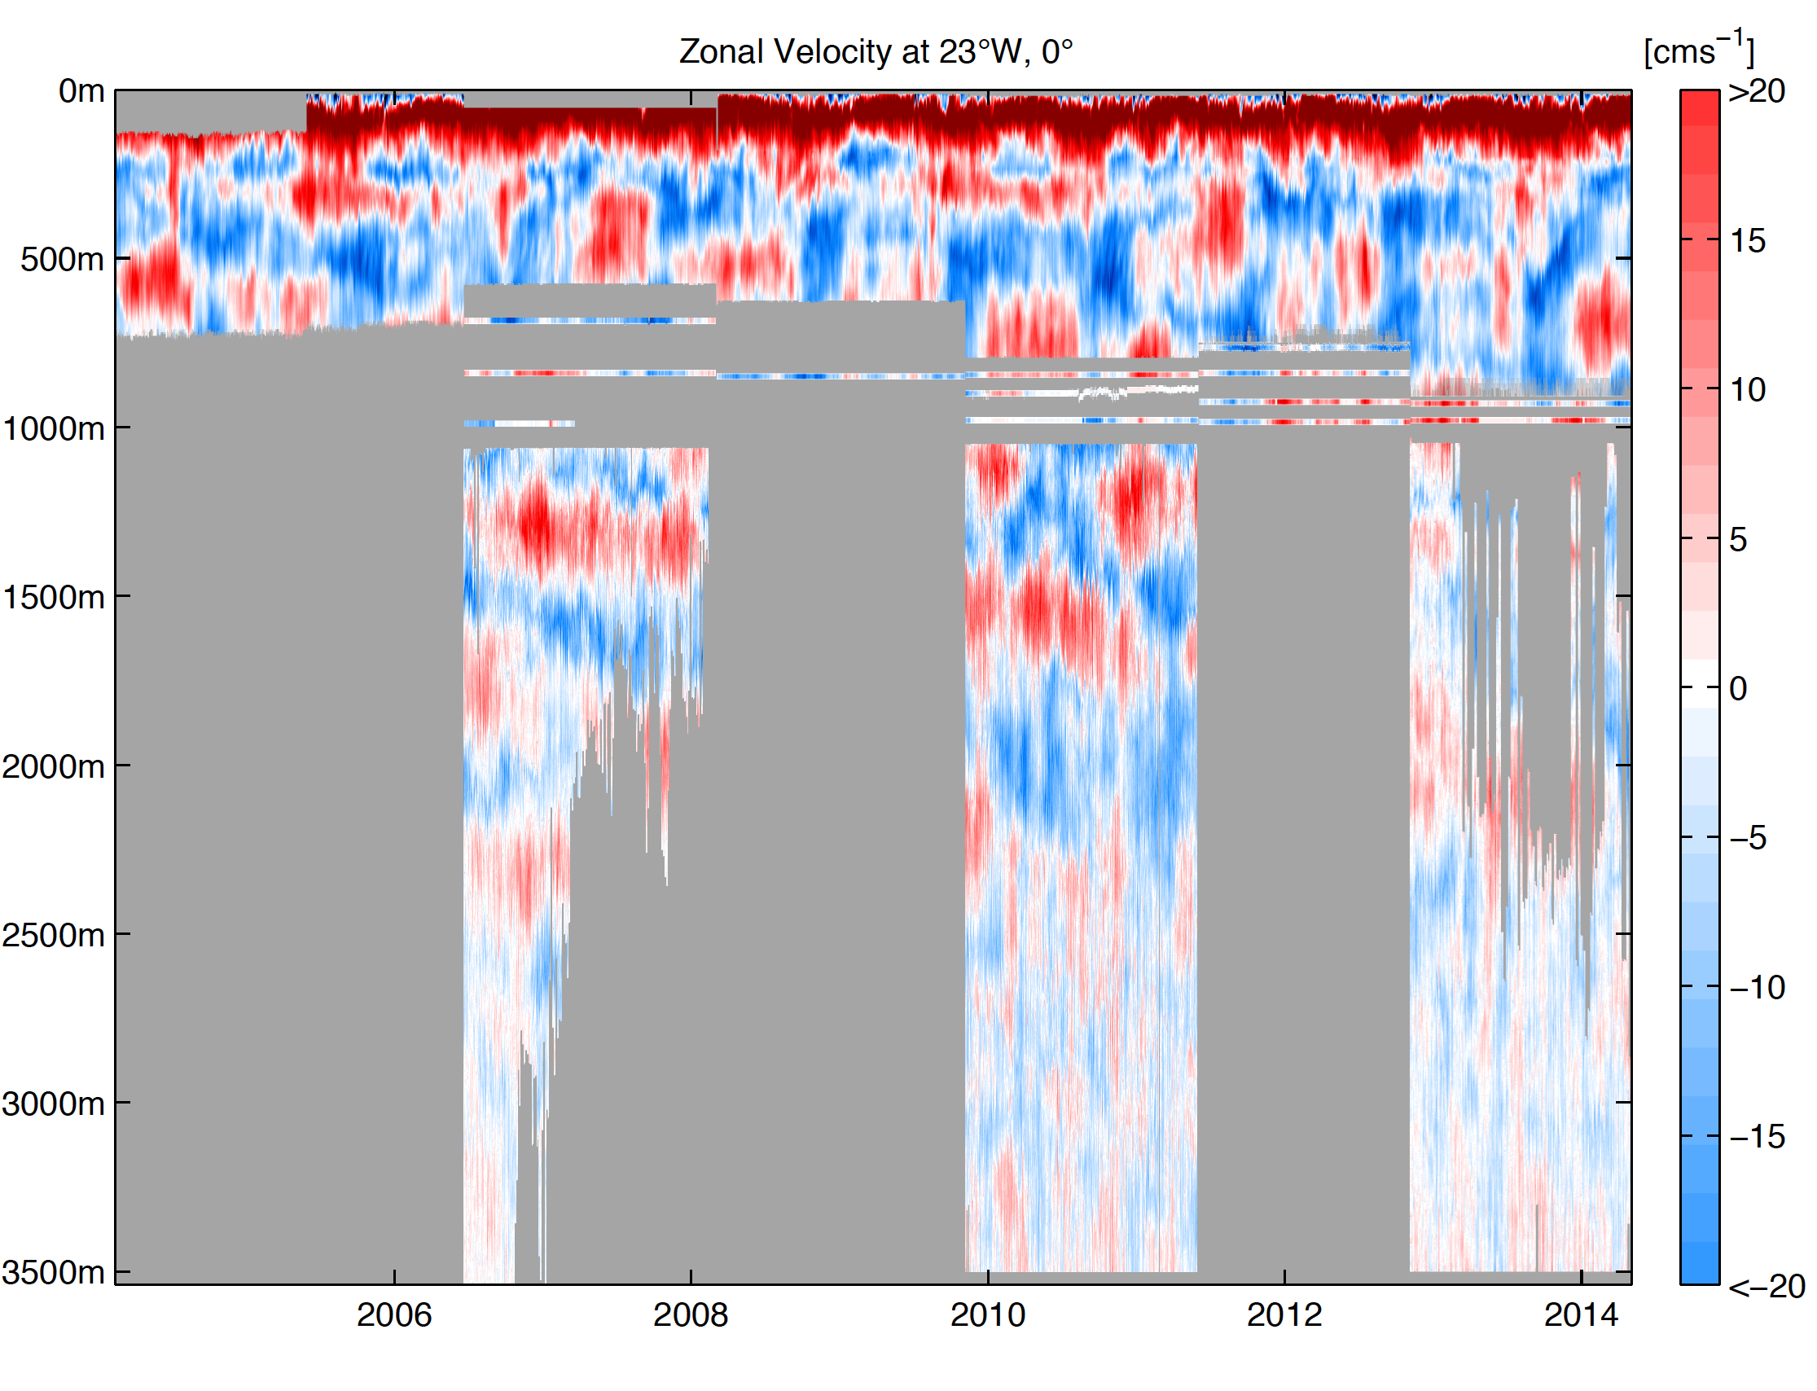
Deep Equatorial Circulation
10 years of zonal velocity data at 23°W with irregular gaps

Slide 24
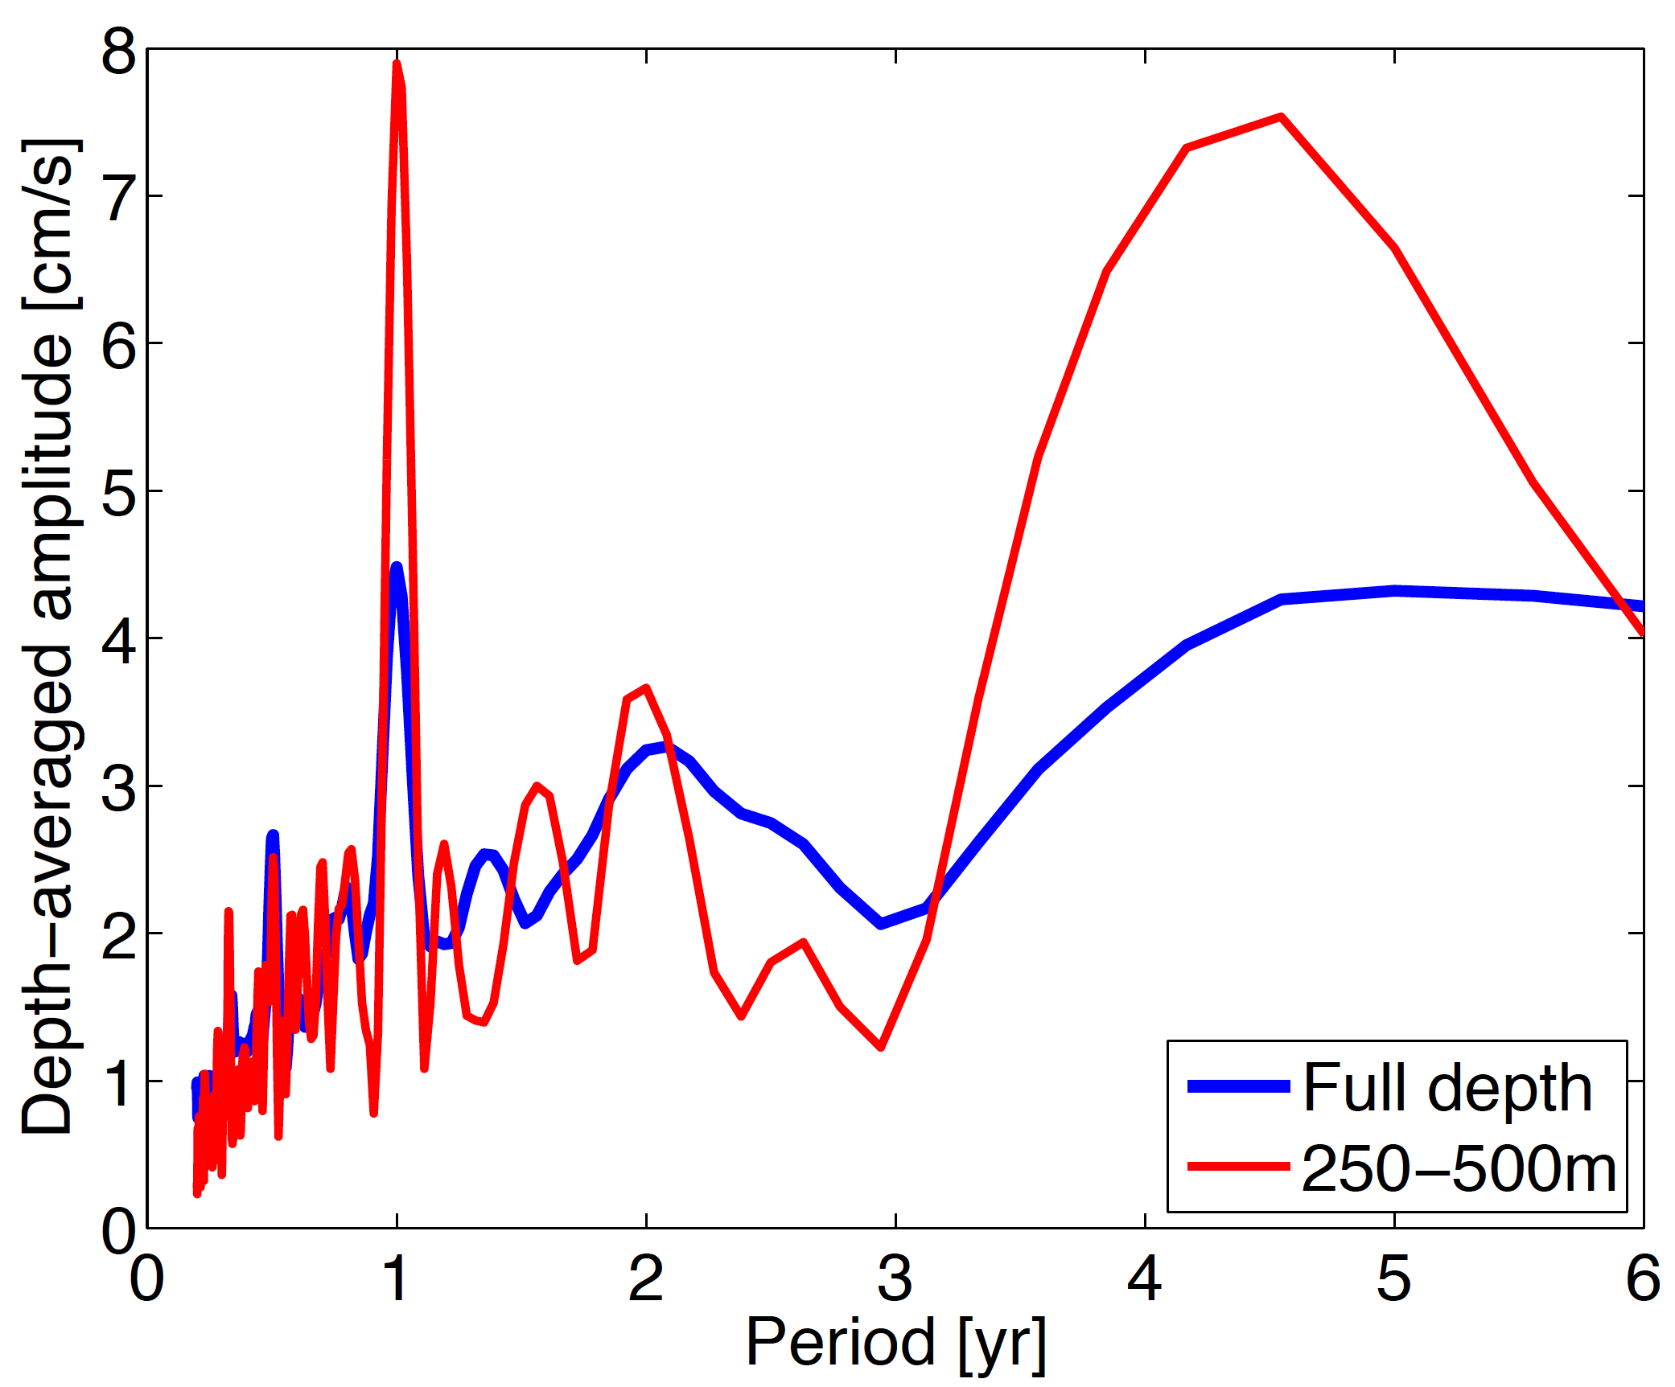
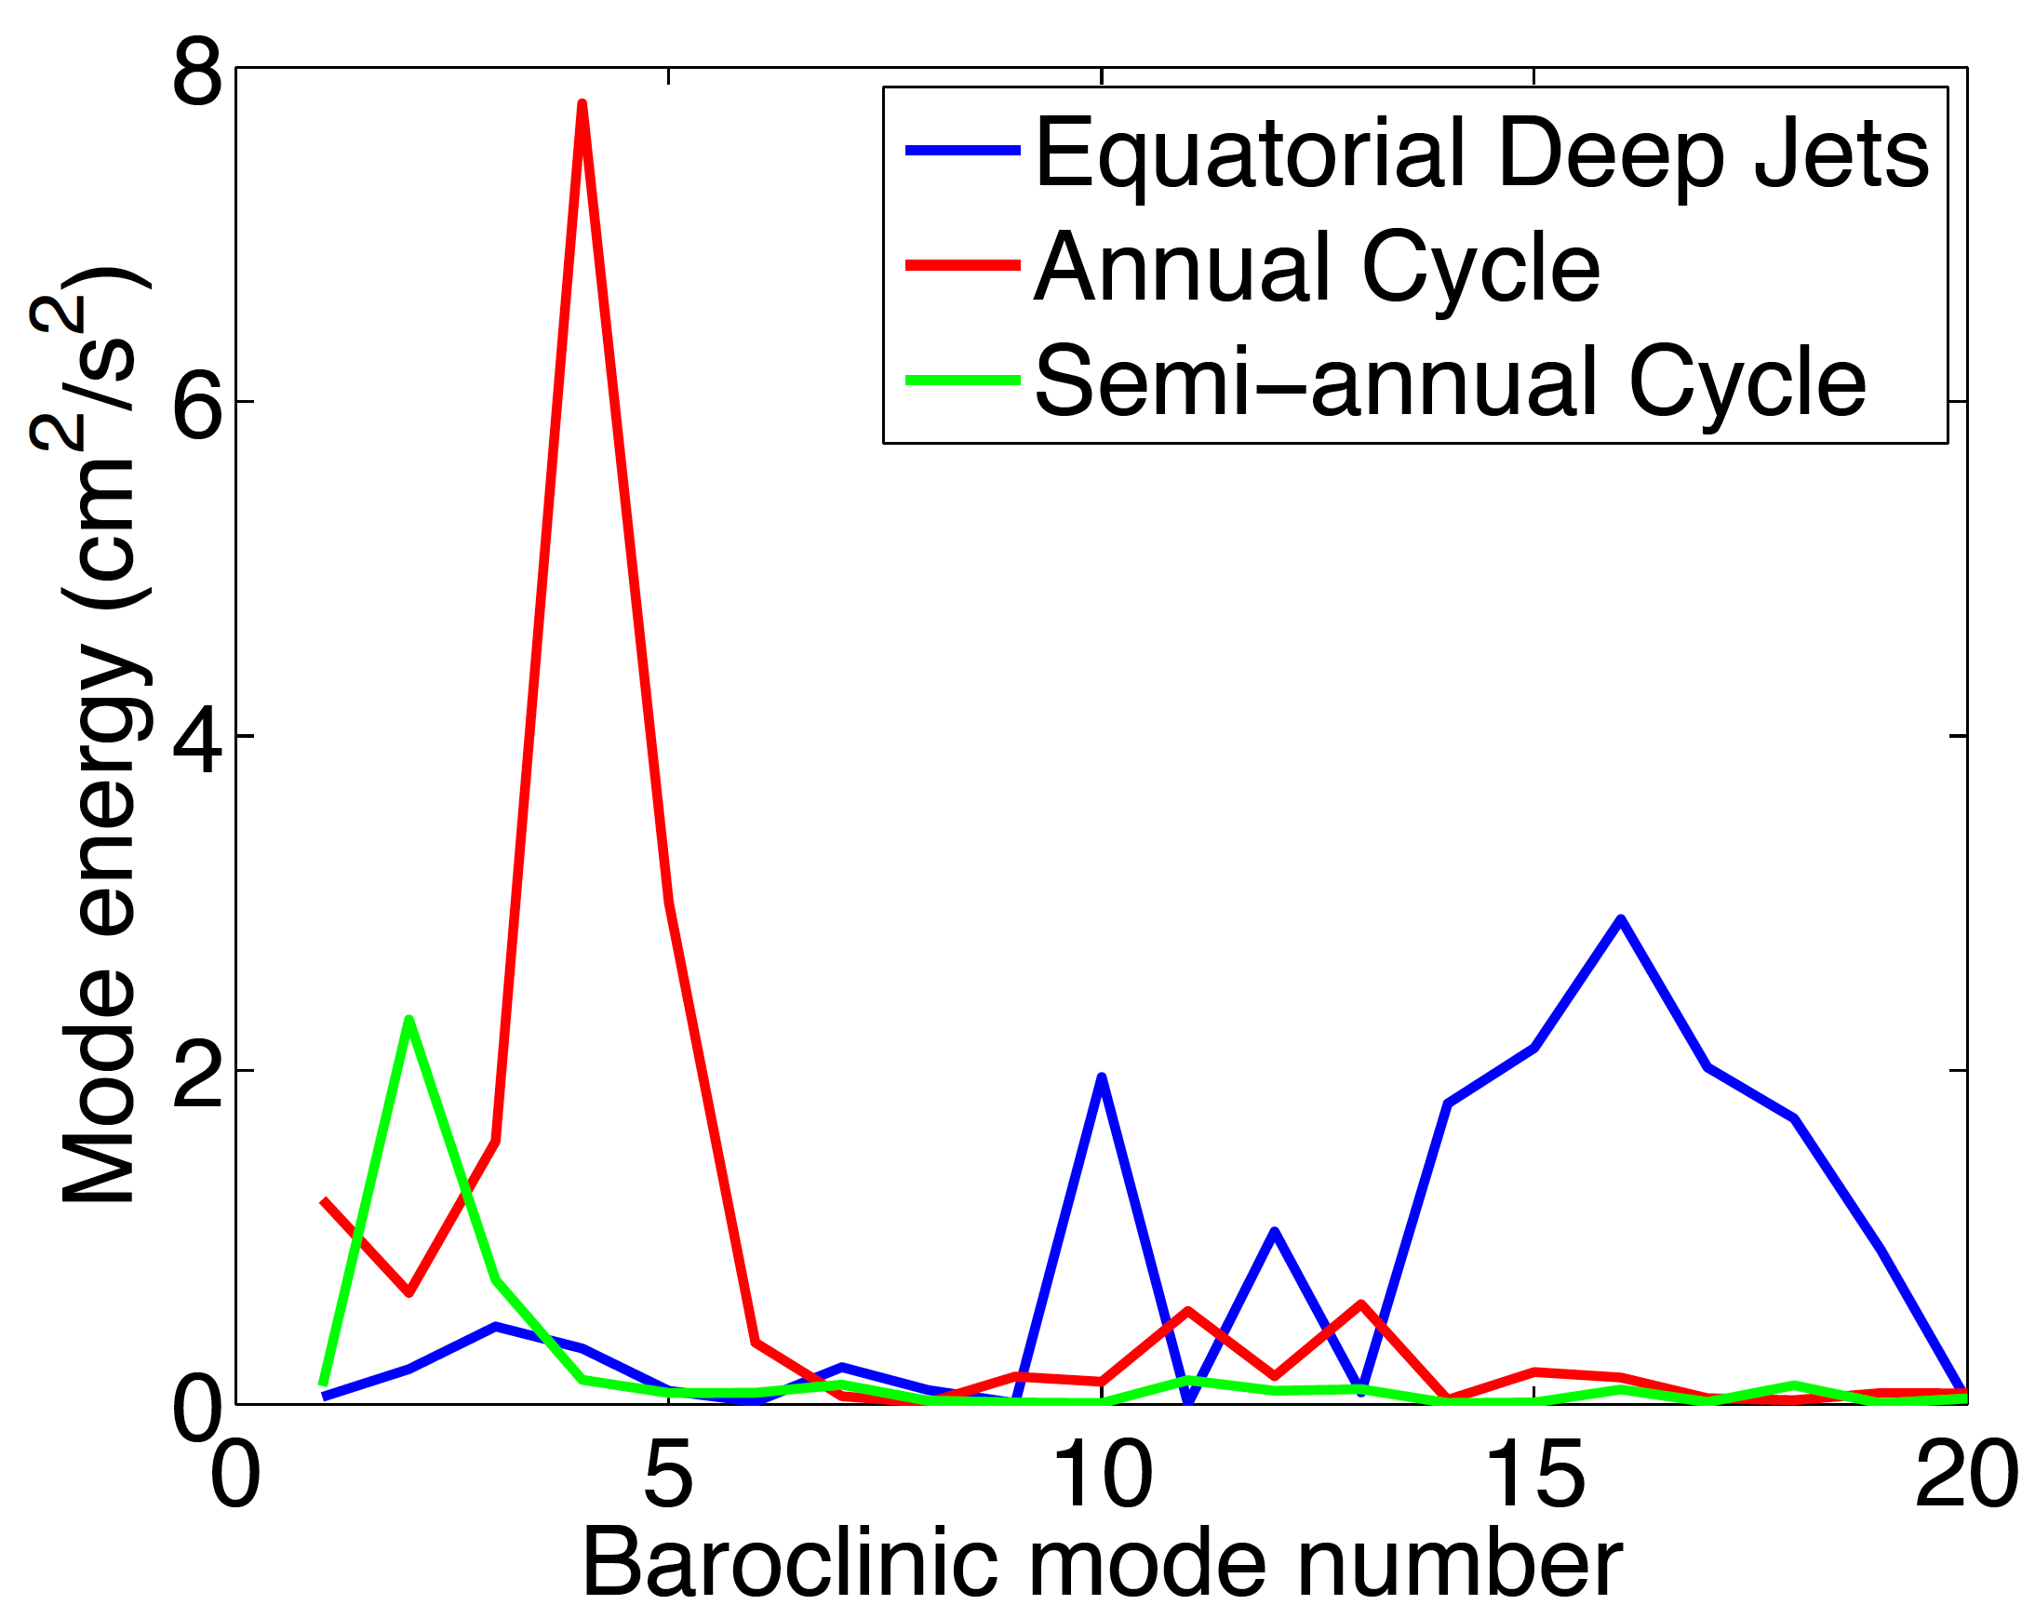
Spectral Peaks of Zonal Velocity
Distinct peaks are associated with
equatorial deep jets (about 4.5 years)
annual cycle
semi-annual cycle
Baroclinic Structure

Slide 25
Equatorial Basin Modes
Cane and Moore (1981) described low-frequency standing equatorial modes composed of equatorial Kelvin and long Rossby waves using single layer reduced-gravity model
Period of the gravest basin mode:
Applications:
Resonance of 2nd baroclinic mode semi-annual cycle in the Indic (Jensen 1993, Han et al. 1999) and Atlantic (Thierry et al. 2004, Ding et al. 2009)
Resonance of intraseasonal variability in the Indic (Han et al. 2005, Fu 2007)
EDJ behavior (Johnson and Zhang 2003, d‘Orgeville et al. 2007)
Notes:
Fu 2007: The semiannual SSH variability is characterized by a basin mode involving Rossby waves and Kelvin waves
traveling back and forth in the equatorial Indian Ocean between 10°S and 10°N. However, the interference
of these waves with each other masks the appearance of individual Kelvin and Rossby waves, leading to a
nodal point (amphidrome) of phase propagation on the equator at the center of the basin. The characteristics
of the mode correspond to a resonance of the basin according to theoretical models. For the semiannual
period and the size of the basin, the resonance involves the second baroclinic vertical mode of the
ocean.

Slide 26
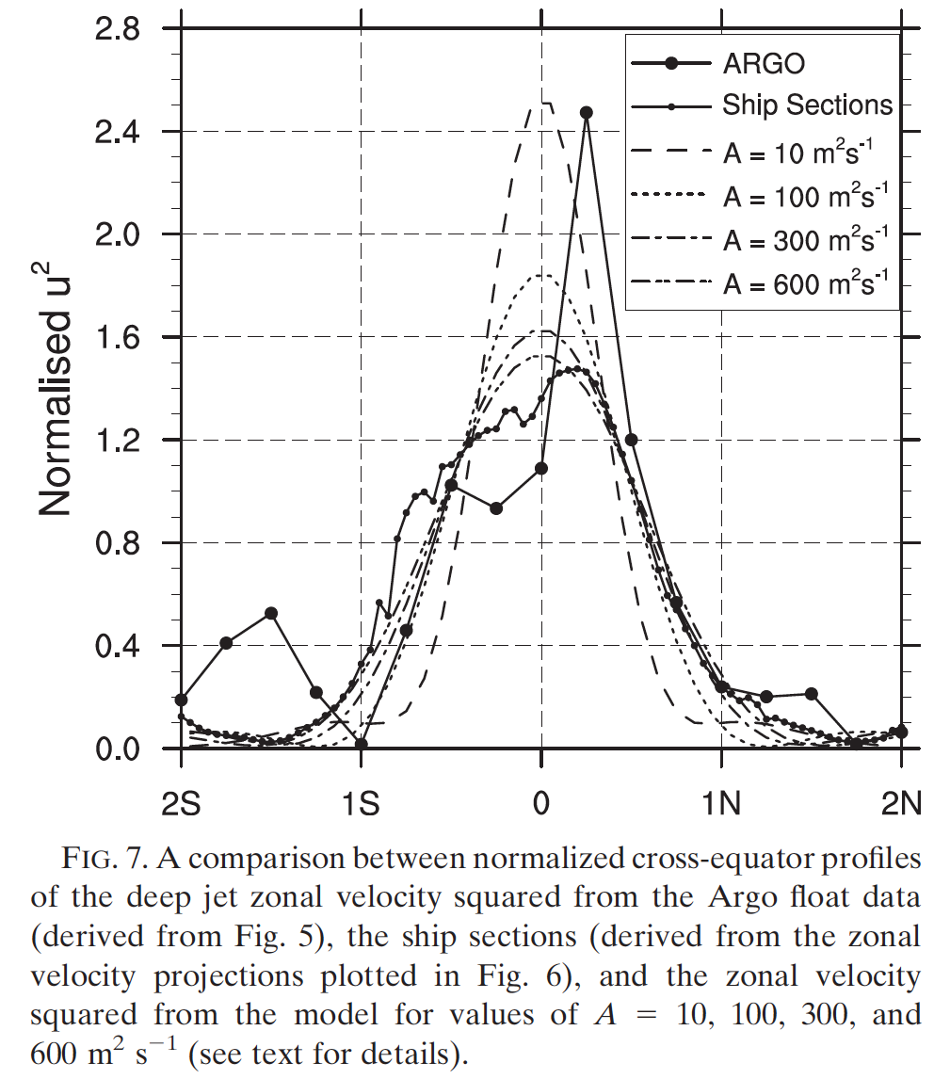
Basin modes for the Description of Equatorial Deep Jets
Greatbatch et al. 2012
Inclusion of eddy viscosity results in more realitic width of equatorial deep jets

Slide 27
Equatorial Deep Jets
Deep ocean is dominated by EDJs
Downward phase and upward energy propagation
Is there an impact on the surface circulation?

Slide 28
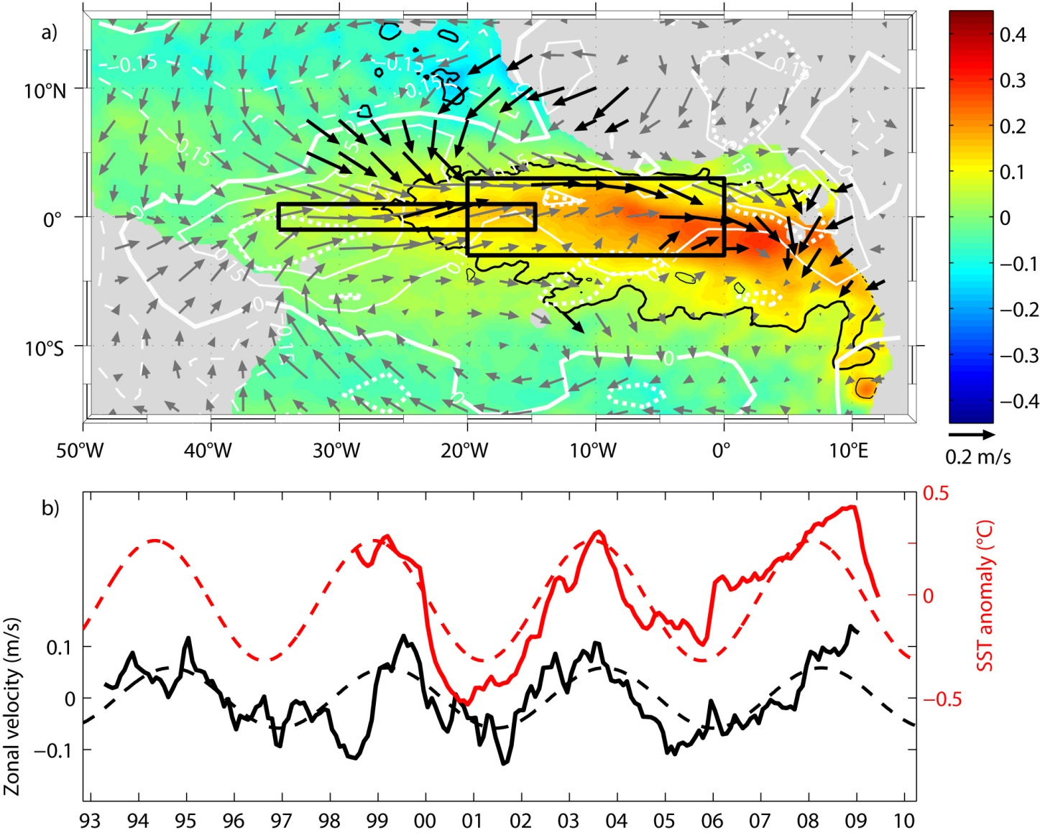
4.5-year Climate Cycle
Geostrophic equatorial zonal surface velocity, SST, and wind with 4.5-year variability
However, many open questions regarding EDJ oscillations …
Brandt, Funk, Hormann, Dengler, Greatbatch, Toole 2011

Slide 29
Equatorial Deep Jets
Greatbatch et al. (2012): EDJ can be described by high-baroclinic, equatorial basin modes.
How are the jets forced?
Inertial Instability (Hua et al. 1997, d’Orgeville et al. 2004, Eden and Dengler 2008)
Destabilization of mixed Rossby-gravity waves (Ascani et al. 2006, d’Orgeville et al. 2007, Hua et al. 2008, Ménesguen et al. 2009)
Ascani et al. (2015) simulated EDJs generated by the destabilization of internally generated tropical instability waves (TIWs)
Notes:
Inertial instability (Hua et al., 1997, 2008): On the equatorial β-plane, inertial instability occurs whenever the maximum angular momentum M = u−1/2 βy² (where u is the zonal velocity, y is latitude and β is the meridional gradient of planetary vorticity at the equator) is displaced from the equator and is thus triggered whenever a zonal flow is not symmetric with respect to y = 0.
Destabilization of mixed Rossby-gravity waves (Hua et al. 2008): For short enough zonal wavelength, the westward phase propagating MRG wave is strongly destabilized by barotropic shear instability leading to the formation of zonal jets.
d´Orgeville et al. (2007): high-resolution model with 1/11° horizontal and, throughout the water column, 12.5/25 m vertical resolution; temporally oscillating mass flux that is confined to the western boundary is applied at its northern and southern boundaries (15°S/N) to force Yanai waves; Yanai-wave forcing produces equatorial jets, basin modes sets the time scale of jets.
Ascani et al. (2010): relatively low horizontal (1/4°) and high Vertical resolution (50 m), model is forced with N/S wind stress to produce artificially 30 day Yanai waves that form a downward propagating Yanai beam, model is able to predict the occurrence of a realistic EICS, but simulates only very weak equatorial deep jets. In another simulation Ascani et al. (2006), they were able from the destabilization of the Yanai waves to produce EDJs. The model was very sensitive to different parameterizations (bottom fricting and mixing).
Eden and Dengler (2008) suggest that EDJ are related to the deep western boundary current; inertial instability may be important for their generation. They show that the strength of EDJ increase with increasing vertical and horizontal resolution, but are still underestimated at very high resolution.

Slide 30
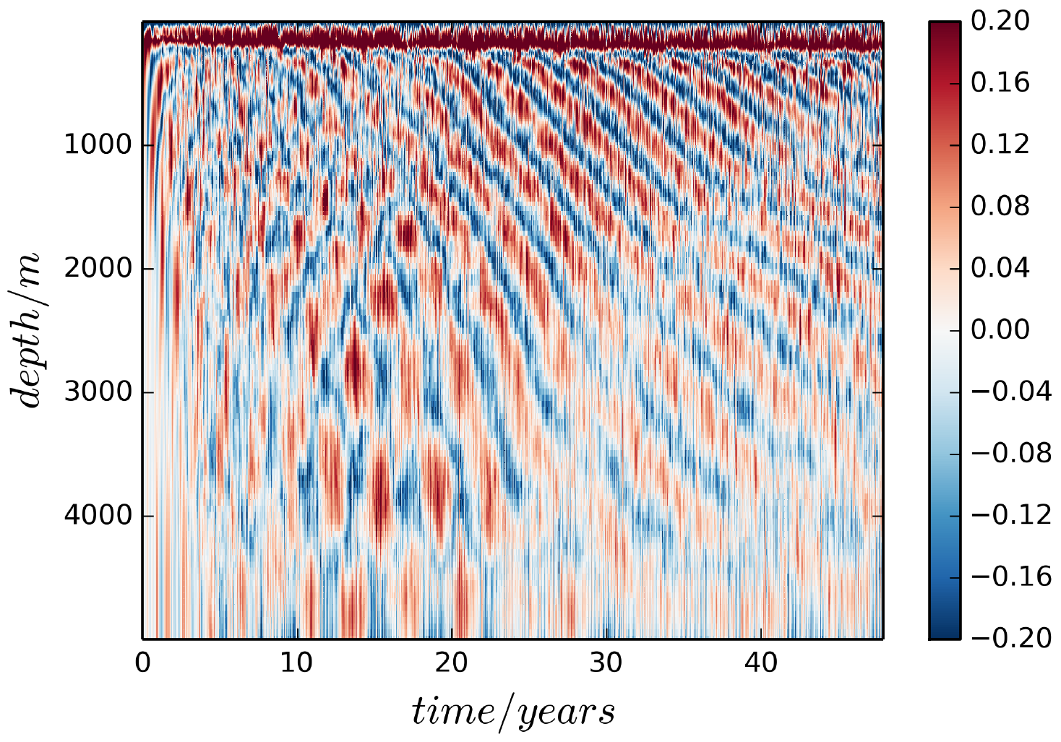
Simulations of EDJs
Ascani et al. (2015): equatorial rectangular basin forced with constant, but realistic zonal winds (1/4° resolution, 100/200 levels)
Model simulates wind-driven circulation including EUC, SEC and NECC
Near-surface circulation becomes unstable and generates TIWs
TIWs propagate downward, become barotropically unstable and give rise to EDJs
EDJs form dissipative equatorial basin modes
Superposition of several basin modes yield downward phase and upward energy propagation
Matthießen et al. 2015, submitted

Slide 31
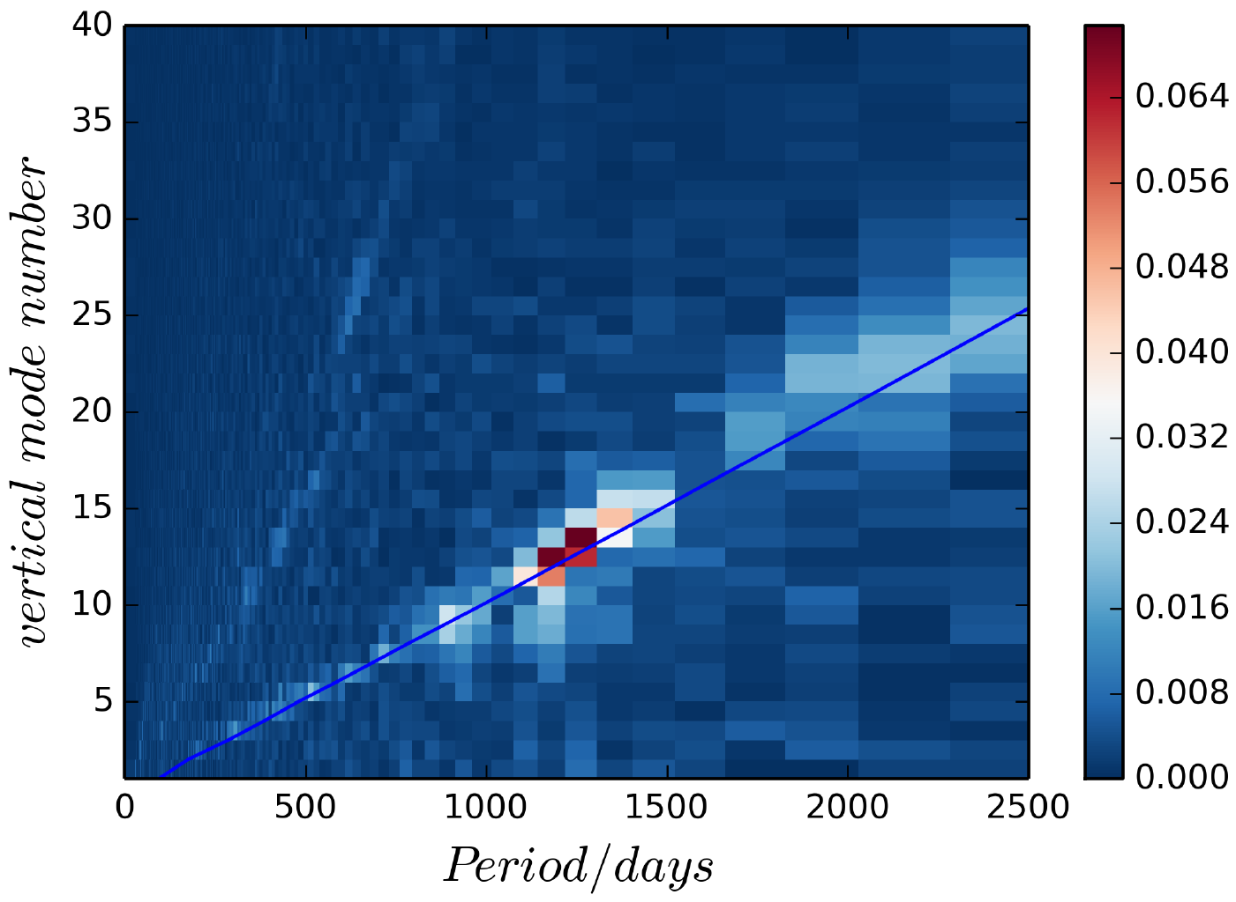
Simulations of EDJs
Modal energy is organized along basin mode characteristics
Also higher order basin modes are excited
[m/s]
Matthießen et al. 2015, submitted

Slide 32
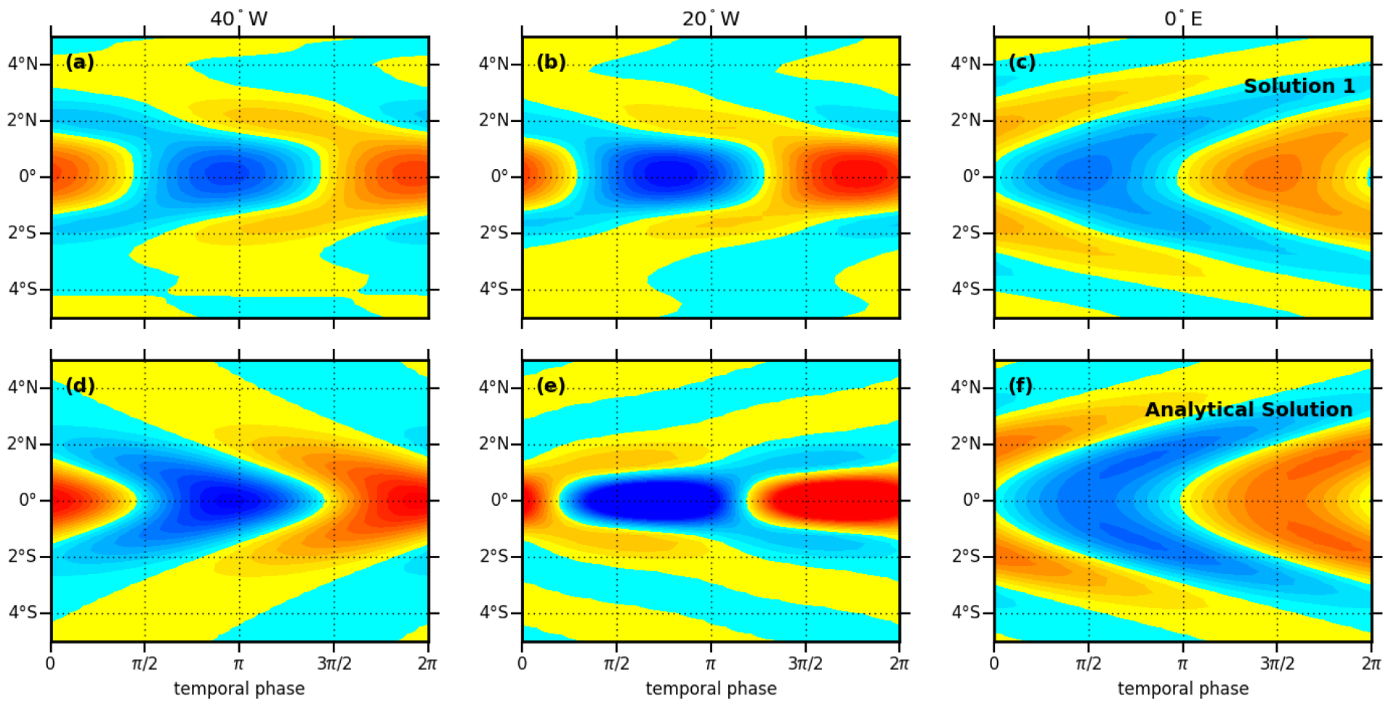
Simulations of EDJs
Horizontal and temporal structure of simulated EDJs are in good agreement with analytical solution of Cane and Moore (1981)
Ascani et al. 2015, submitted
Notes:
3.9-yr period, 12th baroclinic mode

Slide 33
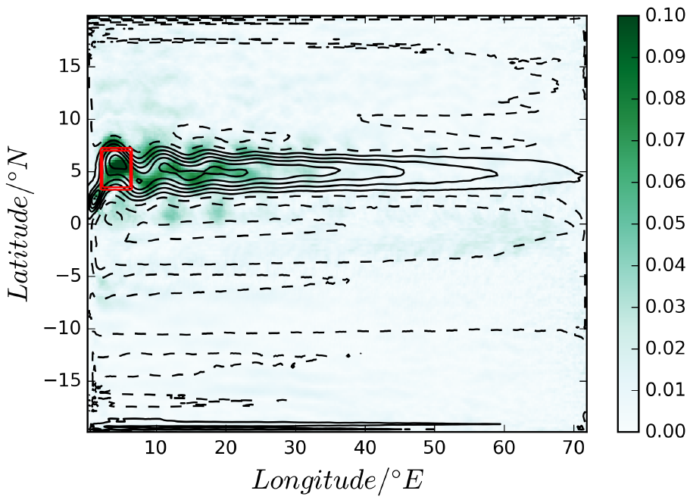
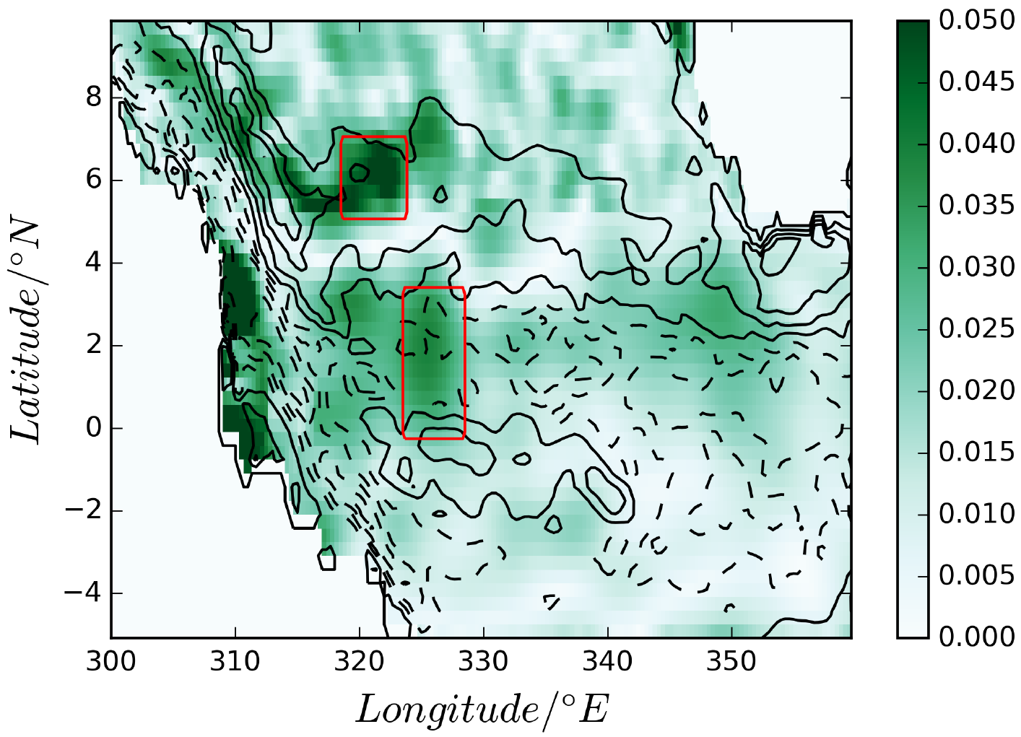
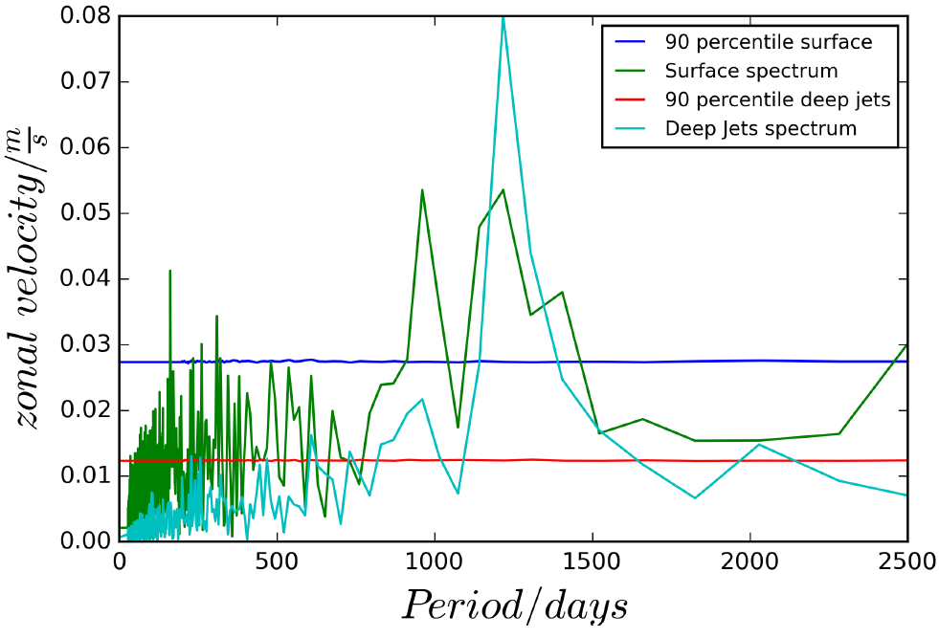
Surface Expression of EDJs
EDJ simulations reveal surface velocity signal with the same period
Strongest signal within the NECC
4.5-yr period of geostrophic zonal velocity from altimetry shows similar behavior (c.f. Hormann et al. 2012)
Matthießen et al. 2015, submitted
Notes:
The NECC has a strong interannual variability as shown by Hormann et al. (2012). Here we show that part of that variability might be linked to the upward propagation of the EDJs providing a possible feedback from the EDJs to the variability of the NECC. We argue that the presence of signicant variability in the NECC at the basin mode period (that is for the high baroclinic vertical normal mode that dominates the EDJ variability) supports the view that the influence at this period is upward, from the EDJ to the NECC, and not the other way round.

Slide 34
Summary (2)
Equatorial zonal velocity variability dominated by equatorial basin modes of different periods
High baroclinic mode EDJs oscillate at 4.5-yr period and represent internal variability of the ocean
EDJ generation due to downward propagating TIWs
EDJs are associated with surface flow variability at the same period, most dominant within the NECC
Better process understanding is required for EDJ-surface flow interaction as well as for the impact of surface flow variability on SST and climate

Slide 35
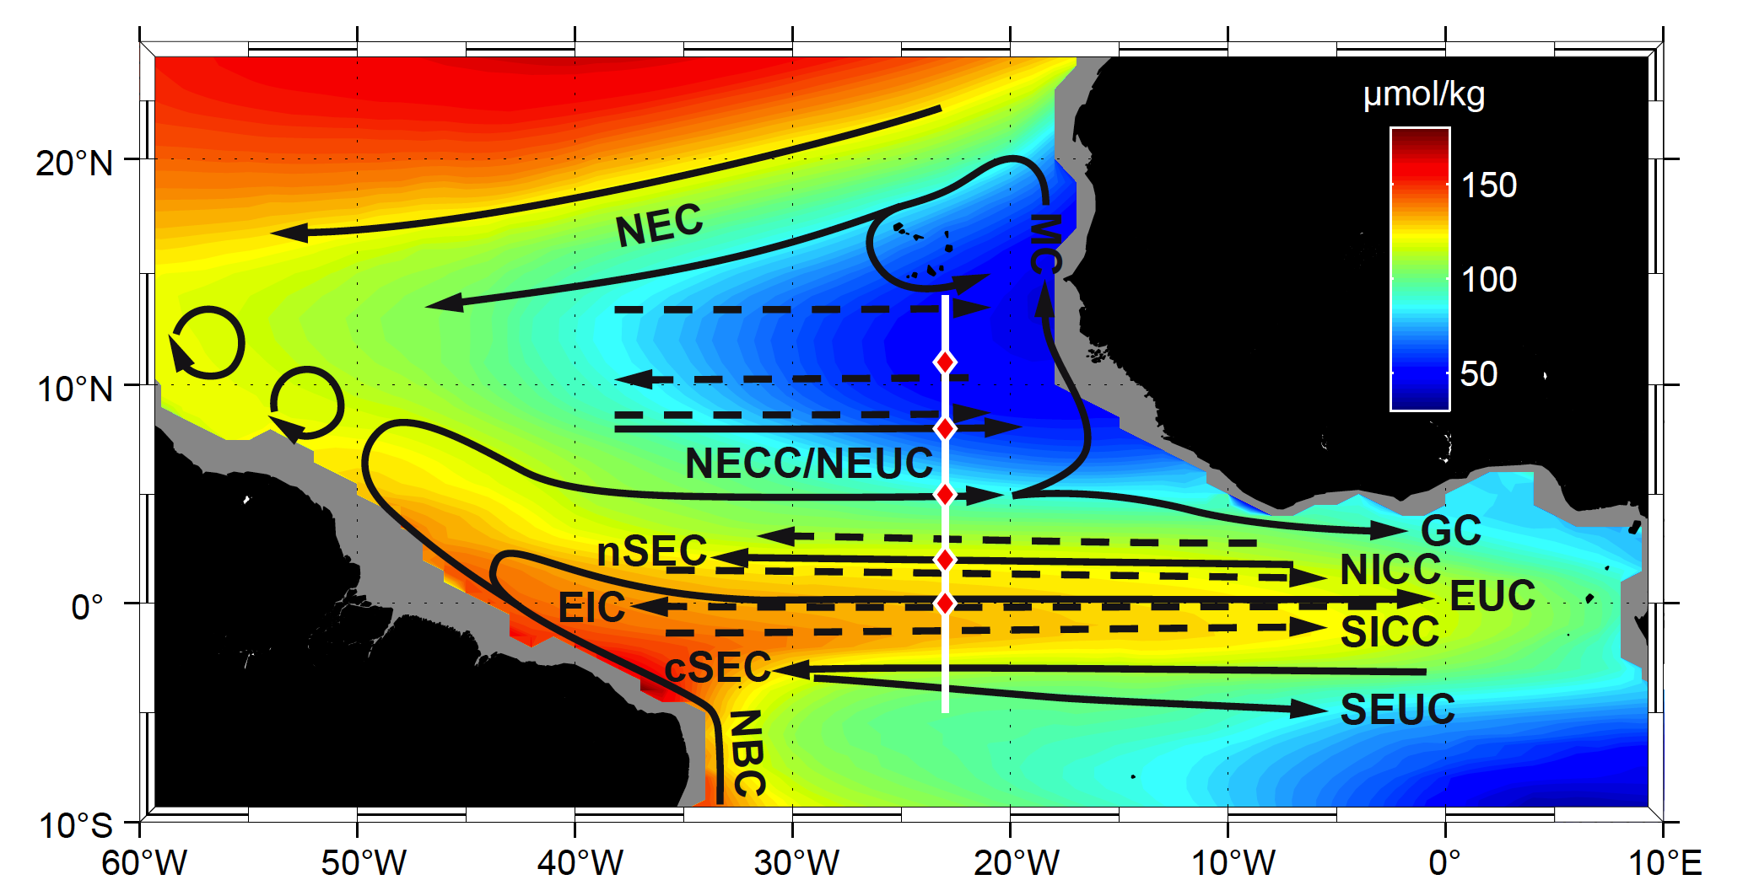
Circulation‘s Role in Ventilating the Oxygen Minimum Zone
Energetic equatorial circulation and latitudinally stacked jets
Measurement program along 23°W
Brandt et al. 2015

Slide 36
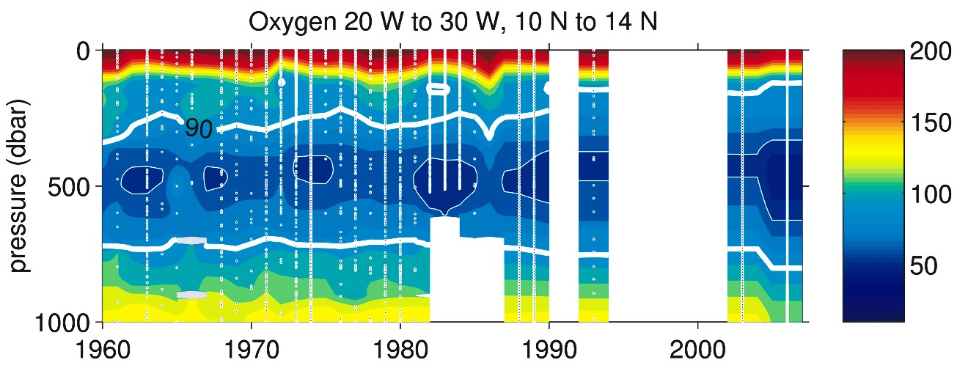
Deoxygenation in the tropical North Atlantic OMZ
Oxygen data show a reduction of dissolved oxygen in the North Atlantic OMZ over the last 40 years
Better understanding of ventilation physics required
μmol/kg
Stramma et al. 2008

Slide 37
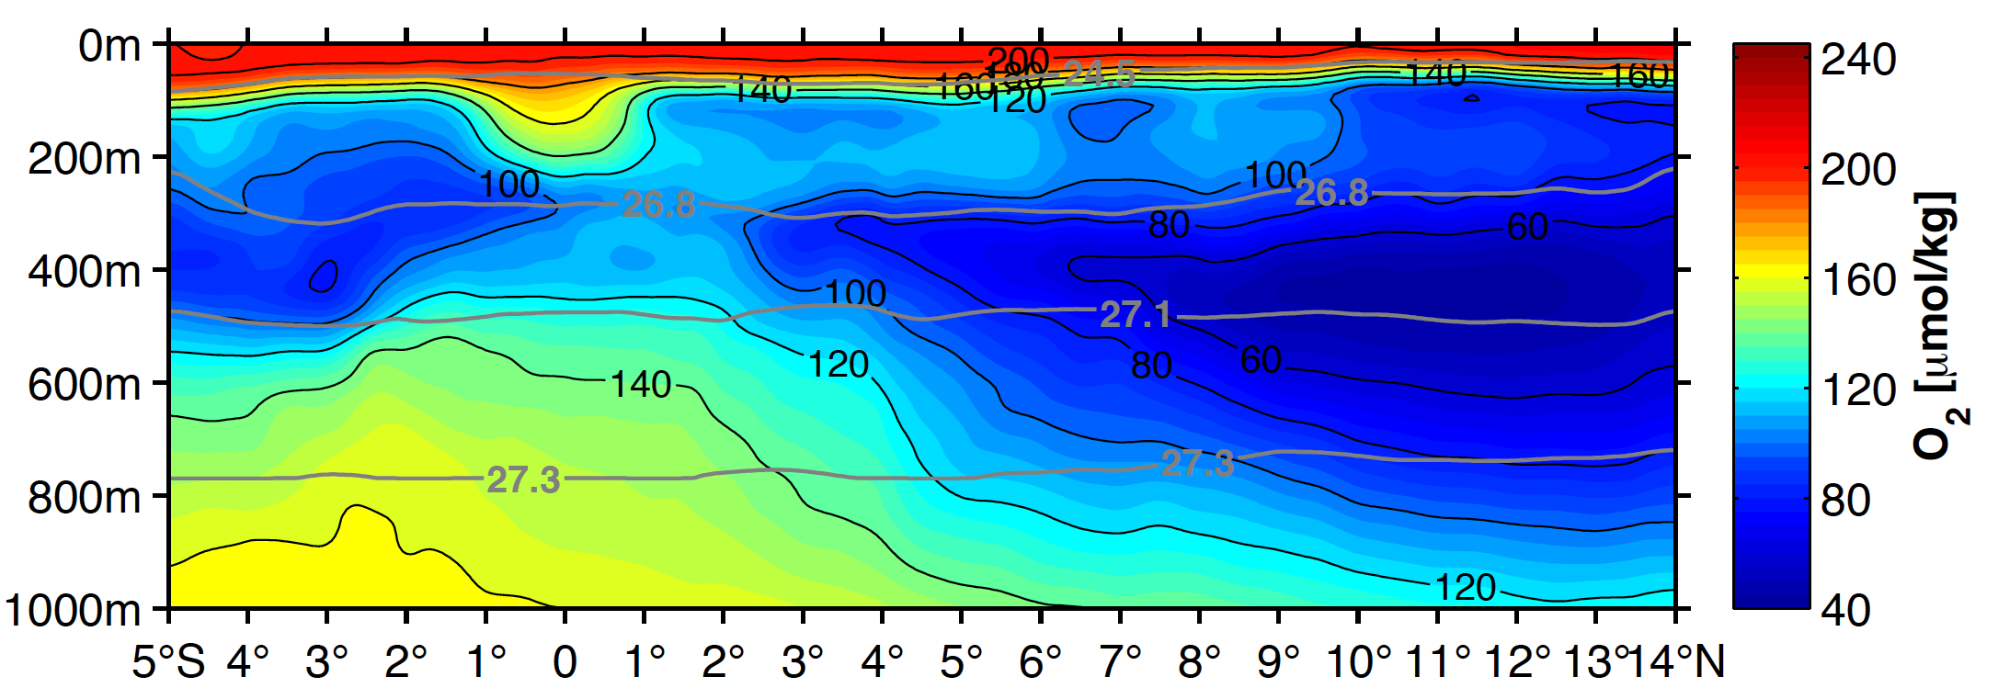
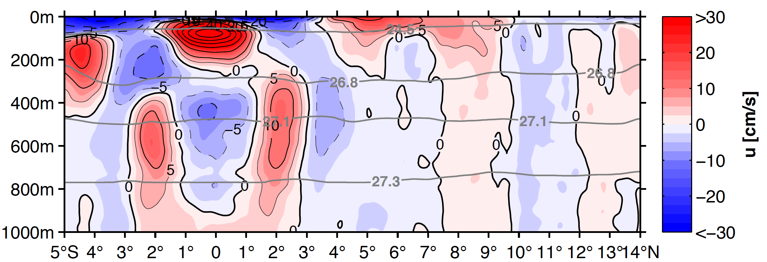
Mean 23°W Section
Equatorial oxygen maximum
Deep oxycline at about 300m or σ_{θ}=26.8 kg/m³
OMZ is ventilated from the west by zonal currents

Slide 38
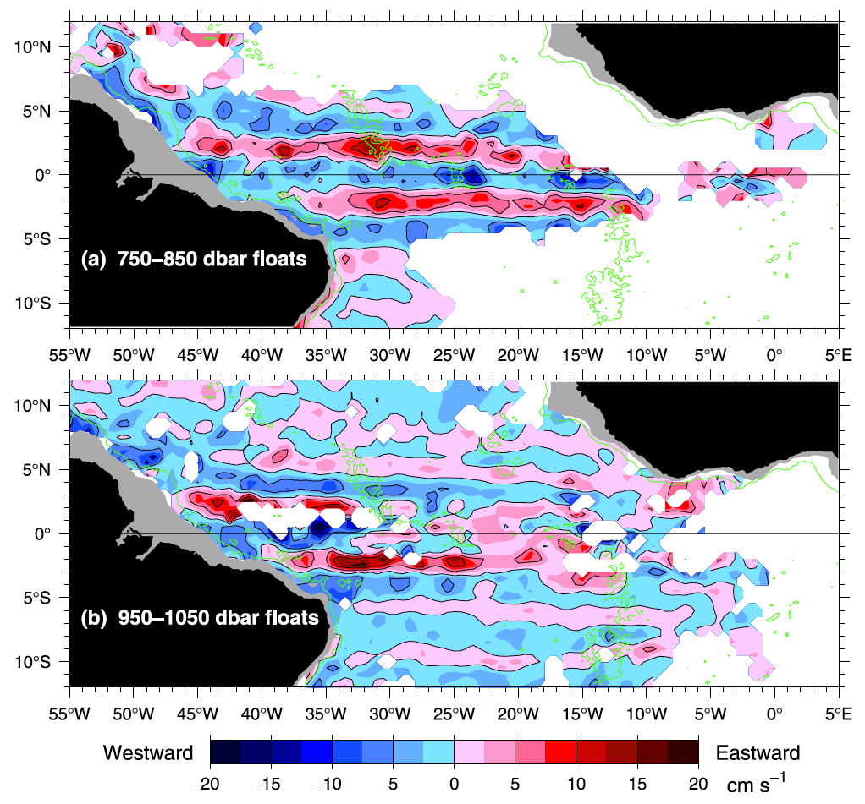
Latitudinally Stacked Zonal Jets in the Tropical Atlantic
Mean zonal velocity from profiling and acoustically-tracked floats
Zonal jets penetrating into the OMZ
Ollitrault et al. 2006
Notes:
Particularly strong latitudinally alternating zonal jets (or EIC system) are observed in the Pacific and Atlantic Oceans, comparably weak EICS in the Indian Ocean. Note that Equatorial Deep Jets are of comparable strengths in all three oceans.

Slide 39
Equatorial oxygen and velocity distribution
Oxygen maximum at and energetic flow along the equator
Largely missing in global Earth System Models
Oschlies, pers. comm. 2013

Slide 40
Role of Equatorial Circulation on the Oxygen Distribution
Velocity field of basin mode oscillations representing EDJs can be used to study their effect on the oxygen distribution
Notes:
The similarity between the EDJ and the gravest equatorial basin mode (Cane and Moore, 1981) for a high order baroclinic vertical normal mode has been noted by many authors, e.g. Johnson and Zhang (2003), d’Orgeville et al. (2007) and Brandt et al. (2011), although since the EDJ propagate vertically they cannot correspond exactly to such a mode (in reality there is forcing and dissipation as well as the influence of variable bottom topography and non-linearity to break an exact correspondence to a basin mode).

Slide 41
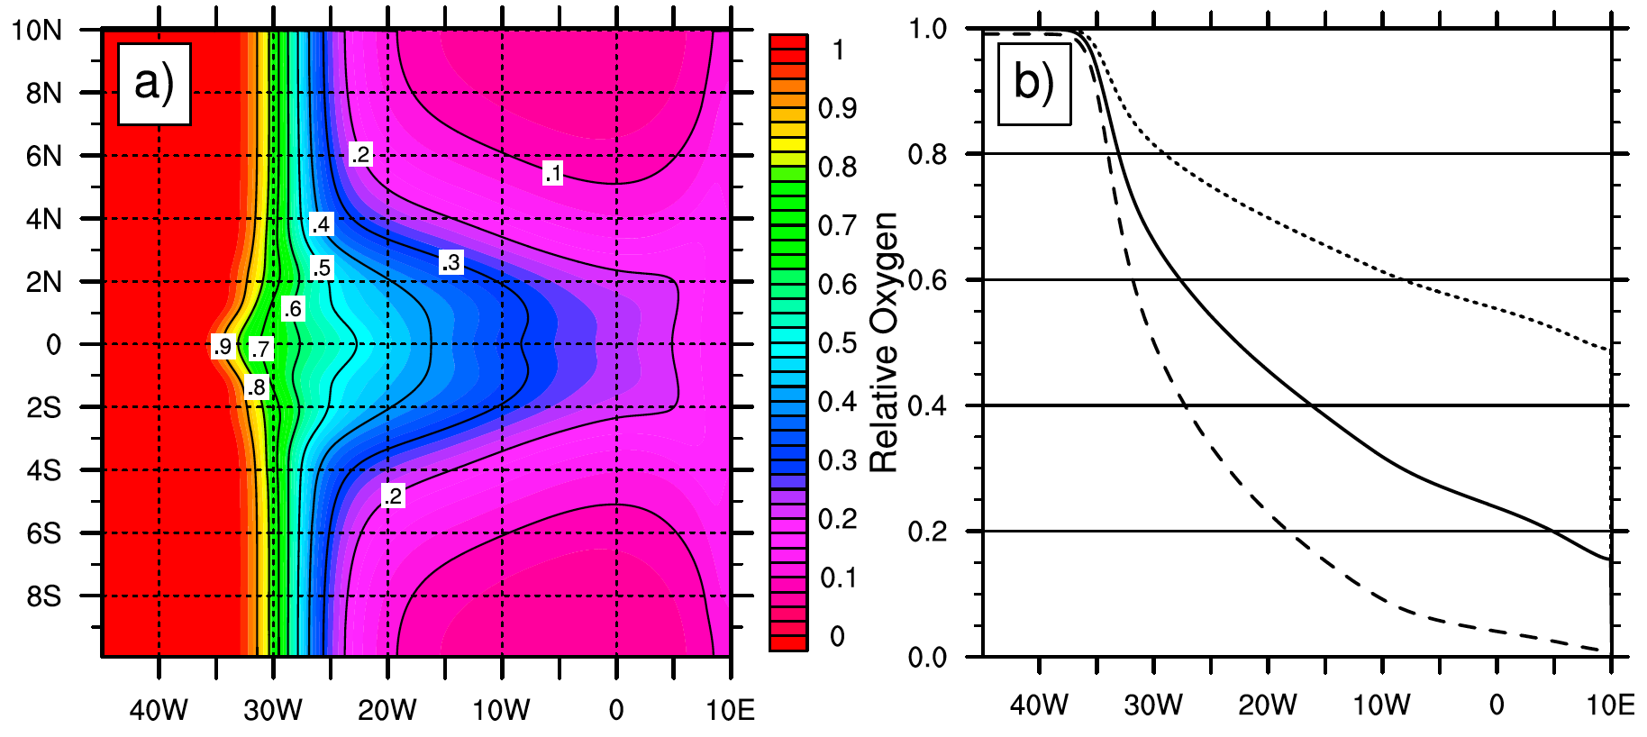
Advection-Diffusion Model
Model is forced by the velocity field of the equatorial basin mode
It includes a restoring to western boundary oxygen concentrations within a boundary layer and oxygen consumption (van Geen et al. 2006 and factor 5 larger, dashed or smaller, dotted)
Simulation are performed until a constantly oscillating state is reached (about 160 yr)
Mean relative oxygen shows ventilation of the equatorial band due to basin mode oscillations
Equator
Brandt et al. 2012

Slide 42
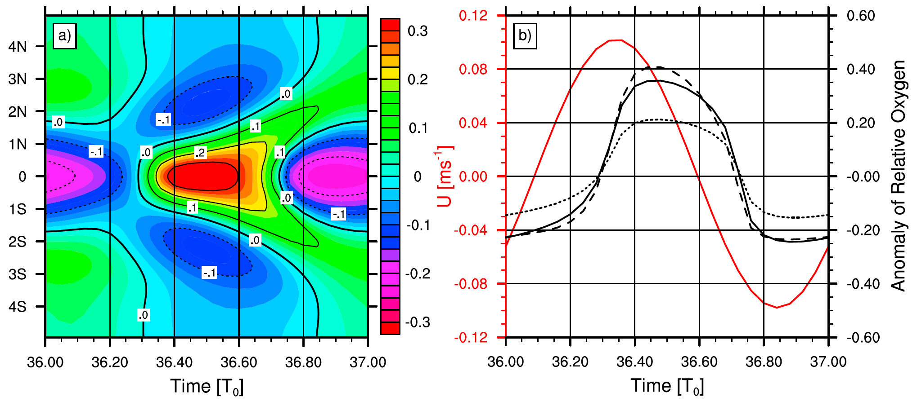
Simulated Variability of Relative Oxygen Concentration at 23°W
Oxygen oscillates with the basin mode period (T₀ = 4.5 yr) cycle having amplitudes of about 25% of western boundary values
Maximum oxygen concentration occurs after maximum eastward velocity (not in quadrature → mean flux)
Notes:
The total range of the oxygen concentration variability is about 55% of the western boundary value.

Slide 43
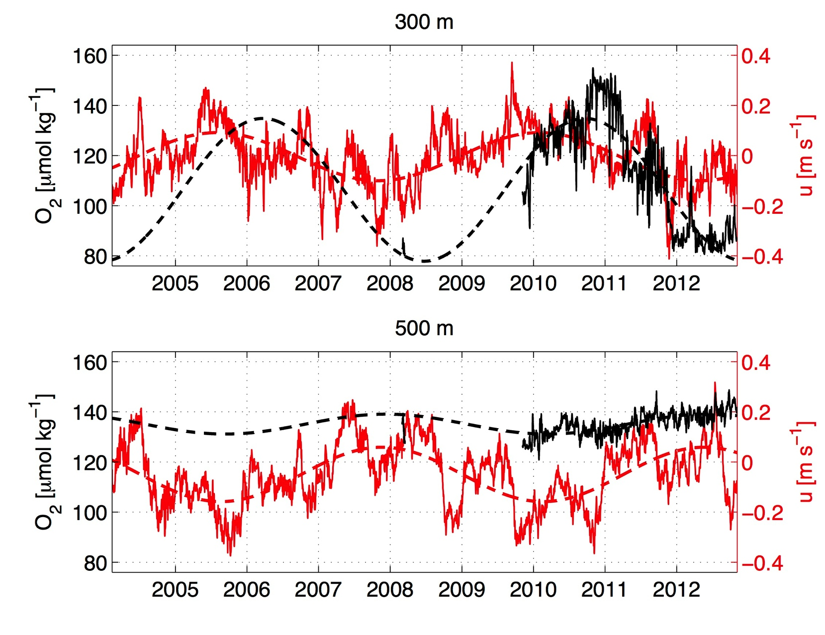
4.5-yr Deep Jet Cycle in Moored Observations at Equator, 23°W
Max O₂ slightly after max zonal velocity
Larger O₂ amplitude at 300 m than at 500 m
Ventilation of equatorial Atlantic by Deep Jets
Update of Brandt et al. 2012
Notes:
Oxygen time series are from March 1st to March 16th, 2008 and from November, 2009 to October, 2012.

Slide 44
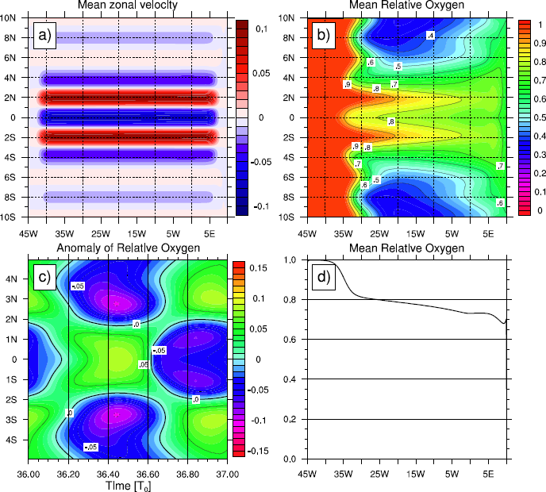
Advection-Diffusion Model with EDJs & Latitudinally Stacked Jets
Mean zonal flow field
Mean oxygen distribution
Oxygen anomaly along 23°W
Mean Oxygen along the equator

Slide 45
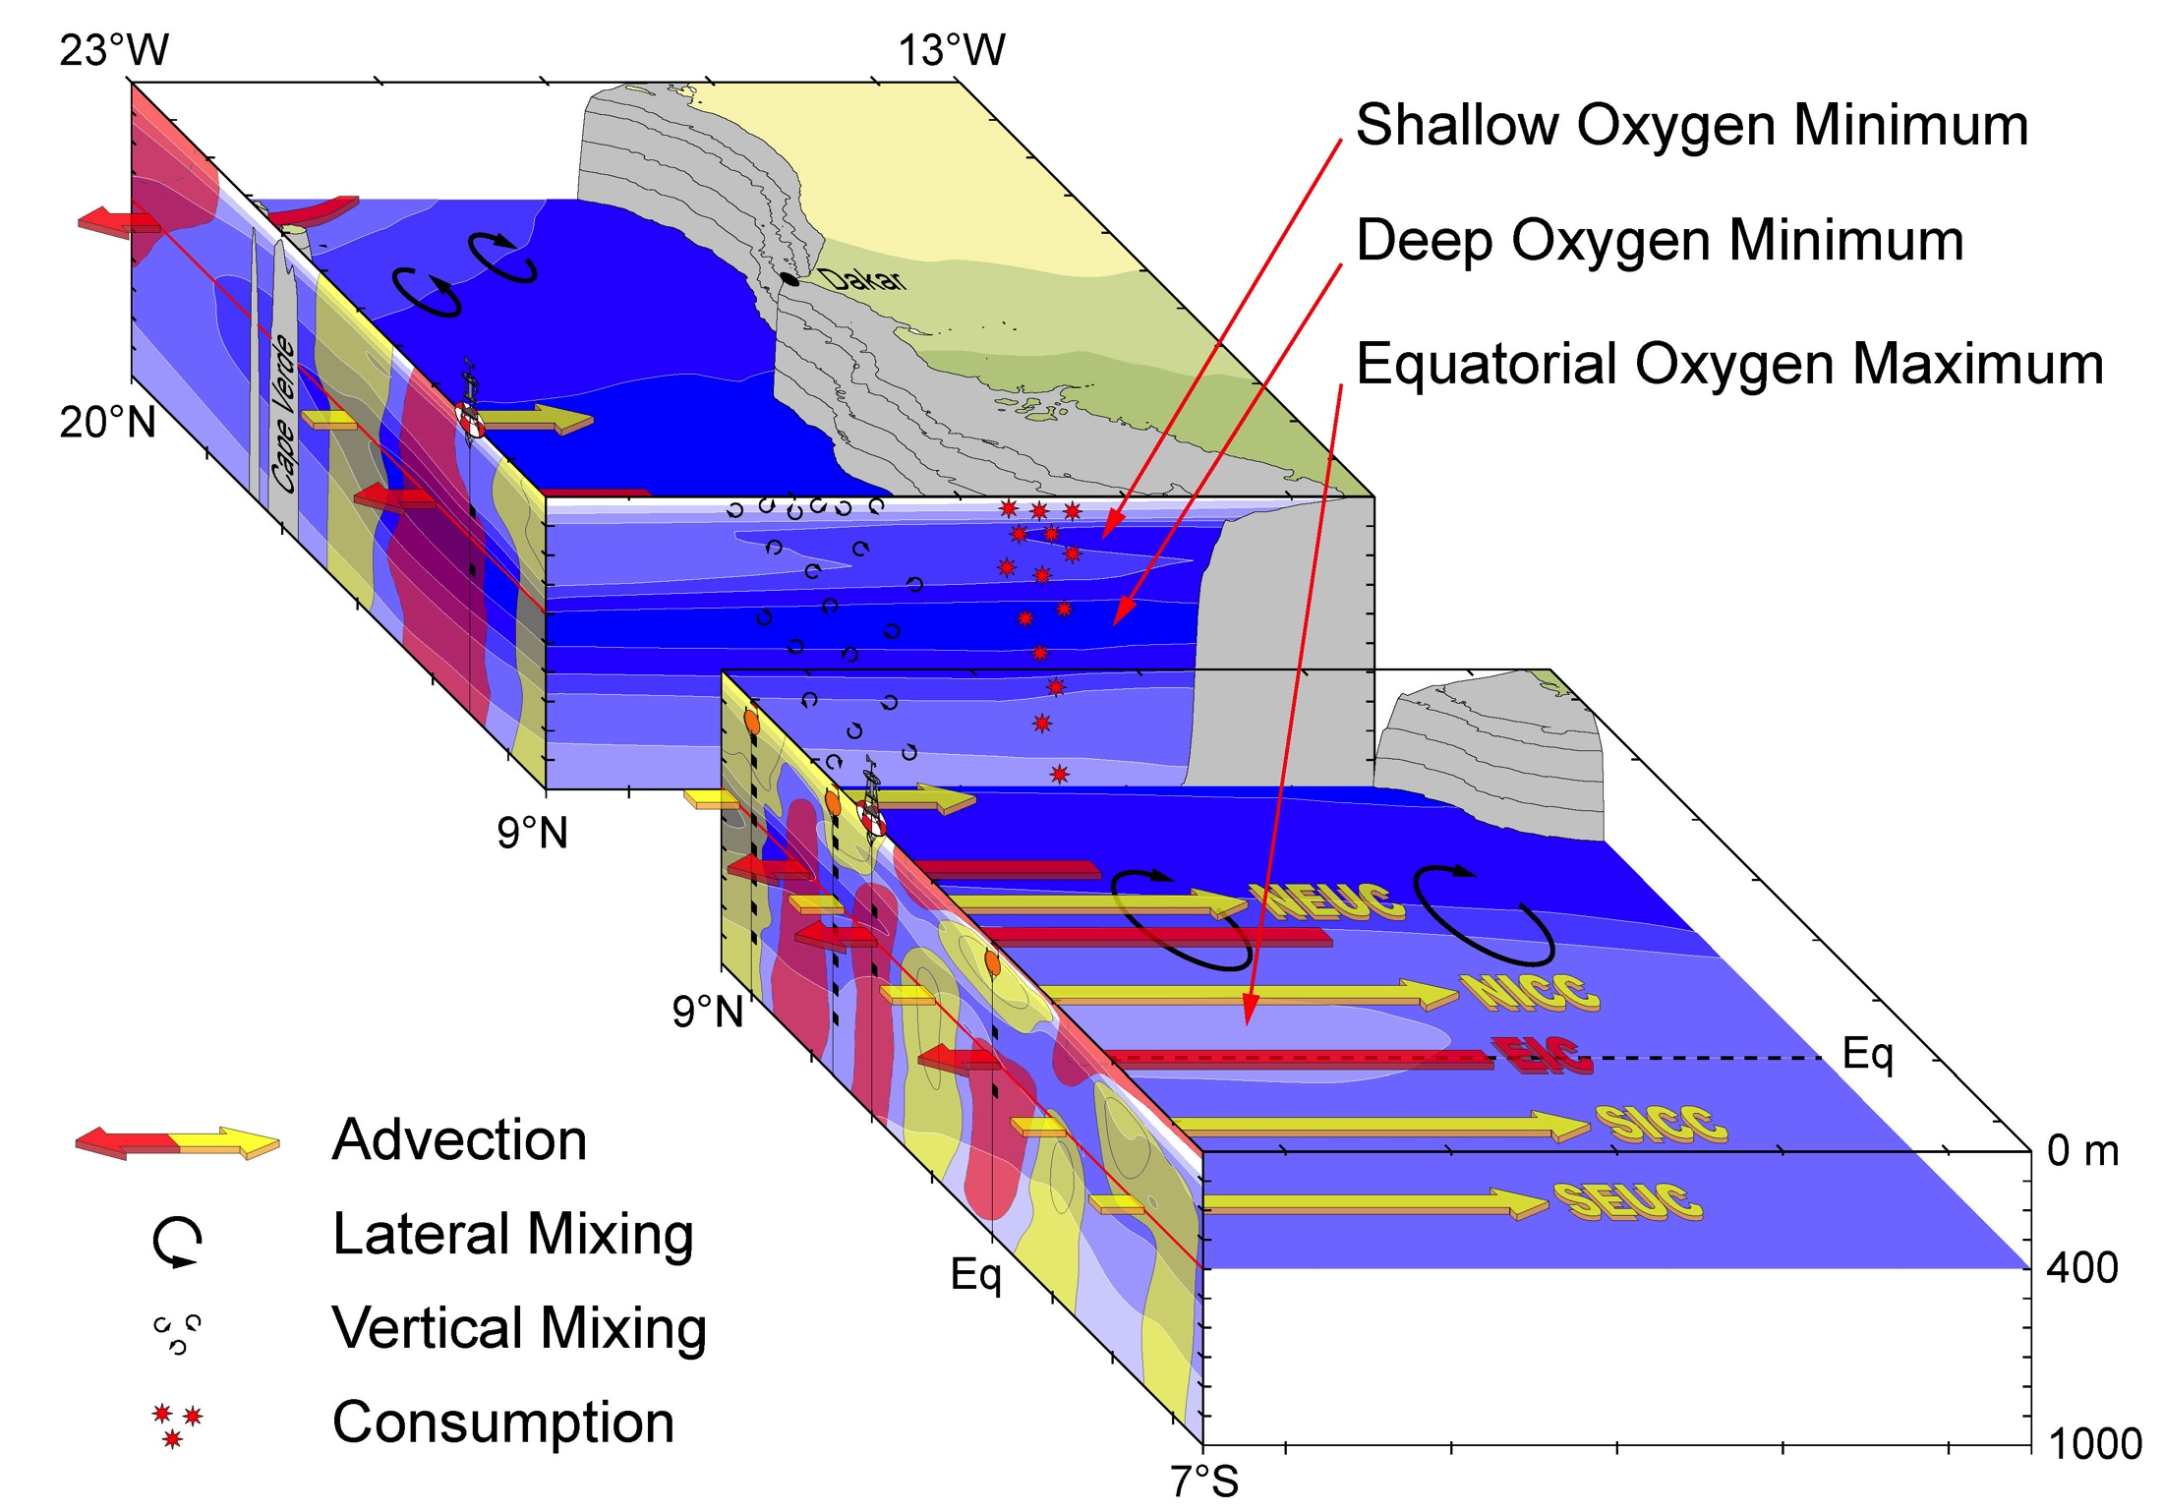

Slide 46
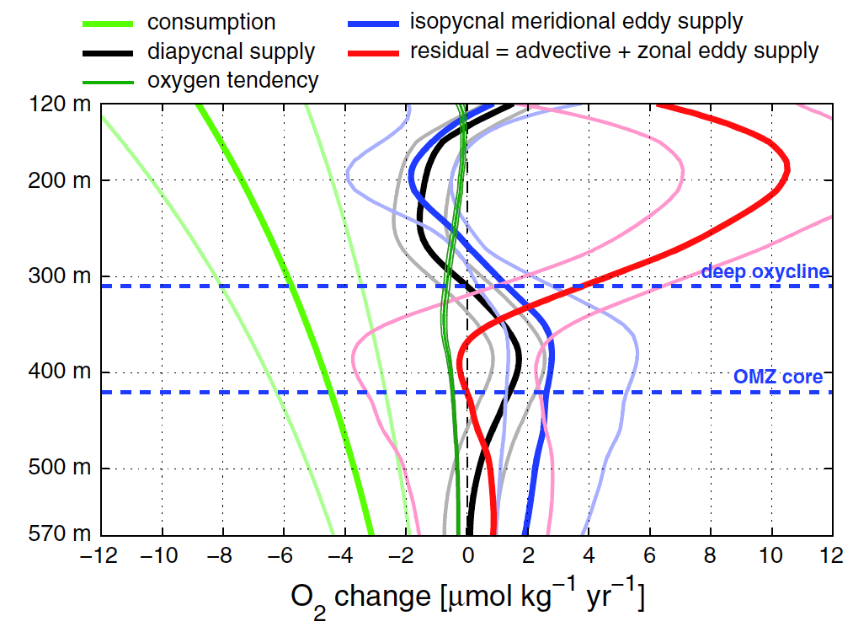
Oxygen Budget of the ETNA OMZ
Oxygen sink
Heterotrophic respiration
Oxygen source or sink:
Diapycnal mixing
Meridional eddy fluxes
Advection by latitudinally alternating zonal jets
Oxygen tendency
1972-85 to 1999-2008
Hahn et al. 2014

Slide 47
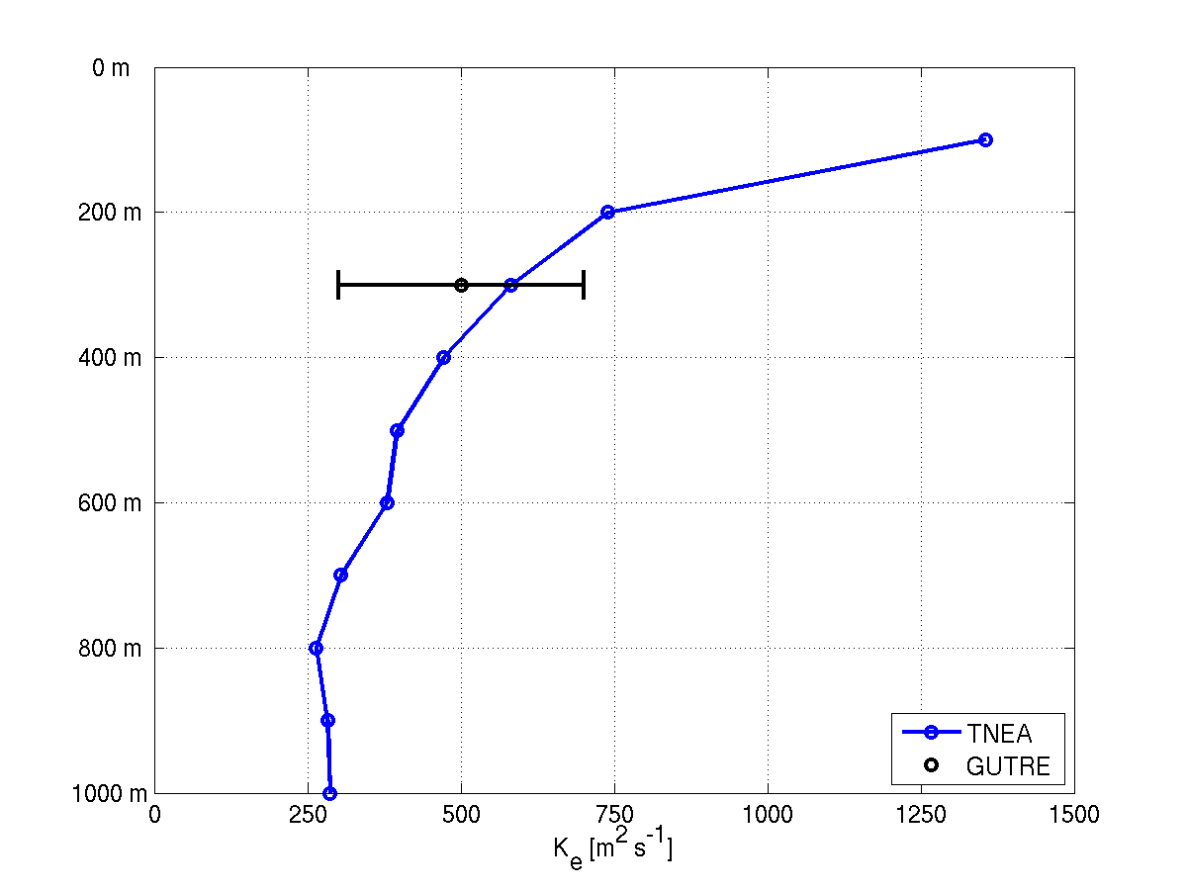
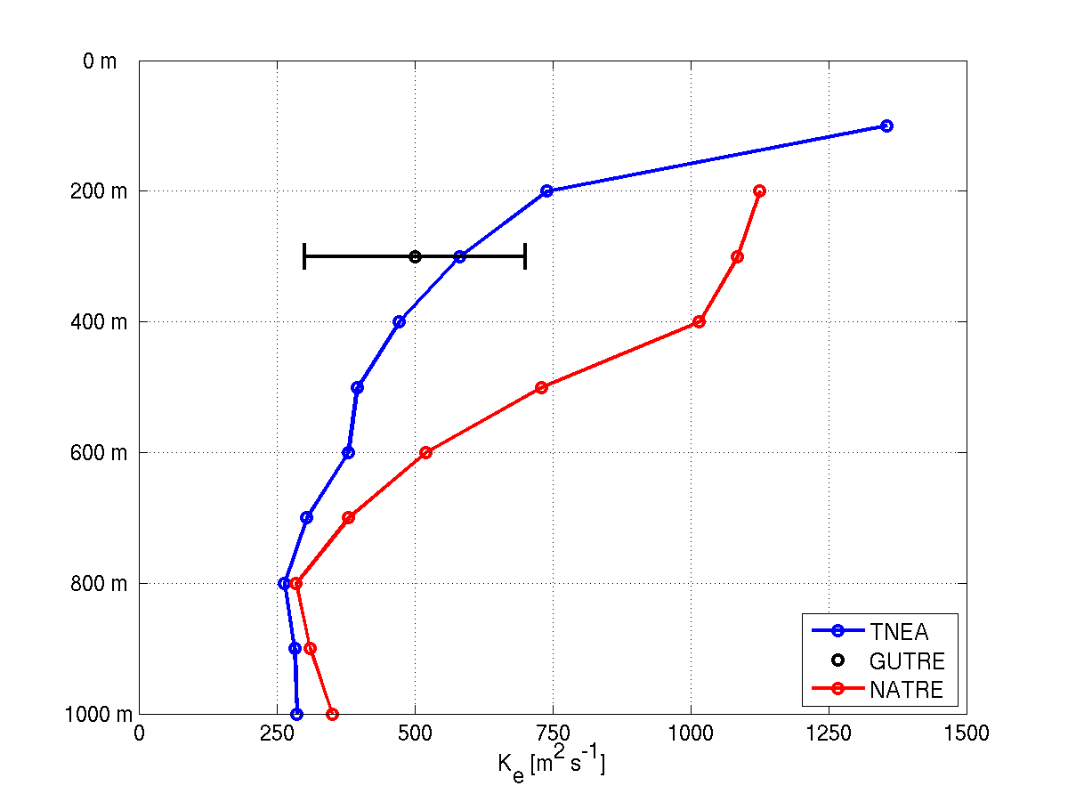
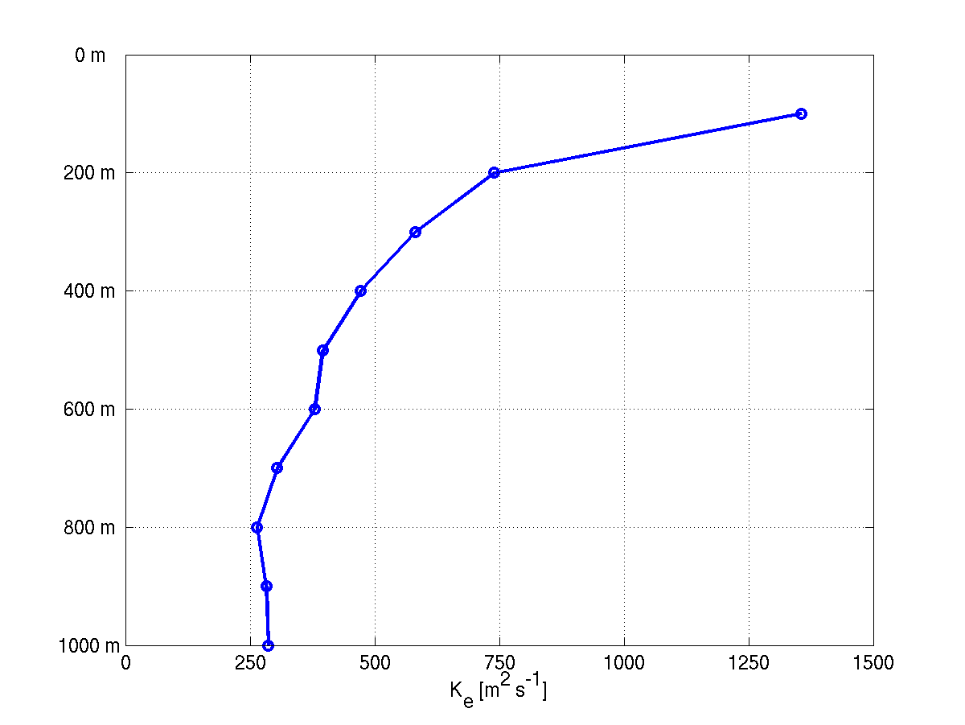
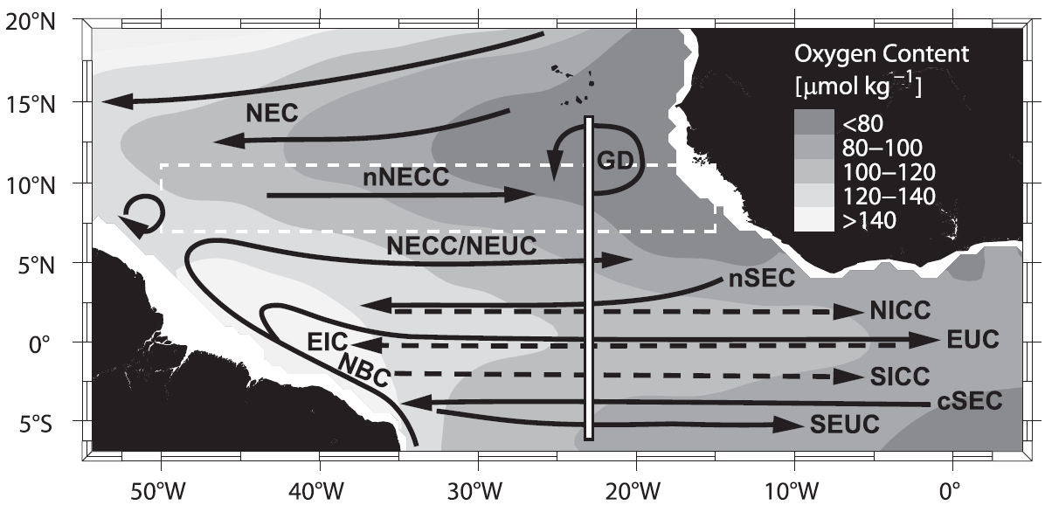
Mean Eddy Diffusivity Profile K_{e}
Brandt et al. (2010)
TNEA: Hahn et al. (2014)
GUTRE: Banyte et al. (2013)
NATRE: Ferrari and Polzin (2005)

Slide 48
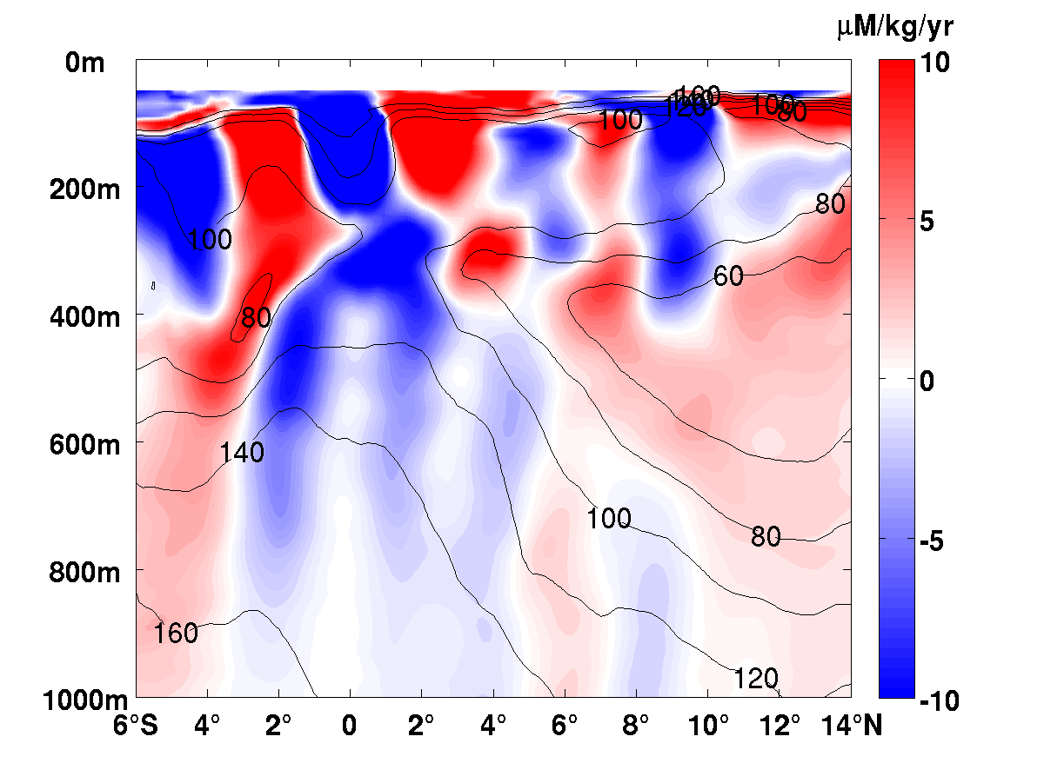
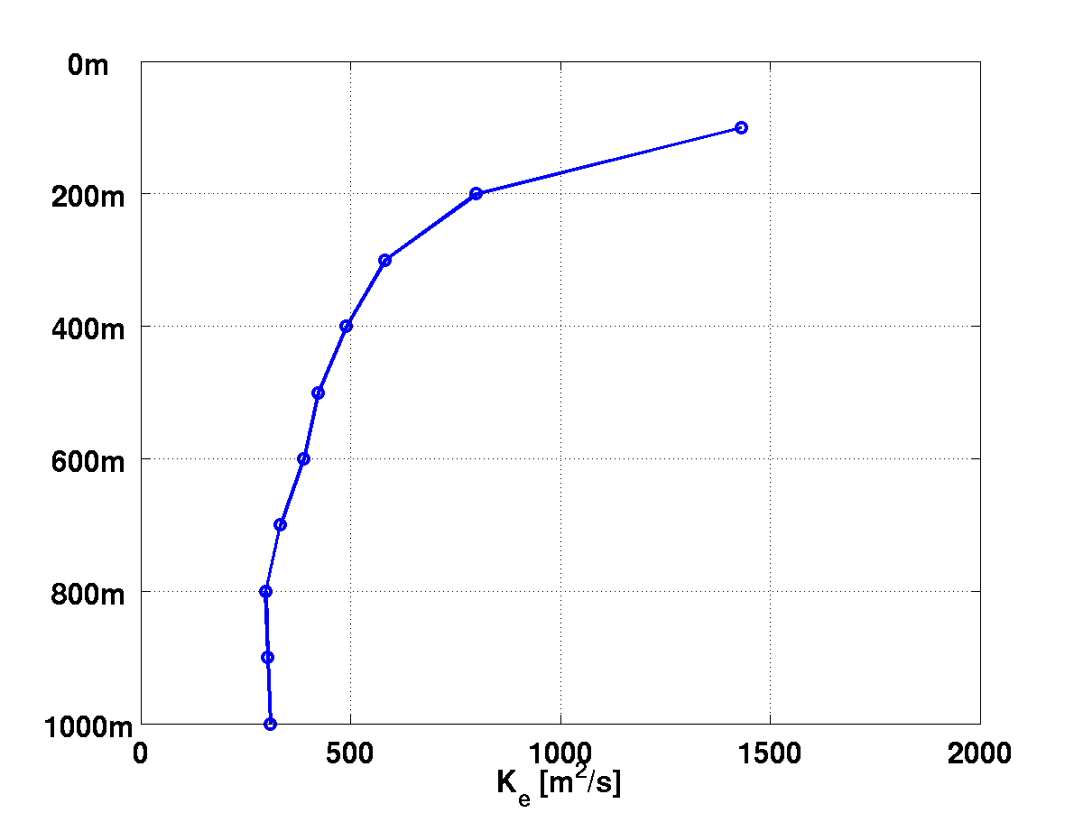
Eddy Flux Divergence
Oxygen supply due to meridional eddy flux
Meridional eddy diffusivity
Hahn et al. 2014
Notes:
In the jet like structures of the upper ocean, eddy diffusivity distributes oxygen: high-oxygen cores of eastward currents looses oxygen, while low-oxygen cores of westward currents gains oxygen.

Slide 49
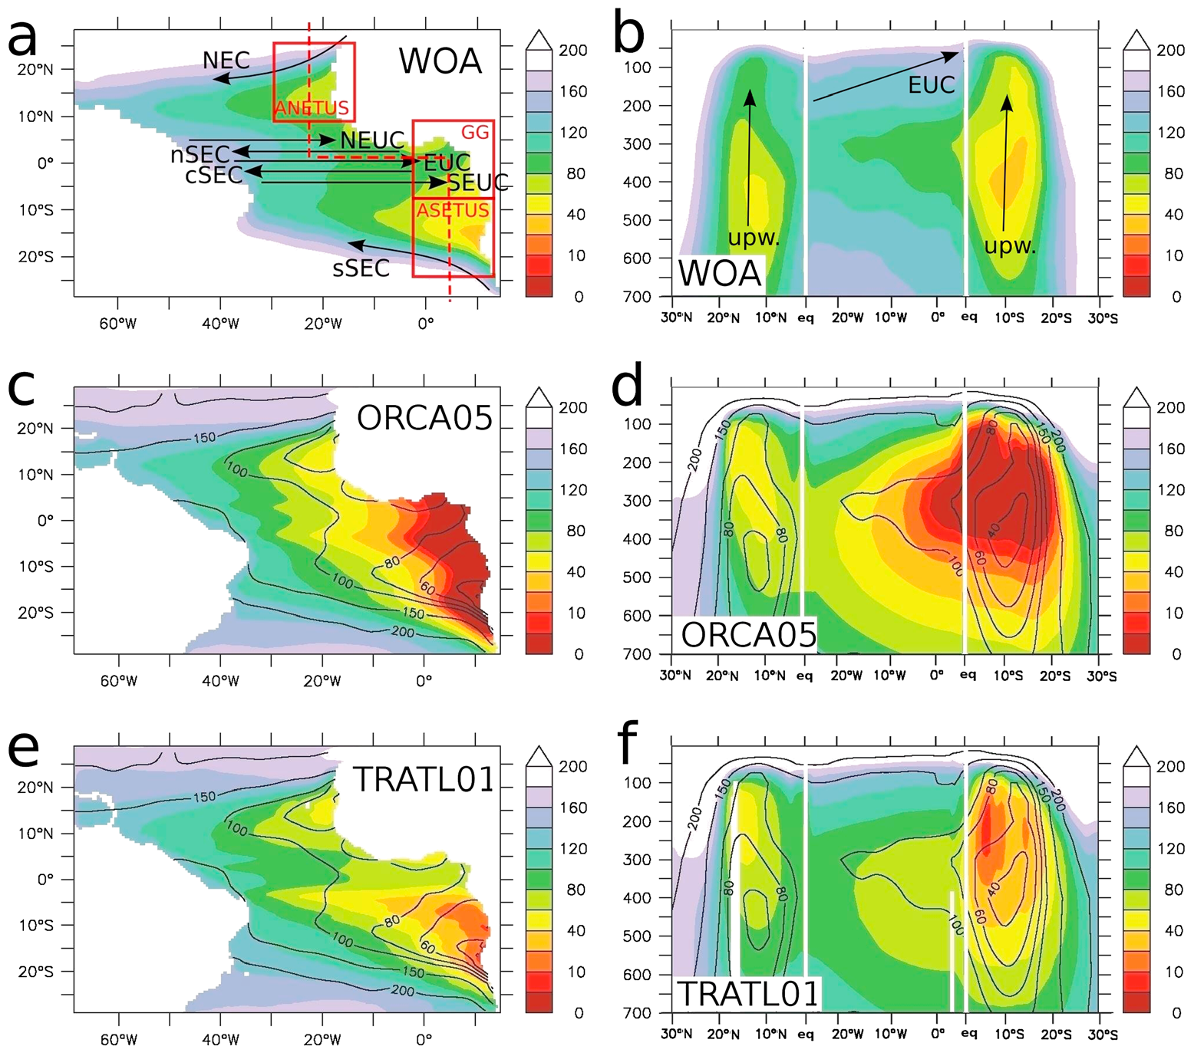
High-Resolution Simulations
High-resolution simulations confirm the major role of the equatorial current system in setting oxygen levels in the eastern tropical Atlantic identified in observations
Duteil et al. 2014
Notes:
ORCA05: the global ocean model has a nominal resolution in latitude and longitude of 0.5° by 0.5° cos φ (where φ is the latitude). Effects of unresolved mesoscale eddies are parameterized following Gent and McWilliams [1990].
TRATL01: a 0.1° resolution two ways AGRIF (Adaptive Grid Refinement In Fortran) nest [Debreu et al., 2008] nest has been embedded between 30°N and 30°S in the Atlantic Ocean into a global ORCA05 grid. Since themodel is eddying in the nested region the Gent and McWilliams’ [1990] parameterization is not used there.

Slide 50
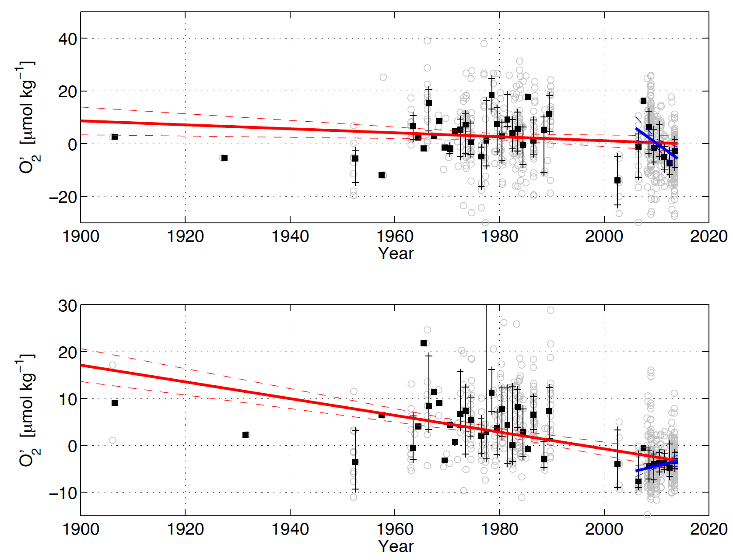
150-300m, 9-15°N, 20-26°W
350-700m, 9-15°N, 20-26°W

Slide 51
Summary (3)
Zonal jets at 2°N/S and EDJs produce a broad oxygen maximum at the equator
Oxygen consumption in the deep OMZ balanced by oxygen supply due to meridional eddy fluxes (60 %), vertical mixing (20 %, locally up to 30 %)
In the upper 300 to 400m of the OMZ, zonal jets dominate the oxygen supply and generate the intermediate oxygen maximum
Long-term oxygen changes on different time scales also due to circulation changes

Slide 52
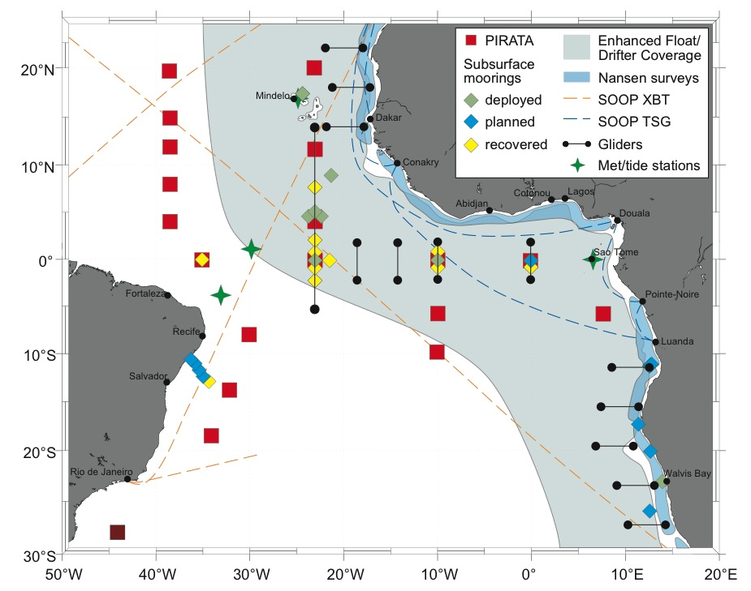
Outlook
Kiel Collaborative Research Centre SFB 754: first two phases from 2008-2011 and 2012-2015, third and last phase (2016-2019) is in the stage of proposal submission: continuation of 23°W measurements
New programs:
EU PREFACE
BMBF SACUS/RACE
Stronger focus on South Atlantic climate studies

Slide 53
Acknowledgements
This study was supported by the German Federal Ministry of Education and Research as part of the co-operative projects “NORDATLANTIK” and “RACE” and by the German Science Foundation (DFG) as part of the Sonderforschungsbereich 754 “Climate-Biogeochemistry Interactions in the Tropical Ocean”.
Moored velocity observations were acquired in cooperation with the PIRATA project.

