Slide 1
Annual and semi-annual variations of equatorial Atlantic circulation associated with basin mode resonance
Peter Brandt¹, Martin Claus¹, Richard J. Greatbatch¹, Robert Kopte¹, John M. Toole², William E. Johns³
¹GEOMAR Helmholtz-Zentrum für Ozeanforschung Kiel, Germany
²Woods Hole Oceanographic Institution, Woods Hole, USA
³RSMAS/MPO, University of Miami, USA

Slide 2
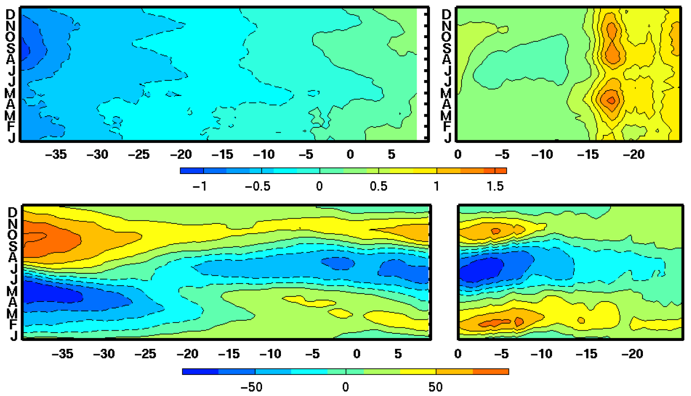
Forcing of Annual and Semi-annual Waves
Bi-annual intrusion of tropical water in the northern Benguela upwelling
Equatorial Waveguide
Coastal Waveguide
Wind stress
[N/m²] (zonal along equator, meridional along coast)
What is the associated variability of circulation and
vertical structure? At the equator? Along the coast?
°E
°N
Sea level anomaly [cm]
°E
°N
Rouault 2012

Slide 3
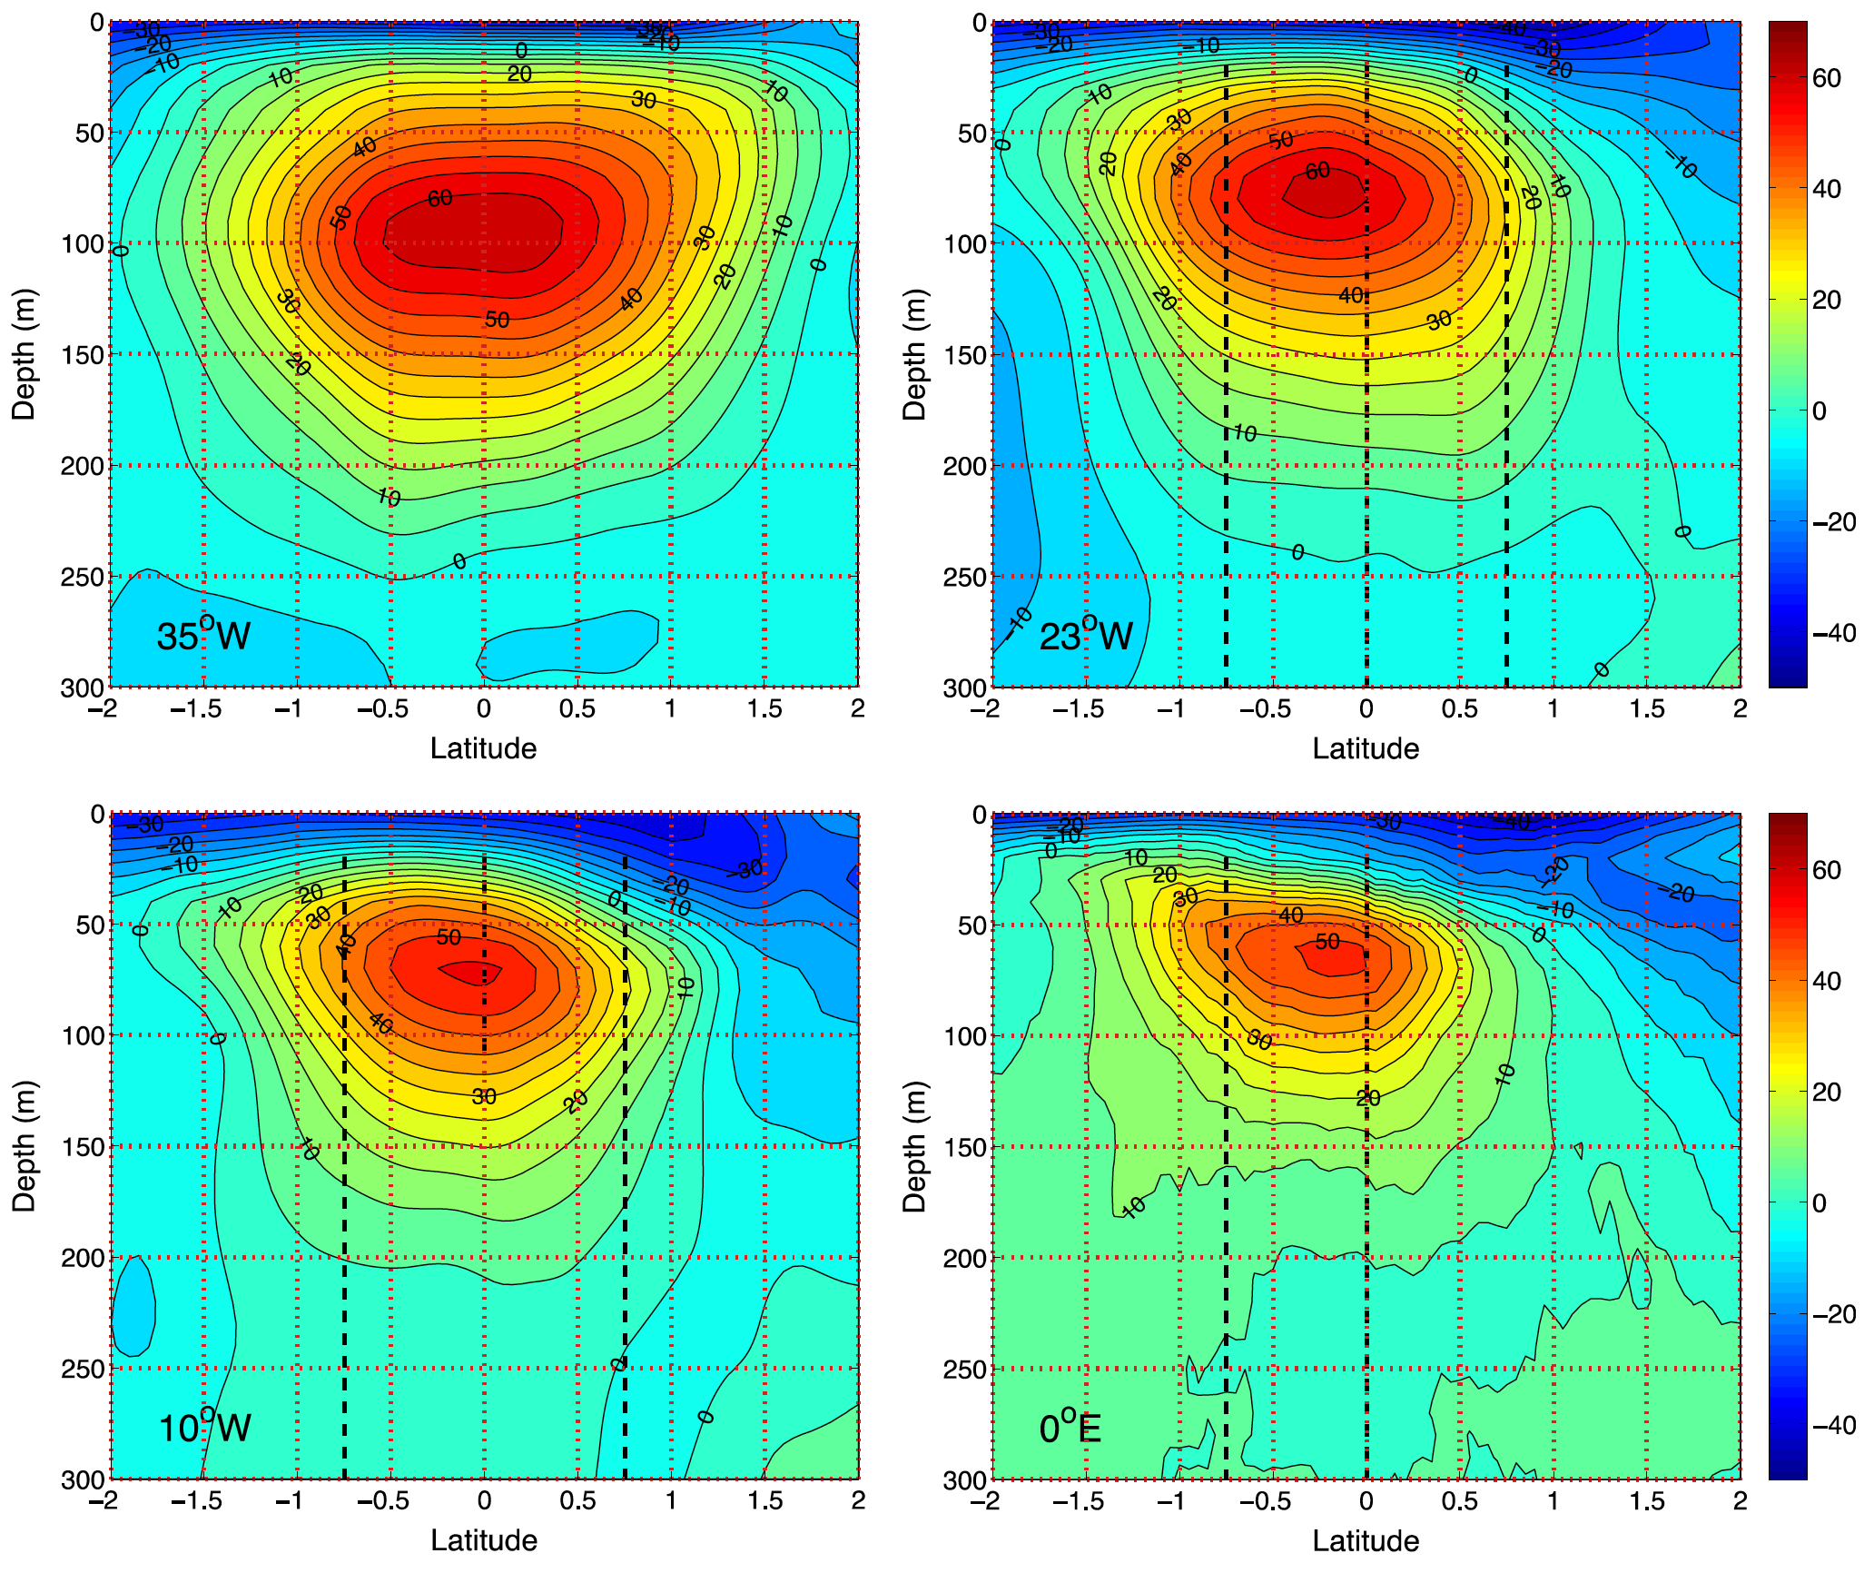
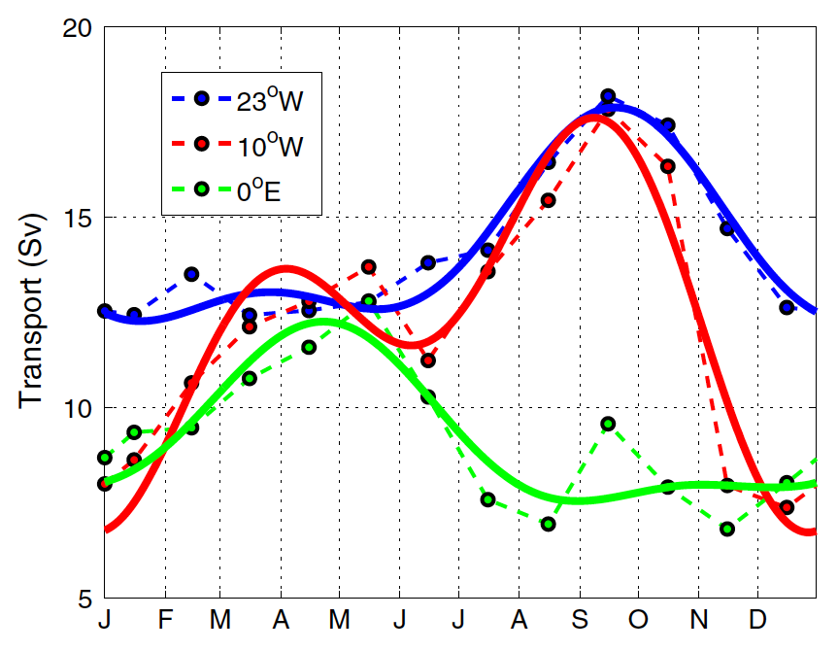
Equatorial Undercurrent (EUC)
Observations during TACE reveal mean EUC structure and seasonal variability
Pronounced annual and semi-annual cycle
Johns et al. 2014

Slide 4
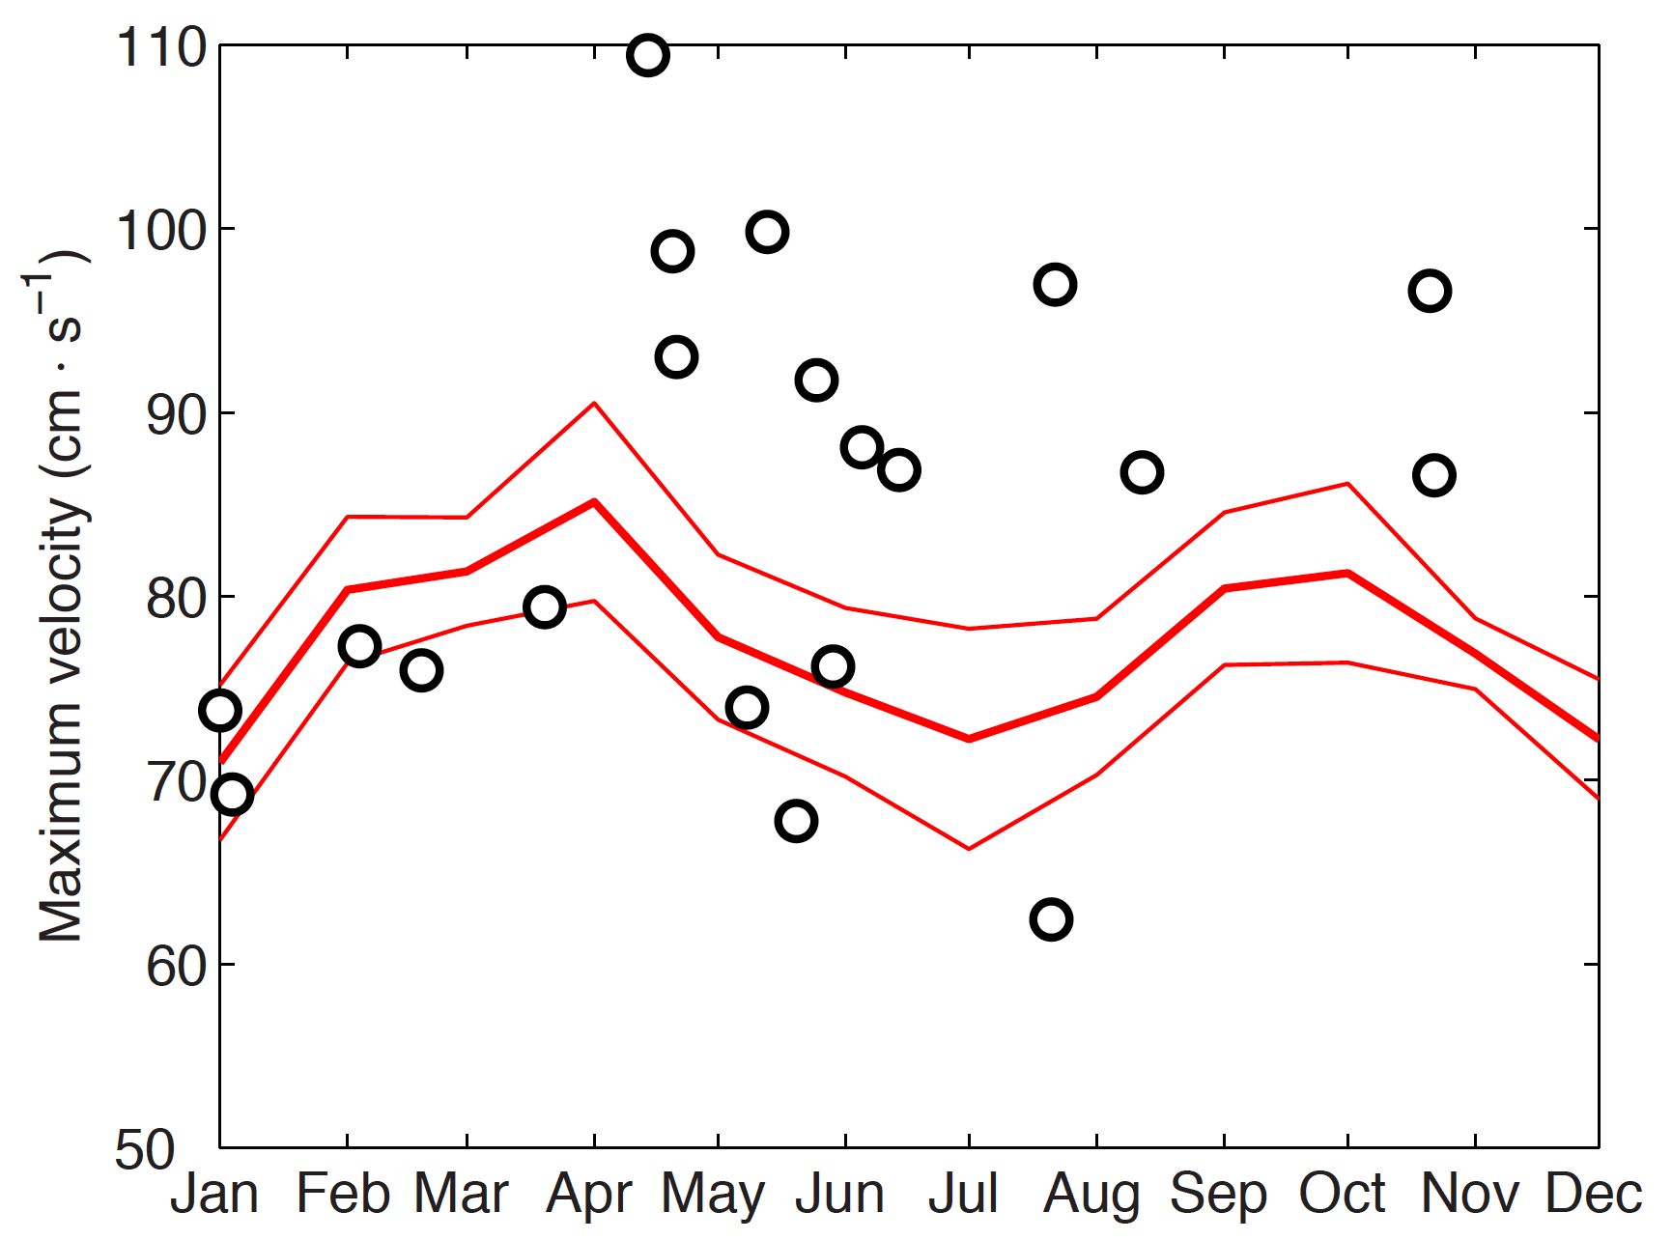
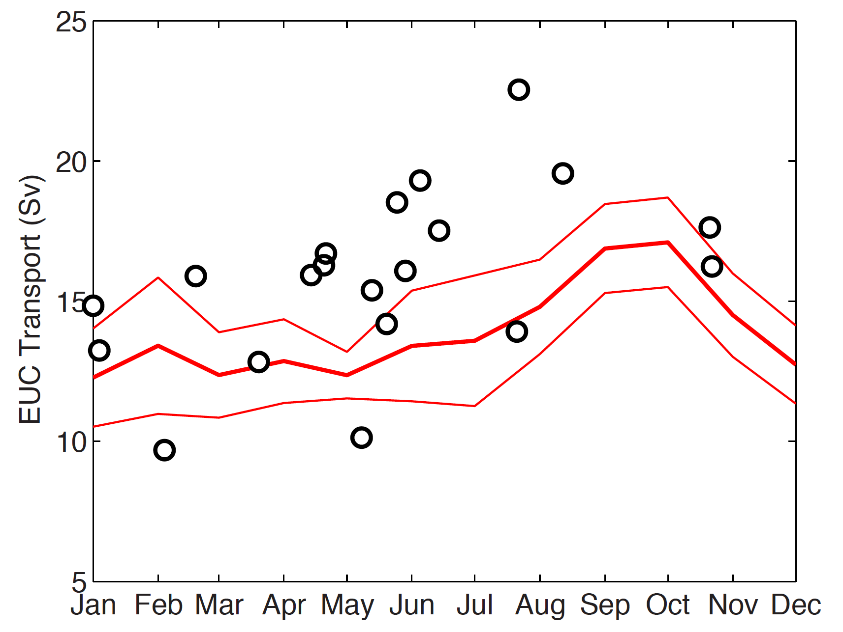
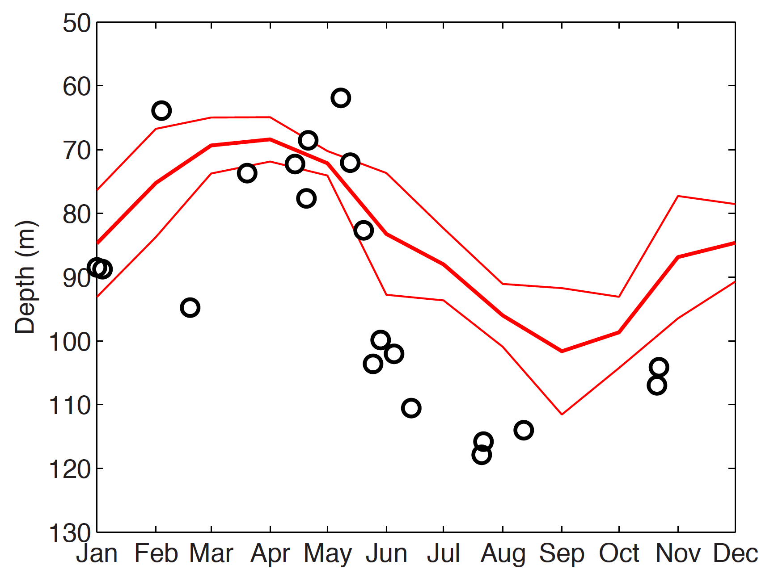
EUC Seasonal Cycle at 23°W
Maximum transport in autumn
Semi-annual cycle of core velocity
Shallow EUC in spring and deep EUC in autumn
How can we explain the
seasonal cycle?
EUC Core Velocity
Black circles:
shipboard
measurements
Red lines:
moored
observations
EUC Transport
EUC Core Depth
Brandt et al. 2014

Slide 5
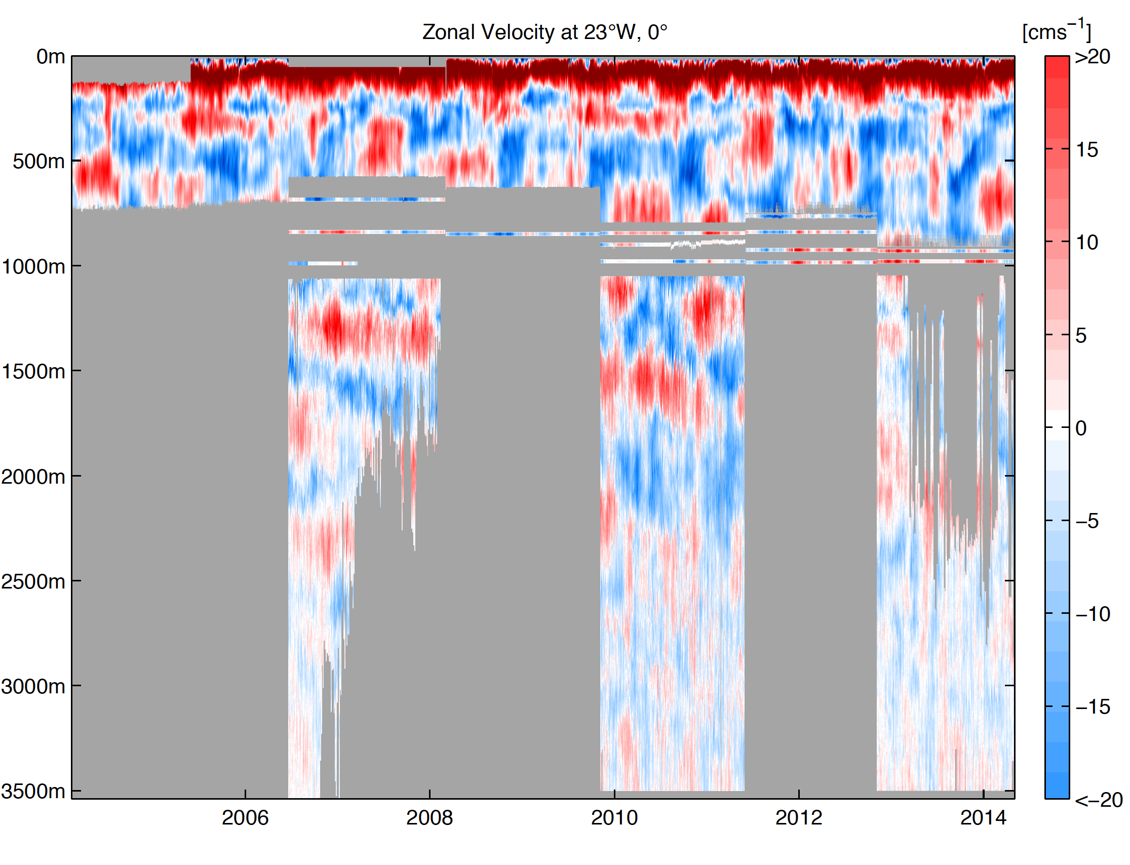
Zonal Velocity at Equator, 23°W
Moored observations of zonal velocity allow analysis of the vertical structure of seasonal variability

Slide 6
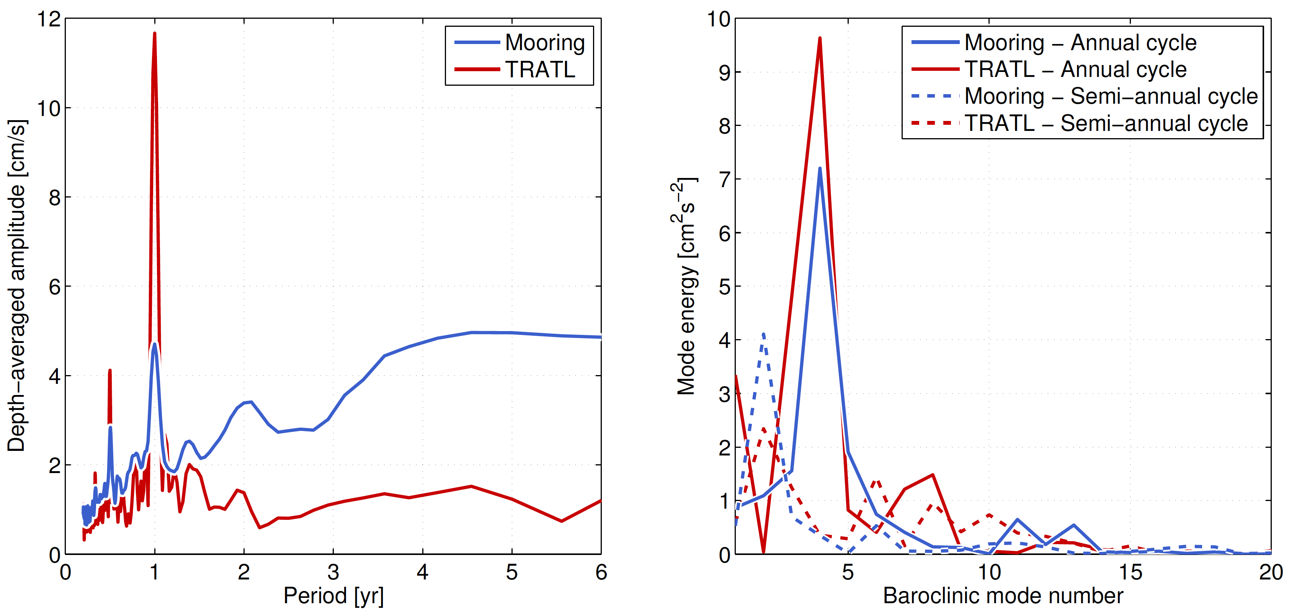
Temporal and Vertical Structure of Zonal Velocity
Spectrum shows peaks at annual and semi-annual cycle
Peaks are dominated by the 2nd and 4th baroclinic mode
Good agreement between observations and model

Slide 7
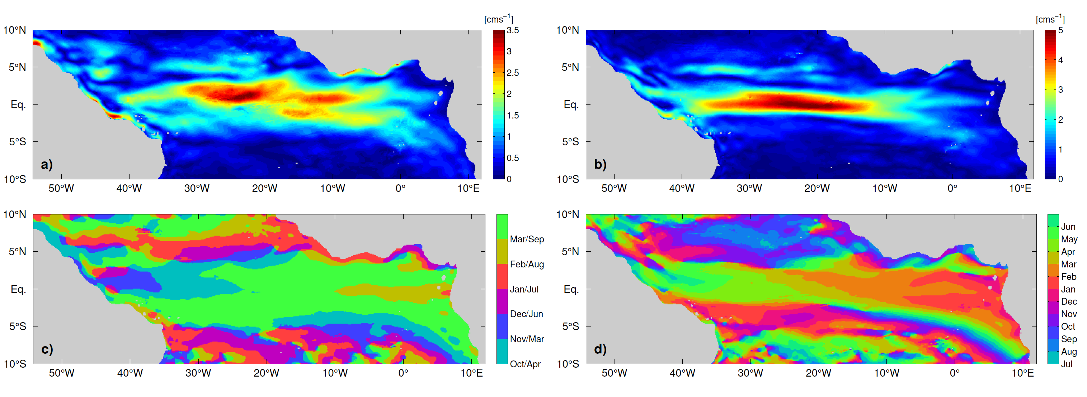
Dominant Seasonal Variability of Zonal Velocity in GCM Simulation
2nd baroclinic mode, semi-annual cycle
4th baroclinic mode, annual cycle
Horizontal pattern show amplitude maximum along the equator and generally westward phase propagation as typically found for linear equatorial basin modes
GCM output by courtesy of F. Schwarzkopf, C. Böning

Slide 8
Equatorial Basin Modes
Cane and Moore (1981) discovered analytical solutions of low-frequency standing equatorial modes composed of equatorial Kelvin and long Rossby waves
Period of the gravest basin mode:
Applications:
Resonance of 2nd baroclinic mode semi-annual cycle in the Indic (Jensen 1993, Han et al. 1999) and Atlantic (Thierry et al. 2004, Ding et al. 2009)
Resonance of 1st baroclinic mode intraseasonal variability in the Indic (Han et al. 2005, Fu 2007)
EDJ behavior (Johnson and Zhang 2003, d‘Orgeville et al. 2007, Brandt et al. 2011, Greatbatch et al. 2012, Claus et al. 2014)
Simulation of such resonant equatorial modes using
a linear reduced-gravity model
Notes:
Fu 2007: The semiannual SSH variability is characterized by a basin mode involving Rossby waves and Kelvin waves
traveling back and forth in the equatorial Indian Ocean between 10°S and 10°N. However, the interference
of these waves with each other masks the appearance of individual Kelvin and Rossby waves, leading to a
nodal point (amphidrome) of phase propagation on the equator at the center of the basin. The characteristics
of the mode correspond to a resonance of the basin according to theoretical models. For the semiannual
period and the size of the basin, the resonance involves the second baroclinic vertical mode of the
ocean.

Slide 9
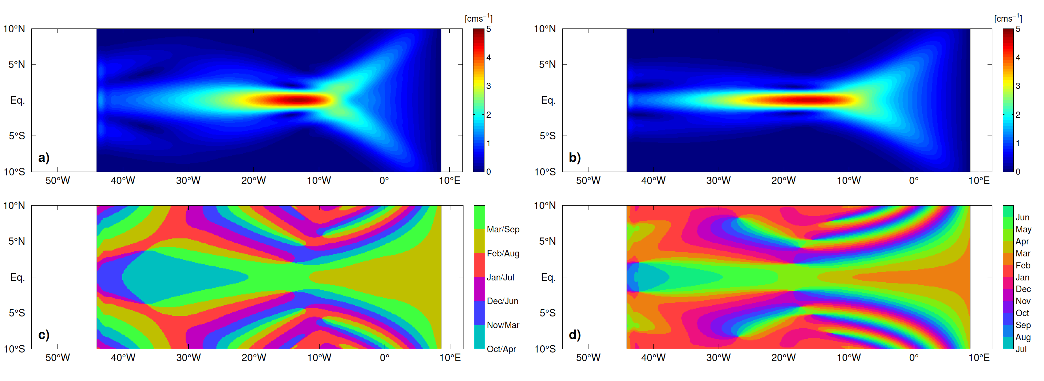
Reduced-Gravity Model
Rectangular box model, with spatially constant oscillating zonal wind forcing
2nd baroclinic mode, semi-annual cycle
4th baroclinic mode, annual cycle

Slide 10
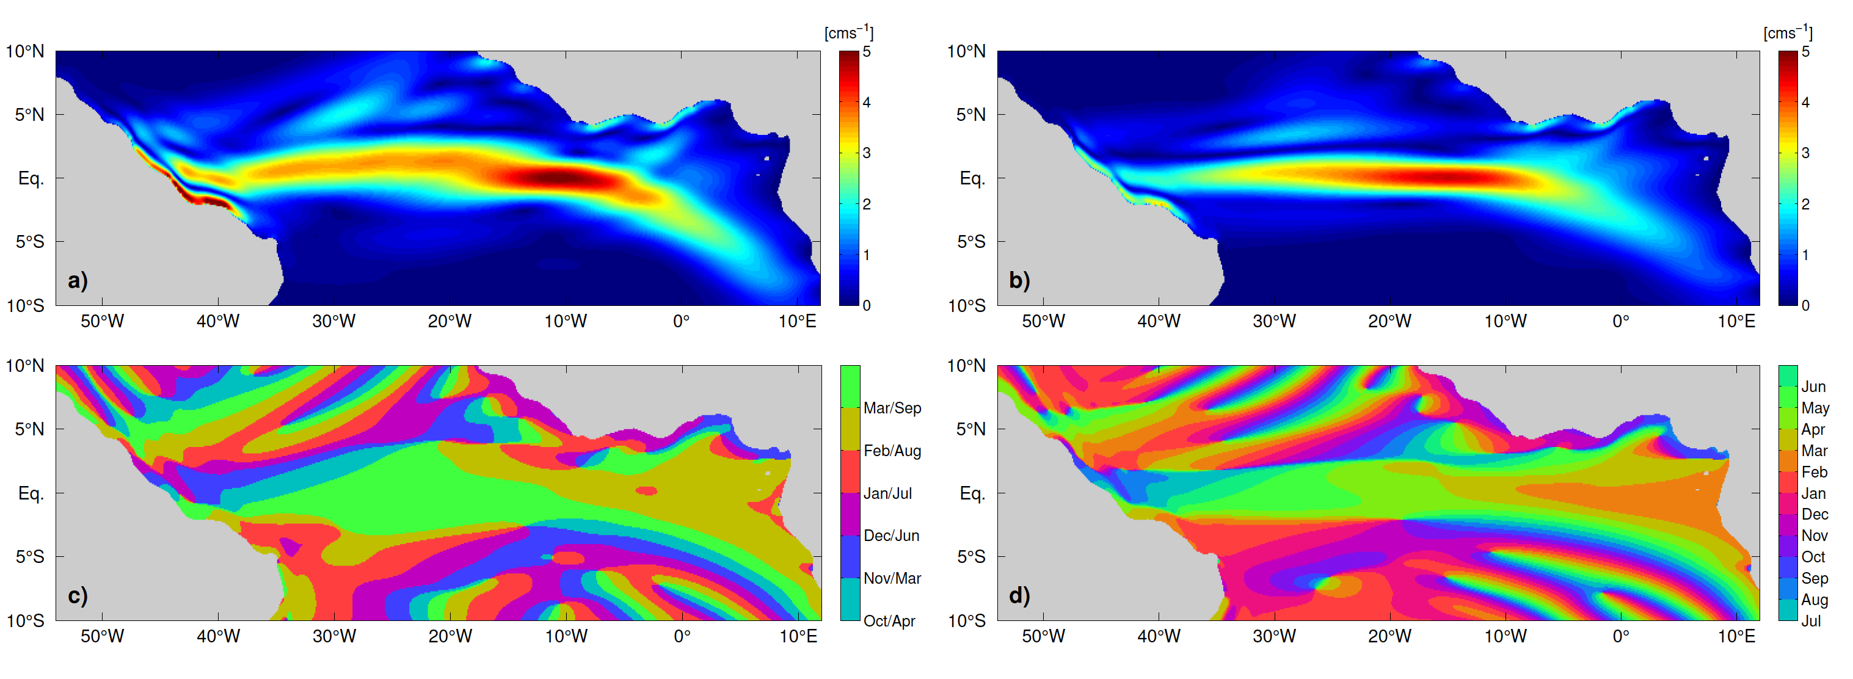
Reduced-Gravity Model
Realistic coast lines, with spatially constant oscillating zonal wind forcing
2nd baroclinic mode, semi-annual cycle
4th baroclinic mode, annual cycle

Slide 11
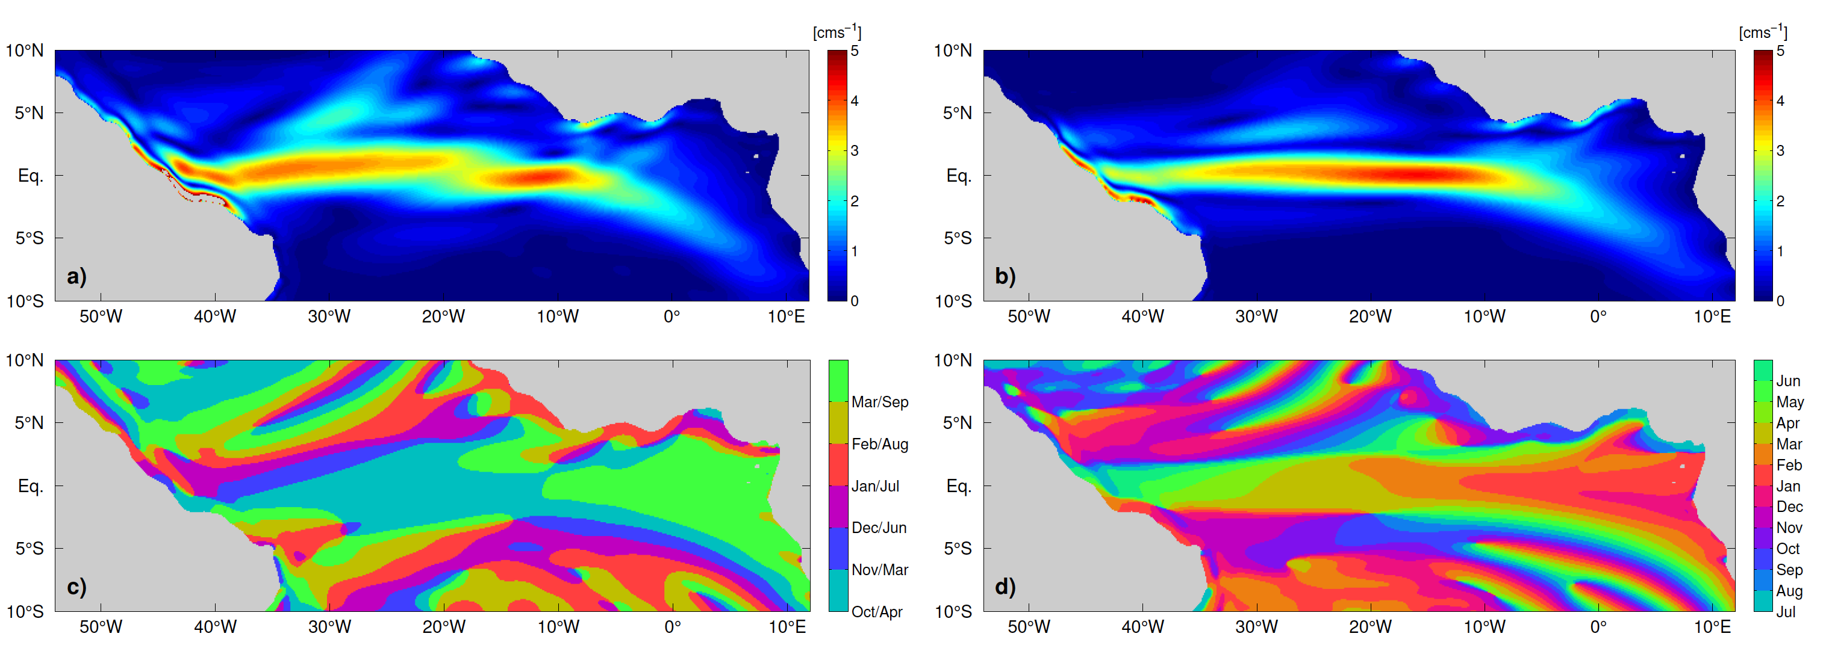
Reduced-Gravity Model
Realistic coast lines and realistic wind forcing
2nd baroclinic mode, semi-annual cycle
4th baroclinic mode, annual cycle

Slide 12
General Circulation Model
In general good agreement between basin modes simulated with reduced gravity model and GCM
2nd baroclinic mode, semi-annual cycle
4th baroclinic mode, annual cycle

Slide 13
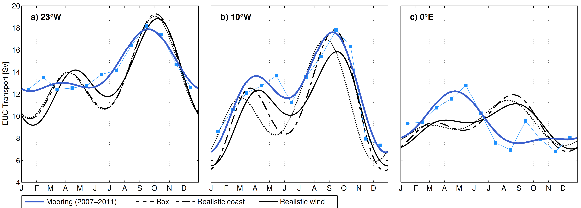
EUC Transport: Observations vs. Reduced-Gravity Simulations
Superposition of the two dominant modes are used to explain characteristics of the observed seasonal cycle of EUC transport across the basin

Slide 14
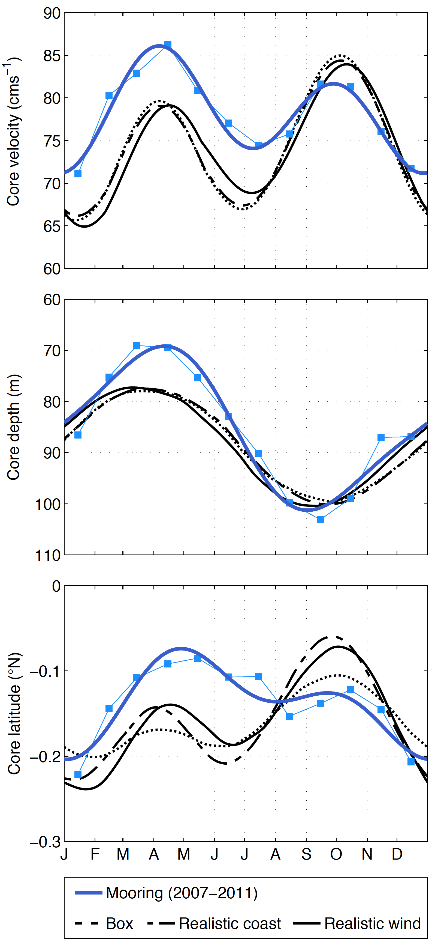
EUC Characteristics: Observations vs. Reduced-Gravity Simulations
Main characteristics of EUC at 23°W can be reproduced

Slide 15
Summary
Equatorial zonal velocity variability dominated by linear equatorial basin modes of different periods/baroclinic modes
Wind-forced annual and semi-annual basin modes help to explain seasonal cycle of the EUC
semi-annual cycle of core velocity; in particular velocity maximum during boreal spring associated with weak winds
vertical migration of the EUC core: shallow in boreal spring, deep in boreal autumn
Associated propagation of coastal Kelvin waves results in variability of eastern boundary circulation

Slide 16
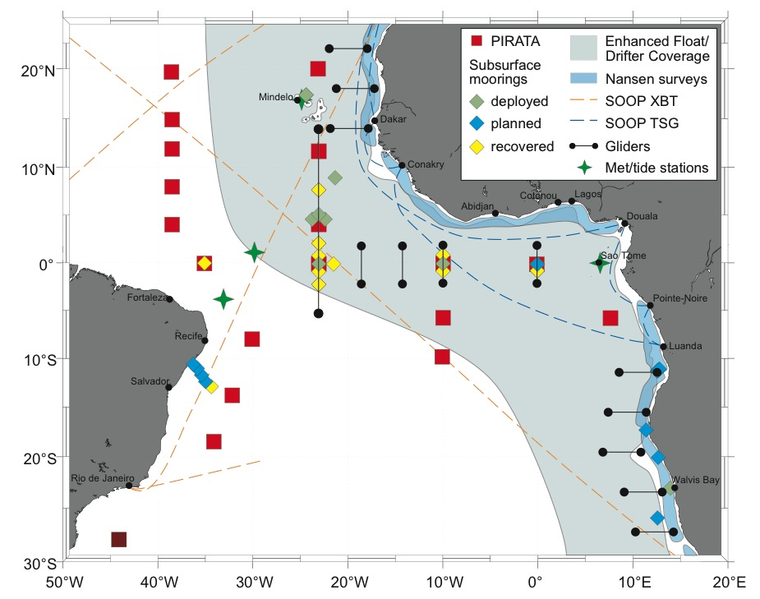
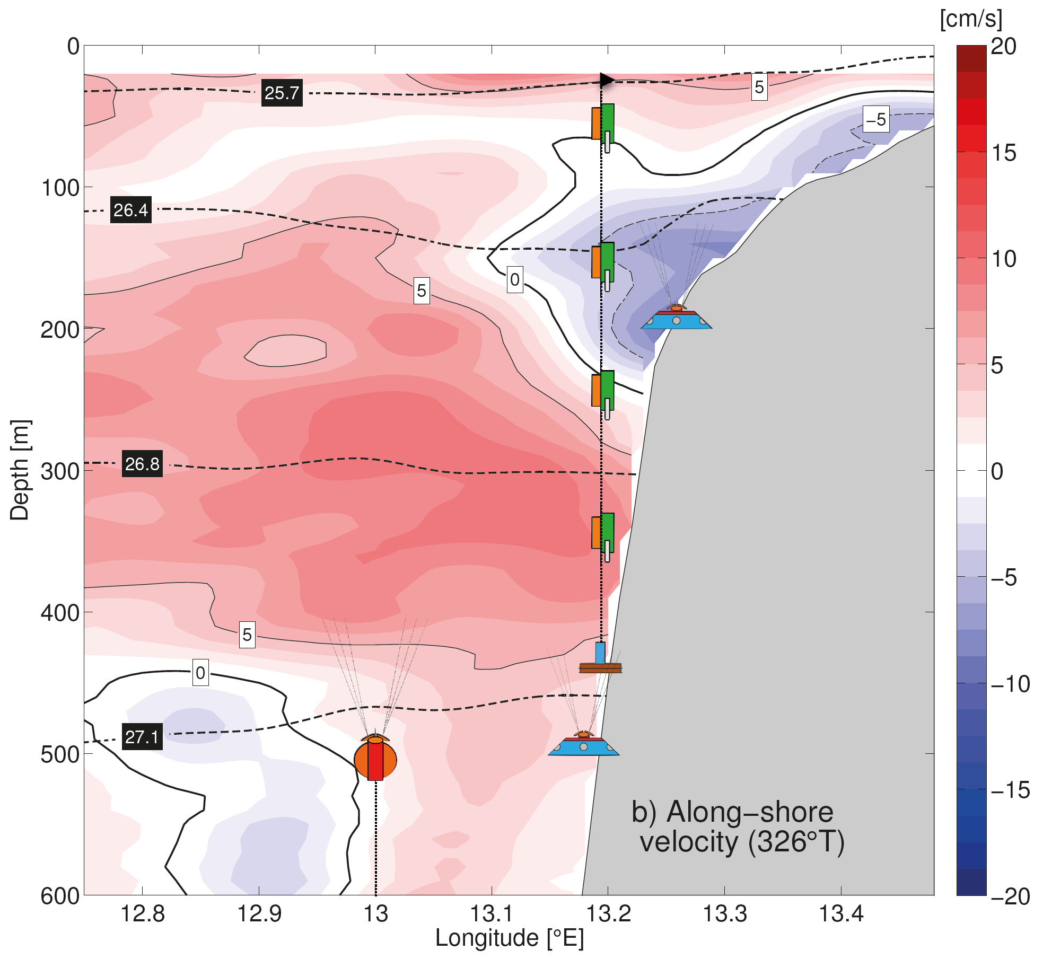
Outlook: Coastal Waveguide
EUC measurements are continued in the frame of PIRATA, SFB 754, and EU PREFACE
Measurements at 11°S off Angola in the frame of BMBF SACUS/EU PREFACE, next cruise: Oct. 2015

Slide 17
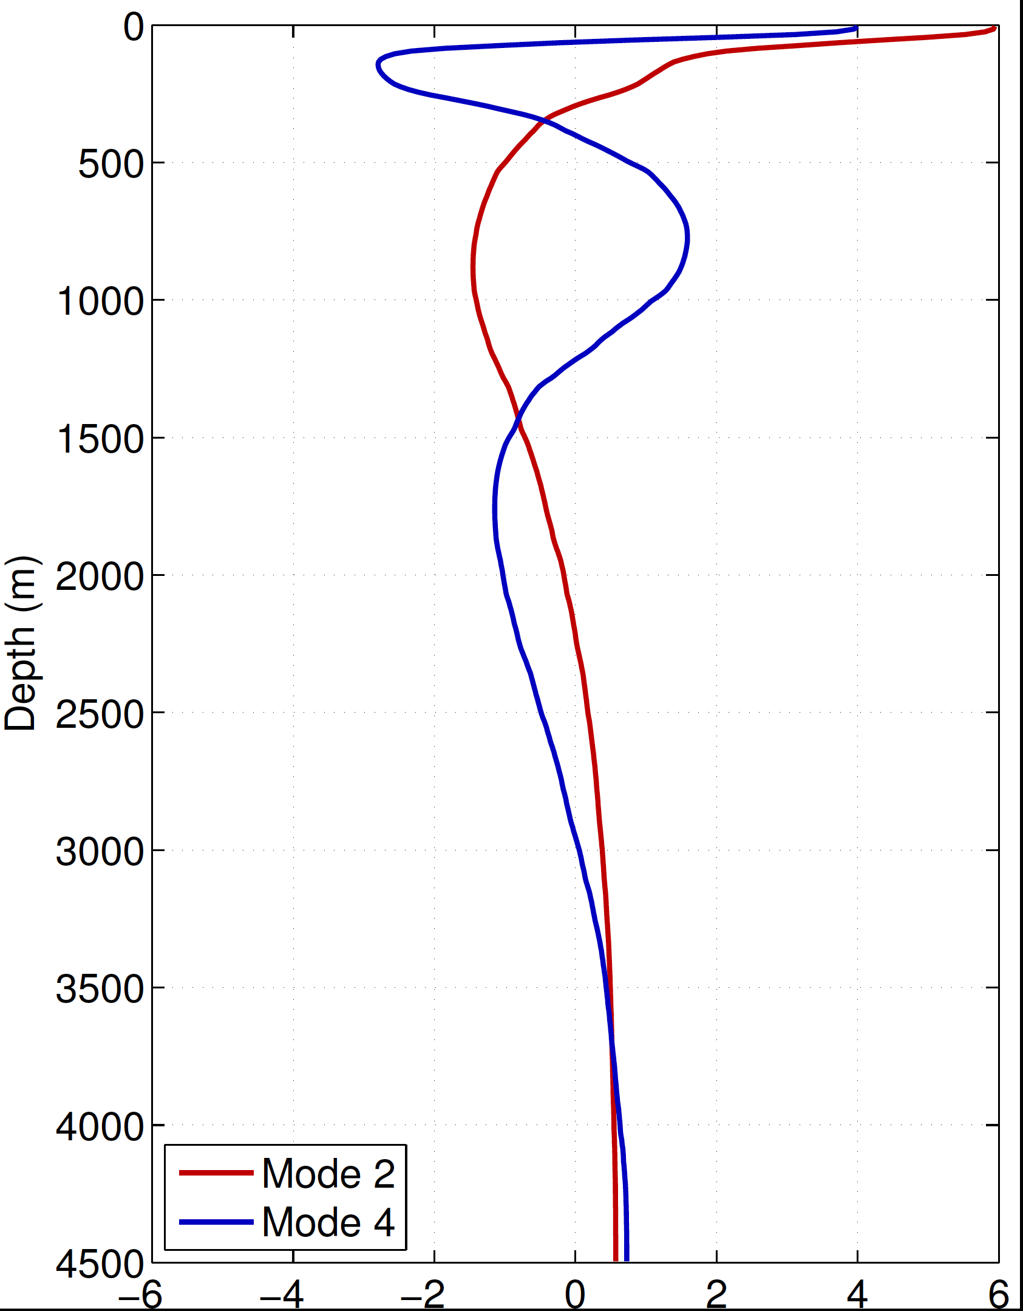
Vertical structure functions
for the 2nd baroclinic mode
and the 4th baroclinic mode

