Slide 1


Interannual to decadal changes in the Western Boundary Circulation in the Atlantic at 11°S
Rebecca Hummels¹, Peter Brandt¹, Marcus Dengler¹, Jürgen Fischer¹, Moacyr Araujo², Doris Veleda² and Jonathan V. Durgadoo¹
¹GEOMAR Helmholtz Zentrum für Ozeanforschung, Kiel, Germany
²DOCEAN Department of Oceanography UFPE Refice, Brazil
IV Seminar of the Bilateral Cooperation DOCEAN – GEOMAR, 2015, Recife, Brazil, 14.10.2015

Slide 2
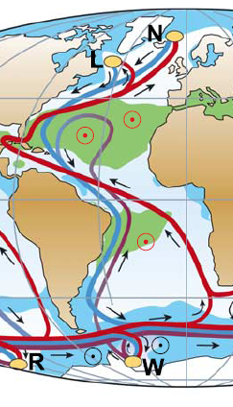
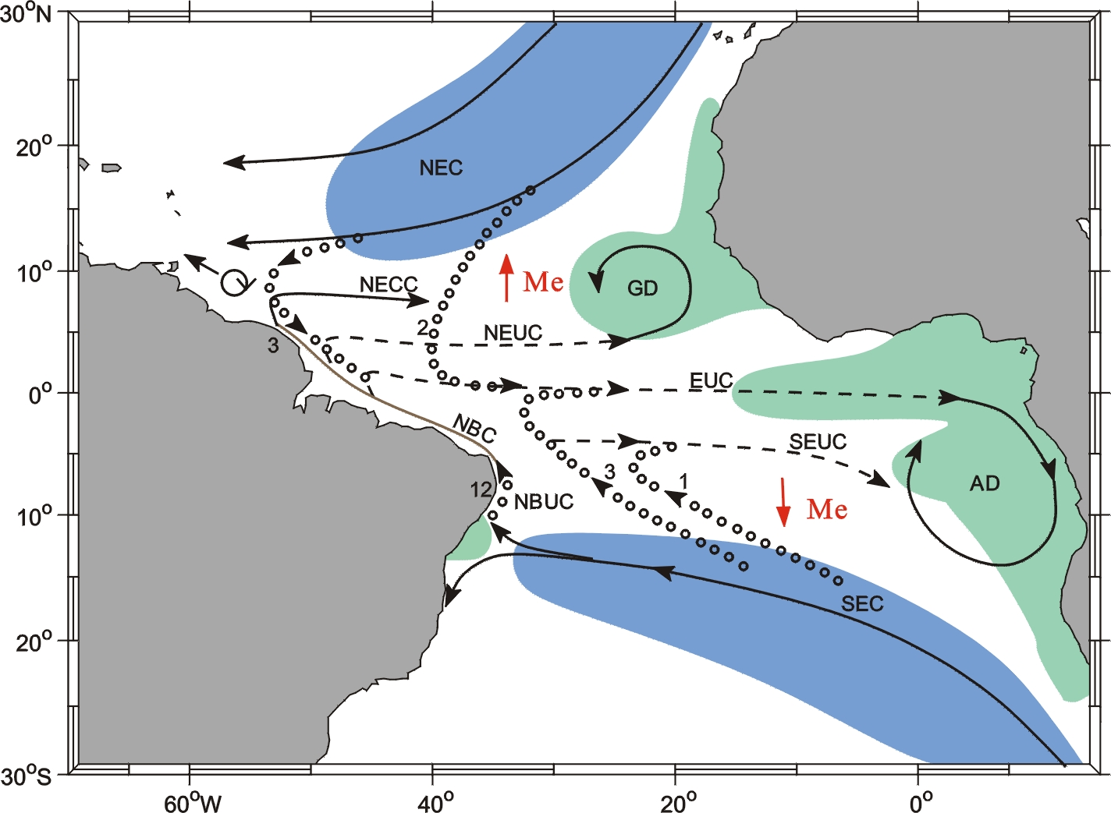
Circulation within the tropical Atlantic
Atlantic thermohaline circulation (ATHC)
Shallow Subtropical-tropical Cells (STC)
→ Interaction between the hemispheres is focused on the western boundary

Slide 3
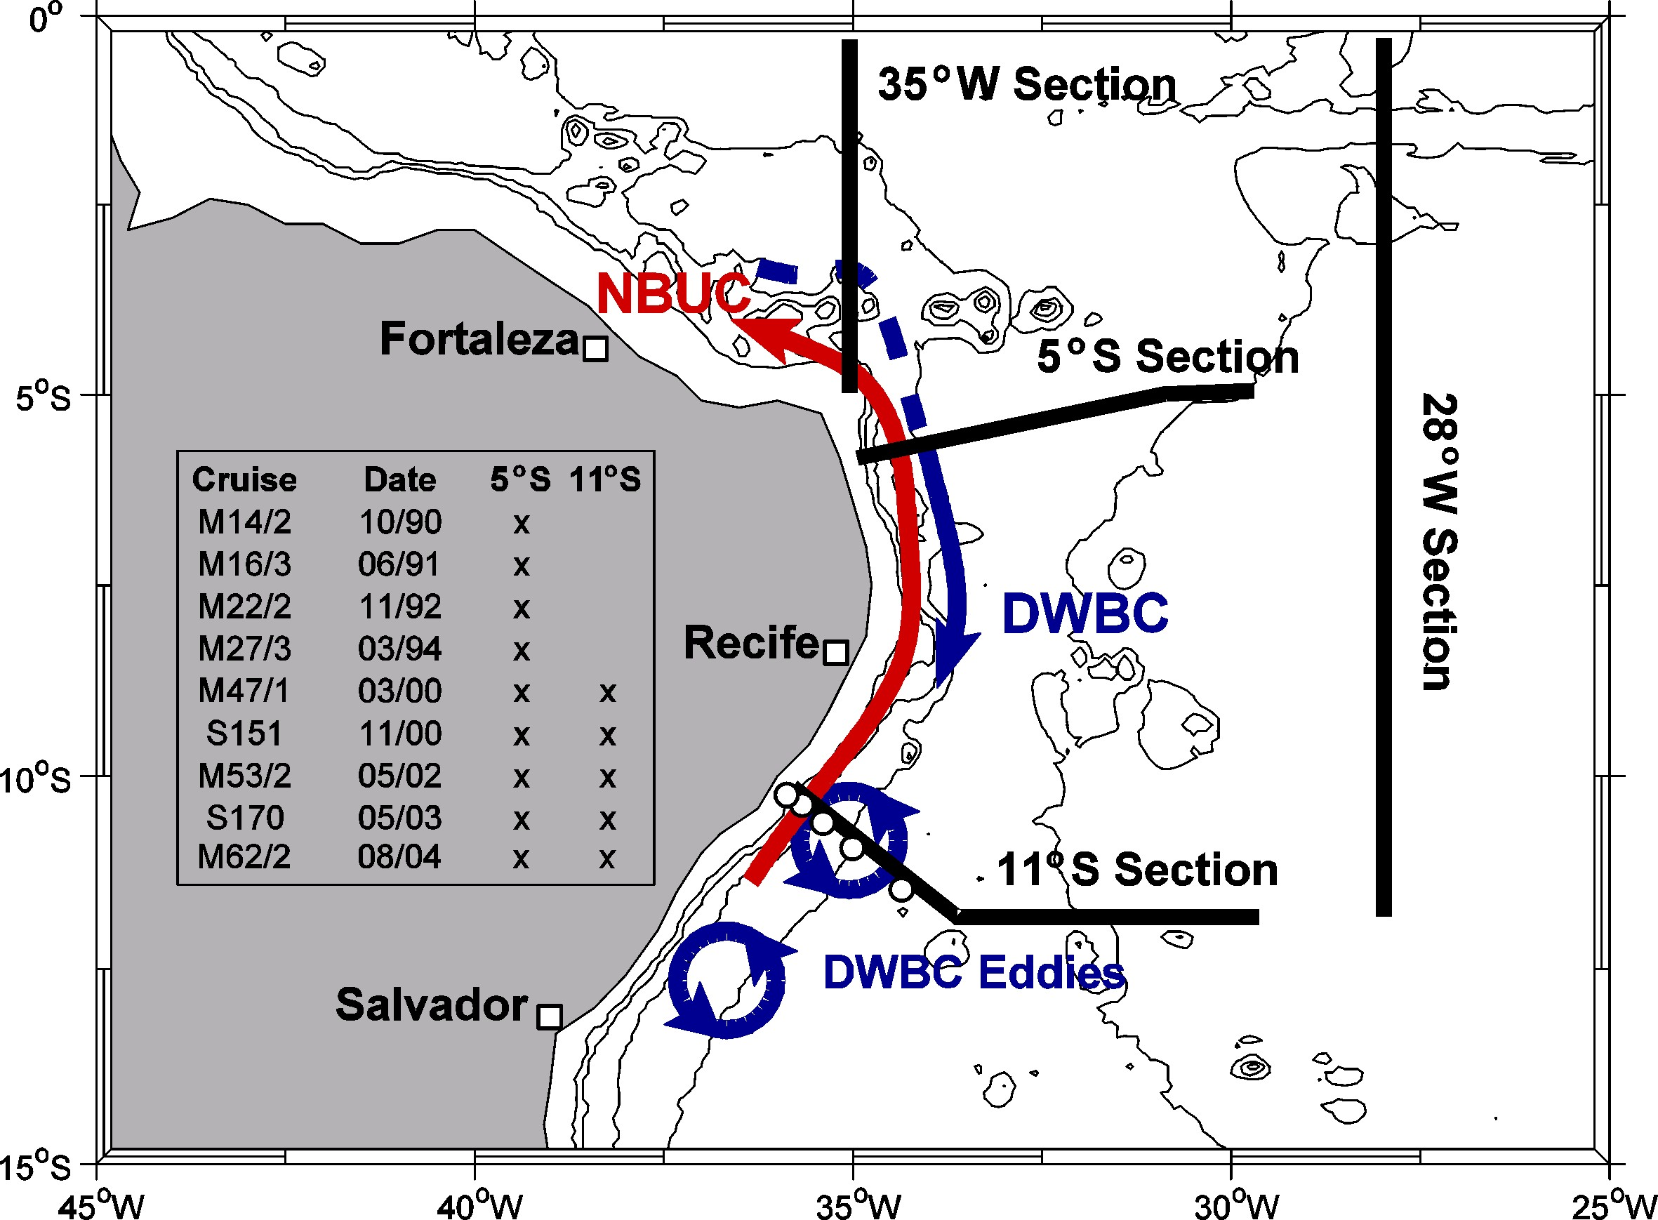
Observations at 5°S and 11°S between 1990-2004:
Observations:
9 research cruises: repeatedly occupied the 5°S and 11°S section
Mooring array at 11°S
2000-2004
Schott et al. 2005

Slide 4
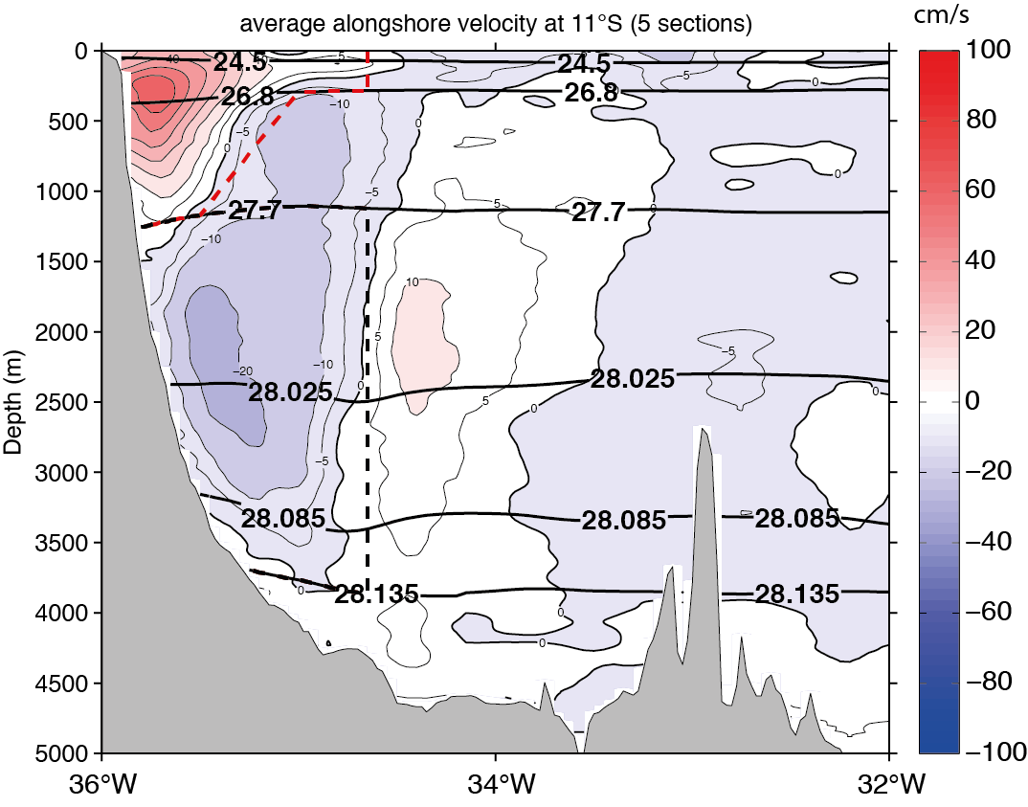
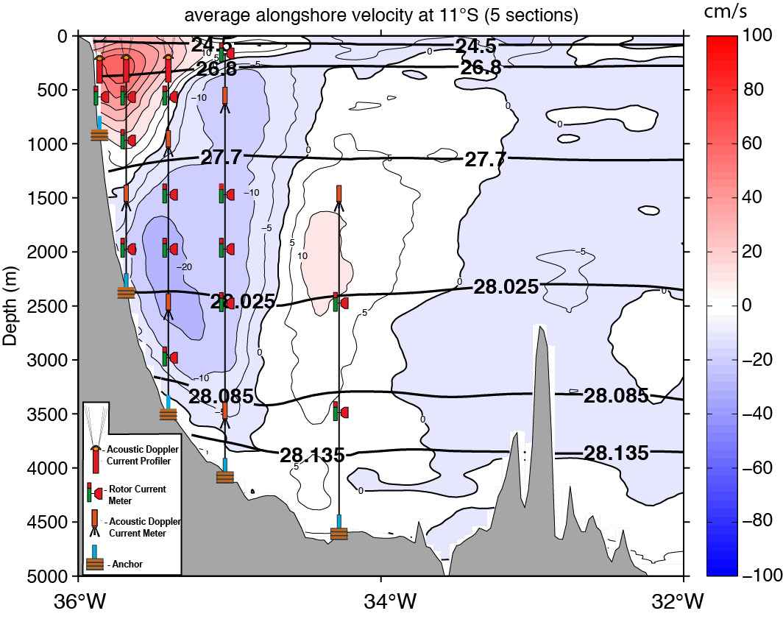
Observations at 11°S between 2000-2004: Mean state
cm/s
remake of Schott et al. 2005
Average transports at 11°S (ship):
NBUC 24 +/- 4 Sv [=1 x10⁶ m³s⁻¹]
DWBC -34.8 +/- 8.6 Sv
Average transports at 11°S (mooring):
NBUC 27.1 +/- 1.1 Sv
DWBC -18.6 +/- 1.7 Sv

Slide 5
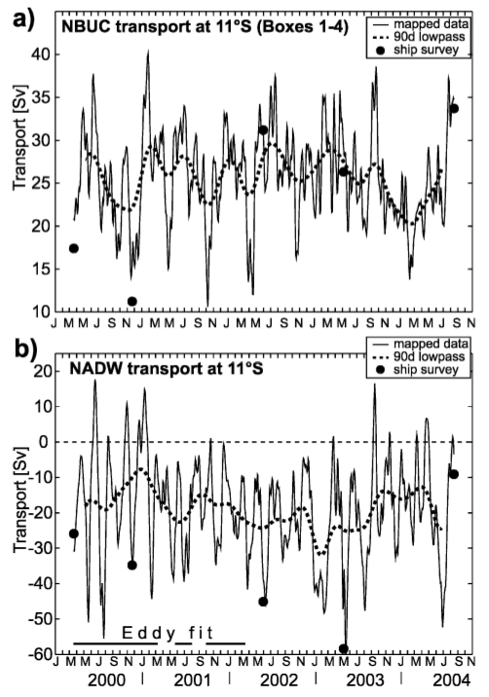
Observations at 11°S between 2000-2004: Variability
NBUC:
Average transport is
similar to ship sections
DWBC:
Average transport is lower than from ship sections
Spectral peak at 60-70 days period associated with deep eddies
Schott et al. 2005

Slide 6
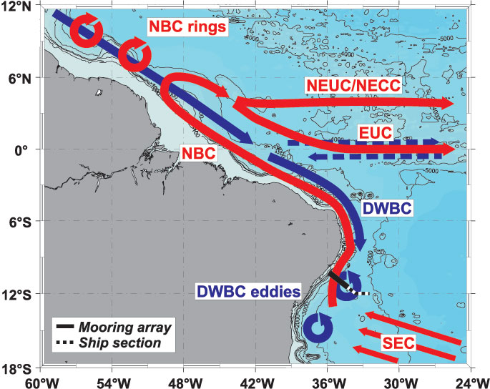
Observations at 11°S between 2000-2004:
Break up of DWBC in to deep eddies at around 8°S
Dengler et al. 2004

Slide 7
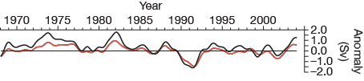
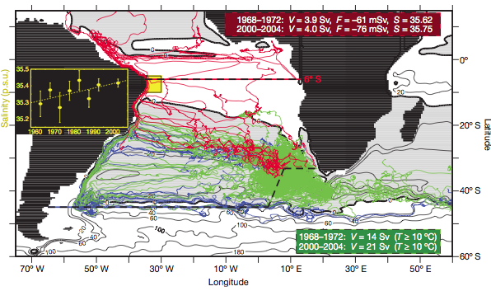
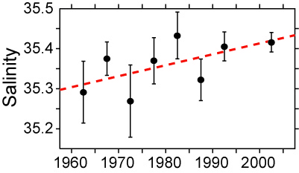
Other studies after observational period:
Biastoch et al. 2008:
close correspondence between AMOC strength and NBUC transport on inter-annual time scales
AMOC strength at 6°S
NBUC transport
Biastoch et al. 2009:
Salinity anomalies within the NBUC are related to the variability of the Agulhas leakage and might have implications for further evolution of MOC

Slide 8
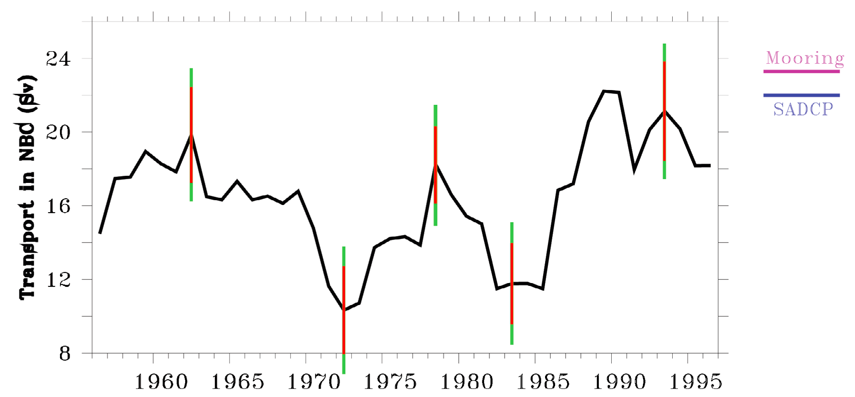
Other studies after observational period:
Transport in NBC (Sv)
Zhang et al. 2011:
Strong multidecadal NBUC transport variability in geostrophic transport timeseries based on historical hydrographic observations

Slide 9
Other studies after observational period:
Biastoch et al. 2008
Biastoch et al. 2009
?
Transport in NBC (Sv)
Zhang et al. 2011
2000
2005
2010
2015

Slide 10
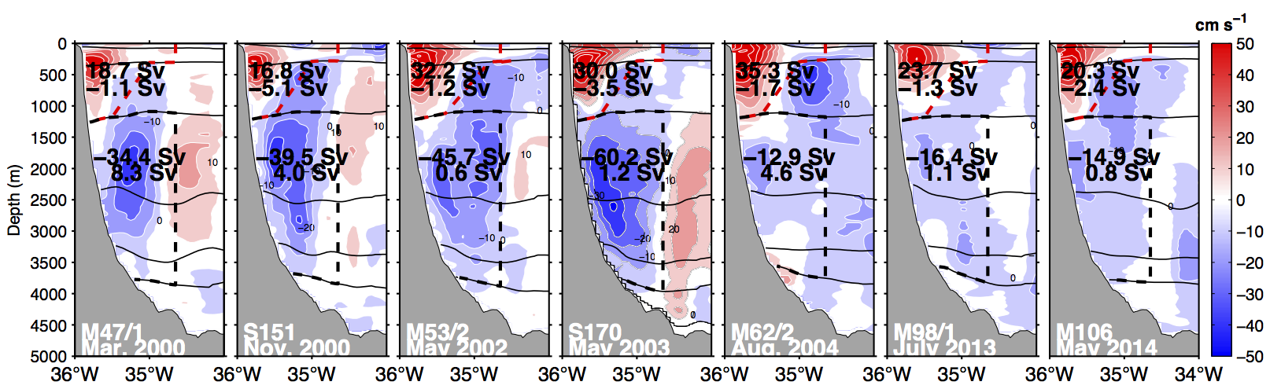
New observations at 11°S: velocities
2 research cruises:
M98 (July 2013)
M106 (May 2014)
redeployment of mooring array in 2013

Slide 11
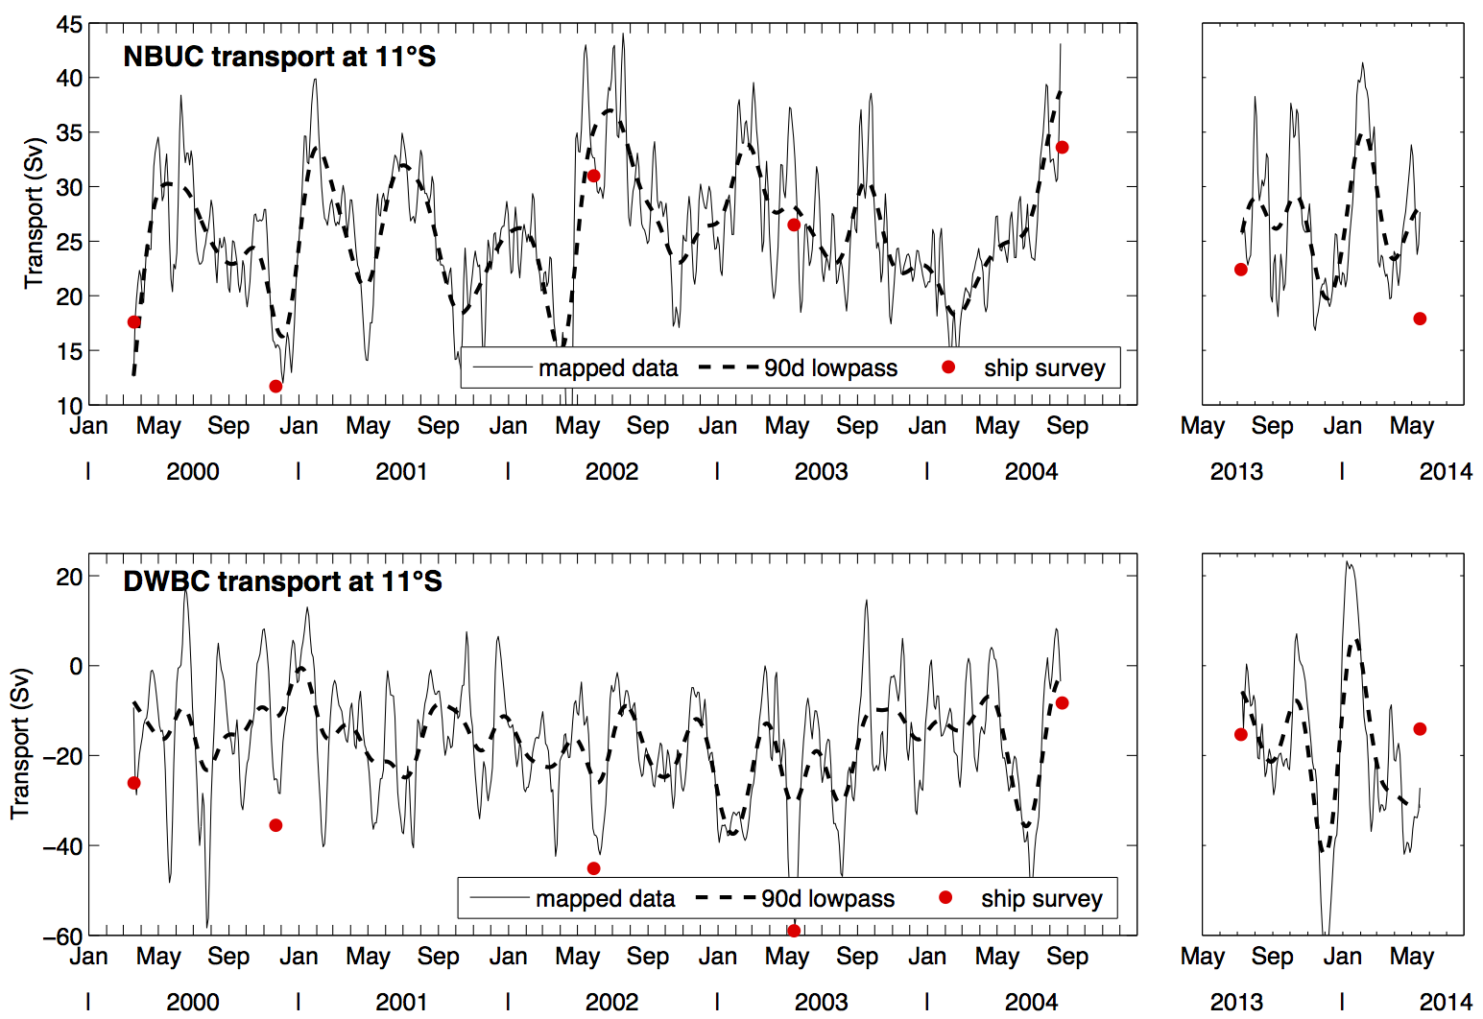
New observations at 11°S: velocities
2 research cruises:
M98 (July 2013)
M106 (May 2014)
redeployment of mooring array in 2013
average
(2000-2004)
25.8 ±1.2 Sv
average
(2013-2014)
26.8 ±1.8 Sv
←25.4 ± 2.4→←25 ± 1.8→←27.7 ± 3.1→←25.1 ±2.1→
←26.8±1.8→
average
(2000-2004)
-17 ±1.6 Sv
average
(2013-2014)
-19.2 ±5.2 Sv

Slide 12
New observations at 11°S: velocities
2 research cruises:
M98 (July 2013)
M106 (May 2014)
redeployment of mooring array in 2013
What is INALT01?
global 0.5° horizontal resolution (ORCA05)
1/10° horizontal resolution within the nest
46 vertical levels
forced with CORE2b dataset
Durgadoo et al. 2013

Slide 13
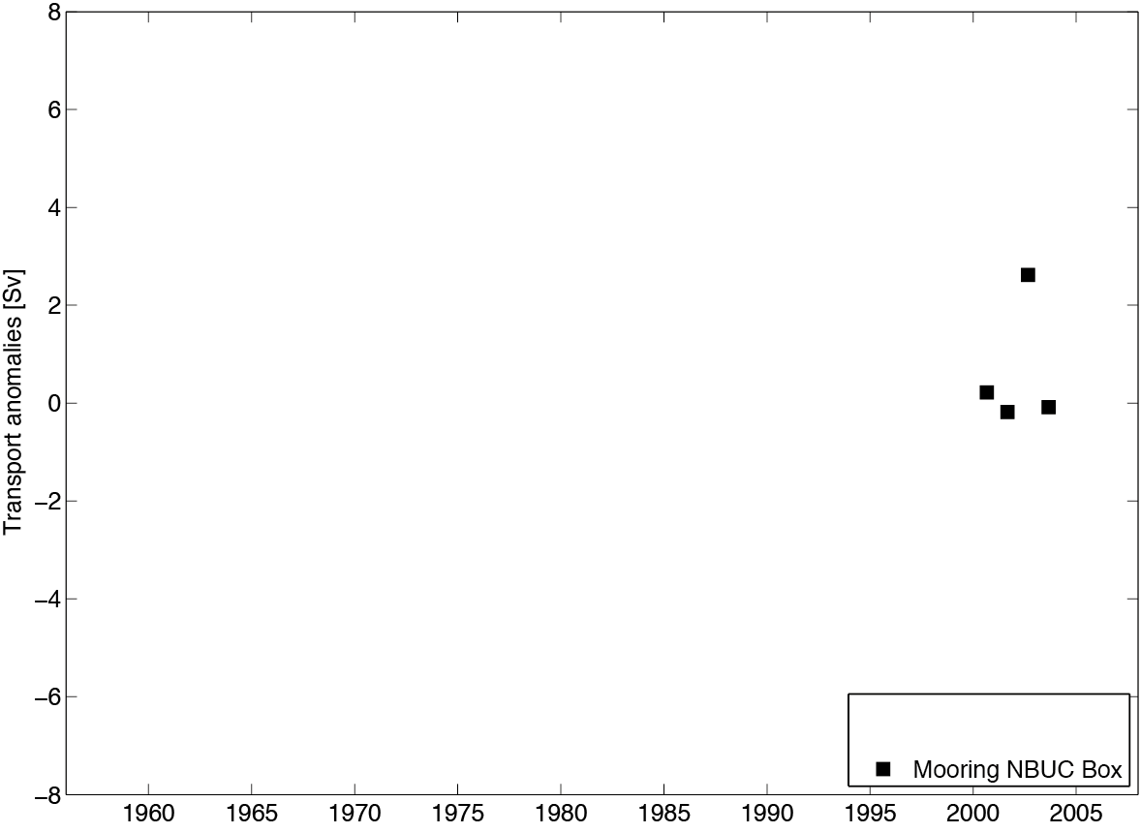
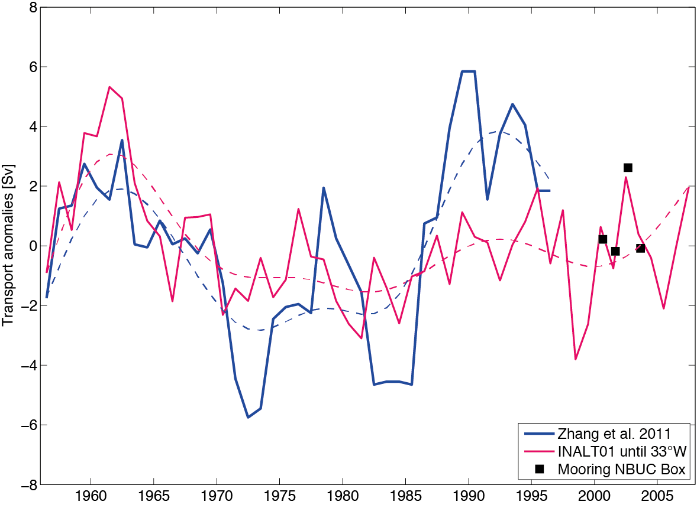
New observations at 11°S: velocities
2 research cruises:
M98 (July 2013)
M106 (May 2014)
redeployment of mooring array in 2013
Averages subtracted:
25.2 Sv Mooring
16.3 Sv Zhang ´11
14.9 Sv INALT01

Slide 14
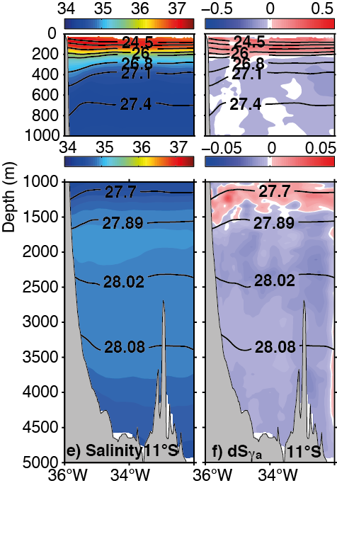
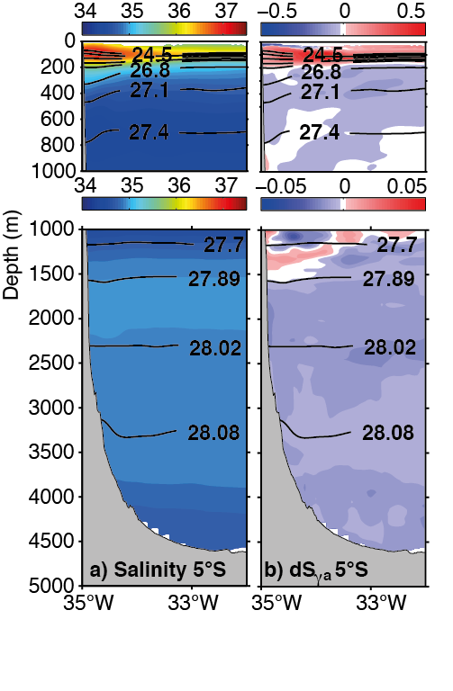
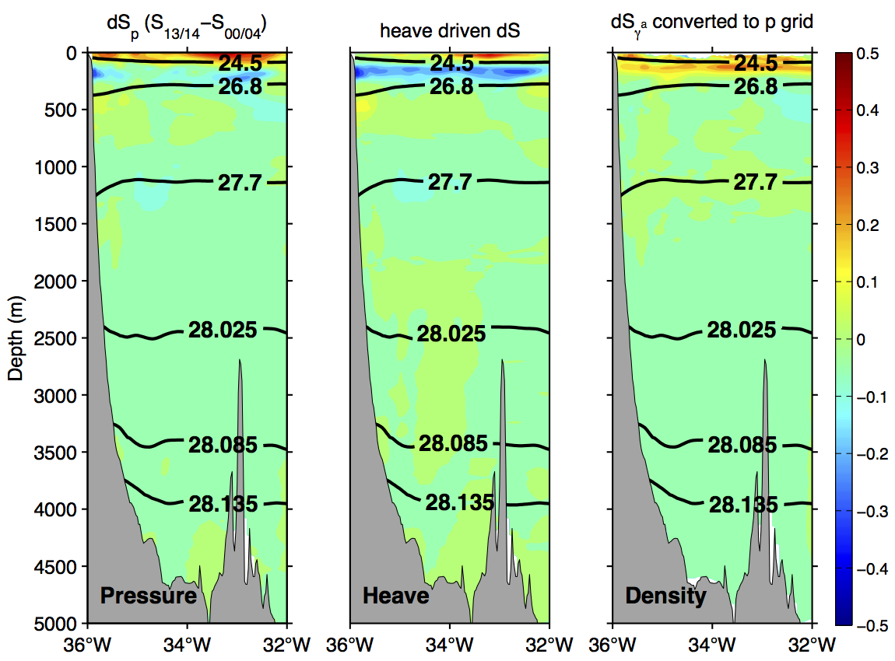
New observations at 11°S: hydrography
2 research cruises:
M98 (July 2013)
M106 (May 2014)
redeployment of mooring array in 2013
11°S
5°S

Slide 15
New observations at 11°S: hydrography
2 research cruises:
M98 (July 2013)
M106 (May 2014)
redeployment of mooring array in 2013
11°S
Biastoch et al., 2009:
trend: +0.028 psu / decade
(100-600m NBUC region)
Average salinity differences across section:
dS_{γ} (100-600m) = 0.024 / decade
dS_{γ} (1500-4000m) = -0.007 / decade

Slide 16
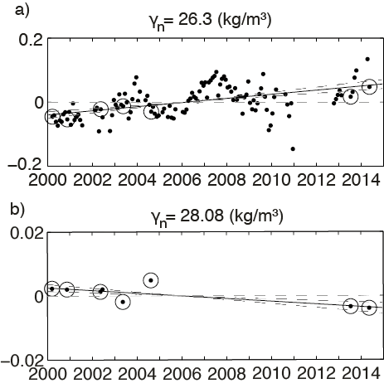
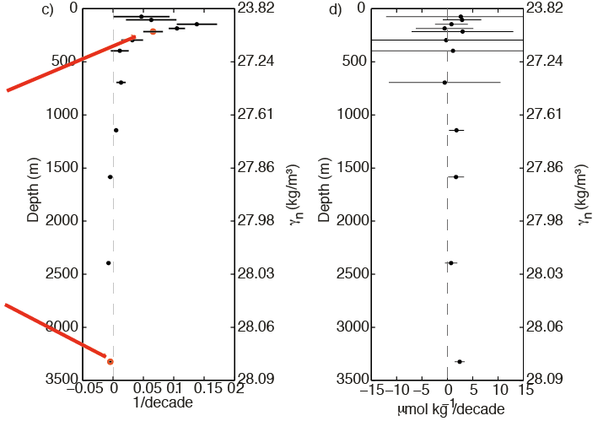
New observations at 11°S: hydrography
2 research cruises:
M98 (July 2013)
M106 (May 2014)
redeployment of mooring array in 2013
Hydrographic data from ship cruises
+ Argo
+ WOA
+Brazilian Navy
within a box between 40°W and 30°W and 12°S and 8°S

Slide 17
New observations at 11°S: hydrography
2 research cruises:
M98 (July 2013)
M106 (May 2014)
redeployment of mooring array in 2013
Summary of new observations:
no significant transport changes between the observational periods, which are a decade apart
interannual variations in NBUC transport from observations fit to numerical simulations (INALT01)
decadal variability of NBUC transport is similar in INALT01 and the geostrophic transports estimated in Zhang et al. 2011 and should be detectable with the currently installed observing system
positive (negative) decadal salinity trend within the central water (DWBC layer) consistent with changes in the large scale circulation of the Atlantic

Slide 18
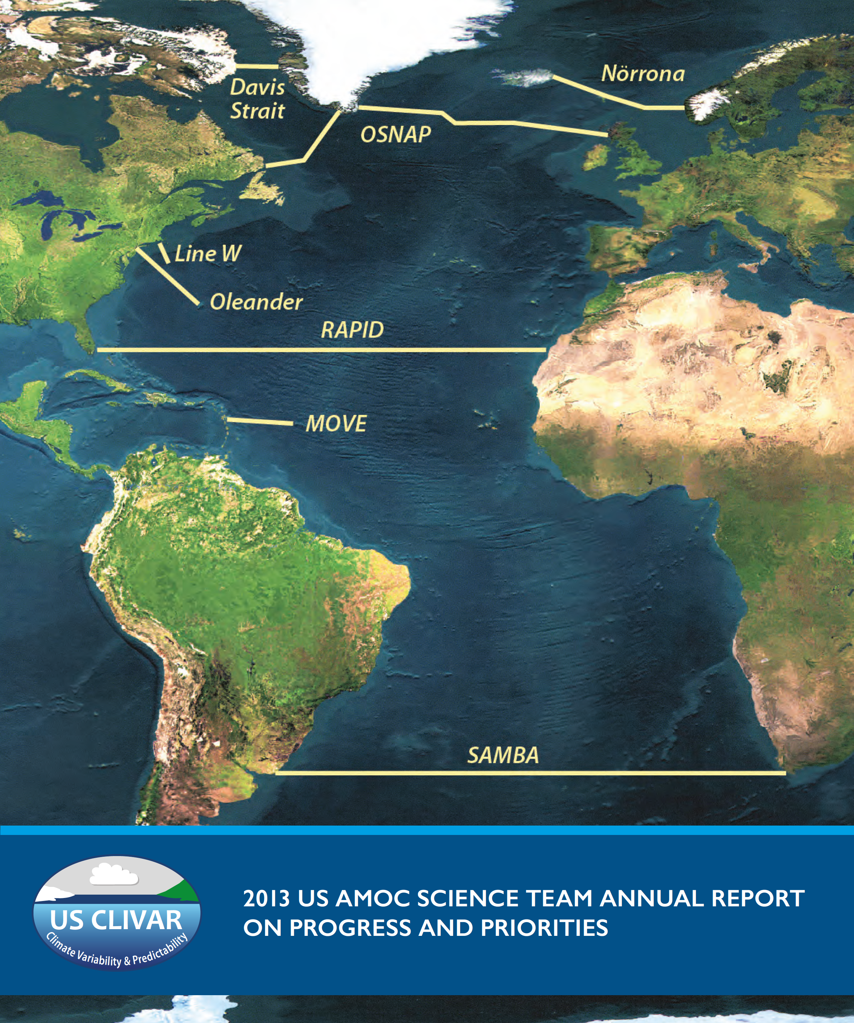
AMOC observations in the North Atlantic particularly including BMBF RACE measurements are well established.
The tropical array measurements will significantly contribute to the understanding of AMOC coherence and propagation of signals of northern and southern hemisphere origin.

Slide 19
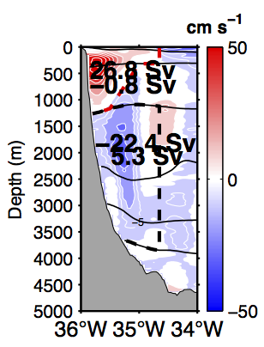
New observations at 11°S: velocities

Slide 20
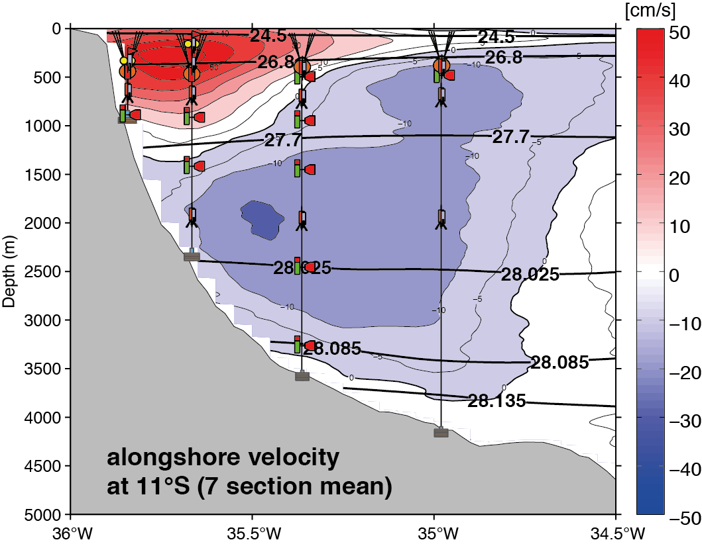
New observations at 11°S: velocities
K1
K2
K3
K4

Slide 21
Further plans and aims
  November 2016
  mooring array at least until 2018

Slide 22
Further plans and aims
  November 2016
  mooring array at least until 2018
  estimate the northward transport of central and intermediate water within the NBUC as part of the AMOC and STC on interannual to decadal time scales

Slide 23
Further plans and aims
  November 2016
  mooring array at least until 2018
  estimate the northward transport of central and intermediate water within the NBUC as part of the AMOC and STC on interannual to decadal time scales
  analyze the connection between transport variations in the western boundary current system of the tropical South Atlantic (warm and cold water route) and the variability of the subpolar North Atlantic with respect to the signal propagation within the AMOC
Notes:
.

Slide 24
Further plans and aims
  November 2016
  mooring array at least until 2018
  estimate the northward transport of central and intermediate water within the NBUC as part of the AMOC and STC on interannual to decadal time scales
  analyze the connection between transport variations in the western boundary current system of the tropical South Atlantic (warm and cold water route) and the variability of the subpolar North Atlantic with respect to the signal propagation within the AMOC
  analyze the connection between assessed NBUC variability at 11° S and EUC variability at 23°W on the equator and its relevance for climate variability

Slide 25
Further plans and aims
  November 2016
  mooring array at least until 2018
  estimate the northward transport of central and intermediate water within the NBUC as part of the AMOC and STC on interannual to decadal time scales
  analyze the connection between transport variations in the western boundary current system of the tropical South Atlantic (warm and cold water route) and the variability of the subpolar North Atlantic with respect to the signal propagation within the AMOC
  analyze the connection between assessed NBUC variability at 11° S and EUC variability at 23°W on the equator and its relevance for climate variability
  analyze the propagation of water mass anomalies in the AMOC, which can e.g. be caused by the variability in the Agulhas leakage

Slide 26
Further plans and aims
  November 2016
  mooring array at least until 2018
  estimate the northward transport of central and intermediate water within the NBUC as part of the AMOC and STC on interannual to decadal time scales
  analyze the connection between transport variations in the western boundary current system of the tropical South Atlantic (warm and cold water route) and the variability of the subpolar North Atlantic with respect to the signal propagation within the AMOC
  analyze the connection between assessed NBUC variability at 11° S and EUC variability at 23°W on the equator and its relevance for climate variability
  analyze the propagation of water mass anomalies in the AMOC, which can e.g. be caused by the variability in the Agulhas leakage
  investigate the variability of the basin-wide (S)AMOC at 11°S

Slide 28
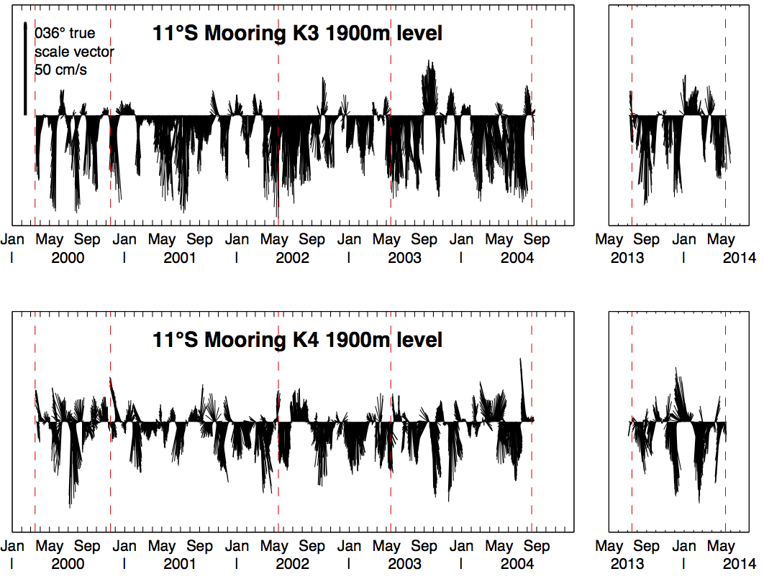
New observations at 11°S: velocities
2 research cruises:
M98 (July 2013)
M106 (May 2014)
redeployment of mooring array in 2013
K1
K2
K3
K4

Slide 29
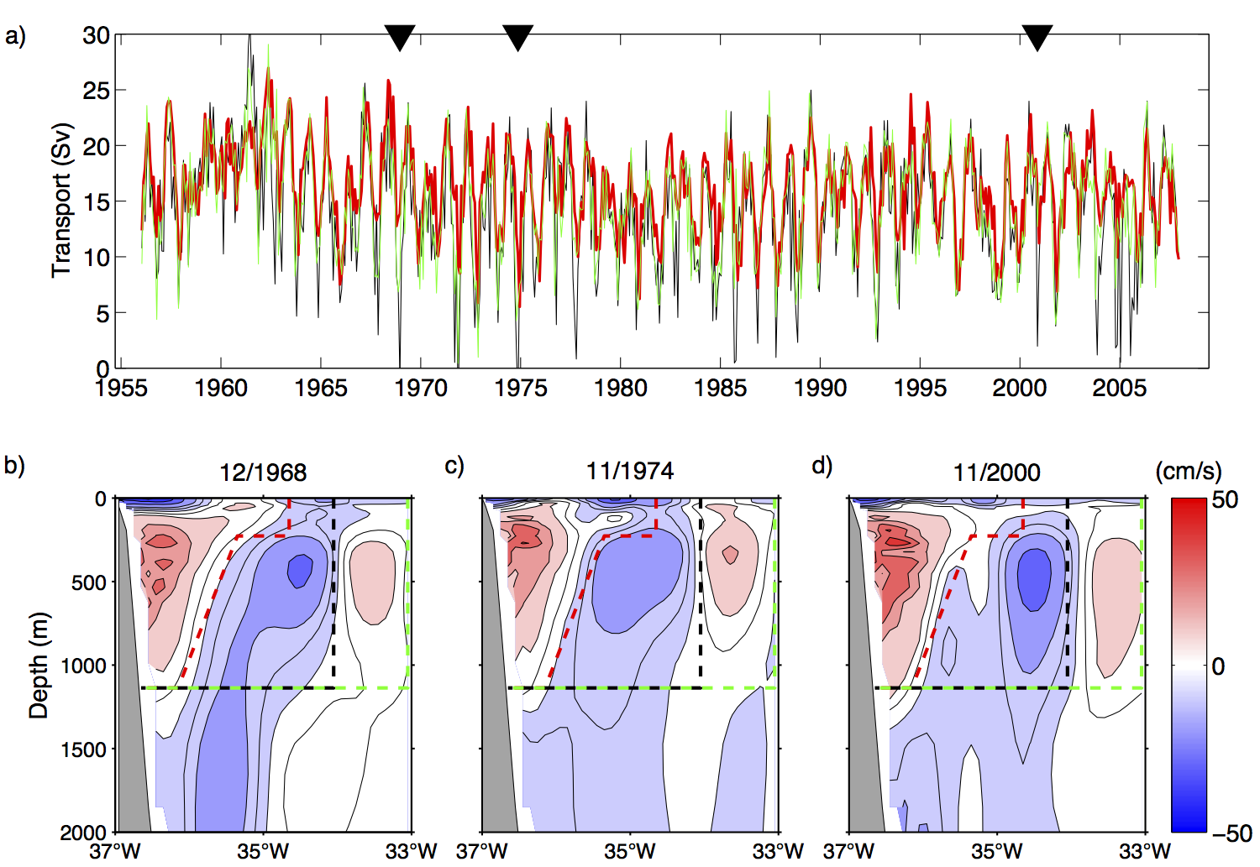
New observations at 11°S: velocities
2 research cruises:
M98 (July 2013)
M106 (May 2014)
redeployment of mooring array in 2013

Slide 30
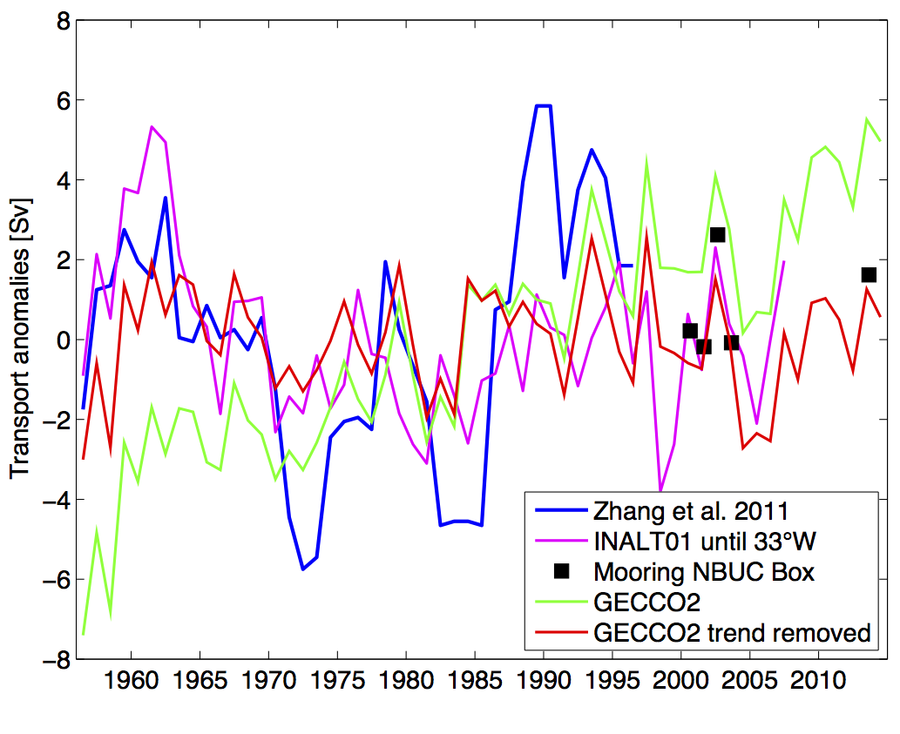
New observations at 11°S: velocities
2 research cruises:
M98 (July 2013)
M106 (May 2014)
redeployment of mooring array in 2013

