Slide 1
Some Thoughts About Descriptor 3.3
Rainer Froese
ICES MSFD Workshop
14.01.2014 Copenhagen

Slide 2
MSFD Descriptor 3
The level of pressure of the fishing activity, measured either as fishing mortality F relative to the one associated with the maximum sustainable yield (F_{msy}) or, if F is unknown, the ratio between catch and biomass, with a reference point that is compatible with F_{msy}.
The spawning stock biomass SSB relative to the one that can produce the maximum sustainable yield (SSB_{msy}) or other suitable biomass indices.
The age and size distribution within the population, with the sub-indicators
Proportion of fish larger than the mean size of first sexual maturation;
Mean maximum length across all species found in research vessel surveys;
95 % percentile of the fish length distribution observed in research vessel surveys;
Size at first sexual maturation [relative to historic sizes], which may reflect the extent of undesirable genetic effects of exploitation.

Slide 3
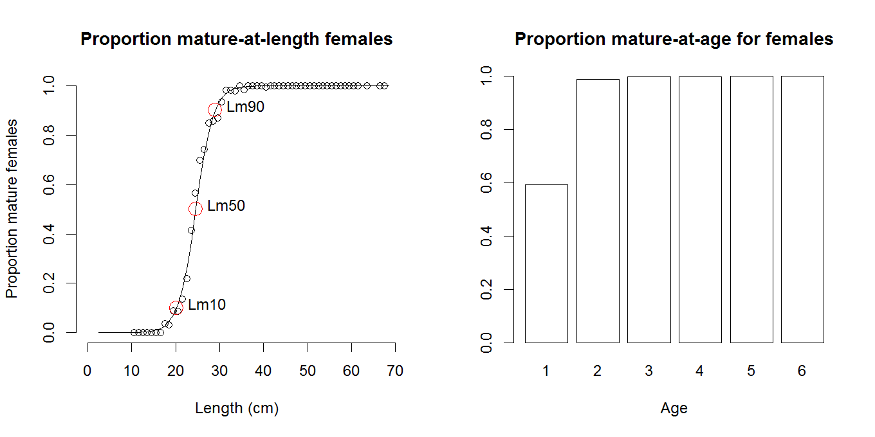
North Sea Haddock
North Sea haddock, data from DATRAS, Linf = 62 cm, Lm90 = 29 cm, tm95 = 2

Slide 4
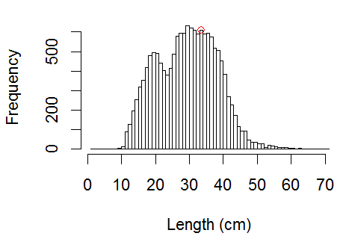
Length-Frequency in DATRAS
North Sea haddock: largest fish not representative of proportion of large fish.
Vertical line represents Lm90 = 29 cm.
Mean length in catch depends on gear selectivity, which is different from commercial gears

Slide 5
D 3.3 Considerations
Size/age at maturity is reasonable, known biological reference point
Proportion of large fish depends on gear selectivity
Largest fish not representative of proportion of large fish
DATRAS has lower size selectivity than commercial catches
Recruitment pulses lower mean size in catch

Slide 6
D 3.3 Limit
Use length or age where 90% of the females have reached maturity as lower limit reference point
Use mean length / age in commercial catches as indicator
If entry in fishery is above limit reference point, then recruitment pulses can not lead to negative assessment

Slide 7
D 3.3 and Dx.x Target
A given catch has the least impact on cohort biomass and size/age structure if it is taken at the length/age where cohort biomass has its maximum
$L_{opt}=L_{inf}\frac{3}{3+\frac{M}{K}}$
Thus, L_{opt}, which is close to 2/3 L_{inf}, is a target length for fishing that wants to minimize impact on the stock, which is the intentionally impacted part of the ecosystem for a given fishery

