Slide 1
Publications and Research Data – crosslinking repositories
Barbara Schmidt & Hela Mehrtens

Slide 2
Publications and Research Data – crosslinking repositories
OceanRep (GEOMAR Institutional Repository)
OSIS (GEOMAR Ocean Science Information System)
Pangaea (Data Publisher for Earth & Environmental Science)
GLORIA (GEOMAR Library Ocean Research Information Access)
Recent developments
Notes:
We want to tell you about the repositories at GEOMAR.
To accomodate changing requirements we constantly develop new features.
Today we want to show you the crosslinking between publications and research data.
Here you see the different components we will talk about.

Slide 3
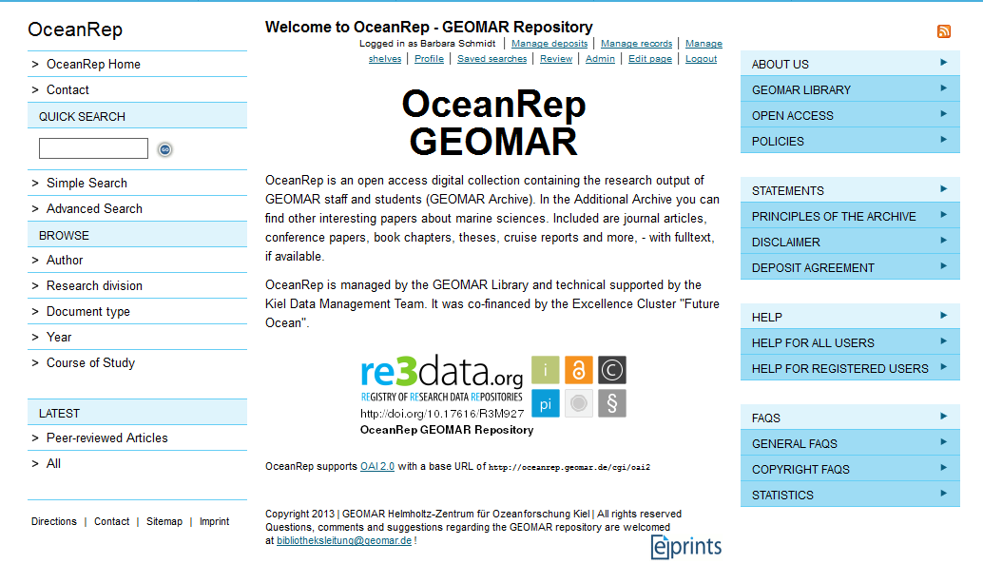
Publications and Research Data – crosslinking repositories
Notes:
B:
OceanRep is based on ePrints (Southampton). It is an open access digital collection containing the research output of GEOMAR staff and students. Included are journal articles, conference papers, book chapters, theses and more, - with fulltext, if available.
Let‘s have a little peek on what we are talking about. This is a current screenshot of the repository. The look was adjusted according to the GEOMAR homepage. In the left navigations bar you see the various search and browse options. In the navigation bar on the right you can see multiple options for getting further information about OceanRep. The navigation menu is shown in every topic you choose.

Slide 4
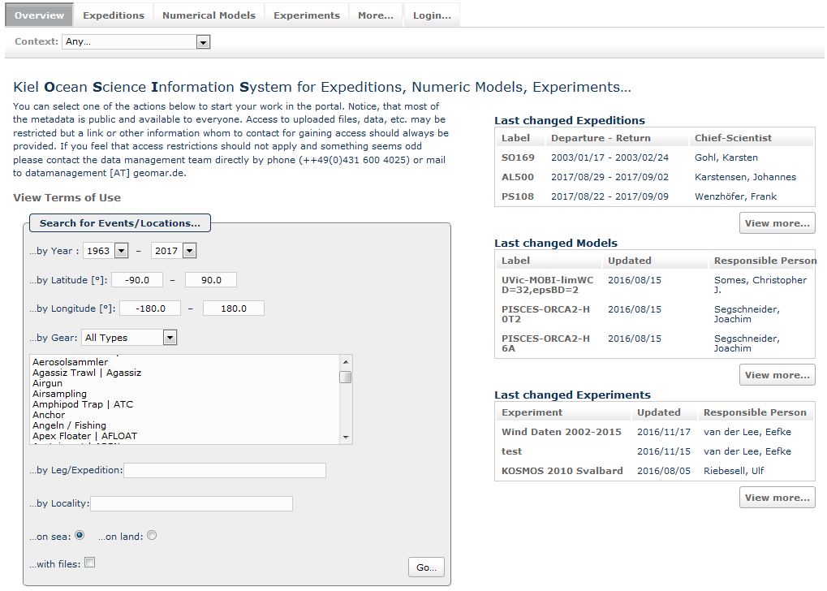
Publications and Research Data – crosslinking repositories
Notes:
H:
The data management portal is providing access to several projects, offers Web 2.0 exchange options and gives access to the expedition database OSIS, that organizes data description and exchange of expeditions, numerical model and experiments for each project. There is a crosslink between OceanRep and OSIS, allowing the linkage to data from a paper or the listing of papers for certain data. As the data portal is mainly for internal use, data publishing is done via the world data centre PANGAEA.

Slide 5
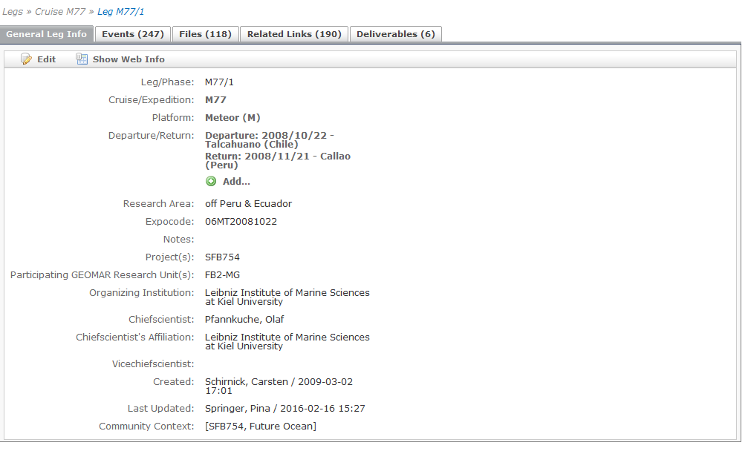
Publications and Research Data – crosslinking repositories
Notes:
Take Leg M77/1
Click on related links

Slide 6
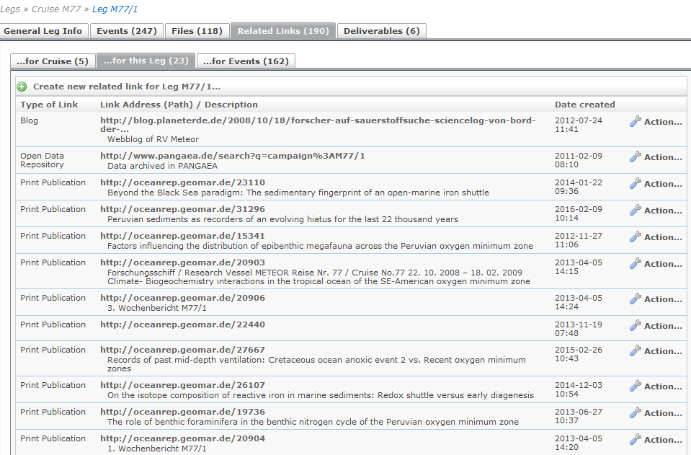
Publications and Research Data – crosslinking repositories
Notes:
Here you find the link to the publication which was written based on the research data sampled during M77/1

Slide 7
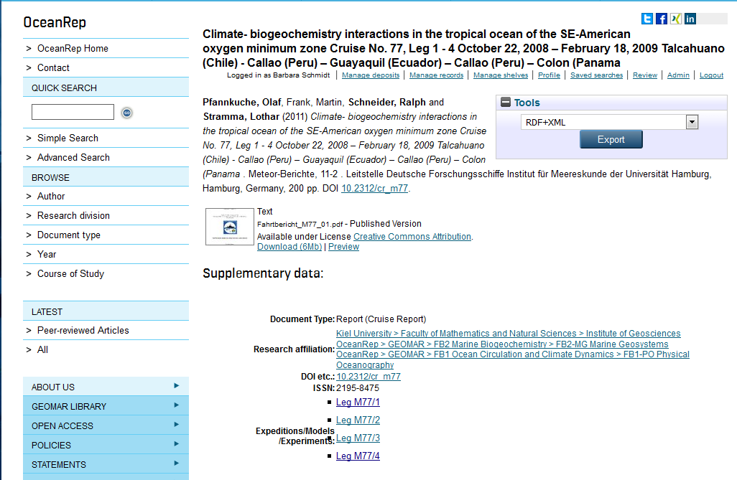
Publications and Research Data – crosslinking repositories
Notes:
B:
The Link leads you right to the entry in OceanRep. Most cruise reports are open access – you can see there is no restriction on this pdf (1)

Slide 8
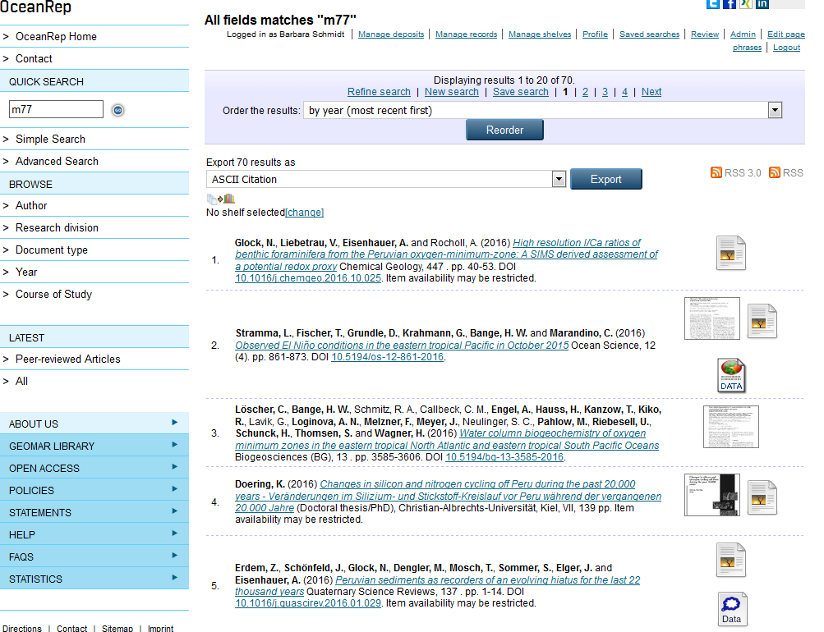
Publications and Research Data – crosslinking repositories
Notes:
Of course you can also use OceanRep to search for publications related to a cruise

Slide 9
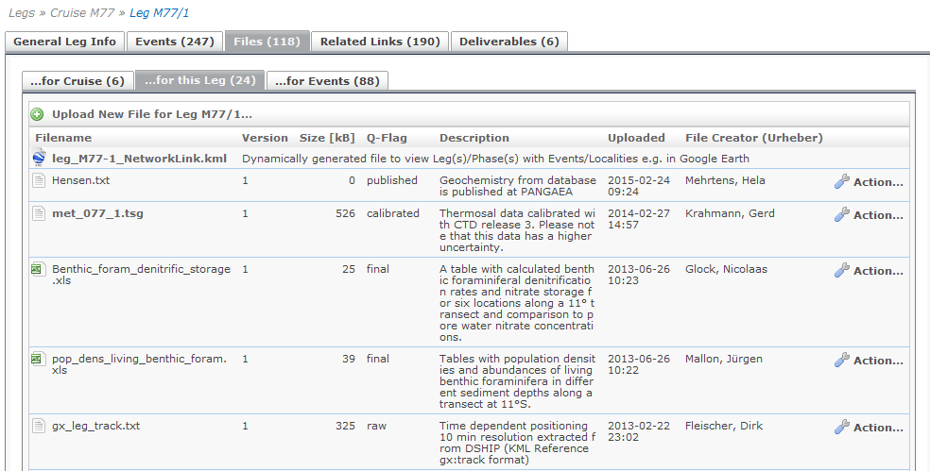
Publications and Research Data – crosslinking repositories
Notes:
H:
In case you have Google Earth installed on your computer, you can go to „Files“ within this leg and download the Google Earth File.

Slide 10
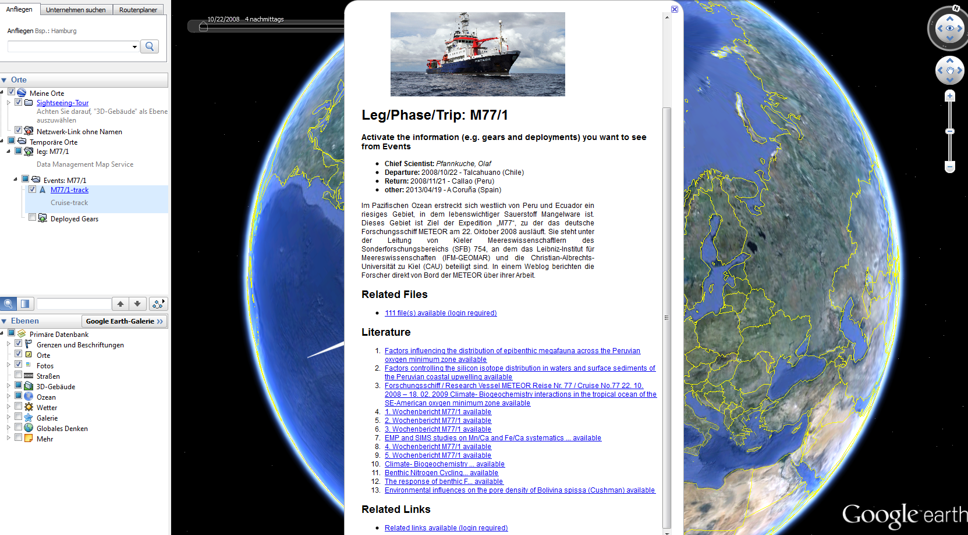
Publications and Research Data – crosslinking repositories
Notes:
And you will be shown which information can be found on this track: The data files, the link to the publication and links to other related links. For the data files and other related links a login is required, the link to the publication is open for everybody, of course.

Slide 11
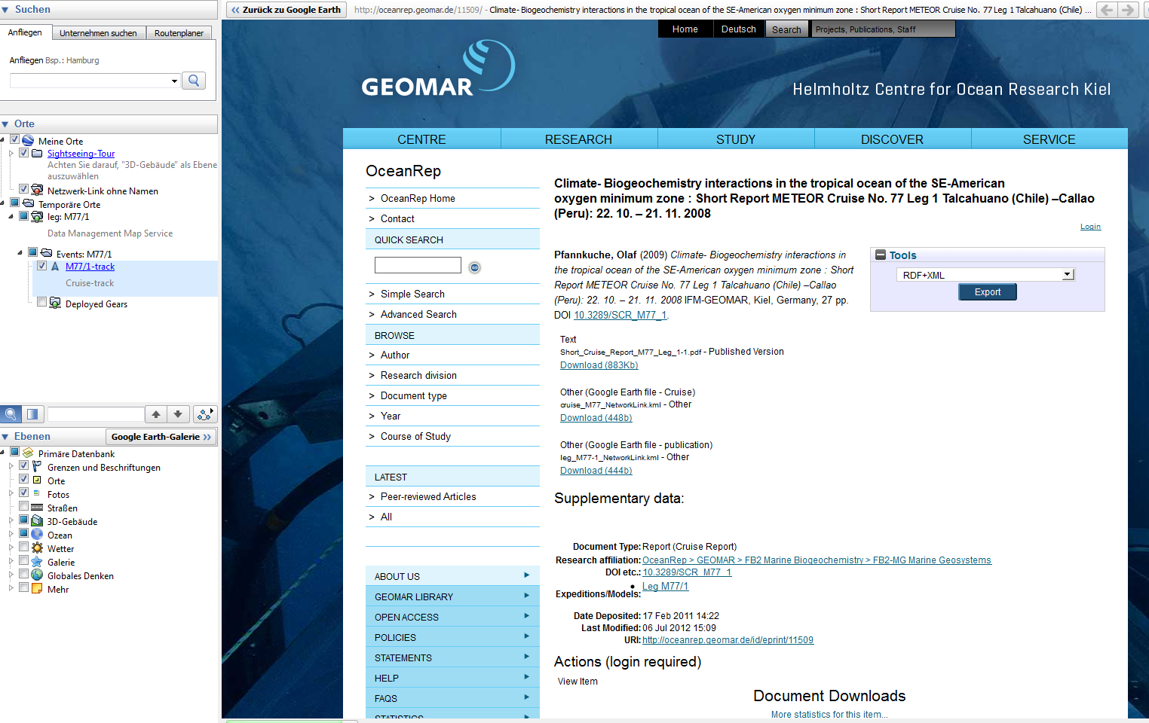
Publications and Research Data – crosslinking repositories
Notes:
B:
We offer the same connection coming from OceanRep. You can find a link within the publication entry which will lead you to the data database and to the expedition in Google Earth.

Slide 12
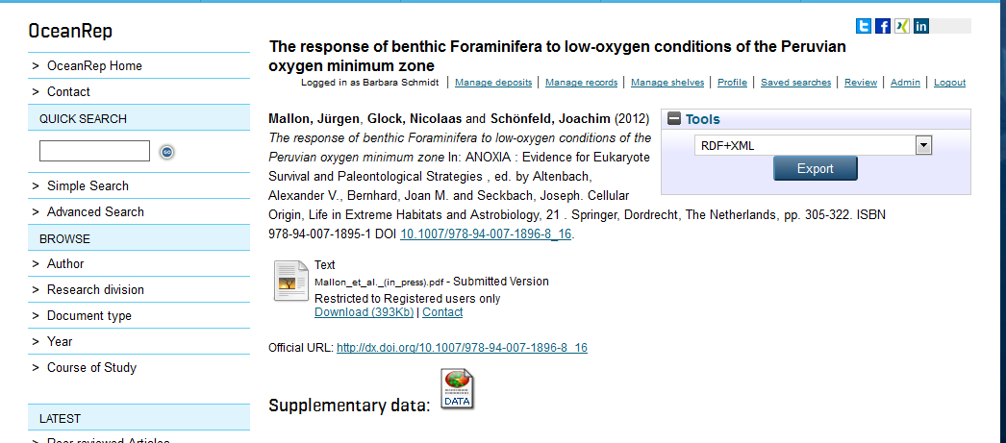
Publications and Research Data – crosslinking repositories
Notes:
Here you can see an entry in OceanRep that leads you to the data center Pangaea

Slide 13
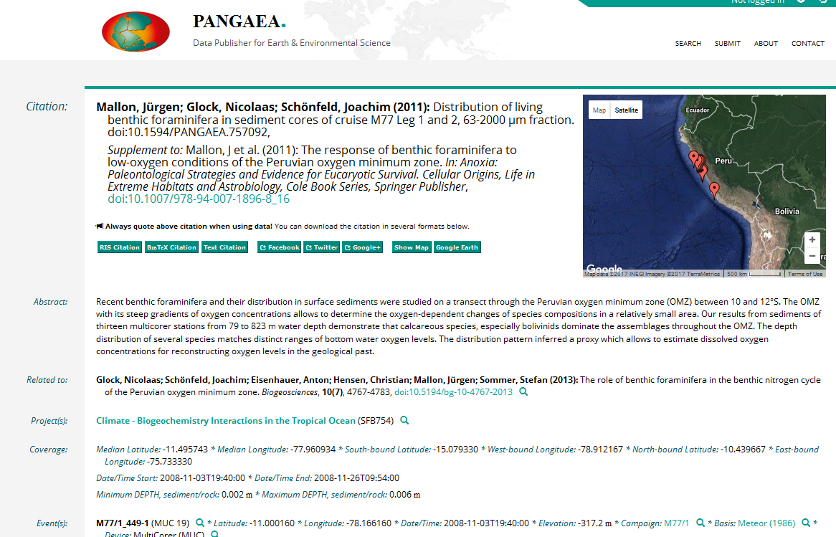
Publications and Research Data – crosslinking repositories
Notes:
Where you again find the citation of the paper

Slide 14
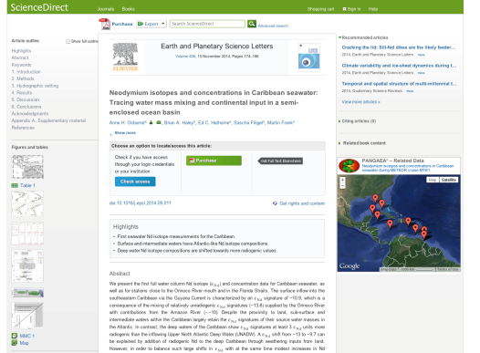
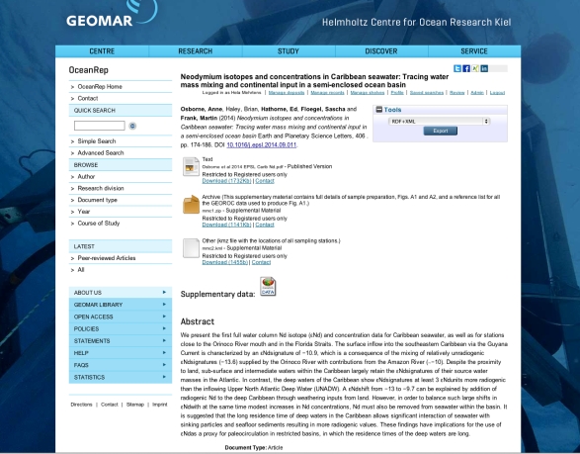
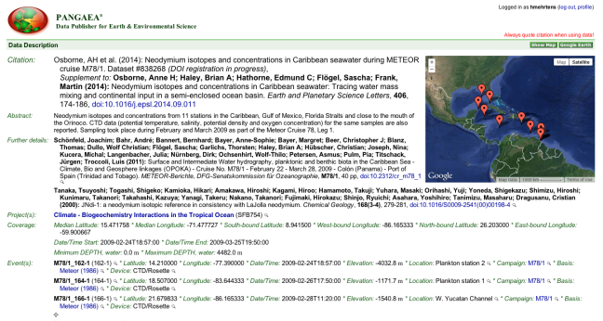
Publications and Research Data – crosslinking repositories
Science Direct:
http://www.sciencedirect.com/science/article/pii/S0012821X14005664
OceanRep:
http://oceanrep.geomar.de/25746/
PANGAEA:
http://dx.doi.org/10.1594/PANGAEA.838268
Notes:
H

Slide 15
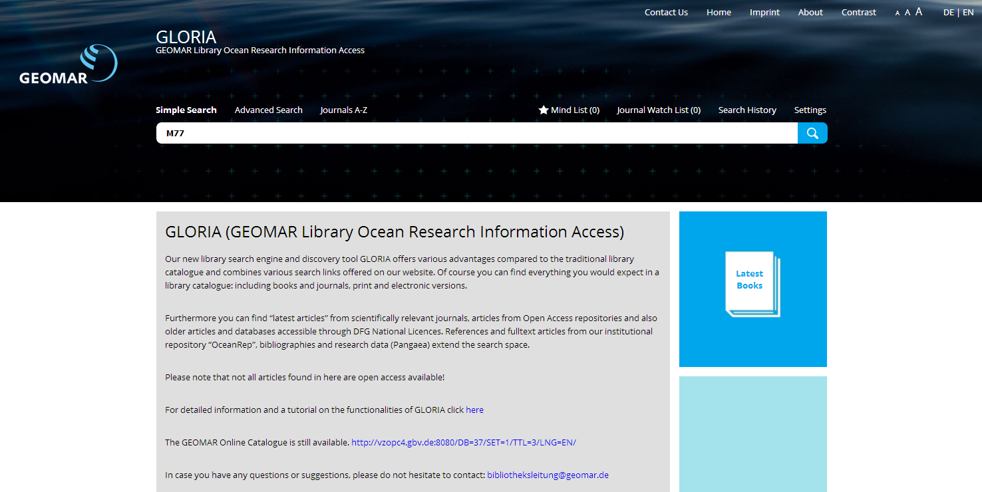
Publications and Research Data – crosslinking repositories
Notes:
GLORIA (GEOMAR Library Ocean Research Information Access)
Our new library search engine and discovery tool GLORIA offers various advantages compared to the traditional library catalogue and combines various search links offered on our website. Of course you can find everything you would expect in a library catalogue: including books and journals, print and electronic versions. The recently established discovery tool GLORIA allows the combined search of publications and data.

Slide 16
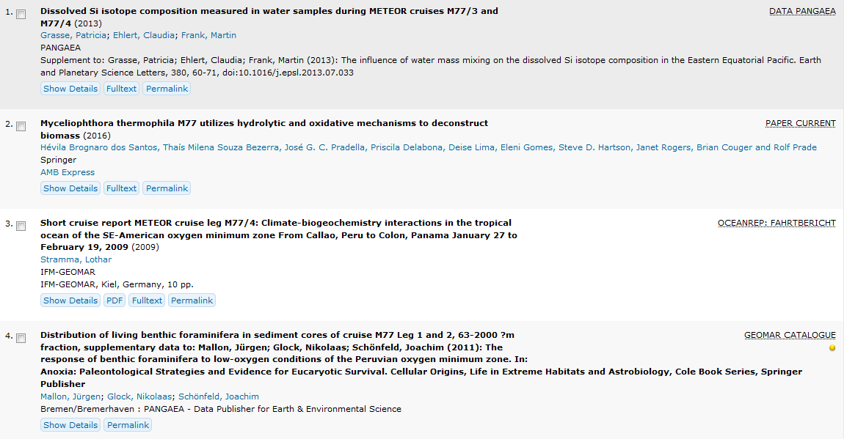
Publications and Research Data – crosslinking repositories
Notes:
Furthermore you can find “latest articles” from scientifically relevant journals, articles from Open Access repositories and also older articles and databases accessible through DFG National Licences. References and fulltext articles from our institutional repository “OceanRep”, bibliographies and research data (Pangaea) extend the search space.

Slide 17
Publications and Research Data – crosslinking repositories
Notes:
In Germany the funders want to have more and more information during the evaluation process of an institution….
With the help of other E-Prints users we developed a plugin to save all the needed information

Slide 18
Publications and Research Data – crosslinking repositories
Notes:
One of the automatically generated views for evaluations shows the number of the different publication types of those articles, where the corresponding author is from GEOMAR

Slide 19
Publications and Research Data – crosslinking repositories

