Slide 1


Variability of the Boundary Circulation Systems at 11°S
Rebecca Hummels¹, Peter Brandt¹, Marcus Dengler¹, Jürgen Fischer¹, Moacyr Araujo², Doris Veleda², Jonathan V. Durgadoo¹, Josefine Herrford¹ and Robert Kopte¹
¹GEOMAR Helmholtz Zentrum für Ozeanforschung, Kiel, Germany
²DOCEAN Department of Oceanography UFPE Refice, Brazil
2017 US AMOC Science Team Meeting, Santa Fe, New Mexico, 23.05.2017

Slide 2
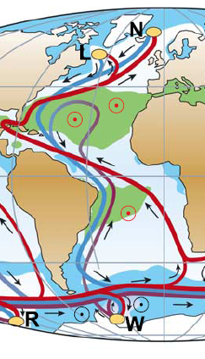
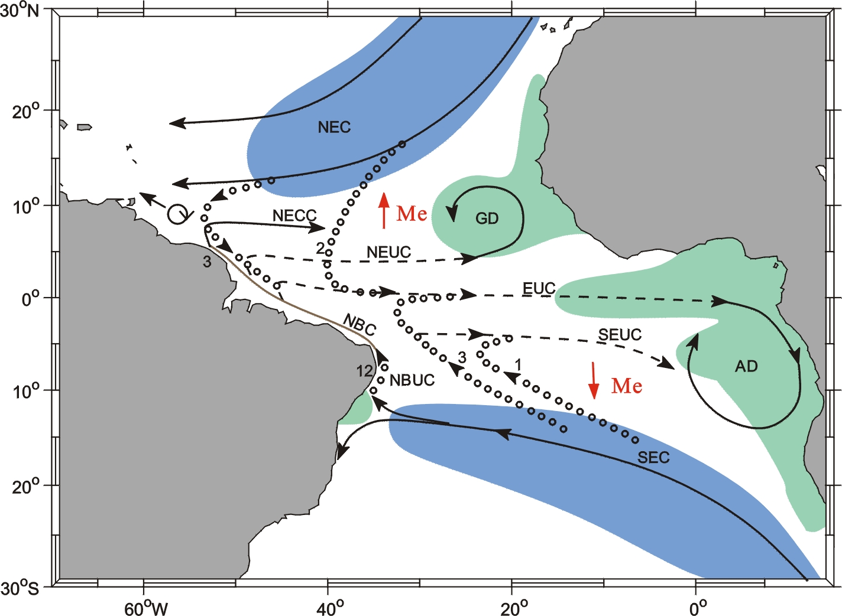
Western Boundary Circulation System (WBCS)
Atlantic thermohaline circulation (ATHC)
Shallow Subtropical-tropical Cells (STC)
Kuhlbroedt et al. 2007
Schott et al. 2004
Interaction between the hemispheres is focused on the western boundary

Slide 3
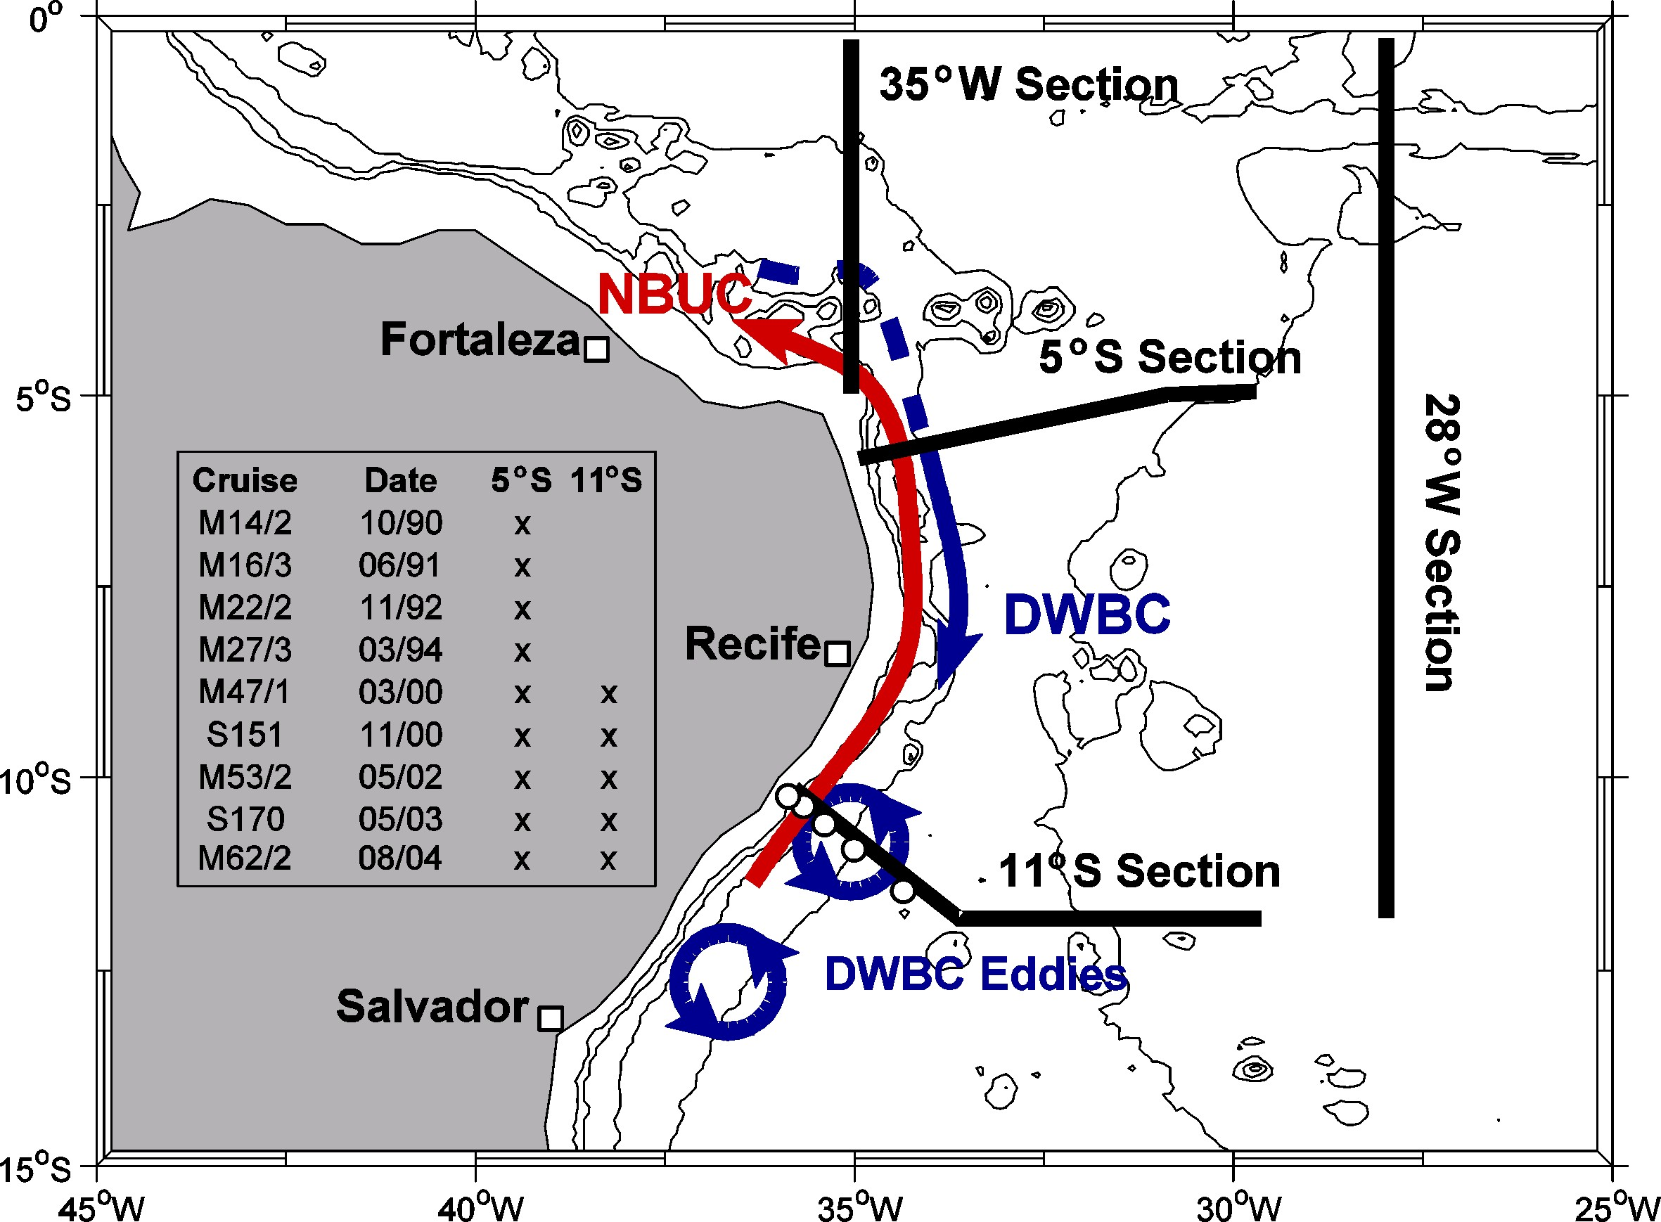
Western Boundary Circulation System (WBCS)
Observations at 5°S and 11°S between 1990-2004:
9 research cruises: repeatedly occupied the 5°S and 11°S section
Mooring array at 11°S
2000-2004
Schott et al. 2005

Slide 4
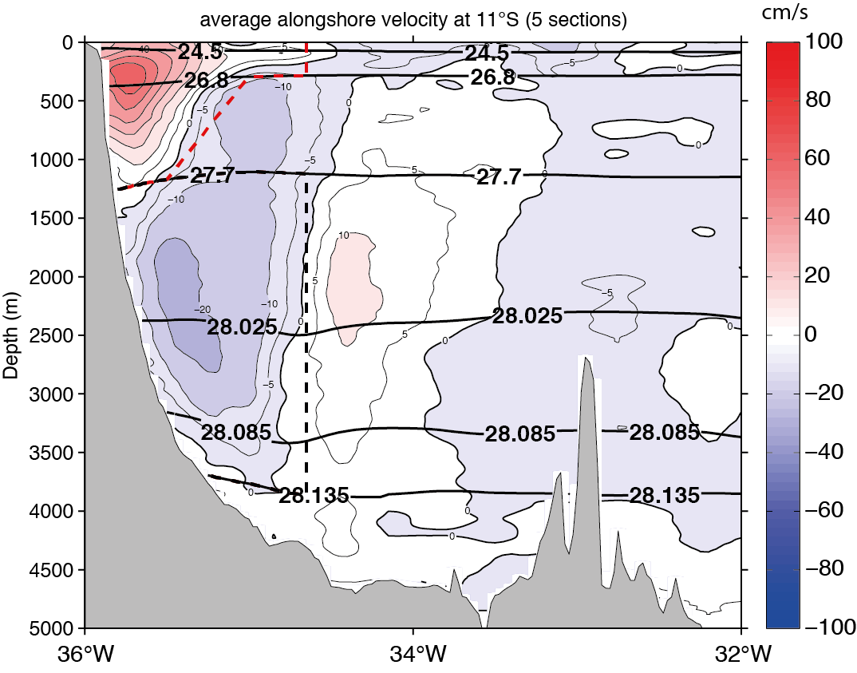
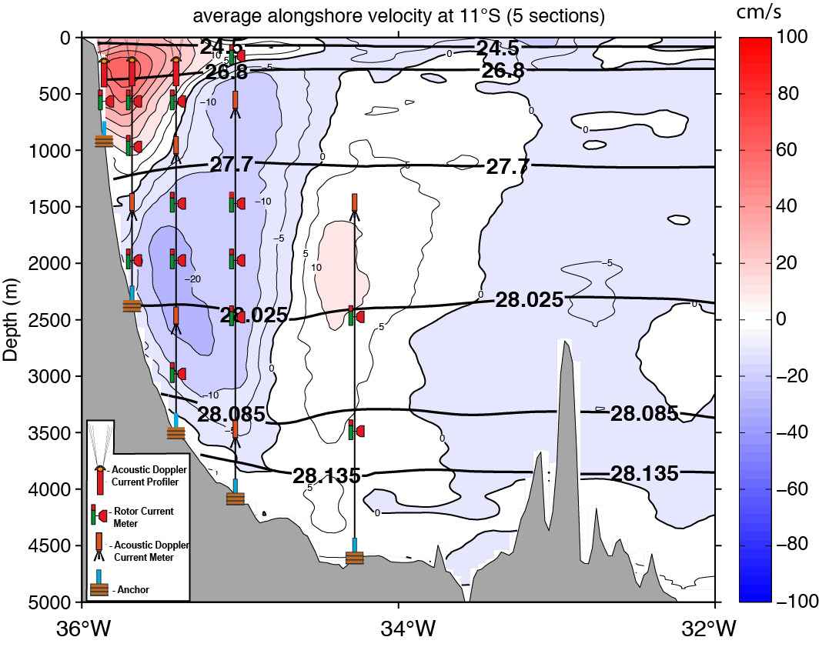
Western Boundary Circulation System (WBCS)
Observations at 11°S between 2000-2004: Mean state
cm/s
remake of Schott et al. 2005
Average transports at 11°S (ship):
NBUC 24 +/- 4 Sv [=1 x10⁶ m³s⁻¹]
DWBC -34.8 +/- 8.6 Sv
Average transports at 11°S (mooring):
NBUC 27.1 +/- 1.1 Sv
DWBC -18.6 +/- 1.7 Sv

Slide 5
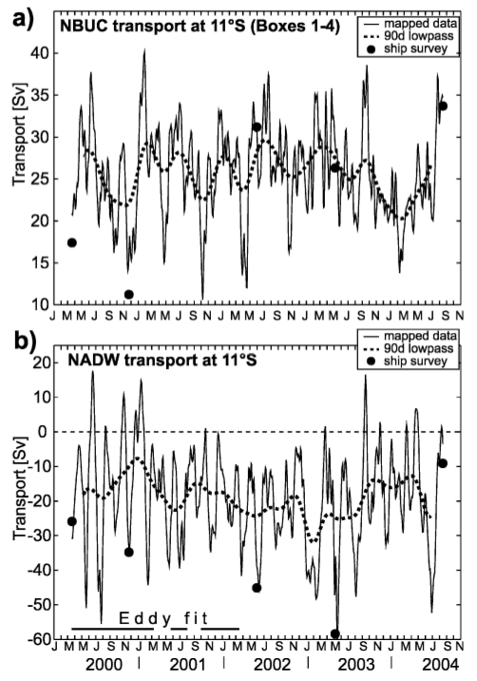
Western Boundary Circulation System (WBCS)
Observations at 11°S between 2000-2004: Intraseasonal to Seasonal Variability
NBUC:
Average transport is
similar to ship sections
DWBC:
Average transport is lower than from ship sections
Spectral peak at 60-70 days period associated with deep eddies
Schott et al. 2005

Slide 6
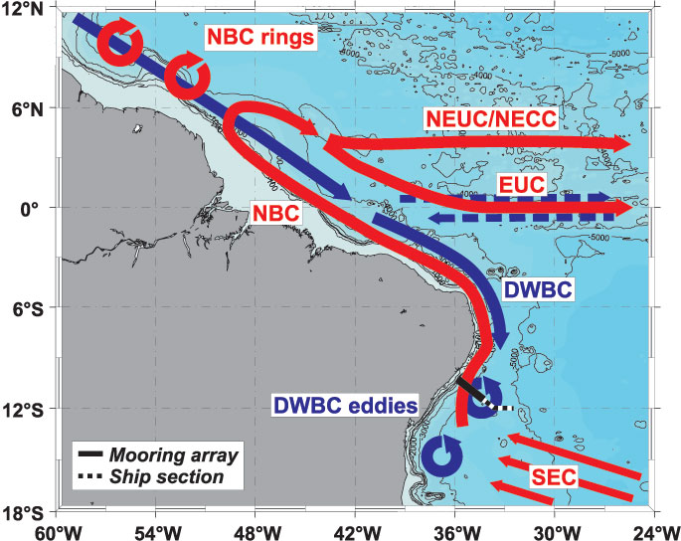
Western Boundary Circulation System (WBCS)
Observations at 11°S between 2000-2004
Break up of DWBC in to deep eddies at around 8°S
Dengler et al. 2004

Slide 7
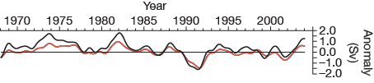
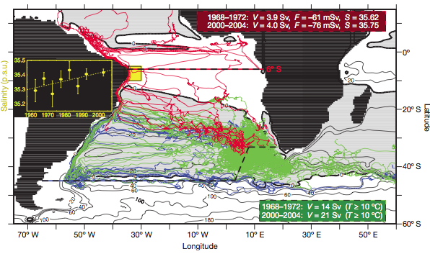
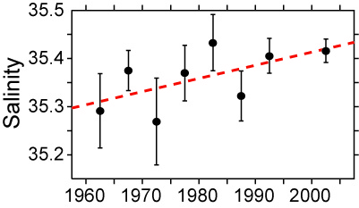
Western Boundary Circulation System (WBCS)
Other studies after observational period
close correspondence between AMOC strength and NBUC transport on inter-annual time scales
AMOC strength at 6°S
NBUC transport
Biastoch et al. 2008
Salinity anomalies within the NBUC are related to the variability of the Agulhas leakage and might have implications for further evolution of MOC
Biastoch et al. 2009

Slide 8
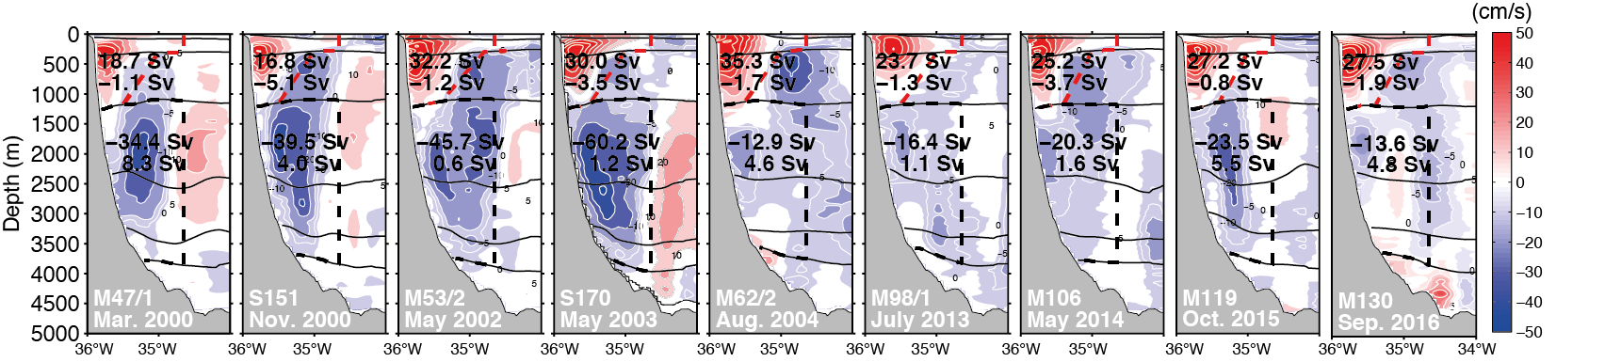
Western Boundary Circulation System (WBCS)
New observations at 11°S: velocities
4 new research cruises:
M98 (July 2013)
M106 (May 2014)
M119 (October 2015)
M130 (September 2016)
redeployment of mooring array in 2013

Slide 9
Western Boundary Circulation System (WBCS)
New observations at 11°S: velocities
redeployment of mooring array in 2013
average
(2000-2004)
25.8 ±1.1 Sv
average
(2013-2016)
25.6 ±1 Sv
←25.4 ± 2.4→←25 ± 1.8→←27.7 ± 3.1→←25.1 ±2.1→
average
(2000-2004)
-17 ±1.6 Sv
average
(2013-2016)
-19 ±2.2 Sv
update from Hummels et al. 2015

Slide 10
Western Boundary Circulation System (WBCS)
New observations at 11°S: velocities
redeployment of mooring array in 2013
What is INALT01?
global 0.5° horizontal resolution (ORCA05)
1/10° horizontal resolution within the nest
46 vertical levels
forced with CORE2b dataset
Durgadoo et al. 2013

Slide 11
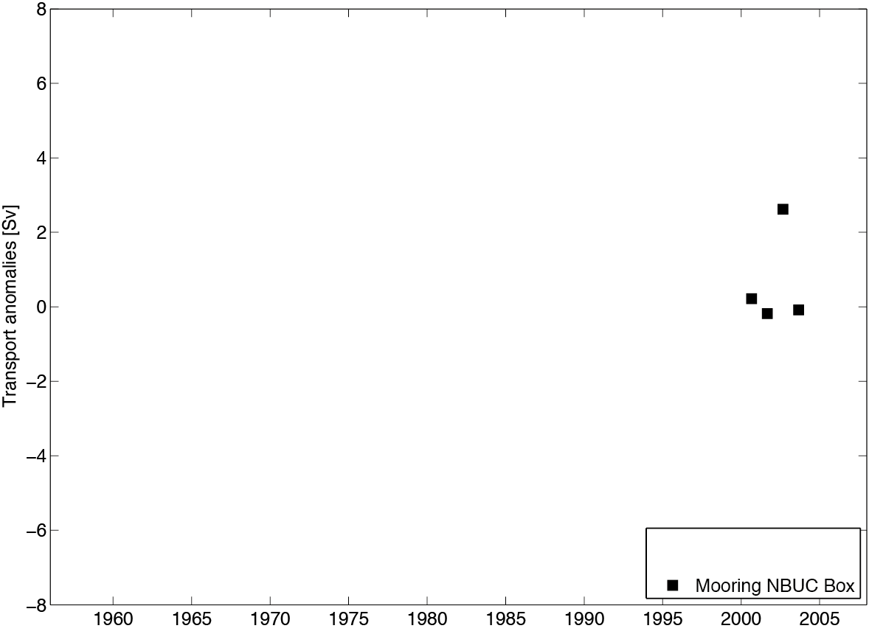
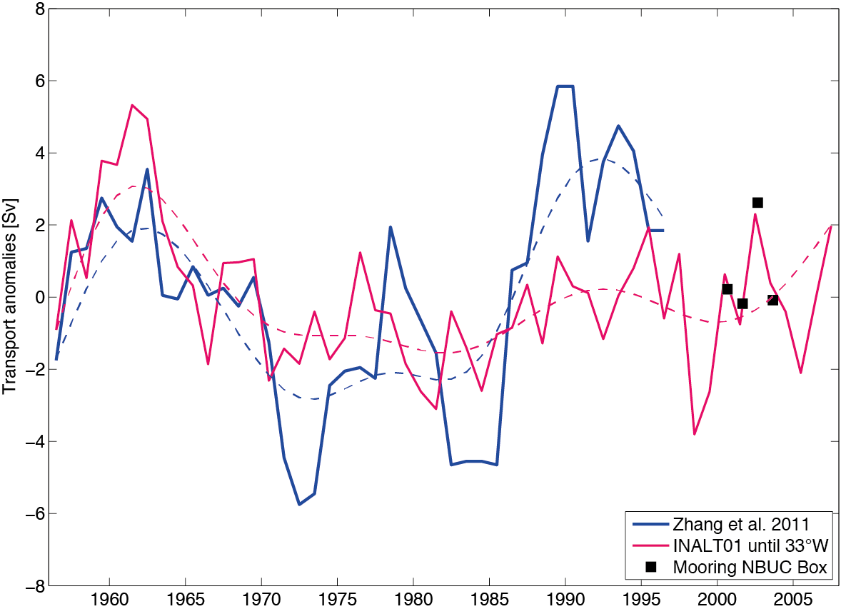
Western Boundary Circulation System (WBCS)
New observations at 11°S: velocities
redeployment of mooring array in 2013
16.3 Sv Zhang ´11
Averages subtracted:
25.2 Sv Mooring
14.9 Sv INALT01
Hummels et al. 2015

Slide 12
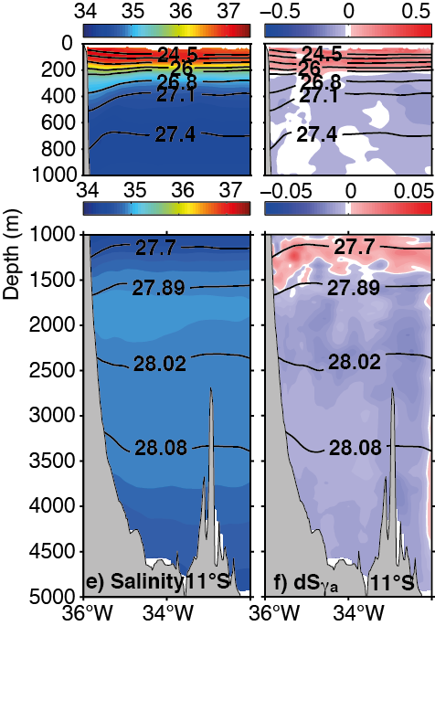
Western Boundary Circulation System (WBCS)
New observations at 11°S: hydrography
11°S
Biastoch et al. 2009
trend: +0.028 psu / decade
(100-600m NBUC region)
Hummels et al. 2015
Average salinity differences across section:
dS_{γ} (100-600m) = 0.024 / decade
dS_{γ} (1500-4000m) = -0.007 / decade

Slide 13
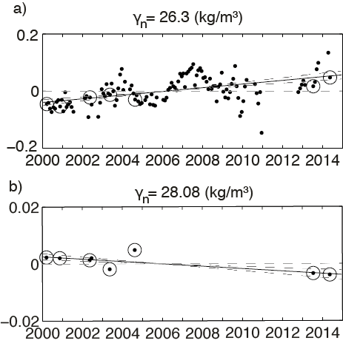
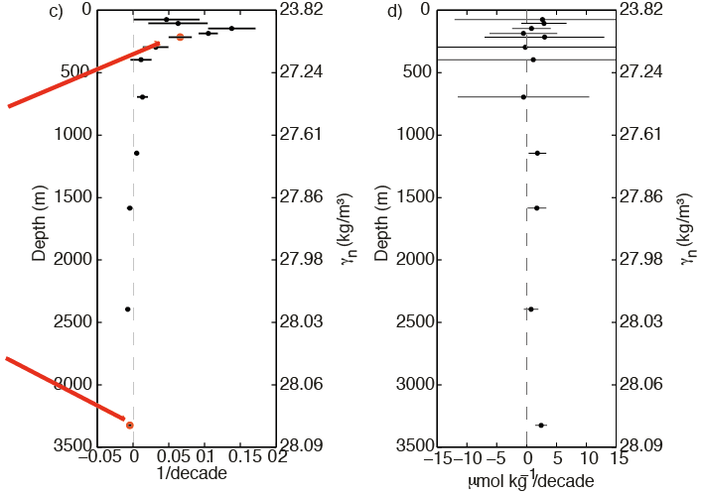
Western Boundary Circulation System (WBCS)
New observations at 11°S: hydrography
All available hydrographic data between 40°W-30°W and 12°S-8°S
Hydrographic data from ship cruises
+ Argo
+ WOA
+Brazilian Navy
within a box between 40°W and 30°W and 12°S and 8°S
Hummels et al. 2015

Slide 14
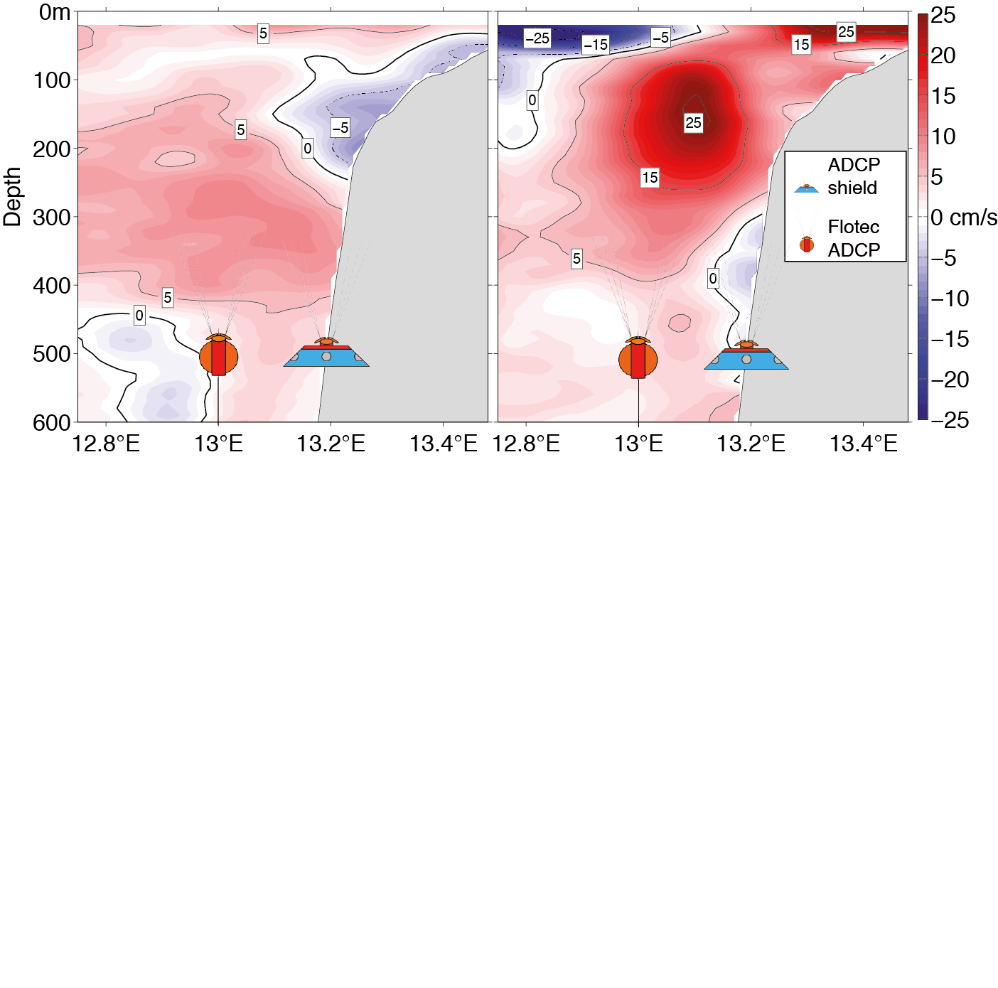
Eastern Boundary Circulation System (EBCS)
3 research cruises
M98 (July 2013)
M120 (November 2015)
M131 (October 2016)
deployment of mooring array in 2013
Alongshore velocities highly variable (alternating between north-and southward) with a weak mean southward flow of about 5-8 cm/s
Seasonal variability is dominated by 120-day, semi-annual and annual oscillations
Kopte et al. 2016

Slide 15
Eastern Boundary Circulation System (EBCS)
3 research cruises
M98 (July 2013)
M120 (November 2015)
M131 (October 2016)
deployment of mooring array in 2013
update from Kopte et al. 2016
The Angola Current (AC) transport shows a mean of -0.32±0.05 and its semiannual cycle is quasi-synchronized with semiannual coastal Kelvin waves.

Slide 16
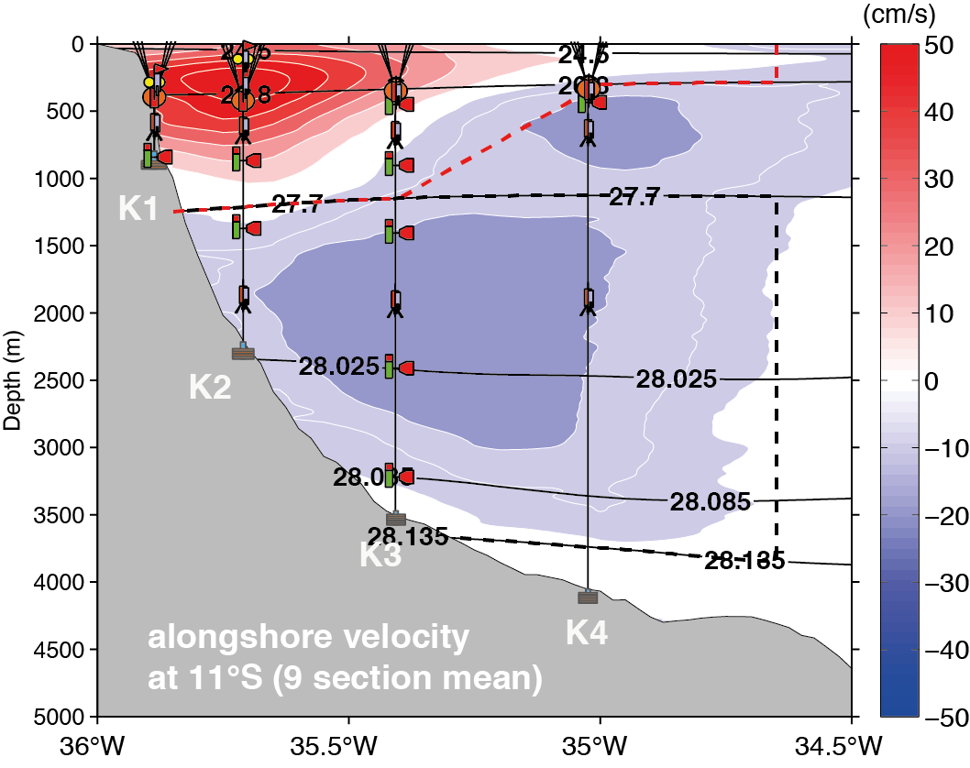
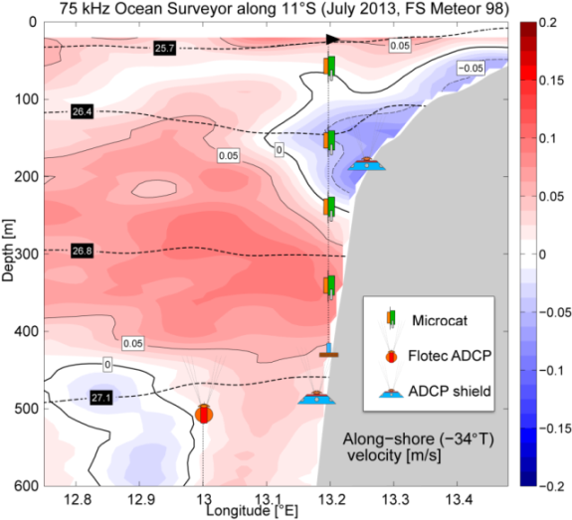
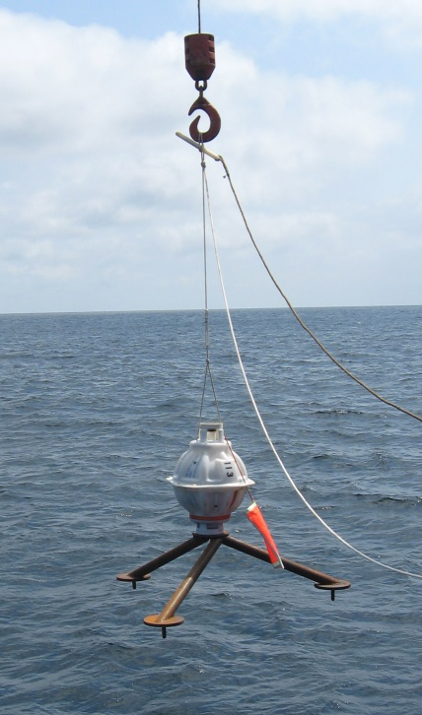
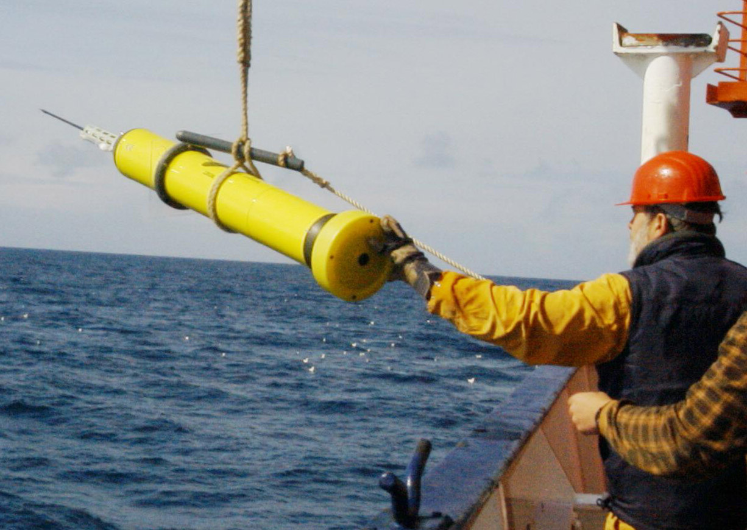
AMOC estimate at 11°S
Interior mid-ocean transport
WB
Ekman
EB
WB
EB

Slide 17
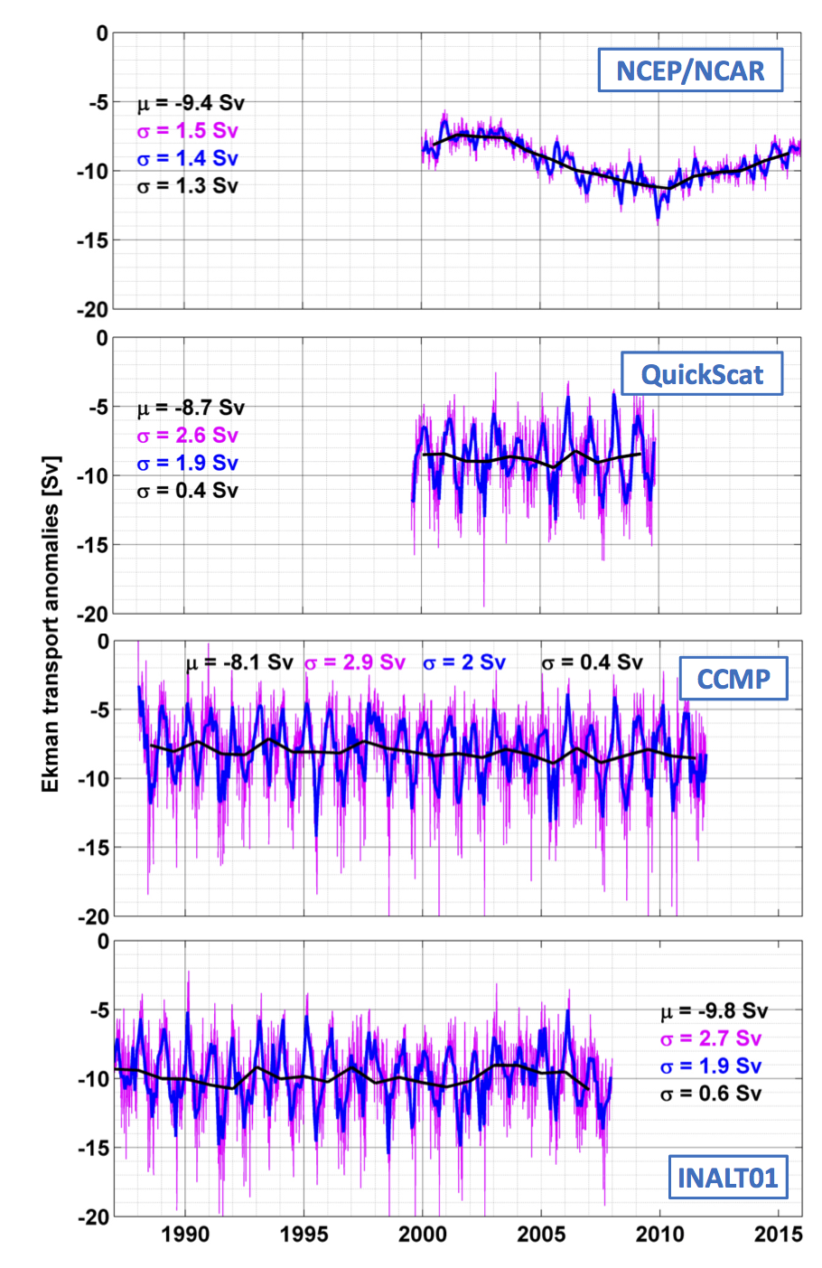
AMOC estimate at 11°S
Ekman
– weekly – monthly – annual data
large differences can arise depending on the method used to estimate wind stress from the wind products
Wind stress is estimated from wind at 10m after Large and Yeager (2004) assuming neutral stability
mean Ekmantransports range between 8.1-9.8 Sv among products and is dominated by seasonal variability (~2Sv)
NCEP/NCAR: weak seasonal variability and spurious decadal trend

Slide 18
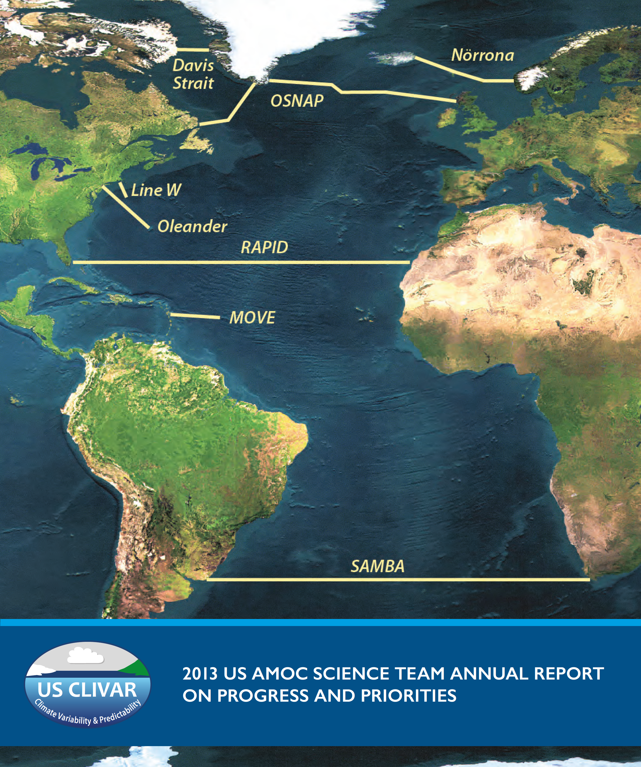
AMOC observations in the North Atlantic particularly including BMBF RACE measurements are well established.
The tropical array measurements will significantly contribute to the understanding of AMOC coherence and propagation of signals of northern and southern hemisphere origin.

Slide 20
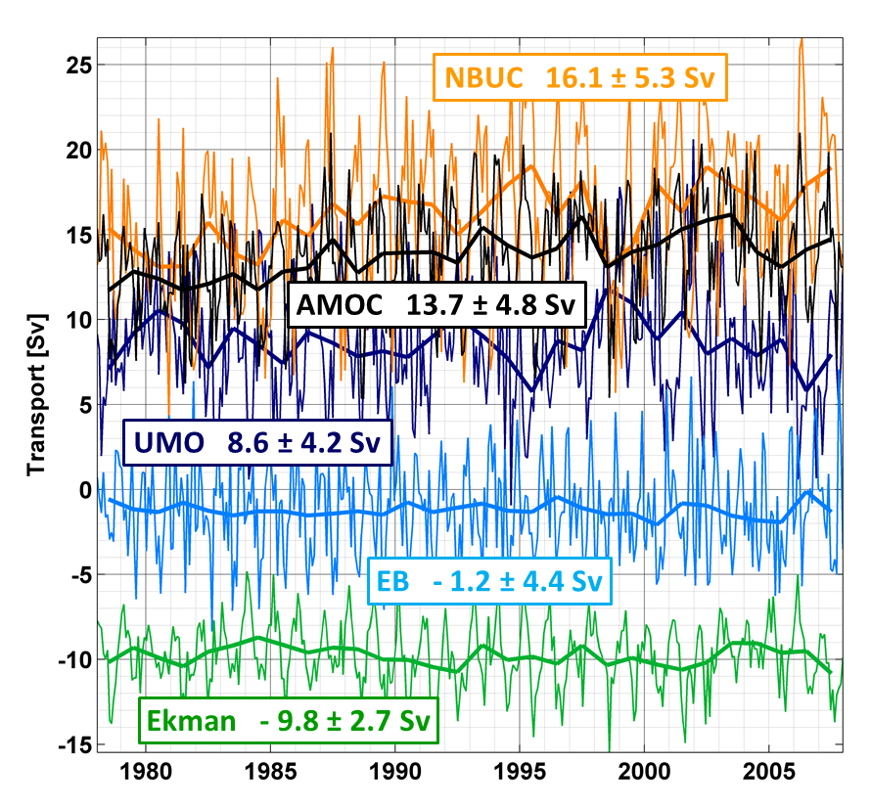
AMOC estimate at 11°S
Interior mid-ocean transport
WB
Ekman
EB
Durgadoo et al. 2013, INALT01

Slide 21
Western Boundary Circulation System (WBCS)
Summary
4 new research cruises:
M98 (July 2013)
M106 (May 2014)
M119 (October 2015)
M130 (September 2016)
redeployment of mooring array in 2013
------------------------------------------------------------------------------------------------------------
no significant transport changes between the observational periods, which are a decade apart
interannual variations in NBUC transport from observations fit to numerical simulations (INALT01)
decadal variability of NBUC transport is similar in INALT01 and the geostrophic transports estimated in Zhang et al. 2011 and should be detectable with the currently installed observing system
positive (negative) decadal salinity trend within the central water (DWBC layer) consistent with changes in the large scale circulation of the Atlantic

Slide 22
Further plans and aims
  2 research cruises: September 2015, March 2017
  mooring array at least until 2017

Slide 23
Further plans and aims
  2 research cruises: September 2015, March 2017
  mooring array at least until 2017
  estimate the northward transport of central and intermediate water within the NBUC as part of the AMOC and STC on interannual to decadal time scales

Slide 24
Further plans and aims
  2 research cruises: September 2015, March 2017
  mooring array at least until 2017
  estimate the northward transport of central and intermediate water within the NBUC as part of the AMOC and STC on interannual to decadal time scales
  analyze the connection between transport variations in the western boundary current system of the tropical South Atlantic (warm and cold water route) and the variability of the subpolar North Atlantic with respect to the signal propagation within the AMOC

Slide 25
Further plans and aims
  2 research cruises: September 2015, March 2017
  mooring array at least until 2017
  estimate the northward transport of central and intermediate water within the NBUC as part of the AMOC and STC on interannual to decadal time scales
  analyze the connection between transport variations in the western boundary current system of the tropical South Atlantic (warm and cold water route) and the variability of the subpolar North Atlantic with respect to the signal propagation within the AMOC
  analyze the connection between assessed NBUC variability at 11° S and EUC variability at 23°W on the equator and its relevance for climate variability

Slide 26
Further plans and aims
  2 research cruises: September 2015, March 2017
  mooring array at least until 2017
  estimate the northward transport of central and intermediate water within the NBUC as part of the AMOC and STC on interannual to decadal time scales
  analyze the connection between transport variations in the western boundary current system of the tropical South Atlantic (warm and cold water route) and the variability of the subpolar North Atlantic with respect to the signal propagation within the AMOC
  analyze the connection between assessed NBUC variability at 11° S and EUC variability at 23°W on the equator and its relevance for climate variability
  analyze the propagation of water mass anomalies in the AMOC, which can e.g. be caused by the variability in the Agulhas leakage

Slide 27
Further plans and aims
  2 research cruises: September 2015, March 2017
  mooring array at least until 2017
  estimate the northward transport of central and intermediate water within the NBUC as part of the AMOC and STC on interannual to decadal time scales
  analyze the connection between transport variations in the western boundary current system of the tropical South Atlantic (warm and cold water route) and the variability of the subpolar North Atlantic with respect to the signal propagation within the AMOC
  analyze the connection between assessed NBUC variability at 11° S and EUC variability at 23°W on the equator and its relevance for climate variability
  analyze the propagation of water mass anomalies in the AMOC, which can e.g. be caused by the variability in the Agulhas leakage
  investigate the variability of the basin-wide (S)AMOC at 11°S

Slide 28
Notes:
Tav is comprised of two dominant climate phenomen, which are called the meriodioanl and the zonal mode, where across and along equatorial SST anomaly patterns are related to rainfall anomalies over the adjacent continents. As an illustration I am showing you the typcial SST pattern of the Atlantic cold tongue, which appears annualy in summer. SSTs decrease by about 6°C between May and August. Looking at the inter-annual variability of SST at 10°W, shows inter-annual variability in onset and strength of this phenmenem, which is described in the so called zonal mode and was e..g. related to the onset of the WAM. The idea is that improved forecast skill for SSTs on these time-scales should improve the forecast skill of rainfall anomalies. There is some evidence that inter-annual SST anomalies are related to ocean dynamics, which would give hope that forecasting of SSTs might be possible.

Slide 29
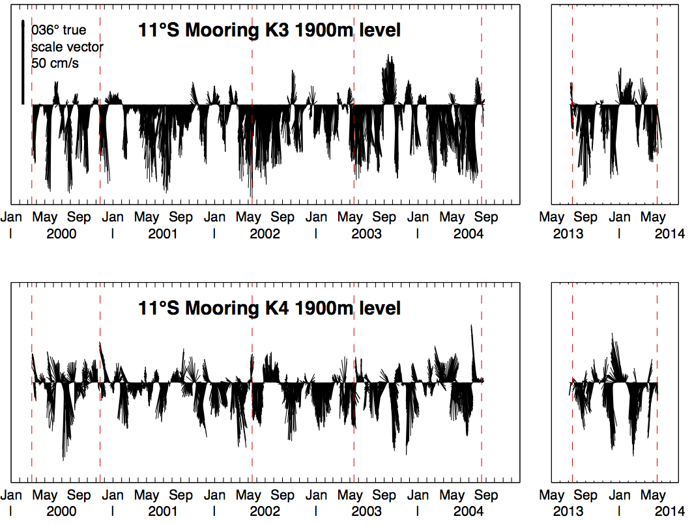
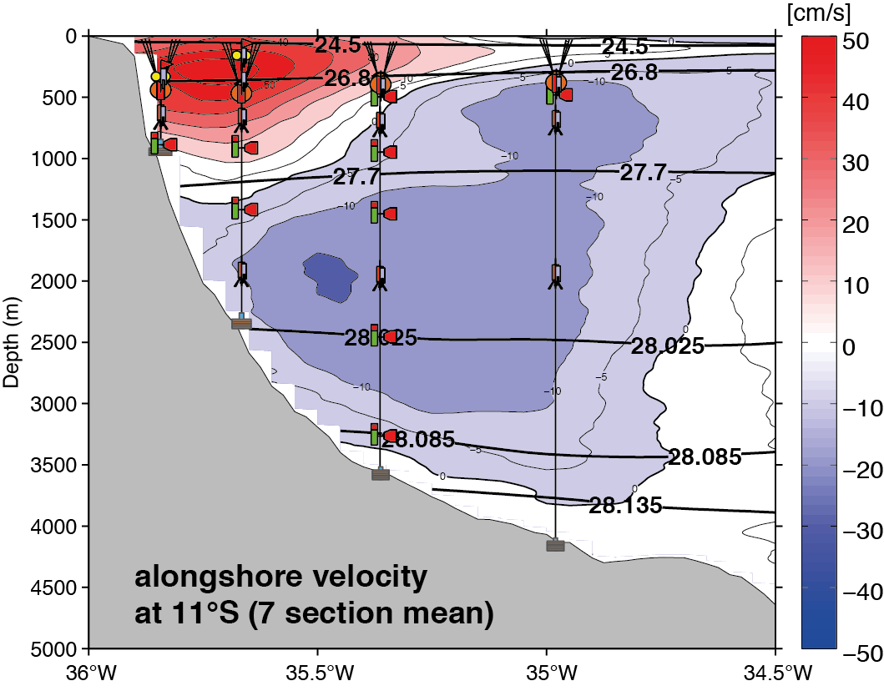
New observations at 11°S: velocities
2 research cruises:
M98 (July 2013)
M106 (May 2014)
redeployment of mooring array in 2013
K1
K2
K3
K4

Slide 30
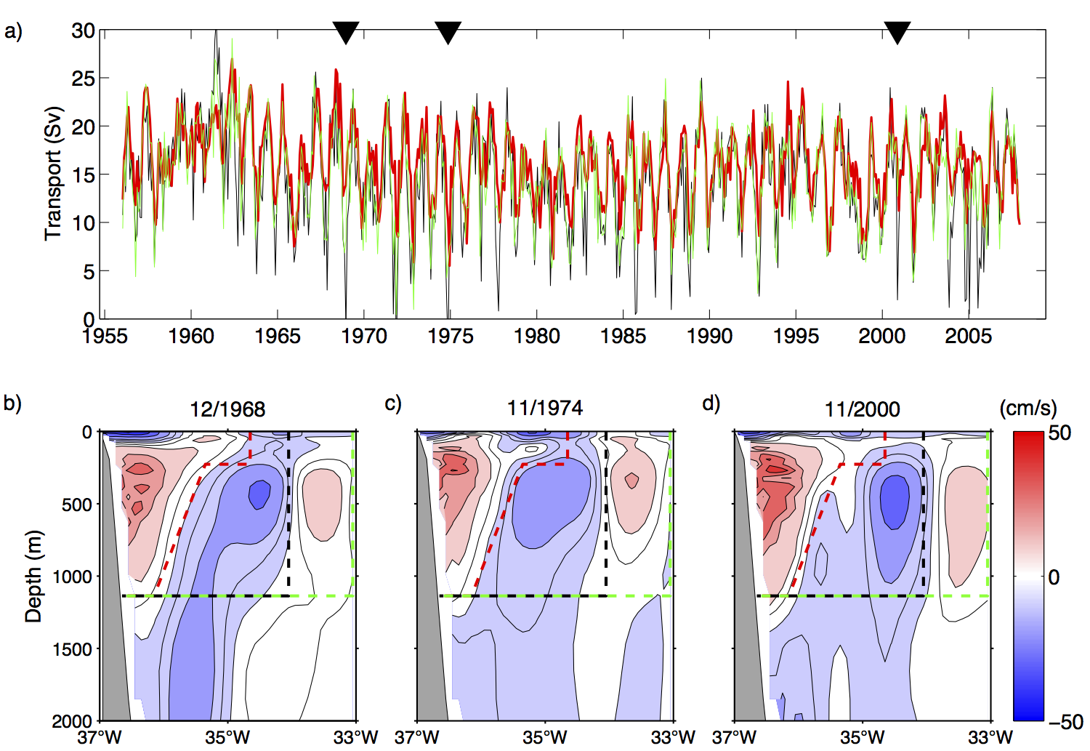
New observations at 11°S: velocities
2 research cruises:
M98 (July 2013)
M106 (May 2014)
redeployment of mooring array in 2013

Slide 31
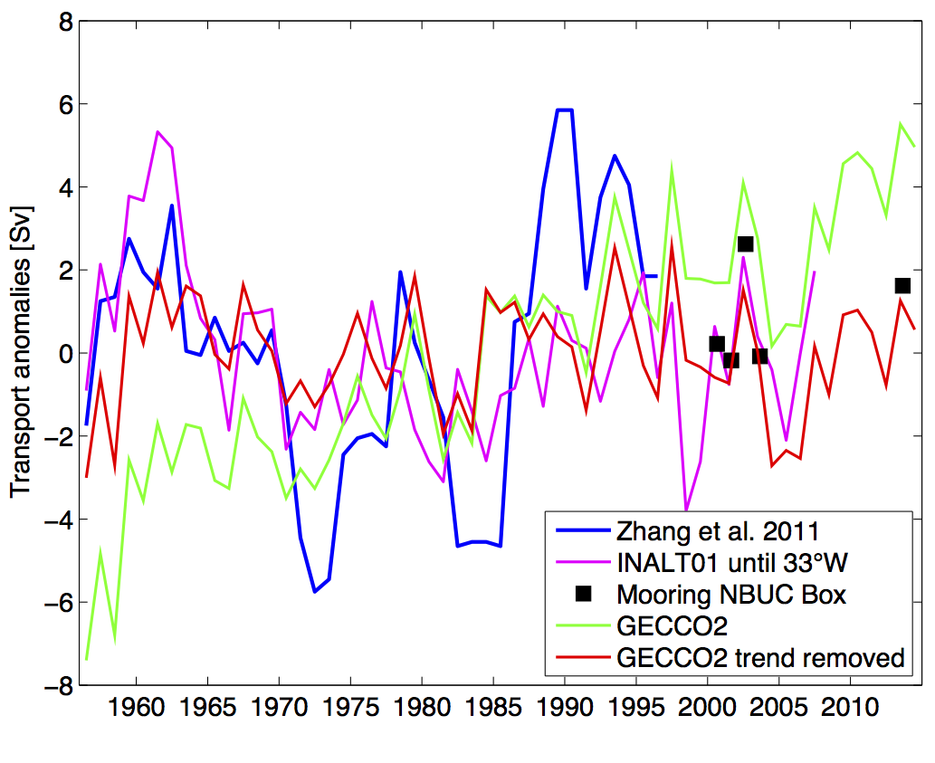
New observations at 11°S: velocities
2 research cruises:
M98 (July 2013)
M106 (May 2014)
redeployment of mooring array in 2013

