Slide 1
Performance Testing Support in a Continuous Integration Infrastructure
Sören Henning

Slide 2
Continuous Integration
Developer #1
Fail or Succeed
Test
Developer #2
Build
Developer #3
Source Control
CI Server

Slide 3
Outline
Foundations
Proposal for a Performance Testing Framework
Execution within Continuous Integration
Evaluation of Feasibility

Slide 4
Outline
Foundations
Proposal for a Performance Testing Framework
Execution within Continuous Integration
Evaluation of Feasibility

Slide 5
Performance Measurements in Java
t = end - start

Slide 6
Performance Measurements in Java
Beware of:
Environmental influences
Class loading on demand
Dynamically recompilation (JIT)
Compiler optimizations

Slide 7
Java Microbenchmarking Harness (JMH)
@BenchmarkMode(Mode.AverageTime)
@OutputTimeUnit(TimeUnit.NANOSECONDS)
@Fork(3)
@Warmup(iterations = 5)
@Measurement(iterations = 30)
public class ExampleBenchmark {
double x = Math.PI;
@Benchmark
public double measure(BlackHole blackHole) {
blackHole.consume(Math.log(x));
}
}

Slide 8
Continuous Integration Server
> git pull
> build binaries
> run tests
> _

Slide 9
Pipe-And-Filter Architectural Pattern
Producer Stage
Transformer Stage
Consumer Stage

Slide 10
Outline
Foundations
Proposal for a Performance Testing Framework
Execution within Continuous Integration
Evaluation of Feasibility

Slide 11
Typical Unit Test
public class CalculatorTests {
@Test
public void testPressEquals() {
Calculator calculator = new Calculator();
calculator.enter(2);
calculator.pressPlus();
calculator.enter(2);
calculator.pressEquals();
Assert.assertEquals(4, calculator.getDisplay());
}
}

Slide 12
Typical Unit Test
Instructions
Calculator calculator = new Calculator();
calculator.enter(2);
calculator.pressPlus();
calculator.enter(2);
calculator.pressEquals();
Assert.assertEquals(4, calculator.getDisplay());
Assertion
Notes:
Hier noch einmal vergrößert
Folge von Instructionen
Assertion, die am Ende gelten muss

Slide 13
Performance Test
Instructions
JMH Benchmark
Assertion Intervals per Machine
Assertion

Slide 14
Proposal for a Performance Testing Framework
Test
Benchmark
Assertions
RadarGun
Test
Benchmark
Assertions
Test
<Benchmark,
Assertions>
Results
Test #1
Test #2

Slide 15
Division into 3 Processing Steps
Execute Benchmarks
Compare with Assertions
Generate Reports

Slide 16
RadarGun‘s Processing Steps
Execute Benchmarks
Compare with Assertions
Generate Reports

Slide 17
RadarGun‘s Processing Steps
Execute Benchmarks
Compare with Assertions
Generate Reports

Slide 18
Open Questions
How do we identify machines?
Where do we place assertions?
How do we declare assertions?
How do we compare execution result with assertion?

Slide 19
Machine Identification
<<interface>>
MachineIdentifier
+ testMachine() : Boolean
Network Address Identier
MAC Address Identier
Wildcard Identifier
Dismiss Identifier
Windows Computer Identifier

Slide 20
Declaration of Assertions
---
identifier: MacAddressIdentifier
parameters: [01:23:45:67:89:AB]
tests:
myproject.benchmark.MyFirstBenchmark.run: [70, 90]
myproject.benchmark.MySecondBenchmark.run: [6.4, 6.7]
myproject.benchmark.MyThirdBenchmark.run: [1300, 1400]

Slide 21
RadarGun‘s Processing Steps
Execute Benchmarks
Compare with Assertions
Generate Reports
Notes:
Ergebnisse auf der Konsole ausgeben
CSV Export bzw. anhängen an CSV Tabellen
Terminieren bei fehlgeschlagenen Tests
Entweder sofort oder am Ende
Wozu? Build Prozess fehlschlagen lassen

Slide 22
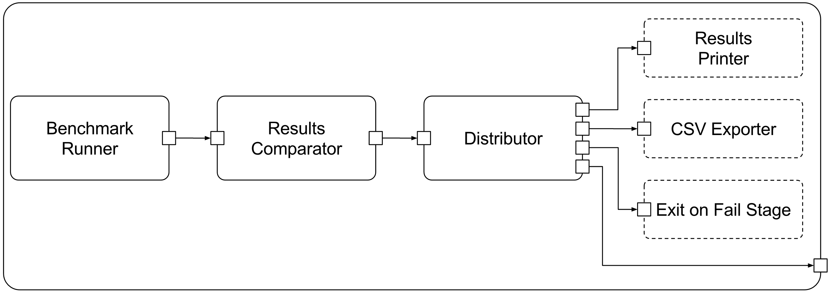
RadarGun‘s Architecture

Slide 23
Outline
Foundations
Proposal for a Performance Testing Framework
Execution within Continuous Integration
Evaluation of Feasibility

Slide 24
Executing RadarGun by a CI Server
Check out Benchmarks
Compile Benchmarks
Execute RadarGun with Benchmarks
Plot Charts

Slide 25
Outline
Foundations
Proposal for a Performance Testing Framework
Execution within Continuous Integration
Evaluation of Feasibility

Slide 26
Case Study
Build Infrastructure

Slide 27
Evaluation Scenarios
S1
Result within bounds
S2
Result lower than lower bound
S3
Result greater than upper bound

Slide 28
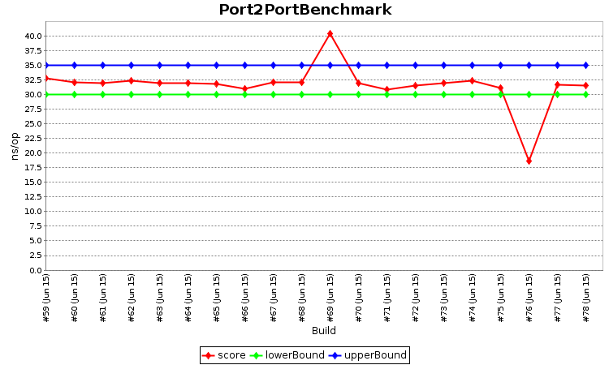
Evaluation Results

Slide 29
Evaluation Results
Build #59
[SUCCESSFULL] teetime.benchmark.Port2PortBenchmark.queue Score: 32.777
(99.9% 1.982 ns/op (Bounds: [30.0, 35.0])
Build #69
[FAILED] teetime.benchmark.Port2PortBenchmark.queue Score: 40.386
(99.9% 1.637 ns/op (Bounds: [30.0, 35.0])
Build #76
[FAILED] teetime.benchmark.Port2PortBenchmark.queue Score: 18.613
(99.9%) 4.536 ns/op (Bounds: [30.0, 35.0])

Slide 30
Conclusions
Presentation of a performance testing framework
Includable into a CI infrastructure
Approach is feasible
Available at: https://soerenhenning.github.io/RadarGun
Future Work
Other JVM languages?
Interactive visualization

