Slide 1
RadarGun: Toward a Performance Testing Framework
Symposium on Software Performance 2017
Sören Henning, Christian Wulf, and
Wilhelm Hasselbring
09.11.2017
Software Engineering Group
Kiel University, Germany
Notes:
first discuss which requirements …
most available ones are functional or benchmarking …

Slide 2
Why No Manual Measurements?
Typical code to measure performance
Strange measurements with VM-based languages:
startInNs = System.nanoTime();
obj.method(x,y,z);
endInNs = System.nanoTime();
durationInNs = endInNs – startInNs;
 | duration
1. | 2500 ns
 | duration
1. | 2500 ns
2. | 500 ns
3. | 450 ns
4. | 440 ns
5. | 470 ns
 | duration
1. | 1800 ns
2. | 400 ns
3. | 370 ns
4. | 350 ns
5. | 380 ns
 | duration
1. | 3100 ns
2. | 620 ns
3. | 550 ns
4. | 560 ns
5. | 550 ns
1. VM run
2. VM run
3. VM run
Notes:
Why do we need a framework? Why don‘t we measurement performance by hand, like shown code snippet
How to get stable measurements?
That is: how to avoid these effects? => next slide

Slide 3
Compiler Optimizations
Methods without side-effects
Method with simple loops
double benchmark() {
return Math.sin(Math.PI));
}
 | duration
1. | 110 ns
2..n | ~0 ns
int benchmark() {
int sum = 0;
for (int i=0; i<numIterations; i++) {
sum = sum + 2;
}
return sum;
}
 | duration
1. | 120 ns
2..n | 120 ns
for: 1; 1,000; 1,000,000
Notes:
memoize return value
return numIterations*2;

Slide 4
Further Considerations
Measurement Aggregation
average, min, max, median
Performance Assertion
assertEquals(avgDurationInNs, 2500);
@Test(timeout=2600)
double benchmark() { … }
timeout in ms! => µs and ns not possible
assertEquals(avgDurationInNs, 2400, 2600);
Notes:
aggregation of multiple runs
due to the operating system's scheduler
drop/decrease of performance
unintended

Slide 5
Hardware-Dependent Results
Automatically differentiate between different machines
Continuous Integration
node
Developer
node
Idea:
a change in performance can be observed on all nodes
Defined assertion:
23-27 ms
Measurements:
avg: 25 ms
min: 23 ms
max: 30 ms
Defined assertion:
42-61 ms
Measurements:
avg: 55 ms
min: 41 ms
max: 59 ms
Notes:
a company uses more than one testing machine, or
detect before pushing changes to the CI server

Slide 6
Available Frameworks
MooBench: only for monitoring frameworks and no performance assertions
java -classpath MooBench.jar kieker.tcp.TcpConsumer
java -javaagent:kieker-aspectj.jar \
-jar MooBench.jar -a MooBench.mA.MonitoredClass \
--output-filename results.csv …
JMH: no performance assertions
java -jar target/benchmarks.jar –o results.csv
Foo et al. [Foo+15]: automatic detection of deviations
based on past measurements
Notes:
command shows: we cannot pass assertions

Slide 7
Outline
Motivation
Performance Testing Framework: RadarGun
Feasibility Evaluation:
Execution on console (for developer node)
Execution in Jenkins (for CI node)
Conclusions & Future Work

Slide 8
RadarGun: Overview
RadarGun
benchmarks.jar
assertions.yaml
java -cp RadarGun.jar:target/benchmarks.jar radargun.Main \ --cp-assertions assertions/se-jenkins.yaml
Notes:
return code unequal to 0
ok? so, let‘s have a closer look at the input and output of RadarGun

Slide 9
Example Input for RadarGun
MyFirstBenchmark.java
@OutputTimeUnit(TimeUnit.NANOSECONDS)
@BenchmarkMode(Mode.AverageTime)
class MyFirstBenchmark {
double x = …;
@Benchmark
double run() {
return Math.sin(x);
}
}
assertions.yaml
---
identifier: MacAddressIdentifier
parameters: [01:23:45:67:89:AB]
tests:
myproject.benchmark.MyFirstBenchmark.run: [70, 90]
myproject.benchmark.MySecondBenchmark.run: [6.4, 6.7]
myproject.benchmark.MyThirdBenchmark.run: [1300, 1400]
---
...

Slide 10
Output on Console
Test result status
Benchmark name
[SUCCESSFUL]
teetime.benchmark.Port2PortBenchmark.queue
Expected score interval: [30.0, 35.0]
Actual score: 32.777 ± 1.982 ns/op (ci=99.9%)
Test measurement
(avg with computed confidence interval)
Defined assertion
Notes:
introduce score as general term in JMH for execution time and throughput

Slide 11
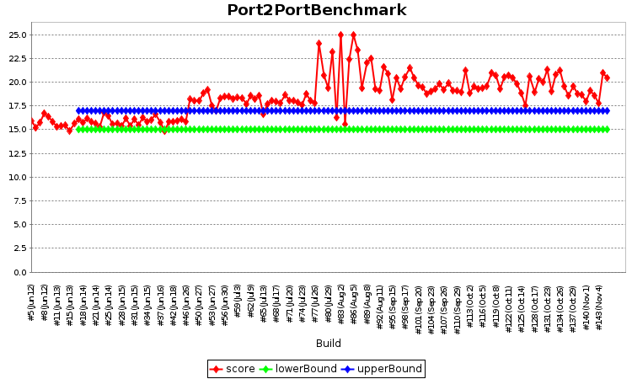
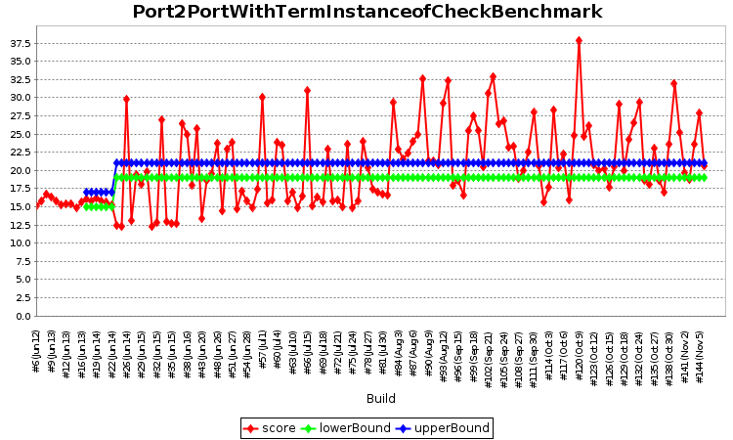
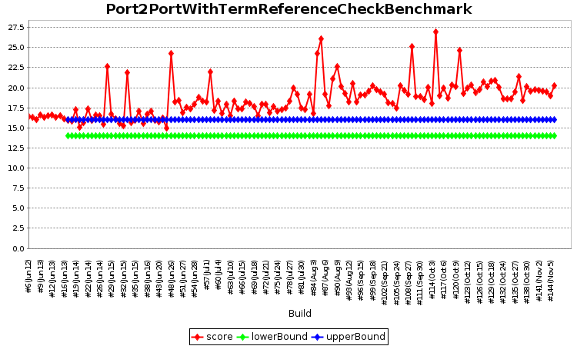
Output in Jenkins
Application‘s Build and Test Job
Application‘s Performance Tests Job

Slide 12
RadarGun‘s Jenkins Plot in Detail
6
5
3
4
2
1

Slide 13
Feasibility Evaluation
Goal: A performance tests correctly passes and fails on console and in Jenkins
Scenarios:
within assertion interval (builds #59-78)
below assertion interval (build #76)
above assertion interval (build #69)
Benchmarks from TeeTime¹ + RadarGun
¹ https://github.com/teetime-framework/TeeTime
Notes:
- combination does not necessarily reflect a real-world scenario
- performance tests must be executed one by one; never in parallel. Otherwise, results cannot be checked reliably.

Slide 14
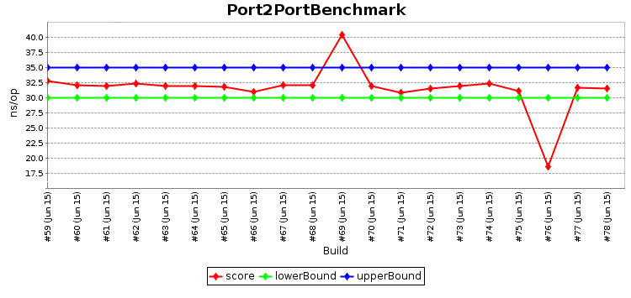
Results in Jenkins
Source: https://build.se.informatik.uni-kiel.de/jenkins/view/TeeTime/job/teetime-nightly-performance-test

Slide 15
Results on Console
[SUCCESSFUL]
teetime.benchmark.Port2PortBenchmark.queue
Expected score interval: [30.0, 35.0]
Actual score: 32.777 ± 1.982 ns/op (ci=99.9%)
[FAILED]
teetime.benchmark.Port2PortBenchmark.queue
Expected score interval: [30.0, 35.0]
Actual score: 40.386 ± 1.637 ns/op (ci=99.9%)
[FAILED]
teetime.benchmark.Port2PortBenchmark.queue
Expected score interval: [30.0, 35.0]
Actual score: 18.613 ± 4.536 ns/op (ci=99.9%)

Slide 16
Conclusions
Minimum requirements on a performance testing framework
VM/warmup/real runs
Time interval assertions (e.g., „may take 23-27 ms“)
Quantiles (e.g., min, median, max) + avg execution time
Hardware-dependent assertions and measurements
RadarGun
https://github.com/SoerenHenning/RadarGun
Future work:
Custom Jenkins Plugin for Plotting Performance Results
Confidence-based stopping criteria
Notes:
Currently, we use JMH‘s capability to stop a benchmark. JMH executes a benchmark multiple times until a given time has passed, e.g., 1 second or 2 minutes.

Slide 17
References
[Foo+15] Chun Foo, King and Ming Jiang, Zhen and Adams, Bram and Hassan, Ahmed E. and Zou, Ying and Flora, Parminder, “An Industrial Case Study on the Automated Detection of Performance Regressions in Heterogeneous Environments”, ICSE, 2015

