Slide 1
High resolution ocean nesting within a flexible model infrastructure
FROM THE DEEP SEA TO THE ATMOSPHERE
Jan Harlaß, Arne Biastoch, FOCI-Team
WP1: 1.1 | 1.2 | 1.5

Slide 2
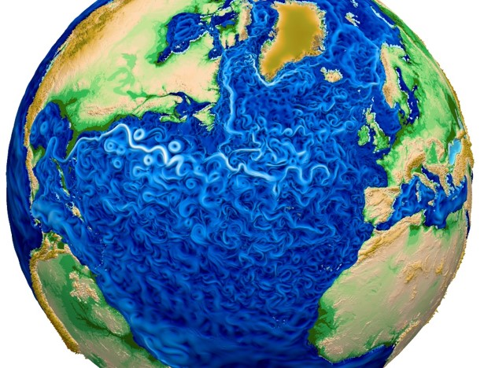
Motivation
Global coverage & high resolution in the ocean
Regional ocean refinement
A-O-Feedbacks
Multi-decadal/centennial simulations
Flexible framework for coupling of Earth system model components
➔ FOCI
Los Alamos National Laboratory
Notes:
Depict some key aspects

Slide 3
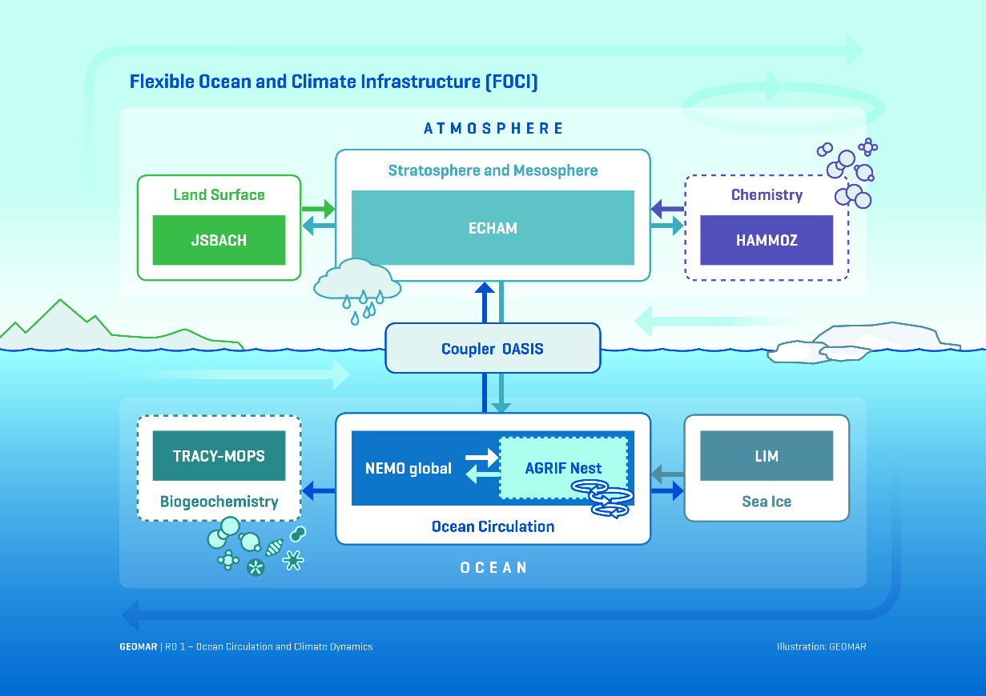
FOCI - Flexible Ocean and Climate Infrastructure
ECHAM6
~1.8˚/T63 L95
Stratosphere
OASIS3-MCT
NEMO 3.6
ORCA05 L46
Talk by D. Ehlert
LIM 2
AGRIF 1/10˚
Notes:
Based on MPI-ESM
TRACY-MOPS: NutrientsPhosphatDetritusC + oxygen + carbon (smaller than PISCES)
MOPS: Model of Oceanic Pelagic Stoichiometry; based on phosphorus, 7 tracers: phosphate, DIM, DOM, phytoplankton, zooplankton, detritus, oxygen.
JSBACH4 land components from ECHAM5, in particular the soil hydrology, the soil heat transport, and the land surface energy balance; represents the dynamics of land carbon uptake and release by incorporating the photosynthesis and canopy radiation, by adding a prognostic phenology scheme, and by developing suitable components for uptake, storage, and release of carbon from vegetation and soils. Natural changes in the geographic extent of landcover is simulated prognostically by a dynamic vegetation module (including wind and fire damage) whereas anthropogenic land cover change is prescribed either by sequences of maps, or by forcing JSBACH with the transition matrices of the New Hampshire Harmonized Protocol.

Slide 4
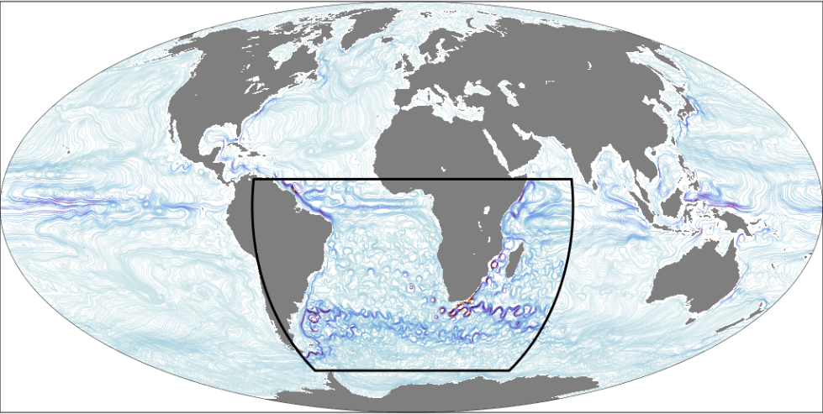
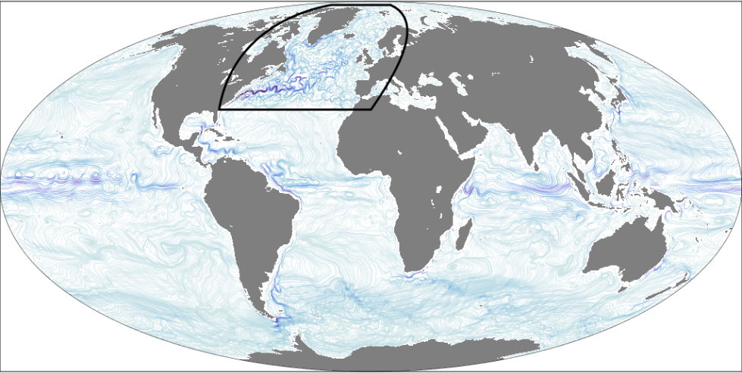
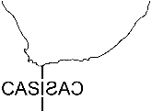
FOCI - Currently Operated Nests
INALT10X
VIKING10
1/2˚ global ocean
1/10˚ nest region
# 64.5m grid points
+ 21m base
# 35.3m grid points
+ 21m base

Slide 5
FOCI – INALT10X
Total cloud cover
10m winds
SST / SSH
Sea ice cover
Notes:
Eddying ocean with overlying atmosphere

Slide 6
FOCI – Technical Coupling
Atmosphere
Flux calculation
Fluxes on atmosphere grid
OASIS3-MCT
Transformation
Transformation
Ocean
2-way-nesting
Notes:
No or very little performance loss

Slide 7
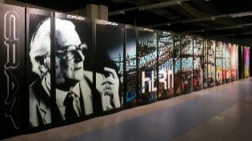
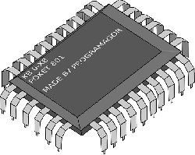
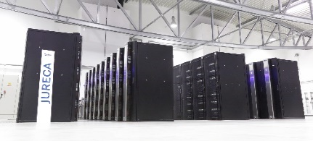
Experimental set-up & HPC
3-hourly coupling
no restoring
ORCA05
00:50 h
936 CPU
576(A)
336(O)
INALT10x
02:55 h
1392 CPU
288(A)
1008(O)
150 yrs
historical
FOCI-hist
1500 years
piControl 1850
0
FOCI-piCtl
historical
FOCI-hist INALT10x
Notes:
Historical CMIP6

Slide 8
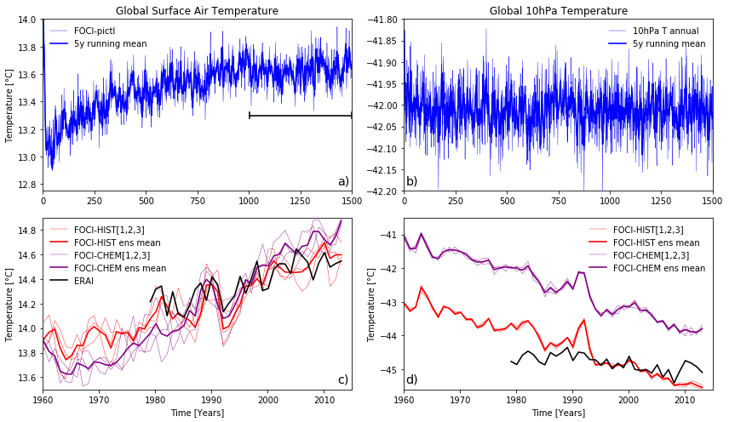
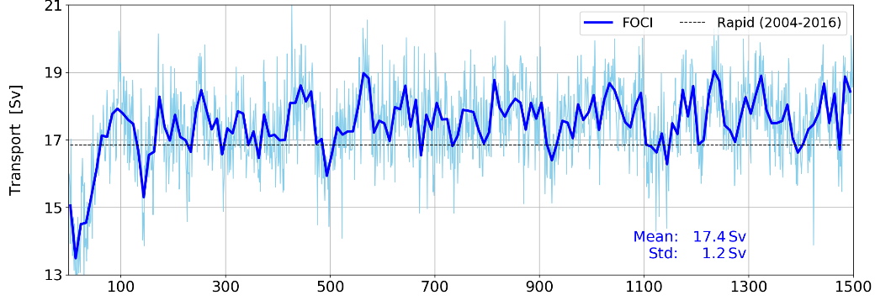
Spin-up, Stable climate
AMOC 26˚N
FOCI-piCtl
FOCI-hist

Slide 9
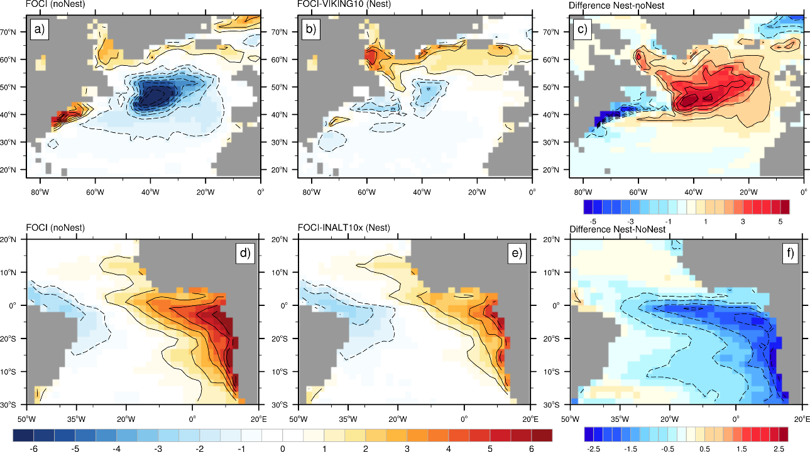
High resolution nesting - SST
SST bias in FOCI
VIKING10
Difference
Bias to HadISST
annual
INALT10X
Difference
Boreal summer
˚C

Slide 10
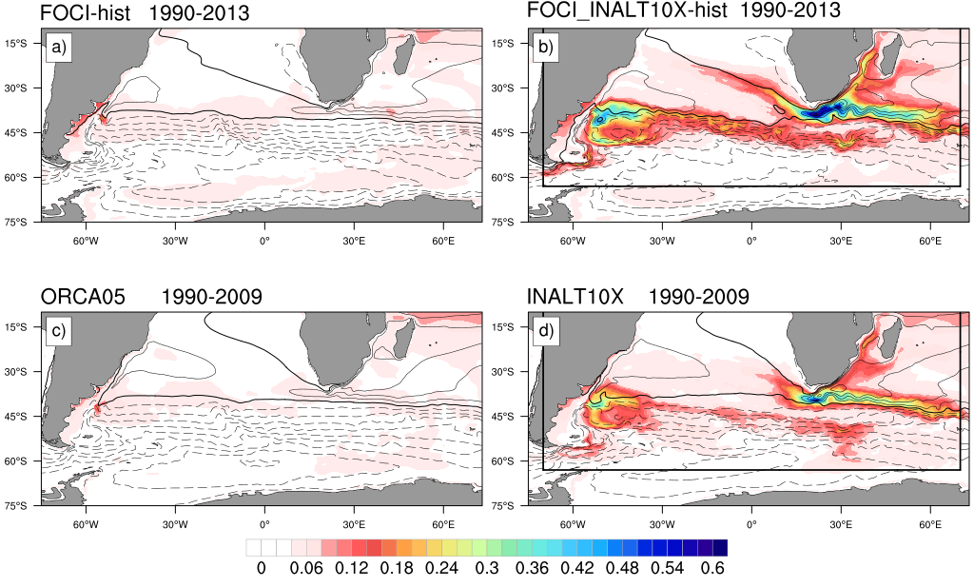
High resolution nesting - SSH
SSH
FOCI-hist
FOCI-hist INALT10X
Ocean Only
Ocean Only INALT10X
Accompanying ocean-only experiments under COREv2 forcing (1958-2009)

Slide 11
High resolution nesting – AMOC / ACC
ACC transport
AMOC 26˚N
FOCI-hist
FOCI-hist INALT10X
(Sv)
Drake Passage
(Sv)

Slide 12
Summary
Flexible framework for coupling of Earth system model components
Regional Ocean refinement
First scientific results and use in projects

