Slide 1


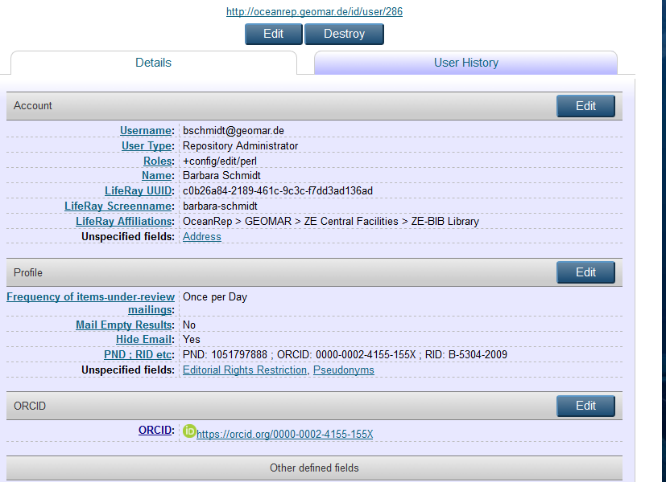
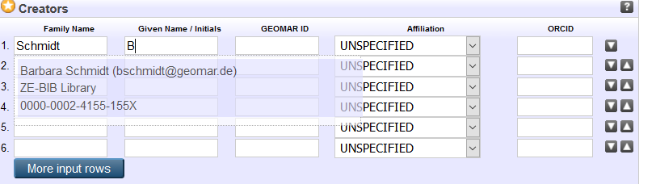
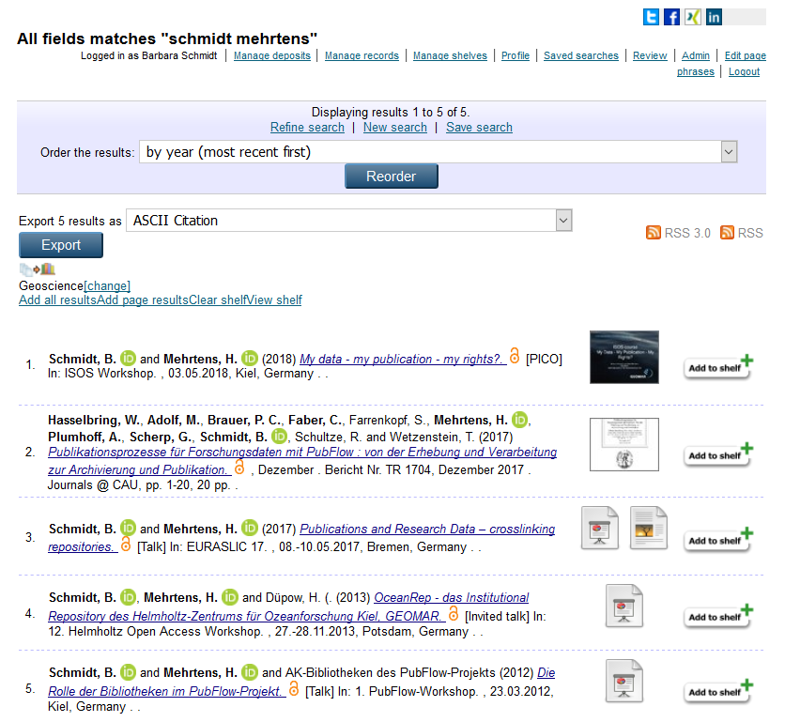
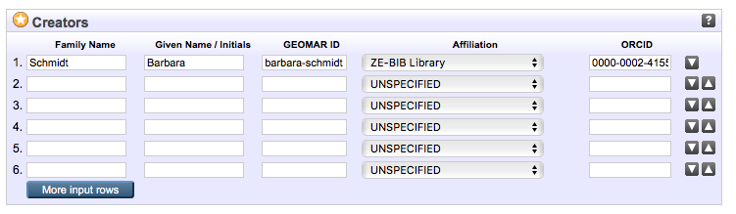
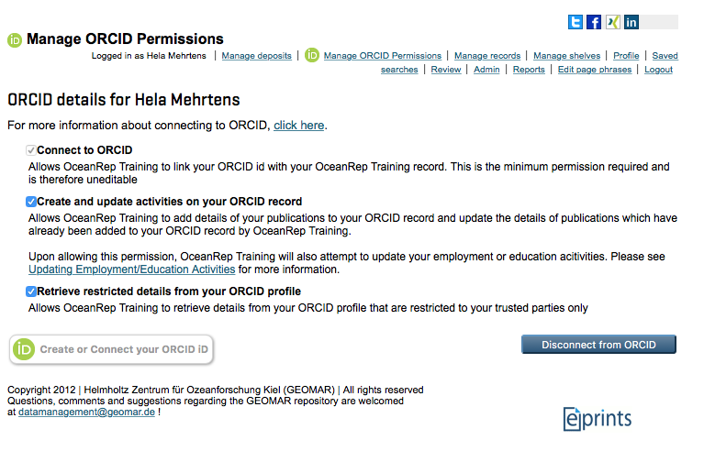

ORCID integration with OceanRep
Hela Mehrtens and Barbara Schmidt
GEOMAR Helmholtz Centre for Ocean Research Kiel, Germany
Aim: Integrating ORCID in OceanRep
Since 2010, OceanRep has been the institutional repository of GEOMAR Helmholtz Centre for Ocean Research Kiel. Based on the Repository Software EPrints, version 3.3, there are more than 40.000 items available and 2500 users have been registered.
OceanRep allows the connection of GEOMAR authors with their research department via lookup tables. The user management is connected to the data management portal.
First step
Installation of ORCID Support Plugin v1.7:
New field „ORCID“ in user profiles leads to the green „ORCID“ icon.
Filled out it automatically appears together with the authors‘ name and affiliation in the lookup table.
Second step
Installation of OrcidDOI.pm (part of ORCID Support Advance Plugin 1.3.2):
Import via DOI includes ORCID. The lookup table only works if the ORCID is written in the user profile.
In case no list is shown: cut out the ORCID, click on the name to activate the list and add the ORCID again.
Then add the ORCID in the user‘s profile (next time the lookup table includes the ORCID).
Next…
The ORCID Support Advance Plugin enables the acceptance of OceanRep as trusted organization and automatic exchange of data between OceanRep and ORCID.
Users will be able to manage their ORCID permission in OceanRep.
Questions/Problems:
Who is allowed to add the ORCID to the authors name?

