Slide 1
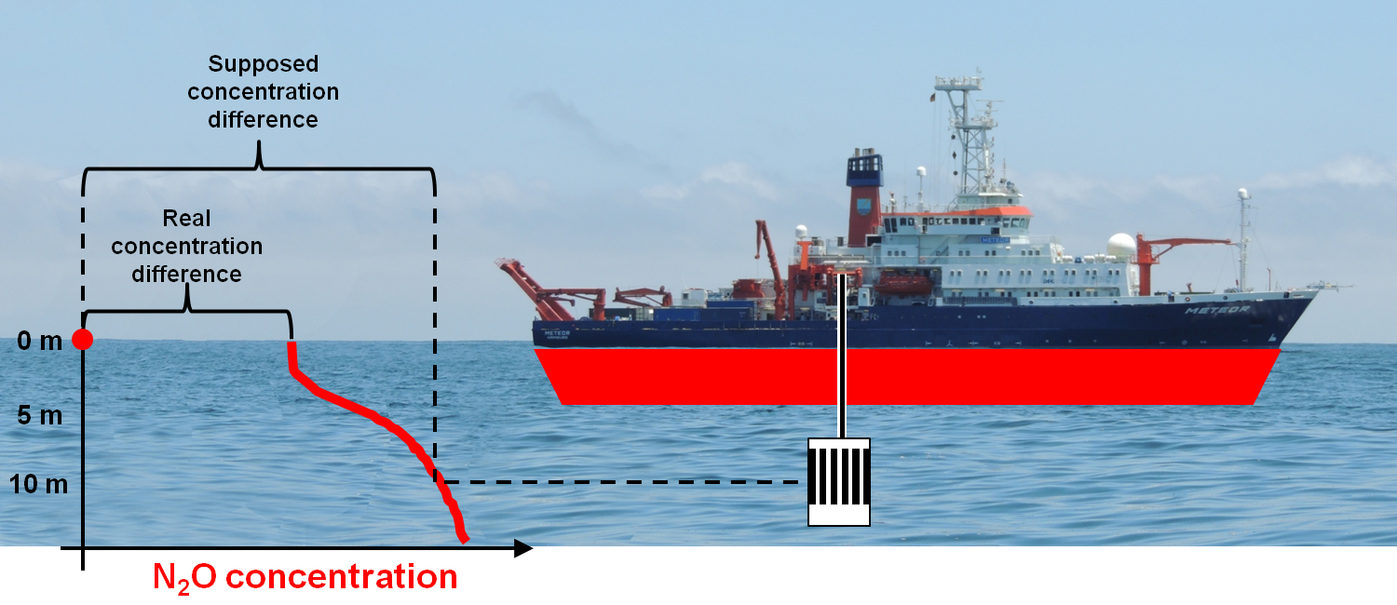
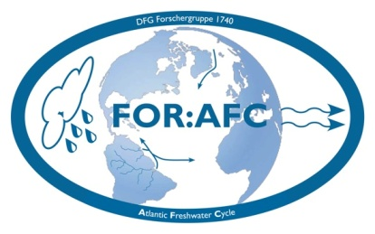
Multi-day near-surface stratification in tropical waters
property
Tim Fischer, Annette Kock, Marcus Dengler,
Peter Brandt, Johannes Karstensen, Damian L. Arévalo-Martínez, Hermann W. Bange
GEOMAR Helmholtz Centre Kiel
DFG-Forschergruppe 1740
„Salinity variability in the Atlantic Ocean“

Slide 2
Outline
Near-surface stratification
Diurnal cycle of near-surface stratification
Multi-day near-surface stratification
(Existence, where, why)
Impact

Slide 3
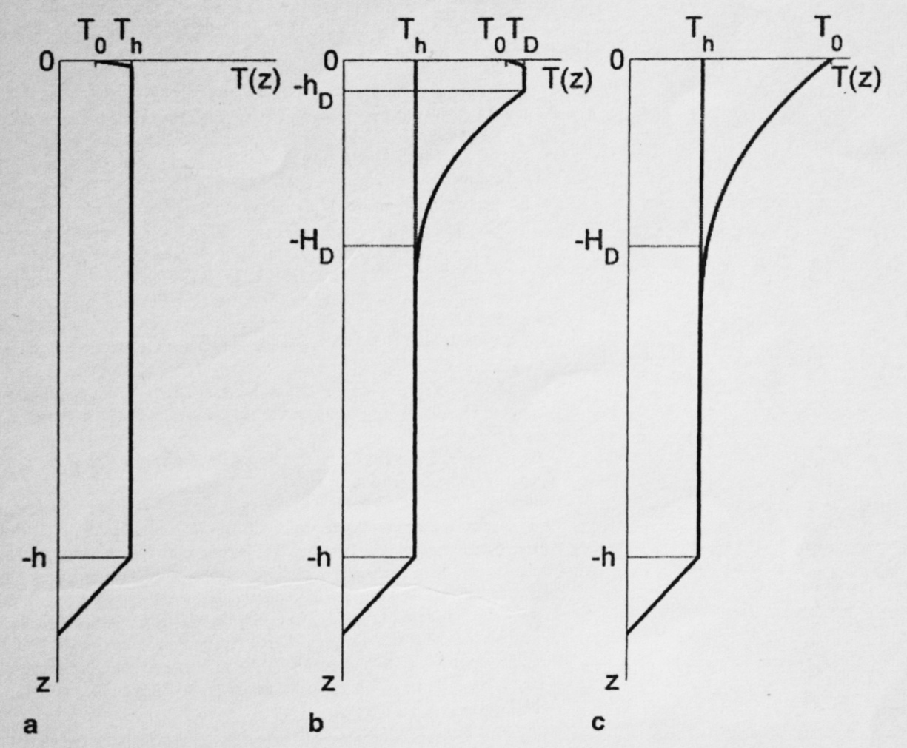
Near-surface stratification
Transient pycnocline in the mixed layer
Since at least half a century it was recognized
[Stommel and Woodcock , 1951; Bruce and Firing, 1974; Soloviev and Vershinsky, 1982]
Caused by:
Strong insolation and light wind (T-driven, this example)
Or heavy rainfall and light wind (S-driven, not shown)
Long-term mixed layer
after Soloviev and Lukas 2014

Slide 4
Diurnal cycle of near-surface stratification
A typical phenomenon of the tropical oceans.
At moderate to low wind …
… daytime insolation allows differential heating of near-surface …
… and temporal near-surface stratification,
which suppresses mixing.
= > Isolation of top layer,
6 to 12 hours typically
Insolation
0
1
2
3
4
5
6
7
Depth in m
Line of max. N²
after Prytherch et al. 2013
T
8:00 12:00 16:00 20:00 0:00 4:00

Slide 5
Diurnal cycle of near-surface stratification
A typical phenomenon of the tropical oceans.
With night heat loss, stratification cannot be preserved against wind and convective mixing,
Nighttime ML is restored.
At moderate to low wind …
… daytime insolation allows differential heating of near-surface …
… and temporal near-surface stratification,
which suppresses mixing.
= > Isolation of top layer,
6 to 12 hours typically
Insolation
0
1
2
3
4
5
6
7
Depth in m
Line of max. N²
after Prytherch et al. 2013
T
8:00 12:00 16:00 20:00 0:00 4:00

Slide 6
Diurnal cycle of near-surface stratification
A typical phenomenon of the tropical oceans.
With night heat loss, stratification cannot be preserved against wind and convective mixing,
Nighttime ML is restored.
At moderate to low wind …
… daytime insolation allows differential heating of near-surface …
… and temporal near-surface stratification,
which suppresses mixing.
= > Isolation of top layer,
6 to 12 hours typically
Insolation
0
1
2
3
4
5
6
7
Depth in m
Line of max. N²
after Prytherch et al. 2013
T
8:00 12:00 16:00 20:00 0:00 4:00
Trapping of heat enhanced SST diurnal cycle
momentum surface-intensified currents
solutes vertical gas gradients

Slide 7
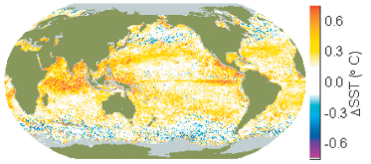
Diurnal cycle of near-surface stratification
Main focus of literature is enhanced SST diurnal cycle.
Goals: remove bias from SST global averages.
enhance heat exchange estimates.
Soloviev et al. 2012 investigated impact on O₂ gas exchange estimates: negligible effect (average of 4% overestimation
if using standard routines and bulk flux formulation).
Annual average of day – night satellite SST
Gentemann et al. 2003

Slide 8
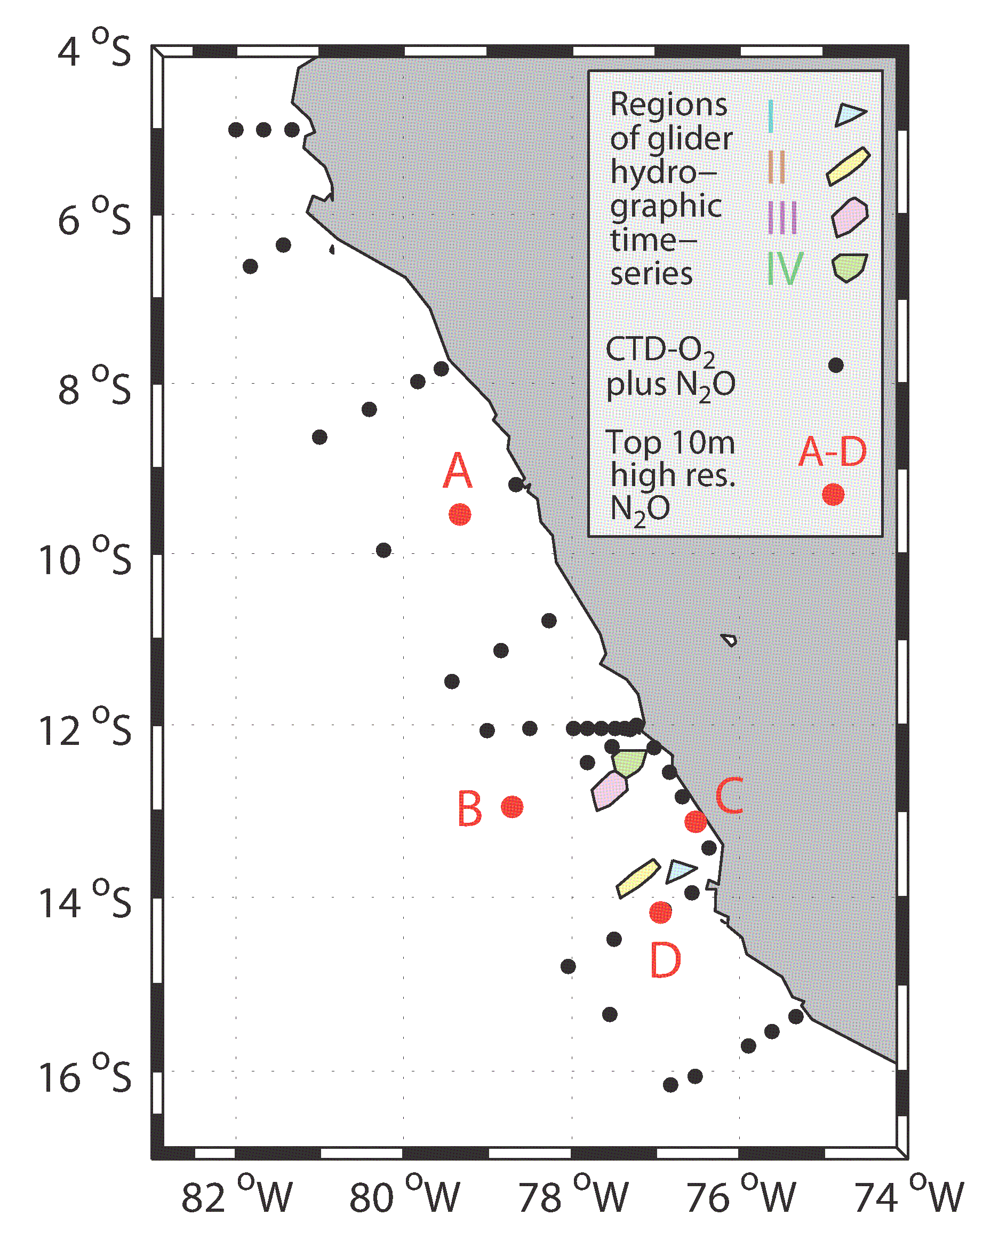
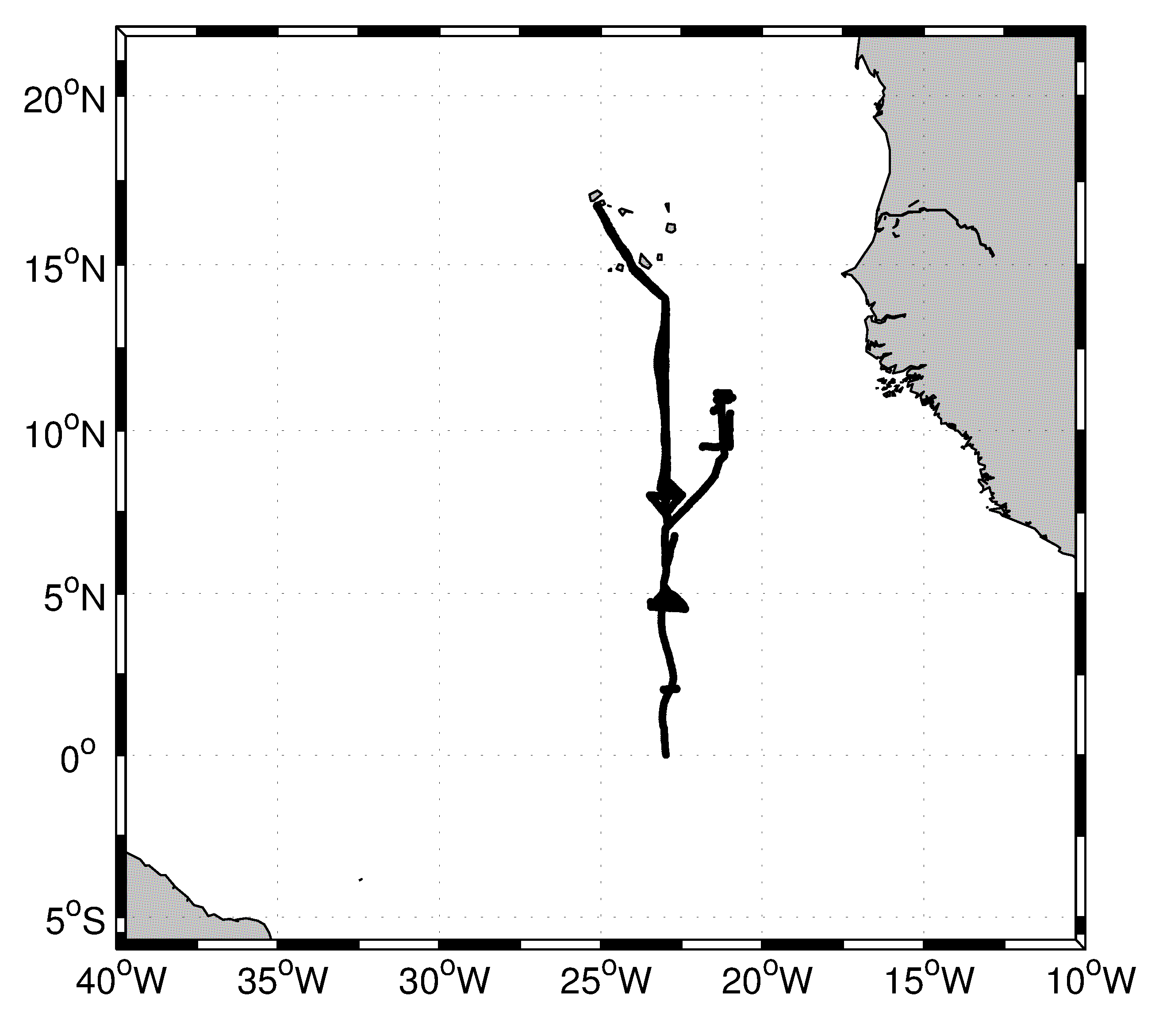
Multi-day near-surface stratification
That means: near-surface stratification has to survive the night
Two study sites
Peruvian upwelling regime:
Near-surface hydrography and N₂O
Tropical Atlantic, influenced by ITCZ:
Near-surface hydrography
1 ship cruise & 7 gliders
13 glider missions

Slide 9
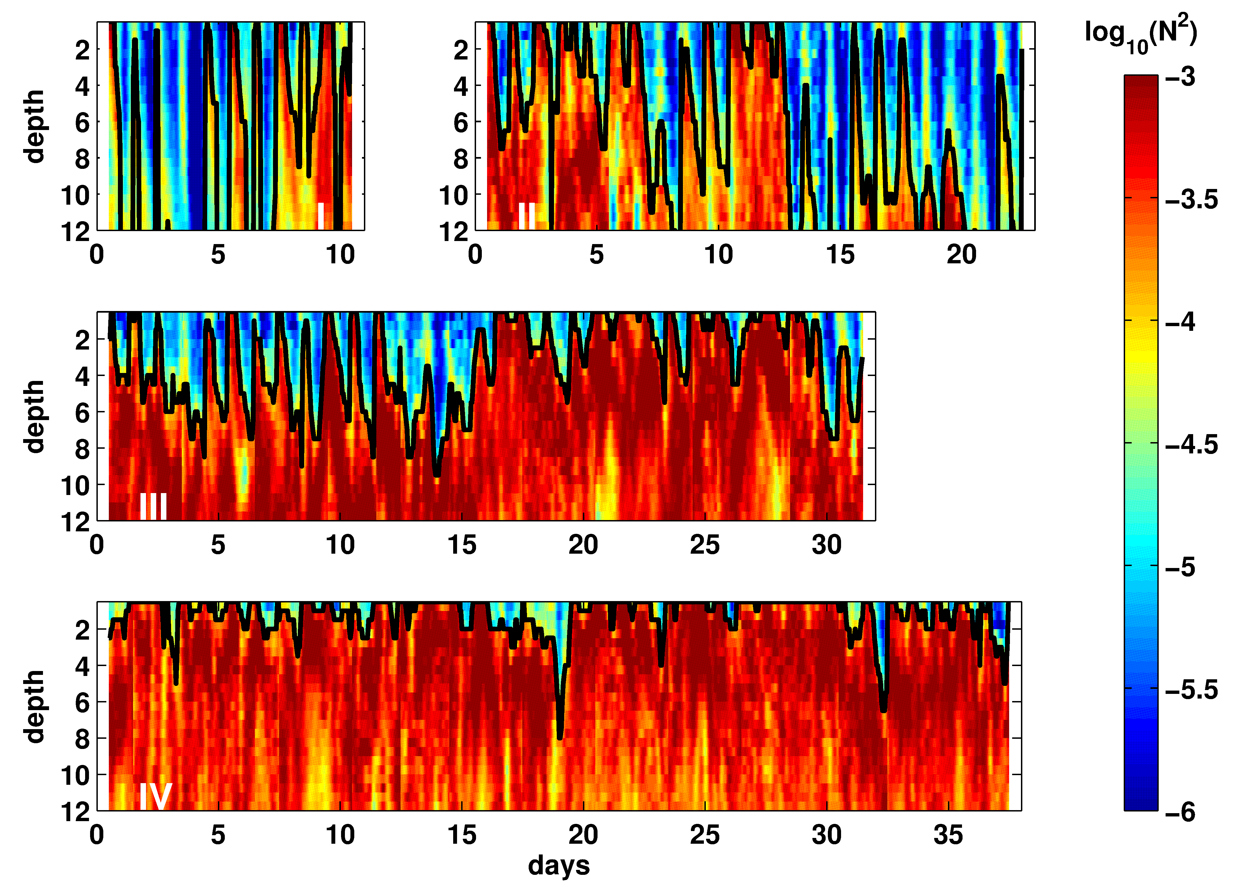
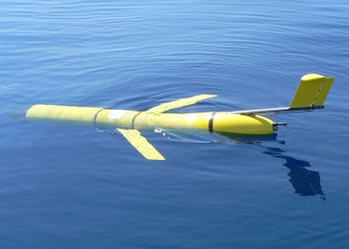
Multi-day near-surface stratification
Peru upwelling regime
Glider timeseries of hydrography:
Periods of diurnal and multi-day stratification

Slide 10
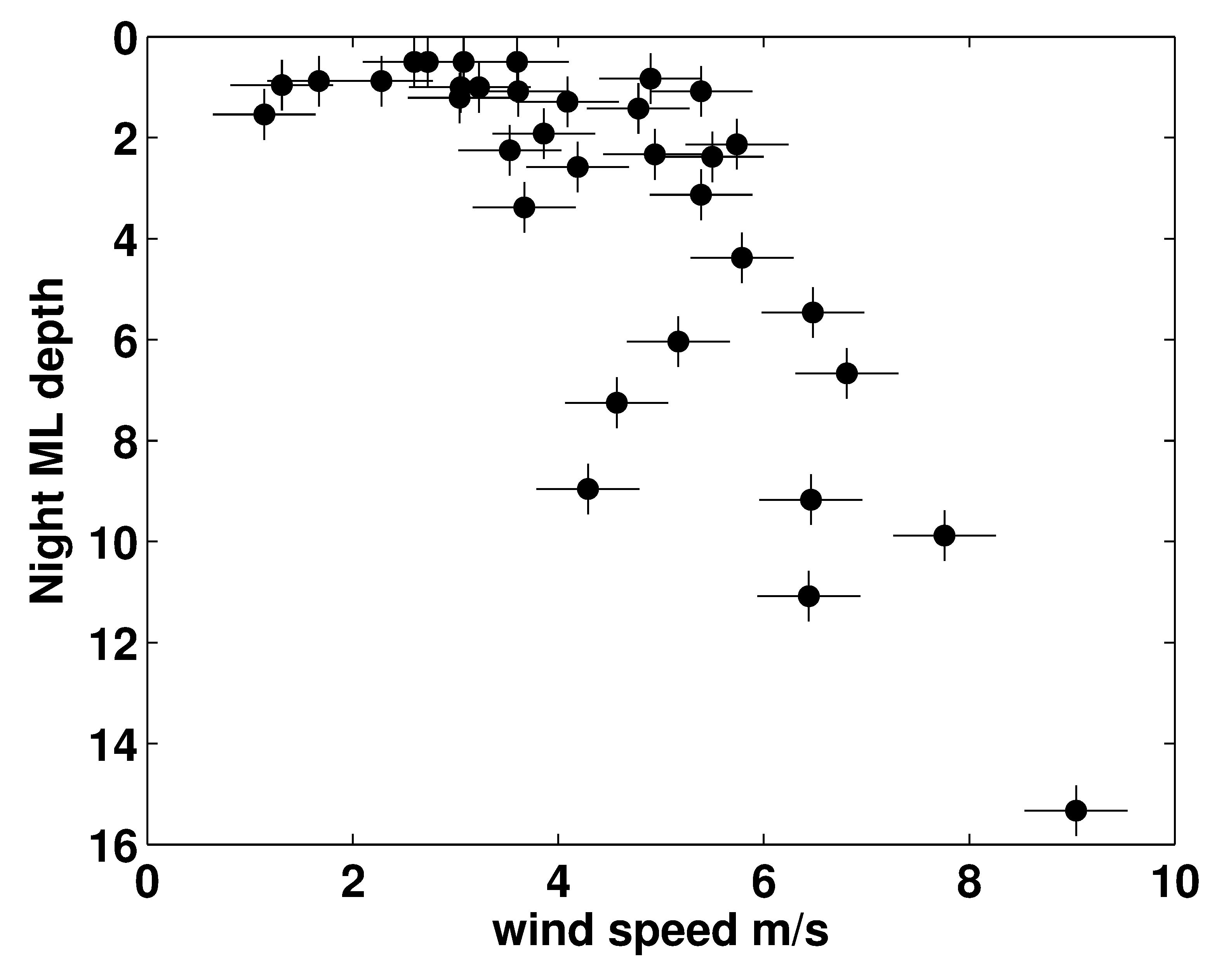
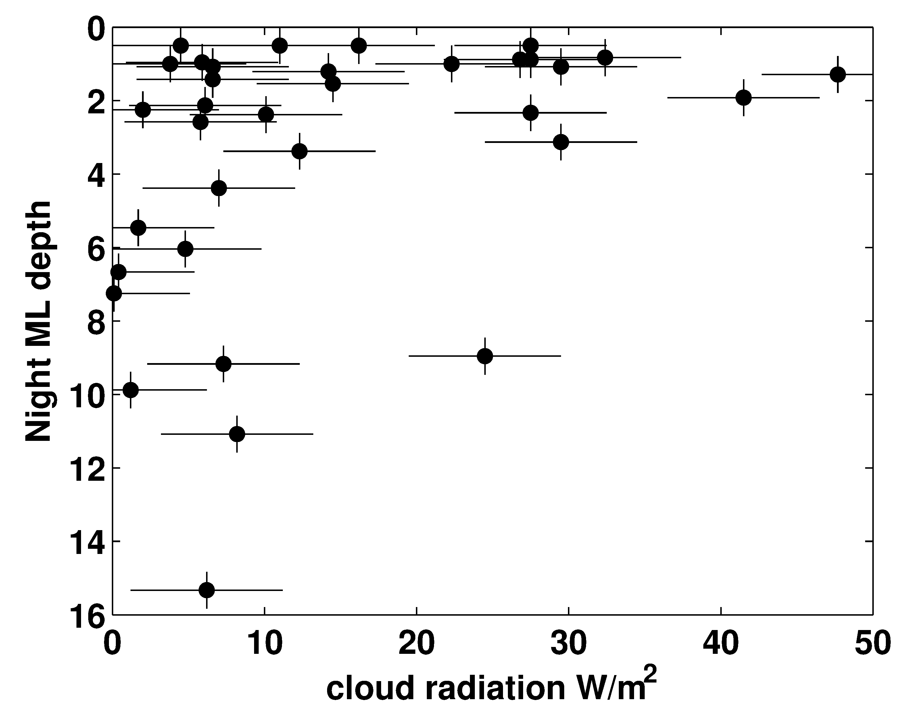
Multi-day near-surface stratification
Peru upwelling regime
Conditions for existence and maintenance
of multi-day near-surface stratification:
Shallow stratification can survive the night with
low to moderate wind; cloud cover is supportive
Both factors reduce heat loss during the night

Slide 11
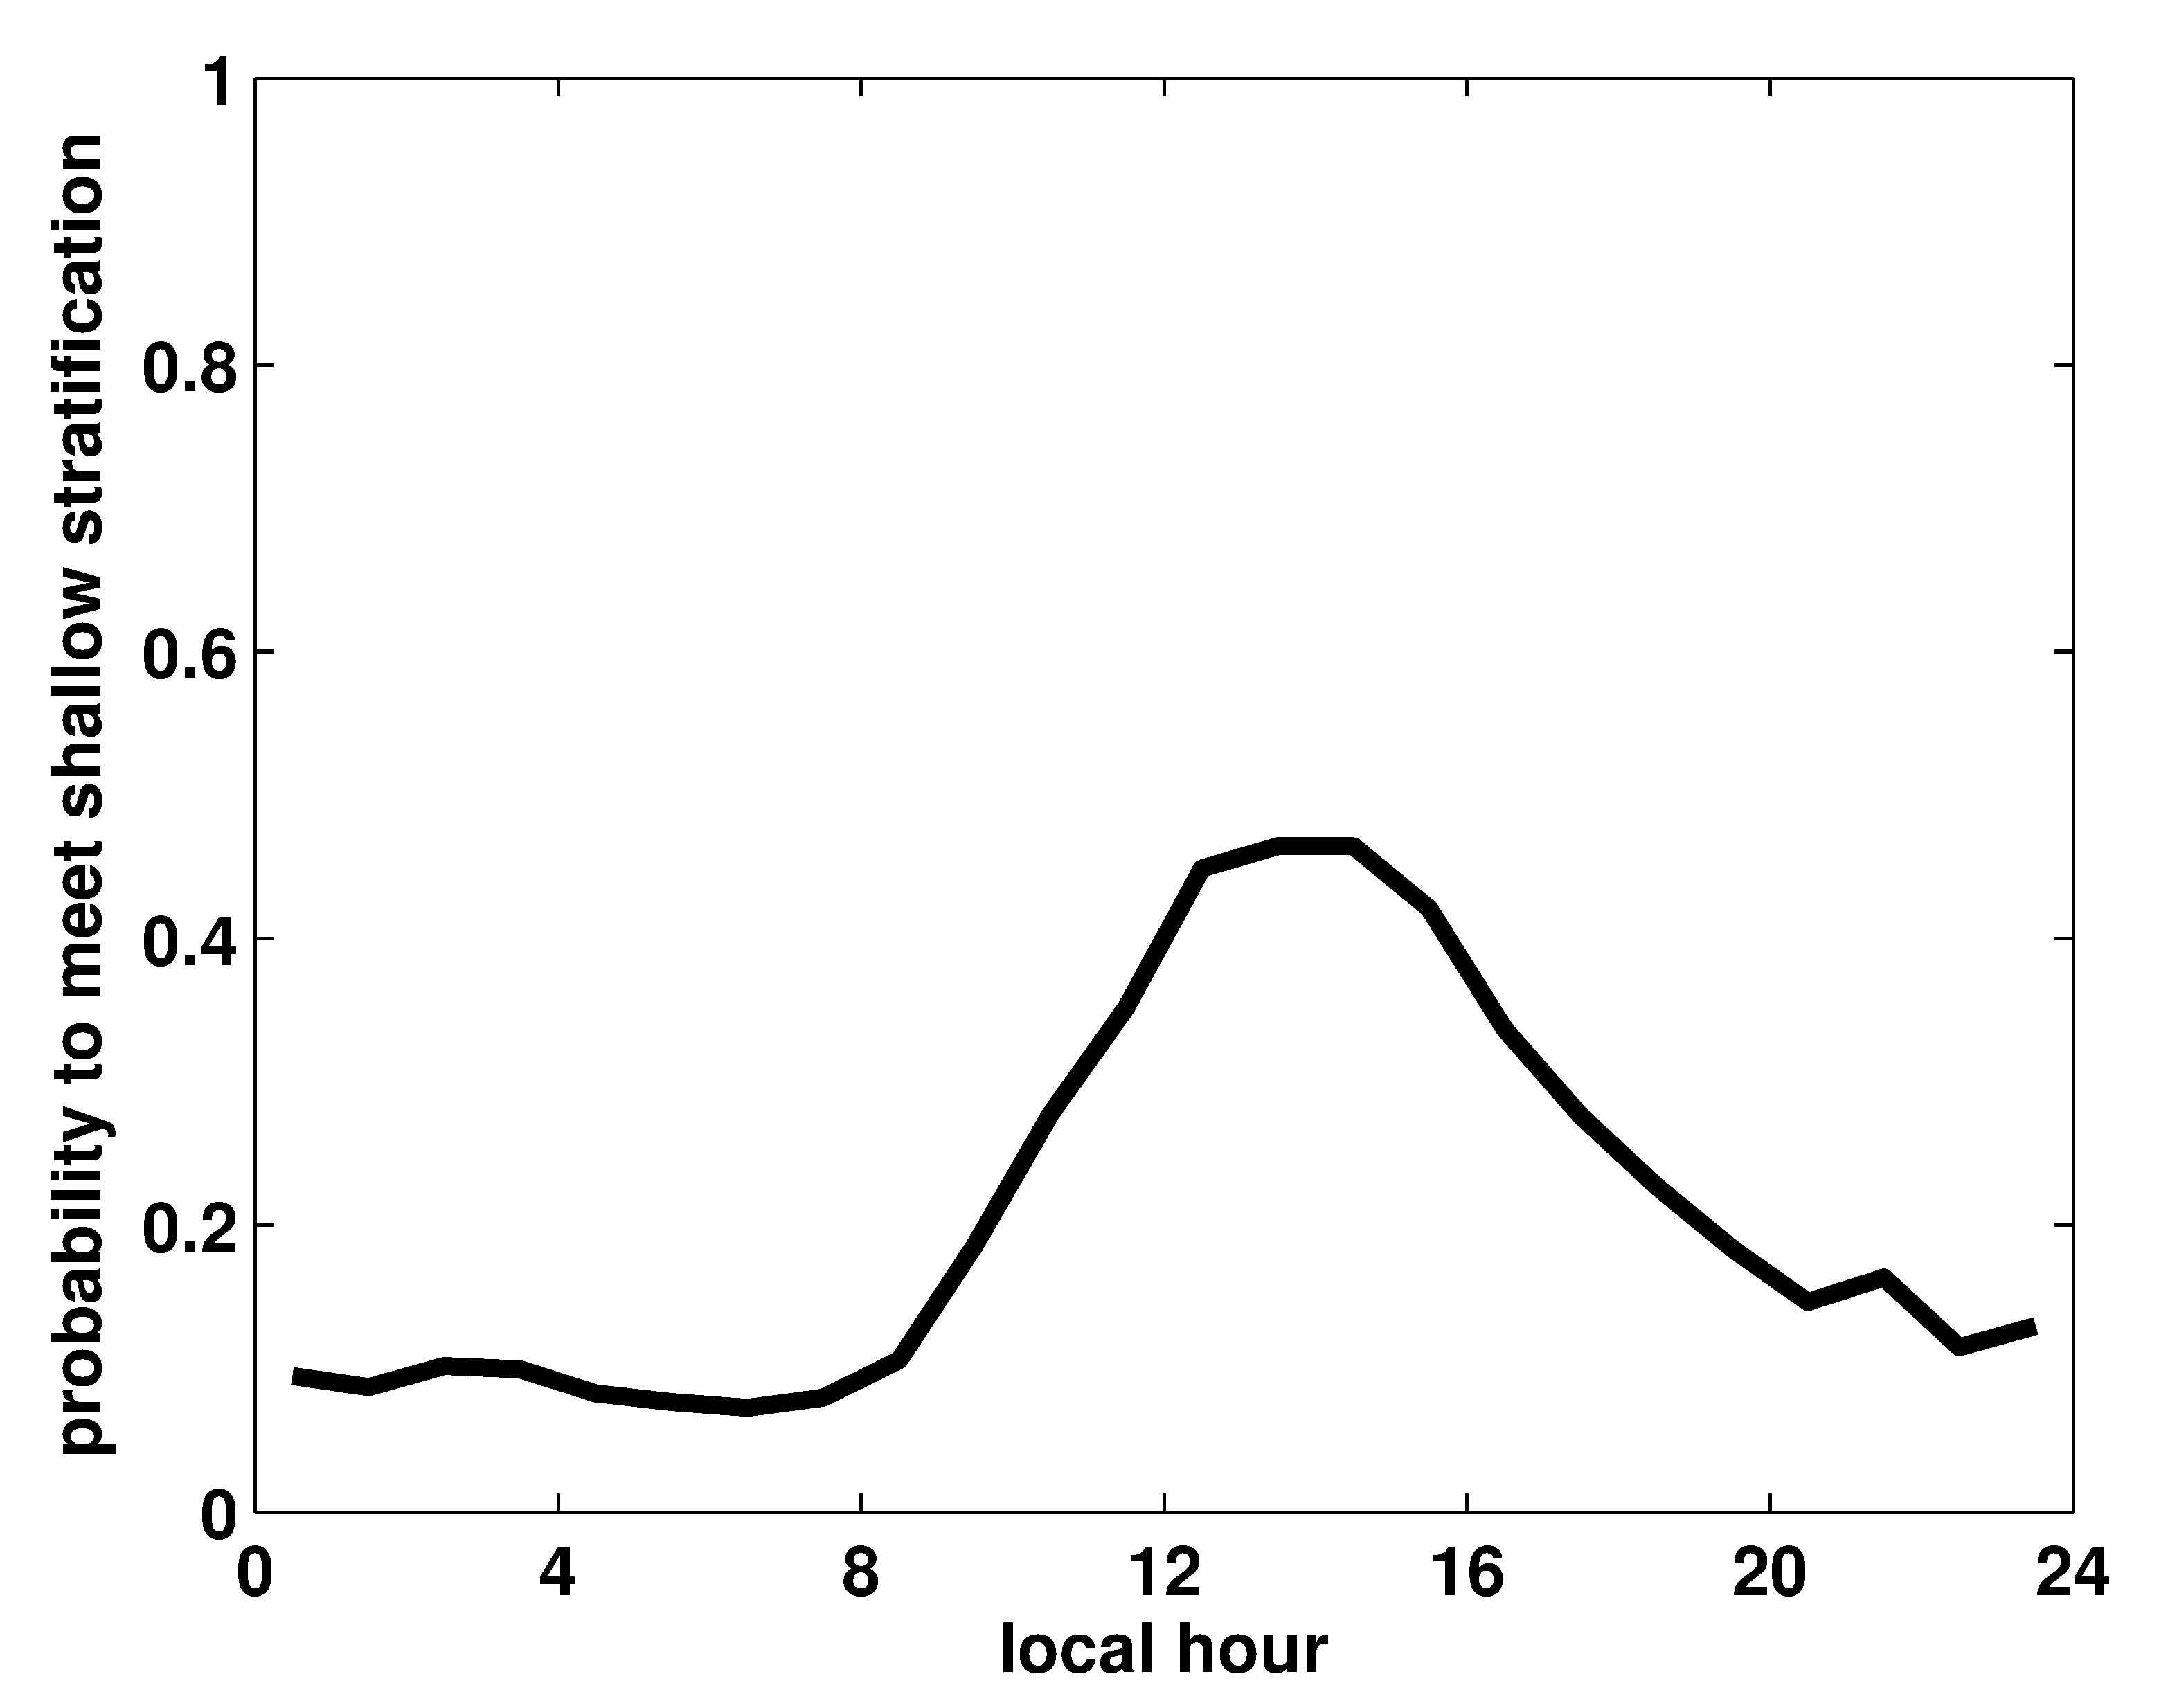
Multi-day near-surface stratification
Atlantic ITCZ, glider observations
25% of the time we find near-surface stratification
(layer of N²>10⁻⁴
in depth < 8m)
1
0.8
0.6
0.4
0.2
0
probability of encounter
0 4 8 12 16 20 24
local hour

Slide 12
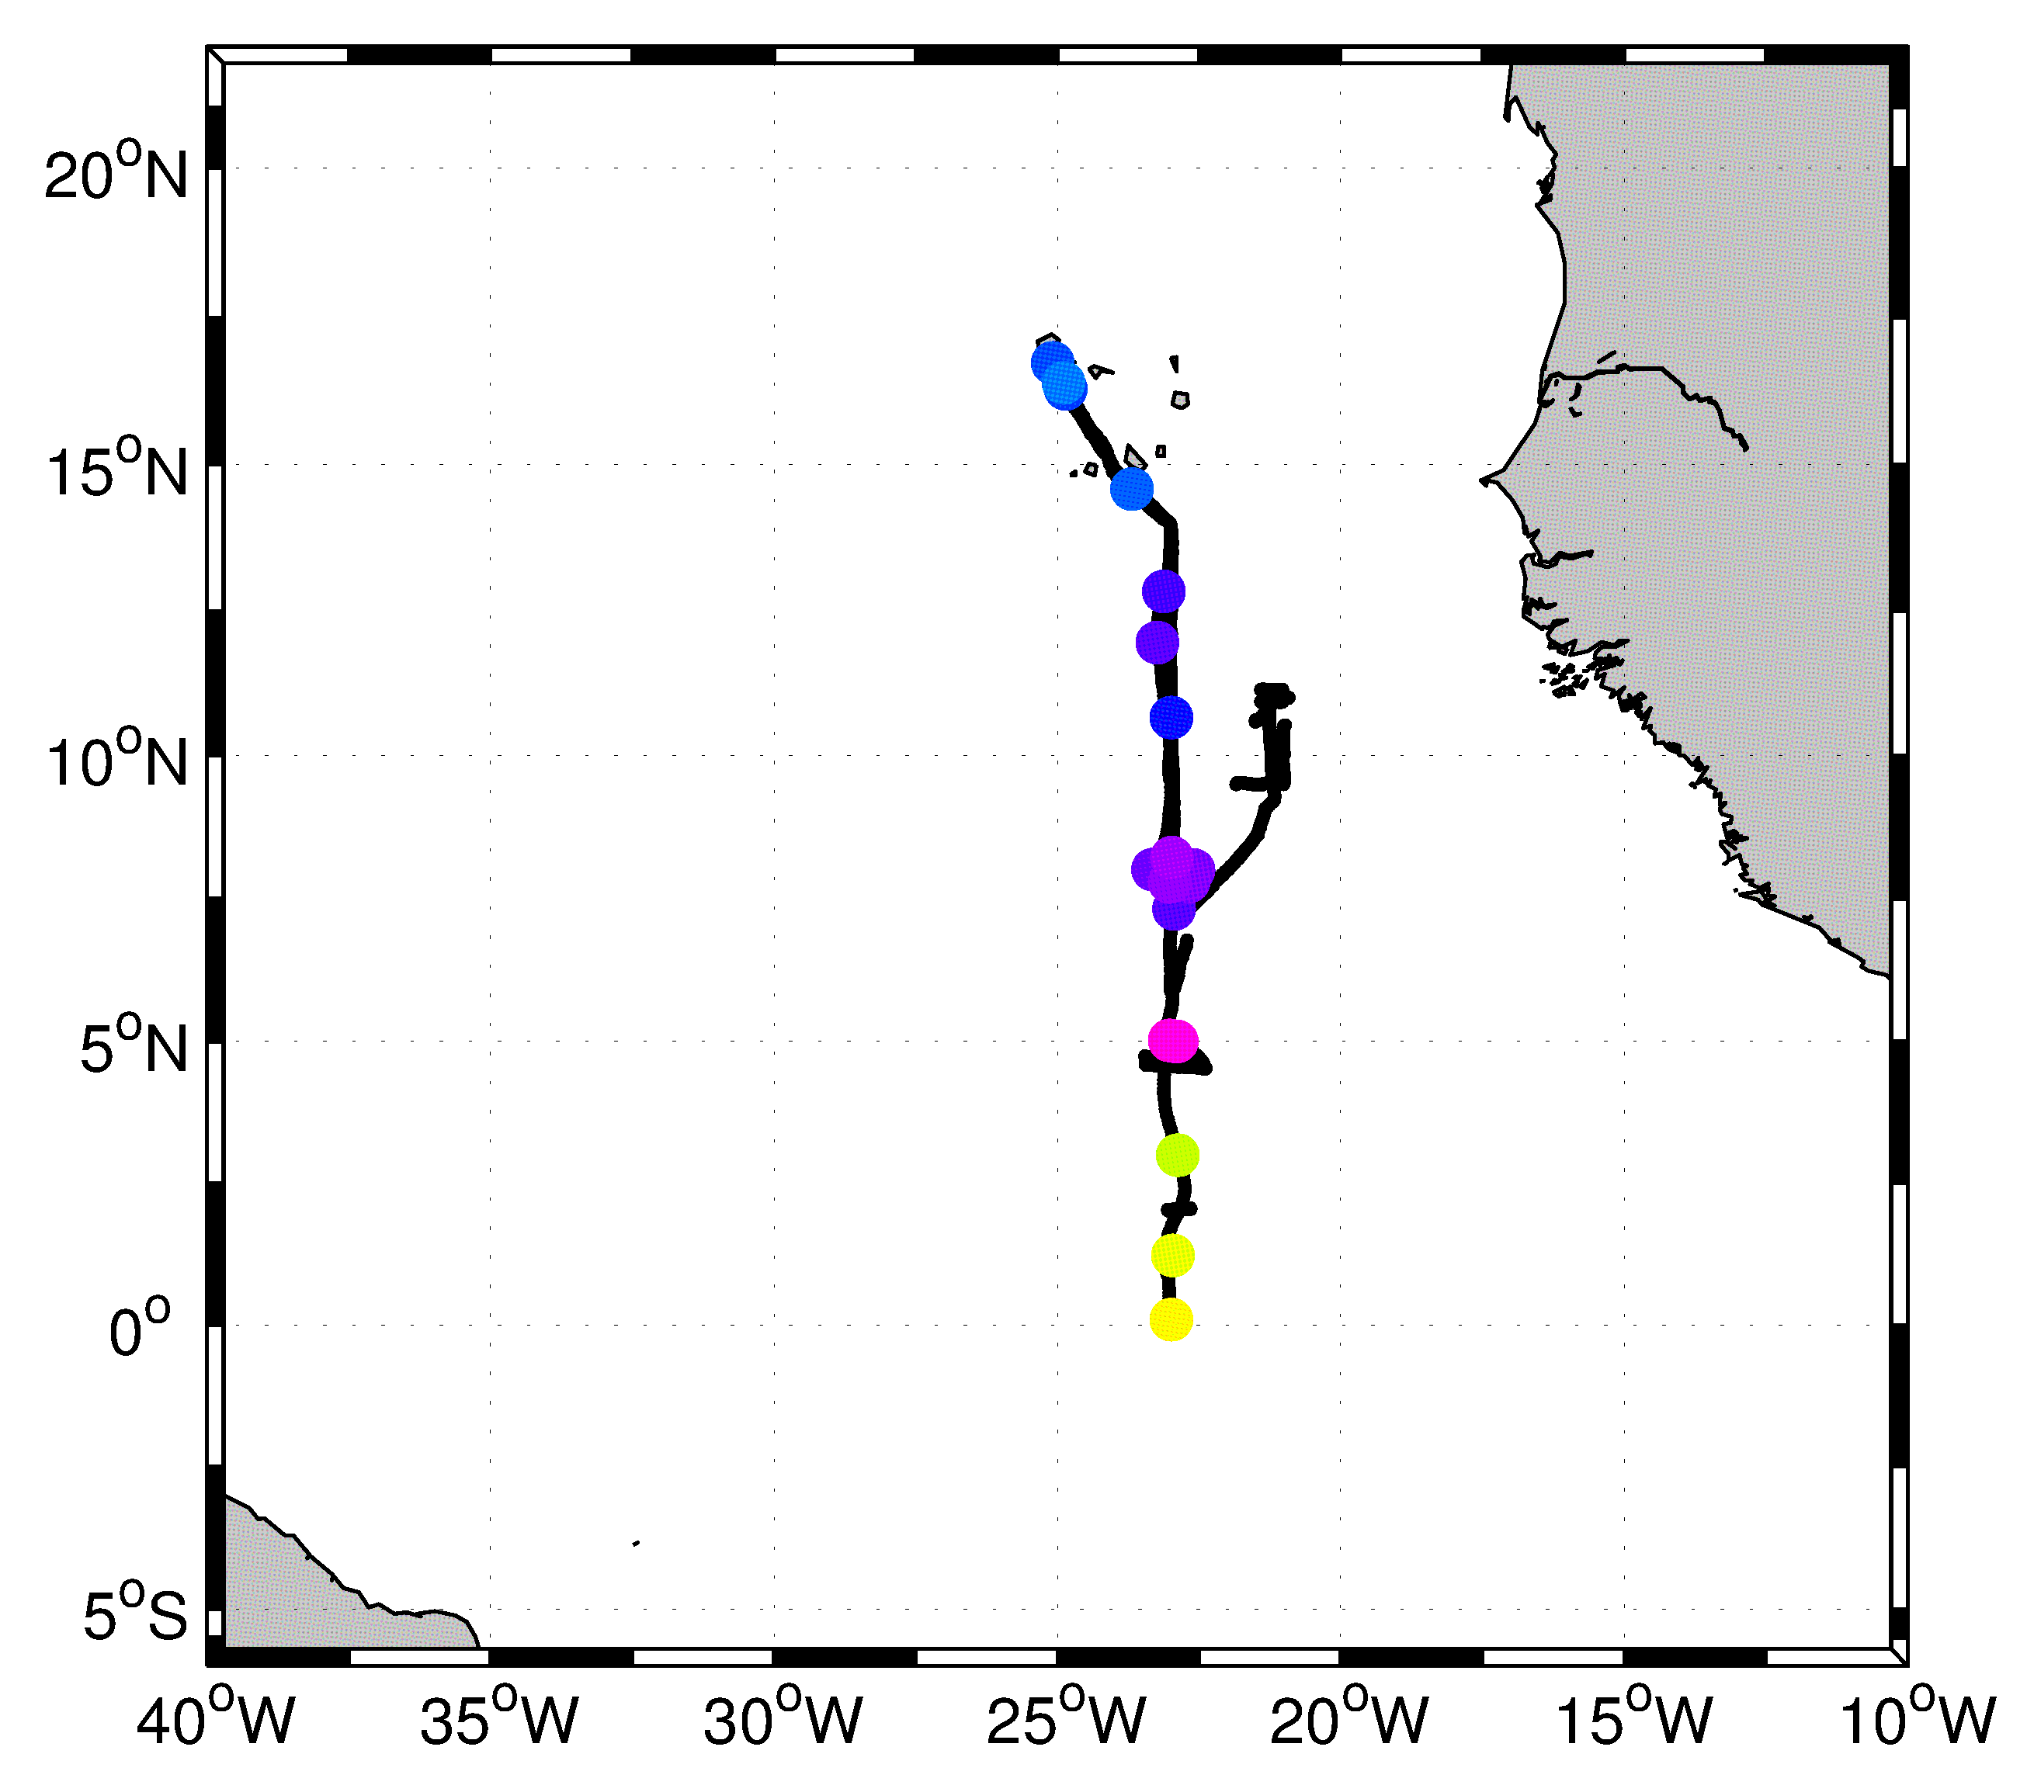
Multi-day near-surface stratification
Atlantic ITCZ, glider observations
25% of the time we find near-surface stratification
(layer of N²>10⁻⁴
in depth < 8m)
1
0.8
0.6
0.4
0.2
0
Aug
Sep
Oct
probability of encounter
Apr
Nov
Mar
Feb
0 4 8 12 16 20 24
local hour
7% of the time we find
multi-day
near-surface stratification
Multi-day stratification is where the ITCZ is,
=> freshwater-driven

Slide 13
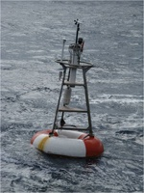
Multi-day near-surface stratification
Atlantic ITCZ, glider observations
25% of the time we find near-surface stratification
(layer of N²>10⁻⁴
in depth < 8m)
1
0.8
0.6
0.4
0.2
0
Aug
Sep
Oct
probability of encounter
Apr
Nov
Mar
Feb
0 4 8 12 16 20 24
local hour
7% of the time we find
multi-day
near-surface stratification
Multi-day stratification is where the ITCZ is,
=> freshwater-driven

Slide 14
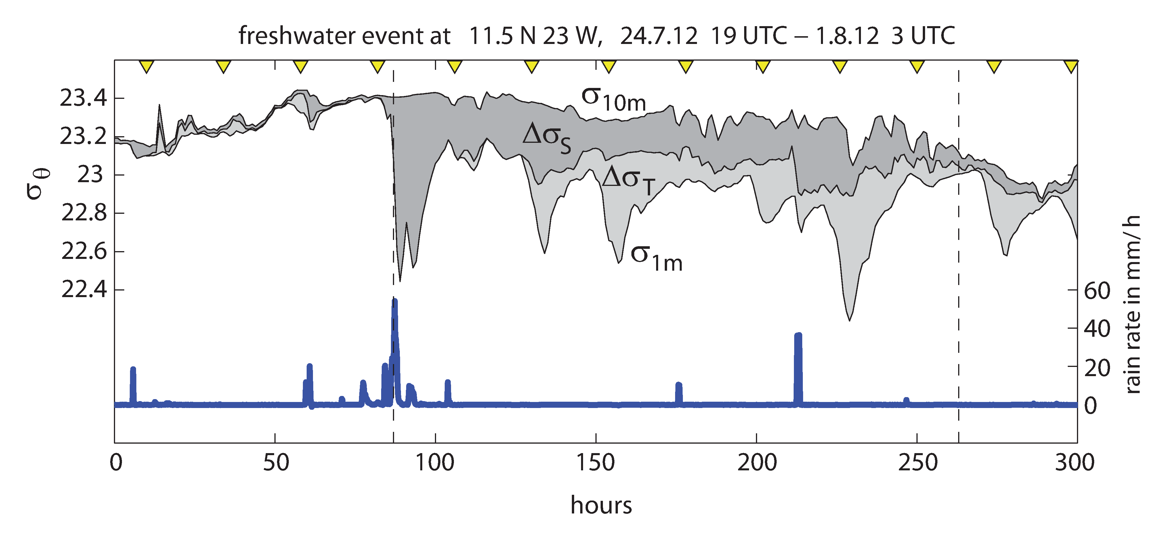
Multi-day near-surface stratification
Atlantic ITCZ, an extreme example
Strong rain, afterwards wind <= 5m/s. Low S layer very slowly mixes, low mixing also leads to amplified diurnal warming of low S layer

Slide 15
Multi-day near-surface stratification - Impact
Impact on gas exchange:
N₂O gradients observed off Peru
High-resolution sampling off-ship
At site C: sampling at 5 to 10m will overestimate N₂O emission by factor 1.5

Slide 16
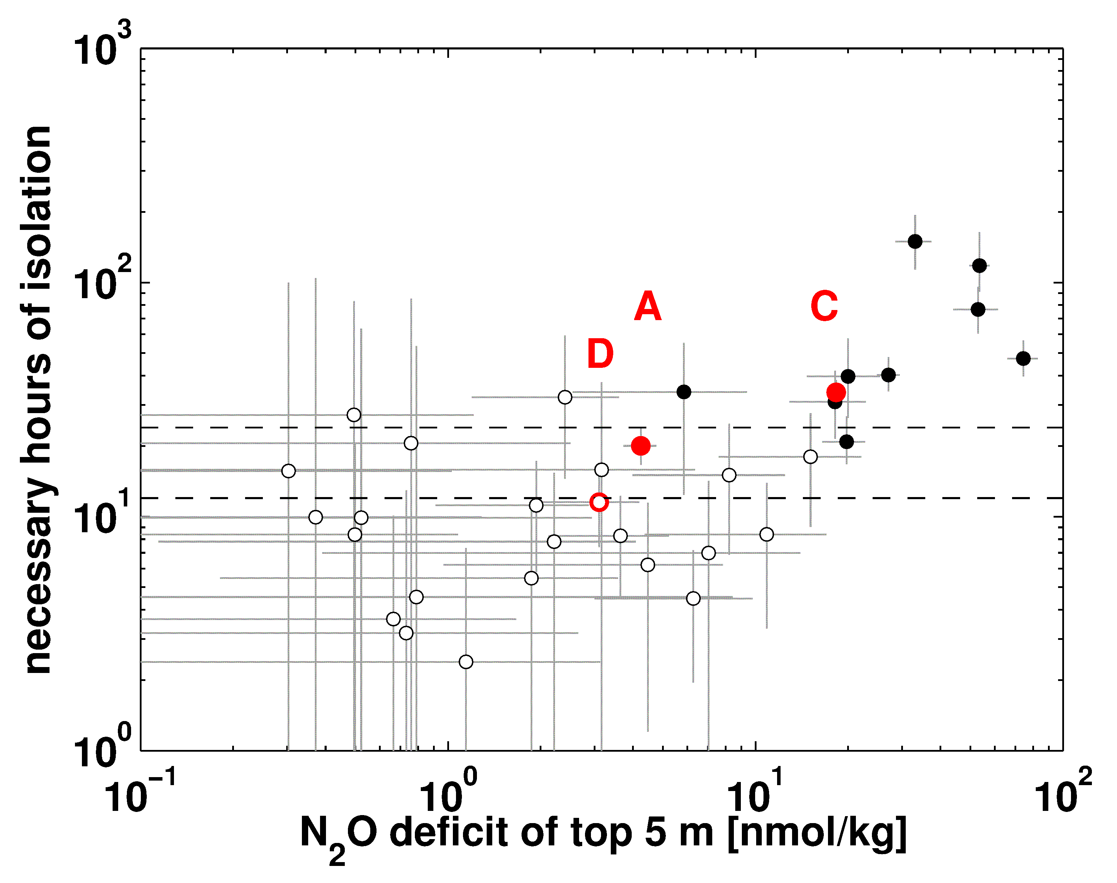
Multi-day near-surface stratification - Impact
Impact on gas exchange:
substantial N₂O gradients only with multi-day stratification
High-resolution sampling off-ship
and ship samples at 5 to 10m
24 h
12 h

Slide 17
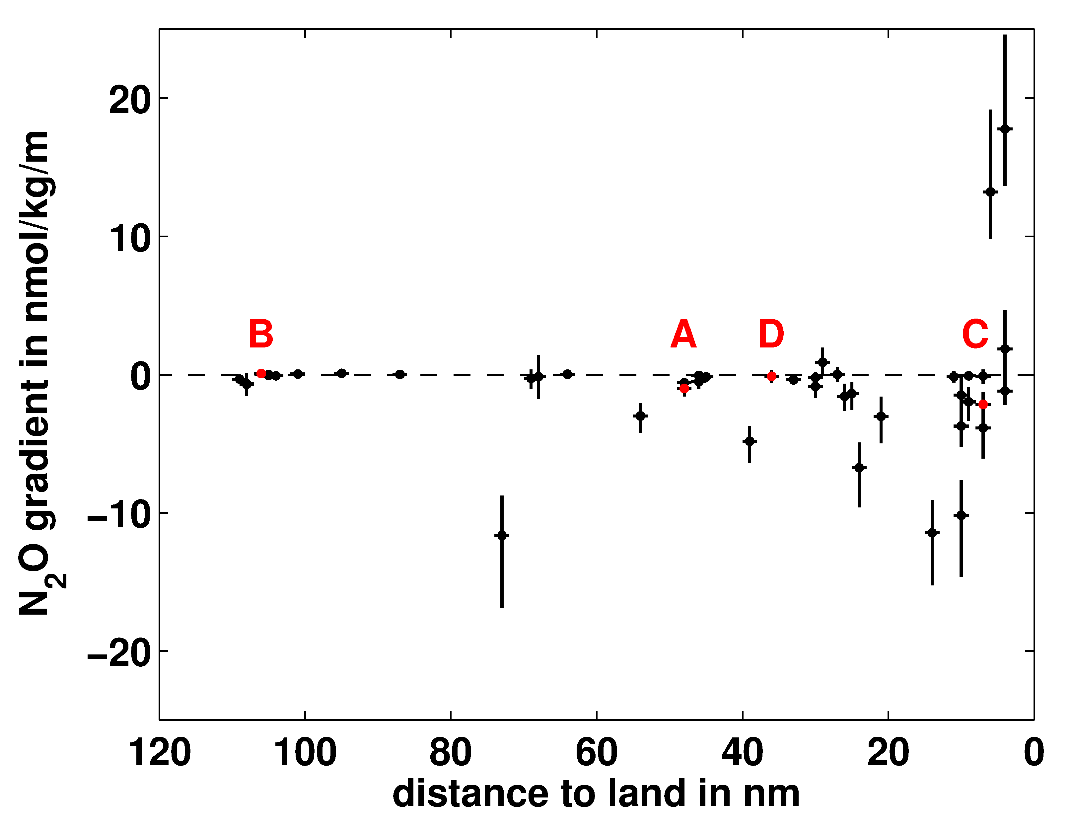
Multi-day near-surface stratification - Impact
Impact on gas exchange:
Apparent zonation in N₂O gradients observed
High-resolution sampling off-ship
and ship samples at 5 to 10m

Slide 18
Multi-day near-surface stratification - Impact
Impact on gas exchange:
Apparent zonation in N₂O gradients observed
wind
productivity
sampling
depth
N₂O
N₂O
N₂O
distance
to land
> 60 nm
60 to 5 nm
< 5 nm
Total effect on emission estimate of 60nm zone: 30% overestimation
due to multi-day stratification (compare 4% at diurnal stratification)

Slide 19
Summary
Multi-day events of near-surface stratification
are not rare in tropical waters
Generation and maintenance by low heat loss at night
(low wind, clouds, Peru example)
and/or freshwater layer (rain, Atlantic ITCZ example)
Main impact is estimation bias of air-sea interaction

Slide 20
References
Bruce, J.G. and Firing, E., (1974):
Temperature measurements in the upper 10 m with modified expendable bathythermograph probes, Journal of Geophysical Research, 79, 4110–4111, doi:10.1029/JC079i027p04110
Gentemann, C.L., Donlon, C.J., Stuart-Menteth, A., and Wentz, F.J. (2003):
Diurnal signals in satellite sea surface temperature measurements, Geophysical Research Letters, 30, 1140, doi:10.1029/2002GL016291
Prytherch, J., Farrar, J.T., and Weller, R.A. (2013):
Moored surface buoy observations of the diurnal warm layer, Journal of Geophysical Research Oceans, 118, 4553-4569, doi:10.1002/jgrc.20360
Soloviev, A. and Lukas R.(2014):
The Near-Surface Layer of the Ocean, Springer, Dordrecht
Soloviev, A.V. and Vershinsky, N.V. (1982):
The vertical structure of the thin surface layer of the ocean under conditions of low wind speed, Deep Sea Research, 29, 1437-1449, doi:10.1016/0198-0149(82)90035-8.
Soloviev, A., Edson, J., McGillis, W., Schluessel, P., and Wanninkhof, R. (2002):
Fine thermohaline structure and gas-exchange in the near-surface layer of the ocean during GasEx-98, in: Donelan, M.A., Drennan, W.M., Saltzman, E.S., and Wanninkhof, R. (eds.): Gas transfer at water surfaces, AGU Geophysical Monograph Series 127, Washington D.C., 181-185
Stommel, H. and Woodcock, A.H. (1951): Diurnal heating of the surface of the Gulf of Mexico in the spring of 1942, Transactions of the American Geophysical Union, 32, 565-571

